Slide 1
Zero knowledge for quantum multiprover interactive proofs
Henry Yuen
University of Toronto
joint work with: Alex Grilo (CWI), William Slofstra (IQC, U. Waterloo)

Slide 2
This talk
Every quantum multiprover protocol
can be efficiently transformed into an
equivalent zero knowledge protocol.
Notes:
In one sentence, this is the main result I’m going to talk about. Every quantum MIP protocol, which are interactive proof systems with quantum provers, can be efficiently transformed into another quantum MIP, but with the zero knowledge property.

Slide 3

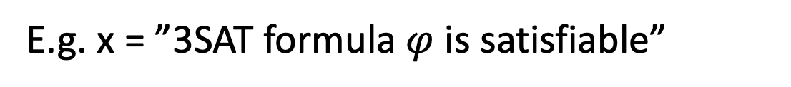
Multiprover interactive protocols (MIP)
All-powerful provers
E.g. x = ”3SAT formula $φ$ is satisfiable”
Is x true?
Poly time verifier V
Notes:
Anand just talked about multiprover interactive proofs, so I’ll review this very quickly. Here we have a polynomial time verifier V, and she wants to know, is some statement x true? An example of such a statement is, some 3SAT formula is satisfiable. We know that deciding such questions is a hard computational task, so to figure this out our verifier is going to run an interactive protocol with multiple all-powerful provers (two in this case). The provers cannot communicate with each other, but are trying to convince the verifier V that x is true.

Slide 4
Multiprover interactive protocols (MIP)
All-powerful provers
E.g. x = ”3SAT formula $φ$ is satisfiable”
Completeness: if x true, then provers can
convince V to accept w.h.p.
Soundness: if x false, V rejects w.h.p.
(no matter what provers say)
Difficult statements can be verified in this model:
MIP = NEXP [BFL ‘90]
Poly time verifier V
Notes:
We want the protocol to satisfy two important properties, completeness and soundness. Completeness says that if x is indeed true, then the provers can convince V to accept w.h.p. Soundness says that if, whenever x is actually false, then no matter what the provers say V will reject w.h.p. As Anand mentioned, when the provers are classical, the class of problems that can be verified in this model is exactly problems solvable in nondeterministic exponential time, or NEXP. This is one of the famous results in classical complexity theory.

Slide 5
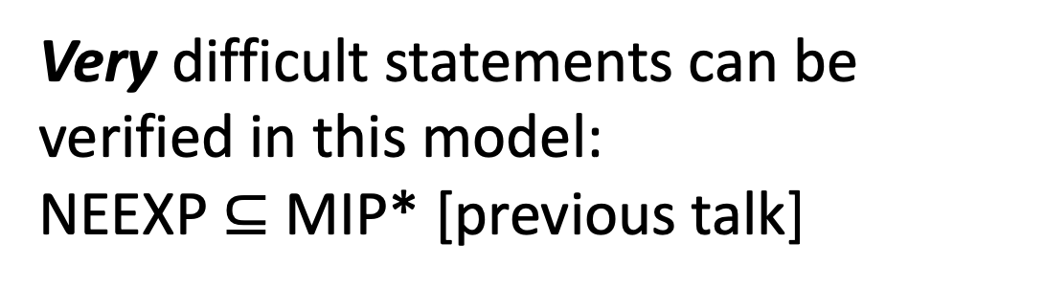
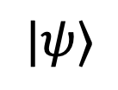
Quantum multiprover interactive protocols (MIP*)
All-powerful entangled provers
$$|ψ⟩$$
Provers allowed to measure entangled state during protocol.
Very difficult statements can be verified in this model:
NEEXP $⊆$ MIP* [previous talk]
Poly time verifier V
Notes:
Now let’s talk about MIP*, which is MIP with quantum entangled provers. As we just heard from Anand, when we allow the provers to share quantum entanglement, the complexity of problems that can be solved in this model becomes wildly complex, at least as hard as NEEXP, and no reasonable upper bound known. Let me just remind us that, the provers are still not allowed to communicate, and the verifier is still classical. But the provers can utilize nonlocal correlations in the protocol.

Slide 6
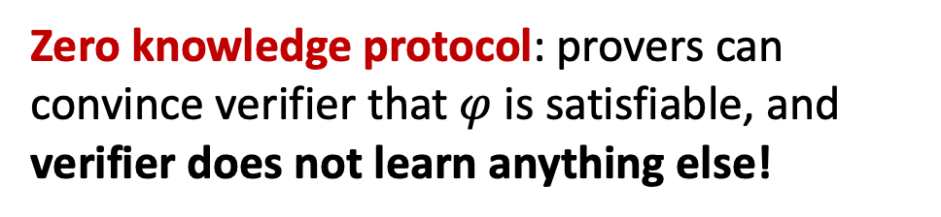
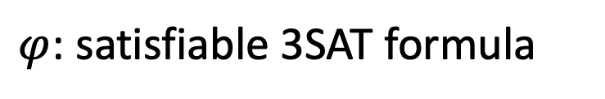
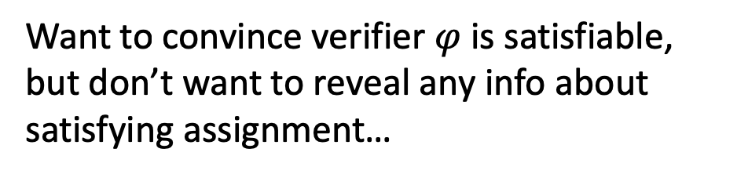
Zero knowledge protocols
$φ$: satisfiable 3SAT formula
All-powerful provers
Want to convince verifier $φ$ is satisfiable,
but don’t want to reveal any info about satisfying assignment…
Zero knowledge protocol: provers can convince verifier that $φ$ is satisfiable, and verifier does not learn anything else!
Poly time verifier V
Central concept in cryptography.
Notes:
So that’s quantum multiprover interactive protocols. Now let me explain what zero knowledge protocols are. Let’s say phi is a satisfiable 3SAT formula, but the verifier doesn’t know that. The provers want to convince V that phi is satisfiable as usual, but they’re really secretive – maybe the satisfying assignment to phi contains information like the provers’ date of birth and home address and things like that, and they don’t want the verifier to learn this information. How can they do this? Well, a zero knowledge protocol exactly allows for this to happen.

Slide 7
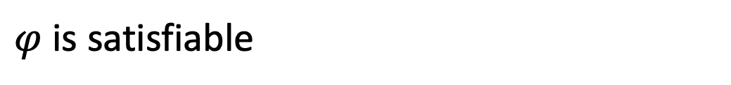
Zero knowledge protocols
$φ$: satisfiable 3SAT formula
All-powerful provers
Zero knowledge property: if x is true, transcript between provers and verifier can be efficiently simulated, without provers help!
$φ$ is satisfiable
Poly time verifier V
Notes:
How do we formalize this notion of “not learning anything else”? The zero knowledge property is the following: if x is true, then the transcript can be efficiently simulated by the verifier, without the provers help. What does this mean? Imagine the following: at the end of the protocol, the verifier concludes that phi is satisfiable. The provers go away, and the verifier examines the transcript of its conversation with the provers.

Slide 8

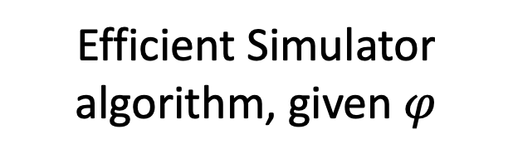
Zero knowledge protocols
$φ$: satisfiable 3SAT formula
All-powerful provers
Zero knowledge property: if x is true, transcript between provers and verifier can be efficiently simulated, without provers help!
Efficient Simulator algorithm, given $φ$
Poly time verifier V
Transcript
Notes:
It realizes that instead of interacting with the provers, it could’ve actually just run a polynomial-time algorithm called a Simulator and generated the transcript by herself!

Slide 9
Zero knowledge protocols
$φ$: satisfiable 3SAT formula
I learned that x is true, but I could’ve simulated the conversation myself…
Zero knowledge property: there exists polytime algorithm Sim such that if x is true,
output distribution of Sim(x) = distribution of transcripts
Efficient Simulator algorithm, given $φ$
Poly time verifier V
Notes:
If there is such a simulator, then it intuitively means that the verifier V didn’t learn anything new other than the fact that phi is satisfiable.

Slide 10
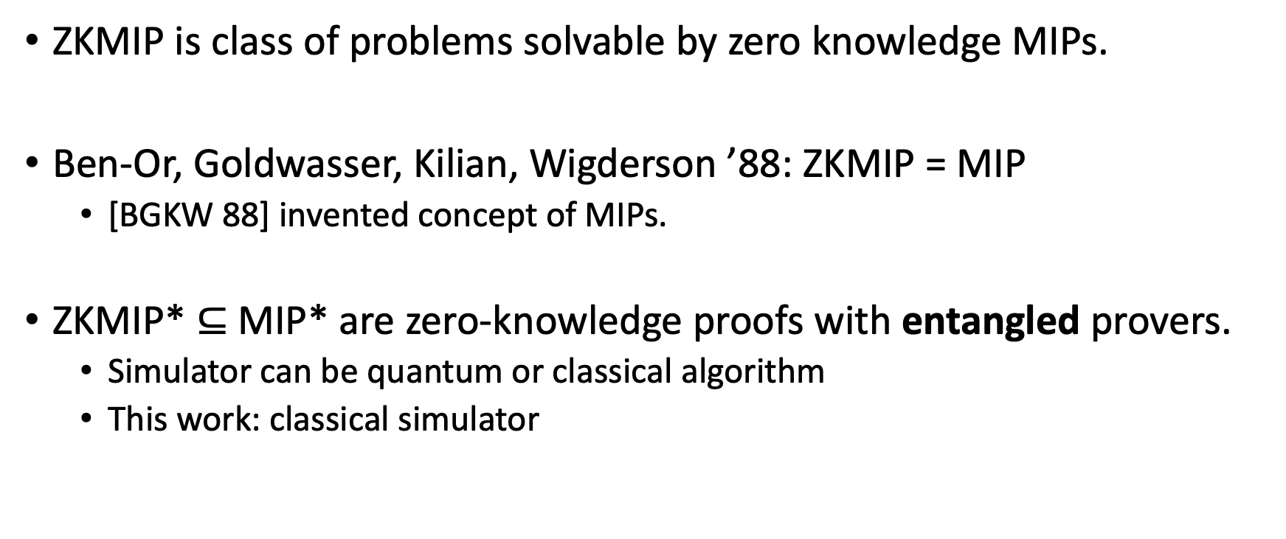
Complexity of zero knowledge MIP
ZKMIP is class of problems solvable by zero knowledge MIPs.
Ben-Or, Goldwasser, Kilian, Wigderson ’88: ZKMIP = MIP
  [BGKW 88] invented concept of MIPs.
ZKMIP* $⊆$MIP* are zero-knowledge proofs with entangled provers.
  Simulator can be quantum or classical algorithm
  This work: classical simulator
What is complexity of ZKMIP*?
Notes:
The study of zero knowledge MIPs has its origins in the foundations of classical complexity theory and cryptography. Let ZKMIP denote the problems solvable by zero knowledge MIPs. In a famous paper by Ben-Or, Goldwasser, Kilian, Wigderson ‘88, the model of multiprover interactive proofs was first defined, and then it was shown that ZKMIP = MIP, or in other words any classical multiprover interactive proof can be converted to a zero knowledge one, unconditionally. This paper was hugely influential in complexity theory and cryptography.
Given the interest in the quantum class MIP*, it makes sense for us to consider the zero knowledge variant, ZKMIP*. There are a couple choices of how one can define this class. For example, one could allow the simulator algorithm to be quantum, instead of a classical algorithm. In this work we will consider classical simulators only.
The natural question is, what is the complexity of ZKMIP*? Is it the same as MIP*? Does the ZK feature place a constraint on the model’s computational complexity?

Slide 11
Zero knowledge MIP*
ZKMIP* studied only very recently:
[Chiesa, Forbes, Gur, Spooner 2018] proved that NEXP ⊆ ZKMIP*
  Proved by lifting algebraic interactive oracle proofs to quantum setting in
  zero-knowledge preserving way.
  2 provers
  poly(n) rounds
[Coudron, Slofstra 2019] studied the complexity of ZKMIP^{co}, the commuting operator variant of ZKMIP*.
Notes:
The study of ZKMIP* is quite new, despite MIP* having been studied for over 15 years now. The only results prior to ours about this is a paper of Chiesa, Forbes, Gur and Spooner, who proved that the class NEXP is at least contained in ZKMIP*.
The

Slide 12
Zero knowledge MIP*
Main Theorem [Grilo-Slofstra-Y. 19]:
MIP* = ZKMIP*
Fun corollary: NEEXP has zero knowledge proofs in the entangled provers model.
Quantum analogue of [BGKW]’s classic(al) result that MIP = ZKMIP.

Slide 13

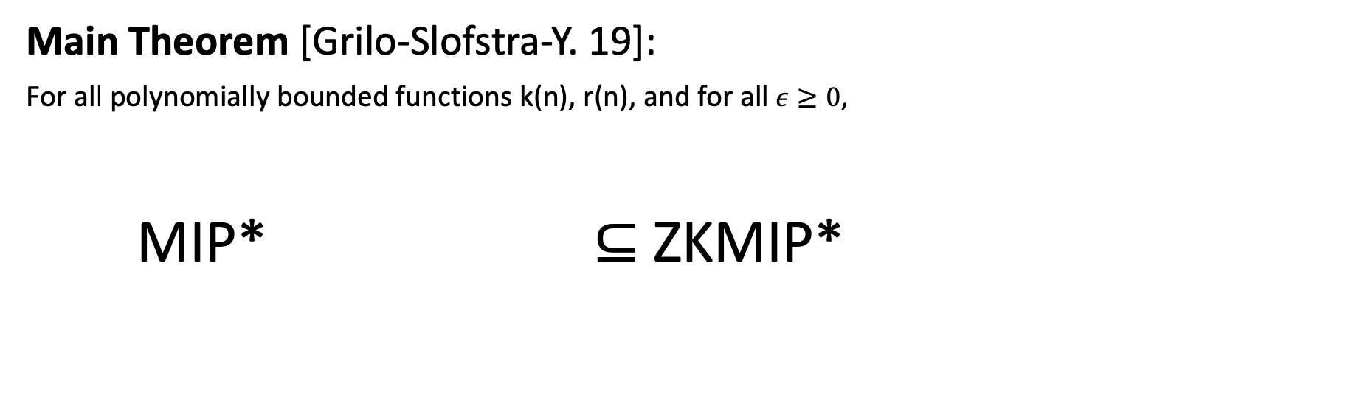

Zero knowledge MIP*
Main Theorem [Grilo-Slofstra-Y. 19]:
For all polynomially bounded functions k(n), r(n), and for all $ε≥0$,
MIP* ⊆ ZKMIP*
Players: $k$
Rounds: $r$
Completeness: $1$
Soundness: $1− ε$
Players: $max \{k,4\}$
Rounds: $1$
Completeness: $1$
Soundness: $1− ε^{α}$

Slide 14
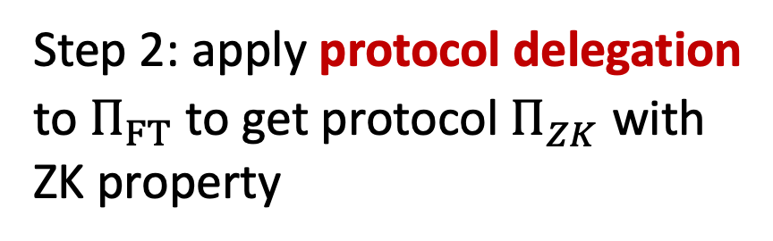
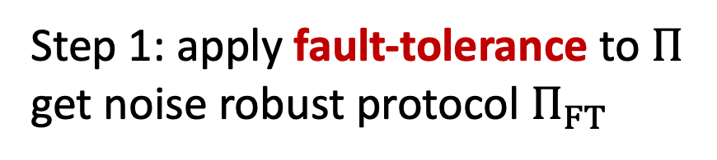
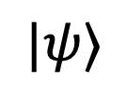
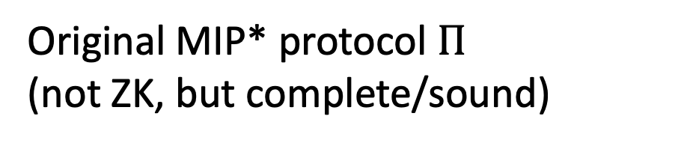
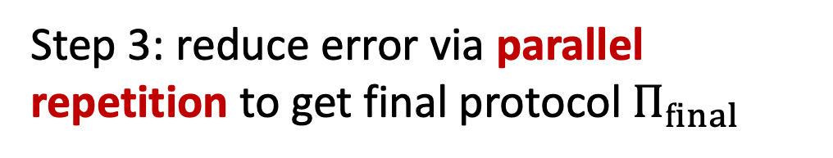
Proof outline
Step 1: apply fault-tolerance to $Π$ get noise robust protocol $Π_{FT}$
$$|ψ⟩$$
Step 2: apply protocol delegation to $Π_{FT}$to get protocol $Π_{ZK}^{}$ with ZK property
Original MIP* protocol $Π$
(not ZK, but complete/sound)
Step 3: reduce error via parallel repetition to get final protocol $Π_{final}$

Slide 15
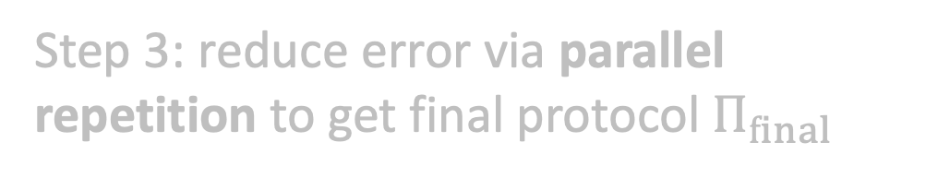
Proof outline
Step 1: apply fault-tolerance to $Π$ get noise robust protocol $Π_{FT}$
$$|ψ⟩$$
Step 2: apply protocol delegation to $Π_{FT}$to get protocol $Π_{ZK}^{}$ with ZK property
Original MIP* protocol $Π$
(not ZK, but complete/sound)
Step 3: reduce error via parallel repetition to get final protocol $Π_{final}$

Slide 16


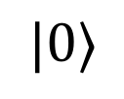







Protocol circuits
Circuit representation of 2-prover 1-round quantum interactive protocol $Π$
$P_{1}$’s private registers
$$P_{1}$$
Messages to/from $P_{1}$
$$|0⟩$$
$$V_{1}$$
$$V_{2}$$
Verifier’s private registers
Messages to/from $P_{2}$
$$P_{2}$$
$P_{2}$’s private registers

Slide 17

Protocol circuits
Circuit representation of 2-prover 1-round quantum interactive protocol $Π$
$P_{1}$’s private registers
$$P_{1}$$
Messages to/from $P_{1}$
$$|0⟩$$
Verifier’s private registers
Messages to/from $P_{2}$
$$P_{2}$$
$P_{2}$’s private registers
arbitrarily complex unitaries
two-qubit gates

Slide 18



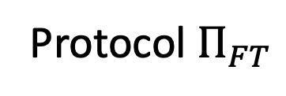


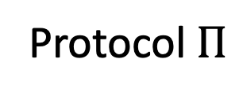




Step 1: robustifying MIP* protocols
Make the original protocol $Π$ fault-tolerant:
Turn verifier into a fault-tolerant quantum circuit using QECC (concanted Steane code)
Messages to/from provers are encoded
Protocol $Π$
Protocol $Π_{FT}$
$$P_{1}$$
$$P_{1}$$
$$V_{1}$$
$$V_{2}$$
$$Enc(V_{1})$$
$$Enc(V_{2})$$
$$P_{2}$$
$$P_{2}$$

Slide 19
Quantum fault tolerance
QECCs are crucial for fault tolerant quantum computation:
  To protect quantum computations as they happen, we compute on top of the encoded data (without ever fully decoding), and (try to) correct errors in
  real-time
  Quantum Threshold Theorem: with only polylog(N) overhead, can
  protect against constant noise levels.
Bare circuit
C
Fault tolerant circuit
C’

Slide 20
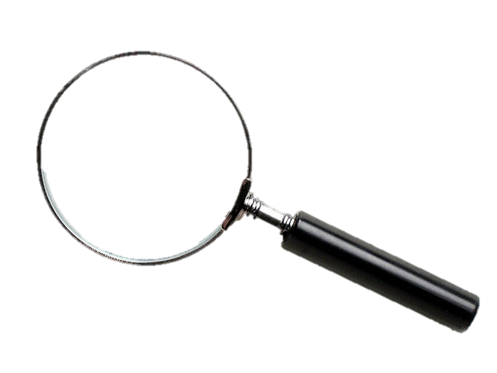
A perspective on quantum error correction
We can think of the noisy environment as an adversary who can take “local peeks” at the computation and try to corrupt it.
01011001
11101101
01011001
01011010
11010101
Bare circuit C

Slide 21
A perspective on quantum error correction
QECC ”smears out” the information about computation – all ”juicy” information is stored in global correlations of the quantum state.
Local views of at most d qubits
(d = QECC distance) looks like noise.
Fault tolerant C’

Slide 22
Step 1: robustifying MIP* protocols
Make the original protocol $Π$ fault-tolerant:
Turn verifier into a fault-tolerant quantum circuit using QECC (concanted Steane code)
Messages to/from provers are encoded
Simulability Lemma: Using distance d concatenated Steane code, the reduced density matrix of every subset of d qubits of protocol at time t is computable in polynomial time.
In our setting, d = 192.

Slide 23
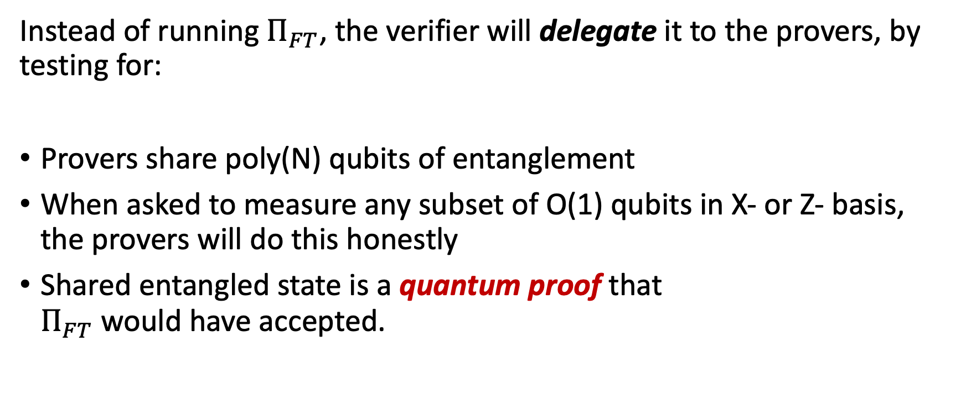
Step 2: delegating MIP* protocols
Instead of running $Π_{FT}$, the verifier will delegate it to the provers, by testing for:
Provers share poly(N) qubits of entanglement
When asked to measure any subset of O(1) qubits in X- or Z- basis,
the provers will do this honestly
Shared entangled state is a quantum proof that
$Π_{FT}$ would have accepted.
Use self-tests like Magic Square game to certify this!

Slide 24

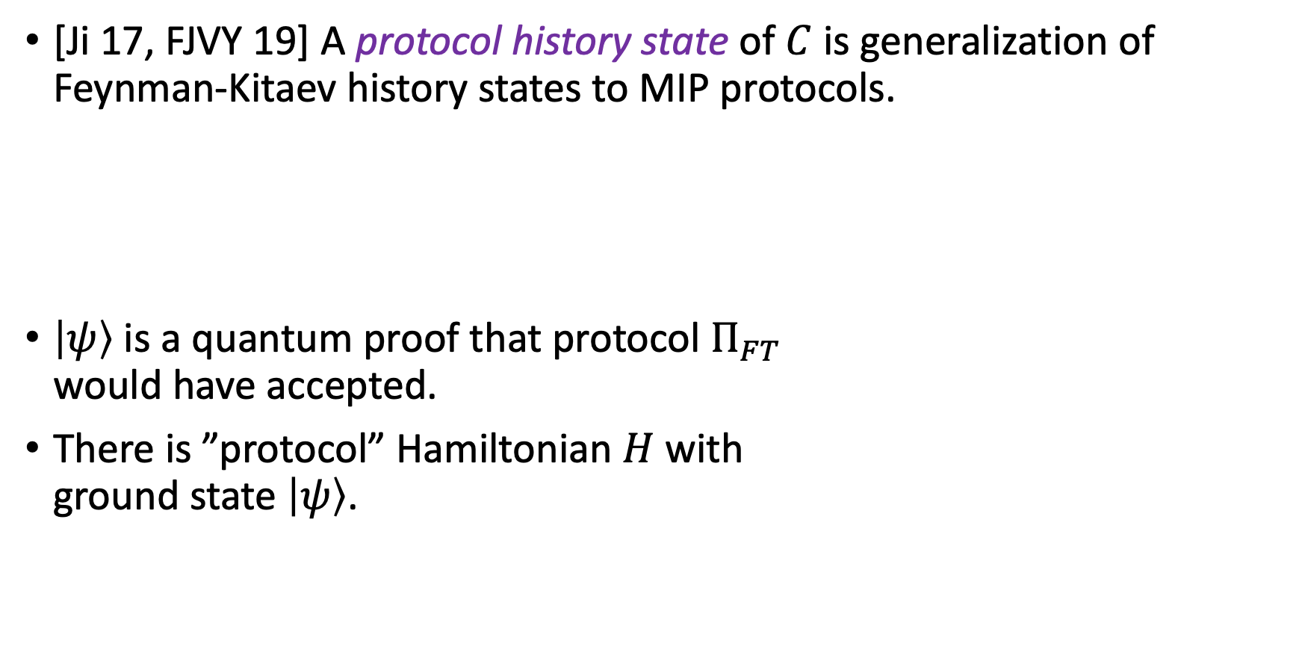






Protocol history states
[Ji 17, FJVY 19] A protocol history state of $C$ is generalization of Feynman-Kitaev history states to MIP protocols.
$\left|ψ\right\rangle$ is a quantum proof that protocol $Π_{FT}$
would have accepted.
There is ”protocol” Hamiltonian $H$ with
ground state $\left|ψ\right\rangle$.
$$\left|ψ\right\rangle =\frac{1}{\sqrt{T+1}}\sum_{t=0}^{T}{\left|t\right\rangle ⊗|ψ_{t}⟩}$$
state of the protocol at time $t$
$$t$$
$$P_{1}$$
$$P_{2}$$
$$V_{1}$$
$$V_{2}$$

Slide 25



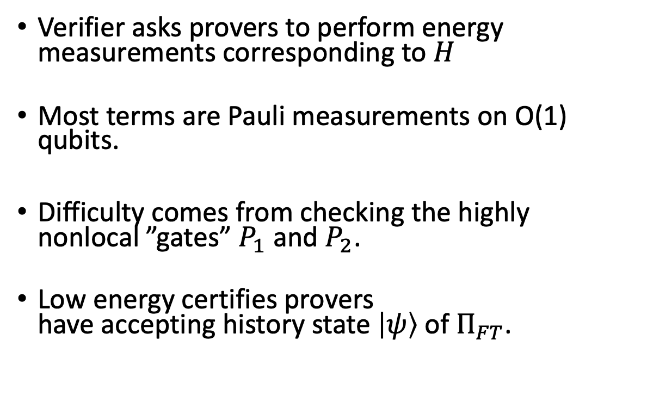
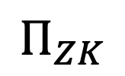
Checking protocol history states
$$P_{1}$$
$$P_{2}$$
Verifier asks provers to perform energy measurements corresponding to $H$
Most terms are Pauli measurements on O(1) qubits.
Difficulty comes from checking the highly
nonlocal ”gates” $P_{1}$and $P_{2}$.
Low energy certifies provers
have accepting history state $\left|ψ\right\rangle$of $Π_{FT}$.
$$Π_{FT}$$
$$Π_{ZK}$$

Slide 26
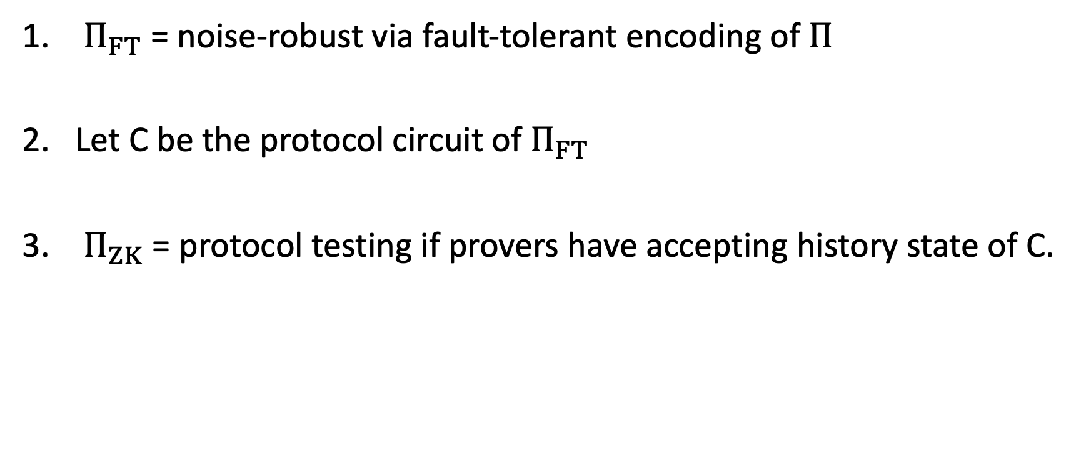
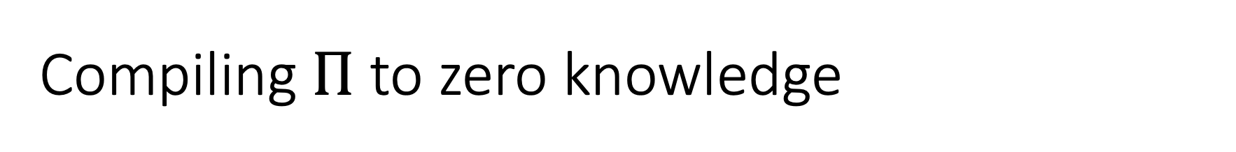
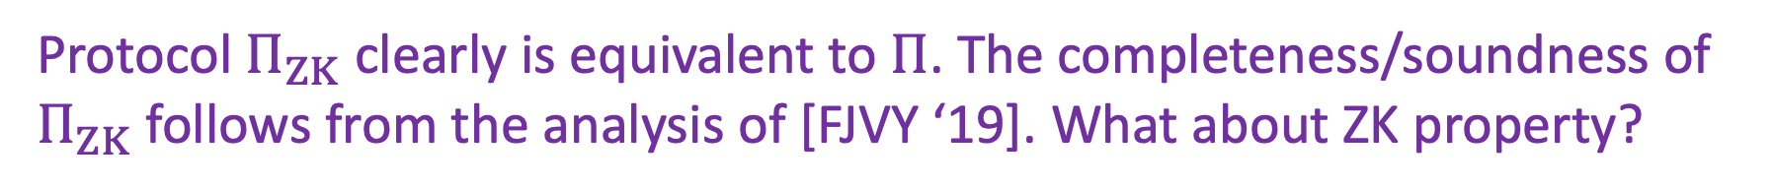
Compiling $Π$ to zero knowledge
$Π_{FT}$ = noise-robust via fault-tolerant encoding of $Π$
Let C be the protocol circuit of $Π_{FT}$
$Π_{ZK}$ = protocol testing if provers have accepting history state of C.
Protocol $Π_{ZK}$ clearly is equivalent to $Π$. The completeness/soundness of $Π_{ZK}$ follows from the analysis of [FJVY ‘19]. What about ZK property?

Slide 27

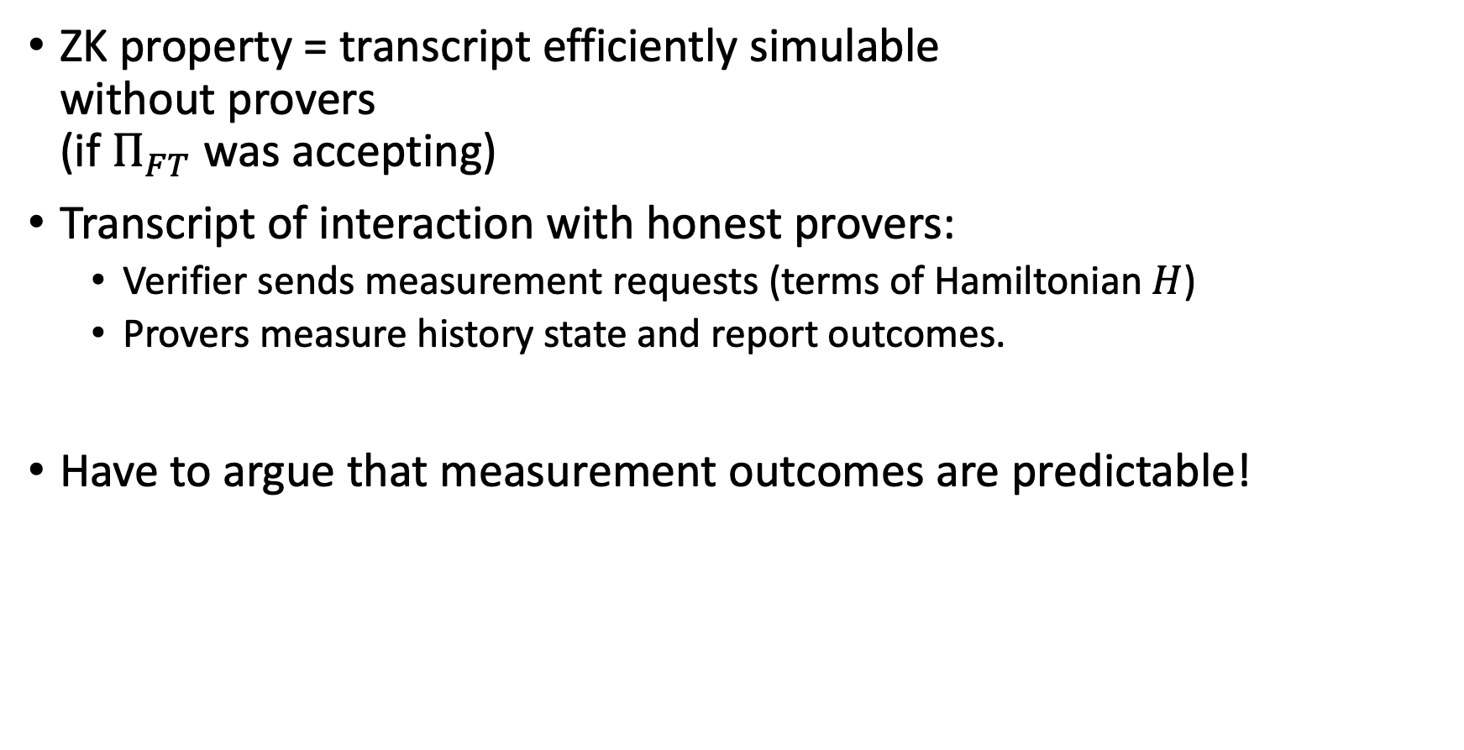




The zero knowledge property
$$t$$
$$P_{1}$$
ZK property = transcript efficiently simulable
without provers
(if $Π_{FT}$ was accepting)
Transcript of interaction with honest provers:
  Verifier sends measurement requests (terms of Hamiltonian $H$)
  Provers measure history state and report outcomes.
Have to argue that measurement outcomes are predictable!
$$P_{2}$$
$$V_{1}$$
$$V_{2}$$

Slide 28
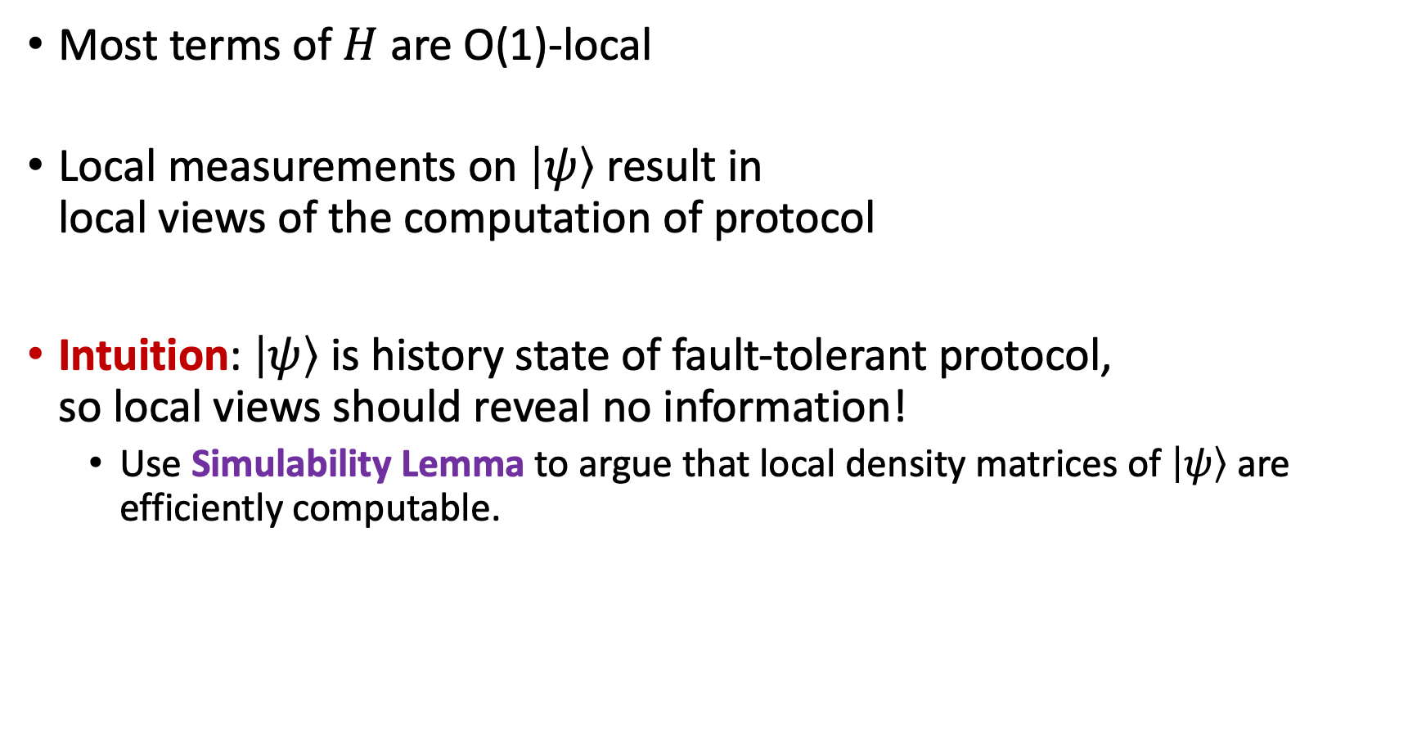
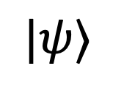
The zero knowledge property
$$|ψ⟩$$
Most terms of $H$ are O(1)-local
Local measurements on $\left|ψ\right\rangle$ result in
local views of the computation of protocol
Intuition: $\left|ψ\right\rangle$ is history state of fault-tolerant protocol,
so local views should reveal no information!
  Use Simulability Lemma to argue that local density matrices of $\left|ψ\right\rangle$ are efficiently computable.

Slide 29
The zero knowledge property
Issue: Simulability Lemma only applies to
single time slices of circuit. History state is
superposition over time slices.
$$|ψ⟩$$
Solution: History state uses unary clock, so local
measurements can only access superpositions of
O(1) consecutive time slices. These are still simulable!
Issue: How to simulate nonlocal terms of $H$?
Solution: We can design protocol so measurements are unbiased.

Slide 30
Summary
Step 1: apply fault-tolerance to $Π$ get noise robust protocol $Π_{FT}$
$$|ψ⟩$$
Step 2: apply protocol delegation to $Π_{FT}$to get protocol $Π_{ZK}^{}$ with ZK property
Original MIP* protocol $Π$
(not ZK, but complete/sound)
Step 3: reduce error via parallel repetition to get final protocol $Π_{final}$

Slide 31
Open questions
Can we do zero knowledge compilation without increasing number of provers? Currently need at least four.
Is there a way to compile quantum multiprover protocols to single prover protocols using computational assumptions, in a way that preserves completeness/soundness/zero knowledge?
Quantum analogues of proof-of-knowledge, argument systems,…?
See followup work by Broadbent and Grilo (arxiv: 1911.07782)

Slide 32
Open questions
Thank you!
Can we do zero knowledge compilation without increasing number of provers? Currently need at least four.
Is there a way to compile quantum multiprover protocols to single prover protocols using computational assumptions, in a way that preserves completeness/soundness/zero knowledge?
Quantum analogues of proof-of-knowledge, argument systems,…?
See followup work by Broadbent and Grilo (arxiv: 1911.07782)

