Slide 1
Quantum Garbled Circuits and their Applications
Zvika Brakerski (Weizmann Institute)
Henry Yuen (Columbia University)
Notes:
Thanks for the invitation to speak. Today I’m going to talk some joint work with Zvika Brakerski, where we come up with a quantum analogue of the famous Garbled Circuits construction. Actually I should say that it was Sanjam who initially pushed me to think about quantum garbled circuits about 3 years ago, when I was postdoc-ing at Berkeley, and there were a lot of dead ends that I explored. So I’m happy that there’s finally a solution for it. I think there should be a lot of applications for quantum garbled circuits in quantum cryptography, and if any of you have ideas, I’d love to talk more about it.
I’m going to try my best not to assume any background in quantum… or maybe I should say, any quantum knowledge you should be able to simulate yourself. ☺

Slide 2
Classical Randomized Encodings
Notes:
Before I talk about _quantum_ GC, I need to talk about _classical_ GC. And before I talk about classical GC, I’m going to talk about the concept of *randomized encodings*, of which GC is a specific construction.

Slide 3
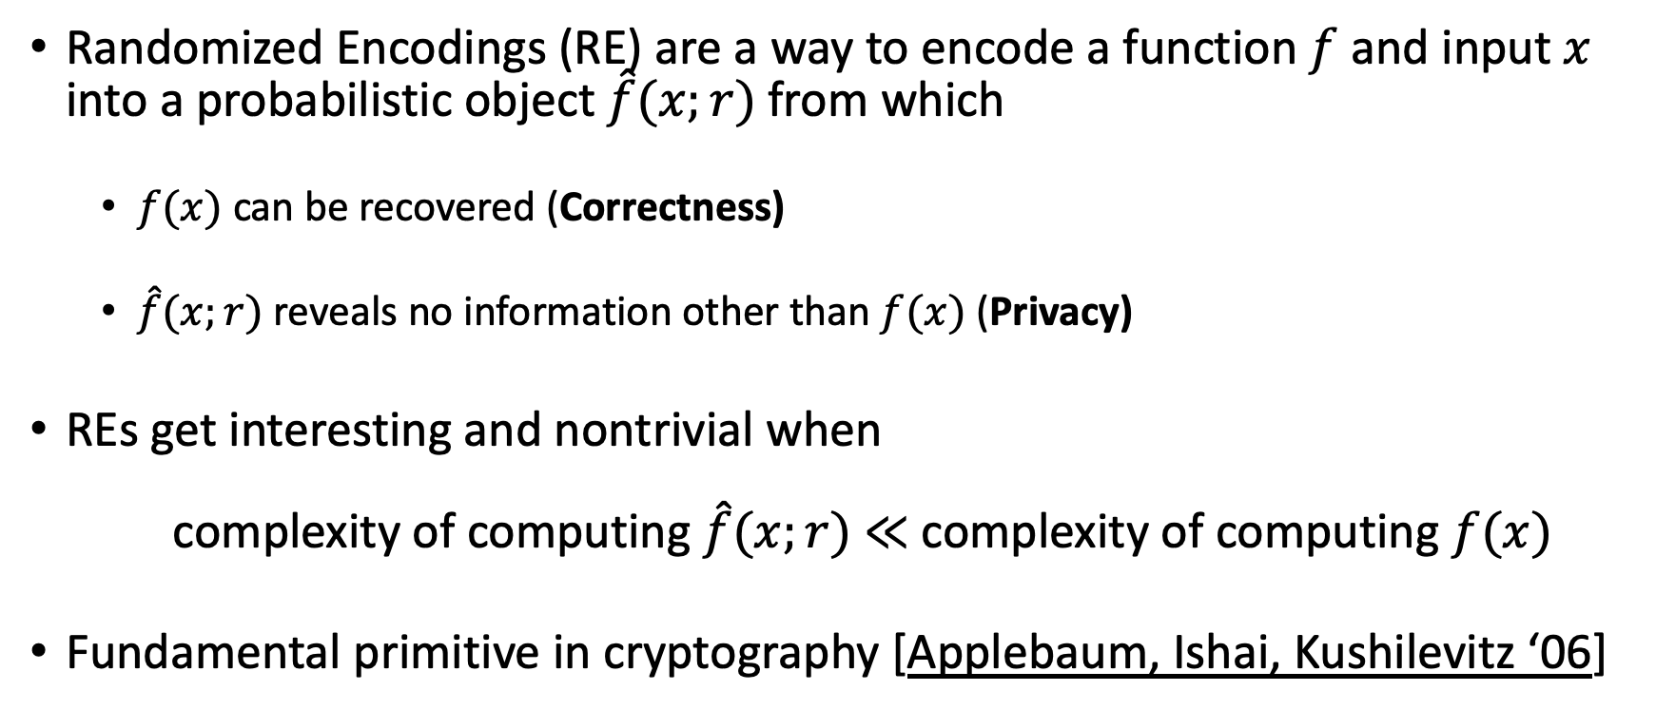
What are Randomized Encodings?
Randomized Encodings (RE) are a way to encode a function $f$ and input $x$ into a probabilistic object $\hat{f}(x;r)$from which
  $f(x)$ can be recovered (Correctness)
  $\hat{f}(x;r)$reveals no information other than $f(x)$ (Privacy)
REs get interesting and nontrivial when
complexity of computing $\hat{f}(x;r)$ $≪$ complexity of computing $f(x)$
Fundamental primitive in cryptography [Applebaum, Ishai, Kushilevitz ‘06]
Notes:
(Describe def).

Slide 4



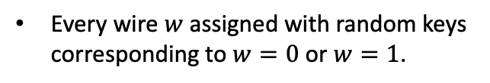
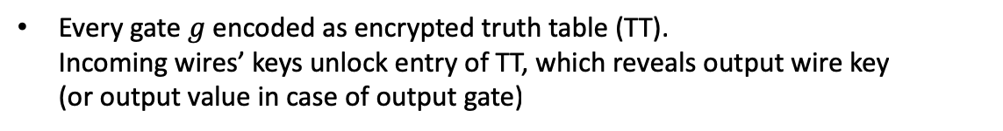
Example: Yao’s Garbled Circuits
The earliest and most famous proposal to do secure multiparty computation.
0
1
1
1
1
1
0
Every wire $w$ assigned with random keys corresponding to $w=0$ or $w=1$.
Every gate $g$ encoded as encrypted truth table (TT).
Incoming wires’ keys unlock entry of TT, which reveals output wire key
(or output value in case of output gate)
$$w=0$$
$$w=1$$
Notes:
The next example of randomized encodings I want to talk about is a famous scheme in cryptography called Yao’s Garbled Circuits, which is perhaps the earliest and most famous proposal to do secure multiparty computation. This was proposed by Andy Yao in the early 1980s and has been extremely influential in cryptography.
Suppose you’re given a circuit with some inputs, like the two OR gates connected to an AND gate depicted here. We can evaluate this circuit so that every wire gets a value or 0 or 1, depending on the original inputs and the circuit. To garble this circuit, we first assign every wire two random keys: one key (shown here in grey) for when the wire is 0, and one key (shown here in gold) for when the wire is 1. The encoding doesn’t specify whether a key is grey or gold – this is just to help us keep track.
Each gate g is encoded as an encrypted truth table, where the four possible output values of the gate are encrypted under the keys of the input wires of the gate. So for example, if the input to this OR gate is 0 and 1, we have a grey key for the top wire and a gold key for the bottom wire. Together these keys can open the top right corner of this truth table. These two keys are unable to open any other box here.

Slide 5
Example: Yao’s Garbled Circuits
The earliest and most famous proposal to do secure multiparty computation.
0
1
1
1
1
1
0
Every wire $w$ assigned with random keys corresponding to $w=0$ or $w=1$.
Every gate $g$ encoded as encrypted truth table (TT).
Incoming wires’ keys unlock entry of TT, which reveals output wire key
(or output value in case of output gate)
$$w=0$$
$$w=1$$
Notes:
When opened, the value of this truth table is not a 0 or 1, but instead contains the encryption key of whether the outgoing wire is 0 or 1. In this case, it’s 1 so it’s a gold key. We can do the same for the bottom gate, and we get the encryption key for this bottom intermediate wire.

Slide 6
Example: Yao’s Garbled Circuits
The earliest and most famous proposal to do secure multiparty computation.
0
1
1
1
1
1
1
1
0
Every wire $w$ assigned with random keys corresponding to $w=0$ or $w=1$.
Every gate $g$ encoded as encrypted truth table (TT).
Incoming wires’ keys unlock entry of TT, which reveals output wire key
(or output value in case of output gate)
$$w=0$$
$$w=1$$
Notes:
Once we get to the last wire of the circuit, the encrypted truth table will contain the output values so that we can determine the value of the circuit.
So again, the encoding of this circuit are these encrypted truth tables, and one key for each input wire. All meaning to the wires and gates are lost, except for the very last output wire which reveals whether the final output is 0 or 1. It’s not too hard to see that this encoding scheme satisfies both Correctness and Privacy properties, and furthermore the encoding complexity of this scheme can be much better than the original circuit, because each wire’s keys can be chosen in parallel, and computing each gate’s truth table can be done in parallel. Furthermore, this randomized encoding scheme has a very nice property called decomposability, which I’ll describe next.

Slide 7

Decomposability
A RE $\left(f,x\right)↦\hat{f}(x;r)$is decomposable if the encoding consists of:
  An offline part ${\hat{f}}_{\text{off}}$ that only depends on $f$ and randomness $r$
  An online part ${\hat{f}}_{\text{on}}=\left({\hat{f}}_{1}\left(x_{1}\right),…,{\hat{f}}_{n}\left(x_{n}\right)\right)$ where each ${\hat{f}}_{i}\left(x_{i}\right)$ depends on randomness $r$ and a single bit of $x$
Yao’s Garbled Circuits is decomposable
  Randomness $r$ used to choose keys/labels for every wire
  Offline part = Gate truth tables
  Online part = Each bit of $x$ selects a key/label for the corresponding input wire

Slide 8
Applications of RE and Garbled Circuits
MPC
Zero-knowledge
Private Simultaneous Messages
Attribute-based/Functional Encryption
Obfuscation
Circuit lower bounds
..more

Slide 9
Quantum Randomized Encodings
Notes:
So hopefully you have a good sense of what randomized encodings are and why they’re interesting. Given how their importance in classical cryptography, it’s natural to ask whether there’s a quantum analogue.

Slide 10
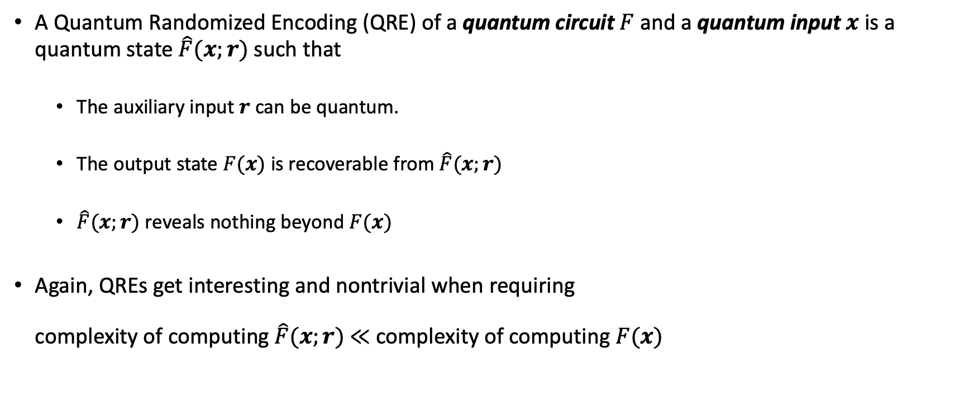
A Quantum Analogue
A Quantum Randomized Encoding (QRE) of a quantum circuit $F$ and a quantum input $x$ is a quantum state $\hat{F}(x;r)$ such that
  The auxiliary input $r$ can be quantum.
  The output state $F(x)$ is recoverable from $\hat{F}(x;r)$
  $\hat{F}(x;r)$ reveals nothing beyond $F(x)$
Again, QREs get interesting and nontrivial when requiring
complexity of computing $\hat{F}(x;r)$ $≪$ complexity of computing $F(x)$
Bold variables indicate quantum states.
Notes:
What we do is propose the following generalization.

Slide 11
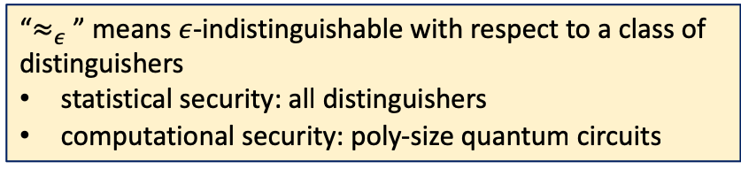
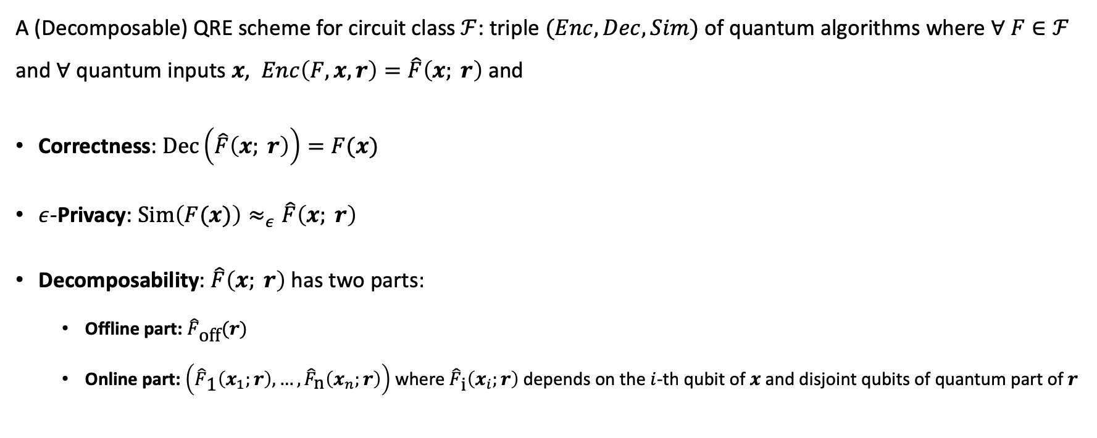
Our Definition of QRE Scheme
A (Decomposable) QRE scheme for circuit class $ℱ$: triple $(Enc,Dec,Sim)$ of quantum algorithms where $∀ F∈ℱ$ and $∀$ quantum inputs $x$, $Enc\left(F,x,r\right)=\hat{F}\left(x; r\right)$ and
Correctness: $Dec\left(\hat{F}\left(x; r\right)\right)=F(x)$
$ε$-Privacy: $Sim\left(F(x)\right)≈_{ε}\hat{F}\left(x; r\right)$
Decomposability: $\hat{F}\left(x; r\right)$ has two parts:
  Offline part: ${\hat{F}}_{\text{off}}(r)$
  Online part: $\left({\hat{F}}_{\text{1}}\left(x_{1};r\right),…,{\hat{F}}_{\text{n}}\left(x_{n};r\right)\right)$ where ${\hat{F}}_{\text{i}}\left(x_{i};r\right)$ depends on the $i$-th qubit of $x$ and disjoint qubits of quantum part of $r$
“$≈_{ε}$ ” means $ε$-indistinguishable with respect to a class of distinguishers
statistical security: all distinguishers
computational security: poly-size quantum circuits

Slide 12
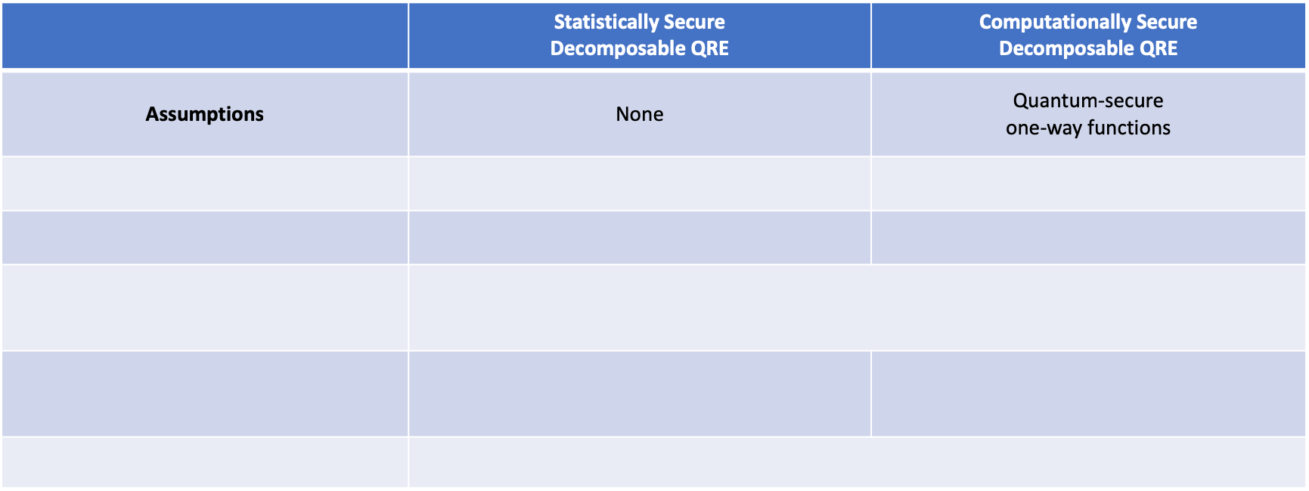
Quantum Garbled Circuits
We exhibit the first Quantum Randomized Encoding schemes, with the following properties:
 | Statistically Secure Decomposable QRE | Computationally Secure Decomposable QRE
Assumptions | None | Quantum-secure one-way functions
Complexity of $Enc$ | O(1)-depth $\text{QN}{\text{C}}_{\text{f}}^{}$ circuits of size $poly\left(s,2^{d}\right)$ | O(1)-depth $\text{QN}{\text{C}}_{\text{f}}^{}$ circuits of size $poly\left(s,λ\right)$
Complexity of $Dec, Sim$ | $$poly\left(s,2^{d}\right)$$ | $poly\left(s,λ\right)$
Auxiliary input $r$ | $r$=(s,e) $s$ = classical random string, $e$ = EPR pairs
$ε$-Privacy | Perfect privacy ($ε=0$) against all distinguishers | $ε=negl(λ)$ privacy against poly-time quantum adversaries
When input $x$ is classical | Online part $\left({\hat{F}}_{\text{1}}\left(x_{1};r\right),…,{\hat{F}}_{\text{n}}\left(x_{n};r\right)\right)$ is classical

Slide 13

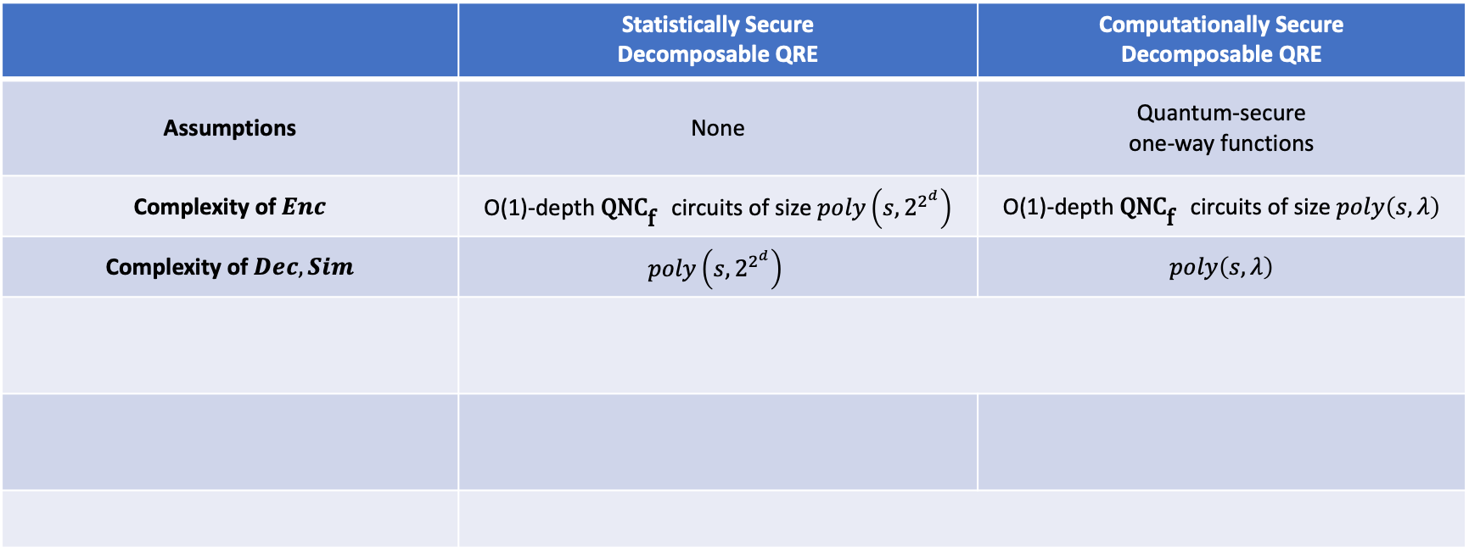

Quantum Garbled Circuits
We exhibit the first Quantum Randomized Encoding schemes, with the following properties:
 | Statistically Secure Decomposable QRE | Computationally Secure Decomposable QRE
Assumptions | None | Quantum-secure one-way functions
Complexity of $Enc$ | O(1)-depth $\text{QN}{\text{C}}_{\text{f}}^{}$ circuits of size $poly\left(s,2^{2^{d}}\right)$ | O(1)-depth $\text{QN}{\text{C}}_{\text{f}}^{}$ circuits of size $poly\left(s,λ\right)$
Complexity of $Dec, Sim$ | $$poly\left(s,2^{2^{d}}\right)$$ | $poly\left(s,λ\right)$
Auxiliary input $r$ | $r$=(s,e) $s$ = classical random string, $e$ = EPR pairs
$ε$-Privacy | Perfect privacy ($ε=0$) against all distinguishers | $ε=negl(λ)$ privacy against poly-time quantum adversaries
When input $x$ is classical | Online part $\left({\hat{F}}_{\text{1}}\left(x_{1};r\right),…,{\hat{F}}_{\text{n}}\left(x_{n};r\right)\right)$ is classical
$F$ has size $s$ and depth $d$
$λ$ = security parameter.

Slide 14
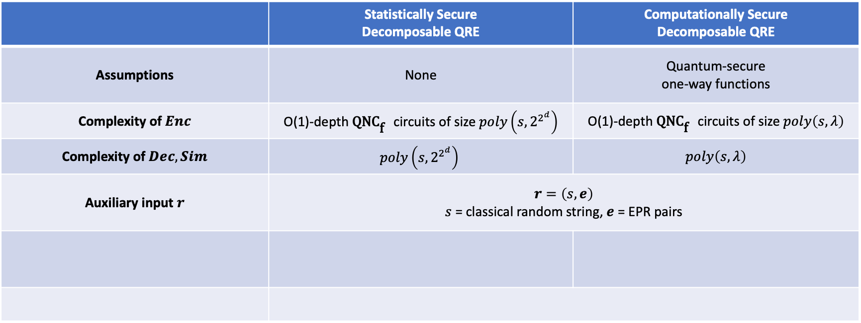
Quantum Garbled Circuits
We exhibit the first Quantum Randomized Encoding schemes, with the following properties:
 | Statistically Secure Decomposable QRE | Computationally Secure Decomposable QRE
Assumptions | None | Quantum-secure one-way functions
Complexity of $Enc$ | O(1)-depth $\text{QN}{\text{C}}_{\text{f}}^{}$ circuits of size $poly\left(s,2^{2^{d}}\right)$ | O(1)-depth $\text{QN}{\text{C}}_{\text{f}}^{}$ circuits of size $poly\left(s,λ\right)$
Complexity of $Dec, Sim$ | $$poly\left(s,2^{2^{d}}\right)$$ | $poly\left(s,λ\right)$
Auxiliary input $r$ | $$r=\left(s,e\right)$$ $s$ = classical random string, $e$ = EPR pairs
$ε$-Privacy | Perfect privacy ($ε=0$) against all distinguishers | $ε=negl(λ)$ privacy against poly-time quantum adversaries
When input $x$ is classical | Online part $\left({\hat{F}}_{\text{1}}\left(x_{1};r\right),…,{\hat{F}}_{\text{n}}\left(x_{n};r\right)\right)$ is classical
$F$ has size $s$ and depth $d$
$λ$ = security parameter.

Slide 15
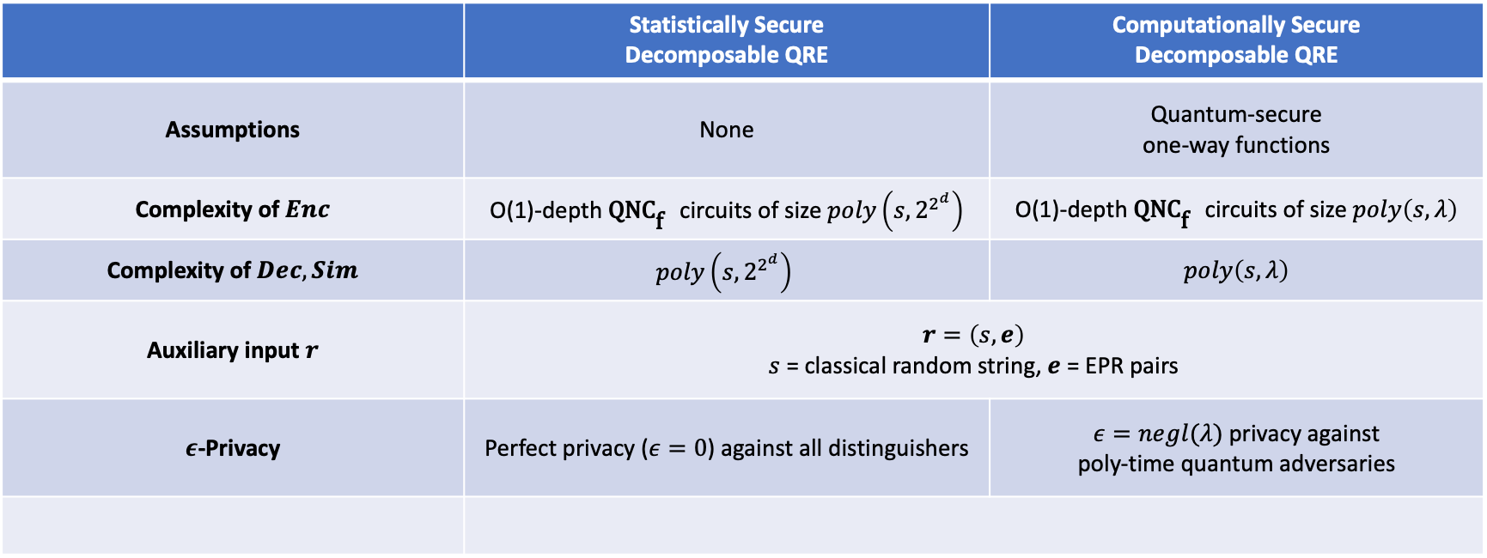
Quantum Garbled Circuits
We exhibit the first Quantum Randomized Encoding schemes, with the following properties:
 | Statistically Secure Decomposable QRE | Computationally Secure Decomposable QRE
Assumptions | None | Quantum-secure one-way functions
Complexity of $Enc$ | O(1)-depth $\text{QN}{\text{C}}_{\text{f}}^{}$ circuits of size $poly\left(s,2^{2^{d}}\right)$ | O(1)-depth $\text{QN}{\text{C}}_{\text{f}}^{}$ circuits of size $poly\left(s,λ\right)$
Complexity of $Dec, Sim$ | $$poly\left(s,2^{2^{d}}\right)$$ | $poly\left(s,λ\right)$
Auxiliary input $r$ | $$r=\left(s,e\right)$$ $s$ = classical random string, $e$ = EPR pairs
$ε$-Privacy | Perfect privacy ($ε=0$) against all distinguishers | $ε=negl(λ)$ privacy against poly-time quantum adversaries
When input $x$ is classical | Online part $\left({\hat{F}}_{\text{1}}\left(x_{1};r\right),…,{\hat{F}}_{\text{n}}\left(x_{n};r\right)\right)$ is classical
$F$ has size $s$ and depth $d$
$λ$ = security parameter.

Slide 16
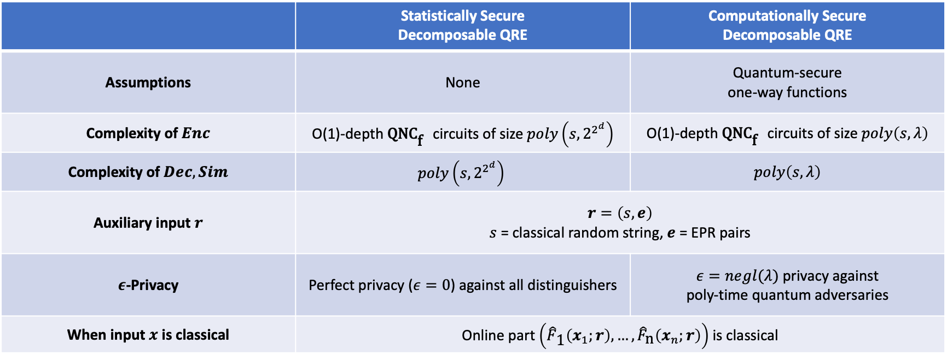
Quantum Garbled Circuits
We exhibit the first Quantum Randomized Encoding schemes, with the following properties:
 | Statistically Secure Decomposable QRE | Computationally Secure Decomposable QRE
Assumptions | None | Quantum-secure one-way functions
Complexity of $Enc$ | O(1)-depth $\text{QN}{\text{C}}_{\text{f}}^{}$ circuits of size$poly\left(s,2^{2^{d}}\right)$ | O(1)-depth $\text{QN}{\text{C}}_{\text{f}}^{}$ circuits of size $poly\left(s,λ\right)$
Complexity of $Dec, Sim$ | $$poly\left(s,2^{2^{d}}\right)$$ | $poly\left(s,λ\right)$
Auxiliary input $r$ | $$r=\left(s,e\right)$$ $s$ = classical random string, $e$ = EPR pairs
$ε$-Privacy | Perfect privacy ($ε=0$) against all distinguishers | $ε=negl(λ)$ privacy against poly-time quantum adversaries
When input $x$ is classical | Online part $\left({\hat{F}}_{\text{1}}\left(x_{1};r\right),…,{\hat{F}}_{\text{n}}\left(x_{n};r\right)\right)$ is classical
$F$ has size $s$ and depth $d$
$λ$ = security parameter.

Slide 17
Application:
Zero-Knowledge QMA
Notes:
Before getting into the details of the construction of Quantum Garbled Circuits, I’ll cover an application of QREs, which is to give a simple construction of a zero knowledge protocol for QMA.

Slide 18

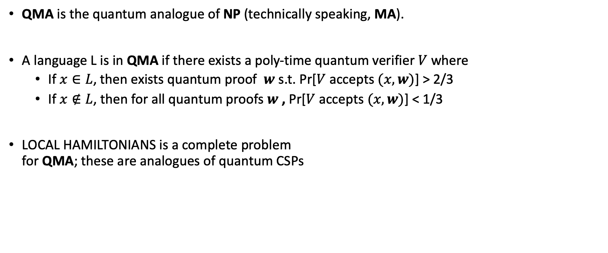


Quantum Merlin-Arthur
QMA is the quantum analogue of NP (technically speaking, MA).
A language L is in QMA if there exists a poly-time quantum verifier $V$ where
  If $x∈L$, then exists quantum proof $w$ s.t. Pr[$V$ accepts $(x,w)$] > 2/3
  If $x∉L$, then for all quantum proofs $w$ , Pr[$V$ accepts $(x,w)$] < 1/3
LOCAL HAMILTONIANS is a complete problem
for QMA; these are analogues of quantum CSPs
$$x$$
Acc/rej
Quantum Verifier $V$
$$w$$

Slide 19

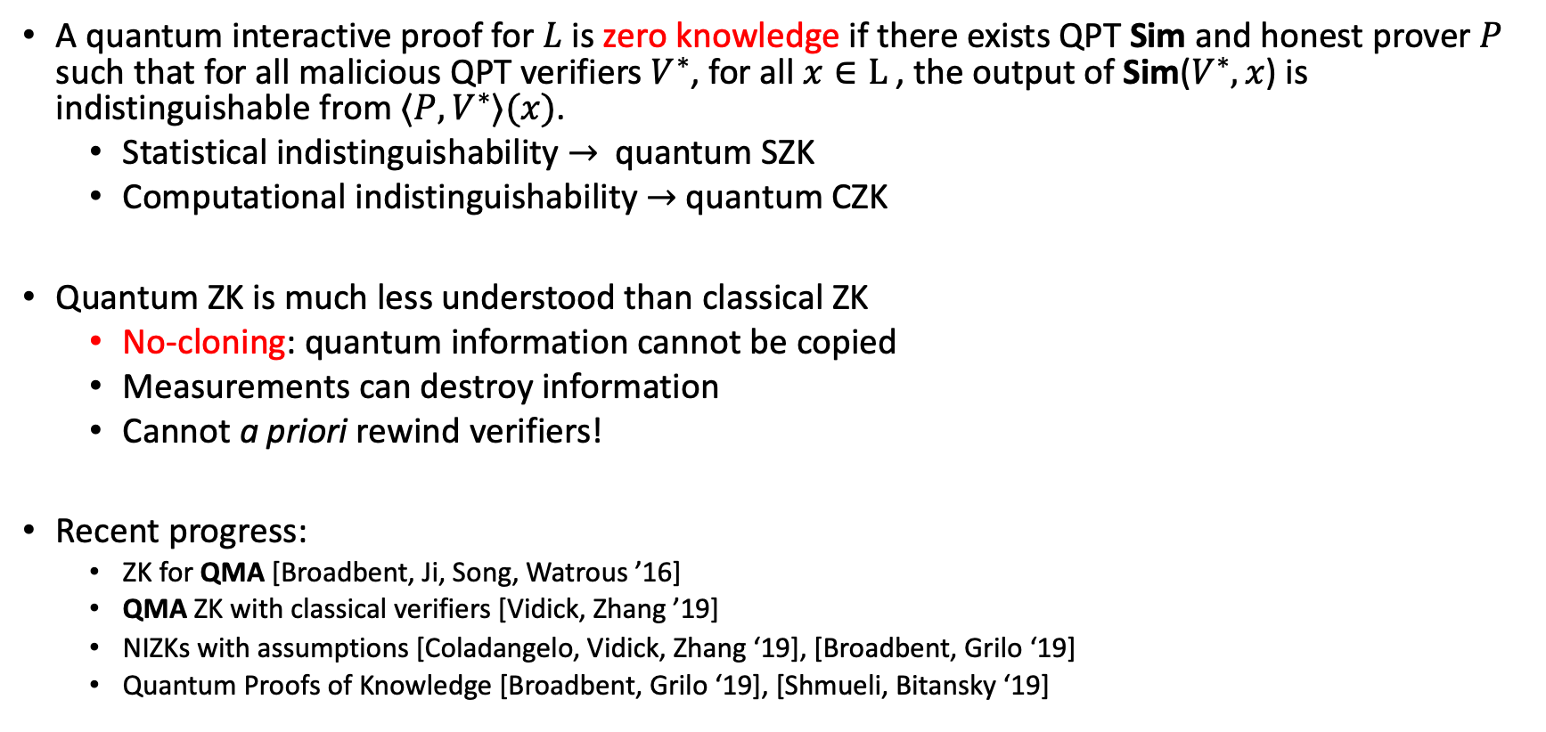


Quantum Zero-Knowledge
A quantum interactive proof for $L$ is zero knowledge if there exists QPT Sim and honest prover $P$ such that for all malicious QPT verifiers $V^{∗}$, for all $x∈L$, the output of Sim($V^{∗},x$) is indistinguishable from $⟨P,V^{∗}⟩(x)$.
  Statistical indistinguishability $→$ quantum SZK
  Computational indistinguishability $→$ quantum CZK
Quantum ZK is much less understood than classical ZK
  No-cloning: quantum information cannot be copied
  Measurements can destroy information
  Cannot a priori rewind verifiers!
Recent progress:
  ZK for QMA [Broadbent, Ji, Song, Watrous ’16]
  QMA ZK with classical verifiers [Vidick, Zhang ’19]
  NIZKs with assumptions [Coladangelo, Vidick, Zhang ‘19], [Broadbent, Grilo ‘19]
  Quantum Proofs of Knowledge [Broadbent, Grilo ‘19], [Shmueli, Bitansky ‘19]
$$|ψ⟩$$
$$|θ⟩$$

Slide 20
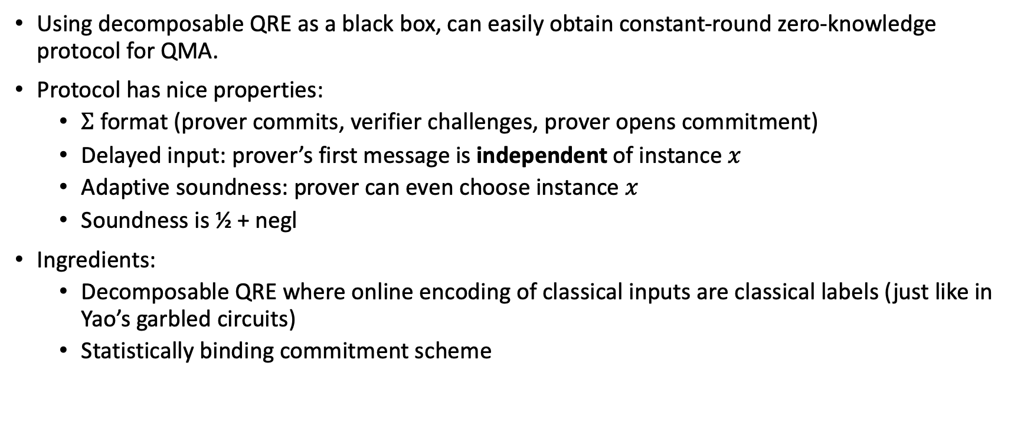
Simple ZK protocol for QMA using QRE
Using decomposable QRE as a black box, can easily obtain constant-round zero-knowledge protocol for QMA.
Protocol has nice properties:
  $Σ$ format (prover commits, verifier challenges, prover opens commitment)
  Delayed input: prover’s first message is independent of instance $x$
  Adaptive soundness: prover can even choose instance $x$
  Soundness is ½ + negl
Ingredients:
  Decomposable QRE where online encoding of classical inputs are classical labels (just like in Yao’s garbled circuits)
  Statistically binding commitment scheme

Slide 21

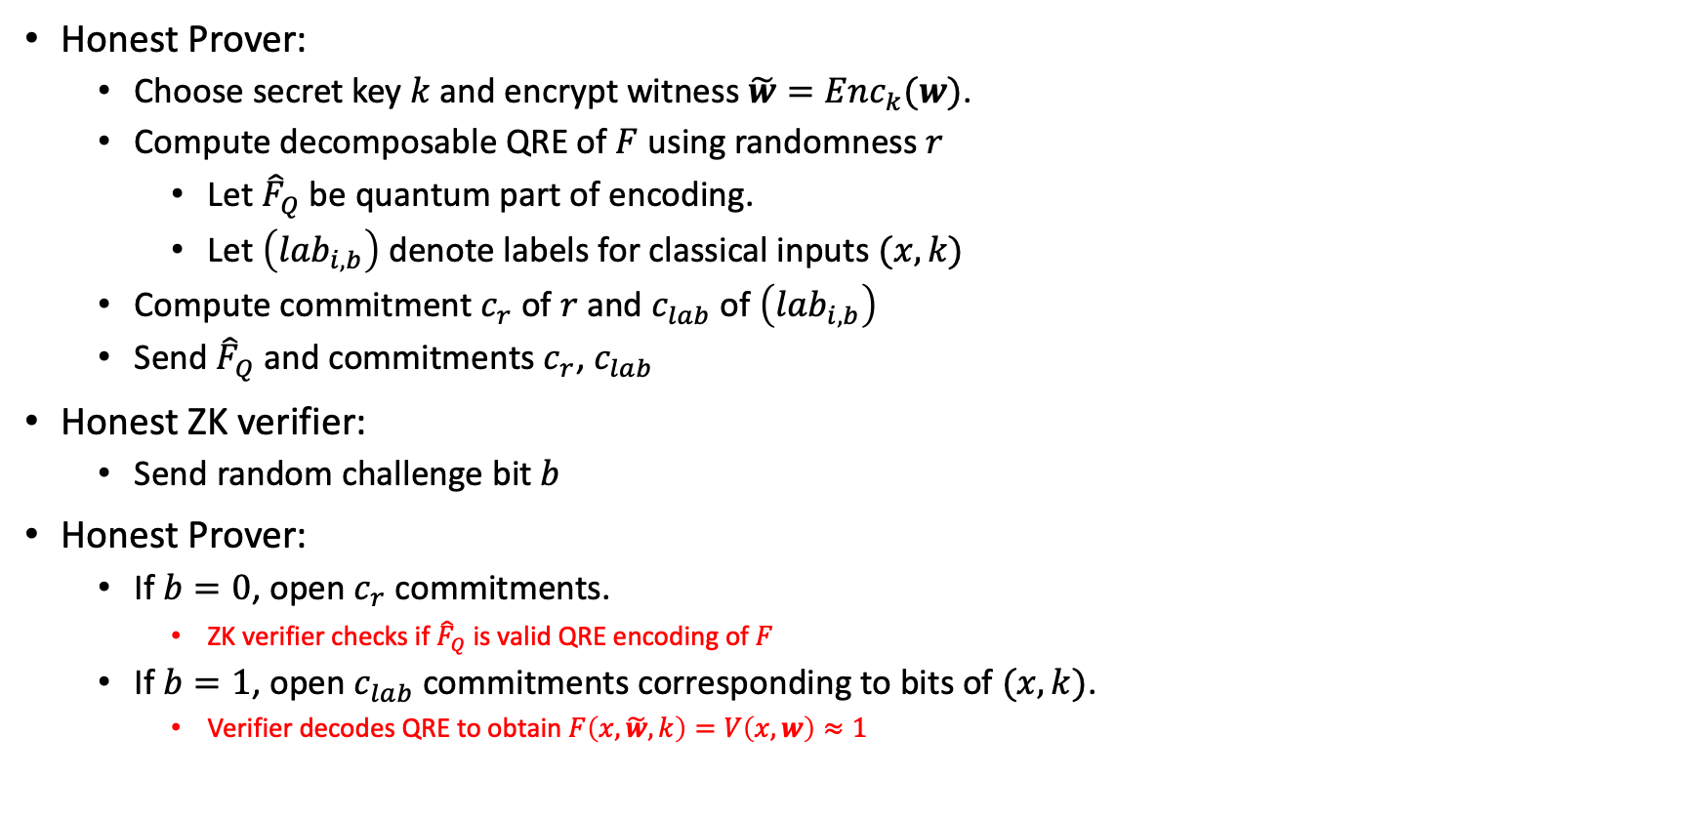




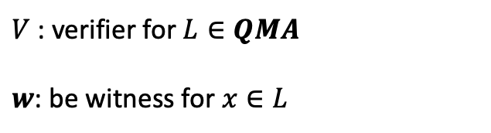
Simple ZK protocol for QMA using QRE
Honest Prover:
  Choose secret key $k$ and encrypt witness $\tilde{w}=Enc_{k}(w)$.
  Compute decomposable QRE of $F$ using randomness $r$
    Let ${\hat{F}}_{Q}$be quantum part of encoding.
    Let $\left(lab_{i,b}\right)$ denote labels for classical inputs $(x,k)$
  Compute commitment $c_{r}$ of $r$ and $c_{lab}$ of $\left(lab_{i,b}\right)$
  Send${\hat{F}}_{Q}$ and commitments $c_{r}$, $c_{lab}$
Honest ZK verifier:
  Send random challenge bit $b$
Honest Prover:
  If $b=0$, open $c_{r}$ commitments.
    ZK verifier checks if ${\hat{F}}_{Q}$ is valid QRE encoding of $F$
  If $b=1$, open $c_{lab}$ commitments corresponding to bits of $(x,k)$.
    Verifier decodes QRE to obtain $F\left(x,\tilde{w},k\right)=V\left(x,w\right)≈1$
$V$ : verifier for $L∈QMA$
$w$: be witness for $x∈L$
$$F$$
$$x$$
Verifier $V$
Acc/rej
$$\tilde{w}$$
Dec
$$k$$

Slide 22
Other Applications of QRE
Any application of classical REs can potentially be transferred to quantum setting!
Examples:
  Private Simultaneous Messages (PSM)
  Constant-round quantum MPC and quantum PSM:
    Not known prior to this work
    Recently, Bartusek, Coladangelo, Khurana, and Ma showed that QREs can be used for constant-round secure 2-party quantum computation.

Slide 23
Other Applications of QRE
Attribute-based/Functional Encryption:
  QREs + classical PKE yield single-key secure public-key Quantum FE
  Open challenges:
    Quantum FE with bounded collusion security?
    Quantum FE with compact ciphertexts?
Path towards obfuscation of quantum circuits:
  QRE enables bootstrapping of weak quantum-iO to quantum iO for all poly-size circuits.
  If there is QRE with classical encoding, then classical iO can be lifted to quantum iO.
  Can recent constructions of iO be “quantized” to obtain quantum iO?
    Constructions use REs under the hood!

Slide 24
Quantum Circuits Overview
Notes:
So hopefully you have a good sense of what randomized encodings are and why they’re interesting. Given how their importance in classical cryptography, it’s natural to ask whether there’s a quantum analogue.

Slide 25
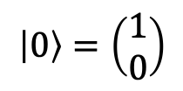
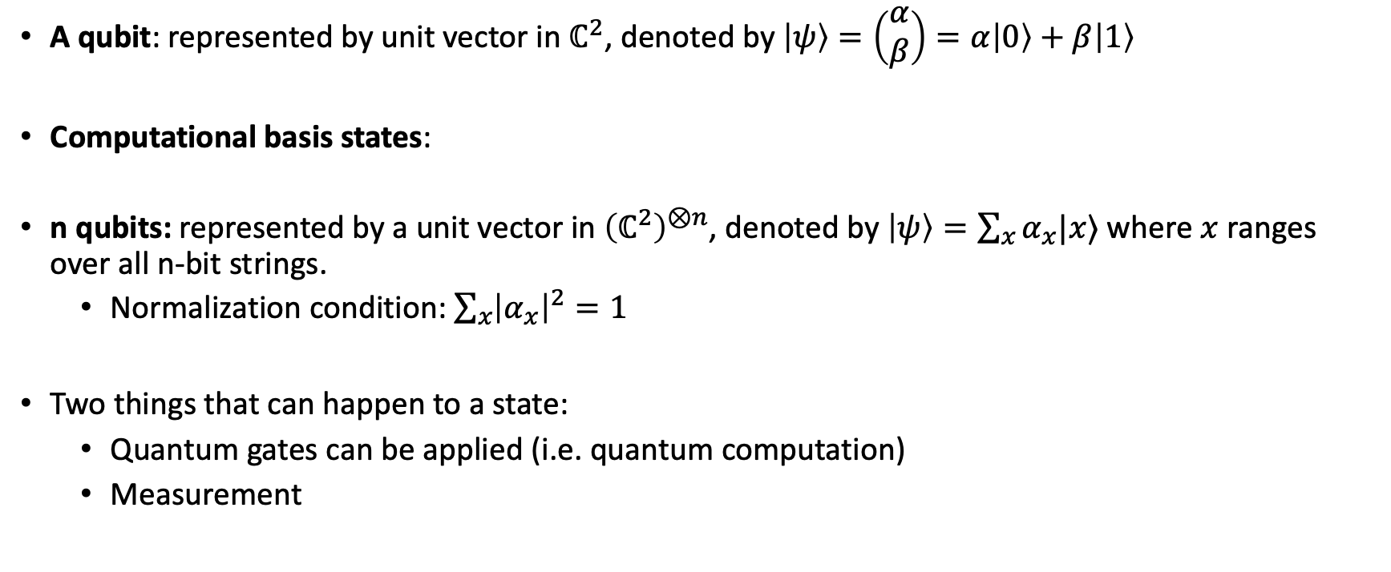
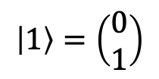
Quantum states
A qubit: represented by unit vector in $ℂ^{2}$, denoted by $\left|ψ\right\rangle =\left(\begin{aligned}α \\ β\end{aligned}\right)=α\left|0\right\rangle +β\left|1\right\rangle$
Computational basis states:
n qubits: represented by a unit vector in ${\left(ℂ^{2}\right)}^{⊗n}$, denoted by $\left|ψ\right\rangle =\sum_{x}{α_{x}|x⟩}$ where $x$ ranges over all n-bit strings.
  Normalization condition: $\sum_{x}{{\left|α_{x}\right|}^{2}}=1$
Two things that can happen to a state:
  Quantum gates can be applied (i.e. quantum computation)
  Measurement
$$\left|0\right\rangle =\left(\begin{aligned}1 \\ 0\end{aligned}\right)$$
$$\left|1\right\rangle =\left(\begin{aligned}0 \\ 1\end{aligned}\right)$$

Slide 26
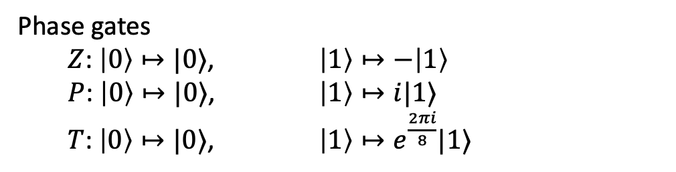
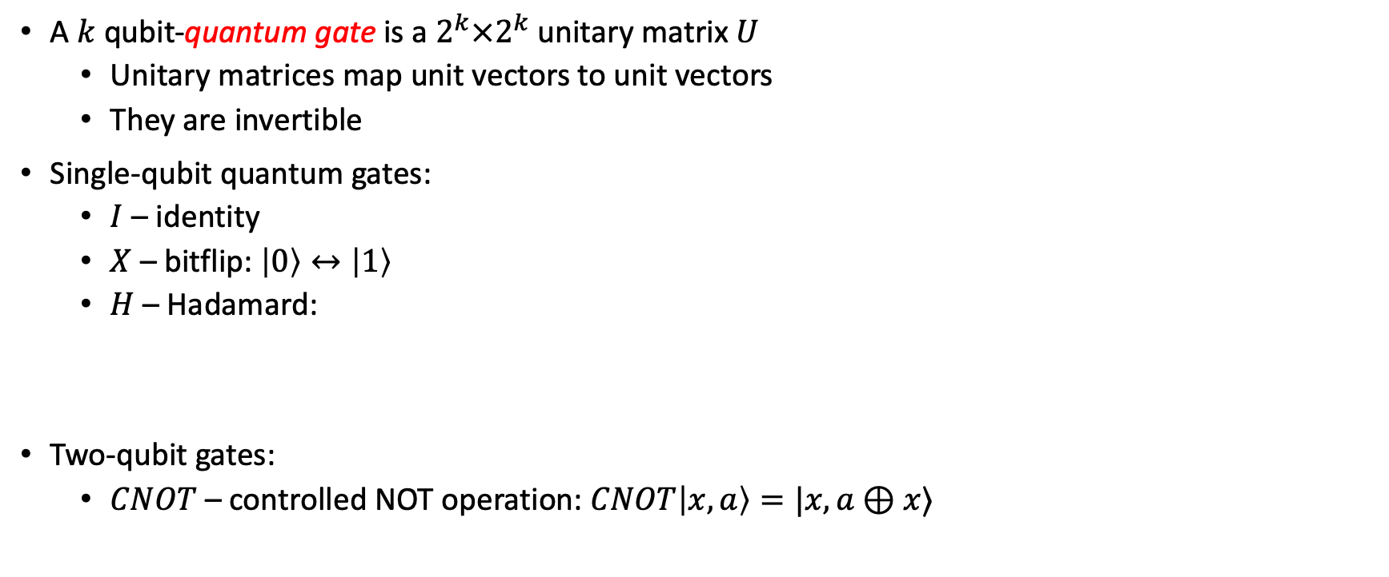

Quantum gates
A $k$ qubit-quantum gate is a $2^{k}×2^{k}$unitary matrix $U$
  Unitary matrices map unit vectors to unit vectors
  They are invertible
Single-qubit quantum gates:
  $I$ – identity
  $X$ – bitflip: $\left|0\right\rangle ↔\left|1\right\rangle$
  $H$ – Hadamard:
Two-qubit gates:
  $CNOT$ – controlled NOT operation: $CNOT\left|x,a\right\rangle =|x,a⊕x⟩$
Phase gates
  $Z$: $\left|0\right\rangle ↦|0⟩$, $\left|1\right\rangle ↦−\left|1\right\rangle$
  $P$: $\left|0\right\rangle ↦|0⟩$, $\left|1\right\rangle ↦i|1⟩$
  $T$: $\left|0\right\rangle ↦|0⟩$, $\left|1\right\rangle ↦e^{\frac{2πi}{8}}|1⟩$
  $$\left|0\right\rangle ↦\frac{1}{\sqrt{2}}\left(\left|0\right\rangle +|1⟩\right) \\ \left|1\right\rangle ↦\frac{1}{\sqrt{2}}\left(\left|0\right\rangle −|1⟩\right)$$

Slide 27
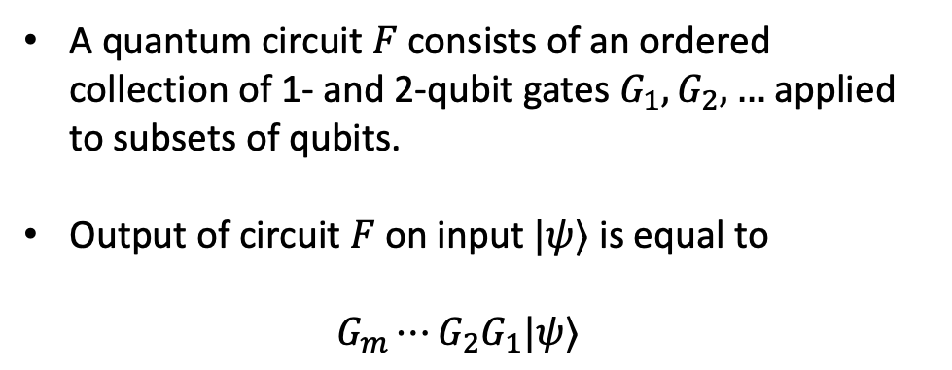

Quantum circuits
2 qubit gates
A quantum circuit $F$ consists of an ordered collection of 1- and 2-qubit gates $G_{1},G_{2},…$applied to subsets of qubits.
Output of circuit $F$ on input $|ψ⟩$ is equal to
$G_{m}⋯G_{2}G_{1}|ψ⟩$
n qubit input
$$\left|ψ\right\rangle$$
….
1 qubit gate

Slide 28
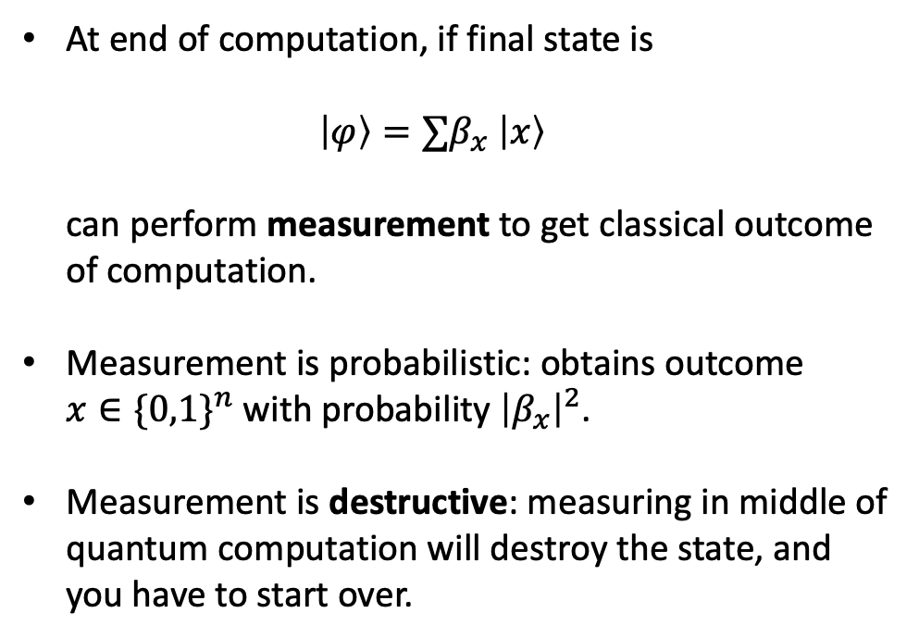
Measurements
2 qubit gates
At end of computation, if final state is
$\left|φ\right\rangle =∑β_{x} \left|x\right\rangle$
can perform measurement to get classical outcome of computation.
Measurement is probabilistic: obtains outcome
$x∈\{0,1\}^{n}$ with probability ${\left|β_{x}\right|}^{2}$.
Measurement is destructive: measuring in middle of quantum computation will destroy the state, and you have to start over.
n qubit input
$$\left|ψ\right\rangle$$
….
1 qubit gate

Slide 29
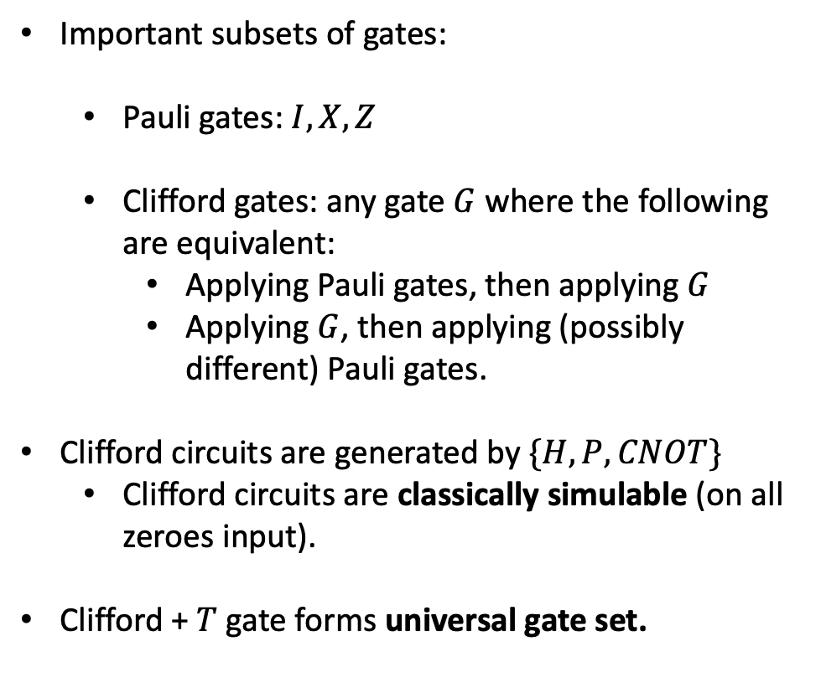
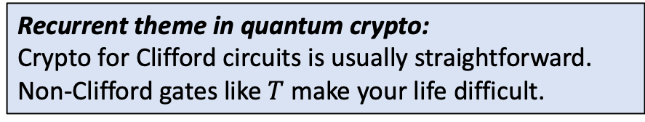
Universal and non-universal gate sets
2 qubit gates
Important subsets of gates:
  Pauli gates: $I, X, Z$
  Clifford gates: any gate $G$ where the following are equivalent:
    Applying Pauli gates, then applying $G$
    Applying $G$, then applying (possibly different) Pauli gates.
Clifford circuits are generated by $\{H,P,CNOT\}$
  Clifford circuits are classically simulable (on all zeroes input).
Clifford + $T$ gate forms universal gate set.
n qubit input
$$\left|ψ\right\rangle$$
….
1 qubit gate
Recurrent theme in quantum crypto:
Crypto for Clifford circuits is usually straightforward.
Non-Clifford gates like $T$ make your life difficult.

Slide 30
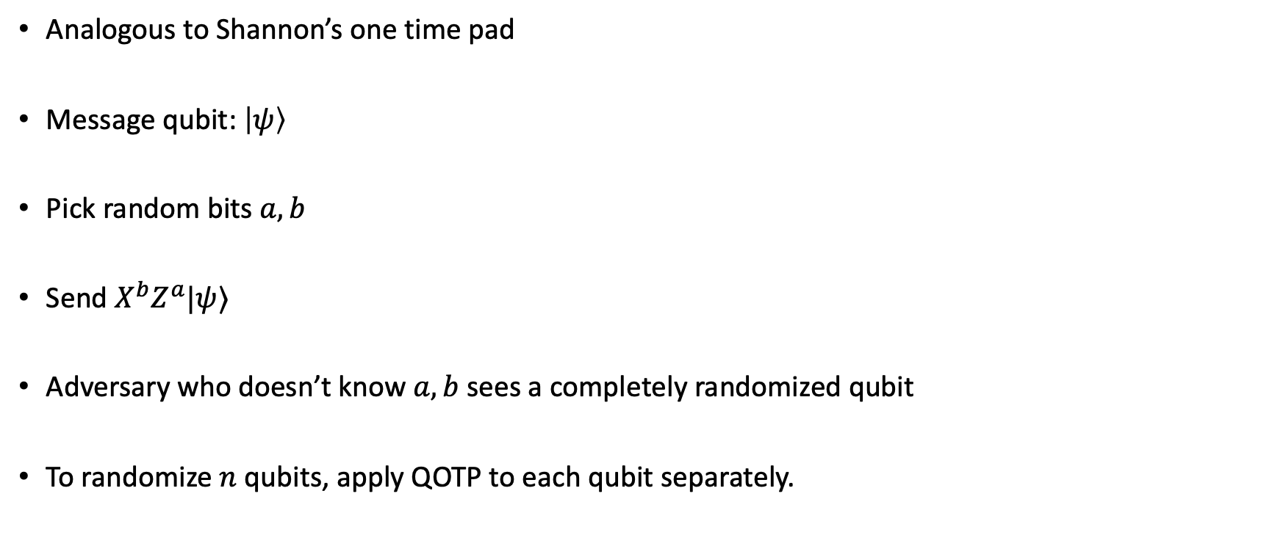
Basic quantum circuits - Quantum one-time pad
Analogous to Shannon’s one time pad
Message qubit: $\left|ψ\right\rangle$
Pick random bits $a,b$
Send $X^{b}Z^{a}|ψ⟩$
Adversary who doesn’t know $a,b$ sees a completely randomized qubit
To randomize $n$ qubits, apply QOTP to each qubit separately.

Slide 31

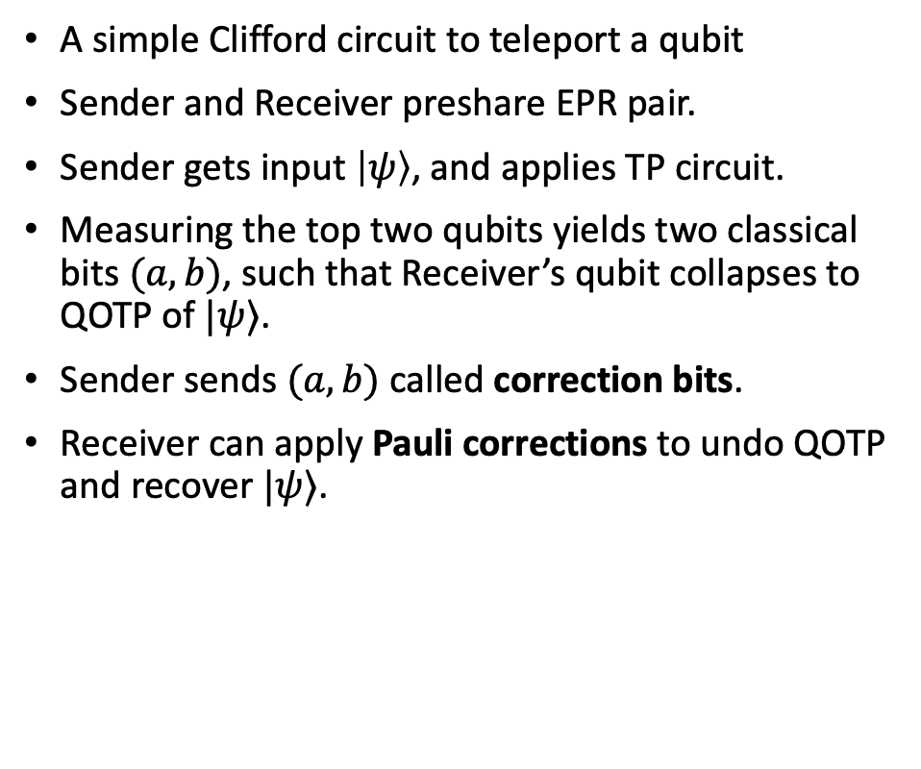


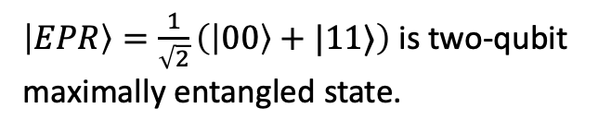




Basic quantum circuits - Quantum teleportation
A simple Clifford circuit to teleport a qubit
Sender and Receiver preshare EPR pair.
Sender gets input $\left|ψ\right\rangle$, and applies TP circuit.
Measuring the top two qubits yields two classical bits $(a,b)$, such that Receiver’s qubit collapses to QOTP of $|ψ⟩$.
Sender sends $(a,b)$ called correction bits.
Receiver can apply Pauli corrections to undo QOTP and recover $|ψ⟩$.
$$|ψ⟩$$
$$H$$
$$a$$
$$b$$
$$|EPR⟩$$
CNOT
$$=$$
$$X^{b}Z^{a}|ψ⟩$$
$\left|EPR\right\rangle =\frac{1}{\sqrt{2}}\left(\left|00\right\rangle +|11⟩\right)$ is two-qubit
maximally entangled state.

Slide 32
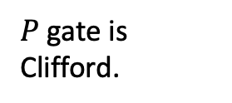
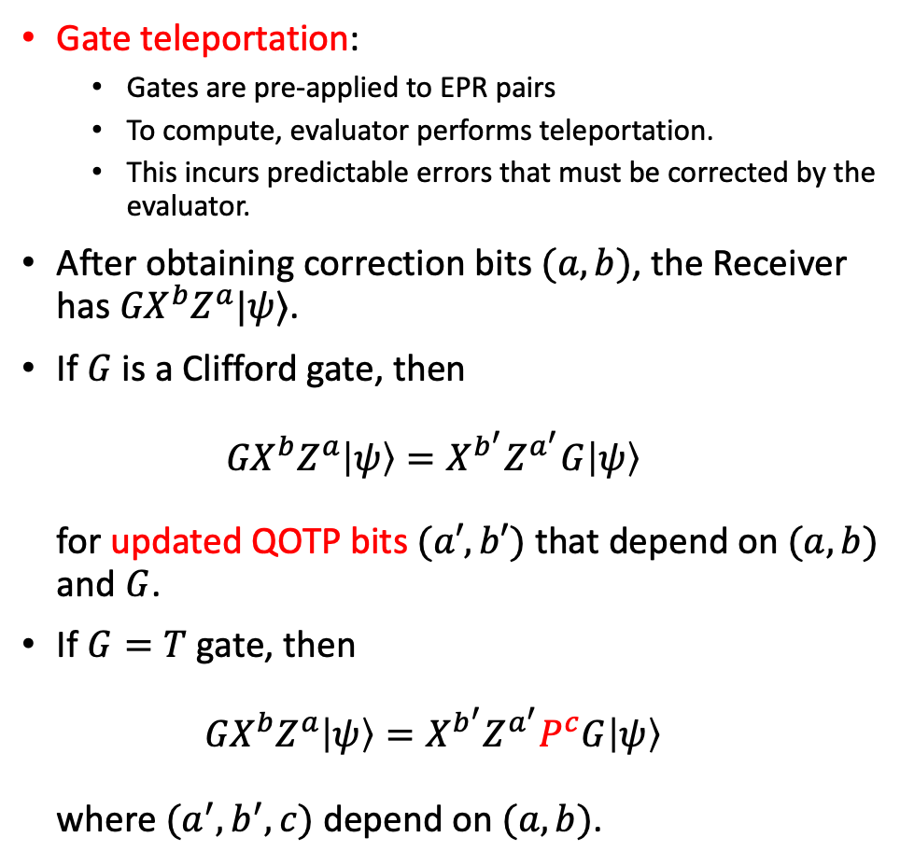

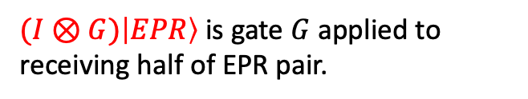

Gate teleportation
Gate teleportation:
  Gates are pre-applied to EPR pairs
  To compute, evaluator performs teleportation.
  This incurs predictable errors that must be corrected by the evaluator.
After obtaining correction bits $(a,b)$, the Receiver has ${GX}^{b}Z^{a}|ψ⟩$.
If $G$ is a Clifford gate, then
${GX}^{b}Z^{a}\left|ψ\right\rangle =X^{b^{′}}Z^{a^{′}}G\left|ψ\right\rangle$
for updated QOTP bits $(a′,b′)$ that depend on $(a,b)$ and $G$.
If $G=T$ gate, then
${GX}^{b}Z^{a}\left|ψ\right\rangle =X^{b^{′}}Z^{a^{′}}P^{c}G\left|ψ\right\rangle$
where $(a^{′},b^{′},c)$ depend on $(a,b)$.
$$|ψ⟩$$
$$H$$
$$a$$
$$b$$
$$|EPR⟩$$
CNOT
$$G$$
$$=$$
$${GX}^{b}Z^{a}|ψ⟩$$
$(I⊗G)\left|EPR\right\rangle$ is gate $G$ applied to receiving half of EPR pair.
Gate teleportation allows gates of a circuit to be performed “ahead of time”, before input arrives. Evaluator only has to measure and apply simple Clifford corrections.
$P$ gate is Clifford.

Slide 33
Quantum Garbled Circuits

Slide 34
The Intuition
Use gate teleportation to “flatten” quantum computations. This enables encoder to be constant-depth.
  Encoder prepares input state and series of EPR pairs for each gate.
  Decoder performs correction and gate teleportation.
Use classical RE scheme (such as Yao’s garbled circuits) so Decoder can compute the proper correction.
  This is to maintain privacy for circuit and input.

Slide 35
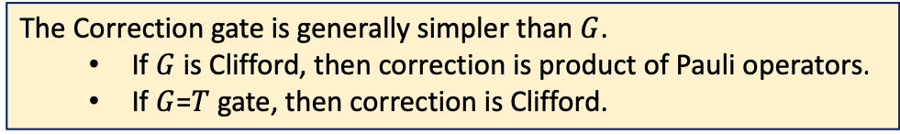






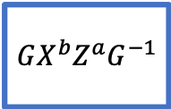



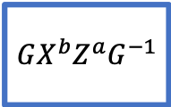


Flattening Quantum Circuits
Randomized Encodings “flatten” computations into constant-depth computations.
  Example: in Yao’s garbled circuits, each gate is garbled independently.
Key idea: we can ”flatten” quantum computations by using gate teleportation.
Correction gate depends on TP measurement results
$${{GX^{b}Z}^{a}G}^{−1}$$
$$|ψ_{1}⟩$$
$$a$$
Teleportation
Measurement
$$b$$
$$|EPR⟩$$
$$|ψ_{1}⟩$$
Corr
$$=$$
$${{GX^{b}Z}^{a}G}^{−1}$$
$$|ψ_{2}⟩$$
G
$$|ψ_{2}⟩$$
$$a$$
Teleportation
Measurement
$$b$$
$$|EPR⟩$$
The Correction gate is generally simpler than $G$.
  If $G$ is Clifford, then correction is product of Pauli operators.
  If $G$=$T$ gate, then correction is Clifford.
G

Slide 36


























Flattening Quantum Circuits
$$C_{i}$$
$$=$$
$${{G_{i}X^{b_{i}}Z}^{a_{i}}G_{i}^{−1}}^{}$$
TP
$$=$$
Teleportation Measurement
Original circuit
$$x$$
$$G_{1}$$
$$G_{2}$$
$$G_{3}$$
$$⋯$$
Encoding computable in constant-depth, but
it is not private!
Flattened circuit
$$a_{1}$$
$$x$$
TP
$$b_{1}$$
$$|EPR⟩$$
$$G_{1}$$
$$C_{1}$$
$$a_{2}$$
TP
$$b_{2}$$
$$|EPR⟩$$
$$a_{3}$$
$$G_{2}$$
$$C_{2}$$
TP
$$b_{3}$$
$$|EPR⟩$$
$$G_{3}$$
$$C_{3}$$
$$⋯$$
$$⋮$$
Encoder prepares this
Decoder performs teleportations + corrections

Slide 37




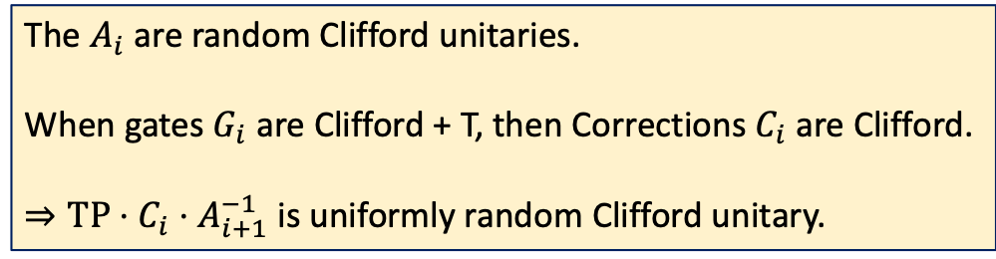





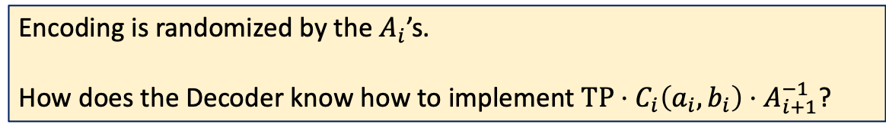
Hiding the Inputs and Gates
Need to hide: (1) Input $x$, (2) Gates $G_{1}$, $G_{2}$, $…$, (3) Teleportation outcomes,
(4) Correction unitaries
The $A_{i}$ are random Clifford unitaries.
When gates $G_{i}$ are Clifford + T, then Corrections$C_{i}$ are Clifford.
$⇒TP⋅C_{i}⋅A_{i+1}^{−1}$ is uniformly random Clifford unitary.
$$a_{1}$$
$$x$$
$$A_{1}$$
$$A_{1}^{−1}$$
TP
$$b_{1}$$
$$|EPR⟩$$
$$G_{1}$$
$$C_{1}$$
$$a_{2}$$
$$A_{2}$$
$$A_{2}^{−1}$$
TP
$$b_{2}$$
$$|EPR⟩$$
$$a_{3}$$
$$G_{2}$$
$$C_{2}$$
$$A_{3}$$
$$A_{3}^{−1}$$
TP
$$b_{3}$$
$$|EPR⟩$$
$$G_{3}$$
$$A_{4}$$
$$A_{4}^{−1}$$
$$C_{3}$$
$$⋯$$
$$⋮$$
Encoding is randomized by the $A_{i}$’s.
How does the Decoder know how to implement $TP⋅C_{i}\left(a_{i},b_{i}\right)⋅A_{i+1}^{−1}$?

Slide 38


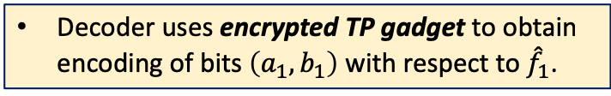

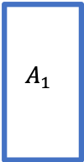

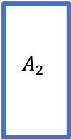
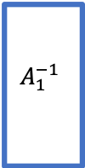


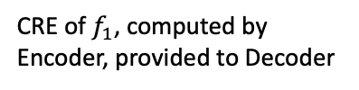
Obfuscating the Correction Gadgets
Need to hide: (1) Input $x$, (2) Gates $G_{1}$, $G_{2}$, $…$, (3) Teleportation outcomes,
(4) Correction unitaries
Let $f_{i}\left(a_{i},b_{i}\right)$ denote classical circuit computing a canonical representation of the correction unitary $TP⋅C_{i}\left(a_{i},b_{i}\right)⋅A_{i+1}^{−1}$
Let ${\hat{f}}_{i}\left(a_{i},b_{i}\right)=({\hat{f}}_{i} ,{\hat{a}}_{i},{\hat{b}}_{i})$ be classical decomposable RE of $f_{i}$
$$x$$
$$A_{1}$$
$$A_{1}^{−1}$$
ETP
$${\hat{a}}_{1},{\hat{b}}_{1}$$
CRE of $f_{1}$, computed by Encoder, provided to Decoder
$$|0⟩$$
$$|EPR⟩$$
Decoder uses encrypted TP gadget to obtain encoding of bits $\left(a_{1},b_{1}\right)$ with respect to ${\hat{f}}_{1}$.
$$G_{1}$$
$$A_{2}$$
$$|0⟩$$
$$⋯$$
$$|EPR⟩$$

Slide 39


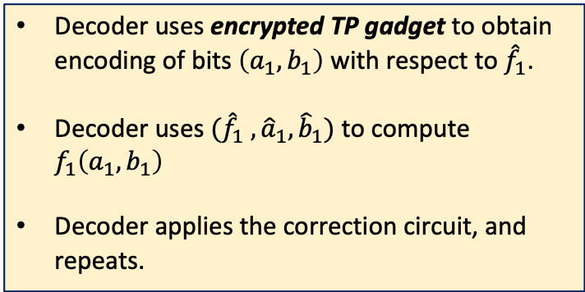
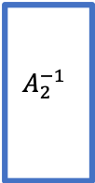

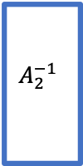
Obfuscating the Correction Gadgets
Need to hide: (1) Input $x$, (2) Gates $G_{1}$, $G_{2}$, $…$, (3) Teleportation outcomes,
(4) Correction unitaries
Let $f_{i}\left(a_{i},b_{i}\right)$ denote classical circuit computing a canonical representation of the correction unitary $TP⋅C_{i}\left(a_{i},b_{i}\right)⋅A_{i+1}^{−1}$
Let ${\hat{f}}_{i}\left(a_{i},b_{i}\right)=({\hat{f}}_{i} ,{\hat{a}}_{i},{\hat{b}}_{i})$ be classical decomposable RE of $f_{i}$
$$A_{2}^{−1}$$
$$C_{1}$$
ETP
$$x$$
$$A_{1}$$
$$A_{1}^{−1}$$
ETP
$$|0⟩$$
$${\hat{a}}_{1},{\hat{b}}_{1}$$
$$|EPR⟩$$
Decoder uses encrypted TP gadget to obtain encoding of bits $\left(a_{1},b_{1}\right)$ with respect to ${\hat{f}}_{1}$.
Decoder uses $({\hat{f}}_{1} ,{\hat{a}}_{1},{\hat{b}}_{1})$ to compute $f_{1}\left(a_{1},b_{1}\right)$
Decoder applies the correction circuit, and repeats.
$$G_{1}$$
$$A_{2}$$
$$A_{2}^{−1}$$
$$C_{1}$$
ETP
$$|0⟩$$
$$|EPR⟩$$
$${\hat{a}}_{2},{\hat{b}}_{2}$$
Note: Decoder only sees canonical representation of this!

Slide 40










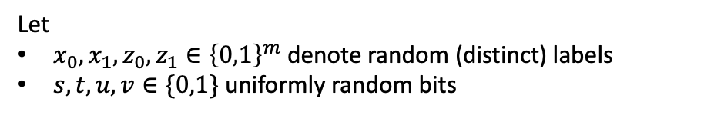







Encrypted Teleportation Gadget
Let
$x_{0},x_{1},z_{0},z_{1}∈{\left\{0,1\right\}}^{m}$ denote random (distinct) labels
$s,t,u,v∈\{0,1\}$ uniformly random bits
$$|ψ⟩$$
$$H$$
$$X^{s}$$
$$Z^{t}$$
Measuring the ancilla registers yields no information about the X and Z corrections!
$$|0⟩$$
$$X\left(z_{0}\right)$$
$$X\left(z_{0}⊕z_{1}\right)$$
$$z_{a}$$
ancilla
$$|0⟩$$
$$X\left(x_{0}\right)$$
$$X\left(x_{0}⊕x_{1}\right)$$
$$x_{b}$$
$$X^{u}$$
$$Z^{v}$$
$$|EPR⟩$$
$$=$$
$$X^{b}Z^{a}|ψ⟩$$

Slide 41








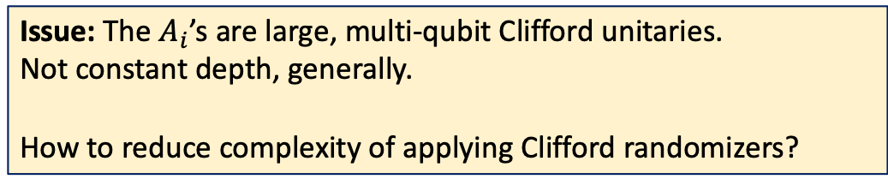



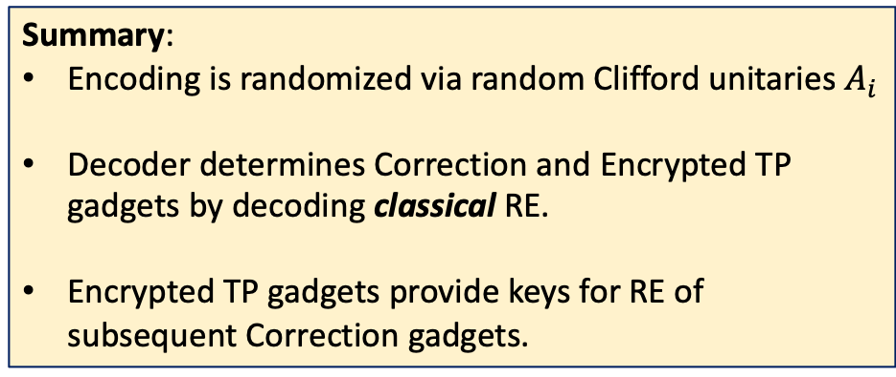





The Scheme So Far
Summary:
Encoding is randomized via random Clifford unitaries $A_{i}$
Decoder determines Correction and Encrypted TP gadgets by decoding classical RE.
Encrypted TP gadgets provide keys for RE of subsequent Correction gadgets.
Need to hide: (1) Input $x$, (2) Gates $G_{1}$, $G_{2}$, $…$, (3) Teleportation outcomes,
(4) Correction unitaries
$${\hat{a}}_{1}$$
$$x$$
$$A_{1}$$
$$A_{1}^{−1}$$
ETP
$${\hat{b}}_{1}$$
$$|EPR⟩$$
$${\hat{a}}_{2}$$
$$G_{1}$$
$$C_{1}$$
$$A_{2}$$
$$A_{2}^{−1}$$
ETP
$${\hat{b}}_{2}$$
$$|EPR⟩$$
$${\hat{a}}_{3}$$
$$G_{2}$$
$$C_{2}$$
$$A_{3}$$
$$A_{3}^{−1}$$
ETP
$${\hat{b}}_{3}$$
$$|EPR⟩$$
$$G_{3}$$
$$A_{4}$$
$$C_{3}$$
$$⋯$$
$$⋮$$
Issue: The $A_{i}$’s are large, multi-qubit Clifford unitaries.
Not constant depth, generally.
How to reduce complexity of applying Clifford randomizers?

Slide 42





QRE for Clifford Circuits
Idea: Recursively apply QRE for Clifford circuits!
QRE for Clifford circuits is much simpler
Since Clifford group maps Paulis to Paulis, we can defer corrections until the very end of circuit.
Encrypted TP gadgets are constant depth, so Encoder can apply them.
Use Classical RE to compute final corrections, which is single layer of Pauli gates.
Need to hide: (1) Input $x$, (2) Gates $G_{1}$, $G_{2}$, $…$, (3) Teleportation outcomes,
(4) Correction unitaries
$${\hat{a}}_{1}$$
$$x$$
ETP
$${\hat{b}}_{1}$$
$$|EPR⟩$$
$${\hat{a}}_{2}$$
$$G_{1}$$
ETP
$${\hat{b}}_{2}$$
$$|EPR⟩$$
$${\hat{a}}_{3}$$
$$G_{2}$$
ETP
$${\hat{b}}_{3}$$
$$|EPR⟩$$
$$G_{3}$$
ETP
$$⋯$$
CRE of function to compute final corrections
$$⋮$$

Slide 43

The Scheme
Summary:
Encoding consists of:
  Input $x$and gate EPR pairs, scrambled by random Clifford unitaries $A_{i}$, which are applied recursively using Clifford QRE.
  Classical RE for correction gadgets.
Decoder determines Correction and Encrypted TP gadgets by decoding classical RE.
Encrypted TP gadgets provide keys for RE of subsequent Correction gadgets.
Need to hide: (1) Input $x$, (2) Gates $G_{1}$, $G_{2}$, $…$, (3) Teleportation outcomes,
(4) Correction unitaries
$${\hat{a}}_{1}$$
$$x$$
$$A_{1}$$
$$A_{1}^{−1}$$
ETP
$${\hat{b}}_{1}$$
$$|EPR⟩$$
$${\hat{a}}_{2}$$
$$G_{1}$$
$$C_{1}$$
$$A_{2}$$
$$A_{2}^{−1}$$
ETP
$${\hat{b}}_{2}$$
$$|EPR⟩$$
$${\hat{a}}_{3}$$
$$G_{2}$$
$$C_{2}$$
$$A_{3}$$
$$A_{3}^{−1}$$
ETP
$${\hat{b}}_{3}$$
$$|EPR⟩$$
$$G_{3}$$
$$A_{4}$$
$$C_{3}$$
$$⋯$$
$$⋮$$

Slide 44

Privacy Analysis
Need to argue that $Enc\left(F,x,r\right)$ can be simulated given $F(x)$ and the topology of $F$.
Main Technical Result: If the classical RE has $ε$-security against class of adversaries $𝒜$, then for all circuits $F$ and inputs $x$,
$Enc\left(F,x,r\right)≈_{ε⋅|F|}Enc\left(I,F\left(x\right),r\right)$
where $I$= identity circuit with the same topology as $F$.
This is proved by:
$Dec\left(Enc\left(F,x,r\right)\right)≈_{ε⋅|F|}Dec\left(Enc\left(I,F(x),r\right)\right)$
and using that $Dec$ can be executed coherently (and thus is unitary).
Non-interactive setting makes privacy analysis easier! No need to model arbitrary adversaries.

Slide 45
Summary:
Randomized Encodings are a fundamental primitive in classical cryptography, with many applications.
Purpose: Very efficiently encode computations in a privacy-preserving manner.
We define Quantum Randomized Encodings.
We present a construction of a QRE, that is quantum analogue of Yao’s Garbled Circuits.
Our construction uses Classical RE’s as black box.
Open Problems:
QRE with classical encoding? Would yield Obfuscation for Quantum Circuits.
Information-theoretic (Q)REs with exponential dependence on depth?
Applications of QRE:
  MPC
  Zero knowledge
  Blind, delegated QC
  Parallel crypto
  …
Reusable quantum garbled circuits?
Thank You!

