Slide 1
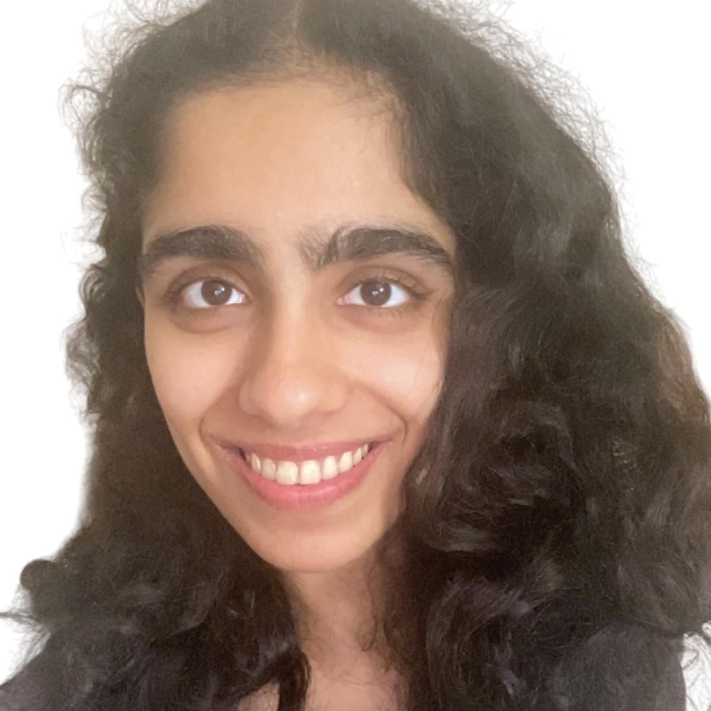
QMA vs. QCMA and Pseudorandomness
Saachi Mutreja (Columbia)
Henry Yuen (Columbia)
Jiahui Liu (MIT → Fujitsu Labs)
Notes:
Hi everyone, thank you so much for having me here. I’ll be talking about query separations between QMA vs. QCMA, which are quantum generalizations of NP, and connections with pseudorandomness. This is joint work with my wonderful collaborators: Jiahui Liu who was a postdoc at MIT but moved to Fujitsu Labs, and my student Saachi Mutreja at Columbia.
I’m not going to assume that people here are necessarily familiar with quantum computing and quantum complexity classes, so I’ll try to go slowly through the concepts here. Feel free to ask questions.

Slide 2
This talk
Main result: Distinguishing between whether an exponentially-large graph (given oracle access to it)
has two disconnected components, or
has a single expanding component
separates QMA from QCMA, assuming a quantum pseudorandomness conjecture.
This is evidence that quantum proofs can convince verifiers of more complex statements than classical proofs.

Slide 3
This talk
Main result: Distinguishing between whether an exponentially-large graph (given oracle access to it)
has two disconnected components, or
has a single expanding component
separates QMA from QCMA, assuming a quantum pseudorandomness conjecture.
The quantum pseudorandomness conjecture is interesting in its own right; it is connected to open questions about quantum speedups for solving unstructured problems, and the Aaronson-Ambainis conjecture about influences of low-degree bounded polynomials.

Slide 4
Quantum generalizations of NP

Slide 5
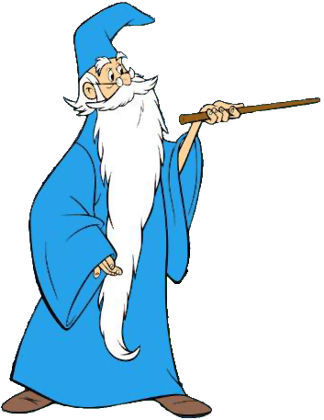
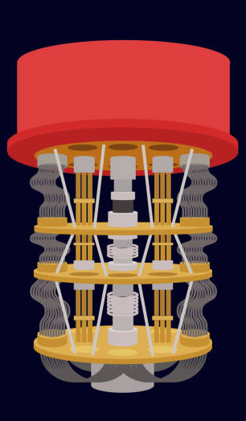
Quantum Merlin-Arthur (QMA)
Informally: QMA = problems efficiently verifiable on quantum computers with help of a quantum proof.
Formally: $L∈QMA$ iff there exists a poly-time quantum verifier $V$ such that
$x∈L$ $⟹∃$ quantum proof $|ψ⟩$ where $V(x,|ψ⟩)$ accepts w.h.p.
$x∉L$ $⟹$ all quantum proofs $\left|ψ\right\rangle$ cause $V(x,|ψ⟩)$ to reject w.h.p.
$$x$$
Accept/Reject
$$x$$
$$\left|ψ\right\rangle$$
Merlin: All-powerful, but untrusted prover
Arthur: polynomial-time quantum verifier

Slide 6
Quantum Merlin-Arthur (QMA)
Complexity landscape
Problems in QMA
LOCAL HAMILTONIANS: Deciding if there exists quantum state with energy $≤α$ or $≥β$ for $\left|α−β\right|≥1/poly$ (QMA-complete).
CIRCUIT EQUIVALENCE: Deciding whether two quantum circuits are equivalent (co-QMA complete).
GROUP NON-MEMBERSHIP: Deciding whether a given group element is outside of a succinctly presented subgroup (given access to group oracle).
PSPACE
QMA
NP
BQP

Slide 7
Quantum Classical Merlin-Arthur (QCMA)
Informally: QCMA = problems efficiently verifiable on quantum computers with help of a classical proof.
Formally: $L∈QCMA$ iff there exists a poly-time quantum verifier $V$ such that
$x∈L$ $⟹∃$ classical proof $w$ where $V(x,w)$ accepts w.h.p.
$x∉L$ $⟹$ all classical proofs $w$cause $V(x,w)$ to reject w.h.p.
$$x$$
$$x$$
$$w$$
Merlin: All-powerful, but untrusted prover
Arthur: polynomial-time quantum verifier

Slide 8
Quantum Classical Merlin-Arthur (QCMA)
Complexity landscape
Problems in QCMA
PSPACE
GROUND SPACE CONNECTIVITY: Given a local Hamiltonian and poly-sized descriptions of two ground states (promised that such descriptions exist), decide if there exists an “energy barrier” between the two states (QCMA complete).
GROUP NON-MEMBERSHIP: Under some group theory assumptions, this problem has a QCMA protocol.
QMA
QCMA
NP
BQP

Slide 9
QMA vs. QCMA
How useful are quantum proofs?
Although a $n$-qubit state requires $2^{n}$ parameters to specify, it can’t be used to convey more than $n$ bits of classical information, by Holevo’s theorem.
Examples of problems where quantum proofs do not appear to help:
Approximating set size
Formula unsatisfiability
Certifying that a black-box function is 1-to-1 rather than 2-to-1.

Slide 10
QMA vs. QCMA
If QMA = QCMA, quantum proofs can be efficiently replaced by classical proofs.
Consequences:
Ground states of local Hamiltonians have efficiently checkable classical descriptions. This implies that physically-relevant quantum systems have ground states with limited complexity.
If two quantum circuits behave differently, then there is a polynomial-size classical witness of this fact.

Slide 11
QMA vs. QCMA
If QMA ≠ QCMA, then quantum proofs allow for verification of more complex statements than classical proofs.
Unconditionally separating QCMA from QMA is, of course, difficult.
The next best thing is to find oracle evidence that they are different.

Slide 12
Oracle separations of QMA from QCMA

Slide 13
Oracle QMA and QCMA
We consider oracle models of QMA and QCMA where the input to the verifier is an oracle which must be queried.
Complexity parameters measured in terms of oracle size
# of queries made by verifier
size of proof received by verifier
oracle
The verifier’s task is to decide whether the oracle satisfies some property.
$$|ψ⟩$$

Slide 14
Oracle QMA and QCMA
sets of oracles
An QMA/QCMA oracle separation is a decision problem $\left(ℒ_{YES},ℒ_{NO}\right)$ where
There exists QMA verifier $V$ that decides $\left(ℒ_{YES},ℒ_{NO}\right)$ using $polylog(N)$ queries and proof size
Any QCMA verifier needs at least $poly(N)$ queries and proof size.
$N$ = oracle size
Such a separation provides a setting where quantum proofs are more powerful than classical proofs.
oracle
$$|ψ⟩$$

Slide 15
Oracle QMA and QCMA
There is a unitary oracle separating QMA from QCMA (Aaronson, Kuperberg 2007)
The oracle decision problem: decide if $U=I$ or $U=I−2\left|ψ\right\rangle \left\langle ψ\right|$ for some $|ψ⟩$, promised one is the case.
QMA upper bound: prover sends $|ψ⟩$, and verifier can query oracle to check.
oracle
QCMA lower bound bound: if $\left|ψ\right\rangle$ is uniformly random, by concentration of measure, QCMA verifier cannot distinguish $U=I−2\left|ψ\right\rangle ⟨ψ|$ from $U=I$ without exponentially many queries.
$$|ψ⟩$$

Slide 16
Oracle QMA and QCMA
Aaronson and Kuperberg asked if there is a classical oracle separation. A classical oracle is a function $f:[N]→[M]$ queryable in superposition:
$$\sum_{x}{α_{x}\left|x\right\rangle |0⟩}↦\sum_{x}{α_{x}\left|x\right\rangle |f(x)⟩}$$
Partial progress over the years:
Lutomirski 2011
Fefferman, Kimmel 2015
Natarajan, Nirkhe 2022
Bassirian, Fefferman, Marwaha 2022
Ben-David, Kundu 2024
Li, Liu, Pelecanos, Yamakawa 2024
Zhandry 2024
Assume restrictions on oracle model or on verifier
Uses a different pseudorandomness conjecture

Slide 17
Oracle QMA and QCMA
Aaronson and Kuperberg asked if there is a classical oracle separation. A classical oracle is a function $f:[N]→[M]$ queryable in superposition:
$$\sum_{x}{α_{x}\left|x\right\rangle |0⟩}↦\sum_{x}{α_{x}\left|x\right\rangle |f(x)⟩}$$
Partial progress over the years:
Lutomirski 2011
Fefferman, Kimmel 2015
Natarajan, Nirkhe 2022
Bassirian, Fefferman, Marwaha 2022
Ben-David, Kundu 2024
Li, Liu, Pelecanos, Yamakawa 2024
Zhandry 2024
Separations based on graph problems

Slide 18
Oracle QMA and QCMA
Aaronson and Kuperberg asked if there is a classical oracle separation. A classical oracle is a function $f:[N]→[M]$ queryable in superposition:
$$\sum_{x}{α_{x}\left|x\right\rangle |0⟩}↦\sum_{x}{α_{x}\left|x\right\rangle |f(x)⟩}$$
Proposed the Components problem as a candidate QMA/QCMA oracle separation
Partial progress over the years:
Lutomirski 2011
Fefferman, Kimmel 2015
Natarajan, Nirkhe 2022
Bassirian, Fefferman, Marwaha 2022
Ben-David, Kundu 2024
Li, Liu, Pelecanos, Yamakawa 2024
Zhandry 2024
Showed that a randomized-oracle variant of the problem separates QMA/QCMA.

Slide 19
$F:\left[R\right]×\left[N\right]→\left[N\right]$ is a graph oracle if it defines a matching for every color $r∈\left[R\right]$, i.e., $F\left(r,x\right)=y⇔F\left(r,y\right)=x$.
The Components problem
A graph oracle $F:\left[R\right]×\left[N\right]→\left[N\right]$ is a
YES instance if the corresponding graph can be partitioned into two components of size $N/2$.
NO instance if the corresponding graph is a $Δ$-expander
In particular, NO instances are a single component that is highly connected.
Think of $Δ=Ω\left(1\right), R=O\left(1\right), N=2^{n}$.

Slide 20
QMA protocol for Components
$$\left|ψ\right\rangle =\frac{1}{\sqrt{N}}\left(\sum_{x∈S}{|x⟩}−\sum_{x∉S}{|x⟩}\right)$$
Intended quantum proof:
Quantum state on $n=\log{N}$ qubits
Perform one of two tests at random:
1. Balancedness test: check that $|ψ⟩$ is orthogonal to $\frac{1}{\sqrt{N}}\sum_{x∈[N]}{|x⟩}$.
2. Expansion test: pick a random color $r∈[R]$. Check that $|ψ⟩$ is invariant under permuting the vertices according to the matching $F(r,⋅)$.
For YES graph oracles $F$, there is balanced partition $\left[N\right]=S∪\overline{S}$ and no edges cross the partition.
$$S$$
$$\overline{S}$$

Slide 21
QMA protocol for Components
$$\left|ψ\right\rangle =\frac{1}{\sqrt{N}}\left(\sum_{x∈S}{|x⟩}−\sum_{x∉S}{|x⟩}\right)$$
Intended quantum proof:
QMA verifier, on input $|ψ⟩$
Perform one of two tests at random:
1. Balancedness test: check that $|ψ⟩$ is orthogonal to $\frac{1}{\sqrt{N}}\sum_{x∈[N]}{|x⟩}$.
2. Expansion test: pick a random color $r∈[R]$. Check that $|ψ⟩$ is invariant under permuting the vertices according to the matching $F(r,⋅)$.

Slide 22
QMA protocol for Components
$$\left|ψ\right\rangle =\frac{1}{\sqrt{N}}\left(\sum_{x∈S}{|x⟩}−\sum_{x∉S}{|x⟩}\right)$$
Intended quantum proof:
Checks that $|ψ⟩$ specifies a balanced partition of vertices.
QMA verifier, on input $|ψ⟩$
Perform one of two tests at random:
1. Balancedness test: check that $|ψ⟩$ is orthogonal to $\frac{1}{\sqrt{N}}\sum_{x∈[N]}{|x⟩}$.
2. Expansion test: pick a random color $r∈[R]$. Check that $|ψ⟩$ is invariant under permuting the vertices according to the matching $F(r,⋅)$.

Slide 23
QMA protocol for Components
$$\left|ψ\right\rangle =\frac{1}{\sqrt{N}}\left(\sum_{x∈S}{|x⟩}−\sum_{x∉S}{|x⟩}\right)$$
Intended quantum proof:
QMA verifier, on input $|ψ⟩$
Perform one of two tests at random:
1. Balancedness test: check that $|ψ⟩$ is orthogonal to $\frac{1}{\sqrt{N}}\sum_{x∈[N]}{|x⟩}$.
2. Expansion test: pick a random color $r∈[R]$. Check that $|ψ⟩$ is invariant under permuting the vertices according to the matching $F(r,⋅)$.
Checks not many edges cross the cut specified by $|ψ⟩$.

Slide 24
QCMA lower bound for Components
Main Theorem (Liu, Mutreja, Y.)
Assuming a quantum pseudorandomness conjecture, any QCMA protocol for Components must either make $N^{Ω(1)}$ queries to the graph oracle $F$, or receive a classical witness of length $N^{Ω\left(1\right)}$.
In contrast: QMA verifier makes 1 query and receives $O(\log{N)}$-qubit witness.

Slide 25
Quantum Pseudorandomness Conjectures

Slide 26
Dense distributions
Definition: A random variable $X$over ${\{0,1\}}^{N}$ is $δ$-dense if for all subsets $S⊆[N]$ of coordinates,
$$H_{min}\left(X_{S}\right)≥\left(1−δ\right)⋅\left|S\right|$$
$1−δ$ fraction of maximum entropy

Slide 27
Dense distributions
Definition: A random variable $X$over ${\{0,1\}}^{N}$ is $δ$-dense if for all subsets $S⊆[N]$ of coordinates,
$$H_{min}\left(X_{S}\right)≥\left(1−δ\right)⋅\left|S\right|$$
$1−δ$ fraction of maximum entropy

Slide 28
Dense distributions
Definition: A random variable $X$over ${\{0,1\}}^{N}$ is $δ$-dense if for all subsets $S⊆[N]$ of coordinates,
$$H_{min}\left(X_{S}\right)≥\left(1−δ\right)⋅\left|S\right|$$
Example: $X$ uniform over even parity strings in ${\left\{0,1\right\}}^{N}$ is $O\left(\frac{1}{N}\right)$-dense.
$1−δ$ fraction of maximum entropy

Slide 29
Warmup Pseudorandomness Conjecture
For all $T$-query quantum algorithms $A$, for all $δ$-dense distributions $F$ over ${\left\{0,1\right\}}^{N}$, $$\left|\underset{F}{Pr}\left[A^{F}=1\right]−\underset{U}{Pr}\left[A^{U}=1\right]\right|≤poly\left(T\right)⋅poly(δ)$$
where $U=$ uniform distribution over ${\left\{0,1\right\}}^{N}.$

Slide 30
Conjecture is motivated by results in classical cryptography showing that dense distributions fool few-query classical algorithms.
Theorem (Coretti, Dodis, Guo, Steinberger 2017)
For all $T$-query classical randomized algorithms $A$, for all $δ$-dense distributions $F$ over ${\left\{0,1\right\}}^{N}$,
$$\left|\underset{F}{Pr}\left[A^{F}=1\right]−\underset{U}{Pr}\left[A^{U}=1\right]\right|≤δT$$
In cryptography, this is used to argue that short advice about a random oracle cannot be helpful.

Slide 31
(Guo, Li, Liu, Zhang 2021) showed that Warmup Conjecture implies a longstanding conjecture from the late 90s.
No Quantum Speedup Conjecture
For all $T$-query quantum algorithms $A$, there exists a classical algorithm $B$ making $poly\left(T,\frac{1}{ε}\right)$ queries such that
$$\left|\underset{U}{Pr}\left[A^{U}=1\right]−\underset{U}{Pr}\left[B^{U}=1\right]\right|≤ε$$
In other words, conjecture posits there cannot be an exponential quantum speedup for “unstructured” decision problems.

Slide 32
The No Quantum Speedup Conjecture is also implied by the following:
Aaronson-Ambainis conjecture
All degree-$T$ polynomials $p:{\left\{0,1\right\}}^{N}→[0,1]$ have a coordinate $j∈[N]$ where
$$Inf_{j}\left(p\right)≥poly\left(\frac{Var(p)}{T}\right)$$
Partial progress: [OZ15, ABP19, BSdW19, Gutierrez 23, LZ23, Bhattacharya 24]
Aaronson-Ambainis conjecture is still open.

Slide 33
Warmup Pseudorandomness Conjecture, Polynomial version
(Dense distributions fool low-degree bounded polynomials)
Warmup
Pseudorandomness Conjecture
Aaronson-Ambainis Conjecture
(Low-degree bounded polynomials have an influential variable)
(Dense distributions fool quantum algorithms)
No Quantum Speedup Conjecture
(Quantum algorithms can be simulated by classical algorithms on the uniform distribution)

Slide 34
Theorem (weaker version of warmup conjecture)
For all degree-$T$ polynomials $p:{\left\{0,1\right\}}^{N}→[0,1]$, for all $δ$-dense distributions $F$ over ${\left\{0,1\right\}}^{N}$, for all $ε>0$, $$\left|𝔼p\left(F\right)−𝔼p\left(U\right)\right|≤\frac{\sqrt{δ}}{ε}2^{O\left(T\right)}+O\left({\left(δN\right)}^{T/2} ε\right)$$
Right-hand side is $o(1)$ when e.g., $T=O\left(1\right)$, $δ=\frac{N^{O\left(1\right)}}{N}$
Proved using the Fourier tail bound of (Dinur, Friedgut, Kindler, O’Donnell ‘06).

Slide 35
Permutation oracles and distributions
We consider algorithms that query permutations $P:\left[N\right]→\left[N\right]$ and their inverses. Quantum algorithms can call the following unitary operations:
$$U_{P}:\left|x\right\rangle →\left|P\left(x\right)\right\rangle U_{P}^{−1}\left|x\right\rangle =|P^{−1}\left(x\right)⟩$$
Definition: A random permutation $P$over $[N]$ is $δ$-dense if for all subsets $S⊆[N]$ of coordinates,
$$H_{min}\left(P(S)\right)≥\left(1−δ\right)⋅\sum_{j=0}^{\left|S\right|−1}{\log{(N−j)}}$$

Slide 36
Quantum Pseudorandomness Conjecture
For all $T$-query quantum algorithms $A$, for all $δ$-dense random permutations $P:\left[N\right]→[N]$, $$\left|\underset{P}{Pr}\left[A^{P}=1\right]−\underset{U}{Pr}\left[A^{U}=1\right]\right|≤poly\left(T,\log{N}\right)⋅poly(δ)$$
where $U=$ uniformly random permutation over $[N].$
Coretti, Dodis, Guo 2018 proved this for classical algorithms, with applications to cryptography.

Slide 37
Conditionally separating QMA from QCMA

Slide 38
QCMA lower bound for Components
Main Theorem (Liu, Mutreja, Y.)
Assuming the quantum pseudorandomness conjecture, any QCMA protocol for Components must either make $N^{Ω(1)}$ queries to the graph oracle $F$, or receive a classical witness of length $N^{Ω\left(1\right)}$.
A win-win situation: either there is a classical oracle separation between QMA/QCMA, or there is quantum advantage in distinguishing dense permutations from uniform permutations.

Slide 39
Suppose QCMA verifier $V$ solved the Components problem with $T=N^{o(1)}$queries and $Q=N^{o(1)}$ proof length.
Define $ℱ_{w}=\left\{F∈ℱ_{YES} :V^{F}\left(w\right) accepts whp\right\}$. Thus $∃w^{∗}$ where $\frac{\left|ℱ_{w^{∗}}\right|}{\left|ℱ_{YES} \right|}≥2^{−Q}$
Step 1: Hardwire witness $w^{∗}$ into verifier to get $T$-query algorithm $V_{∗}=V(w^{∗})$ that
accepts YES instances $F∈ℱ_{w^{∗}}$ w.p. $≥\frac{9}{10}$
rejects all NO instances whp
$$ℱ_{w^{∗}}$$
$ℱ_{YES}$ = all YES graphs

Slide 40
From graphs to permutations
We can view YES graphs $F:\left[R\right]×\left[N\right]→\left[N\right]$in Components problem as functions of “raw permutations” $X,Y_{1},…, Y_{R},Z_{1},…, Z_{R}$
$$X$$
$$X(1)$$
$$⋮$$
$$X\left(N/2\right)$$
$$X\left(N/2+1\right)$$
$$⋮$$
$$X(N)$$
$$Y_{1}$$
$$Y_{1}\left(1\right)$$
$$⋮$$
$$Y_{1}\left(N/2\right)$$
$$Y_{R}$$
$$Y_{R}\left(1\right)$$
$$⋮$$
$$Y_{R}\left(N/2\right)$$
$$Z_{1}$$
$$Z_{1}\left(1\right)$$
$$⋮$$
$$Z_{1}\left(N/2\right)$$
$$Z_{R}$$
$$Z_{R}\left(1\right)$$
$$⋮$$
$$Z_{R}\left(N/2\right)$$
…
…

Slide 41
From graphs to permutations
We can view YES graphs $F:\left[R\right]×\left[N\right]→\left[N\right]$in Components problem as functions of “raw permutations” $X,Y_{1},…, Y_{R},Z_{1},…, Z_{R}$
$$X$$
$$X(1)$$
$$⋮$$
$$X(N/2)$$
$$X(N/2+1)$$
$$⋮$$
$$X(N)$$
First component
$$X(N−1)$$
$$X(2)$$
$$X(1)$$
$$X(N/2+1)$$
Second component
$$X(N)$$
$$X(N/2)$$
$X$ specifies partition of vertices into two components

Slide 42
From graphs to permutations
We can view YES graphs $F:\left[R\right]×\left[N\right]→\left[N\right]$in Components problem as functions of “raw permutations” $X,Y_{1},…, Y_{R},Z_{1},…, Z_{R}$
$$Y_{r}$$
$$Y_{r}\left(1\right)$$
$$⋮$$
$$Y_{r}(k)$$
$$Y_{r}(k+1)$$
$$⋮$$
$$Y_{r}(N/2)$$
$$X(Y_{r}\left(2\right))$$
$$X(Y_{r}\left(1\right))$$
$$X(Y_{r}\left(5\right))$$
Matched vertices
in 1st component
$$X(Y_{r}\left(3\right))$$
$$X(Y_{r}\left(6\right))$$
$$X(Y_{r}\left(4\right))$$
$Y_{r}$ specifies $r$’th matching in 1st component

Slide 43
From graphs to permutations
We can view YES graphs $F:\left[R\right]×\left[N\right]→\left[N\right]$in Components problem as functions of “raw permutations” $X,Y_{1},…, Y_{R},Z_{1},…, Z_{R}$
$$Z_{r}$$
$$Z_{r}\left(1\right)$$
$$⋮$$
$$Z_{r}(k)$$
$$Z_{r}(k+1)$$
$$⋮$$
$$Z_{r}(N/2)$$
$$X(Z_{r}\left(3\right))$$
$$X(Z_{r}\left(2\right))$$
Matched vertices
in 2nd component
$$X(Z_{r}\left(4\right))$$
$$X(Z_{r}\left(1\right))$$
$$X(Z_{r}\left(6\right))$$
$$X(Z_{r}\left(5\right))$$
$Z_{r}$ specifies $r$’th matching in 2nd component

Slide 44
From graphs to permutations
$V_{∗}$ makes $T$ queries to a graph oracle $F$.
Oracle $F$
Algorithm $V_{∗}$

Slide 45
From graphs to permutations
Equivalently, $V_{∗}$ makes $O(T)$ queries to permutations $X,Y_{r},Z_{r}$, or their inverses.
$$X,X^{−1}$$
$$Y_{r},Y_{r}^{−1}$$
Oracle $F$
Algorithm $V_{∗}$
$$Z_{r}, Z_{r}^{−1}$$

Slide 46
$𝒫_{w^{∗}}=$ all raw permutations corresponding to some $F∈ℱ_{w^{∗}}$
$$\frac{\left|𝒫_{w^{∗}}\right|}{|𝒫|}=\frac{\left|ℱ_{w^{∗}}\right|}{|ℱ_{YES}|}≥2^{−Q}⟹H_{min}\left(𝒫_{w^{∗}}\right)≥\log\left|𝒫\right|−Q$$
$𝒫=$all raw permutations
$$𝒫_{w^{∗}}$$
$$ℱ_{w^{∗}}$$
$ℱ_{YES}$ = all YES graphs

Slide 47
$$\frac{9}{10}≤\underset{F∼ℱ_{w^{∗}}}{Pr}\left[V_{∗}^{F}=1\right]$$
$$=\underset{P∼𝒫_{w^{∗}}}{Pr}\left[V_{∗}^{P}=1\right]$$
$$≤𝔼_{k}\operatorname{Pr}\left[V_{∗}^{G_{k}}=1\right]+ε$$
Querying raw permutations
Min-entropy decomposition lemma
Definition of $V_{∗}, ℱ_{w^{∗}}$
Min-entropy decomposition lemma
If $H_{min}\left(𝒫_{w^{∗}}\right)≥\log\left|𝒫\right|−Q$, then $𝒫_{w^{∗}}$ is $ε$-close to a convex combination of random permutation tuples $\left\{G_{k}\right\}$ such that
$G_{k}$has at most $\frac{1}{δ}\left(Q+\log{\frac{1}{ε}}\right)$ fixed coordinates, and
$G_{k}$ and $G_{k}^{−1}$ are $δ$-dense everywhere outside of fixed coordinates.

Slide 48
In particular, there exists a permutation distribution $G$ with $\frac{1}{δ}\left(Q+\log{\frac{1}{ε}}\right)$ fixed coordinates, and is $δ$-dense everywhere else, such that
$$\operatorname{Pr}\left[V_{∗}^{G}=1\right]≥\frac{9}{10}−ε$$
The quantum pseudorandomness conjecture implies $V_{∗}$ cannot distinguish between $G$ and a uniformly random permutation tuple $P=\left(X,Y_{1},…,Y_{R},Z_{1},…, Z_{R}\right)$ conditioned on the same fixed coordinates!
$$\operatorname{Pr}\left[V_{∗}^{P}=1\right]≥\frac{9}{10}−ε−poly\left(T,\log{N}\right)⋅poly\left(δ\right)≥\frac{8}{10}$$

Slide 49
Translating raw permutations back to graph oracles. A uniformly random permutation tuple $\left(X,Y_{1},…,Y_{R},Z_{1},…, Z_{R}\right)$ with some fixed coordinates corresponds to a uniformly random YES graph oracle conditioned on some fixed structures.
$$66$$
$$8$$
$$2$$
$$7$$
$$5$$
$$11$$
$$1$$
$$117$$
A YES instance with some fixed vertices and edges.

Slide 50
Translating raw permutations back to graph oracles. A uniformly random permutation tuple $\left(X,Y_{1},…,Y_{R},Z_{1},…, Z_{R}\right)$ with some fixed coordinates corresponds to a uniformly random YES graph oracle conditioned on some fixed structures.
Permutations with fixed coordinates
YES instances with fixed structures

Slide 51
The quantum algorithm $V_{∗}$ makes $T$ queries and can distinguish between
a uniformly random YES graph oracle with a fixed structure of size $\frac{1}{δ}\left(Q+\log{\frac{1}{ε}}\right)$
every NO graph oracle.
Lemma
This implies there is a quantum algorithm $W$ making $O\left(Q poly\left(T,\log{N}\right)\right)$ queries and distinguishes between a uniformly random YES and uniformly random NO graph oracle.
When $T,Q=N^{o(1)}$, this contradicts (Ambainis, Childs, and Liu 2011) who proved that solving the average-case Components problem requires $Ω(N^{1/4})$ queries.
QED

Slide 52
Warmup Pseudorandomness Conjecture, Polynomial version
Quantum Pseudorandomness Conjecture
Warmup Pseudorandomness Conjecture
(Dense random permutations fool quantum algorithms)
Aaronson-Ambainis Conjecture
(Dense random functions fool quantum algorithms)
Classical oracle separation of QMA from QCMA
No Quantum Speedup Conjecture

Slide 53
Warmup Pseudorandomness Conjecture, Polynomial version
Quantum Pseudorandomness Conjecture
?
Warmup Pseudorandomness Conjecture
(Dense random permutations fool quantum algorithms)
Aaronson-Ambainis Conjecture
(Dense random functions fool quantum algorithms)
Classical oracle separation of QMA from QCMA
No Quantum Speedup Conjecture

Slide 54
Warmup Pseudorandomness Conjecture, Polynomial version
Quantum Pseudorandomness Conjecture
?
Warmup Pseudorandomness Conjecture
(Dense random permutations fool quantum algorithms)
Aaronson-Ambainis Conjecture
(Dense random functions fool quantum algorithms)
Classical oracle separation of QMA from QCMA
No Quantum Speedup Conjecture

Slide 55
Warmup Pseudorandomness Conjecture, Polynomial version
Quantum Pseudorandomness Conjecture
Warmup Pseudorandomness Conjecture
(Dense random permutations fool quantum algorithms)
Aaronson-Ambainis Conjecture
(Dense random functions fool quantum algorithms)
?
Classical oracle separation of QMA from QCMA
No Quantum Speedup Conjecture

Slide 56
Warmup Pseudorandomness Conjecture, Polynomial version
Quantum Pseudorandomness Conjecture
Warmup Pseudorandomness Conjecture
(Dense random permutations fool quantum algorithms)
Aaronson-Ambainis Conjecture
(Dense random functions fool quantum algorithms)
?
?
?
?
Classical oracle separation of QMA from QCMA
No Quantum Speedup Conjecture
?
?
?
?

Slide 57
Warmup Pseudorandomness Conjecture, Polynomial version
Quantum Pseudorandomness Conjecture
Warmup Pseudorandomness Conjecture
(Dense random permutations fool quantum algorithms)
Aaronson-Ambainis Conjecture
(Dense random functions fool quantum algorithms)
Classical oracle separation of QMA from QCMA
No Quantum Speedup Conjecture
Thank You!

Slide 58
Zhandry’s conjecture
Let $X$ be a distribution over $N$-bit strings that is almost $k$-wise independent, in the sense that
$$2^{−\left|S\right|}≤\operatorname{Pr}\left[X_{S}=0^{|S|}\right]≤\left(1+ε\right)2^{−|S|}$$
for all $S⊆[N]$ of size $k$. Then there exists an exact $k$-wise independent distribution $Y$ such that the substitution distance between $X$ and $Y$ is $δ$.
Assuming this conjecture, there is a classical oracle separation of QMA from QCMA. This is also a “pseudorandomness”-type conjecture. This is used to argue that quantum algorithms cannot distinguish between ”almost $k$-wise independent” distributions (in the sense above) from uniform.

