Slide 1
New developments in quantum pseudorandomness
Henry Yuen (Columbia University)
Based on joint work with
Tony Metger, Alexander Poremba, and Makrand Sinha (arXiv:2404.12647)
Notes:
Thanks to the organizers for inviting me here. This is not my usual venue and I’ve been learning a lot in these talks.
I’ll be talking about new developments in quantum pseudorandomness, specifically on pseudorandom unitary operators.
This is joint work with Tony Metger, Alex Poremba, and Makrand Sinha.

Slide 2
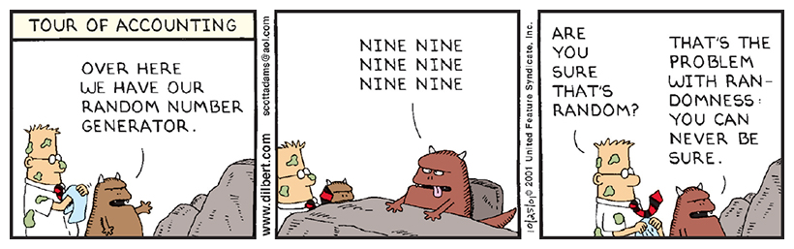
Random or not?
Notes:
I’ll start off with the following age-old question: can you tell if something is random or not? This classic Dilbert cartoon illustrates the core problem with this question. Dilbert is led to the dungeon where he is shown the corporate random number generator, who monotonously repeats “nine, nine, nine, nine, …”. “Are you sure that’s random?” Dilbert says.

Slide 3
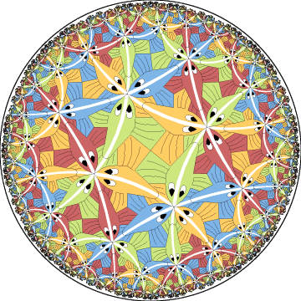
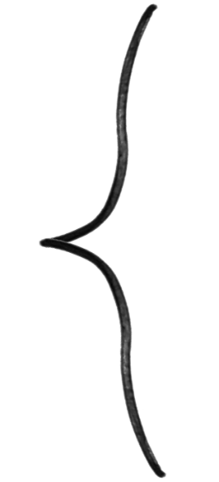



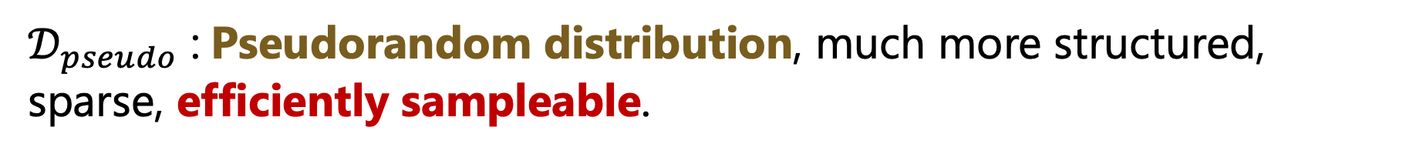

(Pseudo)randomness in the eye of the beholder
$𝒟_{ideal}$ $\text{:}$Truly random distribution, e.g. uniform distribution, Haar measure. But intractable to sample from in high dimensions.
$𝒟_{pseudo}$ $\text{:}$Pseudorandom distribution, much more structured, sparse, efficiently sampleable.
Pseudorandomness depends on the class of observers considered!
Sample drawn
from $𝒟_{ideal}$ or $𝒟_{pseudo}$
Observer
Notes:
The moral of the Dilbert cartoon, that randomness is in the eye of the beholder, underlies the concept of pseudorandomness in mathematics and computer science. In the general setup, there are two distributions of interest: there’s the ideal distribution that we’d like to sample from, which we call the truly random distribution. This can be the uniform distribution over some set or the Haar measure over a compact Lie group, say. However in high dimensions it may be intractable to sample from. On the other hand we have another distribution which is much more sparse and structured, but efficiently sampleable.
We say this second distribution is pseudorandom against a class of observers if any observer from that class cannot distinguish between samples drawn from the ideal distribution versus samples drawn from the second distribution.
Importantly, I want to emphasize that here we have to specify which class of observers the second distribution is supposed to be pseudorandom against.

Slide 4
Types of pseudorandomness
Statistical
view-limited observer cannot distinguish between pseudorandom distribution from truly random distribution
Cryptographic
computationally-limited observer cannot distinguish between pseudorandom distribution from truly random distribution
Example: t-wise-independent hash function
Example: cryptographic pseudorandom generator, pseudorandom functions
Notes:
Broadly speaking there are two types of pseudorandomness that are considered depending on the class of observers. The first is statistical pseudorandomness, where we consider observers that can only view small pieces, or small slices of the sample, which is some high dimensional object. An example of this is a t-wise independent hash function – if you only look at t evaluations of the function, it looks like a uniformly random function.
The second type is what’s called cryptographic pseudorandomness, where the observers can look as much of the sample as it wants – except it is subject to the constraint of being computationally limited (for example, it can only perform polynomial time computations). Subject to this computational constraint, it should not be able to distinguish between samples from the pseudorandom and truly random distributions. Examples of these are cryptographic pseudorandom functions and pseudorandom number generators.

Slide 5
The truly random distribution
(in quantum information)
Notes:
Let’s apply these concepts to quantum information. I first need to identify a truly random distribution that we’re comparing everything to.

Slide 6

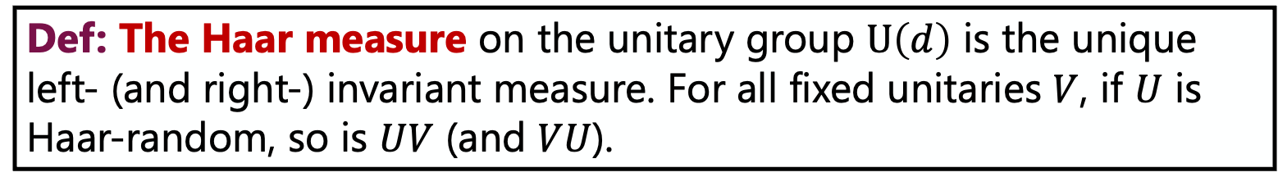
The Haar measure
Def: The Haar measure on the unitary group $\text{U}\left(d\right)$ is the unique left- (and right-) invariant measure. For all fixed unitaries $V$, if $U$ is Haar-random, so is $UV$ (and $VU$).
Applications:
Quantum Shannon theory
Quantum machine learning
Benchmarking/tomography
Quantum cryptography
Quantum gravity
…
Sampling from the Haar measure is intractable: requires $∼d^{2}$ parameters.
Notes:
In quantum information the natural choice is the Haar measure over the unitary group. Formally the Haar measure over the group of unitary matrices of dimension d is the unique translation-invariant measure. For all fixed unitaries V, if U is Haar random, then so is UV and VU. Intuitively this is the “uniform distribution” over the space of unitary matrices.
Arguments and protocols that use the Haar measure are everywhere in quantum information and quantum computing.
However it is intractable to sample from the Haar measure, because it requires ~d^2 parameters, and the dimension is exponential in the number of qubits that we’re interested in. So if we want to use protocols that involve the Haar measure we hope to derandomize them to make them more efficient.

Slide 7
Statistical quantum pseudorandomness
Notes:
The first way of derandomizing them is to use statistical quantum pseudorandomness.

Slide 8
t-designs | Definition
t-design with additive error $ε$: distribution $𝒟$ such that for $t$-partite states $ρ$
$${\left\|𝔼_{U∼Haar}U^{⊗t}ρU^{⊗t,†}−𝔼_{U∼𝒟}U^{⊗t}ρ U^{⊗t,†}\right\|}_{1}≤ε.$$
Ideal distribution
Notes:
The statistical pseudorandom object I want to talk about are t-designs. These are distributions over unitaries where for all density matrices rho acting on t systems, the average of applying t-copies of the unitary U drawn from distribution D is epsilon close in trace distance to average when applying t copies of a Haar random unitary.

Slide 9
t-designs | Definition
t-design with additive error $ε$: distribution $𝒟$ such that for $t$-partite states $ρ$
$${\left\|𝔼_{U∼Haar}U^{⊗t}ρU^{⊗t,†}−𝔼_{U∼𝒟}U^{⊗t}ρ U^{⊗t,†}\right\|}_{1}≤ε.$$
Pseudorandom distribution

Slide 10
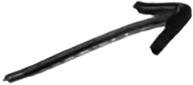

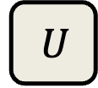

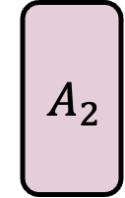
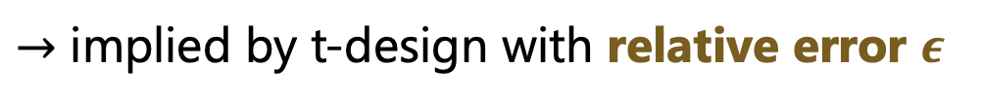

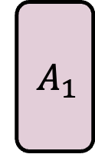

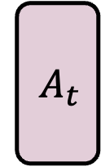


t-designs | Definition
t-design with additive error $ε$: distribution $𝒟$ such that for $t$-partite states $ρ$
$${\left\|𝔼_{U∼Haar}U^{⊗t}ρU^{⊗t,†}−𝔼_{U∼𝒟}U^{⊗t}ρ U^{⊗t,†}\right\|}_{1}≤ε.$$
$$A_{1}$$
$$U$$
$$A_{2}$$
Aside: what about adaptive queries?
$$A_{1}$$
$$U$$
$$A_{2}$$
$$U$$
$$A_{t}$$
$$U$$
can’t tell whether t copies drawn from $𝒟$ or Haar measure
$→$ implied by t-design with relative error $ε$
Notes:
In circuit notation

Slide 11
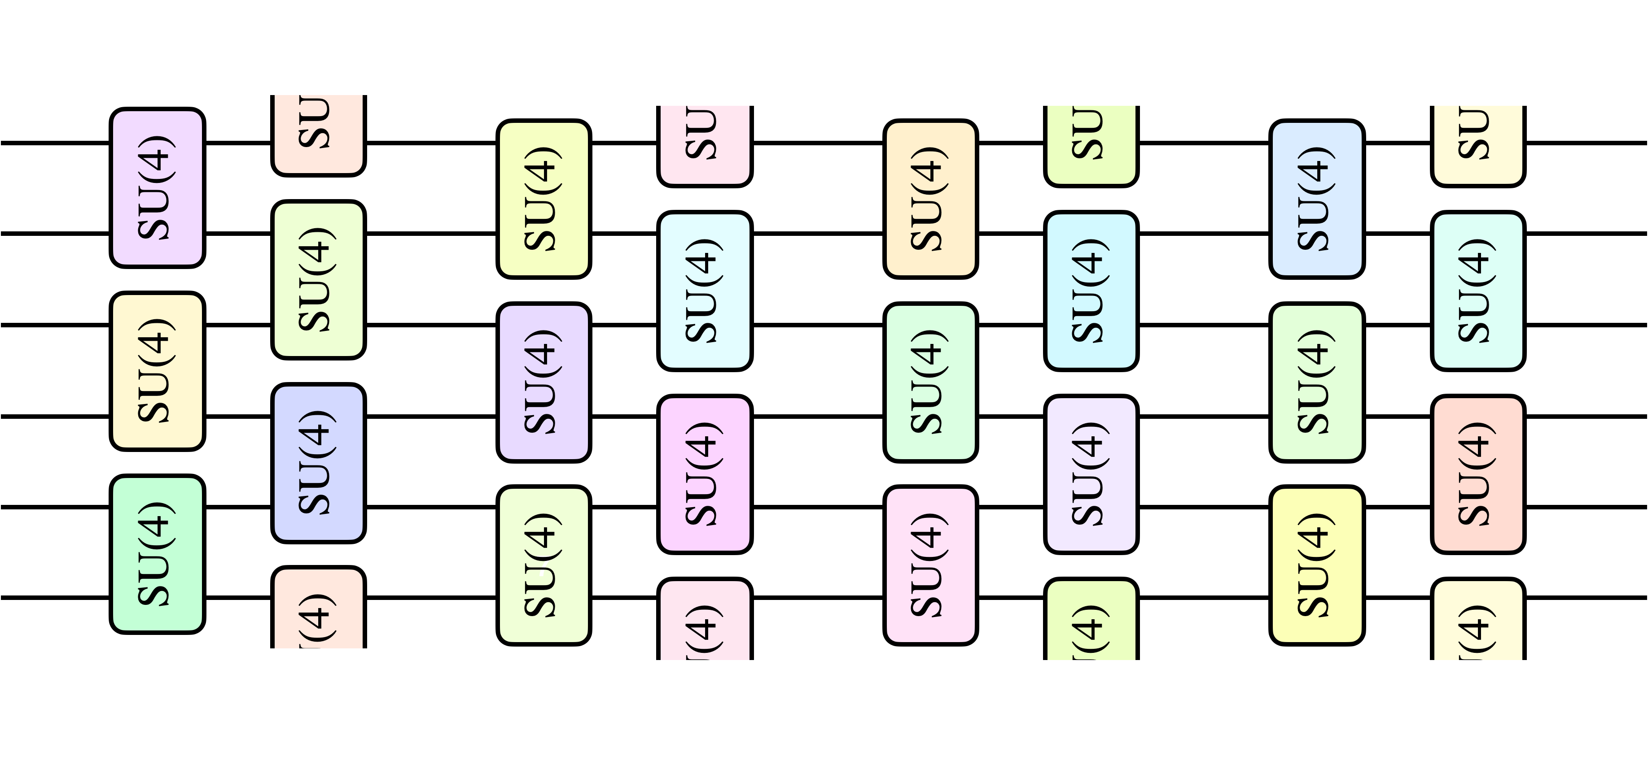
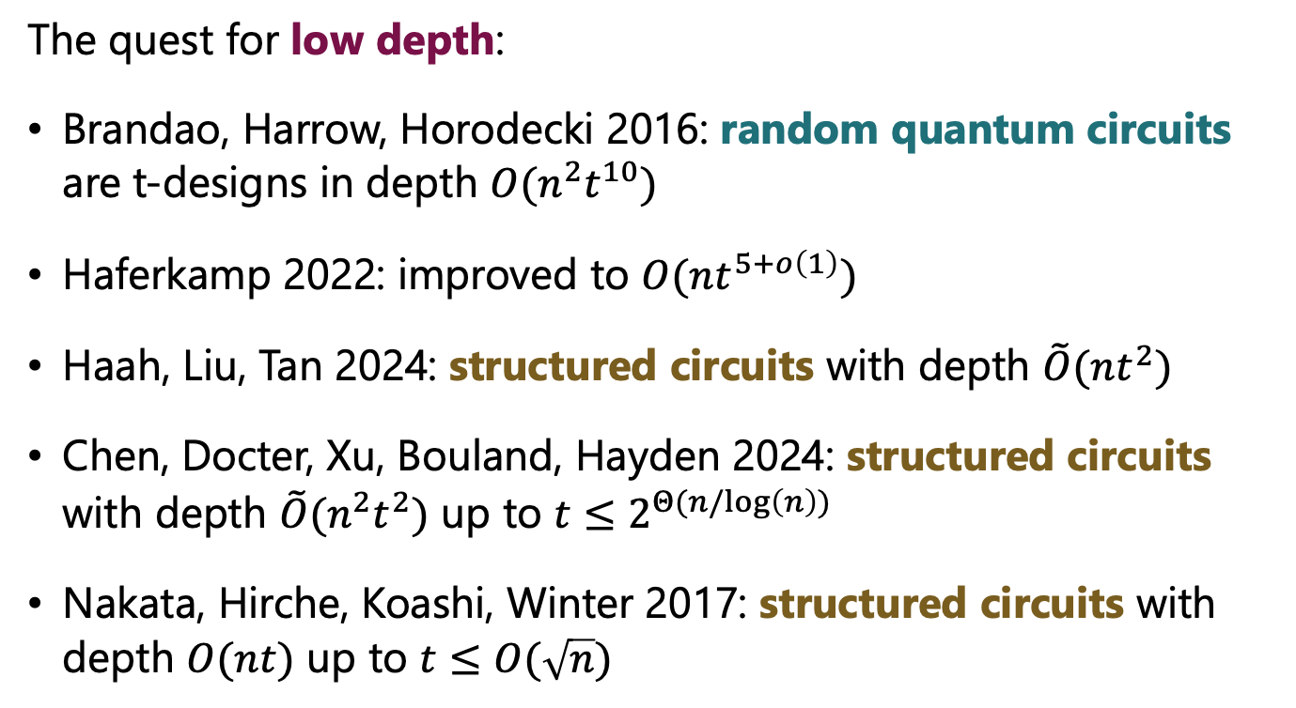

t-designs | Some prior results
The quest for low depth:
Brandao, Harrow, Horodecki 2016: random quantum circuits are t-designs in depth $O(n^{2}t^{10})$
Haferkamp 2022: improved to $O(nt^{5+o\left(1\right)})$
Haah, Liu, Tan 2024: structured circuits with depth $\tilde{O}(nt^{2})$
Chen, Docter, Xu, Bouland, Hayden 2024: structured circuits with depth $\tilde{O}(n^{2}t^{2})$ up to $t≤2^{Θ(n/log\left(n\right))}$
Nakata, Hirche, Koashi, Winter 2017: structured circuits with depth $O(nt)$ up to $t≤O(\sqrt{n})$
$$t≤2^{Θ(n)}$$
Open question: are there t-designs with depth linear in t (even for high moments)?

Slide 12
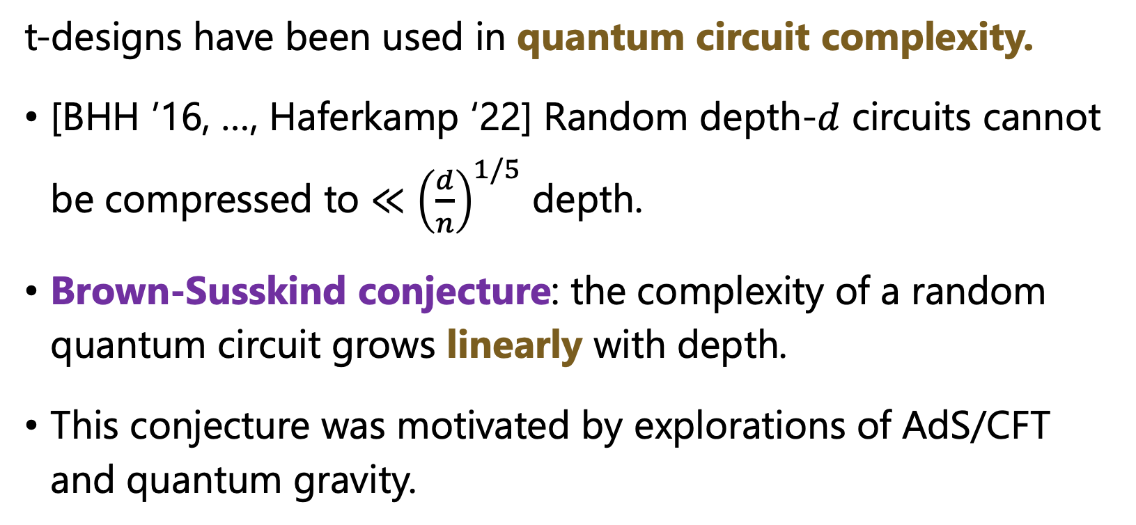
t-designs | Why care about depth complexity?
t-designs have been used in quantum circuit complexity.
[BHH ’16, …, Haferkamp ‘22] Random depth-$d$ circuits cannot be compressed to $≪{\left(\frac{d}{n}\right)}^{1/5}$ depth.
Brown-Susskind conjecture: the complexity of a random quantum circuit grows linearly with depth.
This conjecture was motivated by explorations of AdS/CFT and quantum gravity.

Slide 13
Cryptographic quantum pseudorandomness

Slide 14
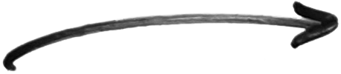
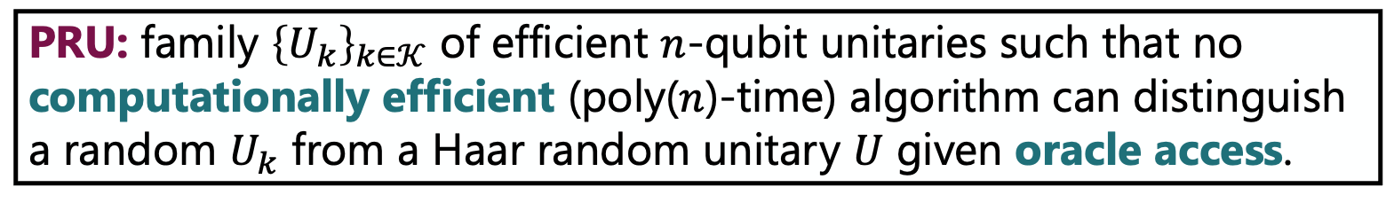
Pseudorandom Unitaries | Definition
PRU: family ${\left\{U_{k}\right\}}_{k∈𝒦}$ of efficient $n$-qubit unitaries such that no computationally efficient (poly($n$)-time) algorithm can distinguish a random $U_{k}$ from a Haar random unitary $U$ given oracle access.
Non-adaptive security
Adaptive security
$$A_{1}$$
$$U$$
$$A_{2}$$
$$A_{1}$$
$$U$$
$$A_{2}$$
$$U$$
$$A_{t}$$
$$U$$
computationally efficient unitaries
can’t tell whether t copies drawn from PRU ensemble or Haar measure

Slide 15
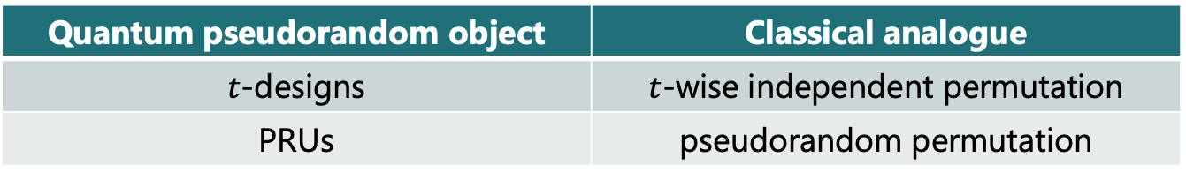
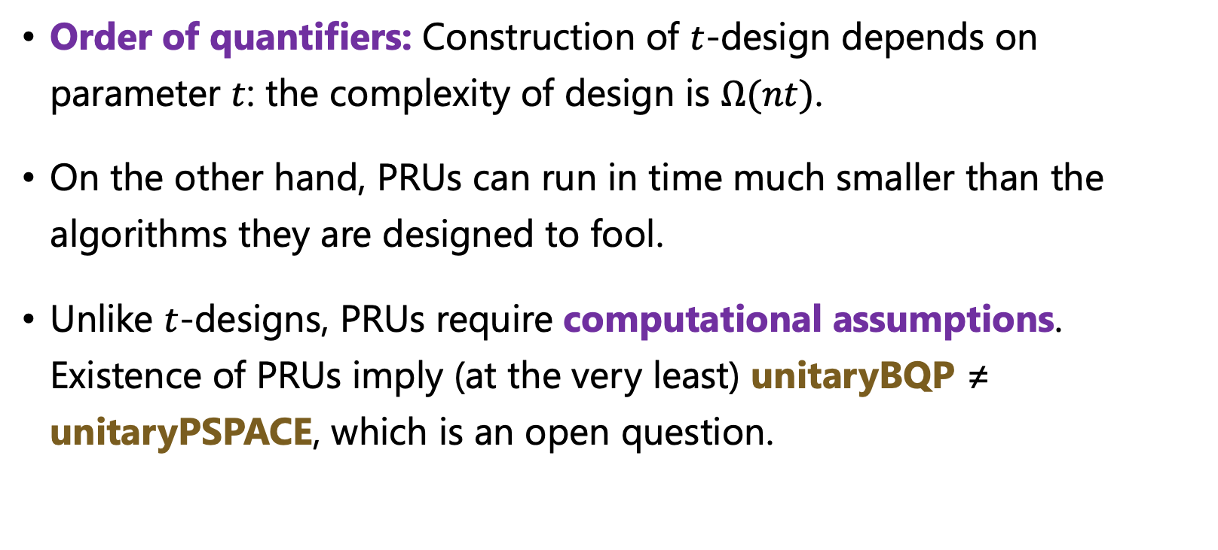
PRUs vs t-designs
Order of quantifiers: Construction of $t$-design depends on parameter $t$: the complexity of design is $Ω(nt)$.
On the other hand, PRUs can run in time much smaller than the algorithms they are designed to fool.
Unlike $t$-designs, PRUs require computational assumptions. Existence of PRUs imply (at the very least) unitaryBQP ≠ unitaryPSPACE, which is an open question.
Quantum pseudorandom object | Classical analogue
$t$-designs | $t$-wise independent permutation
PRUs | pseudorandom permutation

Slide 16
PRUs | Prior results
[Ji, Liu, Song ‘18]: definition and construction of pseudorandom states (efficiently computable states that look Haar-random to poly-time adversaries). Definition of pseudorandom unitaries, only conjectural constructions.
Partial progress:
  Lu, Qin, Song, Yao, Zhao 2023: pseudorandom state scramblers
  Ananth, Gulati, Kaleoglu, Lin 2023: pseudorandom isometries
  Brakerski, Magrafta 2024: real-valued PRUs with restricted inputs
Open question: do PRUs exist?

Slide 17
PRUs | Applications
Quantum cryptography:
  Unclonable cryptography (unclonable encryption, quantum copy-protection)
  Quantum state commitments (Gunn, Ju, Ma, Zhandry 2023)
  Quantum Merkle Trees (Chen, Movassagh 2021)
Quantum gravity
  Model black hole dynamics as PRU (Kim, Preskill 2023, Yang, Englehardt 2023, Englehardt, et al. 2024)
Limits on quantum learning
  Low-depth PRUs → hardness of learning quantum circuits
Open question: what are other compelling applications of PRUs?

Slide 18
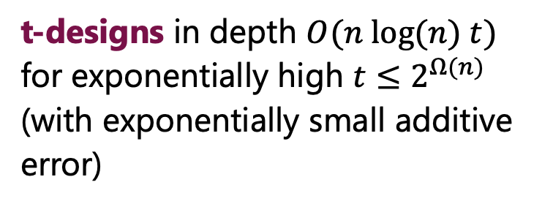
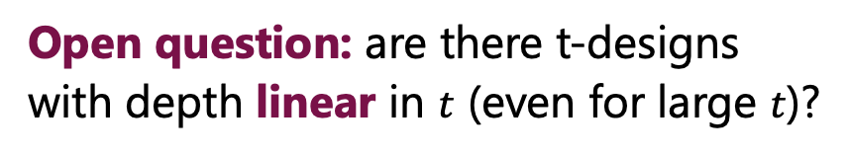
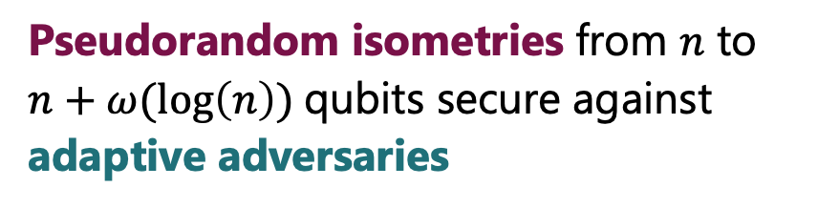
Open question: are there t-designs with depth linear in $t$ (even for large $t$)?
Open question: do PRUs exist?
Our results
t-designs in depth $O(n log(n) t)$ for exponentially high $t≤2^{Ω(n)}$ (with exponentially small additive error)
PRUs secure against non-adaptive adversaries (assuming quantum-secure one-way functions)
Pseudorandom isometries from $n$ to $n+ω(log\left(n\right))$qubits secure against adaptive adversaries
All results obtained from a simple “PFC” construction.

Slide 19
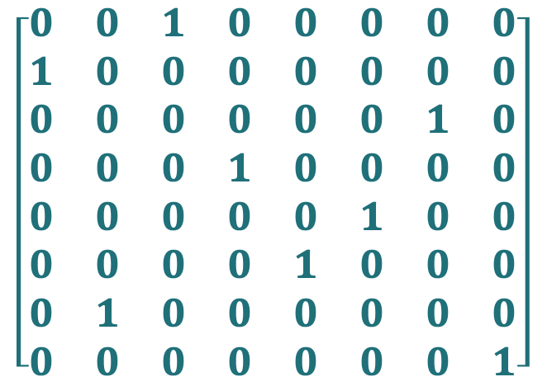

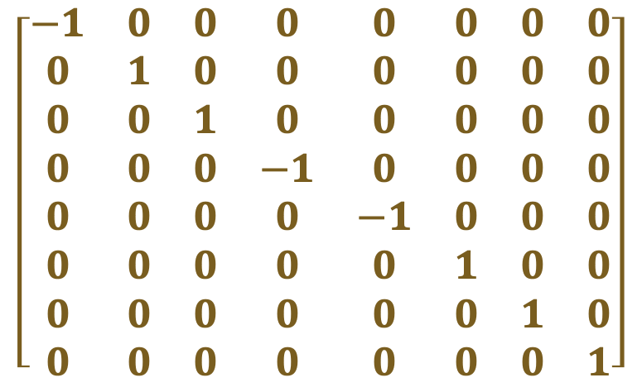
$$U=P⋅F⋅C$$
uniformly random basis state permutation
uniformly random binary phase
uniformly random Clifford unitary
H
$$\left[\begin{matrix}0 & 0 & 1 & 0 & 0 & 0 & 0 & 0 \\ 1 & 0 & 0 & 0 & 0 & 0 & 0 & 0 \\ 0 & 0 & 0 & 0 & 0 & 0 & 1 & 0 \\ 0 & 0 & 0 & 1 & 0 & 0 & 0 & 0 \\ 0 & 0 & 0 & 0 & 0 & 1 & 0 & 0 \\ 0 & 0 & 0 & 0 & 1 & 0 & 0 & 0 \\ 0 & 1 & 0 & 0 & 0 & 0 & 0 & 0 \\ 0 & 0 & 0 & 0 & 0 & 0 & 0 & 1\end{matrix}\right]$$
$$\left[\begin{matrix}−1 & 0 & 0 & 0 & 0 & 0 & 0 & 0 \\ 0 & 1 & 0 & 0 & 0 & 0 & 0 & 0 \\ 0 & 0 & 1 & 0 & 0 & 0 & 0 & 0 \\ 0 & 0 & 0 & −1 & 0 & 0 & 0 & 0 \\ 0 & 0 & 0 & 0 & −1 & 0 & 0 & 0 \\ 0 & 0 & 0 & 0 & 0 & 1 & 0 & 0 \\ 0 & 0 & 0 & 0 & 0 & 0 & 1 & 0 \\ 0 & 0 & 0 & 0 & 0 & 0 & 0 & 1\end{matrix}\right]$$
S

Slide 20


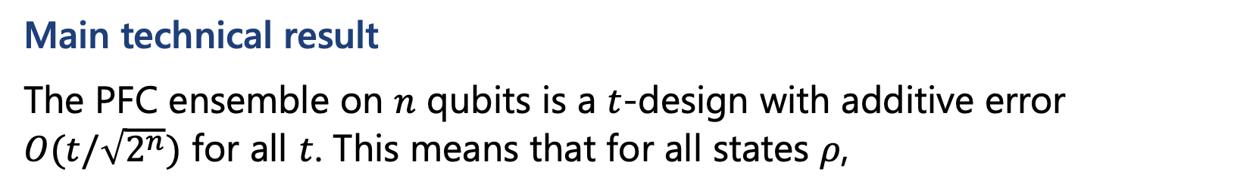
$$U=P⋅F⋅C$$
uniformly random basis state permutation
uniformly random binary phase
uniformly random Clifford unitary
Main technical result
The PFC ensemble on $n$ qubits is a $t$-design with additive error $O(t/\sqrt{2^{n}})$ for all $t$. This means that for all states $ρ$,
$${\left\|𝔼_{U∼Haar}U^{⊗t}ρU^{⊗t,†}−𝔼 {(PFC)}^{⊗t}ρ{(PFC)}^{⊗t,†}\right\|}_{1}≤O(t/\sqrt{2^{n}}).$$
Uniform functions and permutations are not efficiently implementable.
Have reduced Haar randomness to classical randomness.

Slide 21
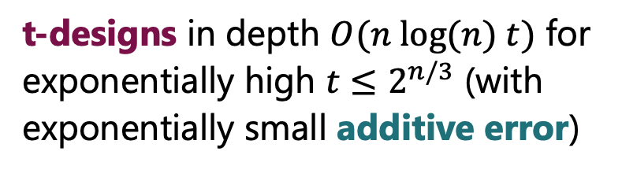
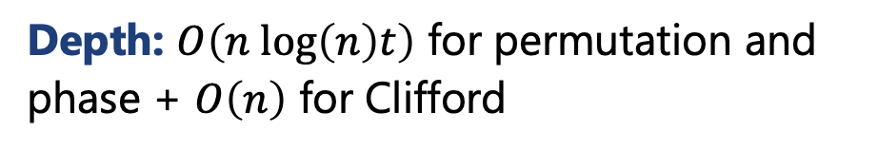
Our results
t-designs in depth $O(n log(n) t)$ for exponentially high $t≤2^{n/3}$ (with exponentially small additive error)
PRUs secure against non-adaptive adversaries
Construction: replace random function and permutation by efficient t-wise independent counterparts.
Construction: replace random function and permutation by quantum-secure pseudorandom function and permutation.
Depth: $O\left(n log\left(n\right)t\right)$ for permutation and phase + $O\left(n\right)$ for Clifford
Proof: adversary with arbitrary polynomial queries cannot distinguish between unitary with random or pseudorandom functions. Then get non-adaptive security because PFC is additive error t-design.
Will say more about proof in a second…

Slide 22
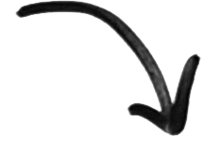
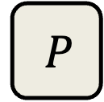
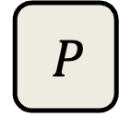
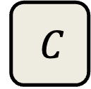
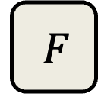
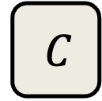
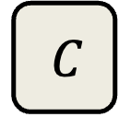
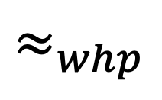
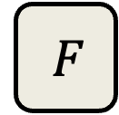
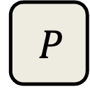
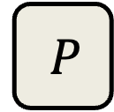
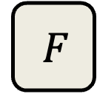
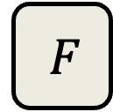

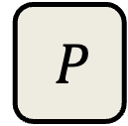
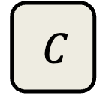

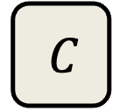

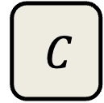
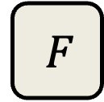
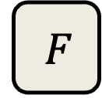

Some ideas behind proof
The purpose of the ”C” in PFC is to reduce the input to the distinct subspace.
$Λ=$ projection onto $span\left\{\left|x_{1},…,x_{t}\right\rangle :x_{1},…,x_{t} \text{distinct}\right\}$
$$P$$
$$F$$
$$C$$
$$|ψ⟩$$
$$P$$
$$F$$
$$Λ$$
$$C$$
$$|ψ⟩$$
$$P$$
$$F$$
$$C$$
$$P$$
$$F$$
$$C$$
$$≈_{whp}$$
……
……
$$P$$
$$F$$
$$C$$
$$P$$
$$F$$
$$C$$

Slide 23
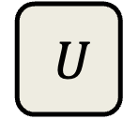





Some ideas behind proof
Key Lemma: for all states $|θ⟩$ in the distinct subspace $Λ$, applying ${\left(PF\right)}^{⊗t}$ is indistinguishable from applying $U^{⊗t}$ for Haar-random $U$.
Haar random
$$P$$
$$F$$
$$\left|θ\right\rangle ∈Λ$$
$$U$$
$$\left|θ\right\rangle ∈Λ$$
$$P$$
$$F$$
$$U$$
Proof: some direct
calculations using
Schur-Weyl duality.
$$≈_{whp}$$
……
$$P$$
$$F$$
$$U$$

Slide 24
Some recent developments

Slide 25

The Brown-Susskind conjecture
PFC circuits are ostensibly highly structured, and do not resemble random quantum circuits, so our result does not directly address the Brown-Susskind conjecture.
Recent work by Chen, Haah, Haferkamp, Liu, Metger, and Tan: Random quantum circuits of depth $\tilde{Ω}(nt)$ are $t$-designs with exponentially small relative error for $t≤2^{n/6}$.
This settles the Brown-Susskind conjecture (circuit complexity grows linearly with depth)!
Proof is a reduction to the PFC ensemble!

Slide 26

Adaptively-secure PRUs
Our result only proves non-adaptive security for PRUs: we could only show security against adversaries that query the PRU in parallel.
For adaptive security it suffices to show that PFC is a relative error t-design: i.e., for all $ρ$, the following operator inequality holds:
$𝔼_{U∼𝒟}U^{⊗t}ρU^{⊗t,†}≤\left(1+ε\right) 𝔼_{U∼Haar}U^{⊗t}ρ U^{⊗t,†}$
Huang and Ma have an upcoming paper that shows that PFC is adaptively secure, using an alternative approach that avoids representation theory – it uses a ”purification” trick. They are also able to handle inverse queries too!

Slide 27
Summary
Thank You!
Motivating question:
How to derandomize the Haar measure?
Exciting developments in just the past few years:
t-designs have been studied for 20 years, but connections to random circuits, quantum complexity, quantum machine learning, etc. are new.
Notion of cryptographically pseudorandom states and unitaries introduced recently by Ji, Liu, Song in 2017. Since then, many constructions and applications of pseudorandom states. Progress on PRUs has been more difficult.
Our work gives a simple construction (PFC) that achieves best known results on PRUs so far.
The road ahead: find more compelling applications of PRUs and cryptographic quantum pseudorandomness.

