Slide 1
Introduction to Quantum Computing
COMS 4281 (Fall 2025)
Week 1
Course homepage: http://www.henryyuen.net/classes/fall2025

Slide 2
Welcome!
Bird’s eye view
Class structure

Slide 3
Welcome!
Bird’s eye view
Class structure

Slide 4
What is quantum computing?
Notes:
Okay, so there’s a new type of quantum computer, so what can it do?

Slide 5
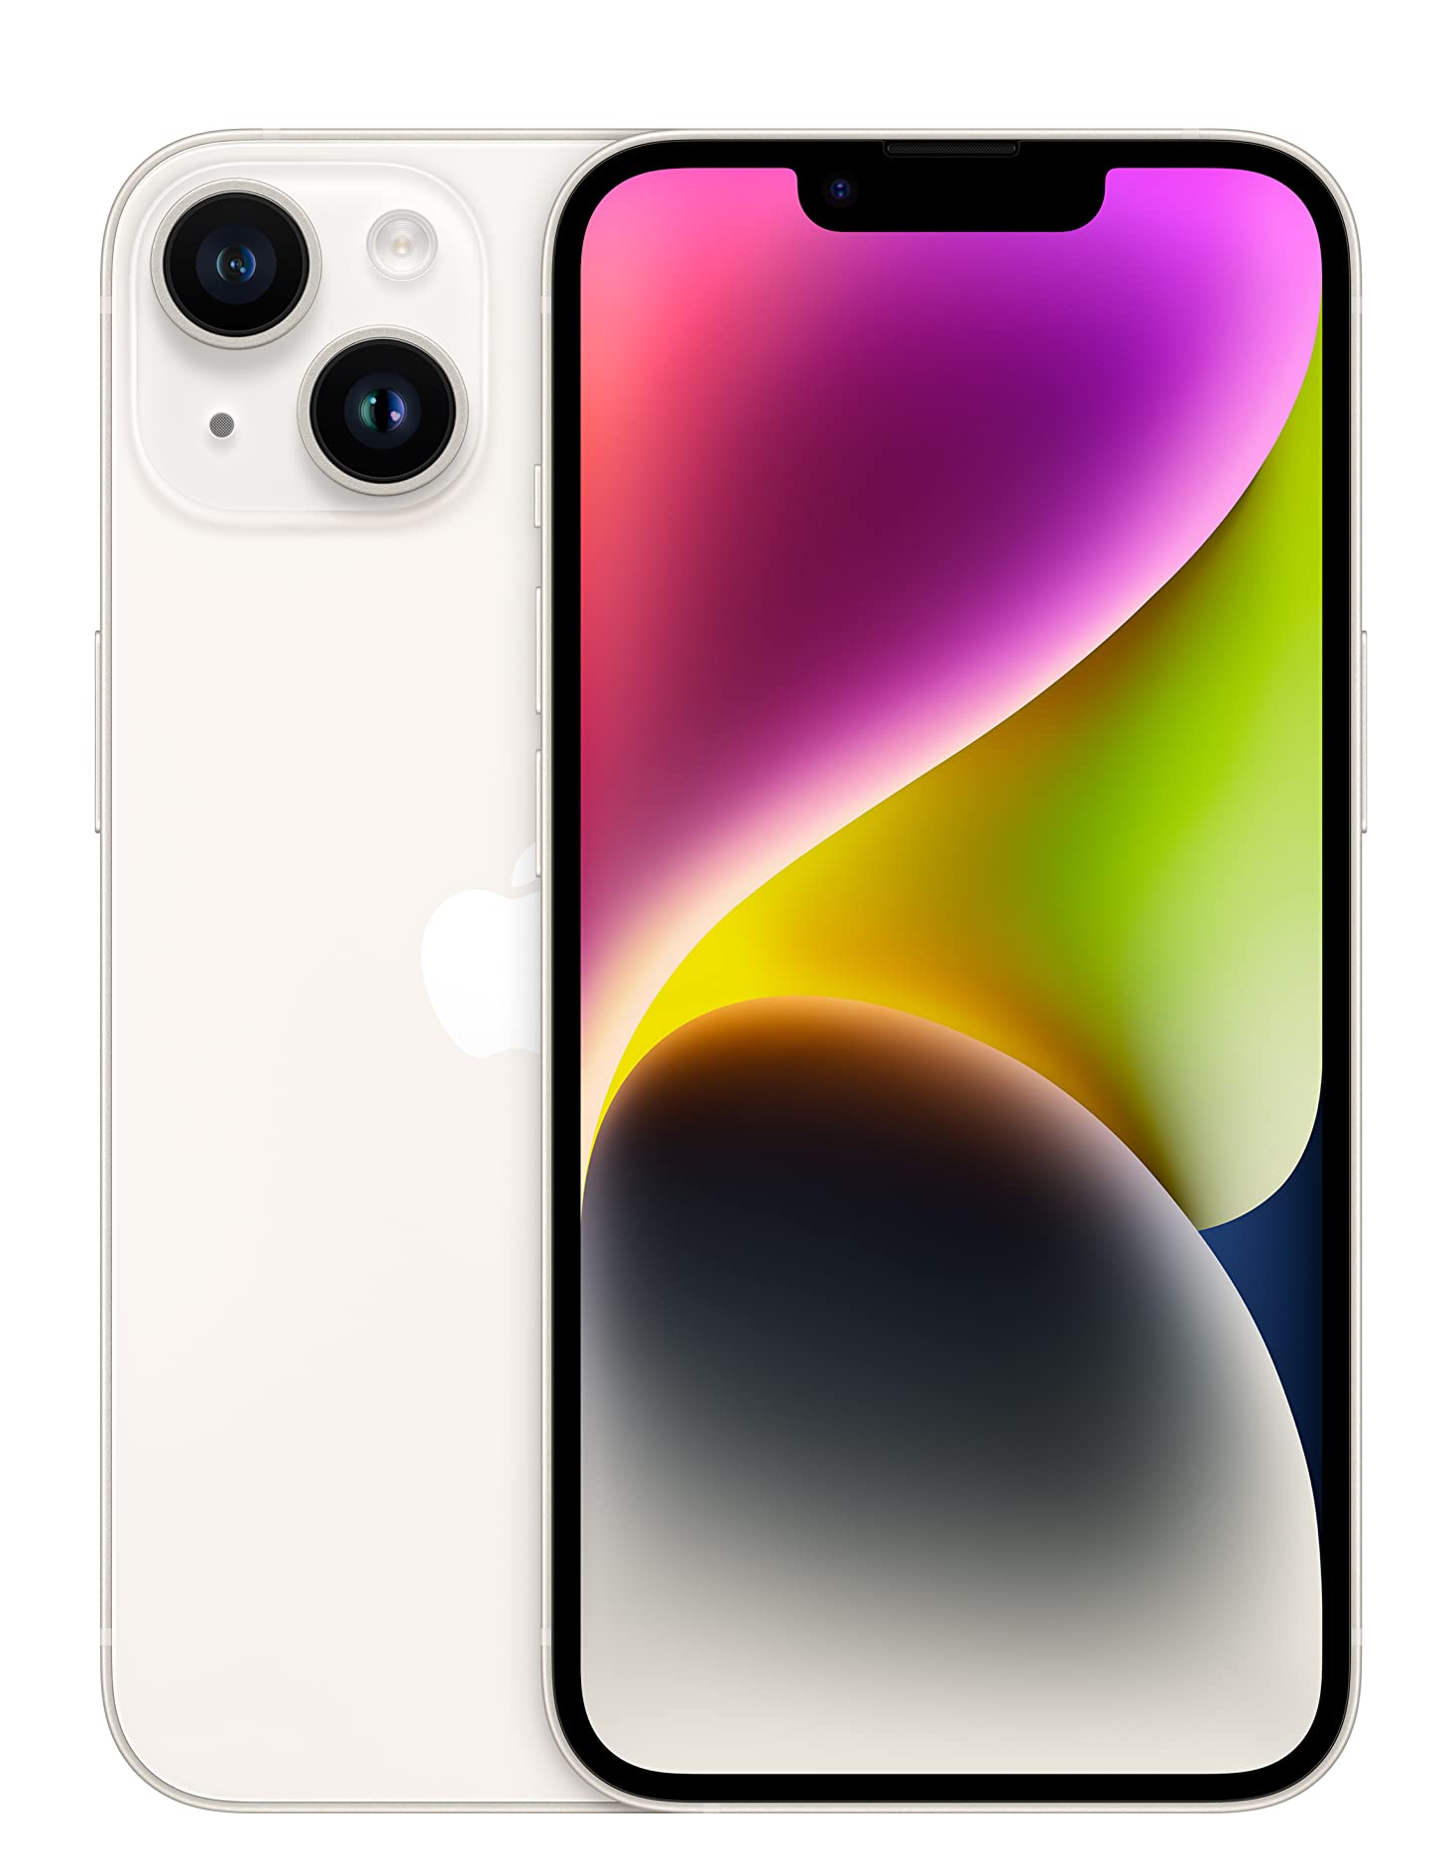
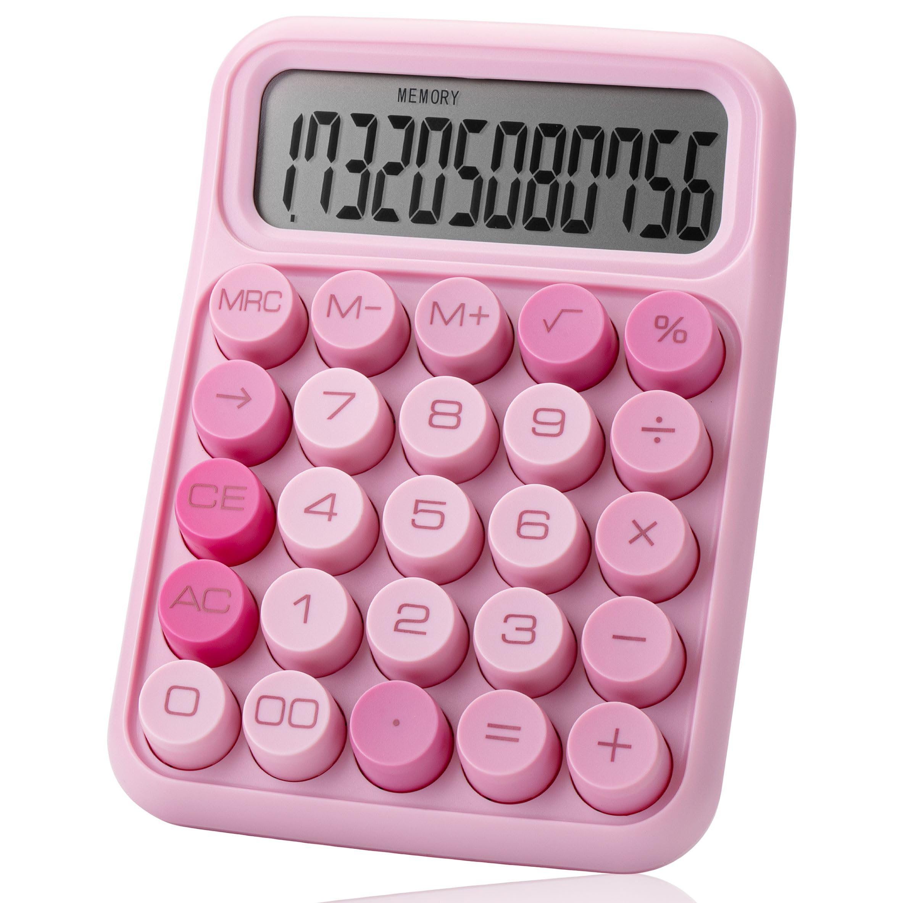

First, classical computing…
Until recently, all computing devices on Earth follow classical computing principles.

Slide 6
0 1
Classical computer
Classical bit
Notes:
We can put together a lot of light bulbs together, and the on/off pattern of these light bulbs represents a series of bits. All the wonders of modern computing is, at the end of the day, simply the manipulation of billions and trillions of these simple bits, at extremely high speeds. The physics needed to describe this kind of information processing is purely classical physics.

Slide 7
0 1
Classical computer
Classical bit
0 1 0 0 1 1
Notes:
We can put together a lot of light bulbs together, and the on/off pattern of these light bulbs represents a series of bits. All the wonders of modern computing is, at the end of the day, simply the manipulation of billions and trillions of these simple bits, at extremely high speeds. The physics needed to describe this kind of information processing is purely classical physics.

Slide 8
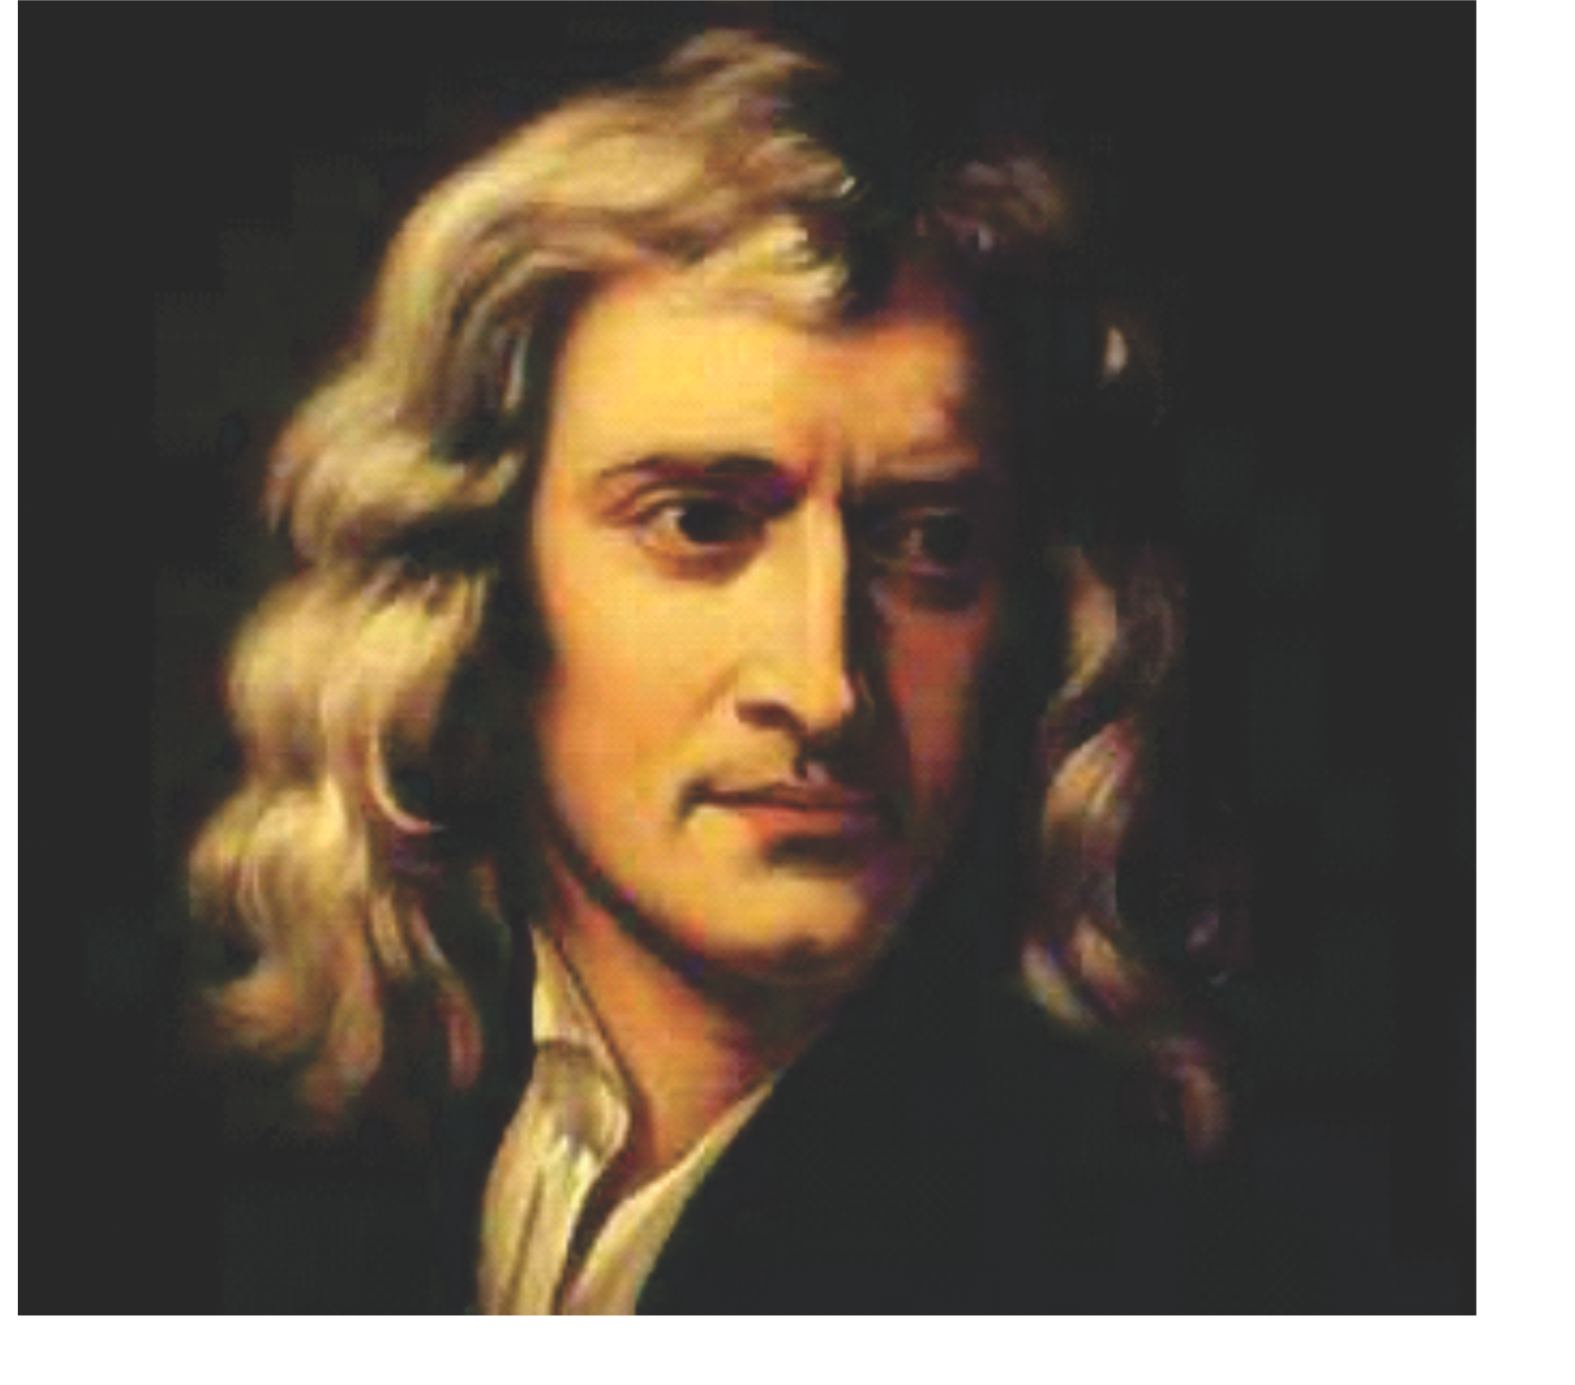
0 1
Classical computer
Classical bit
Newton: Classical physics can describe all information processing today.
Notes:
We can put together a lot of light bulbs together, and the on/off pattern of these light bulbs represents a series of bits. All the wonders of modern computing is, at the end of the day, simply the manipulation of billions and trillions of these simple bits, at extremely high speeds. The physics needed to describe this kind of information processing is purely classical physics.

Slide 9
0 1
Classical computer
Classical bit
Feynman: We live in a
quantum universe.
Notes:
We can put together a lot of light bulbs together, and the on/off pattern of these light bulbs represents a series of bits. All the wonders of modern computing is, at the end of the day, simply the manipulation of billions and trillions of these simple bits, at extremely high speeds. The physics needed to describe this kind of information processing is purely classical physics.

Slide 10
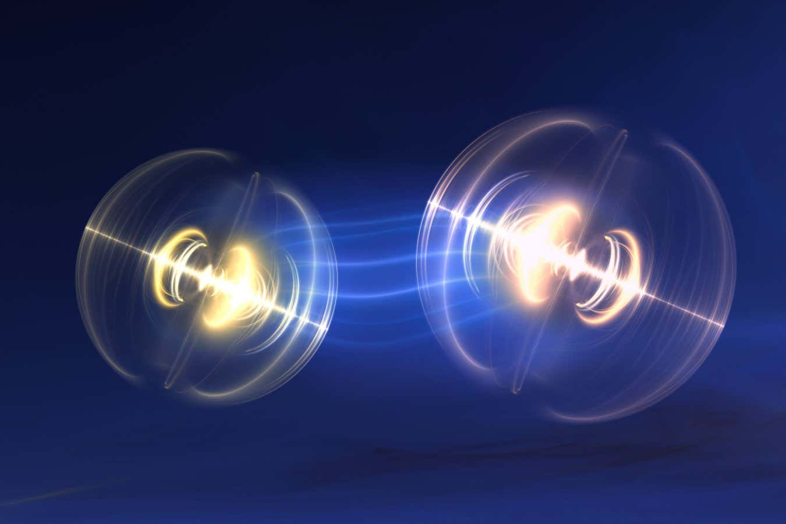
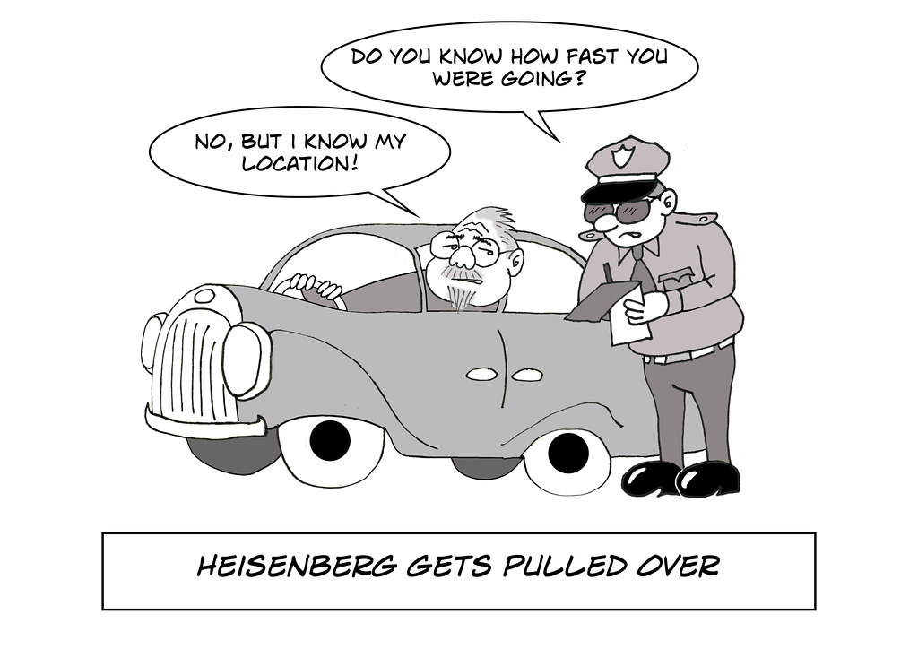
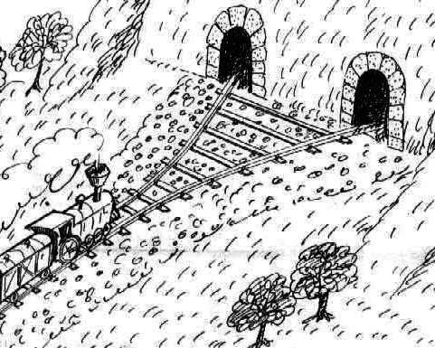
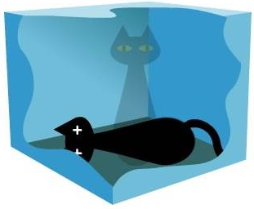
Entanglement
Uncertainty principle
Wave/particle duality
Superposition
Feynman: Quantum mechanics is weird.
Notes:
We can put together a lot of light bulbs together, and the on/off pattern of these light bulbs represents a series of bits. All the wonders of modern computing is, at the end of the day, simply the manipulation of billions and trillions of these simple bits, at extremely high speeds. The physics needed to describe this kind of information processing is purely classical physics.

Slide 11
The weirdest part of all: simulating quantum physics – predicting how quantum system will behave – doesn’t seem easy for classical computers.
Feynman: Can classical computers simulate quantum physics?
Notes:
We can put together a lot of light bulbs together, and the on/off pattern of these light bulbs represents a series of bits. All the wonders of modern computing is, at the end of the day, simply the manipulation of billions and trillions of these simple bits, at extremely high speeds. The physics needed to describe this kind of information processing is purely classical physics.

Slide 12
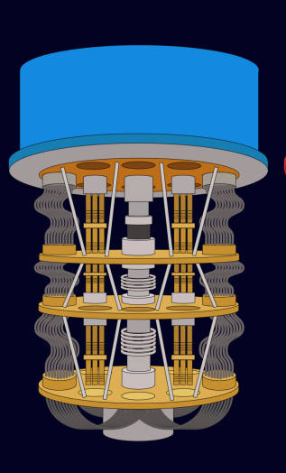
Quantum computer
Quantum bit (“qubit”)
Quantum computing is based on processing qubits, and is based on the laws of quantum physics instead of classical physics.
Notes:
We can put together a lot of light bulbs together, and the on/off pattern of these light bulbs represents a series of bits. All the wonders of modern computing is, at the end of the day, simply the manipulation of billions and trillions of these simple bits, at extremely high speeds. The physics needed to describe this kind of information processing is purely classical physics.

Slide 13
0
Quantum computer
Quantum bit (“qubit”)
Observing the qubit results in a classical bit.
Notes:
We can put together a lot of light bulbs together, and the on/off pattern of these light bulbs represents a series of bits. All the wonders of modern computing is, at the end of the day, simply the manipulation of billions and trillions of these simple bits, at extremely high speeds. The physics needed to describe this kind of information processing is purely classical physics.

Slide 14
0
1
Quantum computer
Quantum bit (“qubit”)
Before observation, the state of the qubit can be in a quantum superposition of 0 and 1 at the same time.
Notes:
We can put together a lot of light bulbs together, and the on/off pattern of these light bulbs represents a series of bits. All the wonders of modern computing is, at the end of the day, simply the manipulation of billions and trillions of these simple bits, at extremely high speeds. The physics needed to describe this kind of information processing is purely classical physics.

Slide 15
0
1
Quantum computer
Quantum bit (“qubit”)
The state of a qubit is described by two numbers called amplitudes...
Notes:
We can put together a lot of light bulbs together, and the on/off pattern of these light bulbs represents a series of bits. All the wonders of modern computing is, at the end of the day, simply the manipulation of billions and trillions of these simple bits, at extremely high speeds. The physics needed to describe this kind of information processing is purely classical physics.

Slide 16
0
1
Quantum computer
Quantum bit (“qubit”)
The state of a qubit is described by two numbers called amplitudes... these are “quantum probabilities”, which can be both positive and negative!
Notes:
We can put together a lot of light bulbs together, and the on/off pattern of these light bulbs represents a series of bits. All the wonders of modern computing is, at the end of the day, simply the manipulation of billions and trillions of these simple bits, at extremely high speeds. The physics needed to describe this kind of information processing is purely classical physics.

Slide 17

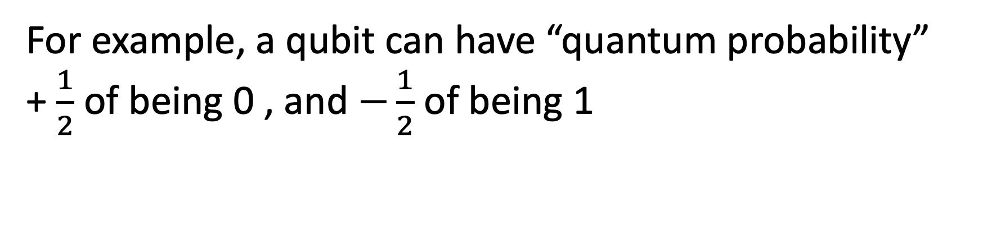
0
1
Quantum computer
Quantum bit (“qubit”)
For example, a qubit can have “quantum probability”
+ $\frac{1}{2}$ of being 0 , and $−\frac{1}{2}$ of being 1
Notes:
We can put together a lot of light bulbs together, and the on/off pattern of these light bulbs represents a series of bits. All the wonders of modern computing is, at the end of the day, simply the manipulation of billions and trillions of these simple bits, at extremely high speeds. The physics needed to describe this kind of information processing is purely classical physics.

Slide 18
1
Quantum computer
Quantum bit (“qubit”)
Quantum probabilities can’t be directly observed… observing the qubit ”collapses” the state of qubit into classical probabilities.
Notes:
We can put together a lot of light bulbs together, and the on/off pattern of these light bulbs represents a series of bits. All the wonders of modern computing is, at the end of the day, simply the manipulation of billions and trillions of these simple bits, at extremely high speeds. The physics needed to describe this kind of information processing is purely classical physics.

Slide 19
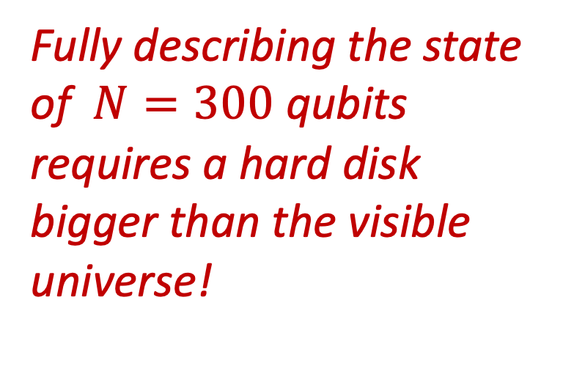
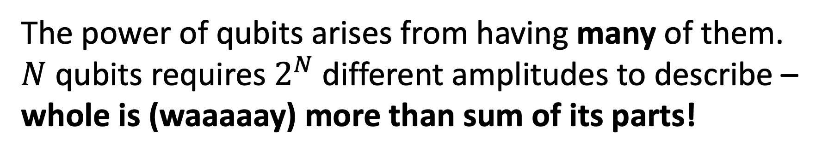
Fully describing the state of $N=300$ qubits requires a hard disk bigger than the visible universe!
Quantum computer
The power of qubits arises from having many of them. $N$ qubits requires $2^{N}$ different amplitudes to describe – whole is (waaaaay) more than sum of its parts!
Notes:
We can put together a lot of light bulbs together, and the on/off pattern of these light bulbs represents a series of bits. All the wonders of modern computing is, at the end of the day, simply the manipulation of billions and trillions of these simple bits, at extremely high speeds. The physics needed to describe this kind of information processing is purely classical physics.

Slide 20
What can a quantum computer do?
Notes:
Okay, so there’s a new type of quantum computer, so what can it do?

Slide 21
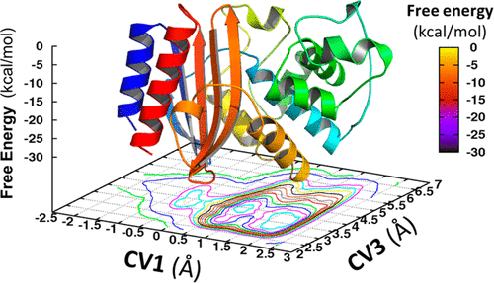
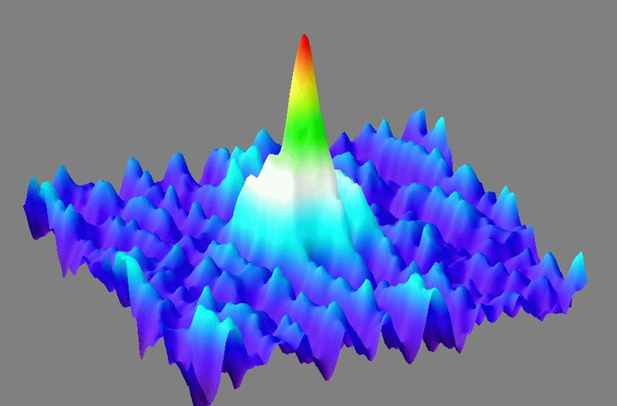
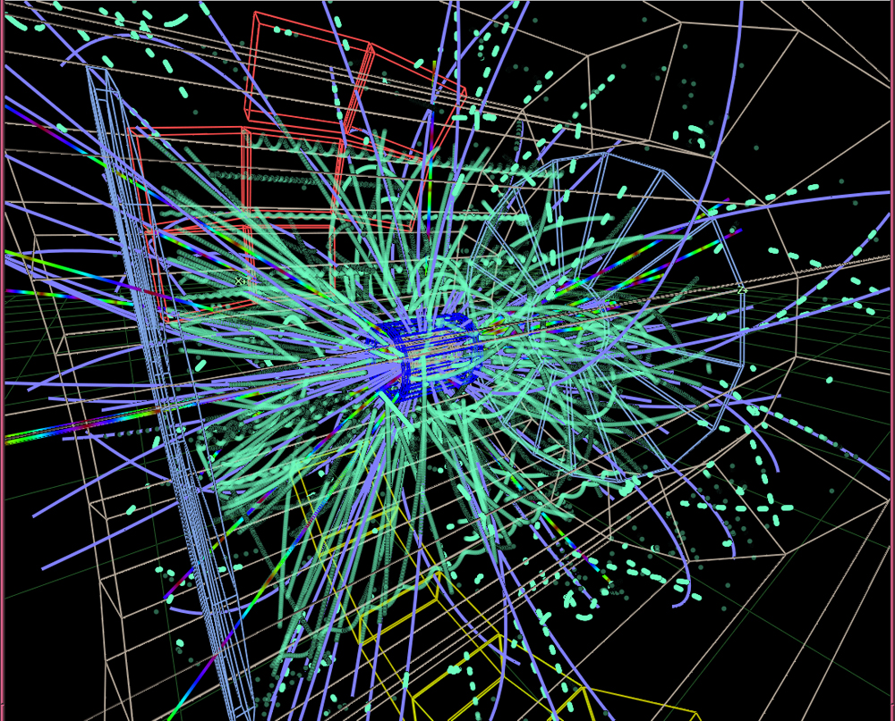
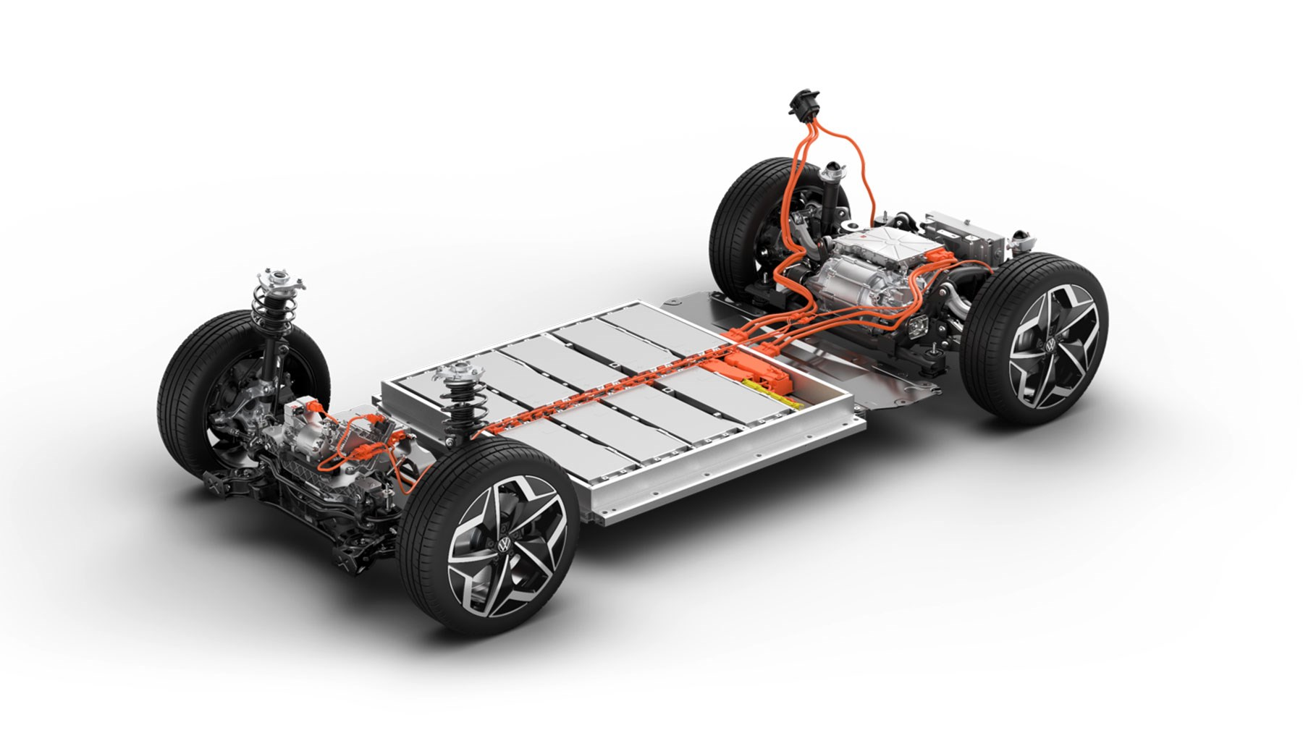
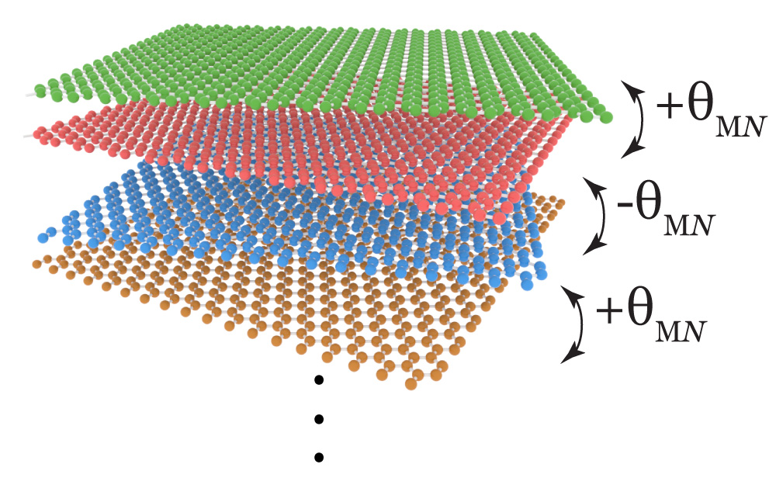
Simulate quantum physics
Biomolecules
Fundamental physics
Feynman: This is the killer app I’ve been dreaming of!
Exotic materials
Notes:
Remember Feynman’s original motivation for coming up with the idea of a quantum computer was about simulating quantum systems. This is perhaps the most important application of quantum computers that we know of. It sounds almost circular; we want to build a quantum computer, based on the principles of quantum physics, to simulate quantum physics. The main point is that a quantum computer is *programmable* -- with a single quantum device, you can simulate many other quantum systems, as long as you know how to program it appropriately. You don’t have to invent a new experimental apparatus for each scenario. For example, you can program the quantum computer to simulate biomolecules as part of a drug design process. The next day you can reprogram the quantum computer to simulate exotic materials for study the performance of electric car batteries. The day after that you can simulate particle colliders to glean insights into fundamental physics.

Slide 22
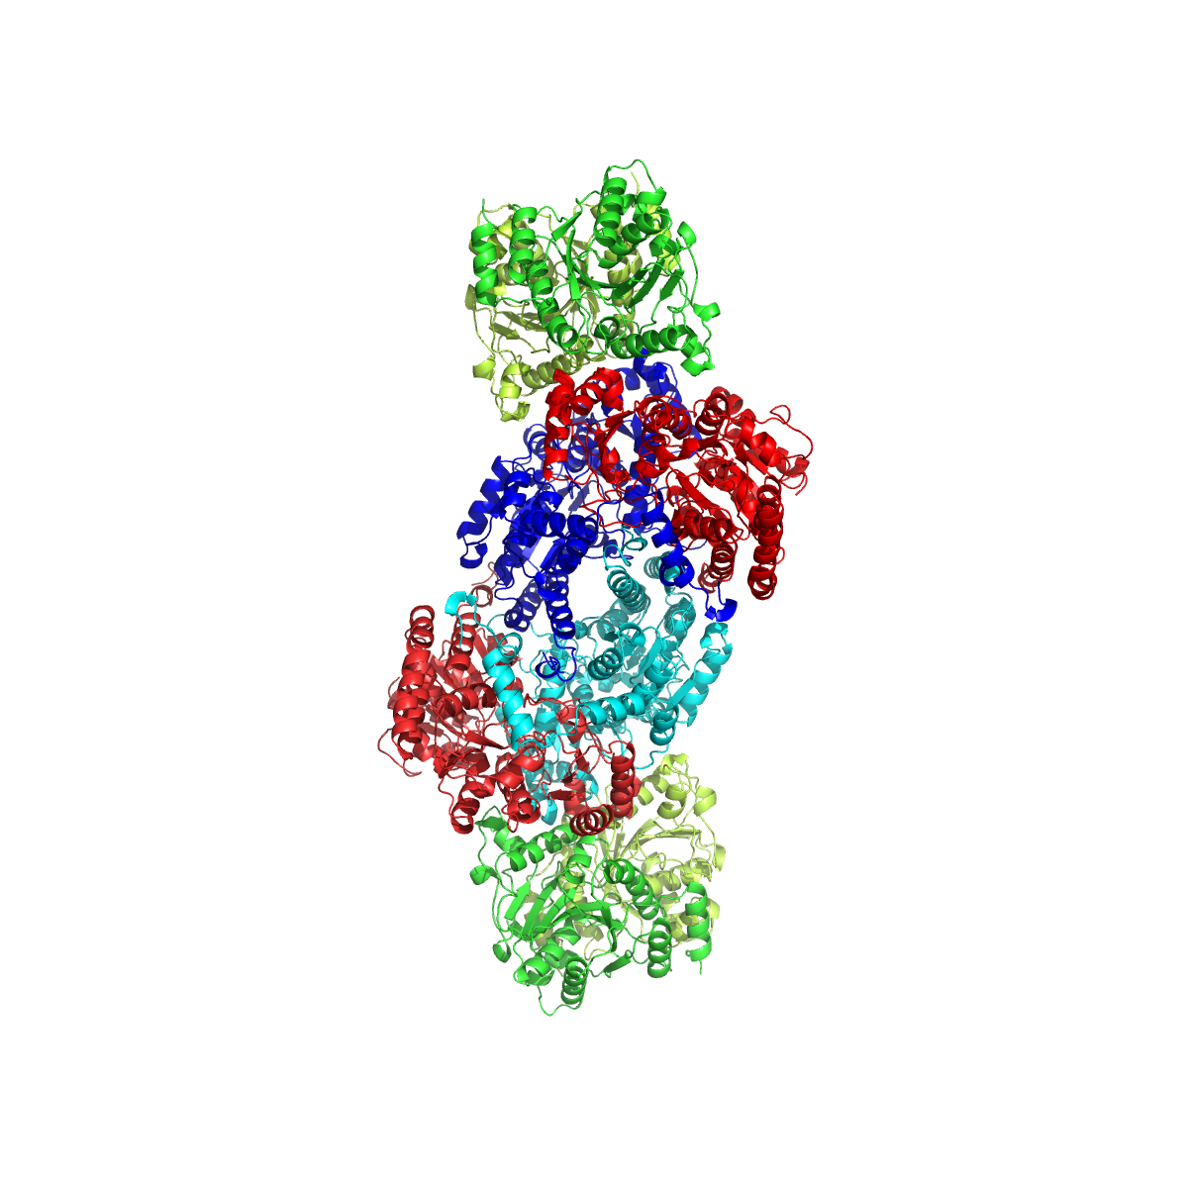
Potential use case: finding new catalysts
Example: The Haber-Bosch process for artificial nitrogen fixation, used to make fertilizer, consumes ~2% of world’s energy output.
In nature, nitrogen fixation is done via the catalyst nitrogenase, which is not yet fully understood.
Hope: Quantum simulation can help study these fundamental chemical processes better, and (potentially) help us find better catalysts.
Notes:
Let me give an illustration of why this could be a big deal, in the context of the potential use case of finding new catalysts. The industrial process for artificial nitrogen fixation, which is called the Haber-Bosch process, it’s used in fertilizer production, makes up at least 2% of the world’s energy consumption. This industrial process relies on an extremely clever catalytic reaction that allows us to produce ammonia in this enormously scalable way. So it’s one of the most important chemical reactions in the world today. However, it requires extremely high temperatures and high pressures, and expensive metal catalysts in order to work. On the other hand, we know that there’s another way of doing nitrogen fixation, and done all the time in nature: algae and bacteria do it all the time via an enzyme called nitrogenase. Clearly, these processes are not happening at extreme pressures and temperatures, but scientists don’t fully understand how nitrogenase works; the quantum details of how it works are hotly debated by scientists.
So the hope is that quantum simulation can help us understand these chemical processes better, and potentially help us find better catalysts. Imagine if we were able to find a way to save even just 0.01% in energy for this reaction. This would have a huge impact on the world.

Slide 23
P = 15904
Q = 93520
P × Q = ?

Slide 24
P = 15904
Q = 93520
P × Q = 1487342080

Slide 25
P × Q = 597680597
P = ?
Q = ?

Slide 26
P × Q = 597680597
P = 17449 Q = 34253

Slide 27

RSA, most widely used encryption scheme, assumes it is difficult to factor large numbers
Peter Shor (1994): quantum computers can factor large numbers very quickly!

Slide 28
Crossroads
Since Shor’s algorithm, physicists and computer scientists have been faced with three options:
Quantum mechanics is wrong.
There is a fast classical algorithm for factoring.
Quantum computers are more powerful than classical computers.
At least one of these must be true!
Any of these possibilities are a radical revision of what we know.

Slide 29
Public Service Announcements

Slide 30
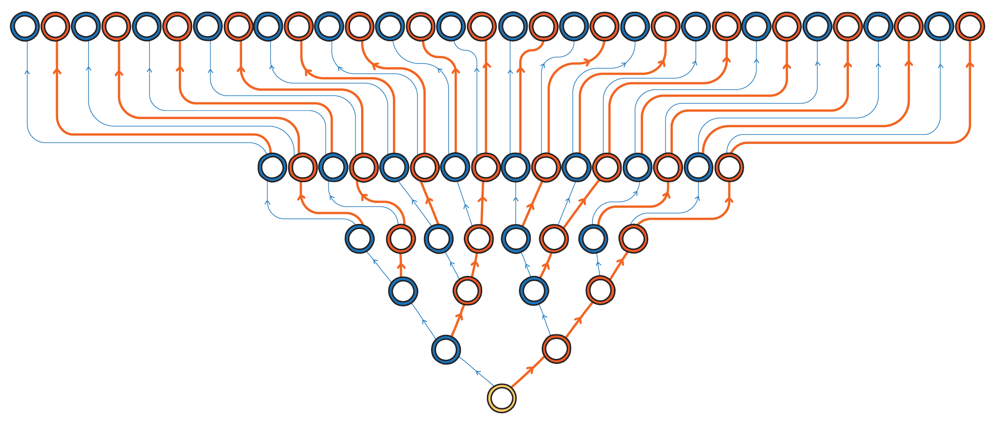
Myth: Quantum computers can speed up every algorithm by exploring all solutions simultaneously.

Slide 31
Reality: Quantum computers can solve certain types of problems faster by manipulating quantum probabilities.
Some solutions get assigned positive “quantum probability”

Slide 32
Reality: Quantum computers can solve certain types of problems faster by manipulating quantum probabilities.
Some solutions get assigned negative “quantum probability”

Slide 33
Reality: Quantum computers can solve certain types of problems faster by manipulating quantum probabilities.
If conditions are juuuuuust right, can get the quantum probabilities of bad solutions to cancel out, leaving only good solutions!

Slide 34
Reality: Quantum computers can solve certain types of problems faster by manipulating quantum probabilities.
If conditions are juuuuuust right, can get the quantum probabilities of bad solutions to cancel out, leaving only good solutions!

Slide 35
Myth: Quantum computers will break all internet security.
(Probably)

Slide 36
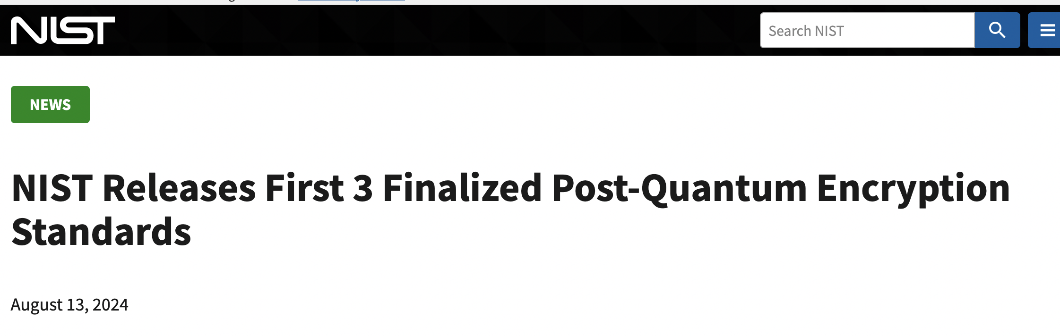

Reality: Fed gov’t recently standardized quantum-resistant encryption systems.
Post-quantum crypto already enabled by default in major software like Chrome.

Slide 37
Myth: Quantum computers are going to solve large-scale industrial problems in the next 5 years.

Slide 38





Reality: Quantum computing is making jump from academia to industry R&D labs…
…but still very much a long-term research endeavor.

Slide 39
What is the status of quantum computing today?
Notes:
Okay, so there’s a new type of quantum computer, so what can it do?

Slide 40
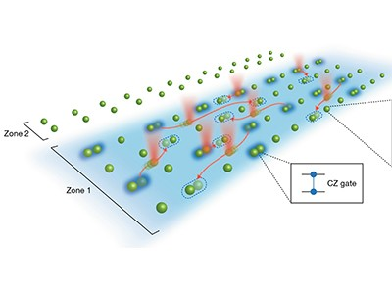


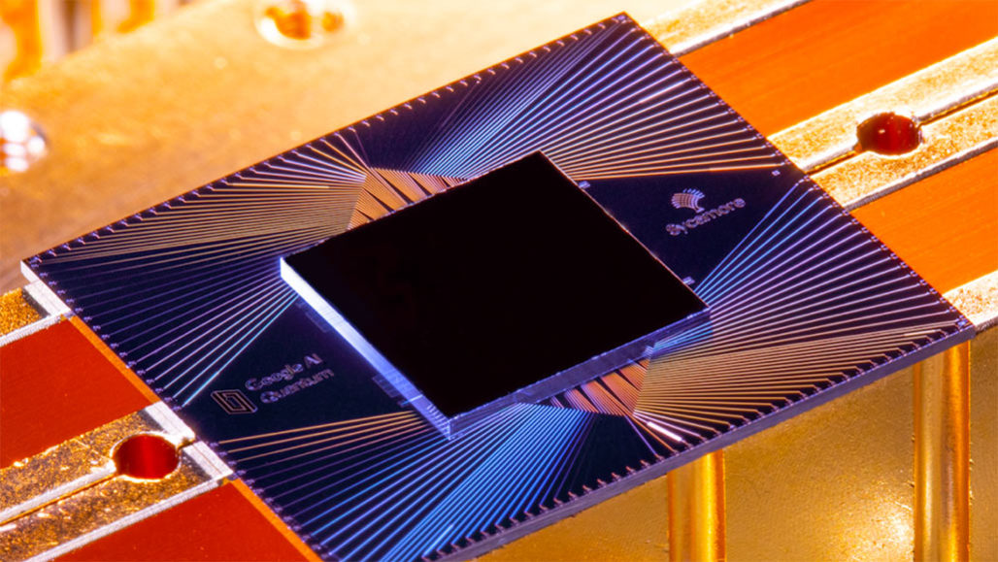





Many competing technological approaches:
Superconducting qubits
Neutral atom arrays
Photonic qubits
Quantum annealers
Trapped ions
Notes:
We can put together a lot of light bulbs together, and the on/off pattern of these light bulbs represents a series of bits. All the wonders of modern computing is, at the end of the day, simply the manipulation of billions and trillions of these simple bits, at extremely high speeds. The physics needed to describe this kind of information processing is purely classical physics.

Slide 41
Many competing technological approaches:
Superconducting qubits
Neutral atom arrays
Qubits are currents running through superconducting circuits. Based on existing semiconductor fabrication technology. Fast operations. Google and IBM have ~100-200 qubit machines.
Photonic qubits
Quantum annealers
Trapped ions
Notes:
We can put together a lot of light bulbs together, and the on/off pattern of these light bulbs represents a series of bits. All the wonders of modern computing is, at the end of the day, simply the manipulation of billions and trillions of these simple bits, at extremely high speeds. The physics needed to describe this kind of information processing is purely classical physics.

Slide 42
Many competing technological approaches:
Superconducting qubits
Neutral atom arrays
Photonic qubits
Qubits are individual atoms. Movable qubits. Slow operations. Harvard and QuEra have ~200-qubit machines.
Quantum annealers
Trapped ions
Notes:
We can put together a lot of light bulbs together, and the on/off pattern of these light bulbs represents a series of bits. All the wonders of modern computing is, at the end of the day, simply the manipulation of billions and trillions of these simple bits, at extremely high speeds. The physics needed to describe this kind of information processing is purely classical physics.

Slide 43
Many competing technological approaches:
Superconducting qubits
Neutral atom arrays
Qubits are individual ions. Movable qubits. Slow operations. Quantinuum H2 device has 56 qubits.
Photonic qubits
Quantum annealers
Trapped ions
Notes:
We can put together a lot of light bulbs together, and the on/off pattern of these light bulbs represents a series of bits. All the wonders of modern computing is, at the end of the day, simply the manipulation of billions and trillions of these simple bits, at extremely high speeds. The physics needed to describe this kind of information processing is purely classical physics.

Slide 44
Many competing technological approaches:
Superconducting qubits
Neutral atom arrays
Qubits are light particles (photons). Very stable. Hard to perform operations. Xanadu has ~10 qubits.
Photonic qubits
Quantum annealers
Trapped ions
Notes:
We can put together a lot of light bulbs together, and the on/off pattern of these light bulbs represents a series of bits. All the wonders of modern computing is, at the end of the day, simply the manipulation of billions and trillions of these simple bits, at extremely high speeds. The physics needed to describe this kind of information processing is purely classical physics.

Slide 45
Many competing technological approaches:
Superconducting qubits
Neutral atom arrays
Photonic qubits
Analog quantum device, extremely noisy, difficult to control. Dwave’s machine has 5000 qubits.
Quantum annealers
Trapped ions
Notes:
We can put together a lot of light bulbs together, and the on/off pattern of these light bulbs represents a series of bits. All the wonders of modern computing is, at the end of the day, simply the manipulation of billions and trillions of these simple bits, at extremely high speeds. The physics needed to describe this kind of information processing is purely classical physics.

Slide 46
Many competing technological approaches:
Superconducting qubits
Neutral atom arrays
Unclear what is “best” platform.
Qubit count isn’t everything.
Photonic qubits
Quantum annealers
Trapped ions
Notes:
We can put together a lot of light bulbs together, and the on/off pattern of these light bulbs represents a series of bits. All the wonders of modern computing is, at the end of the day, simply the manipulation of billions and trillions of these simple bits, at extremely high speeds. The physics needed to describe this kind of information processing is purely classical physics.

Slide 47
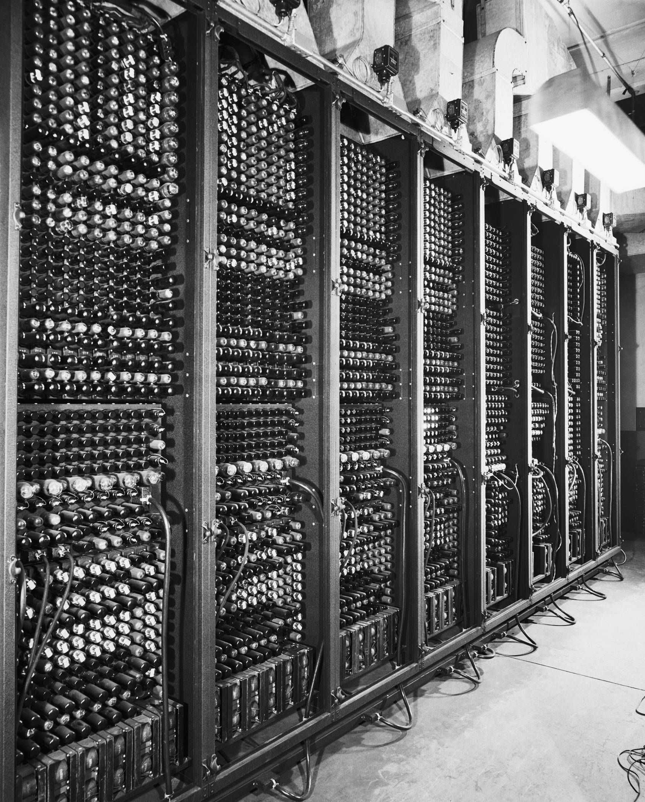
“Vacuum tube” era of quantum computing
Room-sized, highly unreliable parts, limited capabilities
analogy
Quantum computer
Computers in 1940s and 1950s
Notes:
We can put together a lot of light bulbs together, and the on/off pattern of these light bulbs represents a series of bits. All the wonders of modern computing is, at the end of the day, simply the manipulation of billions and trillions of these simple bits, at extremely high speeds. The physics needed to describe this kind of information processing is purely classical physics.

Slide 48

Grand challenge: dealing with noise and errors
Quantum computer
Qubits are fragile: environment is constantly trying to peek inside the qubits of a quantum computer.
Environment
Unwanted observation destroys the quantum probabilities, leading to errors in computation.
Notes:
We can put together a lot of light bulbs together, and the on/off pattern of these light bulbs represents a series of bits. All the wonders of modern computing is, at the end of the day, simply the manipulation of billions and trillions of these simple bits, at extremely high speeds. The physics needed to describe this kind of information processing is purely classical physics.

Slide 49
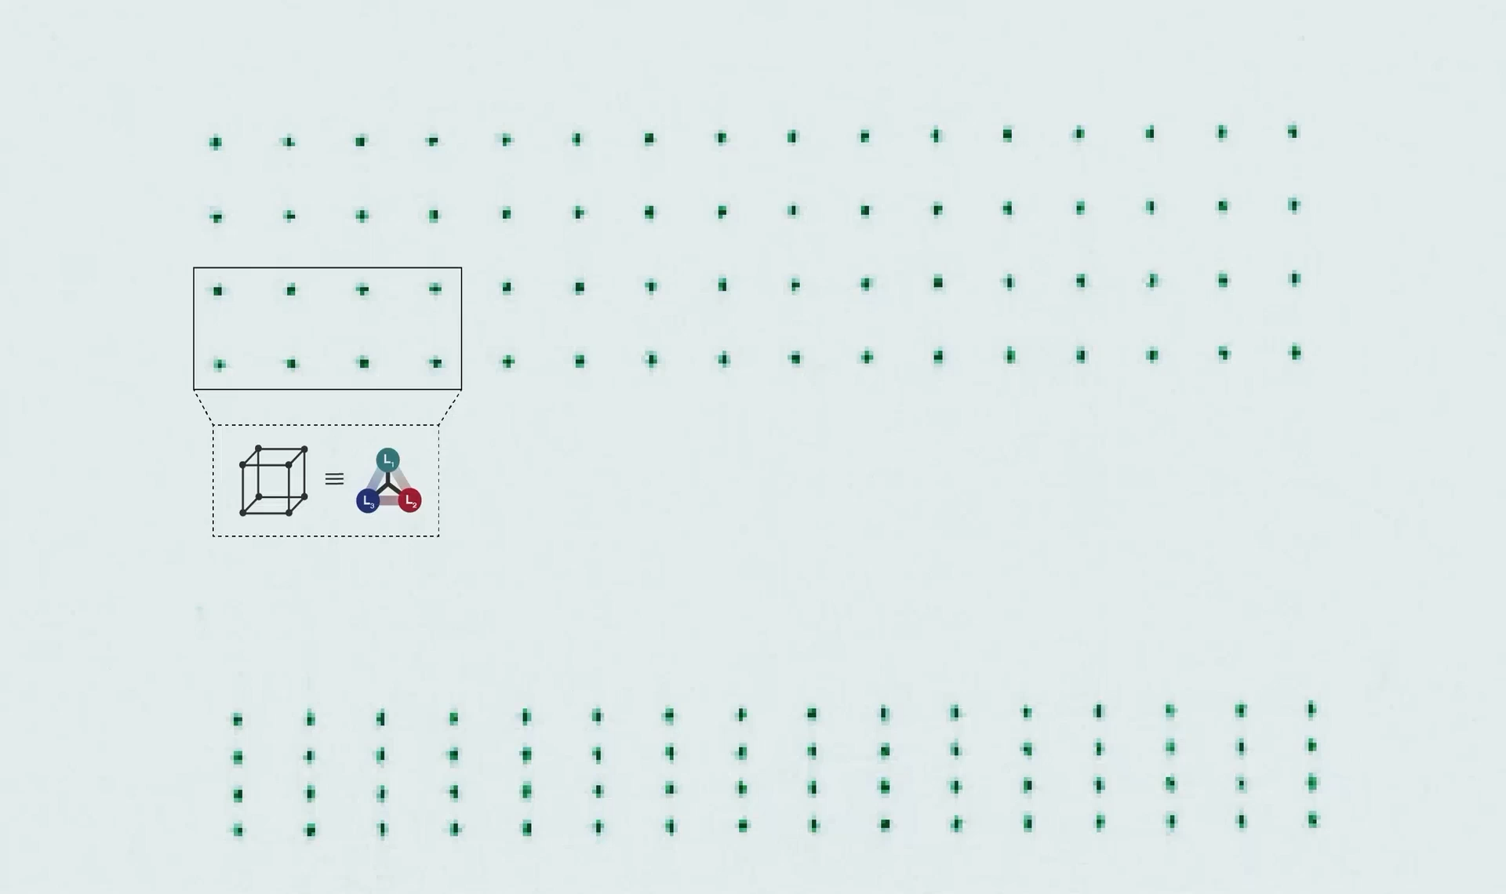
2023: breakthroughs in quantum error-correction.
Experiments show it is possible (in principle) to build a reliable qubit out of many unreliable ones.
Lukin Lab (Harvard) demo of quantum error correction on neutral atom array.
Necessary path forward: scale up error correction.
Notes:
We can put together a lot of light bulbs together, and the on/off pattern of these light bulbs represents a series of bits. All the wonders of modern computing is, at the end of the day, simply the manipulation of billions and trillions of these simple bits, at extremely high speeds. The physics needed to describe this kind of information processing is purely classical physics.

Slide 50
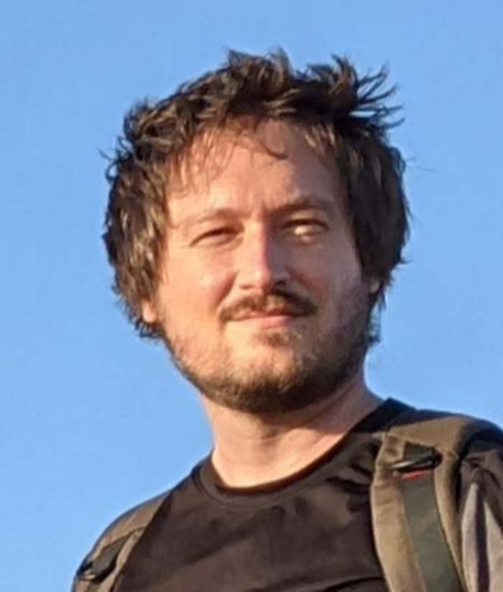
Craig Gidney (Google) has authored the most authoritative analyses of quantum computing resources needed to factor a 2048-bit RSA key.
Gidney, Ekerå (2019) 20 million noisy qubits (≈ 10000 noiseless qubits)
8 hours
Gidney (2025) 1 million noisy qubits (≈ 4000 noiseless qubits)
1 week
IBM’s Quantum Roadmap: 2000 noiseless qubits by 2033

Slide 51
Quantum computers today: science fiction to science reality.
Many fundamental questions:
How to build better qubits?
How to correct errors efficiently?
What are quantum computers good at?
Many engineering challenges ahead.
Notes:
We can put together a lot of light bulbs together, and the on/off pattern of these light bulbs represents a series of bits. All the wonders of modern computing is, at the end of the day, simply the manipulation of billions and trillions of these simple bits, at extremely high speeds. The physics needed to describe this kind of information processing is purely classical physics.

Slide 52
We’re in the early days of quantum computing.

Slide 53
Welcome!
Bird’s eye view
Class structure

Slide 54
What you’ll get out of this class:
Learn the basic principles of quantum information and computation
Learn fundamental quantum algorithms and quantum protocols
Get an idea of the current state of the field, and
Get an idea of what the big questions are.

Slide 55
Target audience
Who this class is for:
Computer scientists, physicists, mathematicians, chemists, …
People with a solid linear algebra and probability background
People who want to learn about the theory of quantum computing and quantum information.
Who this class is NOT for:
People who want to learn how to build a quantum computer
People who want to learn quantum physics

Slide 56
Prerequisites
(Important) Basic linear algebra. You should be comfortable with:
Vector space (subspaces, orthogonal complements, dimension, linear independence, basis, span,...). Inner products. Row vs column vectors. Linear operators (invertibility, composition of linear operators, transpose). Eigenvalues and eigenvectors. Trace.
(Important) Basic probability theory. You should be comfortable with:
Bayes’ rule, conditional distributions. Joint probability spaces. Independent random variables. Mean, variance, etc.
(Helpful, but not required) Computer Science Theory exposure: Analysis and design of algorithms; Complexity theory; Discrete math.
(Helpful) Experience with Python

Slide 57
Grading
Assignment | (Approx.) Date | Percentage
Problem Set 0 | September 12 | 5%
Problem Set 1 | September 26 | 10%
Midterm | October 16 | 35%
Problem Set 2 | Late November | 10%
Final | December 4 | 35%
Weekly Quizzes |  | 5%

Slide 58
Weekly worksheets
Purpose: help you keep up with class material, and gives practice problems for weekly quizzes, problem sets, and midterm/final.
Format: released each Monday. Not graded.
How to prepare: attend lecture and TA office hours.

Slide 59
Weekly quizzes
Purpose: help you keep up with class material, and gives weekly feedback on your understanding of basic class material.
Format: individually complete on Gradescope. Once you start, you have 1 hour to finish (but should be doable in 10-15 minutes). Due Friday at midnight.
How to prepare: attend lecture, TA office hours, and complete worksheets.
Collaborators allowed: No

Slide 60
Problem Sets
Purpose: Challenging and difficult problems for you to apply what you learned from class/worksheets/quizzes. Opportunities to write quantum programs. Opportunities to work in groups.
Format: Two parts: theory and programming. Theory must be LaTeX’d. Both parts submitted separately to GradeScope.
How to prepare: attend lecture, TA office hours, and complete worksheets/quizzes.
Collaborators allowed: Yes

Slide 61
Exams
Purpose: Test your command of the class material without any aids.
Format: Closed book, in-class 75 minute exam.
How to prepare: attend lecture, TA office hours, complete worksheets/quizzes, and complete psets.
Collaborators allowed: No.

Slide 62

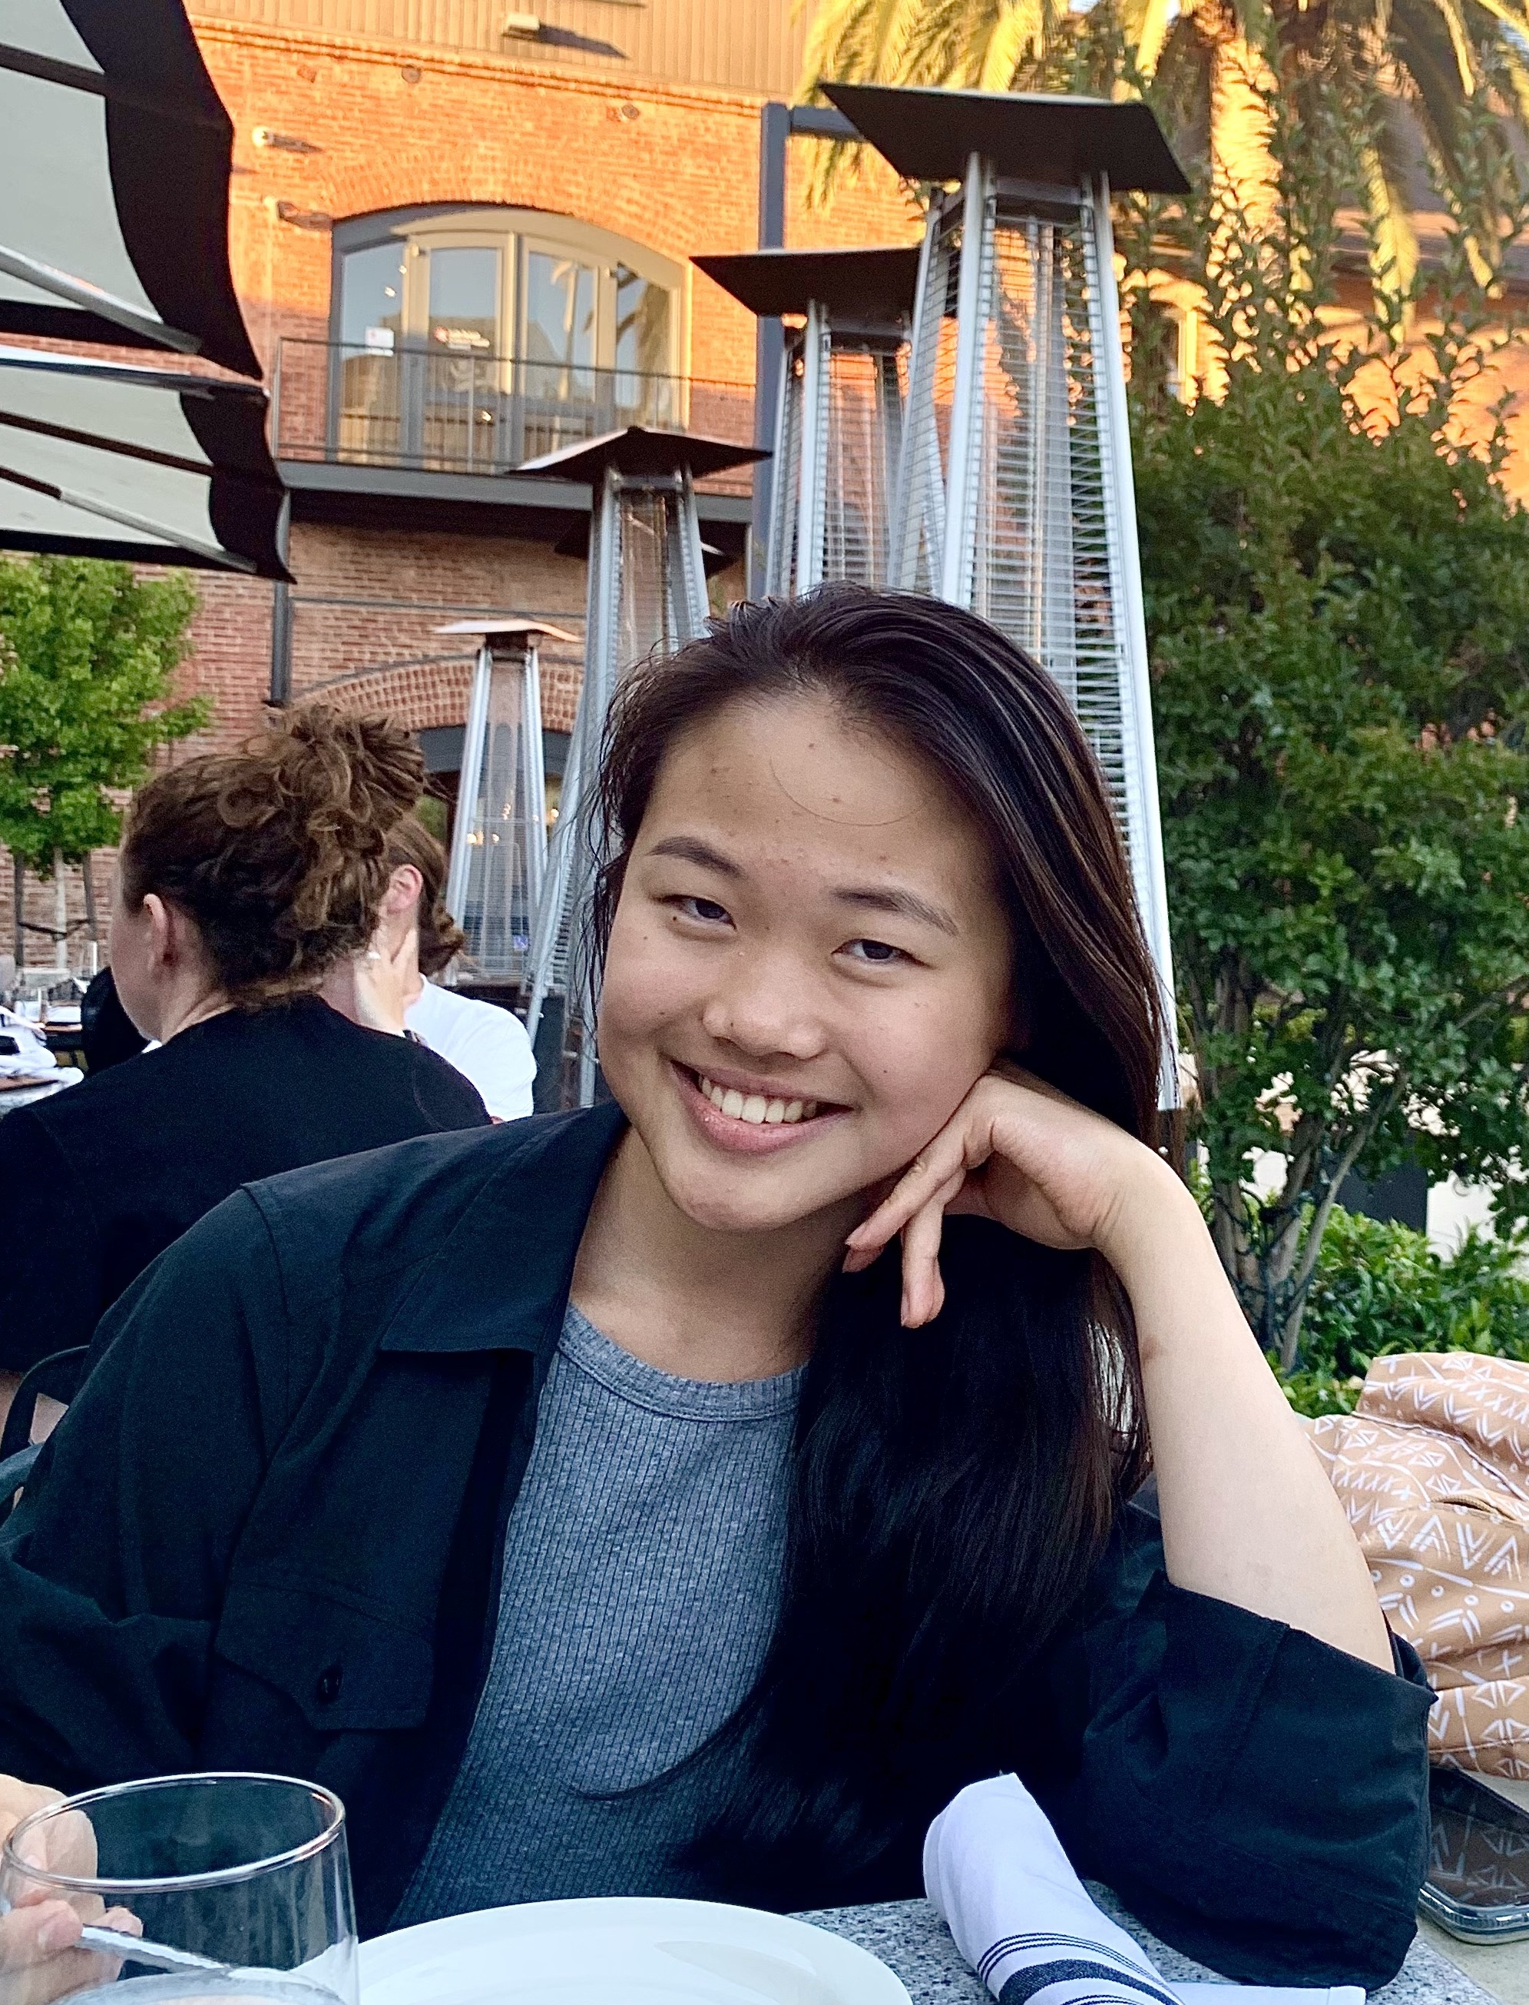
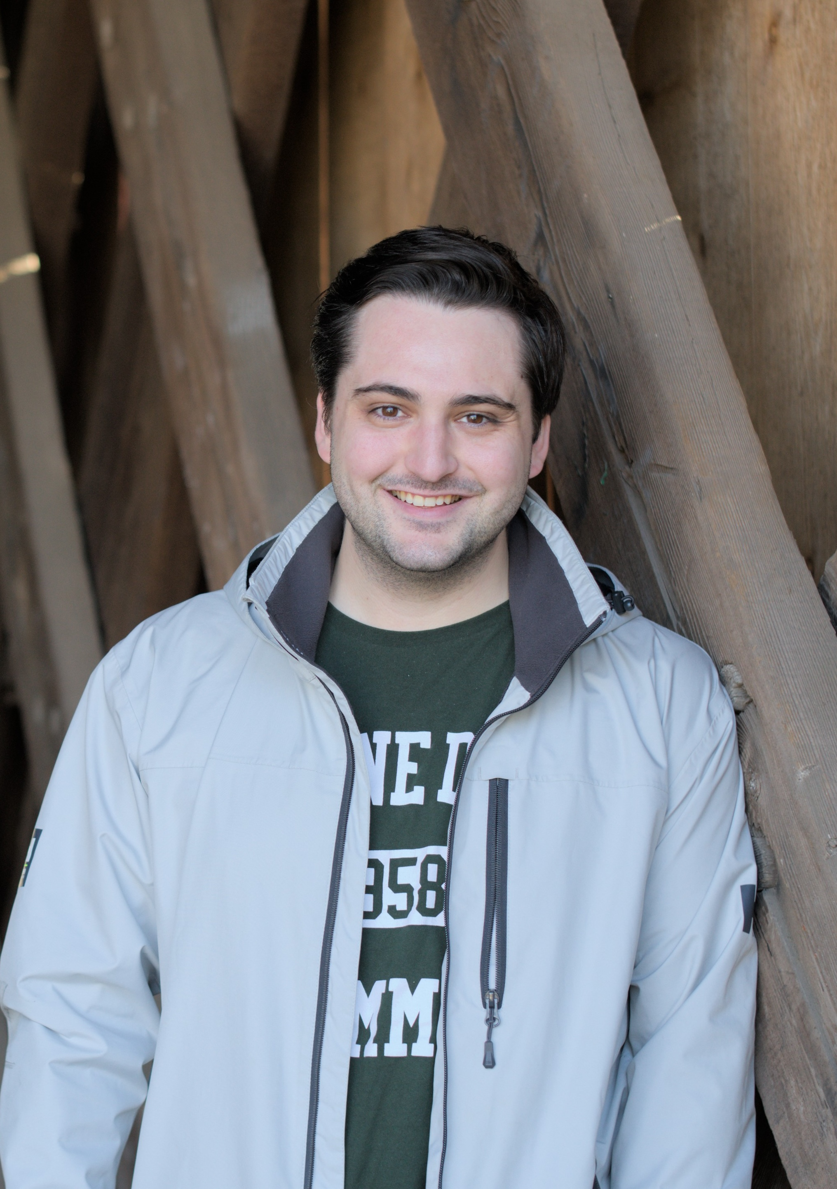
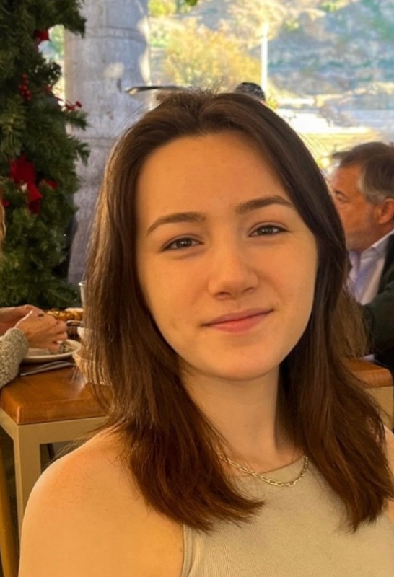

The amazing TAs
Justin Beltran 1st year PhD Computer Science
Christine Li
Senior SEAS
Computer Science
Linguistics minor
Vincent Mutolo
3nd year PhD
Computer Science
Devon Campbell
Masters
Computer Science
John Bostanci
4th year PhD
Computer Science

Slide 63
Class resources
Course homepage: www.henryyuen.net/classes/fall2025
Syllabus, office hours, problem sets, schedule
Discussions on EdStem
Office hours start next week

Slide 64
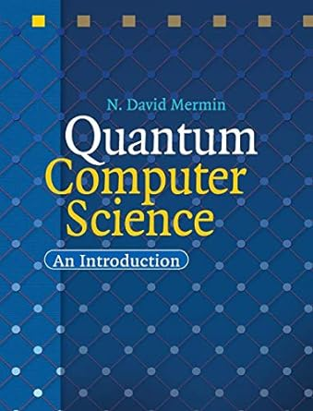
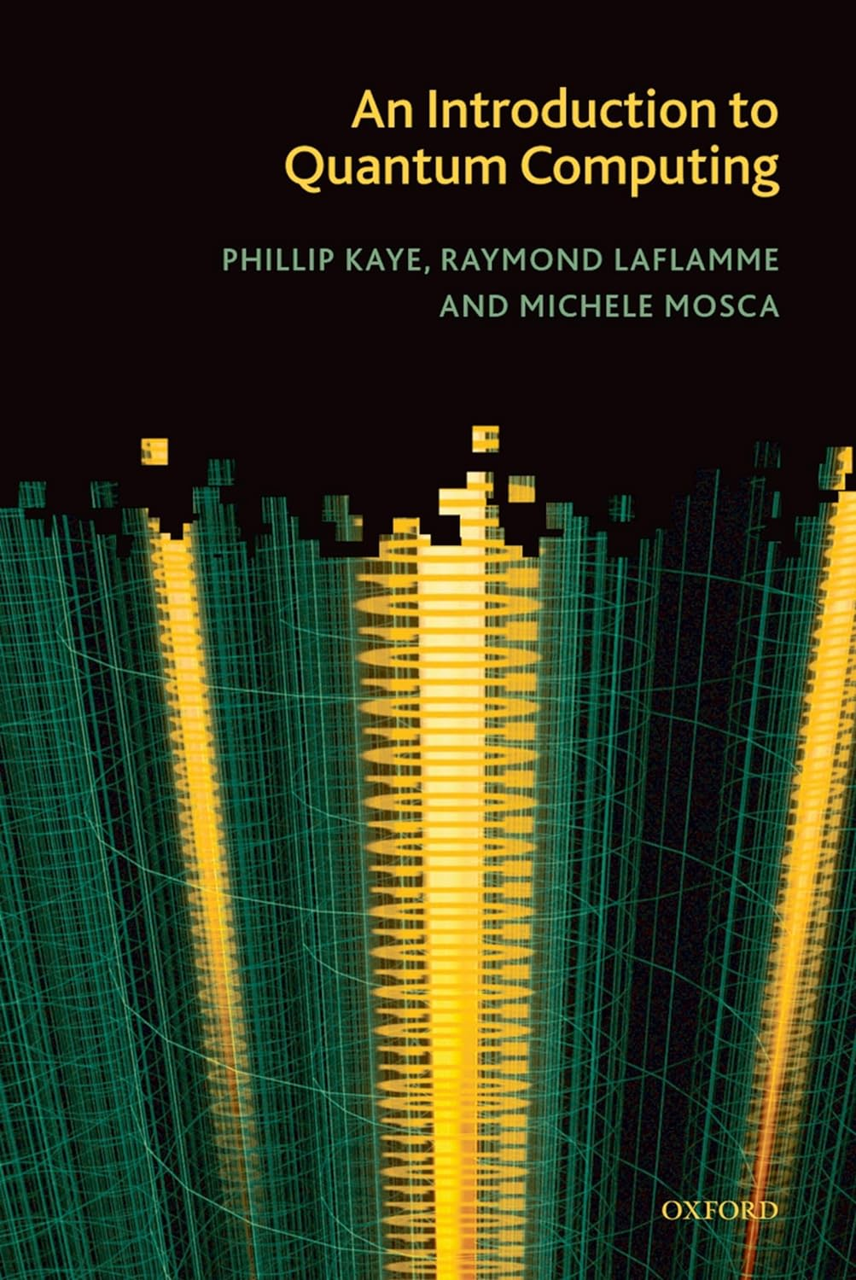
Textbooks
No official textbook, but you might find one of these helpful references

Slide 65
Problem Set 0 (due Sept 12)
Post on EdStem introducing yourself
Where you’re from, your interests, a fun fact.
Sign up for GradeScope
Set up qBraid

