Slide 1
Introduction to Quantum Computing
COMS 4281 (Fall 2025)
Week 1: Reversible computing, basics of quantum info
Course homepage: http://www.henryyuen.net/classes/fall2025

Slide 2
Admin
Due next Friday, September 12
Pset0
Quiz1
Worksheet 1 will be released Monday; it will help you practice for Quiz 1. Use office hours to work through the problems!
Change of Program period ends Friday, September 12, 9:45pm

Slide 3
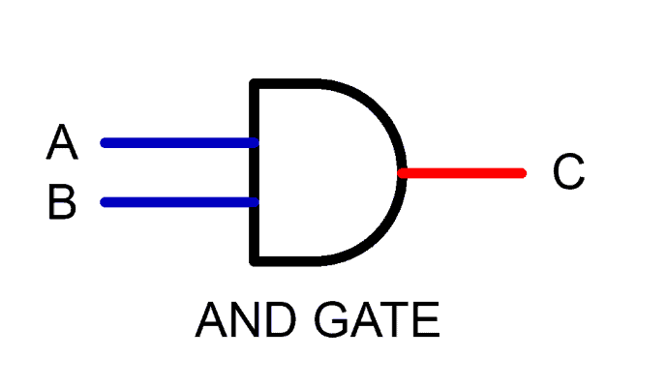
The physics of information
In (classical) computing, we see operations like
Information appears to be erased.
Is this actually possible? Can information… disappear?
...
A = 0 #reset
...
Notes:
To answer this, we really have to dig into the physics of how information is processed. Think about how information is stored on your hard drive, say. Ok, hard drives aren’t made like this anymore, but at some point they were stacks of discs and the data is stored via the orientation of magnetic material on disks. If the magnetization is pointing up, or down, that corresponds to 0 or 1. So when you erase or reset some information,

Slide 4
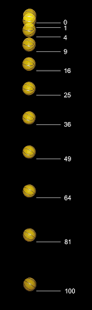
Reversibility of physics
The laws of physics – both quantum and classical – are inherently reversible.
Any isolated physical process running in one direction, can (in principle) run in reverse.
In fact: at a microscopic level, one should not be able to tell the difference between time running forwards or backwards.

Slide 5

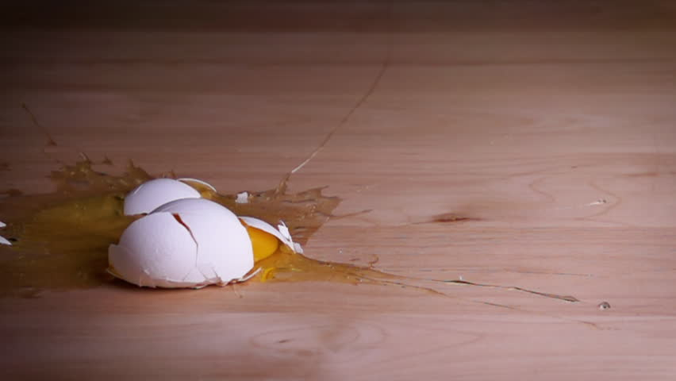
Reversibility of physics
Even the process of an egg falling and breaking is (in principle) reversible and possible according to physics.
However, in the macroscopic world such events are extremely unlikely.

Slide 6
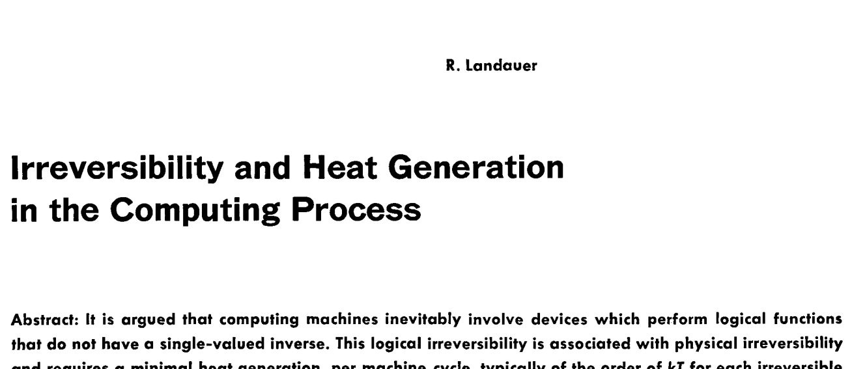
Reversibility of computation
In 1960s the physicist Rolf Landauer had a simple but powerful observation:
Computation is a physical process.
Physical processes are fundamentally reversible.
Therefore, computation can be performed reversibly.
This observation led to study of reversible computing, which later influenced the study of quantum computing.

Slide 7


Reversible classical information processing
Consider a physical system $S$with d distinguishable states $\left|0\right\rangle ,…,|d−1⟩$
The information of the system is stored in its state.
$$S$$

Slide 8

Reversible classical information processing
Consider a physical system $S$with d distinguishable states $\left|0\right\rangle ,…,|d−1⟩$
The information of the system is stored in its state.
$$|0⟩$$
$$S$$

Slide 9

Reversible classical information processing
Consider a physical system $S$with d distinguishable states $\left|0\right\rangle ,…,|d−1⟩$
The information of the system is stored in its state.
$$|5⟩$$
$$S$$

Slide 10
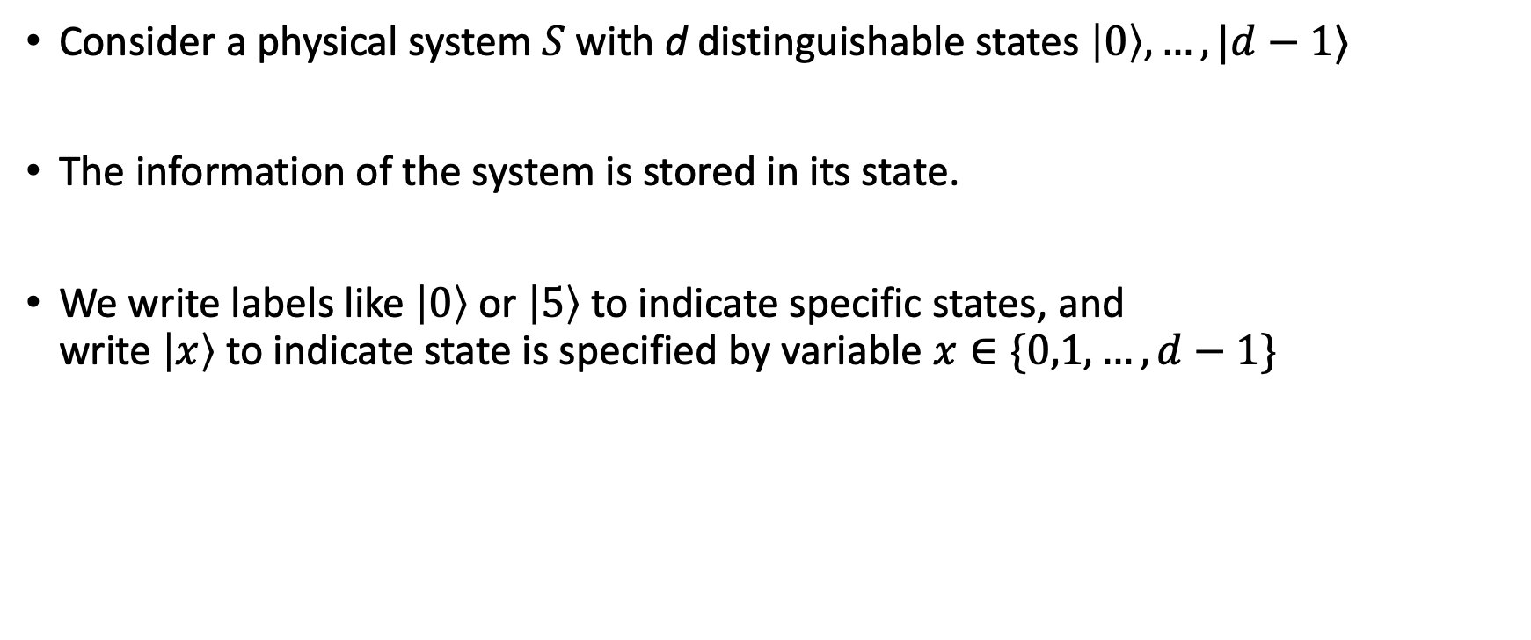

Reversible classical information processing
Consider a physical system $S$with d distinguishable states $\left|0\right\rangle ,…,|d−1⟩$
The information of the system is stored in its state.
We write labels like $\left|0\right\rangle$ or $\left|5\right\rangle$ to indicate specific states, and write $\left|x\right\rangle$ to indicate state is specified by variable $x∈\{0,1,…,d−1\}$
$$|x⟩$$
$$S$$

Slide 11


Reversible classical information processing
The system $S$can undergo transformations, which can change the state.
$$|x⟩$$
$$S$$

Slide 12

Reversible classical information processing
The system $S$can undergo transformations, which can change the state.
$$R$$
$$|x⟩$$
$$S$$

Slide 13
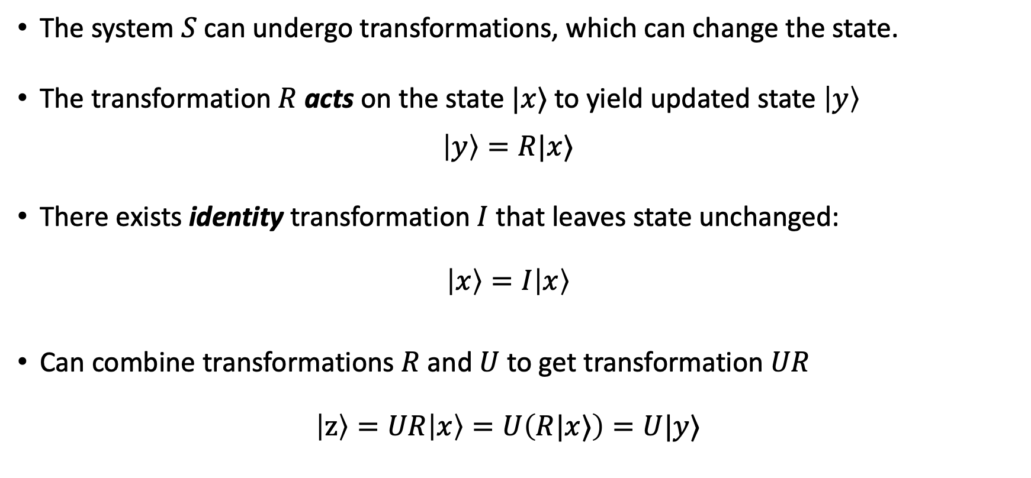

Reversible classical information processing
The system $S$can undergo transformations, which can change the state.
The transformation $R$ acts on the state $|x⟩$ to yield updated state $\left|y\right\rangle$ $\left|y\right\rangle =R|x⟩$
There exists identity transformation $I$ that leaves state unchanged: $\left|x\right\rangle =I\left|x\right\rangle$
Can combine transformations $R$ and $U$ to get transformation $UR$ $\left|z\right\rangle =UR\left|x\right\rangle =U\left(R|x⟩\right)=U|y⟩$
$$|y⟩$$
$$S$$

Slide 14

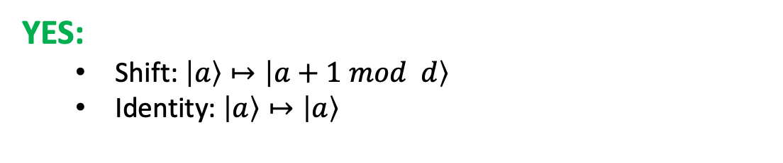

Reversible classical information processing
All transformations $R$must be reversible.
Equivalently: $R$ is a bijection between $\{0,1,…,d−1\}$
Equivalently: $R$ is a permutation
Equivalently: there exists inverse $R^{−1}$ so that $R^{−1}R=RR^{−1}=I$: $\left|x\right\rangle =R^{−1}R\left|x\right\rangle =RR^{−1}|x⟩$
NO:
$$\left|0\right\rangle ↦\left|0\right\rangle$$
$$\left|1\right\rangle ↦\left|0\right\rangle$$
YES:
Shift: $\left|a\right\rangle ↦\left|a+1 mod d\right\rangle$
Identity: $\left|a\right\rangle ↦\left|a\right\rangle$
$$|y⟩$$
$$S$$

Slide 15

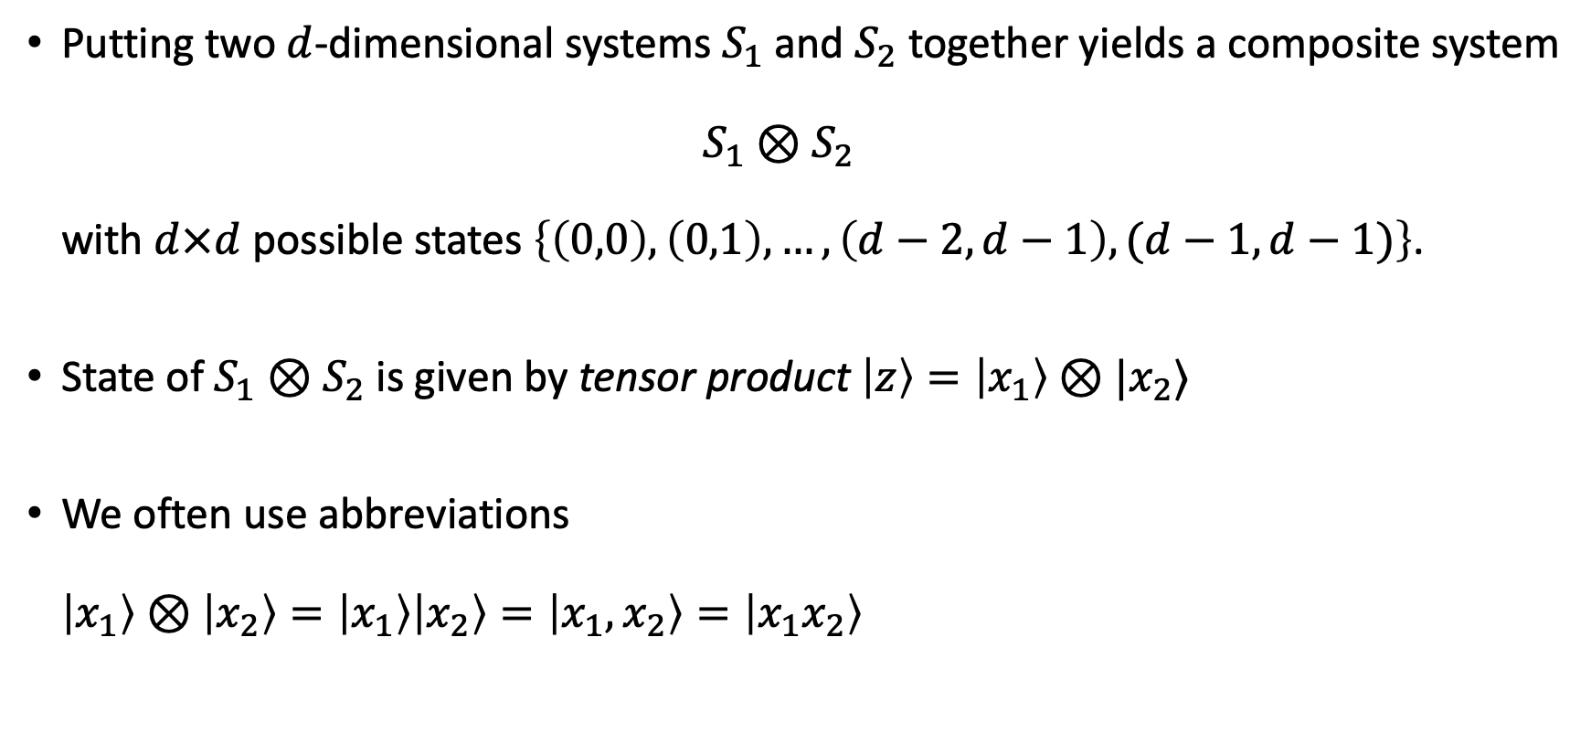



Composite systems
Putting two $d$-dimensional systems $S_{1}$ and $S_{2}$ together yields a composite system $S_{1}⊗S_{2}$ with $d×d$ possible states $\left\{\left(0,0\right),\left(0,1\right),…,\left(d−2,d−1\right),(d−1,d−1)\right\}$.
State of $S_{1}⊗S_{2}$ is given by tensor product $\left|z\right\rangle =\left|x_{1}\right\rangle ⊗|x_{2}⟩$
We often use abbreviations $\left|x_{1}\right\rangle ⊗\left|x_{2}\right\rangle =\left|x_{1}\right\rangle \left|x_{2}\right\rangle =\left|x_{1},x_{2}\right\rangle =\left|x_{1}x_{2}\right\rangle$
$$|x_{1}⟩$$
$$|x_{2}⟩$$
$$S_{1}$$
$$S_{2}$$

Slide 16

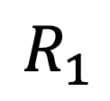

Composite systems
If $R_{1}$ acts on system $S_{1}$ and $R_{2}$ acts on $S_{2}$, then $R=R_{1}⊗R_{2}$ is a transformation on $S_{1}⊗S_{2}$.
$$R_{2}$$
$$R_{1}$$
$$|x_{1}⟩$$
$$|x_{2}⟩$$
$$S_{1}$$
$$S_{2}$$

Slide 17




Composite systems
If $R_{1}$ acts on system $S_{1}$ and $R_{2}$ acts on $S_{2}$, then $R=R_{1}⊗R_{2}$ is a transformation on $S_{1}⊗S_{2}$.
Applying $R_{1}$ to $S_{1}$ and nothing to $S_{2}$ corresponds to the transformation $R_{1}⊗I$.
Initial state: $\left|z\right\rangle =\left|x_{1}\right\rangle ⊗|x_{2}⟩$
Next state: $\left|z′\right\rangle =R\left|z\right\rangle =\left(R_{1}⊗R_{2}\right)\left(\left|x_{1}\right\rangle ⊗|x_{2}⟩\right) =R_{1}\left|x_{1}\right\rangle ⊗R_{2}|x_{2}⟩$
$$R_{1}|x_{1}⟩$$
$$R_{2}|x_{2}⟩$$
$$S_{1}$$
$$S_{2}$$

Slide 18


Composite systems
There are transformations on $S_{1}⊗S_{2}$ that cannot be written as tensor product of separate transformations $R_{1}$ on $S_{1}$ and $R_{2}$ on $S_{2}$. Such transformations interact the systems $S_{1}$ and $S_{2}$ together.
Example:
$S_{1}$ and $S_{2}$ are bits, i.e., $d=2$, with states $\left|0\right\rangle ,|1⟩$
“Controlled-NOT” operation $CNOT$:
$$\left|0,0\right\rangle ↦\left|0,0\right\rangle$$
$$\left|0,1\right\rangle ↦\left|0,1\right\rangle$$
$$\left|1,0\right\rangle ↦\left|1,1\right\rangle$$
$$\left|1,1\right\rangle ↦\left|1,0\right\rangle$$
$$|x_{1}⟩$$
$$|x_{2}⟩$$
First bit ( “control bit”) controls if second bit (“target bit”) gets flipped.
$$S_{1}$$
$$S_{2}$$

Slide 19
Reversible computation
We can put many bits together to compute:
Computation: a sequence of pre-determined transformations on specified subsystems.

Slide 20




Reversible computation
We can describe reversible computation using a circuit diagram.
Multi-bit gates
$$\left|x_{1}\right\rangle$$
$$\left|x_{2}\right\rangle$$
n bit input
$$\left|x_{3}\right\rangle$$
……
$$\left|x_{n}\right\rangle$$
1 bit gates
Time

Slide 21







Reversible computation
CNOT gate
ctrl
tgt
Compute the final state of circuit:
NOT gate
$$\left|1\right\rangle$$
$$|a⟩$$
$$X$$
$$|a⊕1⟩$$
$$\left|0\right\rangle$$
$$X$$
$$\left|0\right\rangle$$

Slide 22
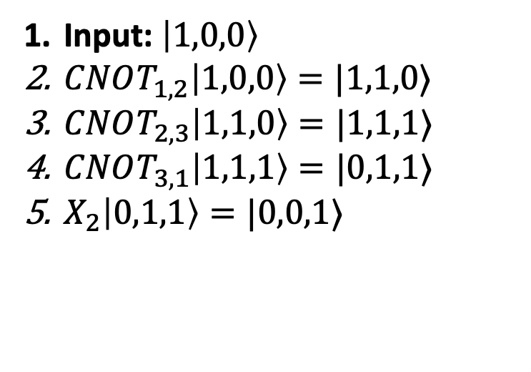
Reversible computation
CNOT gate
ctrl
tgt
Compute the final state of circuit:
NOT gate
$$\left|1\right\rangle$$
$$|a⟩$$
$$X$$
$$|a⊕1⟩$$
$$\left|0\right\rangle$$
$$X$$
$$\left|0\right\rangle$$
Input: $\left|1,0,0\right\rangle$
$CNOT_{1,2}\left|1,0,0\right\rangle =|1,1,0⟩$
$CNOT_{2,3}\left|1,1,0\right\rangle =|1,1,1⟩$
$CNOT_{3,1}\left|1,1,1\right\rangle =|0,1,1⟩$
$X_{2}\left|0,1,1\right\rangle =|0,0,1⟩$
1
2
3
4
5

Slide 23




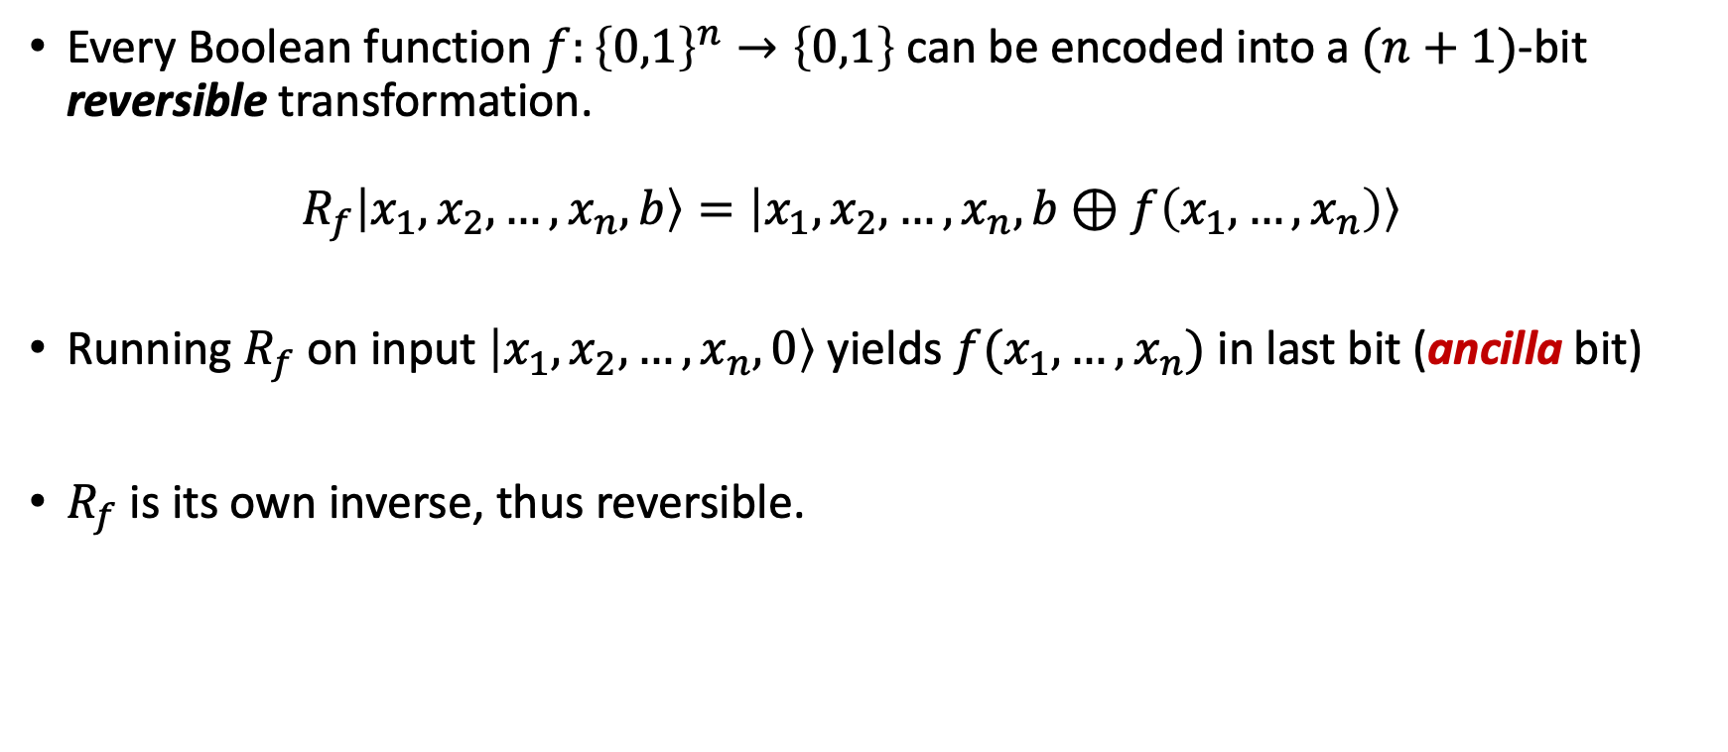





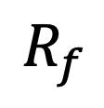

Universal computation with reversible circuits
Every Boolean function $f:{\left\{0,1\right\}}^{n}→\left\{0,1\right\}$ can be encoded into a $(n+1)$-bit reversible transformation. $R_{f}\left|x_{1},x_{2},…,x_{n},b\right\rangle =\left|x_{1},x_{2},…,x_{n},b⊕f\left(x_{1},…, x_{n}\right)\right\rangle$
Running $R_{f}$ on input $\left|x_{1},x_{2},…,x_{n},0\right\rangle$ yields $f(x_{1},…,x_{n})$ in last bit (ancilla bit)
$R_{f}$is its own inverse, thus reversible.
$$\left|x_{1}\right\rangle$$
$$\left|x_{1}\right\rangle$$
$$\left|x_{2}\right\rangle$$
$$\left|x_{2}\right\rangle$$
$$\left|x_{3}\right\rangle$$
$$R_{f}$$
$$\left|x_{3}\right\rangle$$
…
…
…
$$\left|x_{n}\right\rangle$$
$$\left|x_{n}\right\rangle$$
$$\left|b\right\rangle$$
$$\left|b⊕f(x)\right\rangle$$

Slide 24
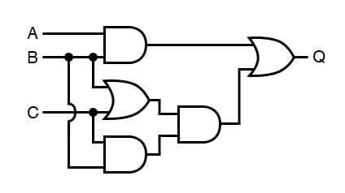

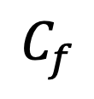
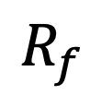
Universal computation with reversible circuits
An irreversible circuit $C_{f}$for $f$, consisting of AND/OR/NOT gates, can be used to construct a reversible circuit for $R_{f}$.
High level idea: convert each gate of $C_{f}$ into its reversible equivalent. You will work this out on the Problem Set!
In general, this construction requires many ancilla bits.
$$C_{f}$$
$$R_{f}$$
$$\left|x_{1}\right\rangle$$
$$\left|x_{1}\right\rangle$$
$$\left|x_{2}\right\rangle$$
$$\left|x_{2}\right\rangle$$
$$\left|x_{3}\right\rangle$$
$$\left|x_{3}\right\rangle$$
…
…
…
$$\left|x_{n}\right\rangle$$
$$\left|x_{n}\right\rangle$$
$$\left|b\right\rangle$$
$$\left|b⊕f(x)\right\rangle$$

Slide 25





Reversible computing, linear algebra style
As a sneak preview of quantum math, let’s put reversible computing on a linear algebraic foundations: the math of vectors, matrices, tensors.
States of $d$-dim system $S$ are represented by $d$-dim column vectors
$$|0⟩=\left(\begin{matrix}1 \\ 0 \\ ⋮ \\ 0\end{matrix}\right)$$
$$|1⟩=\left(\begin{matrix}0 \\ 1 \\ ⋮ \\ 0\end{matrix}\right)$$
$$|d−1⟩=\left(\begin{matrix}0 \\ 0 \\ ⋮ \\ 1\end{matrix}\right)$$
$$⋯$$

Slide 26
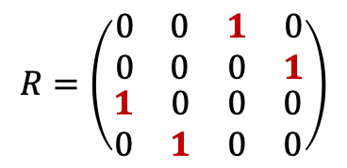
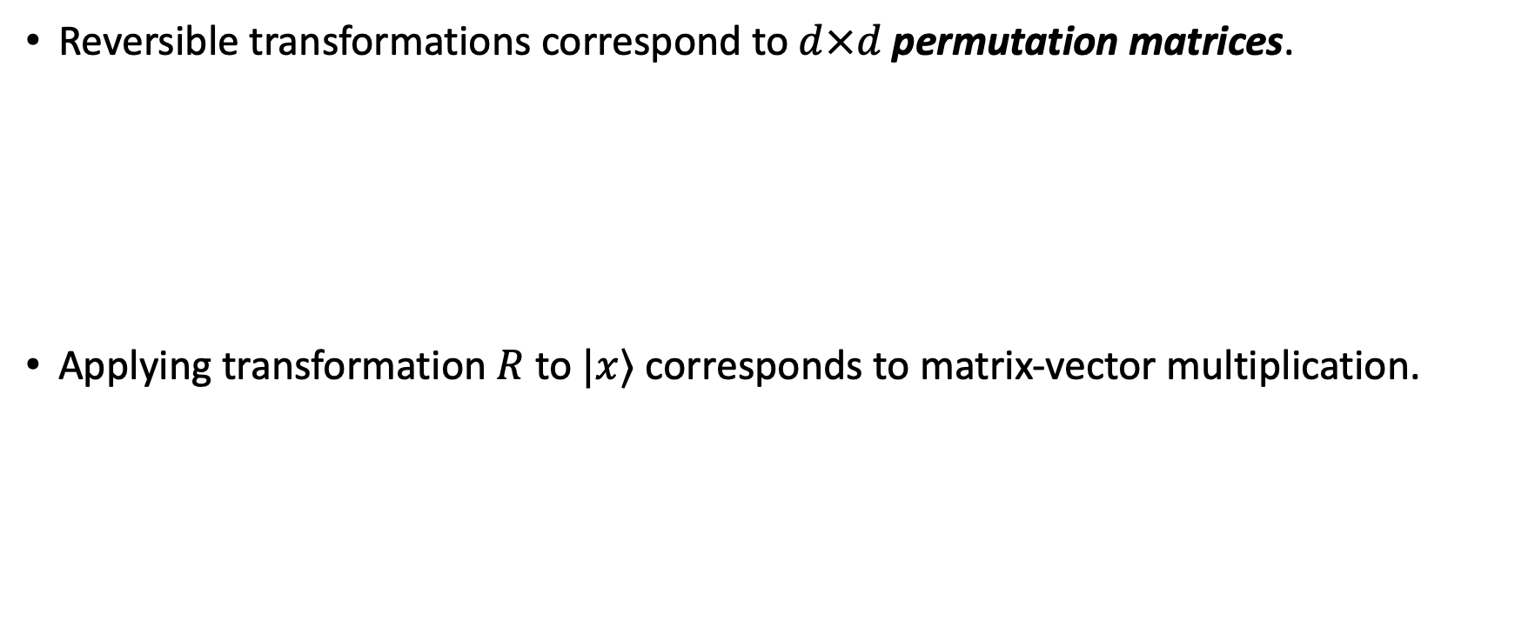
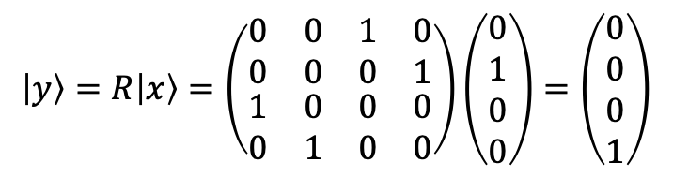
Transformation matrices
Reversible transformations correspond to $d×d$ permutation matrices.
Applying transformation $R$to $|x⟩$ corresponds to matrix-vector multiplication.
Matrix with exactly one 1 in each column and row
$$R=\left(\begin{matrix}\begin{matrix}0 & 0 \\ 0 & 0\end{matrix} & \begin{matrix}1 & 0 \\ 0 & 1\end{matrix} \\ \begin{matrix}1 & 0 \\ 0 & 1\end{matrix} & \begin{matrix}0 & 0 \\ 0 & 0\end{matrix}\end{matrix}\right)$$
$$\left|y\right\rangle =R\left|x\right\rangle =\left(\begin{matrix}\begin{matrix}0 & 0 \\ 0 & 0\end{matrix} & \begin{matrix}1 & 0 \\ 0 & 1\end{matrix} \\ \begin{matrix}1 & 0 \\ 0 & 1\end{matrix} & \begin{matrix}0 & 0 \\ 0 & 0\end{matrix}\end{matrix}\right)\left(\begin{matrix}0 \\ 1 \\ 0 \\ 0\end{matrix}\right)=\left(\begin{matrix}0 \\ 0 \\ 0 \\ 1\end{matrix}\right)$$

Slide 27
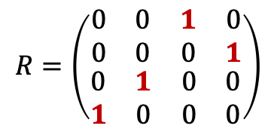
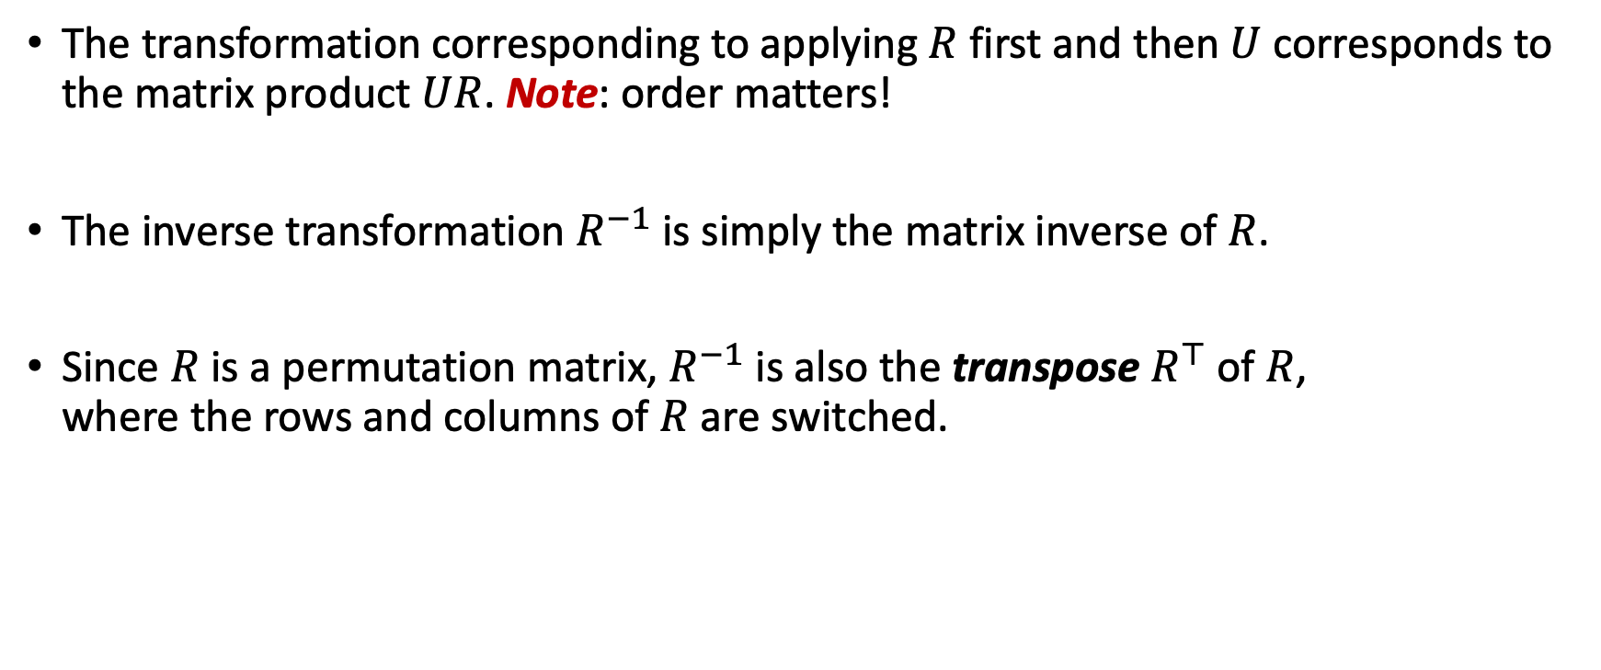

Transformation matrices
The transformation corresponding to applying $R$ first and then $U$ corresponds to the matrix product $UR$. Note: order matters!
The inverse transformation $R^{−1}$ is simply the matrix inverse of $R$.
Since $R$ is a permutation matrix, $R^{−1}$ is also the transpose $R^{⊤}$ of $R$, where the rows and columns of $R$ are switched.
$$R=\left(\begin{matrix}\begin{matrix}0 & 0 \\ 0 & 0\end{matrix} & \begin{matrix}1 & 0 \\ 0 & 1\end{matrix} \\ \begin{matrix}0 & 1 \\ 1 & 0\end{matrix} & \begin{matrix}0 & 0 \\ 0 & 0\end{matrix}\end{matrix}\right)$$
$$R^{⊤}=\left(\begin{matrix}\begin{matrix}0 & 0 \\ 0 & 0\end{matrix} & \begin{matrix}0 & 1 \\ 1 & 0\end{matrix} \\ \begin{matrix}1 & 0 \\ 0 & 1\end{matrix} & \begin{matrix}0 & 0 \\ 0 & 0\end{matrix}\end{matrix}\right)$$

Slide 28
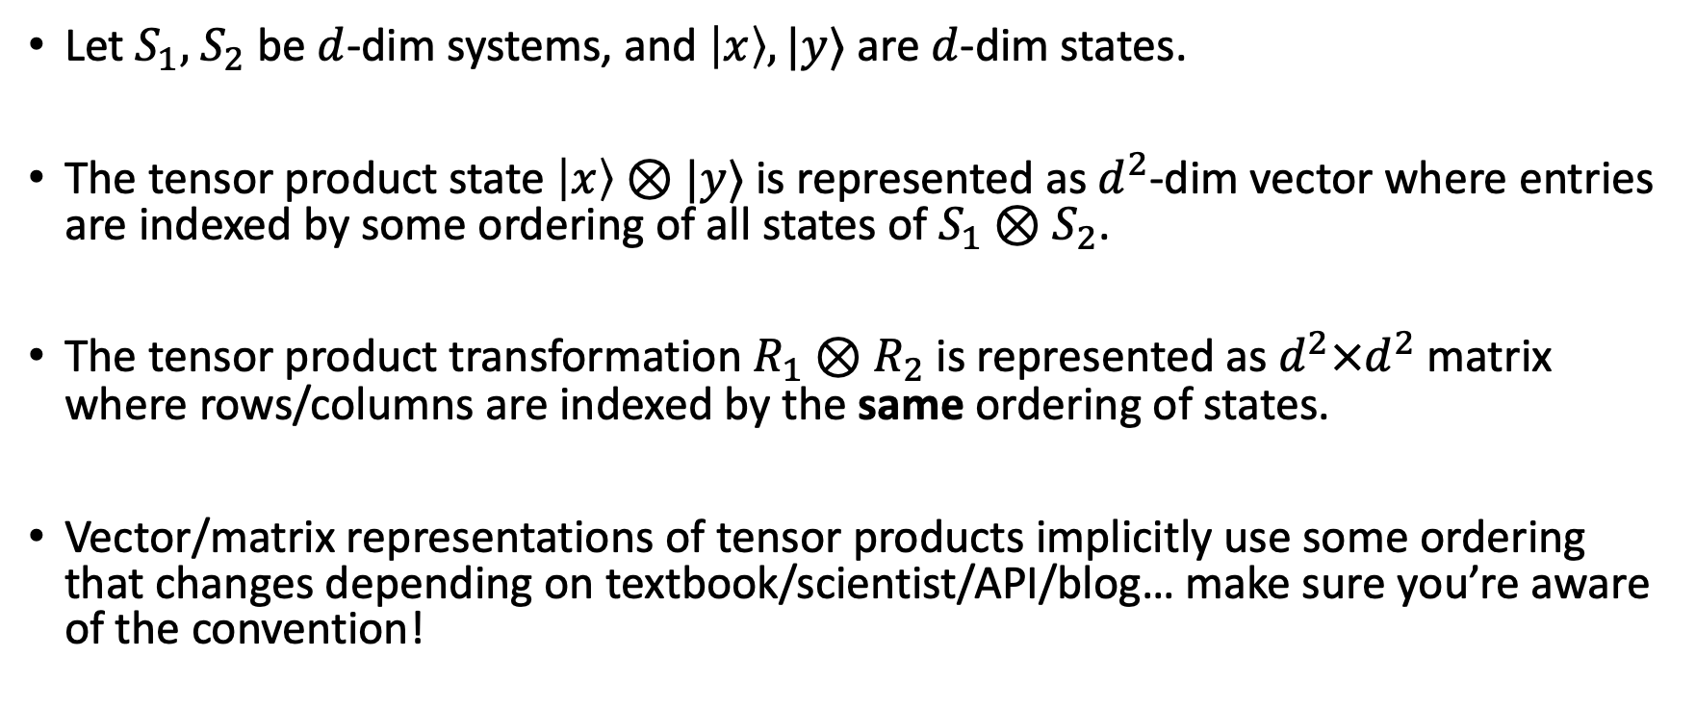
Tensor products
Let $S_{1},$ $S_{2}$ be $d$-dim systems, and $\left|x\right\rangle ,|y⟩$ are $d$-dim states.
The tensor product state $\left|x\right\rangle ⊗|y⟩$ is represented as $d^{2}$-dim vector where entries are indexed by some ordering of all states of $S_{1}⊗S_{2}$.
The tensor product transformation $R_{1}⊗R_{2}$ is represented as $d^{2}×d^{2}$ matrix where rows/columns are indexed by the same ordering of states.
Vector/matrix representations of tensor products implicitly use some ordering that changes depending on textbook/scientist/API/blog… make sure you’re aware of the convention!

Slide 29
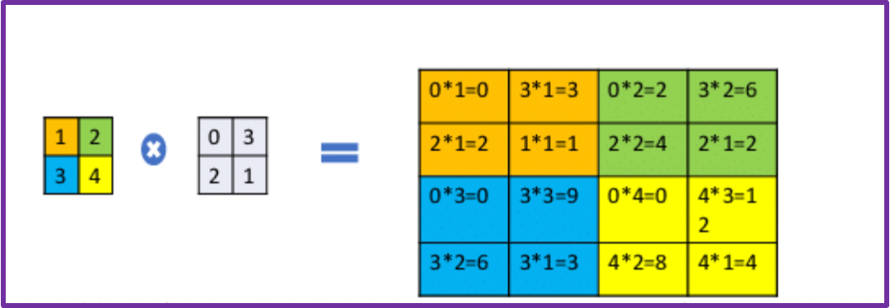
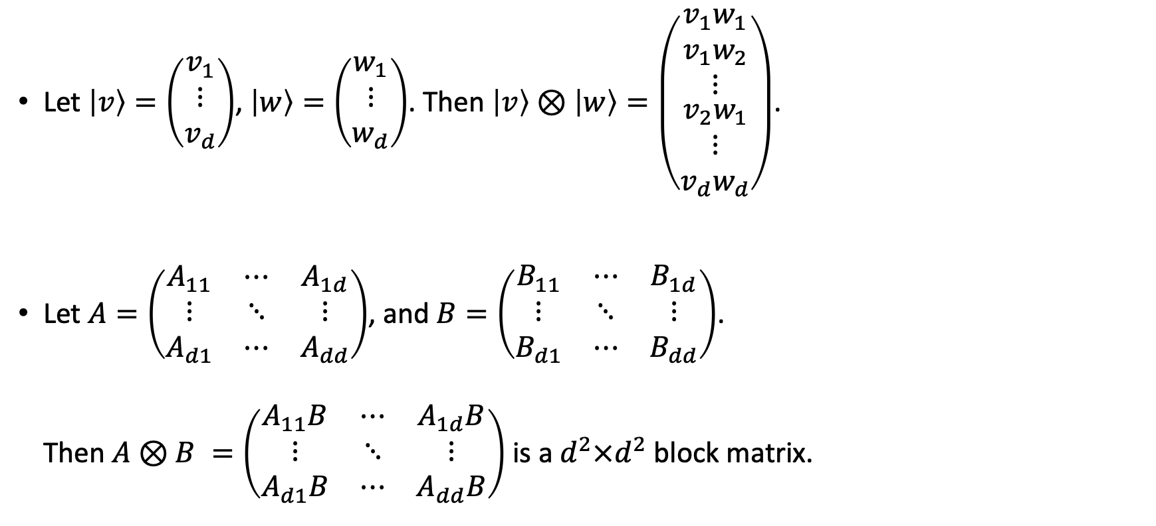
Tensor products, representations
Let $\left|v\right\rangle =\left(\begin{matrix}v_{1} \\ ⋮ \\ v_{d}\end{matrix}\right)$, $\left|w\right\rangle =\left(\begin{matrix}w_{1} \\ ⋮ \\ w_{d}\end{matrix}\right)$. Then $\left|v\right\rangle ⊗\left|w\right\rangle =\left(\begin{matrix}\begin{aligned}{v_{1}w}_{1} \\ v_{1}w_{2}\end{aligned} \\ ⋮ \\ \begin{aligned}v_{2}w_{1} \\ ⋮ \\ v_{d}w_{d}\end{aligned}\end{matrix}\right)$.
Let $A=\left(\begin{matrix}A_{11} & ⋯ & A_{1d} \\ ⋮ & ⋱ & ⋮ \\ A_{d1} & ⋯ & A_{dd}\end{matrix}\right)$, and $B=\left(\begin{matrix}B_{11} & ⋯ & B_{1d} \\ ⋮ & ⋱ & ⋮ \\ B_{d1} & ⋯ & B_{dd}\end{matrix}\right)$. Then $A⊗B =\left(\begin{matrix}A_{11}B & ⋯ & A_{1d}B \\ ⋮ & ⋱ & ⋮ \\ A_{d1}B & ⋯ & A_{dd}B\end{matrix}\right)$ is a $d^{2}×d^{2}$block matrix.

Slide 30
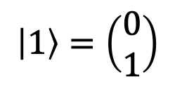
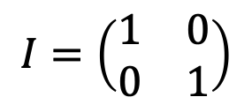
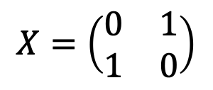
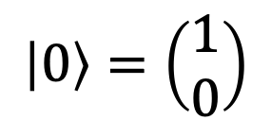
Tensor products, bits
$S$ is a bit, i.e., $d=2$. Vector representation of states:
$$\left|0\right\rangle =\left(\begin{aligned}1 \\ 0\end{aligned}\right)$$
$$\left|1\right\rangle =\left(\begin{aligned}0 \\ 1\end{aligned}\right)$$
Transformations:
$$I=\left(\begin{matrix}1 & 0 \\ 0 & 1\end{matrix}\right)$$
$$X=\left(\begin{matrix}0 & 1 \\ 1 & 0\end{matrix}\right)$$

Slide 31
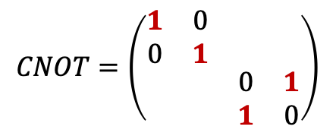
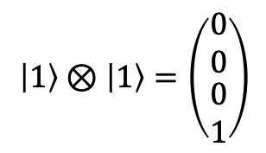
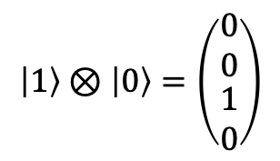
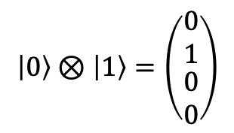
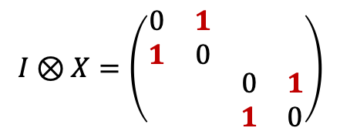
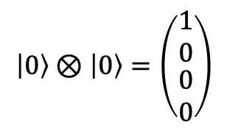
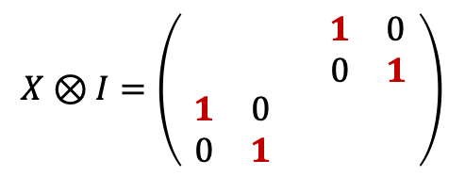
Tensor products, bits
Vector representation of two bits:
$$\left|0\right\rangle ⊗\left|0\right\rangle =\left(\begin{matrix}1 \\ 0 \\ \begin{aligned}0 \\ 0\end{aligned}\end{matrix}\right)$$
$$\left|0\right\rangle ⊗\left|1\right\rangle =\left(\begin{matrix}0 \\ 1 \\ \begin{aligned}0 \\ 0\end{aligned}\end{matrix}\right)$$
$$\left|1\right\rangle ⊗\left|0\right\rangle =\left(\begin{matrix}0 \\ 0 \\ \begin{aligned}1 \\ 0\end{aligned}\end{matrix}\right)$$
$$\left|1\right\rangle ⊗\left|1\right\rangle =\left(\begin{matrix}0 \\ 0 \\ \begin{aligned}0 \\ 1\end{aligned}\end{matrix}\right)$$
Matrix representation of transformations:
$$I⊗X=\left(\begin{matrix}\begin{matrix}0 & 1 \\ 1 & 0\end{matrix} & \\ & \begin{matrix}0 & 1 \\ 1 & 0\end{matrix}\end{matrix}\right)$$
$$X⊗I=\left(\begin{matrix}\begin{matrix} & \\ & \end{matrix} & \begin{matrix}1 & 0 \\ 0 & 1\end{matrix} \\ \begin{matrix}1 & 0 \\ 0 & 1\end{matrix} & \begin{matrix} & \\ & \end{matrix}\end{matrix}\right)$$
$$CNOT=\left(\begin{matrix}\begin{matrix}1 & 0 \\ 0 & 1\end{matrix} & \\ & \begin{matrix}0 & 1 \\ 1 & 0\end{matrix}\end{matrix}\right)$$

Slide 32
Summary
Landauer’s insight: reversibility of physics implies reversibility of computation
Principles of reversible computing
Universal computing with reversible circuits
Linear algebra formulation of reversible computing
Next: quantum information!

