Slide 1
Math Data for AI
2/27/2026
Benny Attar
Machine-Assisted Math

Slide 2
A brief timeline
1990s - human math corpora (printed textbooks, physical lecture notes, etc.)
2000s - early digital math text (PDF textbooks, early arXiv, LaTeX, etc.)
Early 2010s - early math communities (Math StackExchange, math blogs, etc.)
Introduced problems paired with human written explanations!
Late 2010s - worked solution datasets (MATH dataset (Hendrycks et al., 2021), etc)
Early 2020s - formal proof corpora (Lean, Coq, Isabelle libraries)
2023 onwards - synthetic and verified math data

Slide 3
Current status
Two regimes:
Human authored math data
Textbooks, Olympiad problems + solutions, benchmarks like GSM8K, MATH, etc.
Diminishing value
Machine authored + verified math data
Large formal libraries, proof scripts, etc
Mathlib, Lean4 corpora, MiniF2F, etc
Huge scaling opportunities + costs

Slide 4
The main bottleneck
As has been well documented, LLM performance tends to broadly and consistently improve when we grow the model size and data size together
There is a scarcity of human created proof data
LLM mathematical reasoning is constrained by the lack of potential datasets
Key question: how do we get more data?

Slide 5
Solution 1: Auto-formalization
Auto-formalize non-standardized mathematical texts
Websites
Research papers (Arxiv, etc.)
Textbooks
Notebooks / lecture notes
Images
Learn from those translations for training in an expert iteration loop

Slide 6
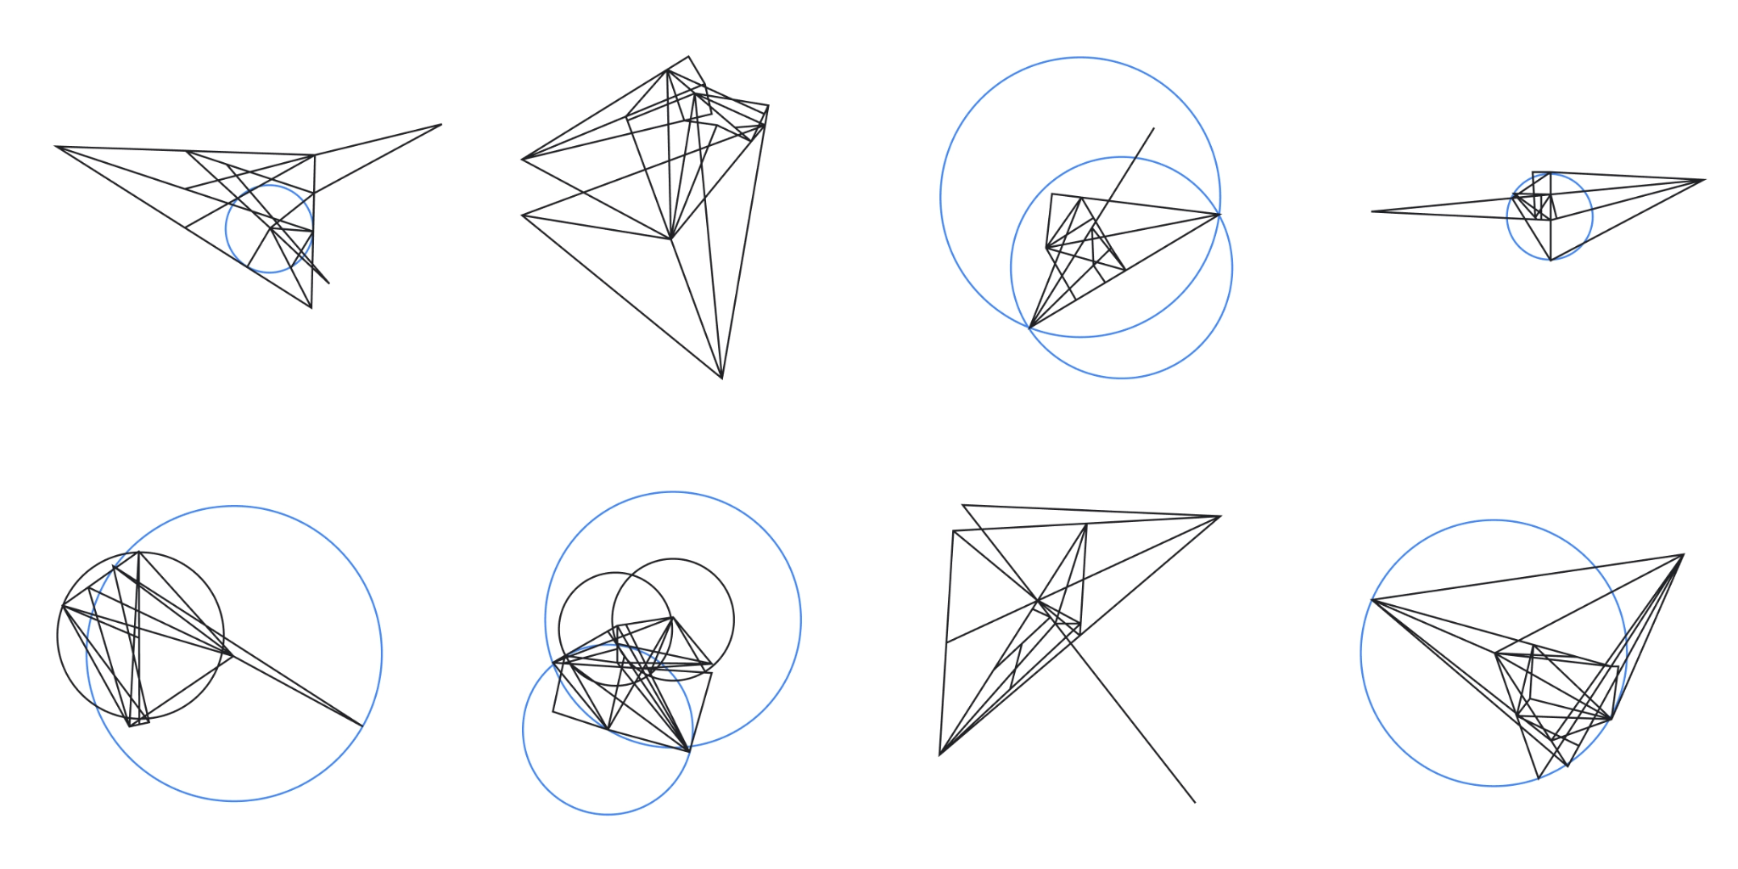
Solution 2: Synthetic data
What if based on existing math data, we can generate new math data?
AlphaGeometry
Generated 100 million unique examples of varying difficulty
Nine million featured added constructs
Verification combined from expert humans and computer

Slide 7
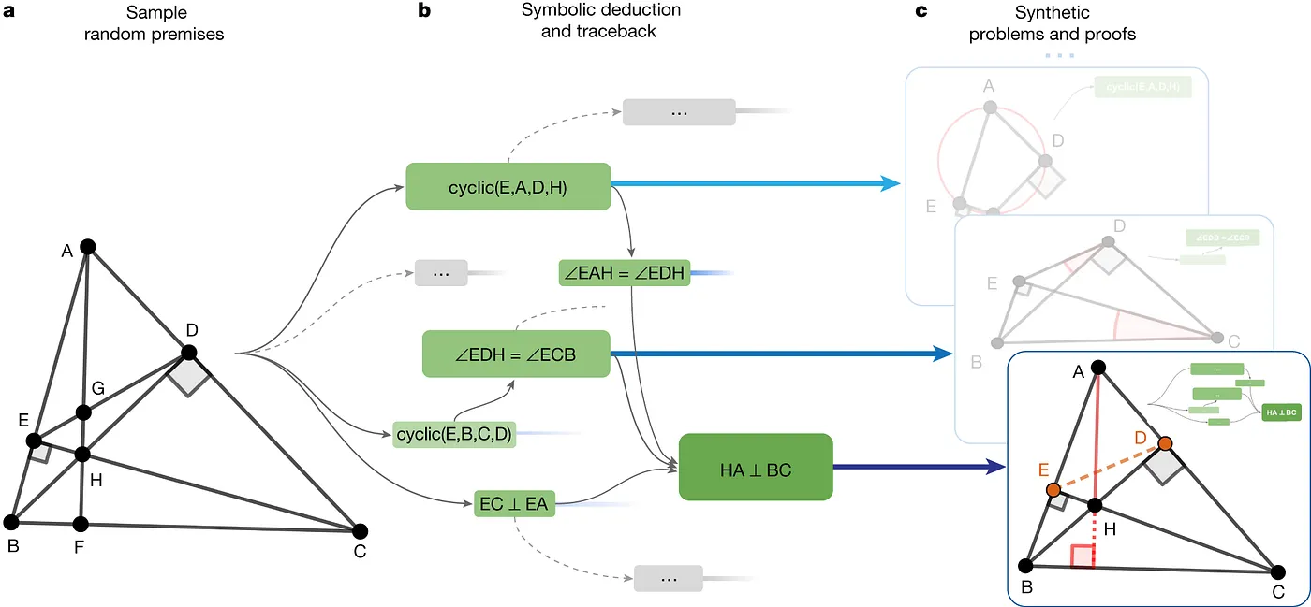
AlphaGeomtery - how did they generate the data?

Slide 8
Solution 3: Data from different modalities
Math data is inherently limited
But there are modals that are similar to math
For example, code. Both require symbolic reasoning!
Why don’t we use code datasets?
Other potential non-math domains of datasets that can improve mathematical reasoning:
Tables / structured data (explicit relations between data)
Interactive environments (models learn which moves reduce complexity)

Slide 9
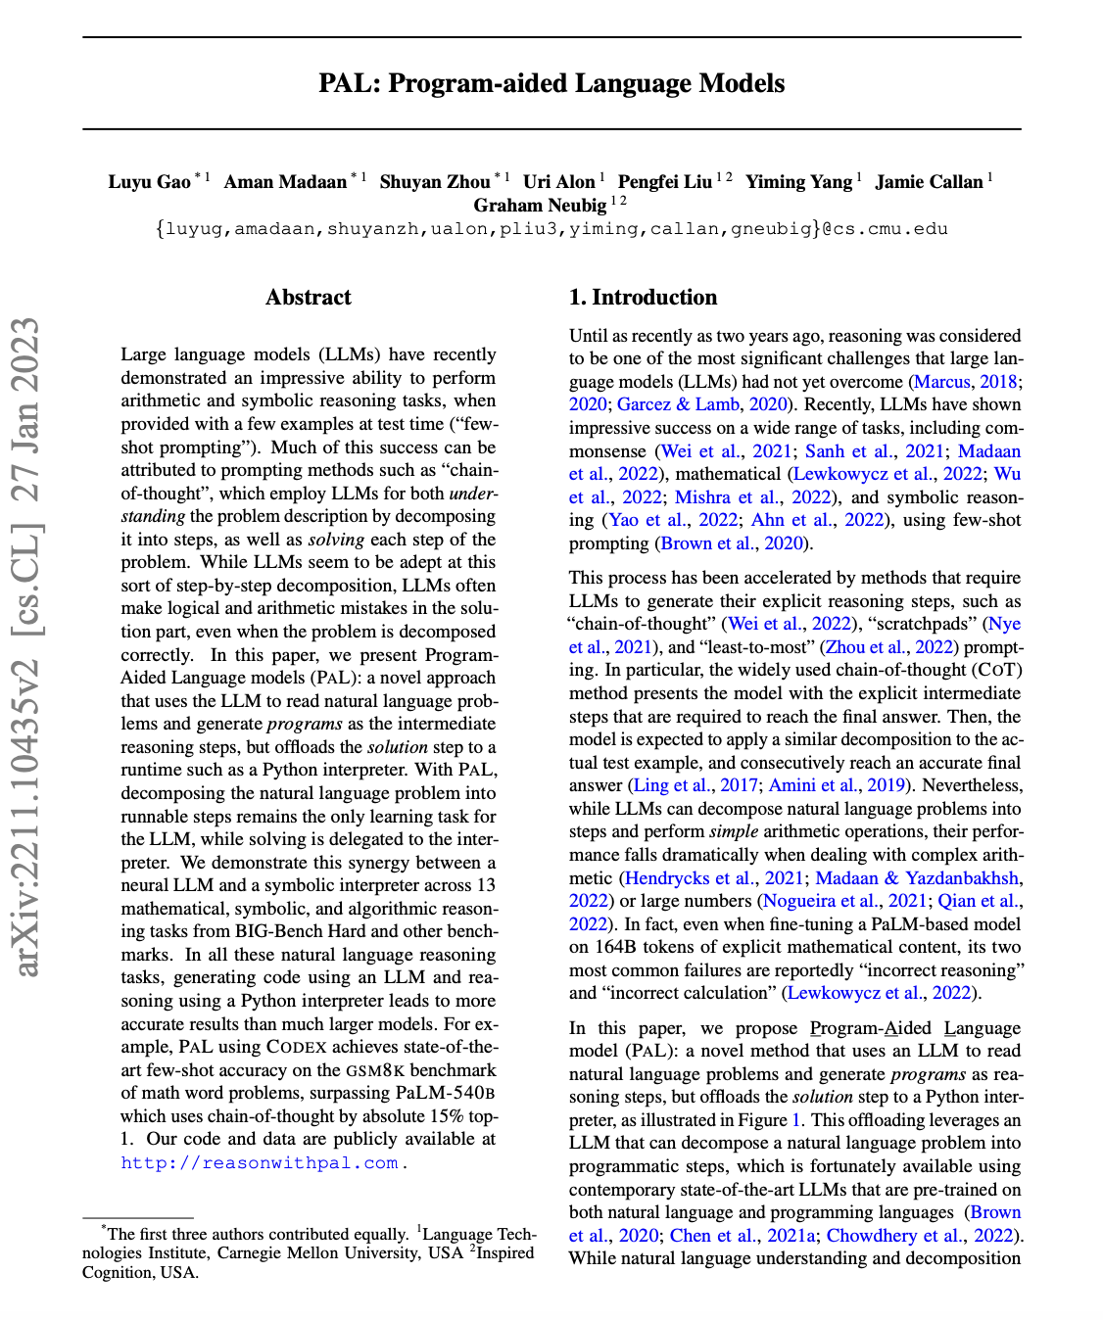
Case study: PAL
Math problems need:
Exact reasoning
Step wise deduction
Verifiable results
So does code.
PAL: so then let's use code to train for math!
LLM reads natural language problems
Generate programs as the intermediate reasoning steps
Offloads the solution step to a Python interpreter
Answer is given in natural language

Slide 10
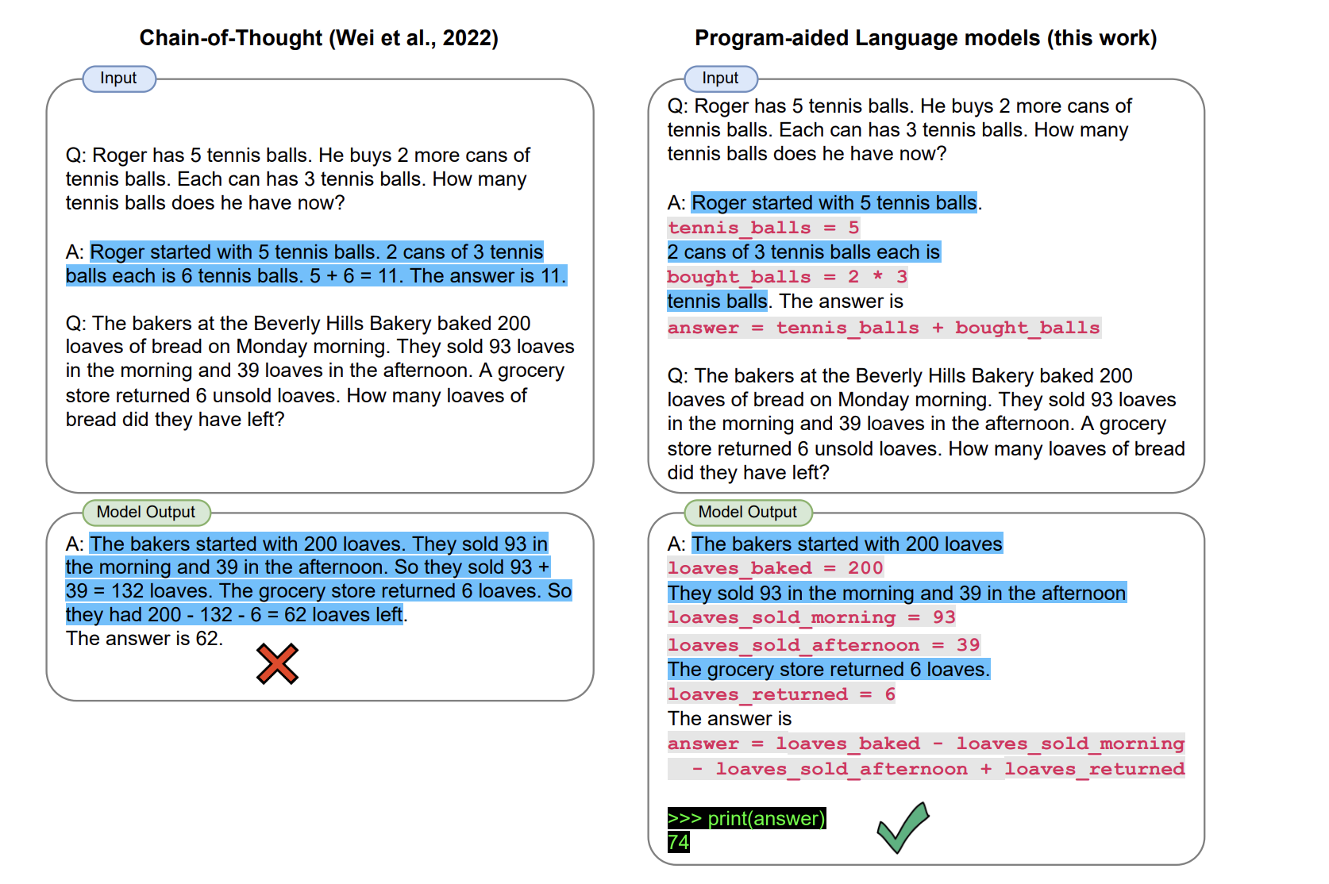
Case study: PAL - Example

Slide 11

Case study: Midas (trymidas.ai)
Midas verifies your training data and model outputs, catching hidden errors
Products
Midas-Formal V1 - 5,560 rigorously validated Lean 4 statements
ProofCheck API
Math dataset hub
Annotate studio - math-specific RLHF environment
Raised a $10M round led by Valor Equity Partners and Nova Global (Feb 6th 2026)

Slide 12
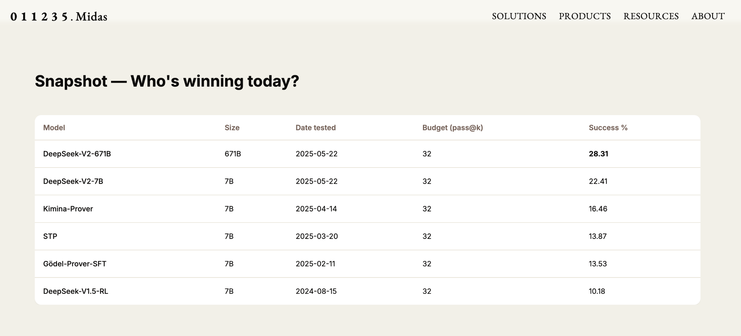
Case study: Midas (trymidas.ai)
Screenshot of leading LLM leaderboard on Midas-formal V1 dataset (2/24/2026)

Slide 13
Future work
Open questions:
What are other ways we can expand the corpus of math data?
Is there a limit to synthetic data?
Can the introduction of RL environments open a new domain for reasoning, and downstream of that, math?
Finite vs infinite amount of math data?
And if so, how can we make do with what we have?

Slide 14
References
Formal Mathematical Reasoning: A New Frontier in AI (Yang, et al, 2026).
AlphaGeometry: An Olympiad Level AI System for Geometry (Trieu Trinh and Thang Luong, 2024).
Olympiad-level formal mathematical reasoning with RL (Hubert, at al, 2025)
BigMATH: A Large-Scale, High-Quality Math Dataset for Reinforcement Learning in Language Models (Albalak, et al, 2025)
PAL: Program Aided Language Models (Gao, et al, 2022)

