Slide 1
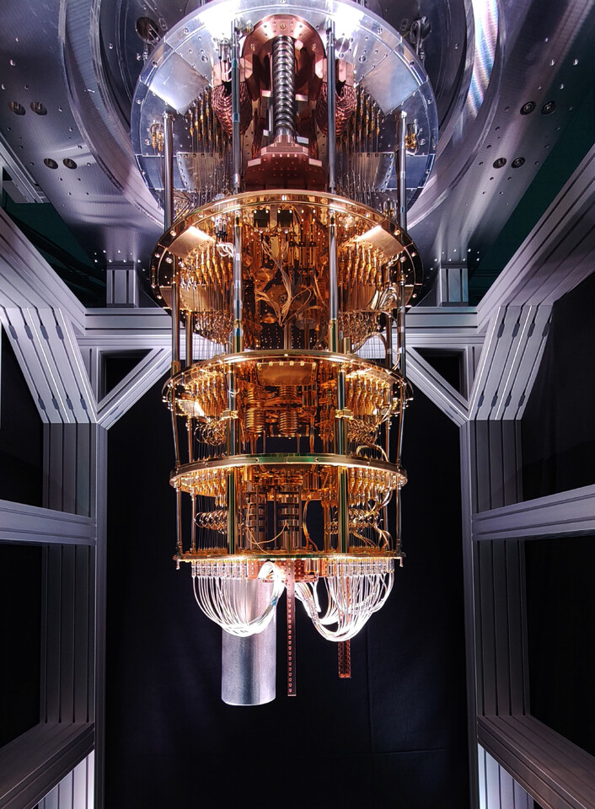
Myths and Realities of Quantum Computing
Henry Yuen
Srivani Family Associate Professor Computer Science, Columbia University
Notes:
Hi, good morning; I’m really happy to be here. I’m a faculty member in computer science department here at Columbia and my field of research is theoretical quantum computing. One of the most exciting things over my academic career so far is how quantum computing went from being this very niche, esoteric research area when I started grad school 15 years ago, and now it’s a common occurrence for me to hear people sitting next to me on planes or my uber driver to talk to me about quantum computers.

Slide 2
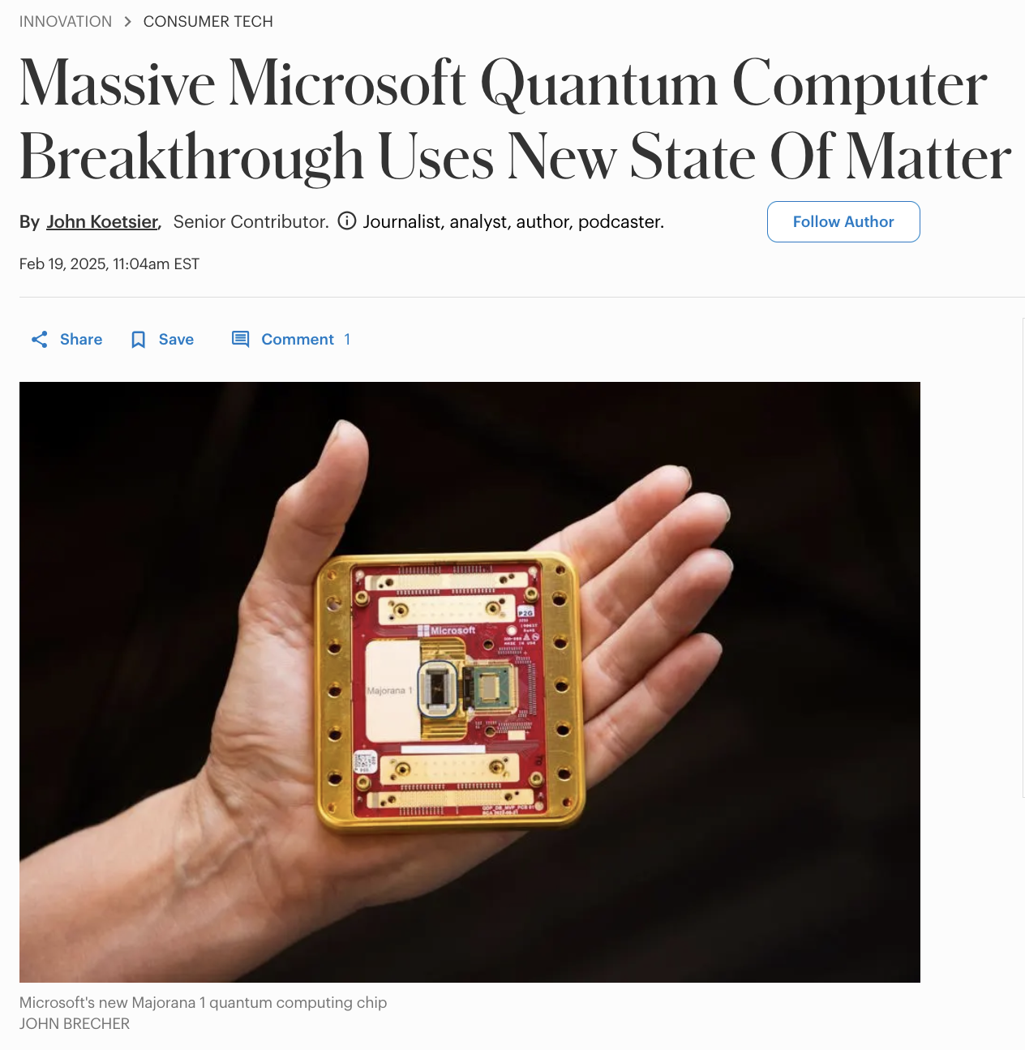
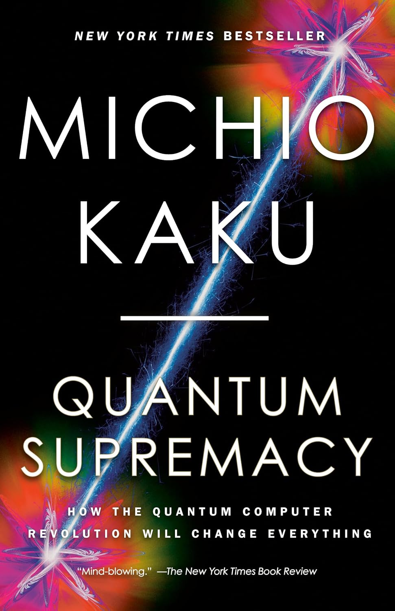
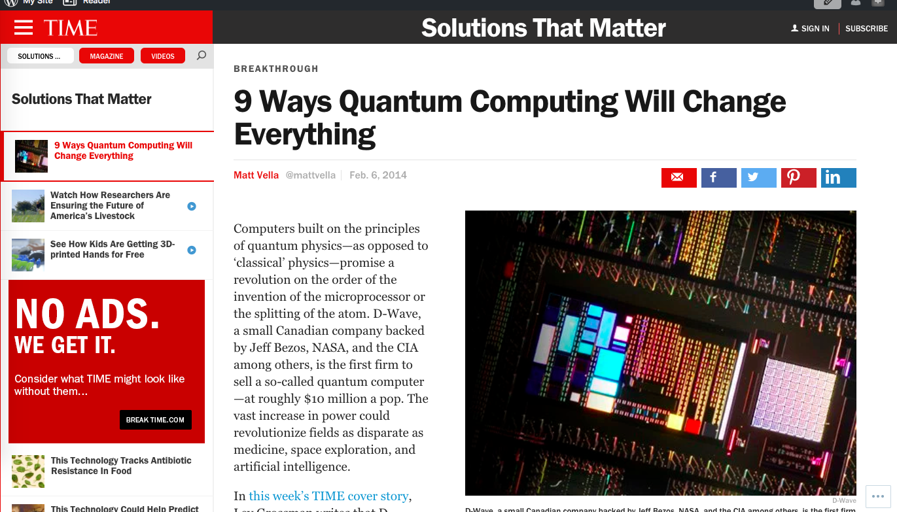
Notes:
Part of that is due to the buzz around quantum computing in the media these days. By now I’m sure many of you have seen the breathless headlines like these.

Slide 3
What is quantum computing?
What’s real, what’s hype?
What’s next? Should I invest in quantum stocks?
Notes:
By now I’m sure many of us are familiar with the breathless headlines about quantum computers.

Slide 4
What is quantum computing?
Notes:
Okay, so there’s a new type of quantum computer, so what can it do?

Slide 5
0 1
Classical computer
Classical bit
Notes:
We can put together a lot of light bulbs together, and the on/off pattern of these light bulbs represents a series of bits. All the wonders of modern computing is, at the end of the day, simply the manipulation of billions and trillions of these simple bits, at extremely high speeds. The physics needed to describe this kind of information processing is purely classical physics.

Slide 6
0 1
Classical computer
Classical bit
0 1 0 0 1 1
Notes:
We can put together a lot of light bulbs together, and the on/off pattern of these light bulbs represents a series of bits. All the wonders of modern computing is, at the end of the day, simply the manipulation of billions and trillions of these simple bits, at extremely high speeds. The physics needed to describe this kind of information processing is purely classical physics.

Slide 7
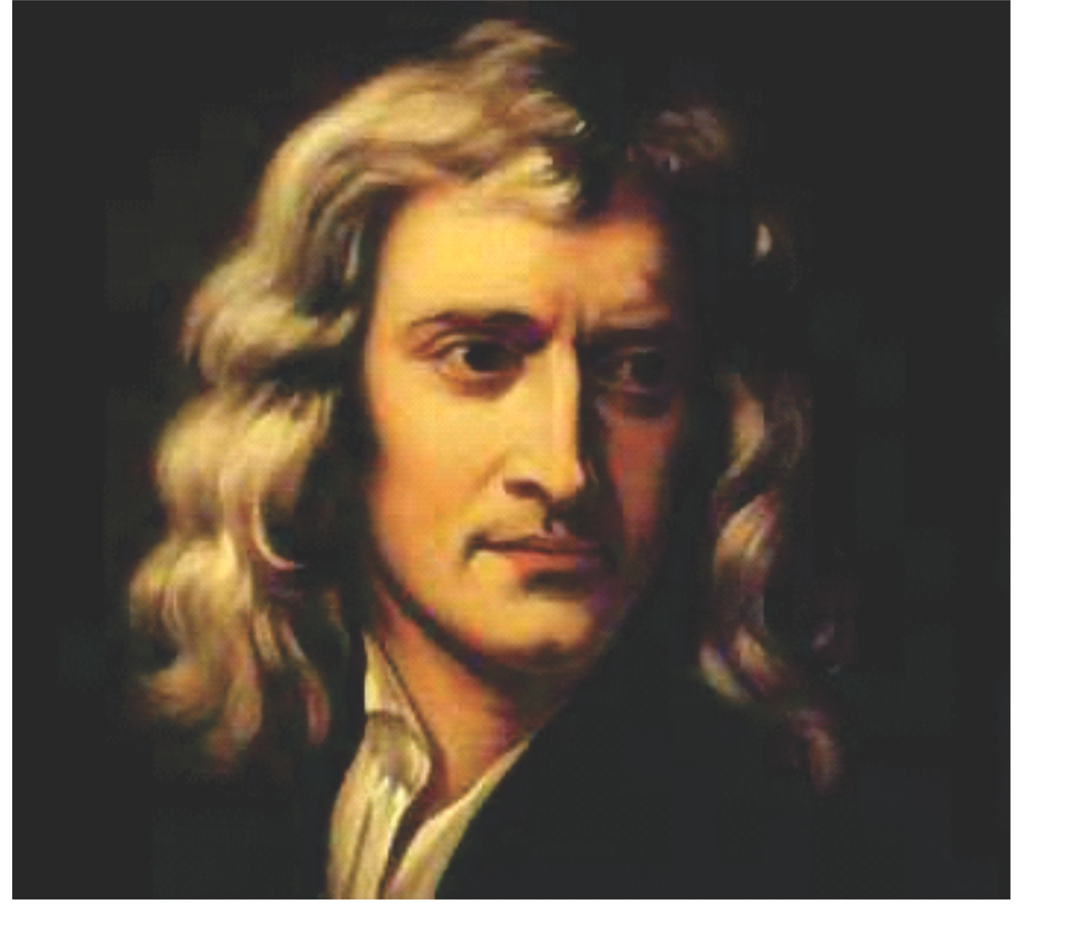
0 1
Classical computer
Classical bit
Newton: Classical physics can describe all information processing today.
Notes:
We can put together a lot of light bulbs together, and the on/off pattern of these light bulbs represents a series of bits. All the wonders of modern computing is, at the end of the day, simply the manipulation of billions and trillions of these simple bits, at extremely high speeds. The physics needed to describe this kind of information processing is purely classical physics.

Slide 8
0 1
Classical computer
Classical bit
Feynman: We live in a
quantum universe.
Notes:
We can put together a lot of light bulbs together, and the on/off pattern of these light bulbs represents a series of bits. All the wonders of modern computing is, at the end of the day, simply the manipulation of billions and trillions of these simple bits, at extremely high speeds. The physics needed to describe this kind of information processing is purely classical physics.

Slide 9
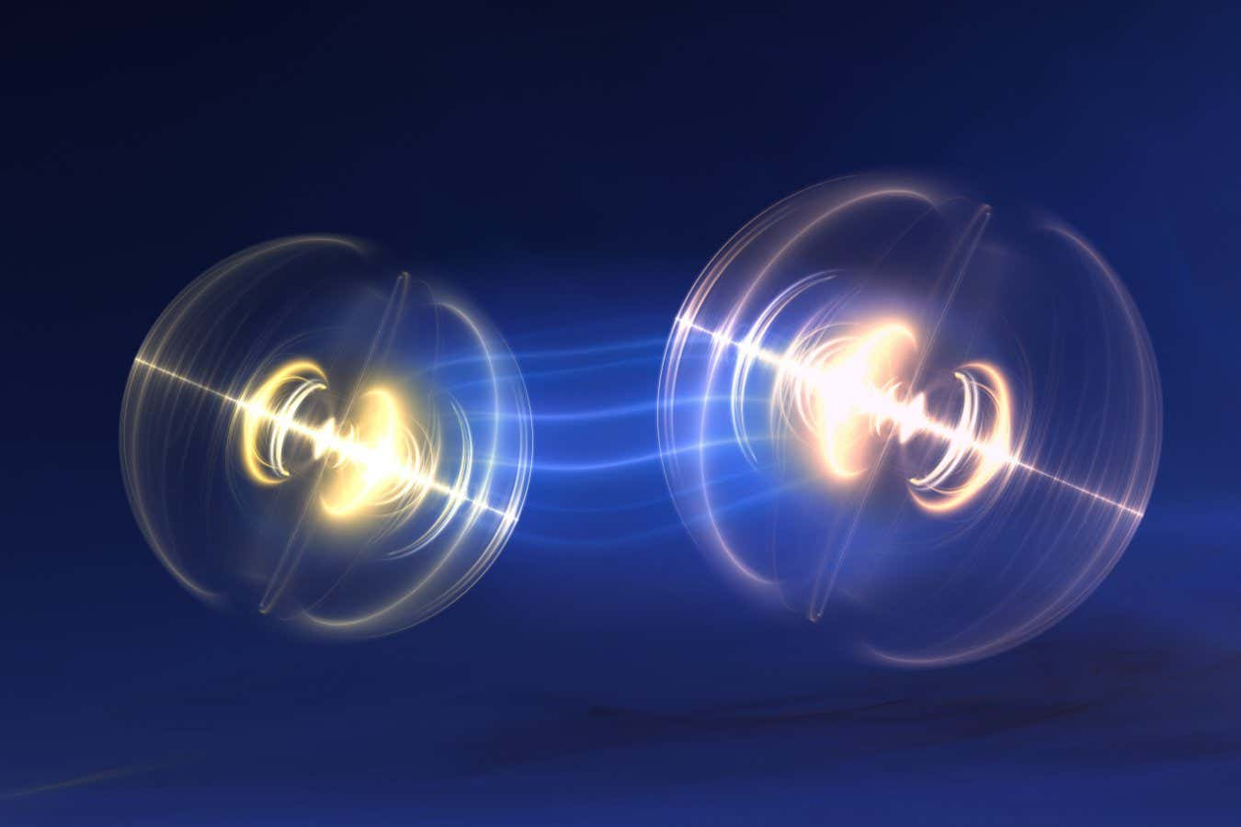
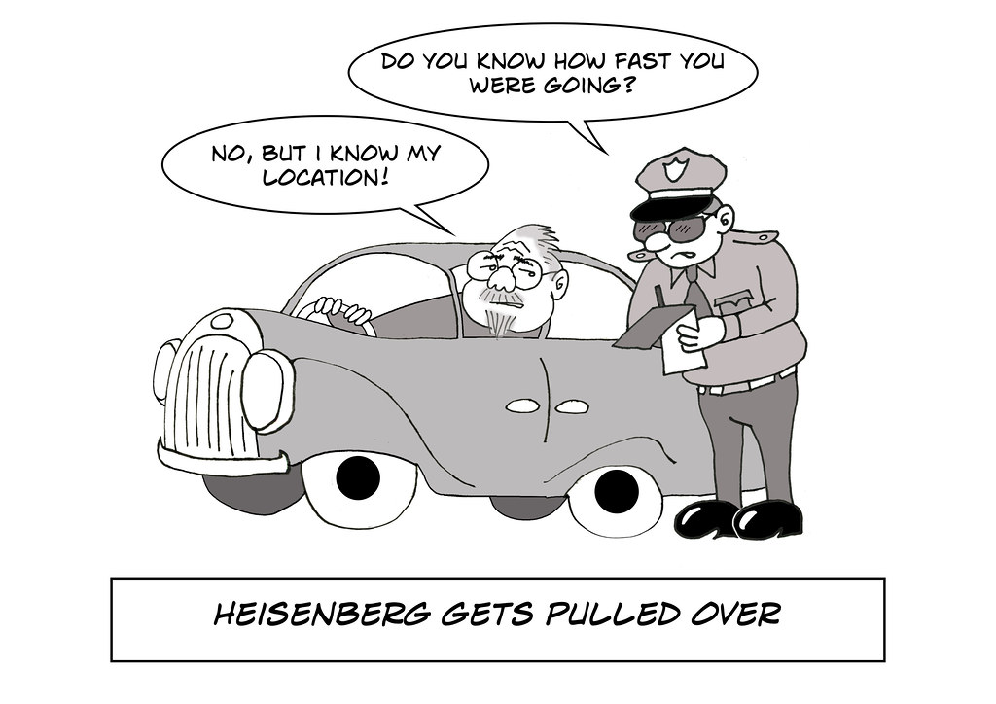
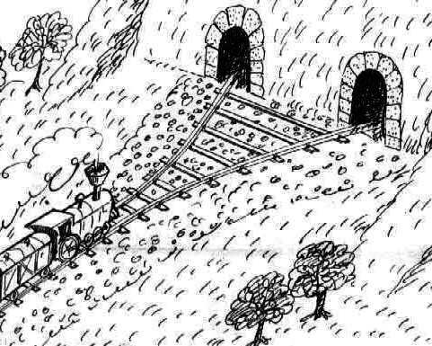
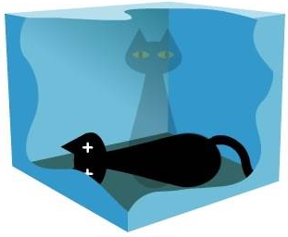
Entanglement
Uncertainty principle
Wave/particle duality
Superposition
Feynman: Quantum mechanics is weird.
Notes:
We can put together a lot of light bulbs together, and the on/off pattern of these light bulbs represents a series of bits. All the wonders of modern computing is, at the end of the day, simply the manipulation of billions and trillions of these simple bits, at extremely high speeds. The physics needed to describe this kind of information processing is purely classical physics.

Slide 10
Entanglement
Uncertainty principle
Wave/particle duality
Superposition
Feynman: Can computers exploit this weirdness?
Notes:
We can put together a lot of light bulbs together, and the on/off pattern of these light bulbs represents a series of bits. All the wonders of modern computing is, at the end of the day, simply the manipulation of billions and trillions of these simple bits, at extremely high speeds. The physics needed to describe this kind of information processing is purely classical physics.

Slide 11
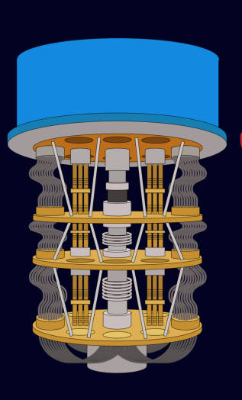
Quantum computer
Quantum bit (“qubit”)
Quantum computing is based on processing qubits, and taking advantage of laws of quantum physics
instead of classical physics.
Notes:
We can put together a lot of light bulbs together, and the on/off pattern of these light bulbs represents a series of bits. All the wonders of modern computing is, at the end of the day, simply the manipulation of billions and trillions of these simple bits, at extremely high speeds. The physics needed to describe this kind of information processing is purely classical physics.

Slide 12
0
Quantum computer
Quantum bit (“qubit”)
Observing the qubit results in a classical bit.
Notes:
We can put together a lot of light bulbs together, and the on/off pattern of these light bulbs represents a series of bits. All the wonders of modern computing is, at the end of the day, simply the manipulation of billions and trillions of these simple bits, at extremely high speeds. The physics needed to describe this kind of information processing is purely classical physics.

Slide 13
0
1
Quantum computer
Quantum bit (“qubit”)
Before observation, the state of the qubit can be in a quantum superposition of 0 and 1 at the same time.
Notes:
We can put together a lot of light bulbs together, and the on/off pattern of these light bulbs represents a series of bits. All the wonders of modern computing is, at the end of the day, simply the manipulation of billions and trillions of these simple bits, at extremely high speeds. The physics needed to describe this kind of information processing is purely classical physics.

Slide 14
0
1
Quantum computer
Quantum bit (“qubit”)
The state of a qubit is described by two numbers called amplitudes...
Notes:
We can put together a lot of light bulbs together, and the on/off pattern of these light bulbs represents a series of bits. All the wonders of modern computing is, at the end of the day, simply the manipulation of billions and trillions of these simple bits, at extremely high speeds. The physics needed to describe this kind of information processing is purely classical physics.

Slide 15
0
1
Quantum computer
Quantum bit (“qubit”)
The state of a qubit is described by two numbers called amplitudes... these are “quantum probabilities”, which can be both positive and negative!
Notes:
We can put together a lot of light bulbs together, and the on/off pattern of these light bulbs represents a series of bits. All the wonders of modern computing is, at the end of the day, simply the manipulation of billions and trillions of these simple bits, at extremely high speeds. The physics needed to describe this kind of information processing is purely classical physics.

Slide 16
0
1
Quantum computer
Quantum bit (“qubit”)
For example, a qubit can have “quantum probability”
+ $\frac{1}{2}$ of being 0 , and $−\frac{1}{2}$ of being 1
Notes:
We can put together a lot of light bulbs together, and the on/off pattern of these light bulbs represents a series of bits. All the wonders of modern computing is, at the end of the day, simply the manipulation of billions and trillions of these simple bits, at extremely high speeds. The physics needed to describe this kind of information processing is purely classical physics.

Slide 17
1
Quantum computer
Quantum bit (“qubit”)
Quantum probabilities can’t be directly observed… observing the qubit ”collapses” the state of qubit into classical probabilities.
Notes:
We can put together a lot of light bulbs together, and the on/off pattern of these light bulbs represents a series of bits. All the wonders of modern computing is, at the end of the day, simply the manipulation of billions and trillions of these simple bits, at extremely high speeds. The physics needed to describe this kind of information processing is purely classical physics.

Slide 18
$N=300$
$2^{N}$ = more than # of atoms in visible universe.
Quantum computer
The power of quantum computing comes through when it uses many qubits. $N$ qubits requires $2^{N}$ different amplitudes to describe – whole is (waaaaay) more than sum of its parts!
Notes:
We can put together a lot of light bulbs together, and the on/off pattern of these light bulbs represents a series of bits. All the wonders of modern computing is, at the end of the day, simply the manipulation of billions and trillions of these simple bits, at extremely high speeds. The physics needed to describe this kind of information processing is purely classical physics.

Slide 19
What can a quantum computer do?
Notes:
Okay, so there’s a new type of quantum computer, so what can it do?

Slide 20
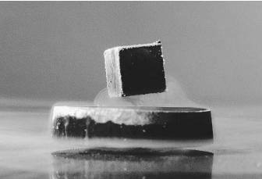
Feynman: We live in a
quantum universe.
Simulate quantum physics.

Slide 21
Example:
Artificial nitrogen fixation for fertilizer production (i.e. Haber process)
Consumes > 1% of world’s energy output.
Quantum computers could speed up
finding more efficient reaction pathways
develop exotic materials
drug design
Notes:
Why would this be such a big deal? Let me give you an example. Here’s an interesting fact. The industrial process for artificial nitrogen fixation, which is called the Haber process, it’s used in fertilizer production, for example, makes up at least 1% of the world’s energy consumption. This industrial process relies on an extremely clever catalytic reaction that allows us to produce ammonia in this enormously scalable way. So it’s one of the most important chemical reactions in the world today. However, despite being so important, we don’t fully understand everything there is to know about it. It relies on some metal catalysts that were discovered to be effective, but there could potentially be better ones, that would cause the reaction to use less energy over all. Imagine if we were able to find a way to save even just 0.01% in energy for this reaction. This would have a huge impact on the world.

Slide 22
P = 15904
Q = 93520
P × Q = 1487342080

Slide 23
P × Q = 597680597
P = 17449 Q = 34253

Slide 24
RSA, most widely used encryption scheme (1978 - ): it is hard to factor large numbers
Peter Shor (1994): quantum computers can factor large numbers very quickly!

Slide 25
Public Service Announcements

Slide 26
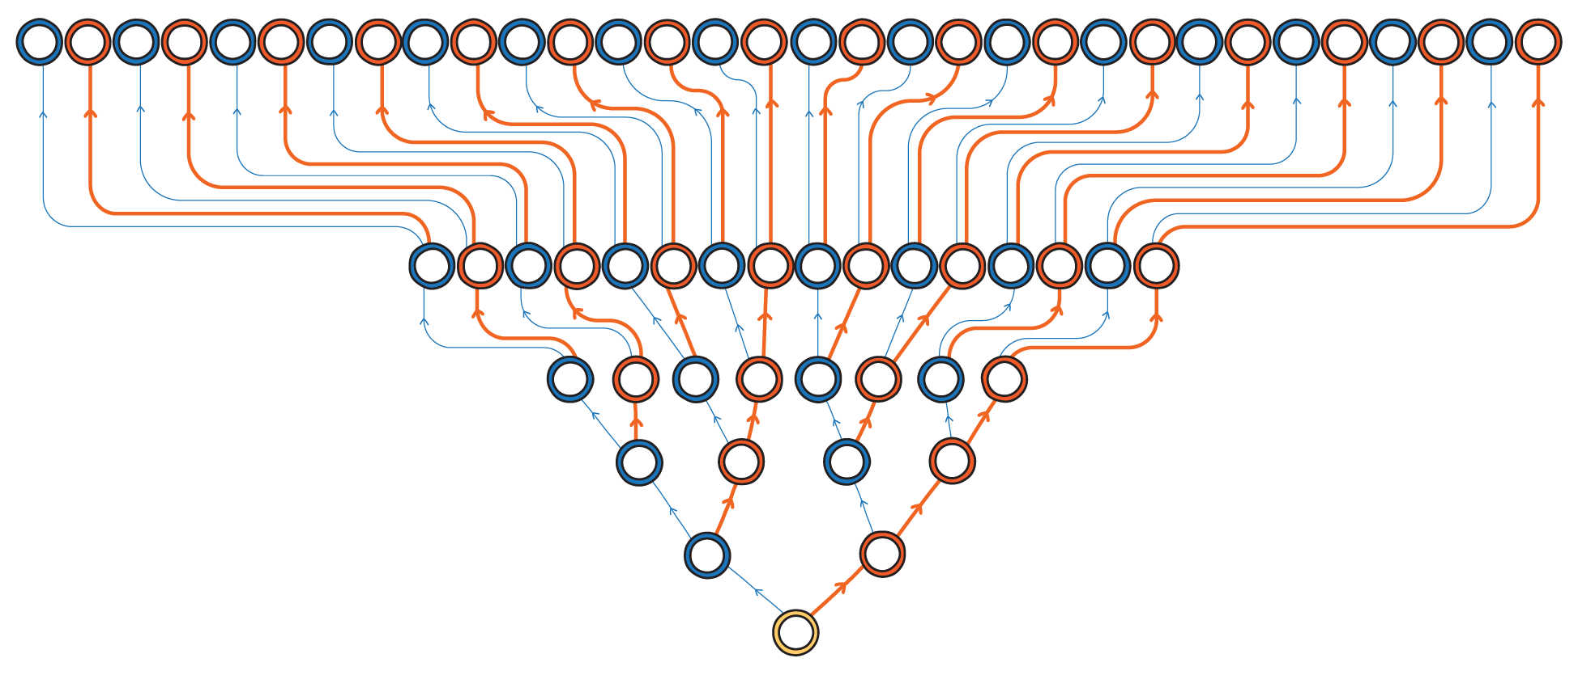
Myth: Quantum computers can speed up every algorithm by exploring all solutions simultaneously.

Slide 27
Reality: Quantum computers can solve certain types of problems faster by manipulating quantum probabilities.
Some solutions get assigned positive “quantum probability”

Slide 28
Reality: Quantum computers can solve certain types of problems faster by manipulating quantum probabilities.
Some solutions get assigned negative “quantum probability”

Slide 29
Reality: Quantum computers can solve certain types of problems faster by manipulating quantum probabilities.
If conditions are juuuuuust right, can get the quantum probabilities of bad solutions to cancel out, leaving only good solutions!

Slide 30
Reality: Quantum computers can solve certain types of problems faster by manipulating quantum probabilities.
If conditions are juuuuuust right, can get the quantum probabilities of bad solutions to cancel out, leaving only good solutions!

Slide 31
Myth: Quantum computers will break all internet security.
(Probably)

Slide 32
Reality: Fed gov’t recently standardized quantum-resistant encryption systems.
Post-quantum crypto already enabled by default in major software like Chrome.

Slide 33
Myth: Quantum computers are going to solve large-scale industrial problems in the next 5 years.

Slide 34
Reality: Quantum computing is making jump from academia to industry R&D labs…
…but still very much a long-term research endeavor.

Slide 35
What is the status of quantum computing today?
Notes:
Okay, so there’s a new type of quantum computer, so what can it do?

Slide 36
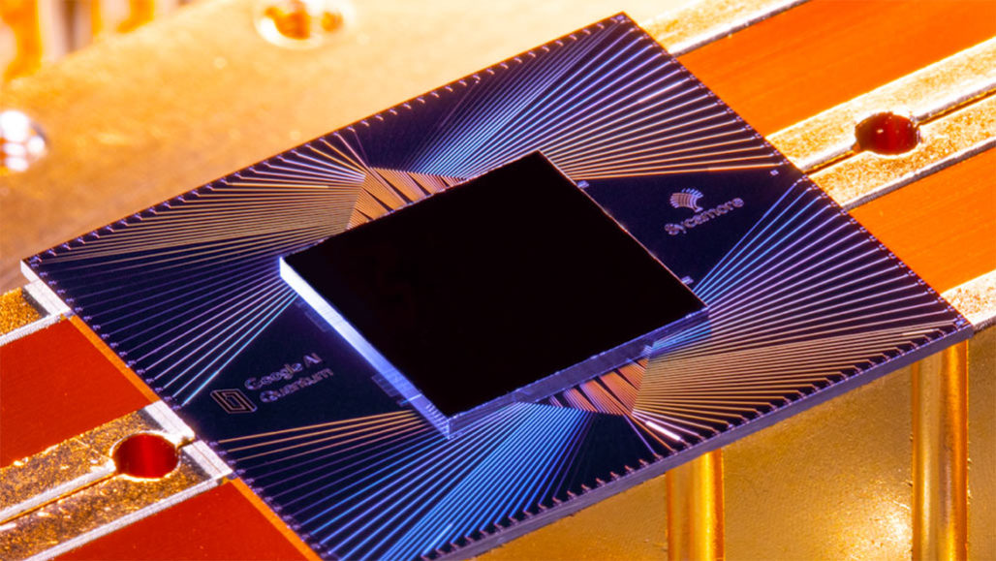
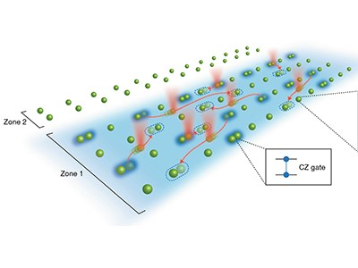
Many competing technological approaches:
Superconducting qubits
Neutral atom arrays
Photonic qubits
Topological qubits
Unclear which will be “best” platform.
Notes:
We can put together a lot of light bulbs together, and the on/off pattern of these light bulbs represents a series of bits. All the wonders of modern computing is, at the end of the day, simply the manipulation of billions and trillions of these simple bits, at extremely high speeds. The physics needed to describe this kind of information processing is purely classical physics.

Slide 37
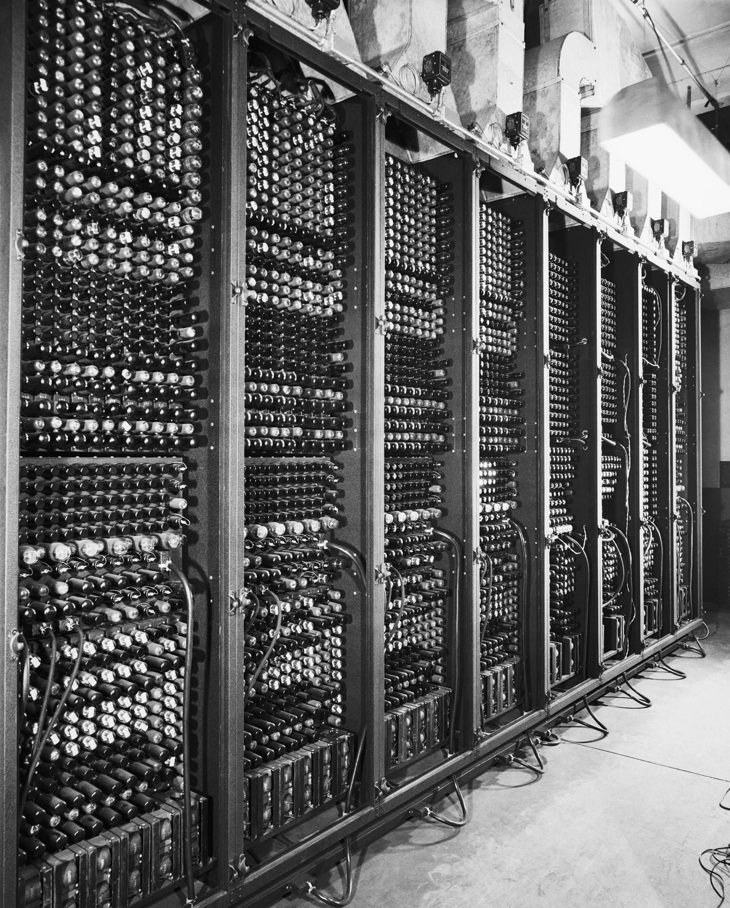
“Vacuum tube” era of quantum computing
Room-sized, highly unreliable parts, limited capabilities
analogy
Quantum computer
Computers in 1940s and 1950s
Notes:
We can put together a lot of light bulbs together, and the on/off pattern of these light bulbs represents a series of bits. All the wonders of modern computing is, at the end of the day, simply the manipulation of billions and trillions of these simple bits, at extremely high speeds. The physics needed to describe this kind of information processing is purely classical physics.

Slide 38
Grand challenge: dealing with noise and errors
Quantum computer
Qubits are fragile: environment is constantly trying to peek inside the qubits of a quantum computer.
Environment
Unwanted observation destroys the quantum probabilities, leading to errors in computation.
Notes:
We can put together a lot of light bulbs together, and the on/off pattern of these light bulbs represents a series of bits. All the wonders of modern computing is, at the end of the day, simply the manipulation of billions and trillions of these simple bits, at extremely high speeds. The physics needed to describe this kind of information processing is purely classical physics.

Slide 39
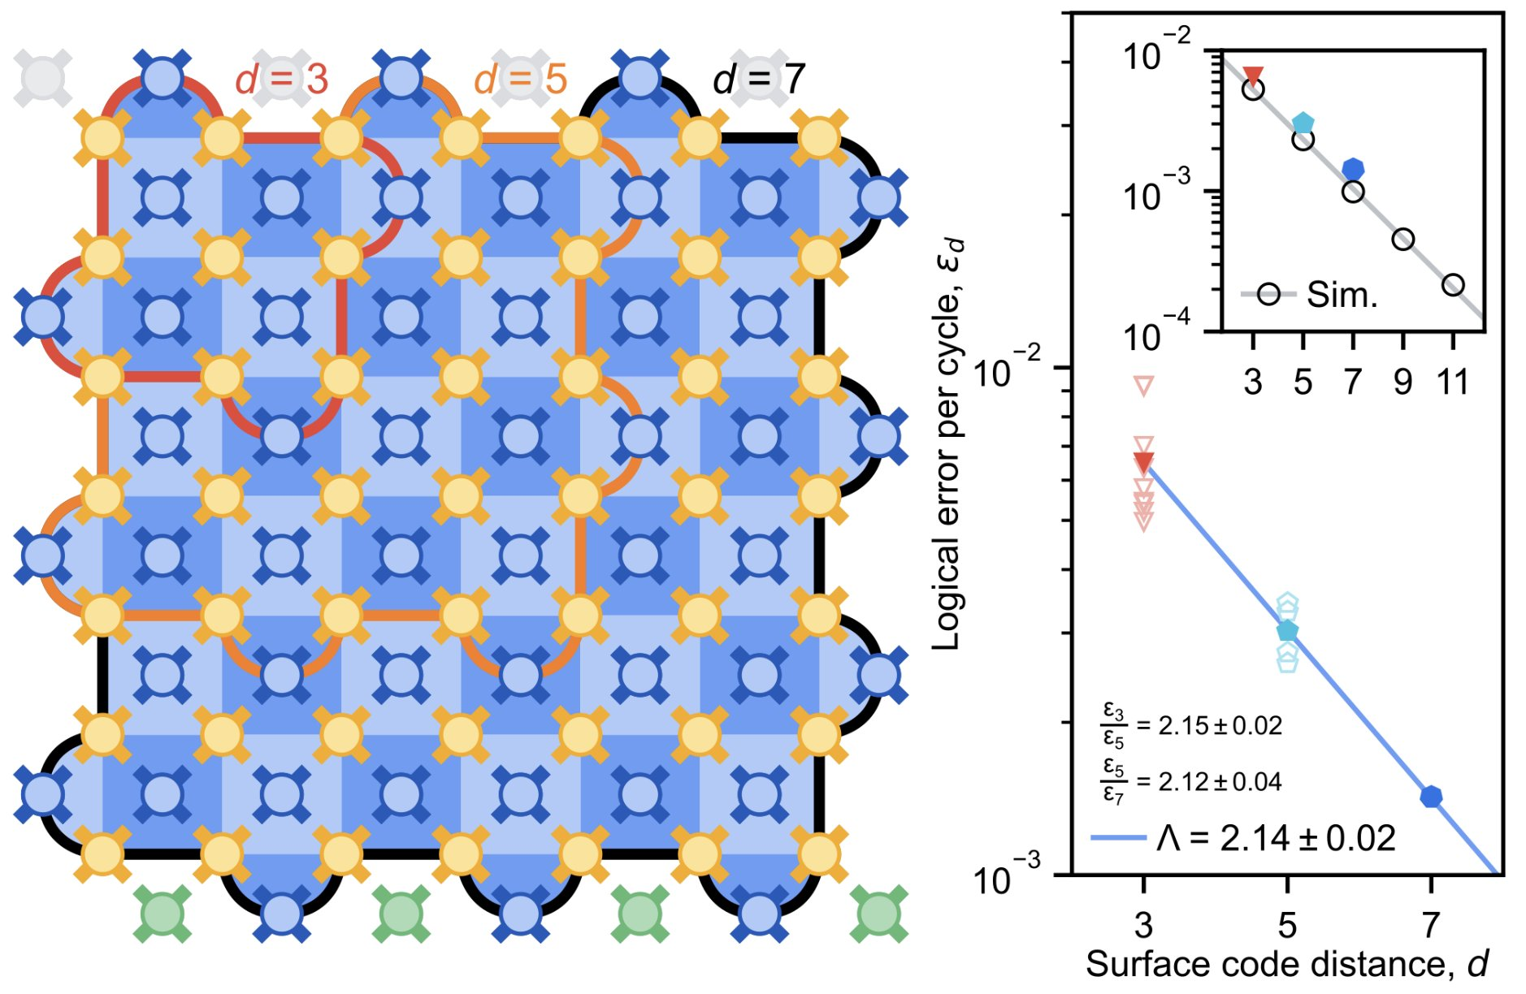
2023: breakthroughs in quantum error-correction.
Experiments show it is possible (in principle) to build a reliable qubit out of many unreliable ones.
Necessary path forward: scale up error correction.
Notes:
We can put together a lot of light bulbs together, and the on/off pattern of these light bulbs represents a series of bits. All the wonders of modern computing is, at the end of the day, simply the manipulation of billions and trillions of these simple bits, at extremely high speeds. The physics needed to describe this kind of information processing is purely classical physics.

Slide 40
Quantum computers: science fiction to science reality.
Many fundamental questions:
How to build better qubits?
How to correct errors efficiently?
What are quantum computers good at?
Many engineering challenges ahead.
Notes:
We can put together a lot of light bulbs together, and the on/off pattern of these light bulbs represents a series of bits. All the wonders of modern computing is, at the end of the day, simply the manipulation of billions and trillions of these simple bits, at extremely high speeds. The physics needed to describe this kind of information processing is purely classical physics.

Slide 41
We’re in the early days of quantum computing.
Thanks for listening!

