Slide 1
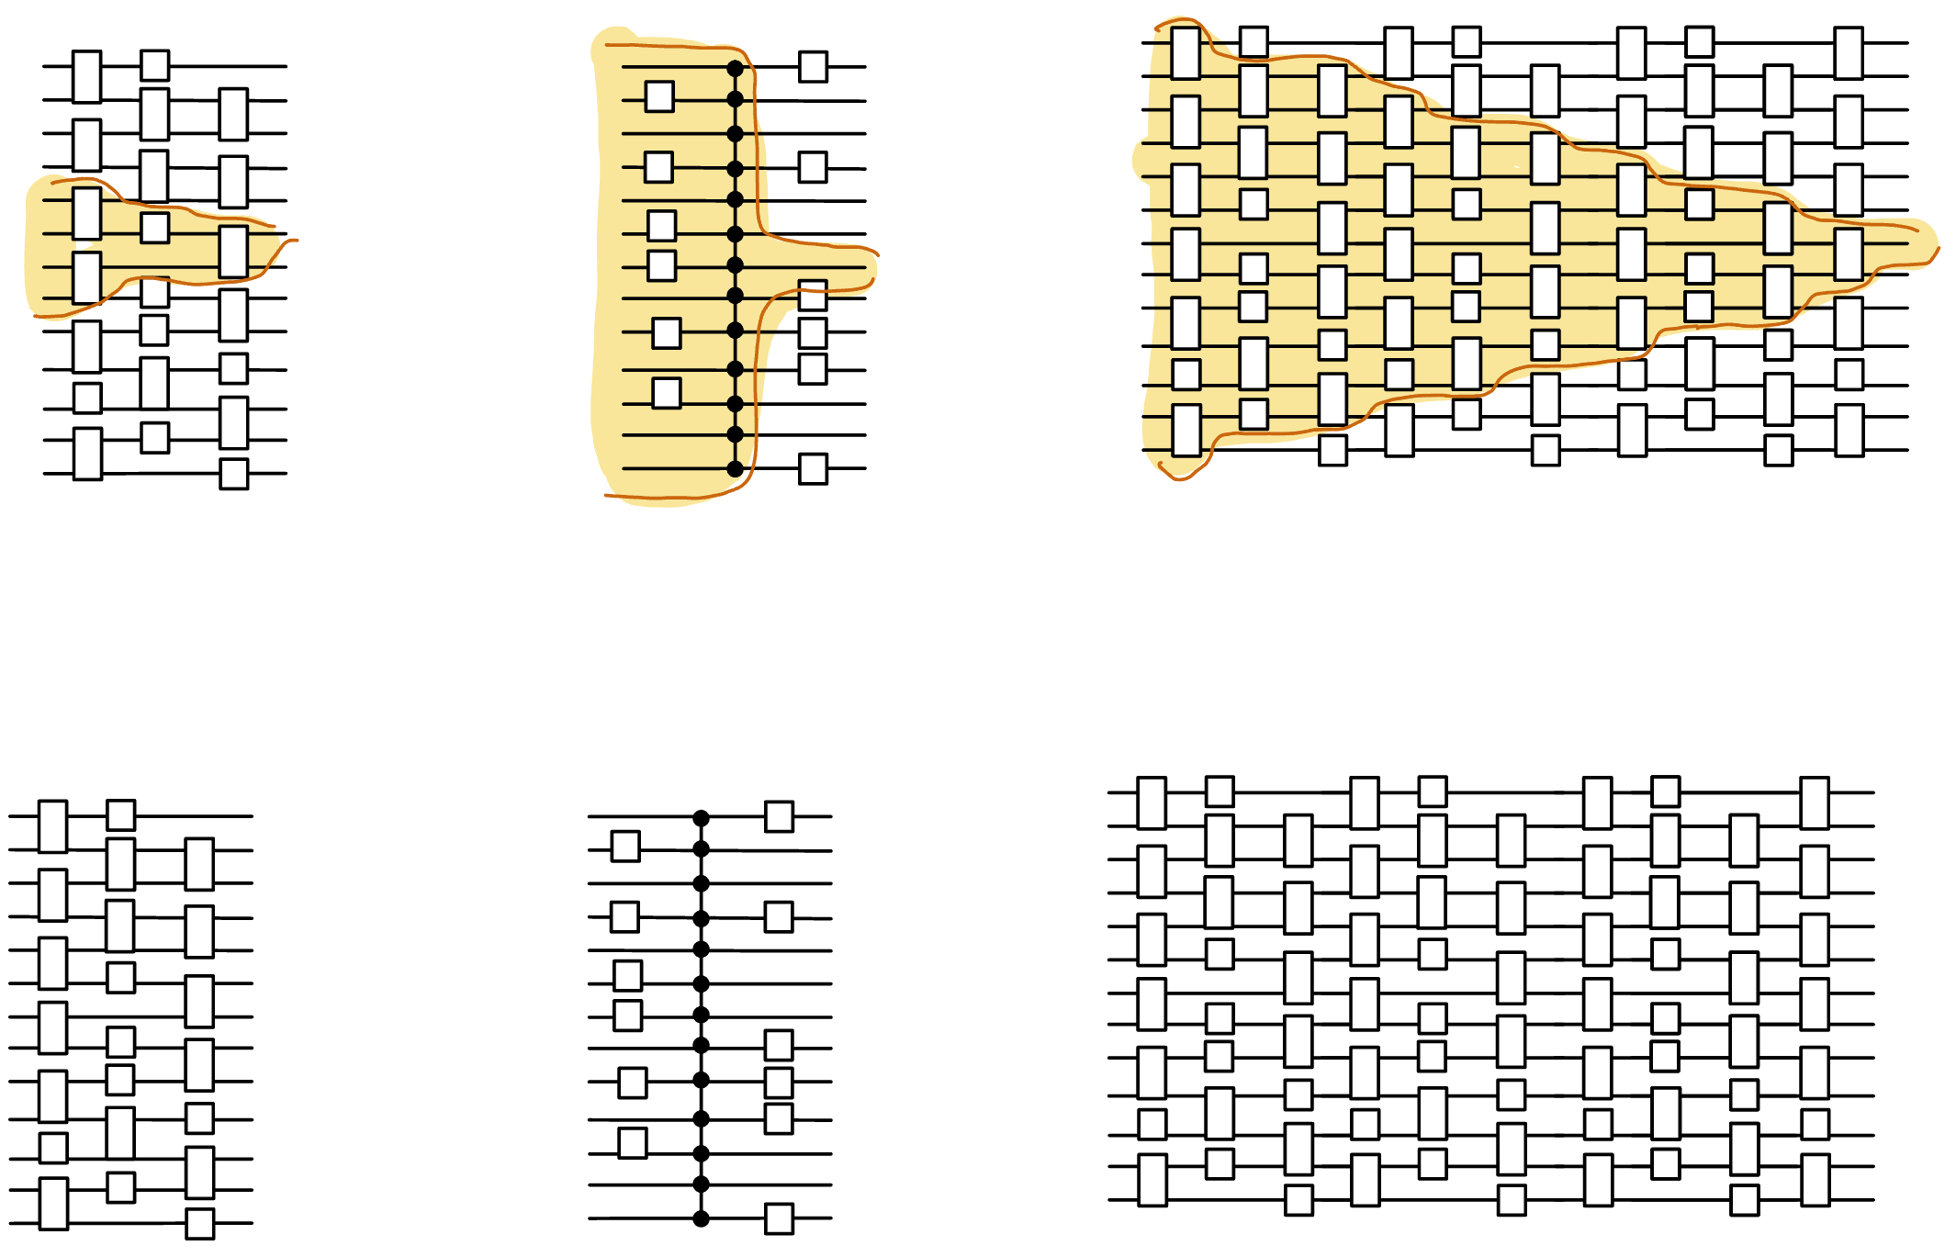
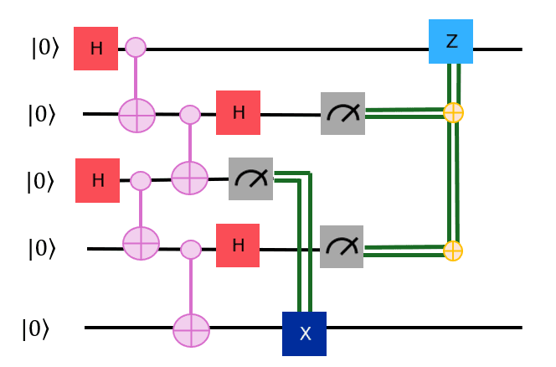
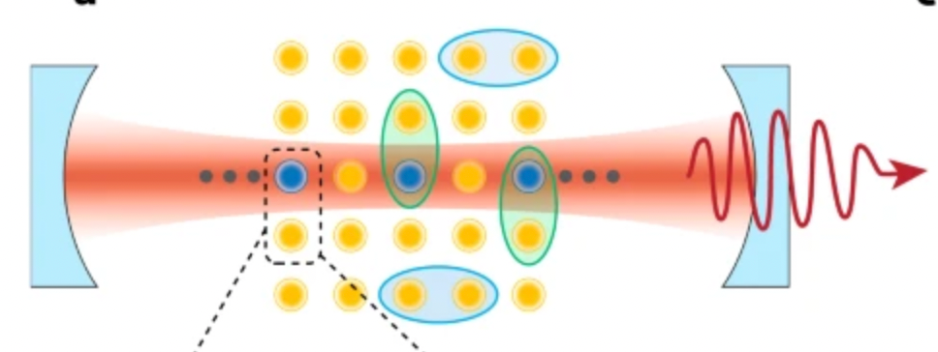
The power and limits of constant-time quantum computation
Henry Yuen
Columbia University
Notes:
Thanks for the invitation to speak. This talk will be about various models of constant-time quantum computation: these are models where the computation on the device takes an amount of time that is independent of the system size. It’s quite a fascinating problem to try to understand the computational power and limitations of these models. This talk will essentially be a bunch of different stories about these models.

Slide 2
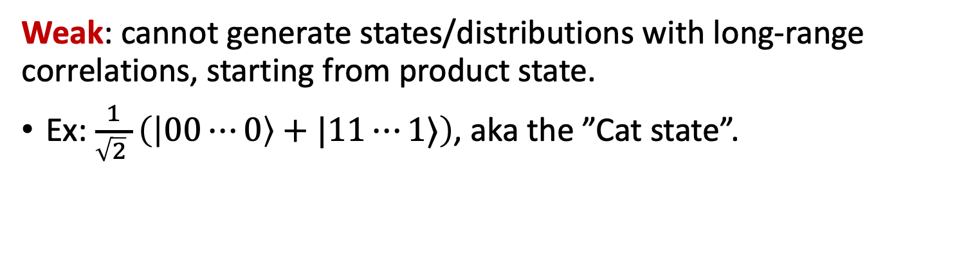
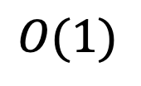
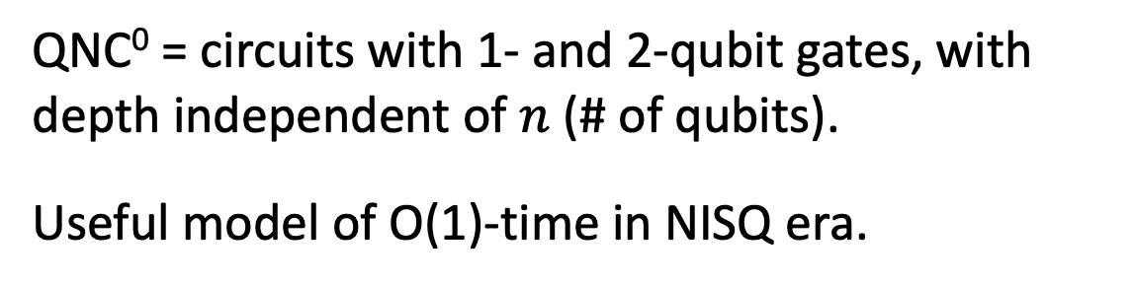

Constant-time quantum computation
QNC⁰ = circuits with 1- and 2-qubit gates, with depth independent of $n$ (# of qubits). Useful model of O(1)-time in NISQ era.
$$n$$
Powerful: QNC⁰ circuits can generate probability distributions that cannot be classically sampled from (under plausible complexity assumptions).
$$O(1)$$
(DiVincenzo-Terhal ’03, Bremner-Josza-Shepherd ‘09, …)
Weak: cannot generate states/distributions with long-range correlations, starting from product state.
Ex: $\frac{1}{\sqrt{2} }\left(\left|00⋯0\right\rangle +|11⋯1⟩\right)$, aka the ”Cat state”.
Notes:
The first model I’ll talk about it something most people are familiar with: constant-depth quantum circuits with single and two-qubit gates. In complexity-speak this model is called QNC0, after the analogous classical circuit model NC0. This is a useful model of constant-time in the NISQ era.
QNC0 circuits have been studied a lot over the last twenty years or so, and we know a lot about them. For example, we know that they can be powerful. On the other hand, these circuits are quite weak in others ways: for example they cannot prepare states with long-range correlations like the Cat state, starting from a product state. This is because of simple lightcone or Lieb-Robinson-type arguments. Constant-depth circuits with only local interactions cannot generate correlations fast enough.

Slide 3
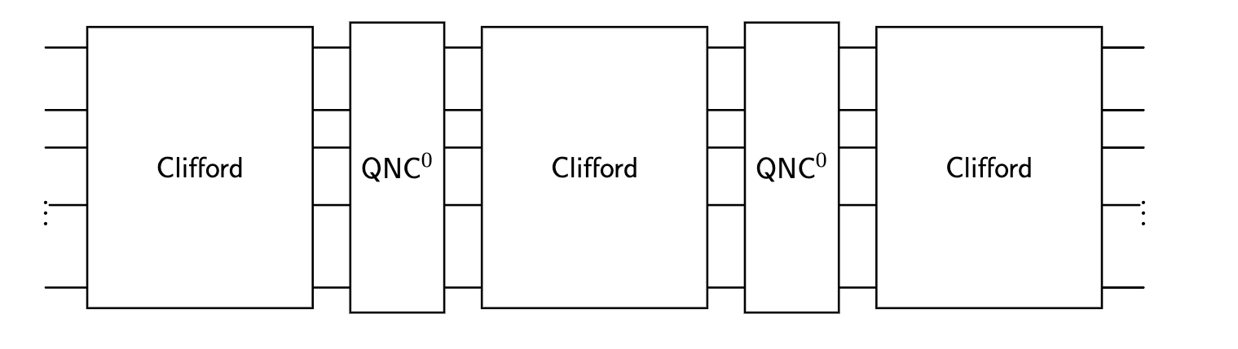
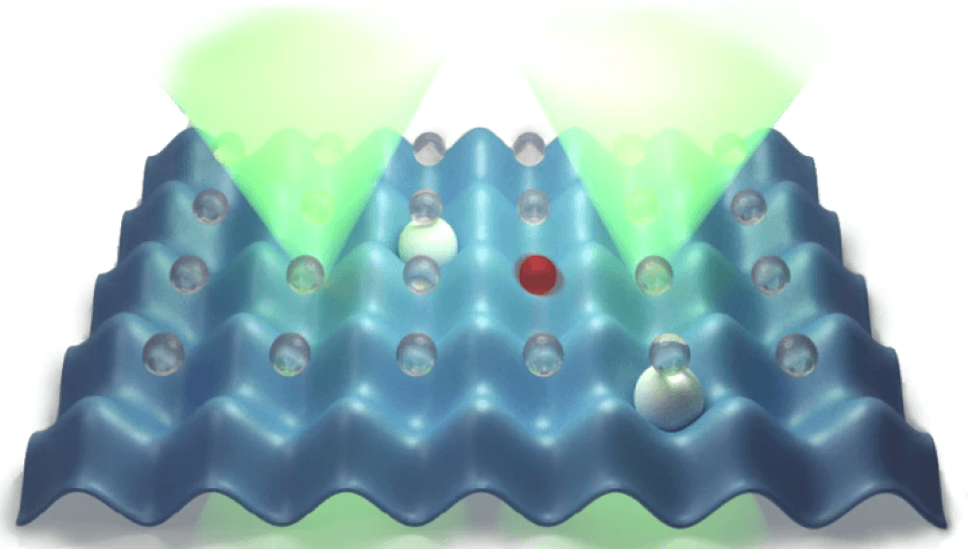
Constant-time models beyond QNC⁰
T-depth/ Magic Hierarchy
Circuits with many-qubit gates (QAC⁰, QAC⁰_{f})
Circuits with intermediate measurements & feed-forward
(aka “dynamic circuits”)
Short-time global Hamiltonian evolution
Notes:
We can consider models of constant-time quantum computation that are augmented with operations that can operate on many qubits simultaneously. Such models seem to get around lightcone arguments and Lieb Robinson bounds, so it’s interesting to think about what they’re capable of. This has motivated people to come up with a bunch of different models. The one that’s probably most familiar and experimentally relevant today are circuits with intermediate measurements and feed-forward operations. I’ll use the term “dynamic circuits” to refer to this; even though that’s a bit of marketing lingo it’s easier and shorter to say.
Another model is that of constant-depth circuits that are completely unitary but you allow many-qubit gates, such as many-qubit Toffoli or many-qubit CZ gates. In complexity theory people have studied models like these, they’re called QAC0 and QAC0_f, these will play an important role in this talk. These are more experimentally speculative, whenever I ask an experimentalist if they can implement many-qubit gates they go “yes! Absolutely! We can do 3-qubit gates. Maybe 4!”. I don’t have the heart to tell them that I mean n as n goes to infinity. The next model is that of constant T-depth circuits, which is something that we learned about yesterday in Isaac Kim’s talk. This is closely related to another model called the Magic Hierarchy, which consists of Clifford circuits interleaved with QNC0 circuits a constant number of times. These models are motivated by fault tolerance, where implementing non-Clifford gates are the dominant cost. And finally the last model is that of short-time global Hamiltonian evolutions, which is a model of what an analog quantum simulator can do. I won’t talk at all about this.

Slide 4
Constant-time models beyond QNC⁰
T-depth/ Magic Hierarchy
Circuits with many-qubit gates (QAC⁰, QAC⁰_{f})
Nontrivial equivalences between some of these models!
Circuits with intermediate measurements & feed-forward
Short-time global Hamiltonian evolution
Notes:
This might seem like a zoo of models, but what’s really interesting is that there are nontrivial equivalences been many of these! For example if you can implement something efficiently with constant-T depth, then you can efficiently implement it in the dynamic circuit model with constantly many rounds of measurement and classical post-processing, and vice versa.

Slide 5

QAC⁰ and QAC⁰_{f}
What is the power of shallow circuits augmented with many-qubit gates?
In 1999, Chris Moore proposed QAC⁰ and QAC⁰_{f} as quantum analogues of the classical circuit model AC⁰.
Important result in classical complexity theory: PARITY $∉$ AC⁰.
(Furst, Saxe, Sipser ‘83, Ajtai ‘86, Hastad ‘86)
Notes:
Let me tell you more about these models with many-qubit gates, namely the QAC0 and QAC0_f models. Th

Slide 6
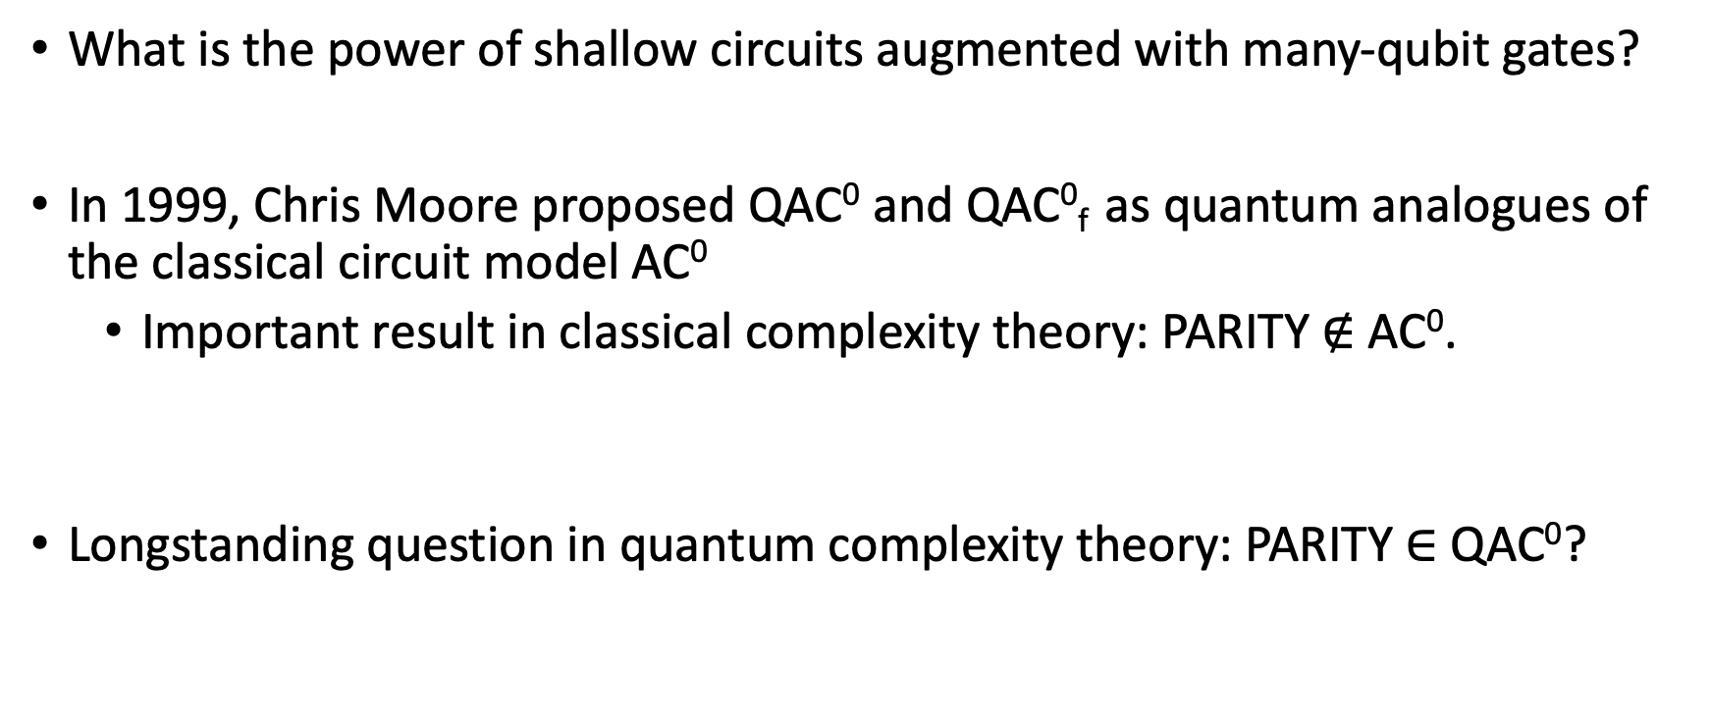
QAC⁰ and QAC⁰_{f}
What is the power of shallow circuits augmented with many-qubit gates?
In 1999, Chris Moore proposed QAC⁰ and QAC⁰_{f} as quantum analogues of the classical circuit model AC⁰
Important result in classical complexity theory: PARITY $∉$ AC⁰.
Longstanding question in quantum complexity theory: PARITY $∈$ QAC⁰?
(Furst, Saxe, Sipser ‘83, Ajtai ‘86, Hastad ‘86)

Slide 7

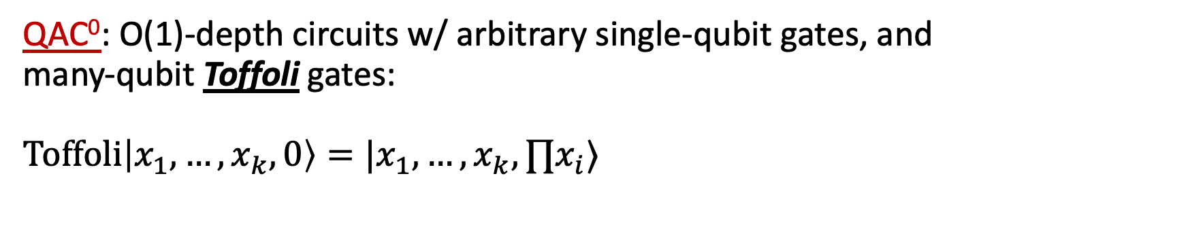



Generalized Toffoli
QAC⁰: O(1)-depth circuits w/ arbitrary single-qubit gates, and many-qubit Toffoli gates: $\text{Toffoli}\left|x_{1},…,x_{k},0\right\rangle =|x_{1},…,x_{k}, ∏x_{i}⟩$
$$x_{1}$$
$$x_{2}$$
$$x_{3}$$
$$b$$

Slide 8

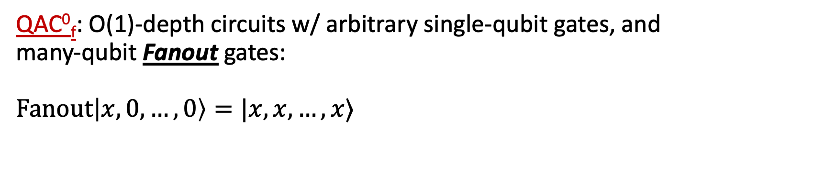



Generalized Toffoli
QAC⁰: O(1)-depth circuits w/ arbitrary single-qubit gates, and many-qubit Toffoli gates: $\text{Toffoli}\left|x_{1},…,x_{k},0\right\rangle =|x_{1},…,x_{k}, ∏x_{i}⟩$
$$x_{1}$$
$$x_{2}$$
$$x_{3}$$
$$b$$
QAC⁰_{f}: O(1)-depth circuits w/ arbitrary single-qubit gates, and many-qubit Fanout gates: $\text{Fanout}\left|x,0,…,0\right\rangle =|x,x,…,x⟩$
Fanout
$$x$$
$$b_{1}$$
$$b_{2}$$
$$b_{3}$$

Slide 9
Generalized Toffoli
QAC⁰: O(1)-depth circuits w/ arbitrary single-qubit gates, and many-qubit Toffoli gates: $\text{Toffoli}\left|x_{1},…,x_{k},0\right\rangle =|x_{1},…,x_{k}, ∏x_{i}⟩$
$$x_{1}$$
$$x_{2}$$
$$x_{3}$$
$$b$$
QAC⁰_{f}: O(1)-depth circuits w/ arbitrary single-qubit gates, and many-qubit Fanout gates: $\text{Fanout}\left|x,0,…,0\right\rangle =|x,x,…,x⟩$
Fanout
$$x$$
$$b_{1}$$
$$b_{2}$$
$$b_{3}$$
Fanout can simulate Toffoli gates, so QAC⁰ $⊆$ QAC⁰_{f}
(Takahashi, Tani 2011)

Slide 10
Equivalence with dynamic circuits
O(1)-depth dynamic circuits:
1- and 2-qubit gates
intermediate measurements
classical postprocessing of measurement outcomes forwarded to next layer of gates

Slide 11
Equivalence with dynamic circuits
O(1)-depth dynamic circuits:
1- and 2-qubit gates
intermediate measurements
classical postprocessing of measurement outcomes forwarded to next layer of gates
Theorem: O(1)-depth dynamic circuits with parity postprocessing are equivalent to QAC⁰_{f}
(folklore, Buhrman, et al ’24, Parham ‘25)

Slide 12
Constant-time models of quantum computation can be powerful

Slide 13
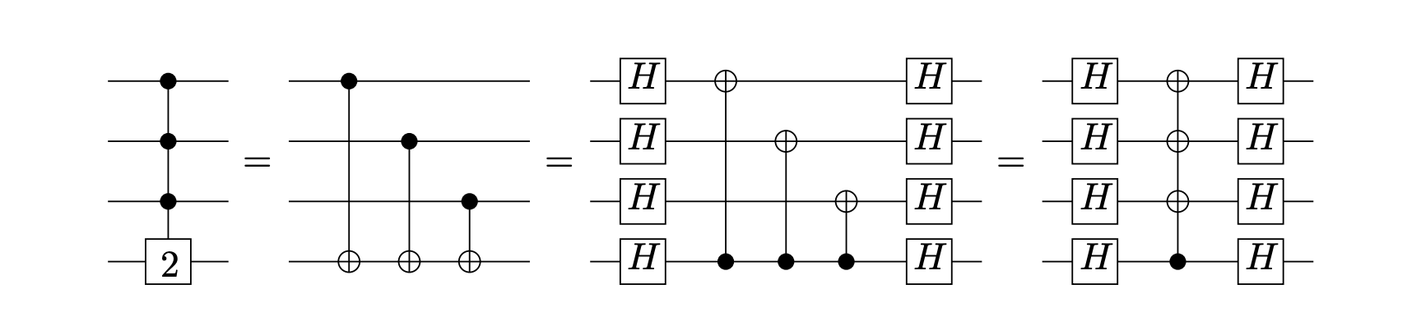

The power of QAC⁰_{f}
FANOUT is equivalent to computing Parity
Thus: PARITY $∈$ QAC⁰_{f}
PARITY
FANOUT

Slide 14
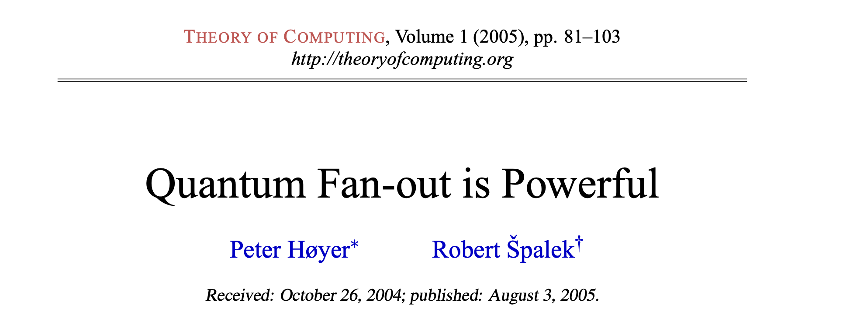
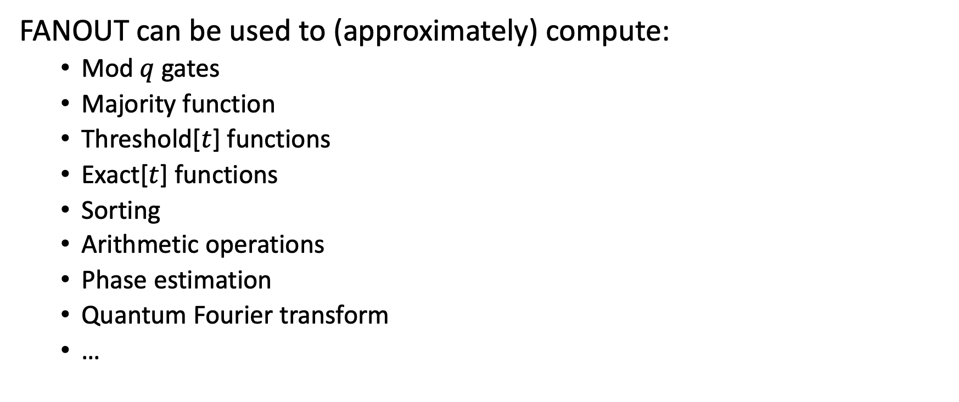
The power of QAC⁰_{f}
FANOUT can be used to (approximately) compute:
Mod $q$ gates
Majority function
Threshold[$t$] functions
Exact[$t$] functions
Sorting
Arithmetic operations
Phase estimation
Quantum Fourier transform
…

Slide 15
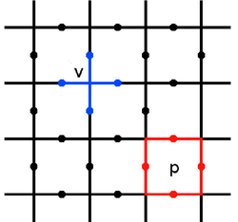
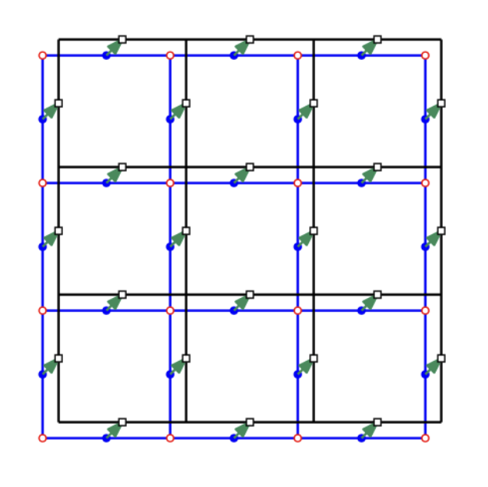



The power of QAC⁰_{f}
Globally entangled states can be prepared in QAC⁰_{f}
$$|0⟩$$
$$|0⟩$$
$$|0⟩$$
$$|0⟩$$
$$H$$
CAT state
Toric code
Non-abelian Anyons (Quantum Double for Solvable Groups)
These states can also be prepared using dynamic circuits with parity processing. (Bravyi, et al. ‘22, Tantivasadakarn, Vishwanath, Verresen, ’23,…)

Slide 16
Example: preparing stabilizer states with Fanout
Every $n$-qubit CNOT circuit can be parallelized to depth $3$ and $n$ ancillas.
CNOT circuit $≡$invertible matrix $M∈𝔽_{2}^{n×n}$ on $n$ bits.

Slide 17


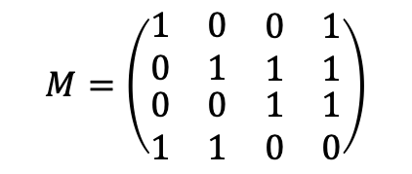





Example: preparing stabilizer states with Fanout
Every $n$-qubit CNOT circuit can be parallelized to depth $3$ and $n$ ancillas.
CNOT circuit $≡$invertible matrix $M∈𝔽_{2}^{n×n}$ on $n$ bits.
$$M$$
$$|x_{1}⟩$$
$$|x_{2}⟩$$
$$|x_{3}⟩$$
$$M=\left(\begin{matrix}\begin{matrix}1 & 0 \\ 0 & 1\end{matrix} & \begin{matrix}0 & 1 \\ 1 & 1\end{matrix} \\ \begin{matrix}0 & 0 \\ 1 & 1\end{matrix} & \begin{matrix}1 & 1 \\ 0 & 0\end{matrix}\end{matrix}\right)$$
$$|x_{4}⟩$$
$$|0⟩$$
$$|0⟩$$
$$|0⟩$$
$$|0⟩$$

Slide 18

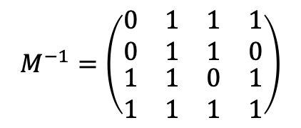
Example: preparing stabilizer states with Fanout
Every $n$-qubit CNOT circuit can be parallelized to depth $3$ and $n$ ancillas.
CNOT circuit $≡$invertible matrix $M∈𝔽_{2}^{n×n}$ on $n$ bits.
$$M$$
$$M^{−1}$$
$$|x_{1}⟩$$
$$|x_{2}⟩$$
$$|x_{3}⟩$$
$$M=\left(\begin{matrix}\begin{matrix}1 & 0 \\ 0 & 1\end{matrix} & \begin{matrix}0 & 1 \\ 1 & 1\end{matrix} \\ \begin{matrix}0 & 0 \\ 1 & 1\end{matrix} & \begin{matrix}1 & 1 \\ 0 & 0\end{matrix}\end{matrix}\right)$$
$$|x_{4}⟩$$
$$M^{−1}=\left(\begin{matrix}\begin{matrix}0 & 1 \\ 0 & 1\end{matrix} & \begin{matrix}1 & 1 \\ 1 & 0\end{matrix} \\ \begin{matrix}1 & 1 \\ 1 & 1\end{matrix} & \begin{matrix}0 & 1 \\ 1 & 1\end{matrix}\end{matrix}\right)$$
$$|0⟩$$
$$|0⟩$$
$$|0⟩$$
$$|0⟩$$

Slide 19




Example: preparing stabilizer states with Fanout
Every $n$-qubit CNOT circuit can be parallelized to depth $3$ and $n$ ancillas.
CNOT circuit $≡$invertible matrix $M∈𝔽_{2}^{n×n}$ on $n$ bits.
$$M$$
$$M^{−1}$$
Swap
$$|x⟩$$
$$|Mx⟩$$
$$M=\left(\begin{matrix}\begin{matrix}1 & 0 \\ 0 & 1\end{matrix} & \begin{matrix}0 & 1 \\ 1 & 1\end{matrix} \\ \begin{matrix}0 & 0 \\ 1 & 1\end{matrix} & \begin{matrix}1 & 1 \\ 0 & 0\end{matrix}\end{matrix}\right)$$
$$M^{−1}=\left(\begin{matrix}\begin{matrix}0 & 1 \\ 0 & 1\end{matrix} & \begin{matrix}1 & 1 \\ 1 & 0\end{matrix} \\ \begin{matrix}1 & 1 \\ 1 & 1\end{matrix} & \begin{matrix}0 & 1 \\ 1 & 1\end{matrix}\end{matrix}\right)$$
$$|0⟩$$
$$|0⟩$$
$$|0⟩$$
$$|0⟩$$
$$|0⟩$$
$$|0⟩$$
$$|0⟩$$
$$|0⟩$$

Slide 20











Example: preparing stabilizer states with Fanout
Theorem: Every Clifford circuit can be written as
Corollary: $n$-qubit Clifford circuits are parallelizable to depth 18 circuits with Fanout and $n$ ancillas.
(Aaronson, Gottesman 2004)
$$H$$
$$CNOT$$
$$P$$
$$CNOT$$
$$P$$
$$CNOT$$
$$H$$
$$P$$
$$CNOT$$
$$P$$

Slide 21
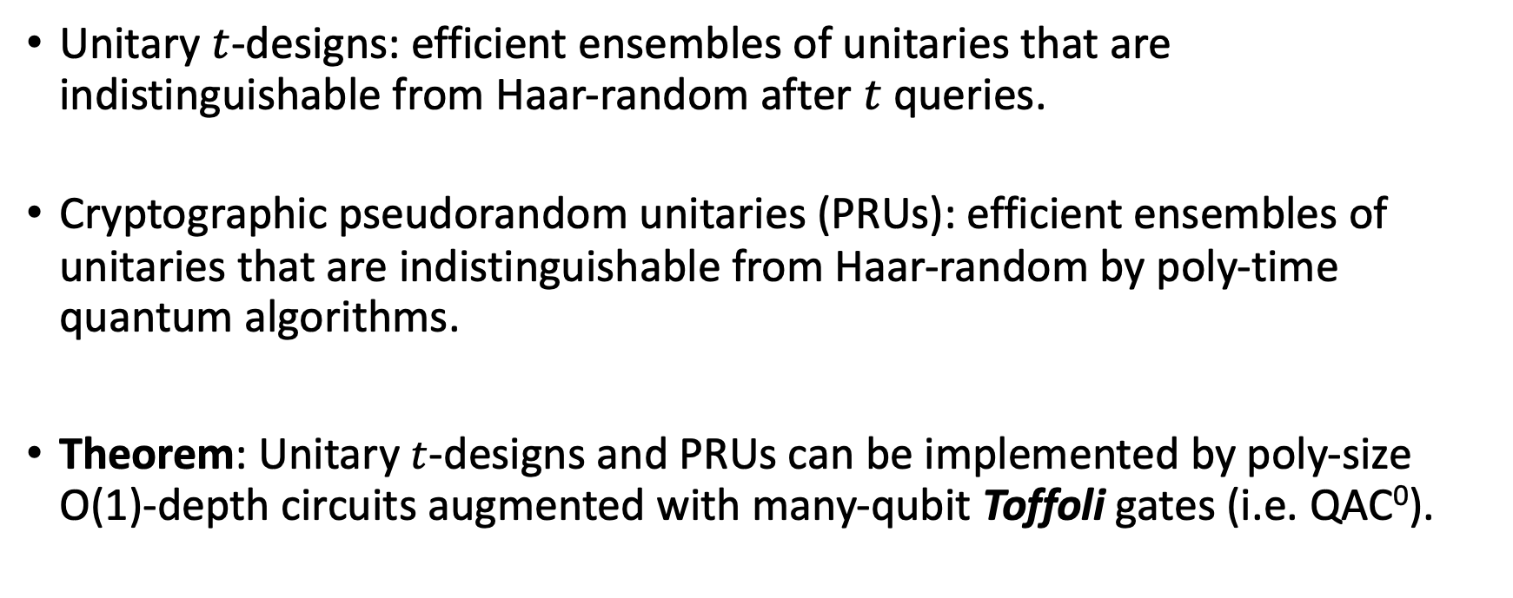
Random unitaries in QAC⁰
Unitary $t$-designs: efficient ensembles of unitaries that are indistinguishable from Haar-random after $t$ queries.
Cryptographic pseudorandom unitaries (PRUs): efficient ensembles of unitaries that are indistinguishable from Haar-random by poly-time quantum algorithms.
Theorem: Unitary $t$-designs and PRUs can be implemented by poly-size O(1)-depth circuits augmented with many-qubit Toffoli gates (i.e. QAC⁰).
(Foxman, Parham, Vasconcelos, Y. ‘25)
To our knowledge, first interesting class of unitaries implementable in QAC⁰!

Slide 22
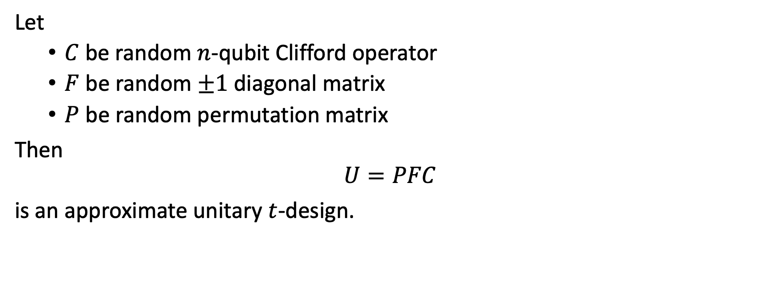
Random unitaries in QAC⁰_{f}
Let
$C$ be random $n$-qubit Clifford operator
$F$ be random $±1$diagonal matrix
$P$ be random permutation matrix
Then
$$U=PFC$$
is an approximate unitary $t$-design.
(Metger, Poremba, Sinha, Y. ‘24)

Slide 23
Random unitaries in QAC⁰_{f}
O(1)-depth implementation
Let
$C$ be random $n$-qubit Clifford operator
$F$ be random $±1$diagonal matrix
$P$ be random permutation matrix
Then
$$U=PFC$$
is an approximate unitary $t$-design.
(Metger, Poremba, Sinha, Y. ‘24)

Slide 24
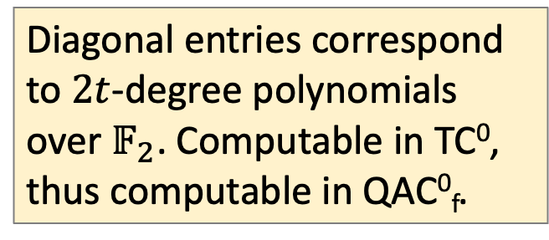
Random unitaries in QAC⁰_{f}
Let
$C$ be random $n$-qubit Clifford operator
$F$ be random $±1$diagonal matrix
$P$ be random permutation matrix
Then
$$U=PFC$$
is an approximate unitary $t$-design.
Diagonal entries correspond to $2t$-degree polynomials over $𝔽_{2}$. Computable in TC⁰, thus computable in QAC⁰_{f}.
(Metger, Poremba, Sinha, Y. ‘24)

Slide 25
Random unitaries in QAC⁰_{f}
Let
$C$ be random $n$-qubit Clifford operator
$F$ be random $±1$diagonal matrix
$P$ be random permutation matrix
Then
$$U=PFC$$
is an approximate unitary $t$-design.
Permutation is computed via “Luby-Rackoff” cipher, which is also computable in QAC⁰_{f}.
(Metger, Poremba, Sinha, Y. ‘24)

Slide 26
Random unitaries in QAC⁰_{f}
Let
$C$ be random $n$-qubit Clifford operator
$F$ be random $±1$diagonal matrix
$P$ be random permutation matrix
Then
$$U=PFC$$
is an approximate unitary $t$-design.
(Metger, Poremba, Sinha, Y. ‘24)
$PFC$ is implementable in $O(1)$-depth with Fanout.
(Chia-Liang-Song ‘24, Foxman, Parham, Vasconcelos, Y. ‘25)

Slide 27
Constant-time models of quantum computation can be weak

Slide 28
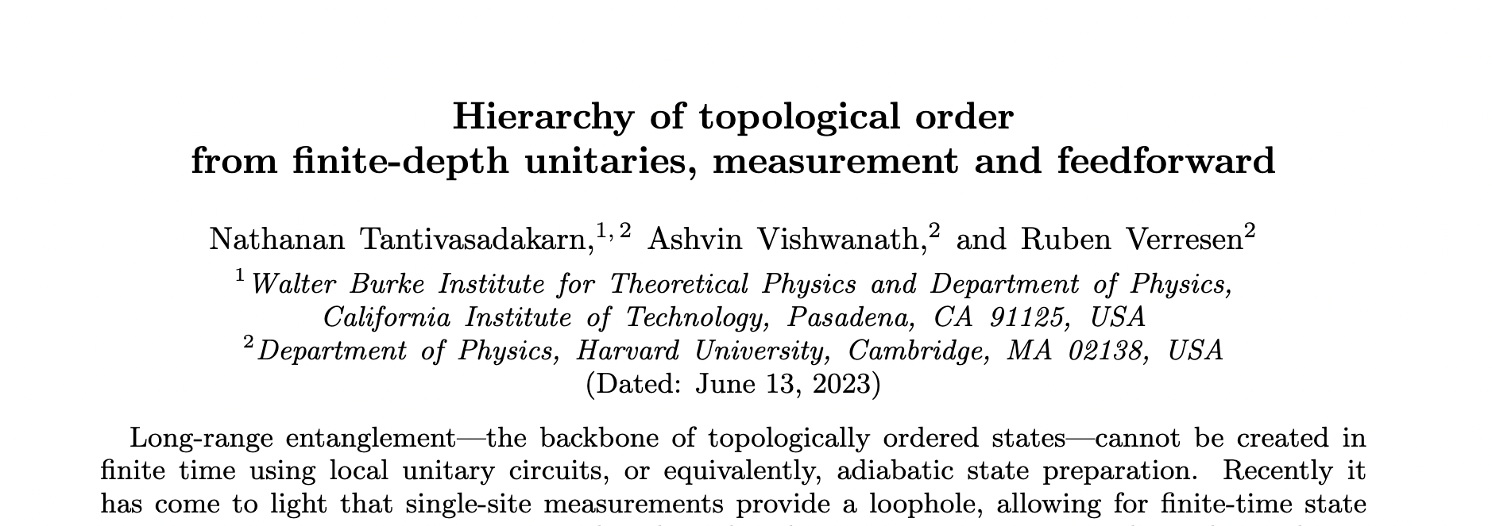
TVV Conjecture
Conjecture (TVV 2023): The following states cannot be prepared in O(1)-depth in dynamic circuit model:
Fibonacci topological order
Quantum double model for non-solvable groups

Slide 29
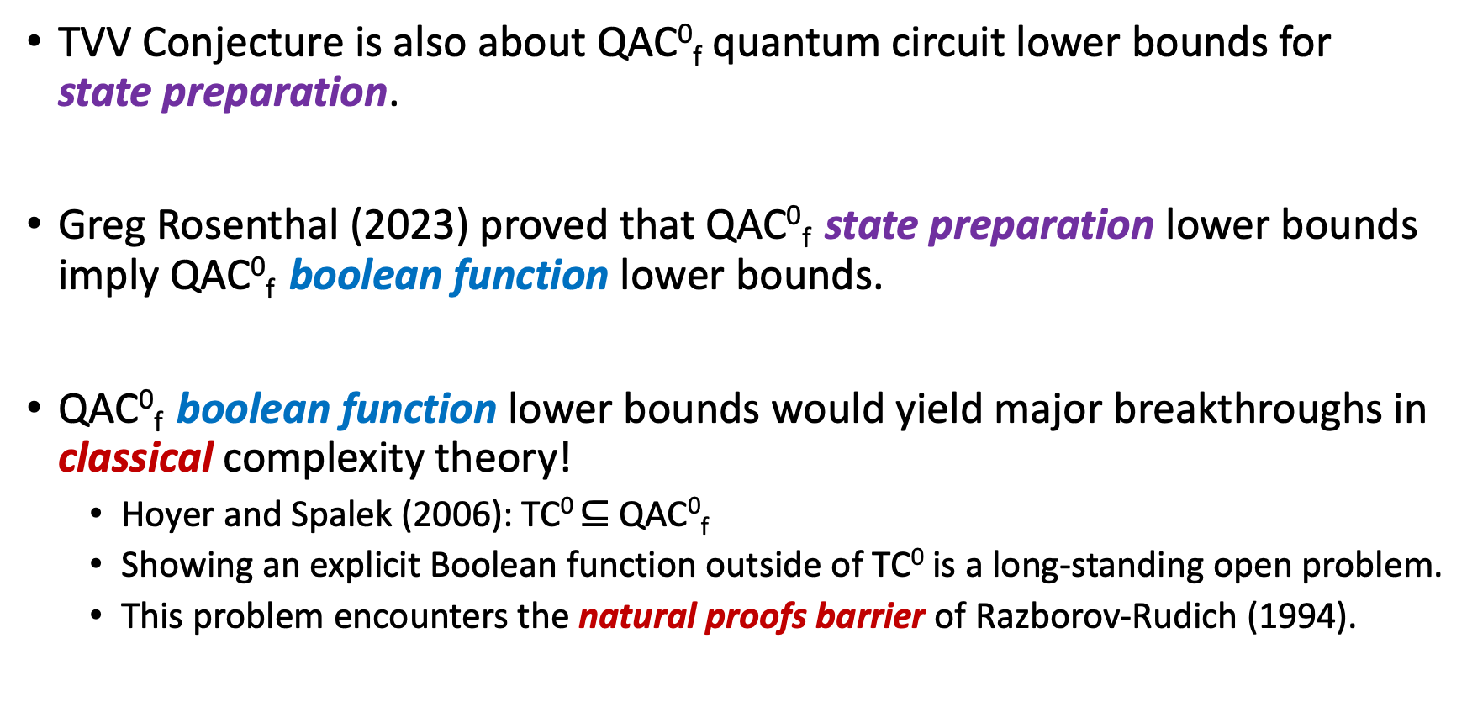
Quantum circuit lower bounds
TVV Conjecture is also about QAC⁰_{f} quantum circuit lower bounds for state preparation.
Greg Rosenthal (2023) proved that QAC⁰_{f} state preparation lower bounds imply QAC⁰_{f} boolean function lower bounds.
QAC⁰_{f} boolean function lower bounds would yield major breakthroughs in classical complexity theory!
Hoyer and Spalek (2006): TC⁰ $⊆$ QAC⁰_{f}
Showing an explicit Boolean function outside of TC⁰ is a long-standing open problem.
This problem encounters the natural proofs barrier of Razborov-Rudich (1994).

Slide 30

TC⁰ lower bounds
QAC⁰_{f} lower bounds
QAC⁰ vs QAC⁰_{f}
Magic Hierarchy lower bounds
These seem more feasible…
Notes:
If we’re to think about proving various circuit lower bounds in terms of scaling the Himalayas, then proving QAC0_f lower bounds is like reaching the peak here. Very difficult, very dangerous, no one has ever done it before. Proving TC0 lower bounds would be like reaching a slightly lower peak, because we know that in order to get here you must’ve been able to get here first. Classical complexity theorists would be thrilled to make it up to this peak,

Slide 31
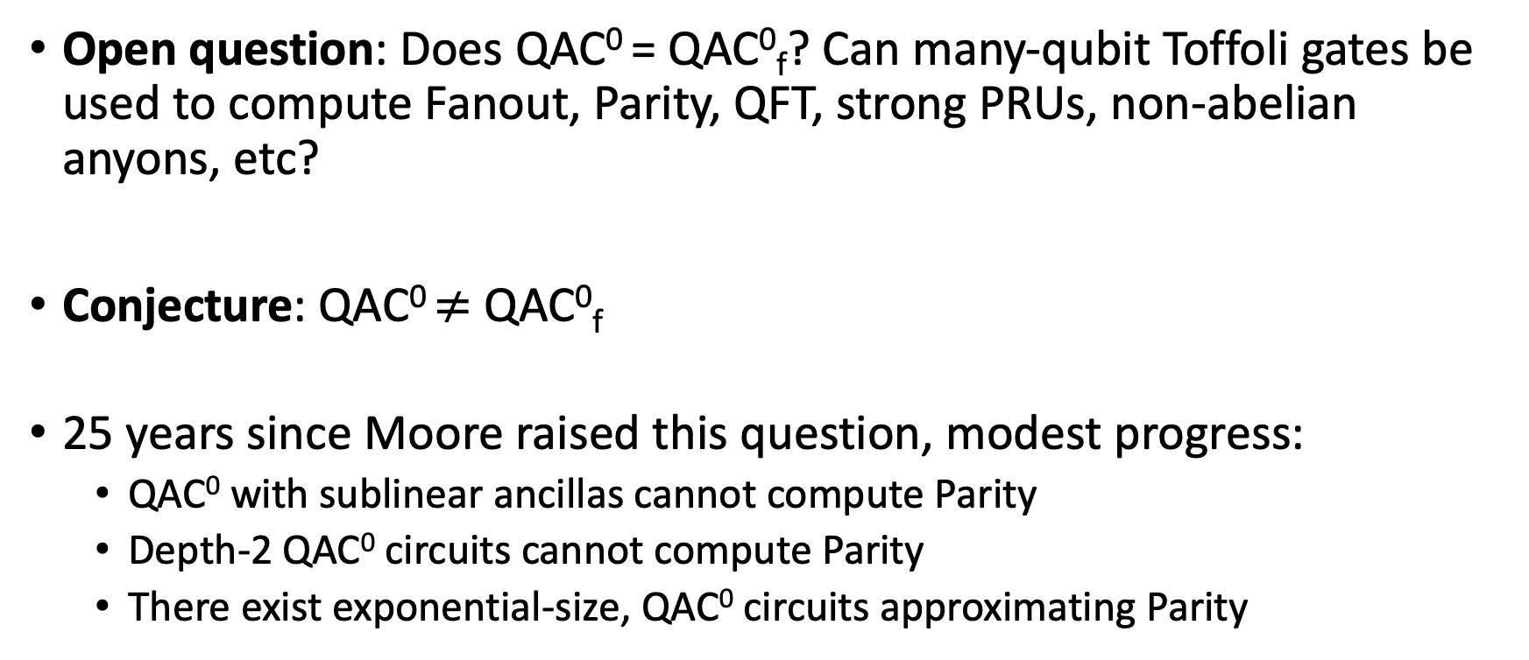
QAC⁰ vs. QAC⁰_{f}
Open question: Does QAC⁰ = QAC⁰_{f}? Can many-qubit Toffoli gates be used to compute Fanout, Parity, QFT, strong PRUs, non-abelian anyons, etc?
Conjecture: QAC⁰ $≠$ QAC⁰_{f}
25 years since Moore raised this question, modest progress:
QAC⁰ with sublinear ancillas cannot compute Parity
Depth-2 QAC⁰ circuits cannot compute Parity
There exist exponential-size, QAC⁰ circuits approximating Parity
Fang, Fenner, Green, Homer, Zhang (‘03)
Pade, Fenner, Grier, Thierauf (‘20)
Rosenthal (‘20)

Slide 32
Pauli Analysis of QAC⁰ circuits
(Nadimpalli, Parham, Vasconcelos, Y. ‘24)
Motivation: develop general techniques for analyzing quantum circuits with many-qubit gates.
We introduce the notion of the Pauli spectrum of a quantum circuit, which is a quantum analogue of the Fourier spectrum of a Boolean function.
Main Result: Pauli spectrum of QAC⁰ circuits (with few ancilla) are highly concentrated on the low-degree components.
Analogous to Linial-Mansour-Nisan theorem (1993): AC⁰-computable Boolean functions have concentrated Fourier spectra.

Slide 33







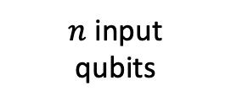

Pauli spectrum of quantum circuits
$C$ = quantum circuit with $n$ input qubits, $a$ ancilla qubits, and 1 output qubit
The following diagram defines an $n$-qubit matrix $Φ_{C}$:
Output qubit
$$Z$$
$n$ input
qubits
$$C^{†}$$
$$C$$
$$⟨0|$$
$$|0⟩$$
$a$ancilla
qubits
$$⟨0|$$
$$|0⟩$$

Slide 34
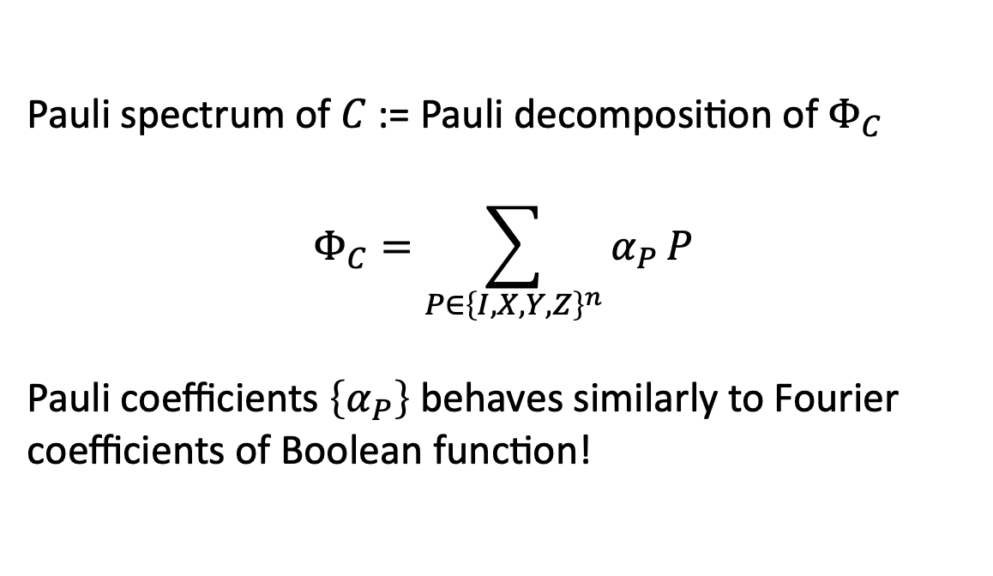
Pauli spectrum of quantum circuits
$C$ = quantum circuit with $n$ input qubits, $a$ ancilla qubits, and 1 output qubit
The following diagram defines an $n$-qubit matrix $Φ_{C}$:
Output qubit
$$Z$$
Pauli spectrum of $C$ := Pauli decomposition of $Φ_{C}$
$$Φ_{C}=\sum_{P∈{\left\{I,X,Y,Z\right\}}^{n}}{α_{P}}P$$
Pauli coefficients $\left\{α_{P}\right\}$ behaves similarly to Fourier coefficients of Boolean function!
$n$ input
qubits
$$C^{†}$$
$$C$$
$$⟨0|$$
$$|0⟩$$
$a$ancilla
qubits
$$⟨0|$$
$$|0⟩$$

Slide 35
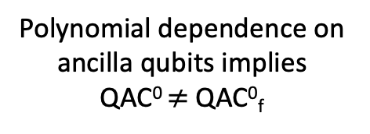

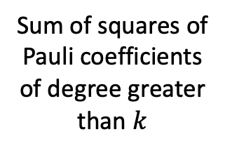
Pauli spectrum concentration of QAC⁰
Theorem (Nadimpalli, Parham, Vasconcelos, Y. ‘24)
If $C$ is computable by depth-$d$size-$s$ QAC⁰ circuit with $a$ ancilla qubits, then its Pauli spectrum concentrates on low degree coefficients:
$$W^{>k}\left[Φ_{C}\right]≤poly(s)⋅2^{−Ω\left(k^{1/d}\right)}⋅2^{a}$$
Resembles classical LMN!
Sum of squares of Pauli coefficients of degree greater than $k$
Polynomial dependence on ancilla qubits implies QAC⁰ $≠$ QAC⁰_{f}

Slide 36
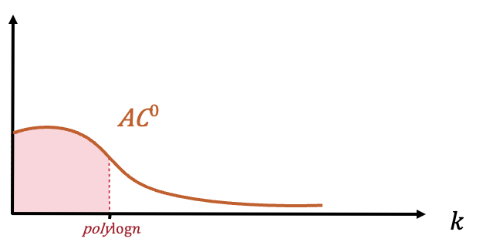
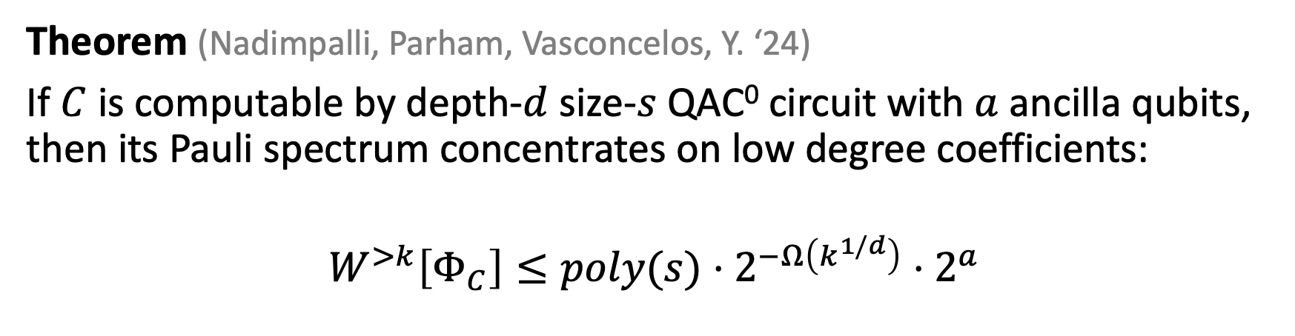
Pauli spectrum concentration of QAC⁰
Theorem (Nadimpalli, Parham, Vasconcelos, Y. ‘24)
If $C$ is computable by depth-$d$size-$s$ QAC⁰ circuit with $a$ ancilla qubits, then its Pauli spectrum concentrates on low degree coefficients:
$$W^{>k}\left[Φ_{C}\right]≤poly(s)⋅2^{−Ω\left(k^{1/d}\right)}⋅2^{a}$$
Corollaries
Poly-size QAC⁰ circuit with few ancilla qubits
Cannot approximate PARITY or MAJORITY
Can be learned in quasipoly time from Choi state samples.

Slide 37
The Magic Hierarchy
Natalie Parham recently introduced the Magic Hierarchy (MH), a circuit model consisting of O(1)-alternations of Clifford and QNC⁰ circuits.
MH is equivalent to
QAC⁰_{f}
O(1)-depth dynamic circuits with parity processing
O(1) T-depth circuits*
(Parham 2025)

Slide 38
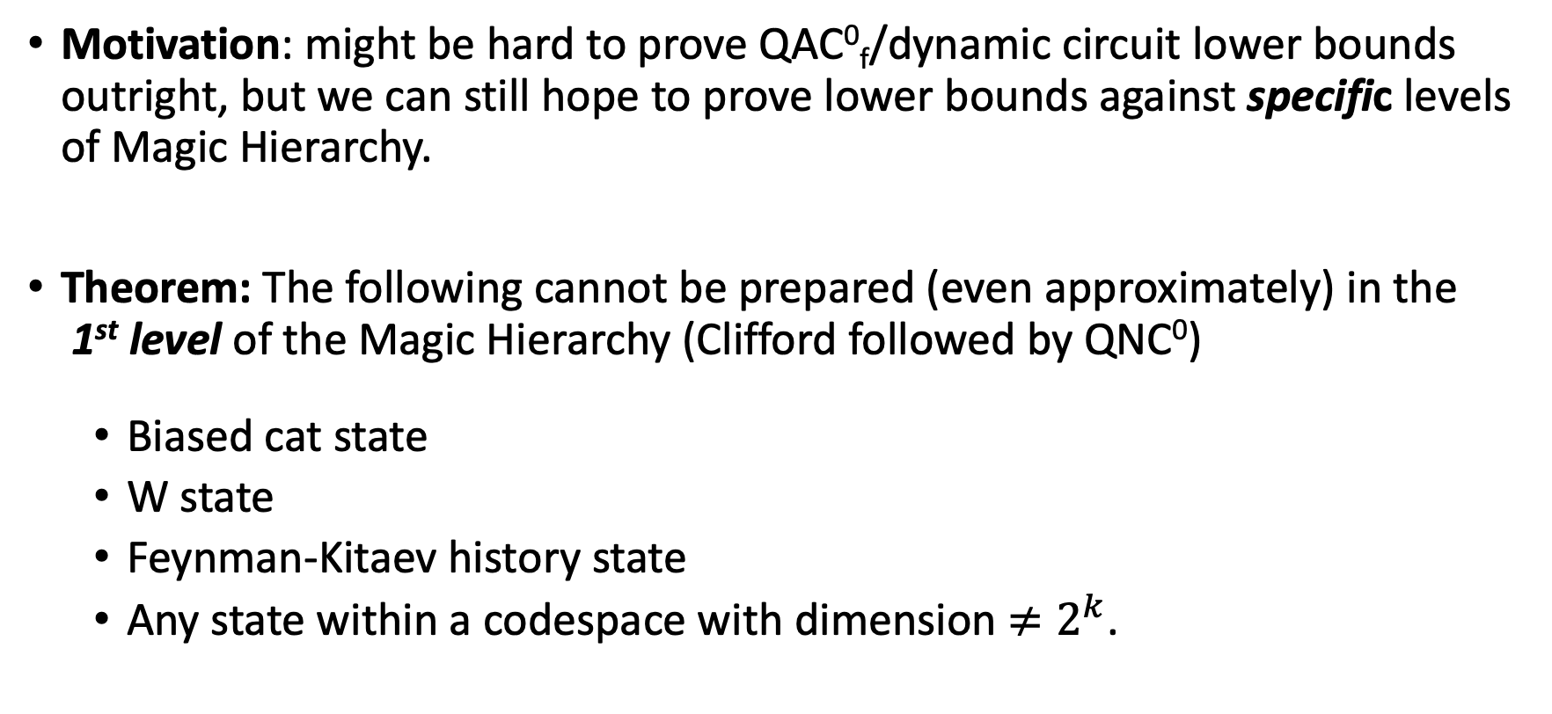
The Magic Hierarchy
Motivation: might be hard to prove QAC⁰_{f}/dynamic circuit lower bounds outright, but we can still hope to prove lower bounds against specific levels of Magic Hierarchy.
Theorem: The following cannot be prepared (even approximately) in the 1st level of the Magic Hierarchy (Clifford followed by QNC⁰)
Biased cat state
W state
Feynman-Kitaev history state
Any state within a codespace with dimension $≠2^{k}$.
(Parham 2025)

Slide 39
Summary
Nontrivial equivalences between models of constant-time quantum computation: QAC⁰, QAC⁰_{f} , dynamic circuits, O(1) T-depth, Magic Hierarchy, …
Power of these models: Can compute complex functions, prepare complex globally entangled states (e.g., some non-abelian anyons), and implement (pseudo)random unitaries.
Weaknesses of these models: TVV conjecture, many-qubit Toffoli vs Fanout, Pauli spectrum analysis of QAC⁰ circuits, Magic Hierarchy lower bounds.

Slide 40
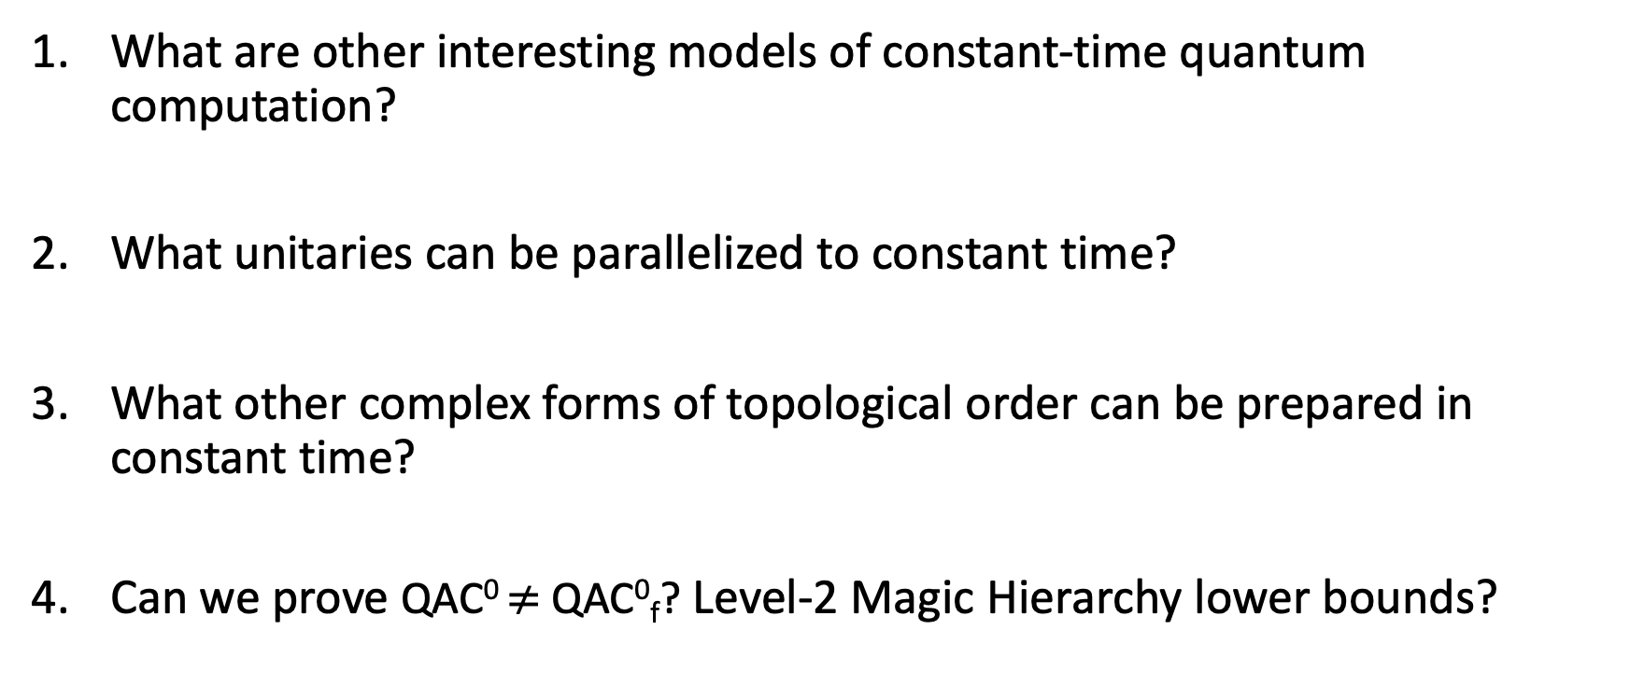
Questions
What are other interesting models of constant-time quantum computation?
What unitaries can be parallelized to constant time?
What other complex forms of topological order can be prepared in constant time?
Can we prove QAC⁰ $≠$ QAC⁰_{f}? Level-2 Magic Hierarchy lower bounds?
Thank You!

