Slide 1
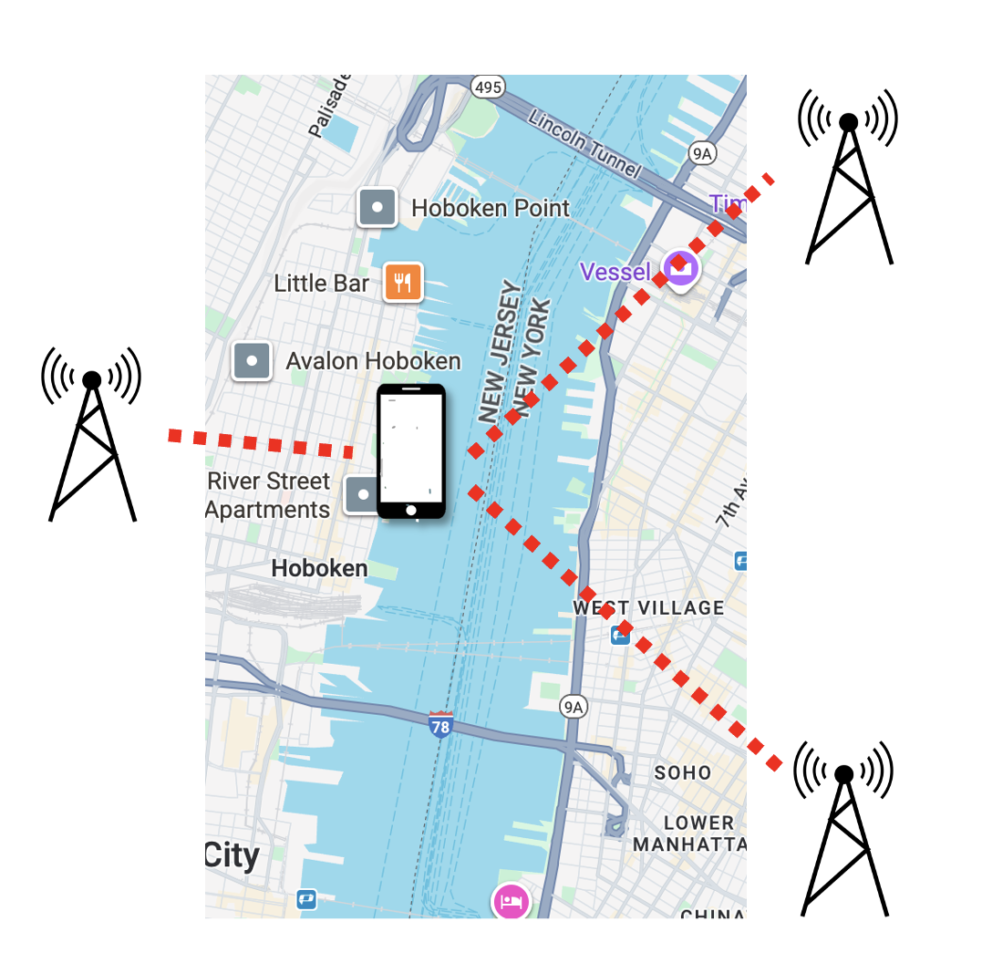
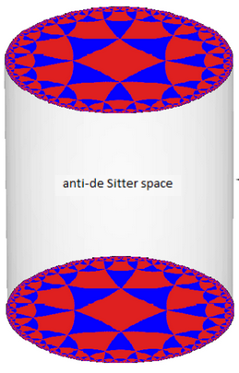
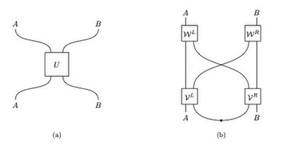
Quantum Position Verification
From Cryptography to Complexity to Quantum Gravity
Henry Yuen
Columbia

Slide 2
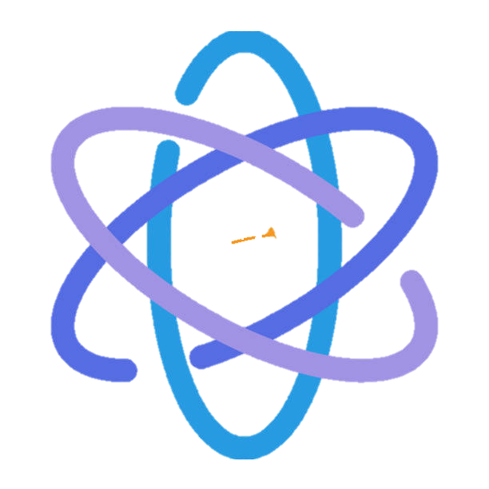
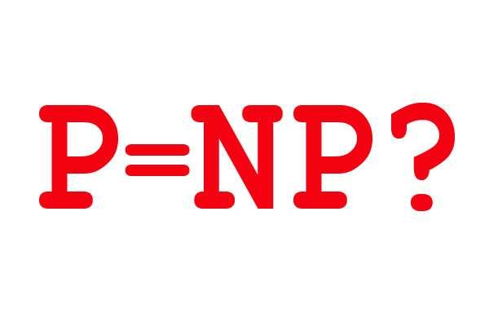

Nonlocal Quantum Computation
Holography and quantum gravity
Quantum Position Verification
Quantum Cryptography
Computational Complexity Theory

Slide 3
Nonlocal Quantum Computation
Holography and quantum gravity
Quantum Position Verification
Quantum Cryptography
Computational Complexity Theory

Slide 4
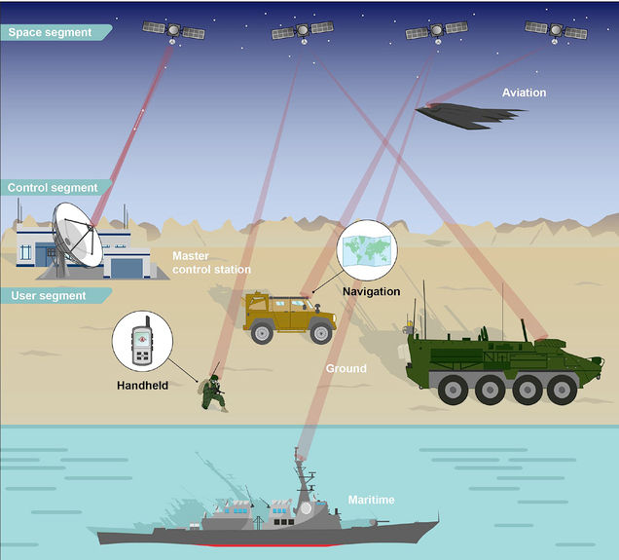
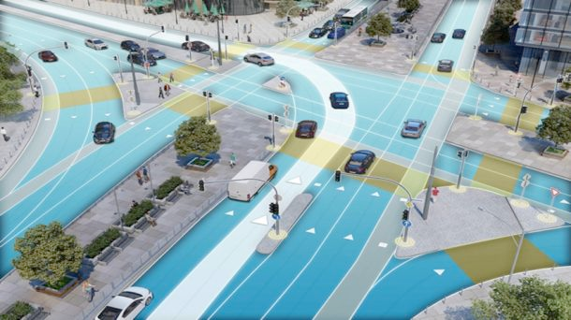
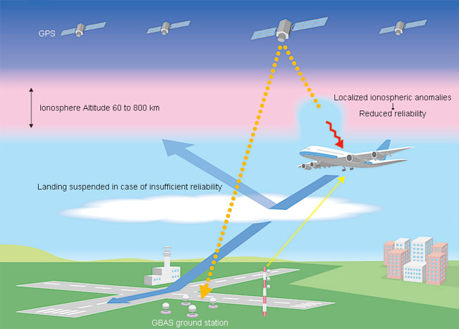
Position information is critical
Complex operations in the physical world rely on trusted positioning.
Autonomous vehicles
Commercial aviation
Defense
Current backbone: GPS and other global navigation satellite systems

Slide 5
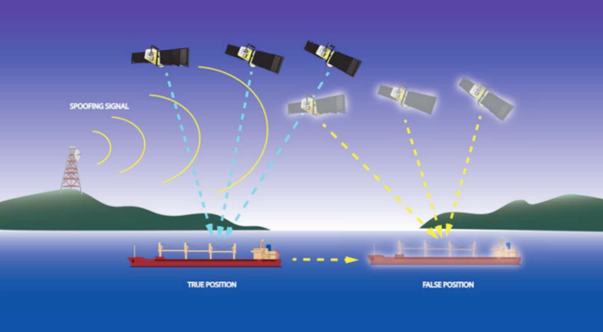
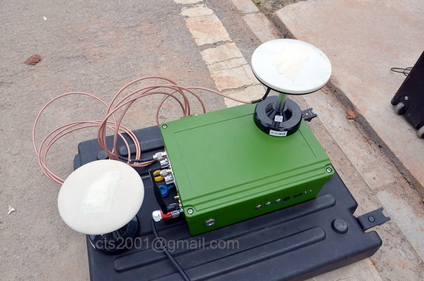
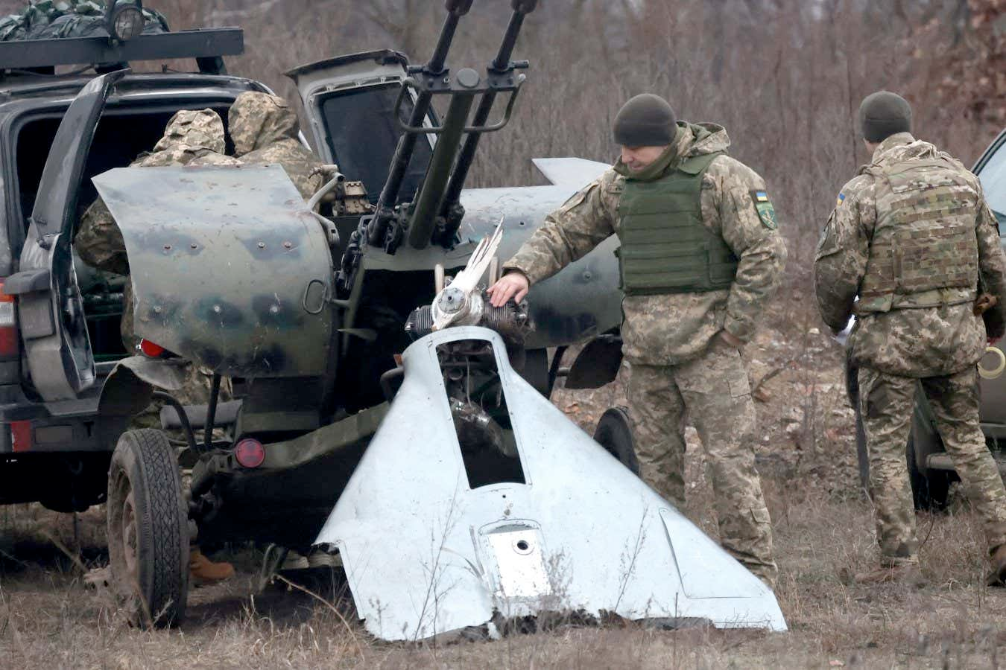
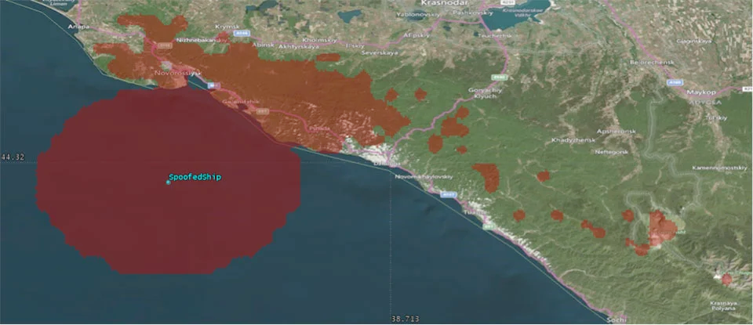
Position information is fragile
Cheap GPS
spoofer
GPS spoofing in Ukraine-Russia war
Maritime GPS spoofing in Black Sea

Slide 6
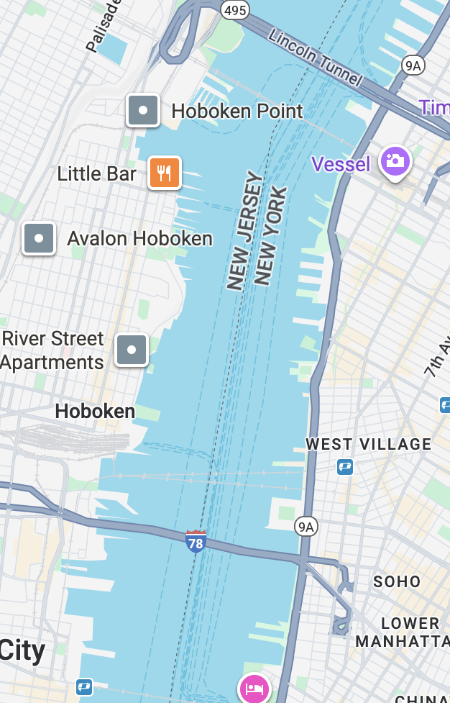
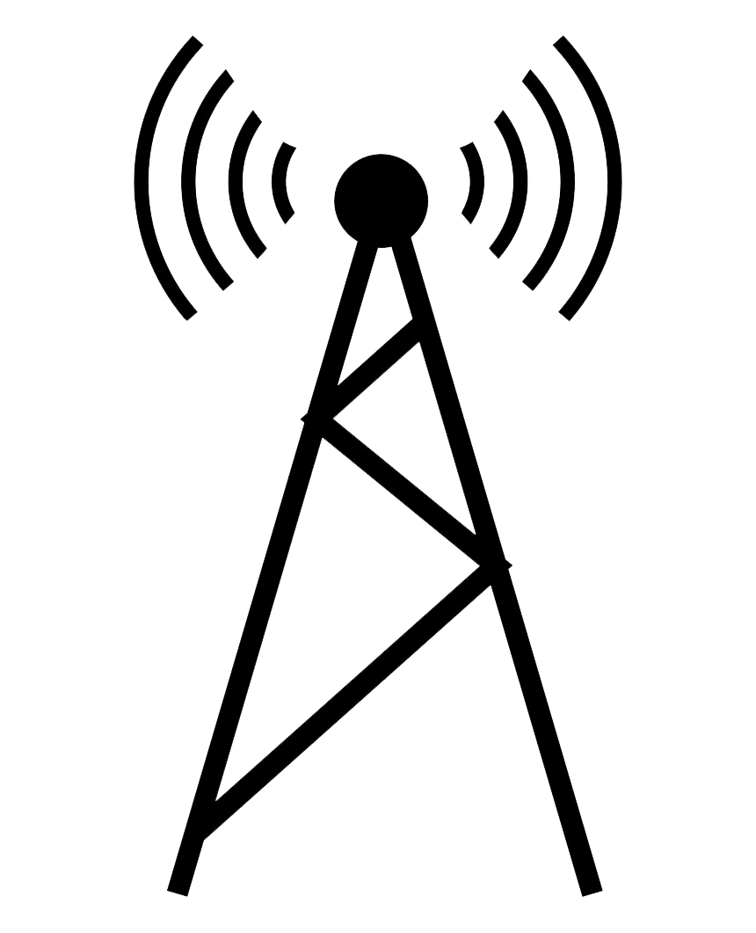

Position verification
Is it possible to verify someone’s location in a remote fashion?
A natural idea: multiple verifiers can check the physical location of a prover by sending signals to the purported location, receiving signals back, and checking timing constraints.
Provers are untrusted. Verifiers want to guard against spoofing.

Slide 7







Example: 1D position verification
Time
$$t=2$$
$$t=1$$
$$t=0$$
$$−1$$
$$0$$
$$+1$$
Position $P$

Slide 8
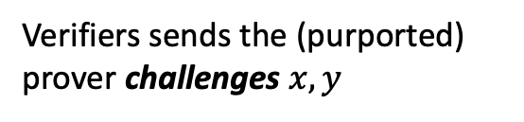


Example: 1D position verification
Time
$$t=2$$
$$t=1$$
Prover
$$y$$
$$x$$
Verifiers sends the (purported) prover challenges $x,y$
$$t=0$$
Position
$$0$$
$$−1$$
$$+1$$

Slide 9

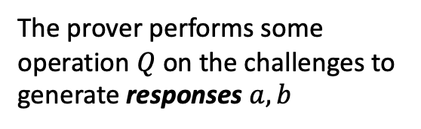

Example: 1D position verification
Time
$$t=2$$
$$a$$
$$b$$
The prover performs some operation $Q$ on the challenges to generate responses $a,b$
$$t=1$$
Prover
$$y$$
$$x$$
$$t=0$$
Position
$$0$$
$$−1$$
$$+1$$

Slide 10
Example: 1D position verification
Time
$$t=2$$
$$a$$
$$b$$
Verifiers check that prover’s responses satisfy some test satisfy timing constraints.
Hope: the only way for prover to generate correct responses in time is to be in the correct position.
$$t=1$$
Prover
$$y$$
$$x$$
$$t=0$$
Position
$$0$$
$$−1$$
$$+1$$

Slide 11
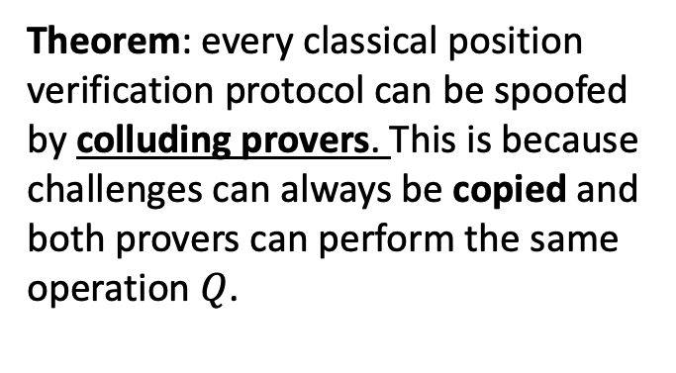
Classical impossibility
Time
$$t=2$$
Suppose the protocol only used classical resources.
Theorem: every classical position verification protocol can be spoofed by colluding provers. This is because challenges can always be copied and both provers can perform the same operation $Q$.
$$t=1$$
$$x$$
$$y$$
Spoofer
Spoofer
(Kent-Munro-Spiller ’11, Buhrman, et al. ‘10)
$$t=0$$
Position
$$0$$
$$−1$$
$$+1$$

Slide 12
Classical impossibility
Time
$$t=2$$
Suppose the protocol only used classical resources.
Theorem: every classical position verification protocol can be spoofed by colluding provers. This is because challenges can always be copied and both provers can perform the same operation $Q$.
$$t=1$$
$$x$$
$$y$$
Spoofer
Spoofer
(Kent-Munro-Spiller ’11, Buhrman, et al. ‘10)
$$t=0$$
Position
$$0$$
$$−1$$
$$+1$$

Slide 13
Classical impossibility
Time
$$t=2$$
Suppose the protocol only used classical resources.
$$a$$
$$b$$
Theorem: every classical position verification protocol can be spoofed by colluding provers. This is because challenges can always be copied and both provers can perform the same operation $Q$.
$$t=1$$
$$x$$
$$y$$
Spoofer
Spoofer
(Kent-Munro-Spiller ’11, Buhrman, et al. ‘10)
$$t=0$$
Position
$$0$$
$$−1$$
$$+1$$

Slide 14
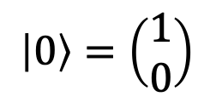
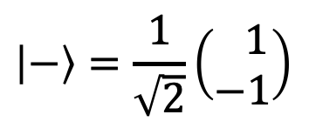
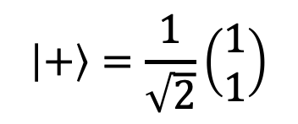
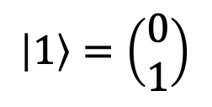
Enter quantum
Classical attack requires the spoofers to copy information.
Idea: send quantum challenges using conjugate coding.
A random qubit $|ψ⟩$ chosen from
$$\left|0\right\rangle =\left(\begin{matrix}1 \\ 0\end{matrix}\right)$$
$$\left|1\right\rangle =\left(\begin{matrix}0 \\ 1\end{matrix}\right)$$
$$\left|+\right\rangle =\frac{1}{\sqrt{2}}\left(\begin{matrix}1 \\ 1\end{matrix}\right)$$
$$\left|−\right\rangle =\frac{1}{\sqrt{2}}\left(\begin{matrix} 1 \\ −1\end{matrix}\right)$$
cannot be copied, due to No-Cloning Theorem!
(Wiesner ’68, Bennett-Brassard ‘84)
Also known as BB84 states, which are basis for quantum key distribution.

Slide 15
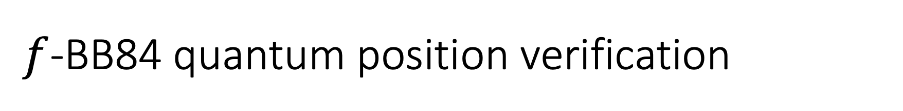
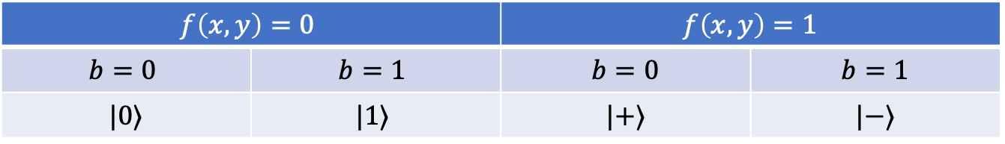

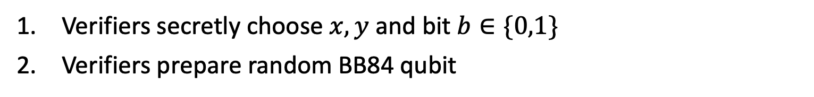
$f$-BB84 quantum position verification
$f(x,y)$: Boolean function on inputs $x,y∈{\left\{0,1\right\}}^{n}$.
Verifiers secretly choose $x,y$ and bit $b∈\{0,1\}$
Verifiers prepare random BB84 qubit
$$f\left(x,y\right)=0$$ |  | $$f\left(x,y\right)=1$$
$$b=0$$ | $$b=1$$ | $$b=0$$ | $$b=1$$
$$|0⟩$$ | $$|1⟩$$ | $$|+⟩$$ | $$|−⟩$$
$$\left|ψ\right\rangle =$$

Slide 16
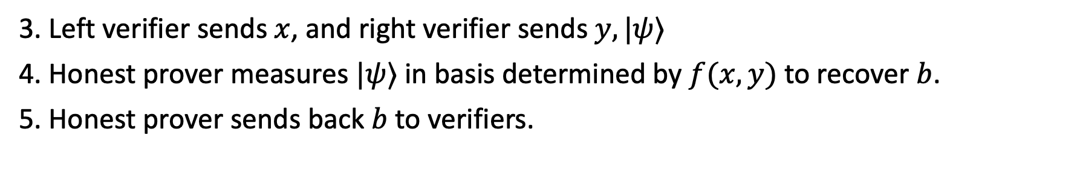
$f$-BB84 quantum position verification
$f(x,y)$: Boolean function on inputs $x,y∈{\left\{0,1\right\}}^{n}$.
Verifiers secretly choose $x,y$ and bit $b∈\{0,1\}$
Verifiers prepare random BB84 qubit
$$f\left(x,y\right)=0$$ |  | $$f\left(x,y\right)=1$$
$$b=0$$ | $$b=1$$ | $$b=0$$ | $$b=1$$
$$|0⟩$$ | $$|1⟩$$ | $$|+⟩$$ | $$|−⟩$$
$$\left|ψ\right\rangle =$$
3. Left verifier sends $x$, and right verifier sends $y,|ψ⟩$
4. Honest prover measures $|ψ⟩$ in basis determined by $f(x,y)$ to recover $b$.
5. Honest prover sends back $b$ to verifiers.

Slide 17

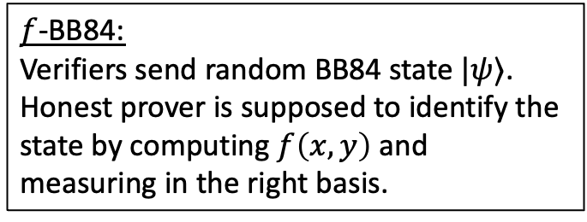
Quantum position verification
$f$-BB84:
Verifiers send random BB84 state $|ψ⟩$. Honest prover is supposed to identify the state by computing $f\left(x,y\right)$ and measuring in the right basis.
Time
$$t=2$$
$$t=1$$
$$x$$
Honest
Prover
$$y,\left|ψ\right\rangle$$
$$t=0$$
$$−1$$
$$0$$
$$+1$$

Slide 18


Quantum position verification
$f$-BB84:
Verifiers send random BB84 state $|ψ⟩$. Honest prover is supposed to identify the state by computing $f\left(x,y\right)$ and measuring in the right basis.
Time
$$t=2$$
$$b$$
$$b$$
$$t=1$$
$$x$$
Honest
Prover
$$y,\left|ψ\right\rangle$$
$$t=0$$
$$−1$$
$$0$$
$$+1$$

Slide 19
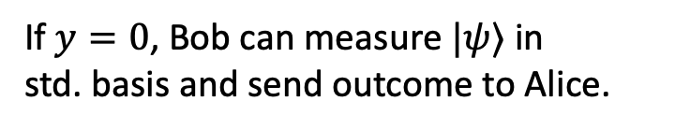
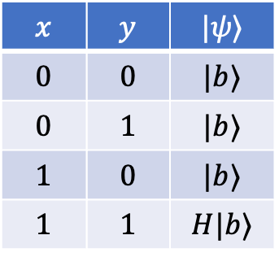
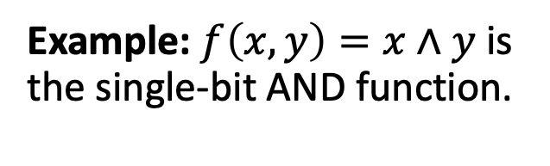
Quantum position verification
Example: $f\left(x,y\right)=x∧y$ is the single-bit AND function.
Time
$$t=2$$
$$x$$ | $$y$$ | $$|ψ⟩$$
$$0$$ | $$0$$ | $$|b⟩$$
$$0$$ | $$1$$ | $$|b⟩$$
$$1$$ | $$0$$ | $$|b⟩$$
$$1$$ | $$1$$ | $$H|b⟩$$
$$t=1$$
$$x$$
$$y,\left|ψ\right\rangle$$
If $y=0$, Bob can measure $|ψ⟩$ in std. basis and send outcome to Alice.
$$t=0$$
$$−1$$
$$0$$
$$+1$$

Slide 20
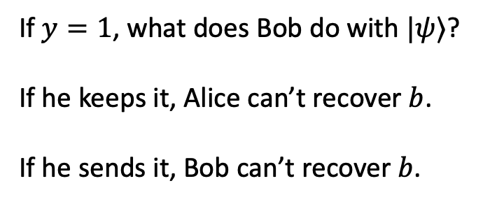
Quantum position verification
Example: $f\left(x,y\right)=x∧y$ is the single-bit AND function.
Time
$$t=2$$
$$x$$ | $$y$$ | $$|ψ⟩$$
$$0$$ | $$0$$ | $$|b⟩$$
$$0$$ | $$1$$ | $$|b⟩$$
$$1$$ | $$0$$ | $$|b⟩$$
$$1$$ | $$1$$ | $$H|b⟩$$
$$t=1$$
$$x$$
$$y,\left|ψ\right\rangle$$
If $y=1$, what does Bob do with $|ψ⟩$?
If he keeps it, Alice can’t recover $b$.
If he sends it, Bob can’t recover $b$.
$$t=0$$
$$−1$$
$$0$$
$$+1$$

Slide 21
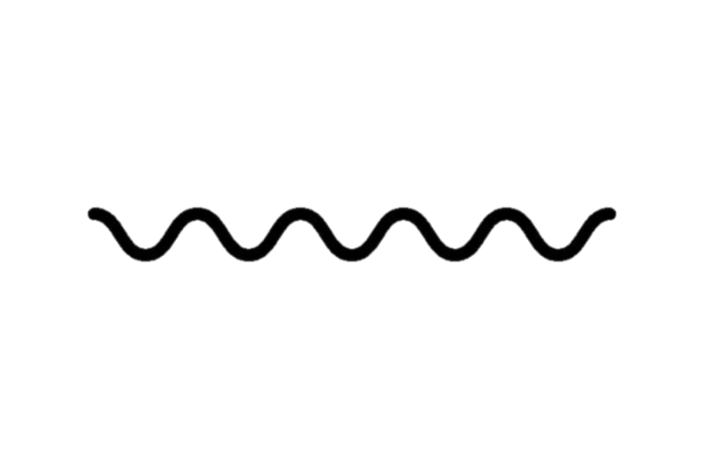
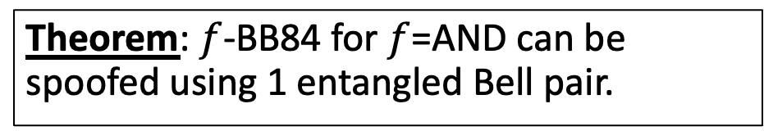


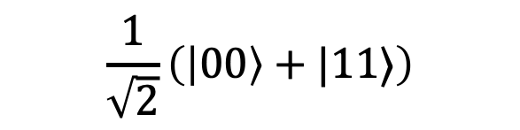
Entanglement attacks on QPV
Spoofers can do more than keep or forward qubits. Quantum entanglement gives rise to a richer, nontrivial set of spoofing strategies.
$$|ψ⟩$$
Teleportation corrections
With entanglement, spoofers can utilize quantum teleportation to perform a distributed version of what the honest prover was supposed to do.
Time
Teleportation measurement
Theorem: $f$-BB84 for $f$=AND can be spoofed using 1 entangled Bell pair.
$$\frac{1}{\sqrt{2}}\left(\left|00\right\rangle +|11⟩\right)$$
$$|ψ⟩$$
(Kent-Munro-Spiller ’11, Lau-Lo ’11)

Slide 22
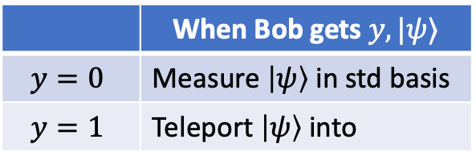


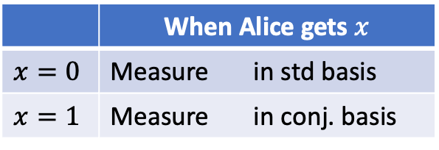
Entanglement attacks on QPV
 | When Alice gets $x$
$$x=0$$ | Measure in std basis
$$x=1$$ | Measure in conj. basis
 | When Bob gets $y,|ψ⟩$
$$y=0$$ | Measure $\left|ψ\right\rangle$ in std basis
$$y=1$$ | Teleport $\left|ψ\right\rangle$ into
Immediately send measurement results.
Immediately send measurement results.
$$x$$
$$y,\left|ψ\right\rangle$$

Slide 23
Entanglement attacks on QPV
 | When Alice gets $x$
$$x=0$$ | Measure in std basis
$$x=1$$ | Measure in conj. basis
 | When Bob gets $y,|ψ⟩$
$$y=0$$ | Measure $\left|ψ\right\rangle$ in std basis
$$y=1$$ | Teleport $\left|ψ\right\rangle$ into
Immediately send measurement results.
Immediately send measurement results.
$$x$$
$$y,\left|ψ\right\rangle$$

Slide 24
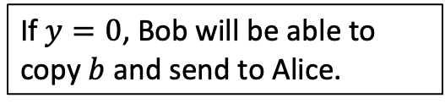
Entanglement attacks on QPV
If $y=0$, Bob will be able to copy $b$ and send to Alice.
 | When Alice gets $x$
$$x=0$$ | Measure in std basis
$$x=1$$ | Measure in conj. basis
 | When Bob gets $y,|ψ⟩$
$$y=0$$ | Measure $\left|ψ\right\rangle$ in std basis
$$y=1$$ | Teleport $\left|ψ\right\rangle$ into
Immediately send measurement results.
Immediately send measurement results.
$$x$$
$$y,\left|ψ\right\rangle$$

Slide 25
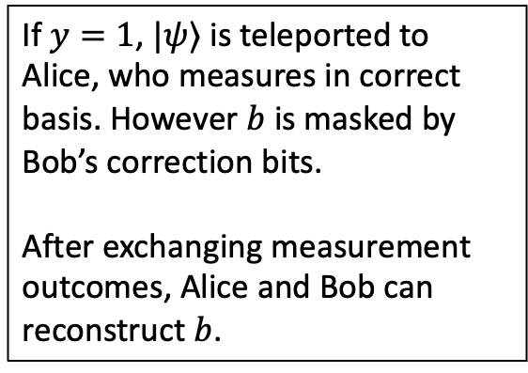
Entanglement attacks on QPV
If $y=1$, $|ψ⟩$ is teleported to Alice, who measures in correct basis. However $b$ is masked by Bob’s correction bits.
After exchanging measurement outcomes, Alice and Bob can reconstruct $b$.
 | When Alice gets $x$
$$x=0$$ | Measure in std basis
$$x=1$$ | Measure in conj. basis
 | When Bob gets $y,|ψ⟩$
$$y=0$$ | Measure $\left|ψ\right\rangle$ in std basis
$$y=1$$ | Teleport $\left|ψ\right\rangle$ into
Immediately send measurement results.
Immediately send measurement results.
$$x$$
$$y,\left|ψ\right\rangle$$

Slide 26
Entanglement attacks on QPV
Theorem: $f$-BB84 can be spoofed using ${\sim 2}^{\sqrt{n\log{n} }}$ qubits of entanglement for all $n$-bit Boolean functions $f$.
(Allerstorfer, et al. 2024)
This attack is highly nontrivial; it is a complicated teleportation-based attack that uses a breakthrough in classical cryptography about secure multiparty computation (Liu, Vaikuntanathan 2017)
Theorem: There exists a Boolean function $f$such that $f$-BB84 cannot be spoofed with less than $\sim \log{n}$ qubits of entanglement.
(Bluhm, Christandl, Speelman 2021)

Slide 27
Entanglement attacks on QPV
Open question: Is there a Boolean function $f$such that spoofing $f$-BB84 requires exponential amounts of entanglement?
This question is immensely difficult, because of unexpected and deep connections to complexity theory and cryptography.

Slide 28
Nonlocal Quantum Computation
Holography and quantum gravity
Quantum Position Verification
Quantum Cryptography
Computational Complexity Theory

Slide 29
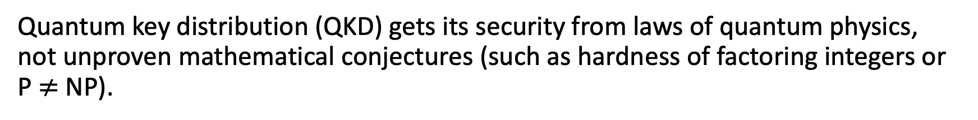
Connections with complexity and cryptography
Quantum key distribution (QKD) gets its security from laws of quantum physics, not unproven mathematical conjectures (such as hardness of factoring integers or P $≠$NP).
Though QPV resembles QKD, it has deeper and unavoidable connections to computational complexity and cryptography.
Theorem: If $f$ admits a classical Private Simultaneous Messages protocol with complexity $C$, then $f$-BB84 can be spoofed using $O(C)$ qubits of entanglement.
(Allerstorfer, et al. 2024)
PSM = model of secure multiparty computation in classical cryptography. Existence of functions requiring exponential PSM complexity is longstanding open question.

Slide 30
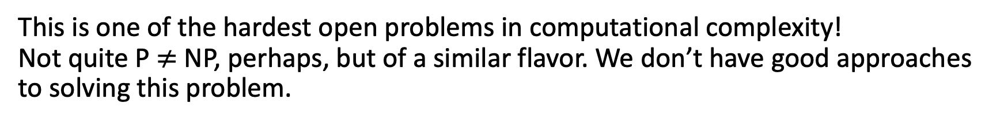
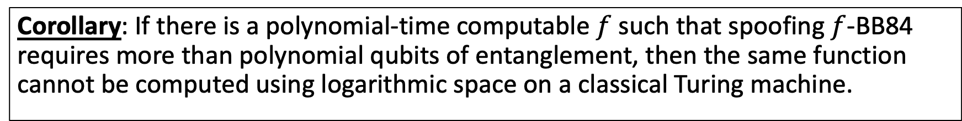
Connections with complexity and cryptography
Corollary: If there is a polynomial-time computable $f$ such that spoofing $f$-BB84 requires more than polynomial qubits of entanglement, then the same function cannot be computed using logarithmic space on a classical Turing machine.
(Allerstorfer, et al. 2024)
This is one of the hardest open problems in computational complexity! Not quite P $≠$ NP, perhaps, but of a similar flavor. We don’t have good approaches to solving this problem.
🤔
Why does security of quantum position verification have anything to do with the space complexity of computing functions on classical Turing machines?!

Slide 31
Nonlocal Quantum Computation
Open question: Is there any QPV protocol (not just $f$-BB84) that is secure against exponential amounts of entanglement?
Theorem: Assuming some unproven conjectures about type constants of Banach spaces, the answer to the above question is Yes.
(Junge, et al. 2021)
The security of QPV is equivalent to nonlocally splitting up quantum computation.

Slide 32
Nonlocal Quantum Computation
When can this…
quantum process
…be implemented non-locally like this?
communication
entanglement
e.g. computation, scattering process, Hamiltonian evolution…

Slide 33
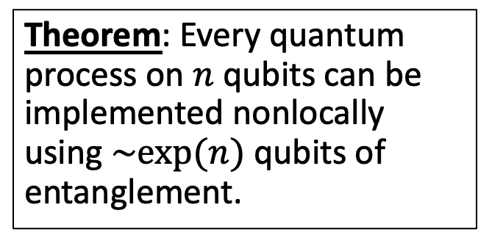
Nonlocal Quantum Computation
Theorem: Every quantum process on $n$ qubits can be implemented nonlocally using $\sim exp⁡(n)$ qubits of entanglement.
(Beigi-Koenig 2011)

Slide 34
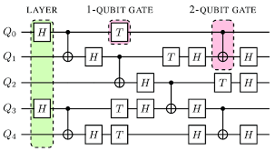
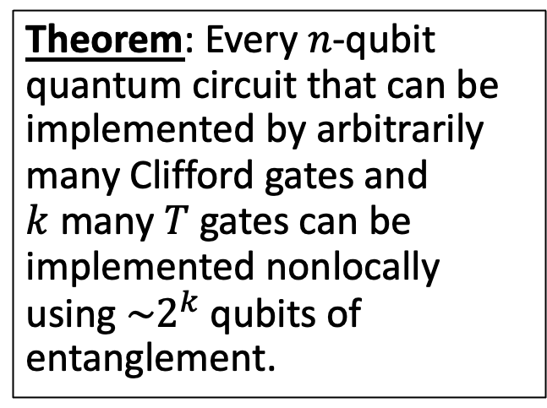
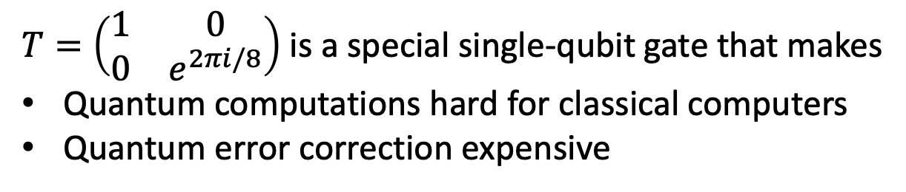
Nonlocal Quantum Computation
Theorem: Every $n$-qubit quantum circuit that can be implemented by arbitrarily many Clifford gates and $k$ many $T$ gates can be implemented nonlocally using $\sim 2^{k}$ qubits of entanglement.
(Speelman 2015)
$T=\left(\begin{matrix}1 & 0 \\ 0 & e^{2πi/8}\end{matrix}\right)$ is a special single-qubit gate that makes
Quantum computations hard for classical computers
Quantum error correction expensive

Slide 35
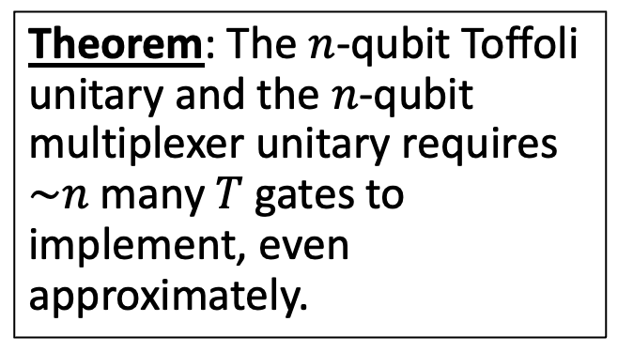
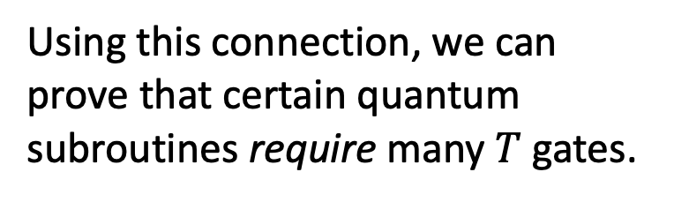
From NLQC to Quantum Circuit Complexity
Using this connection, we can prove that certain quantum subroutines require many $T$ gates.
Theorem: The $n$-qubit Toffoli unitary and the $n$-qubit multiplexer unitary requires $\sim n$ many $T$ gates to implement, even approximately.
Idea: Speelman’s NLQC for Toffoli/multiplexer yields efficient classical communication protocol for classical Boolean functions, which are well studied in theoretical computer science.
(Girish, May, Parham, Y. 2025)

Slide 36
Nonlocal Quantum Computation
Holography and quantum gravity
Quantum Position Verification
Quantum Cryptography
Computational Complexity Theory

Slide 37
Holography and QPV
Holographic principle is conjectured property of theories of quantum gravity that the description of volume of spacetime can be encoded onto boundary.
Juan Maldacena introduced AdS/CFT correspondence as a “toy” model of holographic principle where gravity theory in bulk has equivalent description as pure quantum field theory on boundary.

Slide 38
Holography and QPV
In 2019, Alex May drew a connection between holography and QPV. According to AdS/CFT correspondence, every scattering process in the bulk has an equivalent description on the boundary as a NLQC
Thus, if there exists NLQC requiring exponential entanglement, this tells us something about the nature of the AdS/CFT correspondence.
Likely more to explore here….

Slide 39
Nonlocal Quantum Computation
Holography and quantum gravity
Quantum Position Verification
Quantum Cryptography
Computational Complexity Theory

Slide 40
Position-based cryptography
Computer security and cryptography is about knowing who to trust/distrust based on their identity. Identities are determined by knowledge of some secret information, like a password or a private key.
Position-based cryptography is a different paradigm where identities are determined by physical location.
Bank teller is trusted because they are behind a bullet-proof window, not because they showed us their credentials.
Nuclear missile launch should be trusted because the order came from the White House.
(Okay, maybe not these days…)

Slide 41
Position-based cryptography
Quantum position verification is a tantalizing starting point for this paradigm. Can we do more?
Scenario: QPV allows a person to prove their location in the moment. Can they prove their location in the past to a judge?
E.g., “I was not at the murder scene the night of January 1, 2007”
Scenario: Can a person prove some fact about their location without fully revealing everything about it?
E.g., “I am either in location A or B, but you shouldn’t know which.”

Slide 42
Zero-knowledge position verification
In cryptography, zero-knowledge proofs are protocols for convincing someone that a statement is true, without revealing nothing else about the statement.
E.g., with a zero-knowledge proof you can convince someone that the Riemann Hypothesis is true, but the listener will learn nothing else about the proof aside from the fact that it exists.
Zero-knowledge Position Verification: A user can selectively reveal some information about their location, while keeping the rest private.

Slide 43
Zero-knowledge position verification
Time
Zero-knowledge Position Verification: 1. The verifiers continuously run QPV with the prover.
2. The prover sends a continuous stream of encrypted responses.
3. Later, the prover can execute a cryptographic zero-knowledge proof to convince the verifiers of some statement about its past location history, while revealing zero extra info.
(Girish, Gluch, Goldwasser, Malkin, Orshansky, Y. 2025)
Position

Slide 44













Zero-knowledge position verification
$$Enc_{sk}\left(⊥\right)$$
Time
Zero-knowledge Position Verification: 1. The verifiers continuously run QPV with the prover.
2. The prover sends a continuous stream of encrypted responses.
3. Later, the prover can execute a cryptographic zero-knowledge proof to convince the verifiers of some statement about its past location history, while revealing zero extra info.
$$Enc_{sk}\left(⊥\right)$$
$$Enc_{sk}\left(b\right)$$
$$Enc_{sk}\left(b\right)$$
$$Enc_{sk}\left(⊥\right)$$
$$Enc_{sk}\left(⊥\right)$$
$$Enc_{sk}\left(⊥\right)$$
$$Enc_{sk}\left(⊥\right)$$
$$Enc_{sk}\left(⊥\right)$$
$$Enc_{sk}\left(⊥\right)$$
$$Enc_{sk}\left(⊥\right)$$
$$Enc_{sk}\left(⊥\right)$$
$$Enc_{sk}\left(⊥\right)$$
(Girish, Gluch, Goldwasser, Malkin, Orshansky, Y. 2025)
Position

Slide 45
Summary and Future Directions

Slide 46
Nonlocal Quantum Computation
Holography and quantum gravity
Quantum Position Verification
Quantum Cryptography
Computational Complexity Theory

Slide 47
Future Directions
Cryptography: what are other forms of position-based cryptography?
Complexity: use QPV/NLQC as lens on complexity of quantum computation?
Holography: insights into AdS/CFT correspondence can QPV/NLQC give?
Experiment: demonstrate QPV in real life?
Thank You!

