Slide 1
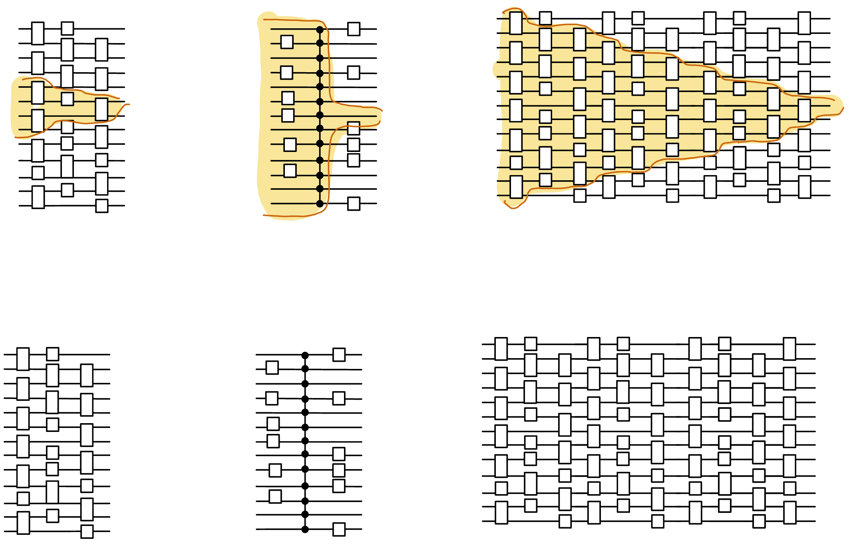
Beyond lightcone arguments in quantum circuit lower bounds
Henry Yuen
Columbia University

Slide 2
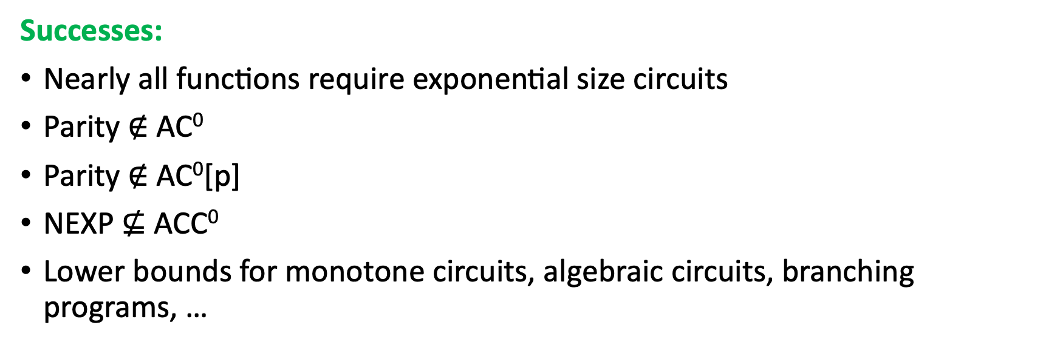
State of (classical) circuit lower bounds
Successes:
Nearly all functions require exponential size circuits
Parity $∉$ AC⁰
Parity $∉$ AC⁰[p]
NEXP $⊈$ ACC⁰
Lower bounds for monotone circuits, algebraic circuits, branching programs, …
(Shannon ‘47)
(Ajtai ’83, Furst-Saxe-Sipser ‘84, Hastad ‘86)
(Razborov-Smolensky ‘87)
(Williams ‘10)
Successful techniques: random restrictions, polynomial method(s), algorithmic method, Fourier analysis, communication complexity, …

Slide 3
State of (classical) circuit lower bounds
Failure:
Don’t know how to prove depth-4 neural networks (TC⁰ circuits) can’t compute all functions in NEXP.
Don’t know how to prove NP requires circuits bigger than n^{1.001}-size.
Barriers: can’t prove lower bounds using
Relativizing proofs
Natural proofs
Algebraizing proofs
(Baker-Gill-Solovay ‘79)
(Razborov-Rudich ‘94)
(Aaronson-Wigderson ‘09)

Slide 4
Quantum circuit complexity

Slide 5
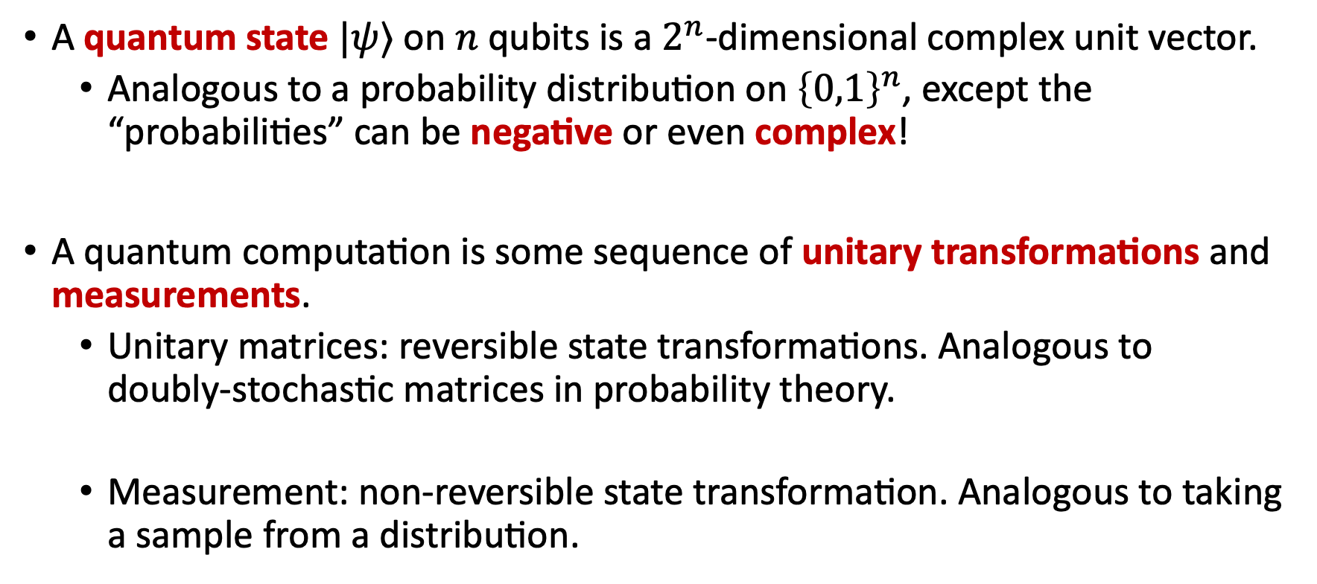
Quantum states and computation
A quantum state $|ψ⟩$ on $n$ qubits is a $2^{n}$-dimensional complex unit vector.
  Analogous to a probability distribution on ${\left\{0,1\right\}}^{n}$, except the “probabilities” can be negative or even complex!
A quantum computation is some sequence of unitary transformations and measurements.
  Unitary matrices: reversible state transformations. Analogous to doubly-stochastic matrices in probability theory.
  Measurement: non-reversible state transformation. Analogous to taking a sample from a distribution.

Slide 6
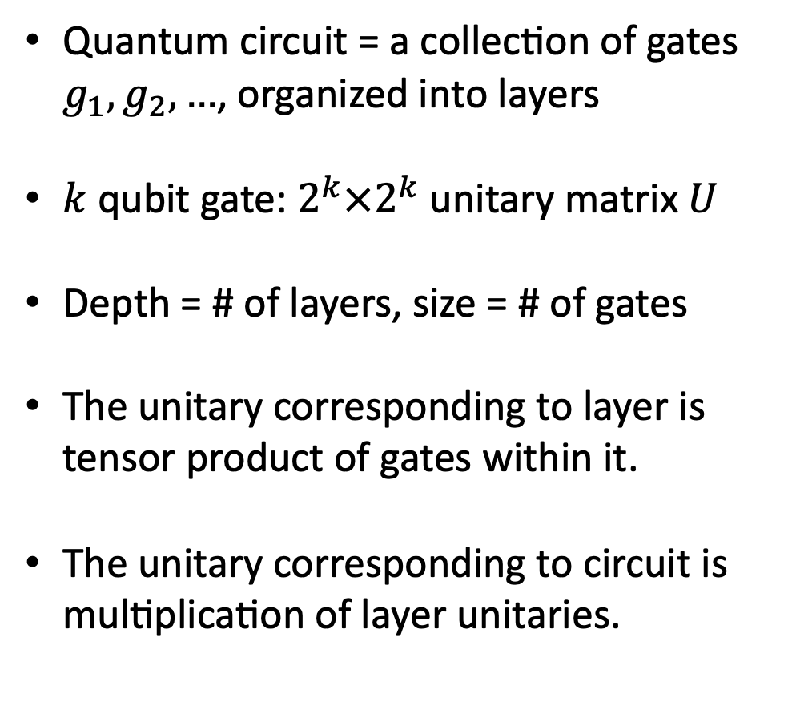

Quantum circuits
Quantum circuit = a collection of gates $g_{1},g_{2},…$, organized into layers
$k$ qubit gate: $2^{k}×2^{k}$unitary matrix $U$
Depth = # of layers, size = # of gates
The unitary corresponding to layer is tensor product of gates within it.
The unitary corresponding to circuit is multiplication of layer unitaries.
2 qubit gates
n qubit input
$$\left|ψ\right\rangle$$
….
1 qubit gates

Slide 7

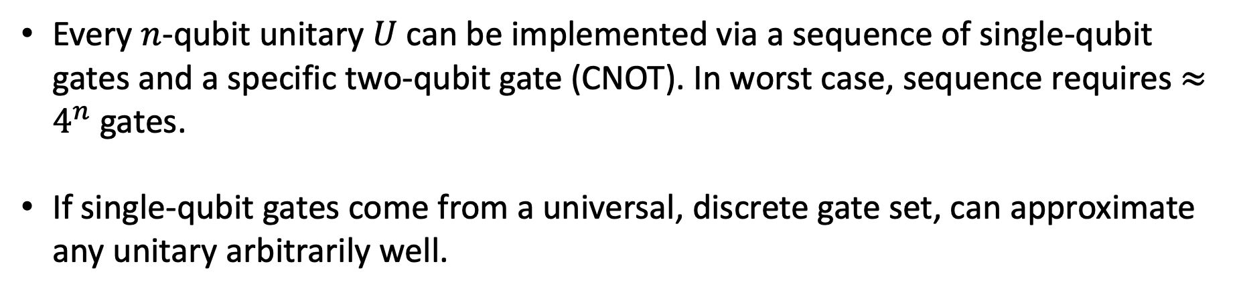
Universality
Every $n$-qubit unitary $U$ can be implemented via a sequence of single-qubit gates and a specific two-qubit gate (CNOT). In worst case, sequence requires $≈4^{n}$ gates.
If single-qubit gates come from a universal, discrete gate set, can approximate any unitary arbitrarily well.
$$=$$
….
….

Slide 8
Quantum circuit lower bounds
Successes:
Nearly all unitary transformations require exponential size circuits
There exists an explicit unitary requiring exponential size circuits to compute exactly
Lightcone argument for shallow quantum circuits.
(Jia, Wolf 2023)
Failures:
Field is too young to have failures ☺

Slide 9
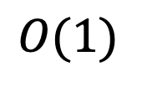
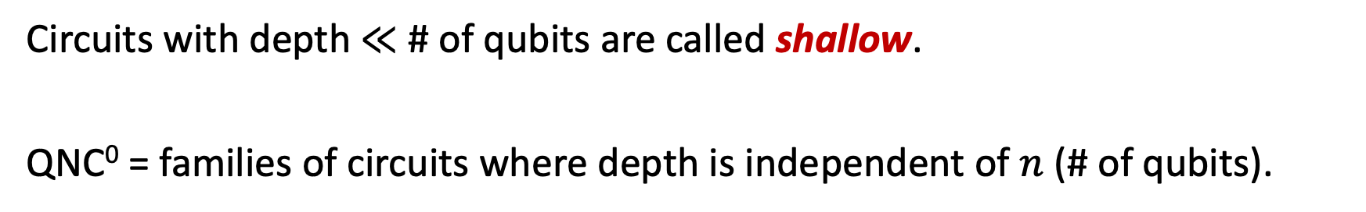

Shallow quantum circuits
Circuits with depth $≪$ # of qubits are called shallow.
QNC⁰ = families of circuits where depth is independent of $n$ (# of qubits).
A useful model of near-term quantum computing.
Current-day quantum computers can only execute a few layers of gates before noise overwhelms the system.
$$n$$
$$O(1)$$

Slide 10
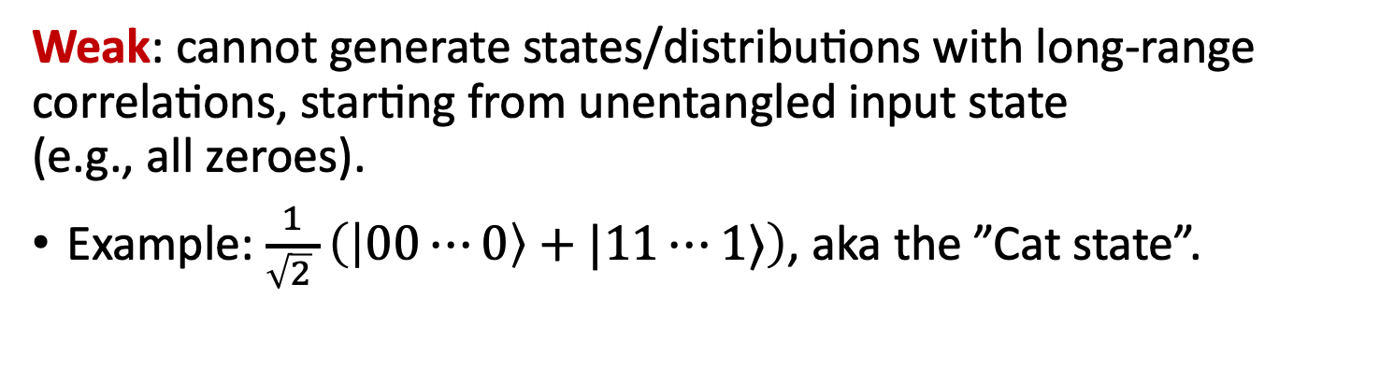
Shallow quantum circuits
Powerful: QNC⁰ circuits can generate probability distributions that cannot be classically sampled from (under plausible complexity assumptions).
(DiVincenzo-Terhal ’03, Bremner-Josza-Shepherd ‘09, …)
Weak: cannot generate states/distributions with long-range correlations, starting from unentangled input state
(e.g., all zeroes).
Example: $\frac{1}{\sqrt{2} }\left(\left|00⋯0\right\rangle +|11⋯1⟩\right)$, aka the ”Cat state”.
$$n$$
$$O(1)$$

Slide 11
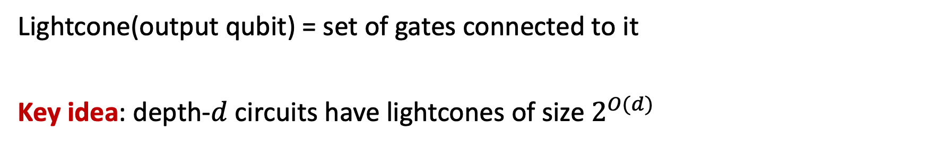
The lightcone argument
Lightcone(output qubit) = set of gates connected to it
Key idea: depth-$d$ circuits have lightcones of size $2^{O(d)}$
Proof that Cat State cannot be prepared by QNC⁰ circuits:
In Cat State, marginal state of any two qubits is equal
mixture of 00 and 11.
On the other hand, two output qubits of QNC⁰ circuit with disjoint lightcones must be uncorrelated with each other.
$$n$$
$$O(1)$$

Slide 12
Motivations from computer science and physics

Slide 13
Quantum PCP Conjecture
Classical PCP Theorem: NP-hard to find approximate solutions to constraint satisfaction problems, even up to constant fraction error.
Quantum PCP Conjecture: It is QMA-hard to approximate lowest energy of local Hamiltonians, even up to constant fraction error.
With plausible complexity assumptions, QPCP implies that low energy states have high quantum circuit complexity.
(Arora-Safra ‘92, Arora-Lund-Motwani-Sudan-Szegedy ‘98)

Slide 14
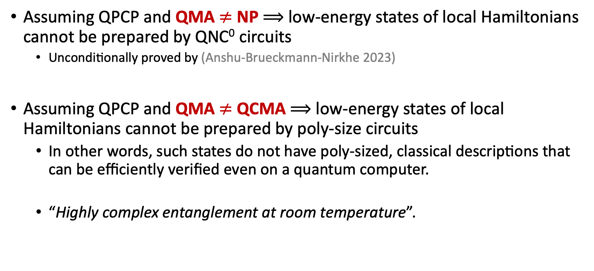
Quantum PCP Conjecture
Assuming QPCP and QMA $≠$ NP $⟹$ low-energy states of local Hamiltonians cannot be prepared by QNC⁰ circuits
  Unconditionally proved by (Anshu-Brueckmann-Nirkhe 2023)
Assuming QPCP and QMA $≠$ QCMA $⟹$ low-energy states of local Hamiltonians cannot be prepared by poly-size circuits
  In other words, such states do not have poly-sized, classical descriptions that can be efficiently verified even on a quantum computer.
  “Highly complex entanglement at room temperature”.

Slide 15
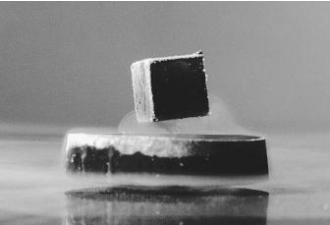
Condensed matter physics
An important goal in condensed matter physics is classifying quantum phases of matter. Distinct quantum phases are have distinct patterns of quantum correlations between particles. E.g., superconducting phases, topological phases, fraction phases.
Modern quantum info perspective:
Thus, classifying phases is equivalent to showing a circuit lower bound!
equivalence class of states connected by constant-depth quantum circuits.
a quantum phase of matter
=

Slide 16
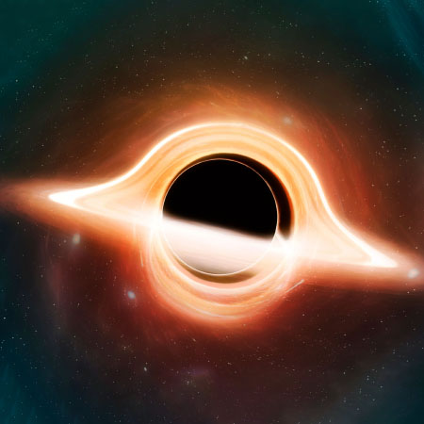
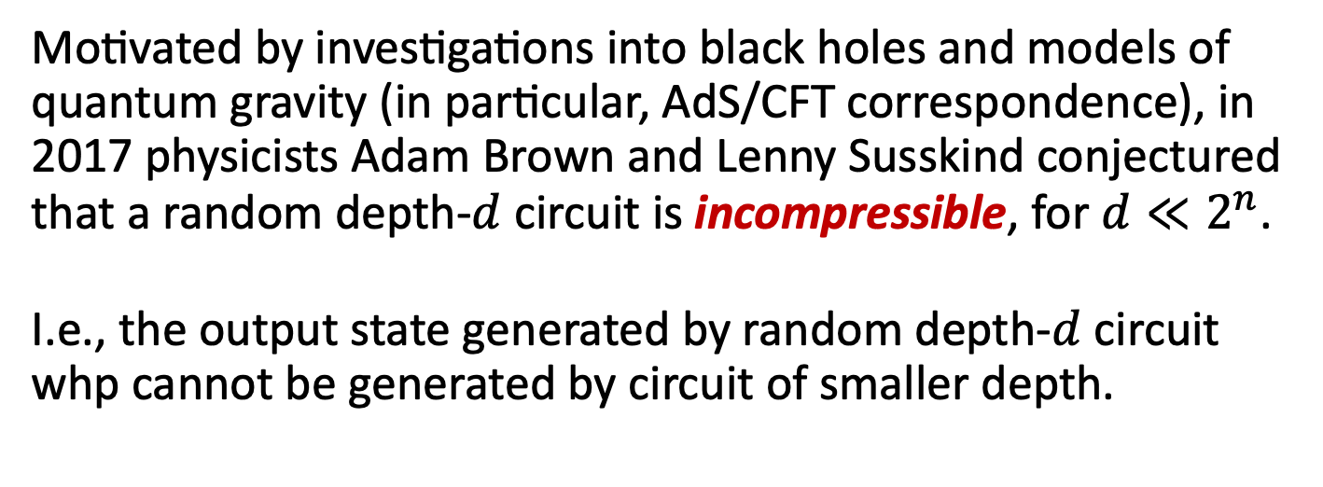
Brown-Susskind conjecture
Motivated by investigations into black holes and models of quantum gravity (in particular, AdS/CFT correspondence), in 2017 physicists Adam Brown and Lenny Susskind conjectured that a random depth-$d$ circuit is incompressible, for $d≪2^{n}$.
I.e., the output state generated by random depth-$d$ circuit whp cannot be generated by circuit of smaller depth.
Exact case of Brown-Susskind conjecture settled in 2021.
Robust case settled in 2024.
(Haferkamp, Faist, Kothakonda,
Eisert, Yunger Halpern)
(Chen, Haah, Haferkamp, Liu, Metger, Tan)

Slide 17
The Frontier of
Quantum Circuit Complexity

Slide 18
Power of many-qubit gates?
What is the power of shallow circuits augmented with gates that can act on many qubits simultaneously?
Lightcone arguments are no longer a barrier: each output qubit can be affected by all input qubits simultaneously.
Answer depends the kind of many-qubit gates allowed.
In 1999, Chris Moore proposed two models QAC⁰ and QAC⁰_{f} as quantum analogues of the classical circuit model AC⁰

Slide 19
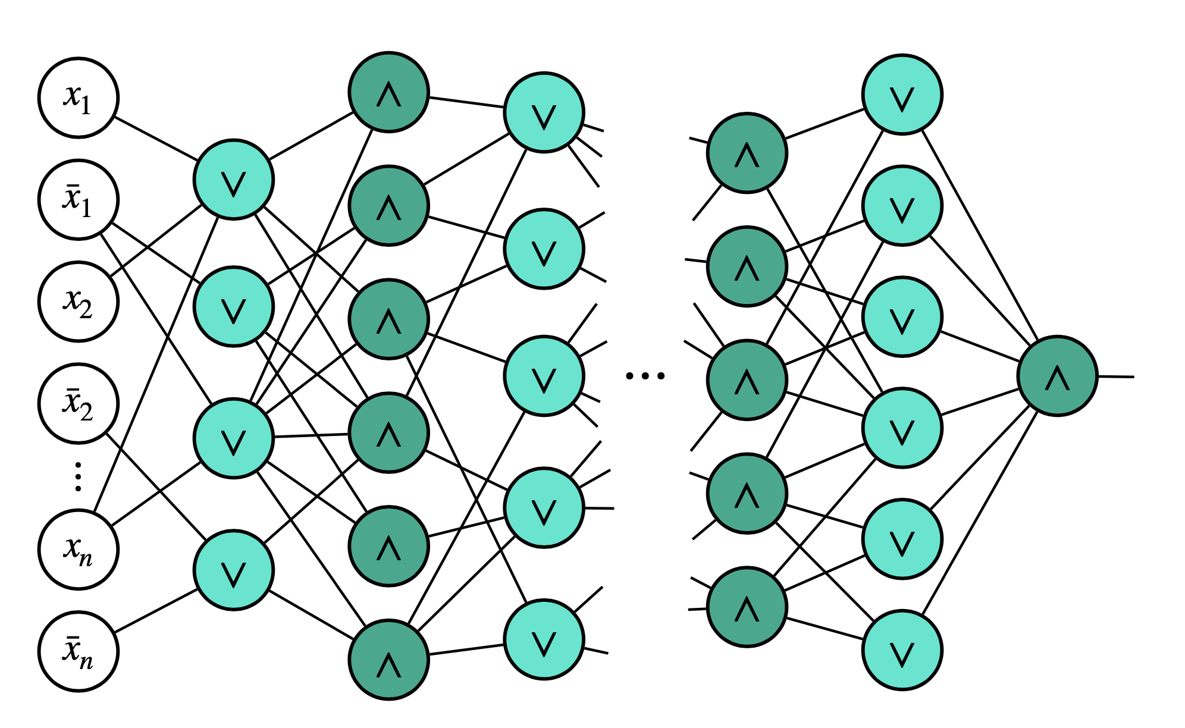
Classical AC⁰ circuits
AC0 = constant-depth, polynomial-size circuits with AND, OR, NOT gates with unbounded fan-in.
We have classical lower bounds beyond lightcones!
Parity cannot be computed by poly-sized AC⁰ circuits.
(Ajtai ’83, Furst-Saxe-Sipser ‘84, Hastad ‘86)
Depth

Slide 20





QAC⁰ with Toffoli gates
QAC⁰: constant-depth circuits with arbitrary single-qubit gates, and
many-qubit Toffoli gates (i.e., reversible AND)
$\text{Toffoli}\left|x_{1},…,x_{k},b\right\rangle =|x_{1},…,x_{k},b⊕x_{1}∧⋯∧x_{k}⟩$
$$x_{1}$$
$$x_{2}$$
$$x_{3}$$
$$b$$
Example of QAC⁰ circuit. Lightcones are large due to Toffoli gates.

Slide 21

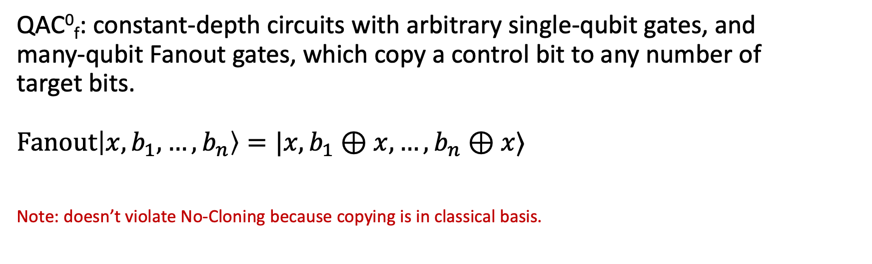



QAC⁰ with Fanout gates
QAC⁰_{f}: constant-depth circuits with arbitrary single-qubit gates, and
many-qubit Fanout gates, which copy a control bit to any number of
target bits.
$\text{Fanout}\left|x,b_{1},…,b_{n}\right\rangle =|x,b_{1}⊕x,…,b_{n}⊕x⟩$
Note: doesn’t violate No-Cloning because copying is in classical basis.
$$x$$
$$b_{1}$$
$$b_{2}$$
$$b_{3}$$
Fanout gates can simulate Toffoli gates, so QAC⁰ $⊆$ QAC⁰_{f}
(Takahashi, Tani 2016)

Slide 22

QAC⁰ with Fanout gates
QAC⁰_{f}: constant-depth circuits with arbitrary single-qubit gates, and
many-qubit Fanout gates, which copy a control bit to any number of
target bits.
$\text{Fanout}\left|x,b_{1},…,b_{n}\right\rangle =|x,b_{1}⊕x,…,b_{n}⊕x⟩$
Note: doesn’t violate No-Cloning because copying is in classical basis.
$$x$$
$$b_{1}$$
Key Questions:
1. What can be computed by QAC⁰, QAC⁰_{f}?
2. Is QAC⁰_{f} more powerful than QAC⁰?
$$b_{2}$$
$$b_{3}$$
Fanout gates can simulate Toffoli gates, so QAC⁰ $⊆$ QAC⁰_{f}
(Takahashi, Tani 2016)

Slide 23
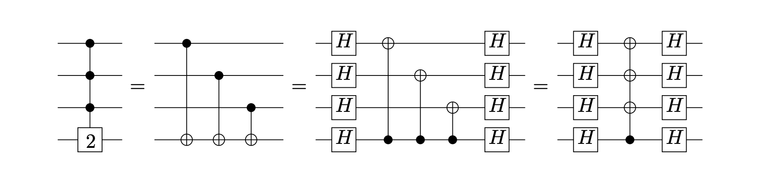

The power of QAC⁰_{f}
FANOUT is equivalent to computing Parity
In other words: Parity $∈$ QAC⁰_{f}
PARITY
FANOUT

Slide 24











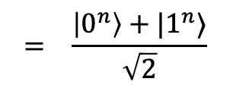



The power of QAC⁰_{f}
FANOUT is equivalent to preparing CAT states:
$$|0⟩$$
$$|0⟩$$
$$|x_{1},…,x_{n}⟩$$
$$|0⟩$$
$$|0⟩$$
$$H$$
$$|b⟩$$
$$=|b⊕c⟩$$
FANOUT $⟹$ CAT
$$|0,…,0⟩$$
$$C$$
$$C^{†}$$
$$C$$
$$= \frac{\left|0^{n}\right\rangle +|1^{n}⟩}{\sqrt{2}}$$
CAT $⟹$ PARITY
$$|0,…,0⟩$$
$$c=x_{1}⊕x_{2}⊕⋯⊕x_{n}$$
CAT state preparation

Slide 25
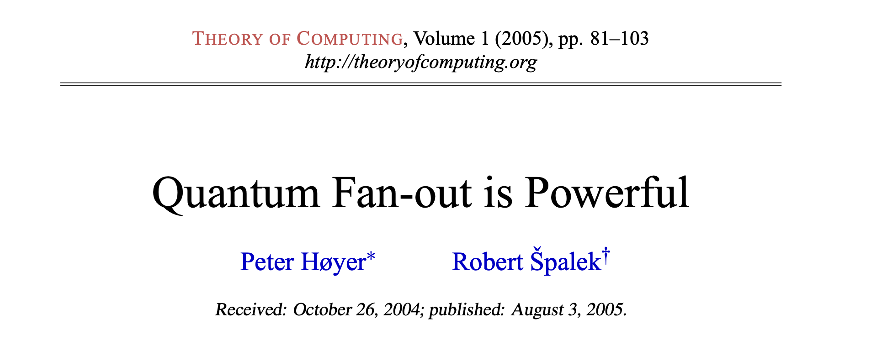
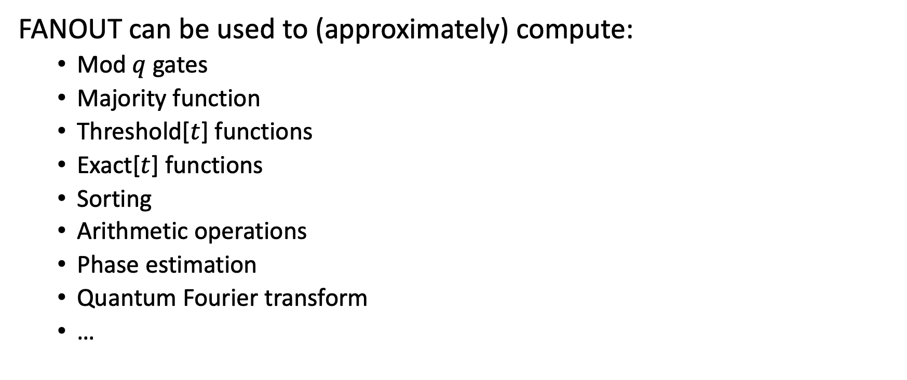
The power of QAC⁰_{f}
FANOUT can be used to (approximately) compute:
  Mod $q$ gates
  Majority function
  Threshold[$t$] functions
  Exact[$t$] functions
  Sorting
  Arithmetic operations
  Phase estimation
  Quantum Fourier transform
  …

Slide 26
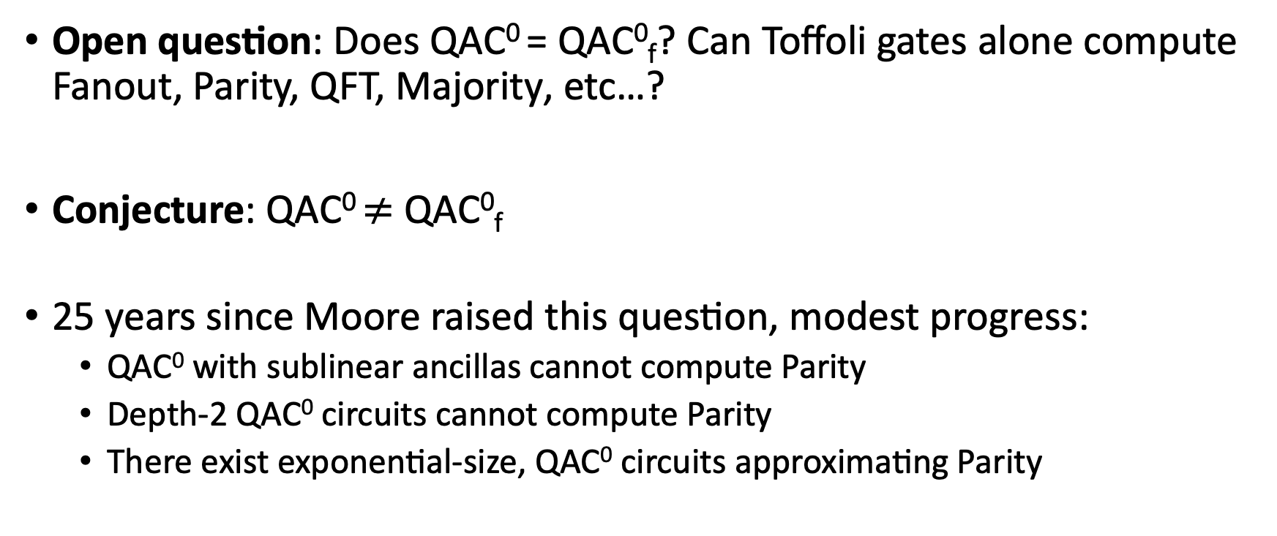
QAC⁰ vs QAC⁰_{f}
Open question: Does QAC⁰ = QAC⁰_{f}? Can Toffoli gates alone compute Fanout, Parity, QFT, Majority, etc…?
Conjecture: QAC⁰ $≠$ QAC⁰_{f}
25 years since Moore raised this question, modest progress:
  QAC⁰ with sublinear ancillas cannot compute Parity
  Depth-2 QAC⁰ circuits cannot compute Parity
  There exist exponential-size, QAC⁰ circuits approximating Parity
Fang, Fenner, Green, Homer, Zhang (‘03)
Pade, Fenner, Grier, Thierauf (‘20)
Rosenthal (‘20)

Slide 27
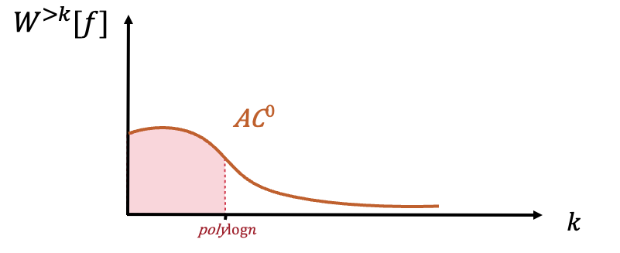
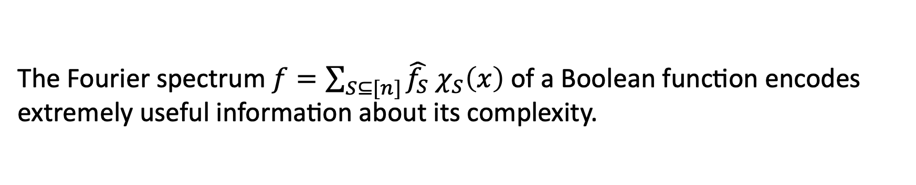
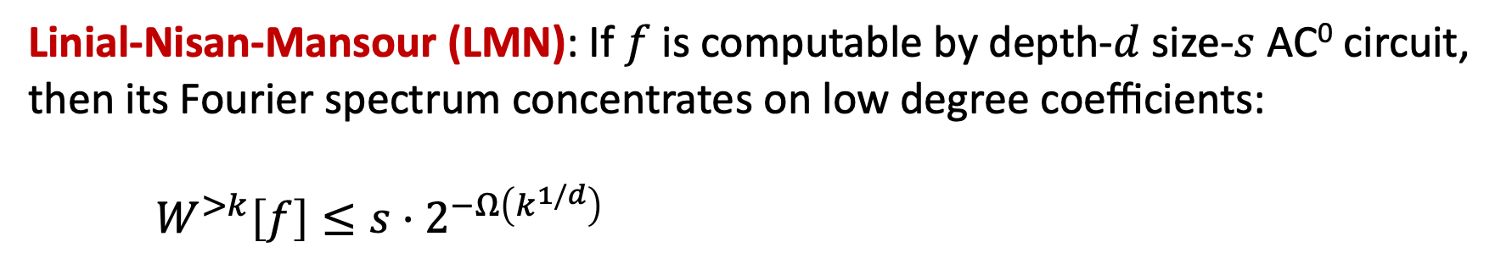
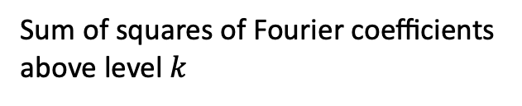
Fourier spectrum vs complexity
The Fourier spectrum $f=\sum_{S⊆[n]}{\hat{f_{S}} χ_{S}\left(x\right)}$of a Boolean function encodes extremely useful information about its complexity.
Linial-Nisan-Mansour (LMN): If $f$ is computable by depth-$d$size-$s$ AC⁰ circuit, then its Fourier spectrum concentrates on low degree coefficients:
$W^{>k}\left[f\right]≤s⋅2^{−Ω\left(k^{1/d}\right)}$
Sum of squares of Fourier coefficients above level $k$

Slide 28

Fourier spectrum vs complexity
Consequences of LMN Theorem:
Lower bounds: AC⁰ functions cannot approximate Parity function
Pseudorandomness: AC⁰ functions cannot be pseudorandom
Learning theory: AC⁰ functions can be learned in quasipolynomial time
Is there a quantum analogue of LMN Theorem for quantum circuits?
$$n$$

Slide 29
Towards Quantum LMN
(Nadimpalli, Parham, Vasconcelos, Y. ‘24)
We introduce the notion of the Pauli spectrum of a quantum circuit, which is a quantum analogue of the Fourier spectrum of a Boolean function.
Result #1: Pauli spectrum of QAC⁰ circuits (with few ancilla) are highly concentrated on the low-degree components.
Corollary: QAC⁰ circuits with few ancilla cannot approximate PARITY or MAJORITY.
Result #2: Quantum circuits with concentrated Pauli spectrum can be learned sample-efficiently.

Slide 30
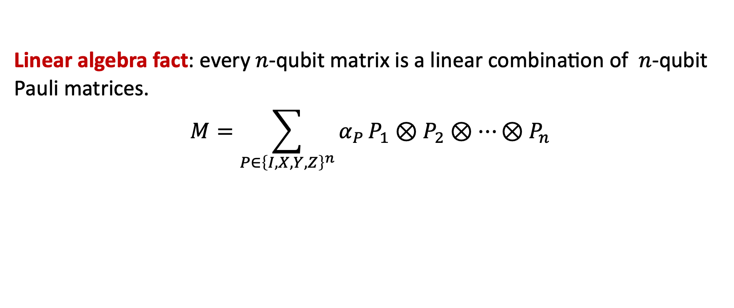
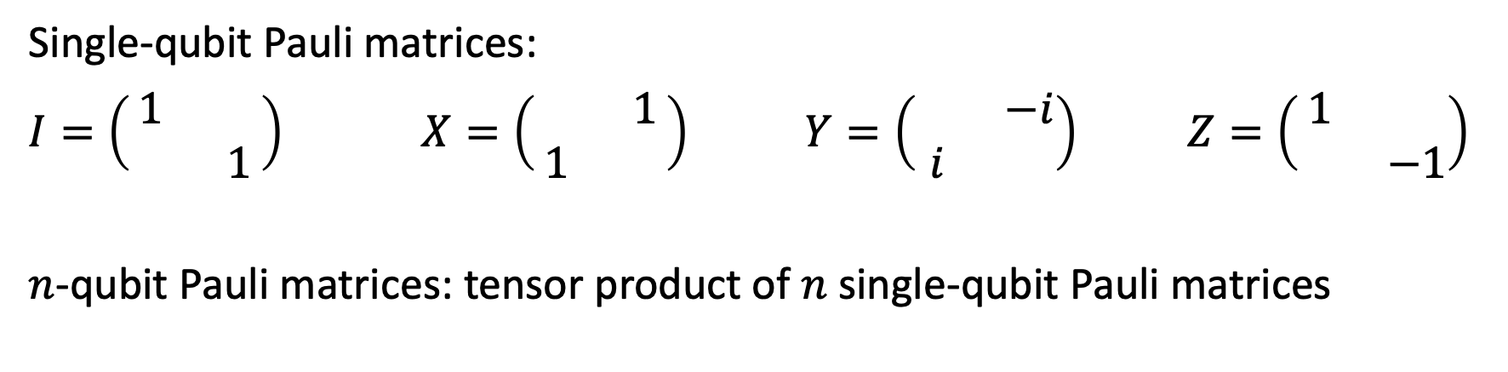
Linear algebra review
Single-qubit Pauli matrices:
$I=\left(\begin{matrix}1 & \\ & 1\end{matrix}\right)$ $X=\left(\begin{matrix} & 1 \\ 1 & \end{matrix}\right)$ $Y=\left(\begin{matrix} & −i \\ i & \end{matrix}\right)$ $Z=\left(\begin{matrix}1 & \\ & −1\end{matrix}\right)$
$n$-qubit Pauli matrices: tensor product of $n$ single-qubit Pauli matrices
Linear algebra fact: every $n$-qubit matrix is a linear combination of $n$-qubit Pauli matrices.
$$M=\sum_{P∈{\left\{I,X,Y,Z\right\}}^{n}}{α_{P}}P_{1}⊗P_{2}⊗⋯⊗P_{n}$$

Slide 31







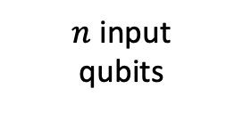

Pauli spectrum of quantum circuits
$C$ = quantum circuit with $n$ input qubits, $a$ ancilla qubits, and 1 output qubit
The following diagram defines an $n$-qubit matrix $Φ_{C}$:
Output qubit
$$Z$$
$n$ input
qubits
$$C^{†}$$
$$C$$
$$⟨0|$$
$$|0⟩$$
$a$ancilla
qubits
$$⟨0|$$
$$|0⟩$$

Slide 32
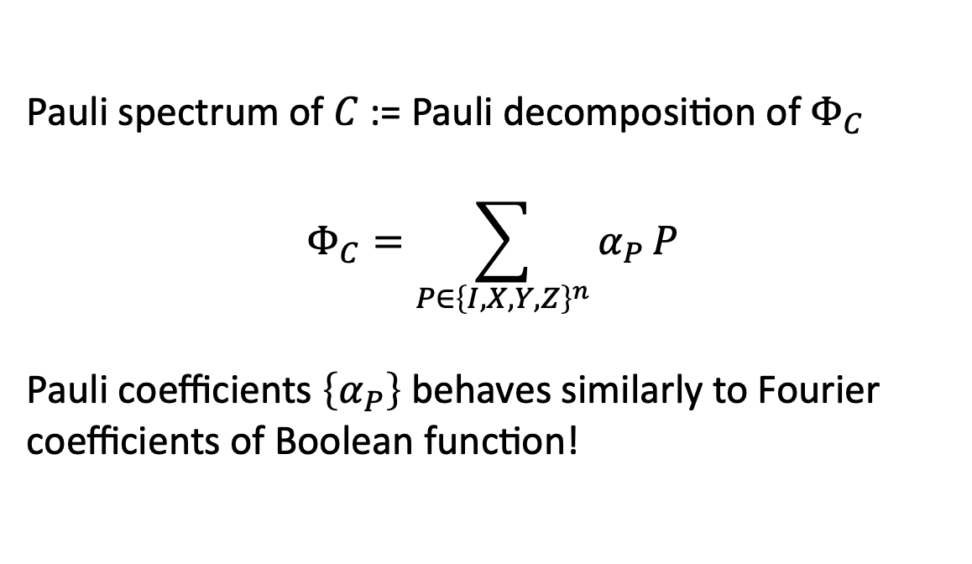
Pauli spectrum of quantum circuits
$C$ = quantum circuit with $n$ input qubits, $a$ ancilla qubits, and 1 output qubit
The following diagram defines an $n$-qubit matrix $Φ_{C}$:
Output qubit
$$Z$$
Pauli spectrum of $C$ := Pauli decomposition of $Φ_{C}$
$$Φ_{C}=\sum_{P∈{\left\{I,X,Y,Z\right\}}^{n}}{α_{P}}P$$
Pauli coefficients $\left\{α_{P}\right\}$ behaves similarly to Fourier coefficients of Boolean function!
$n$ input
qubits
$$C^{†}$$
$$C$$
$$⟨0|$$
$$|0⟩$$
$a$ancilla
qubits
$$⟨0|$$
$$|0⟩$$

Slide 33
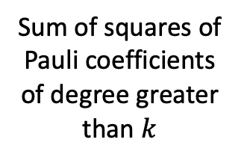

Quantum LMN in few-ancilla setting
Theorem (Nadimpalli, Parham, Vasconcelos, Y. ‘24)
If $C$ is computable by depth-$d$size-$s$ QAC⁰ circuit with $a$ ancilla qubits, then its Pauli spectrum concentrates on low degree coefficients:
$$W^{>k}\left[Φ_{C}\right]≤s^{2}⋅2^{−Ω\left(k^{1/d}\right)}⋅2^{a}$$
Resembles classical LMN!
Sum of squares of Pauli coefficients of degree greater than $k$
Exponential dependence on
# of ancilla qubits

Slide 34
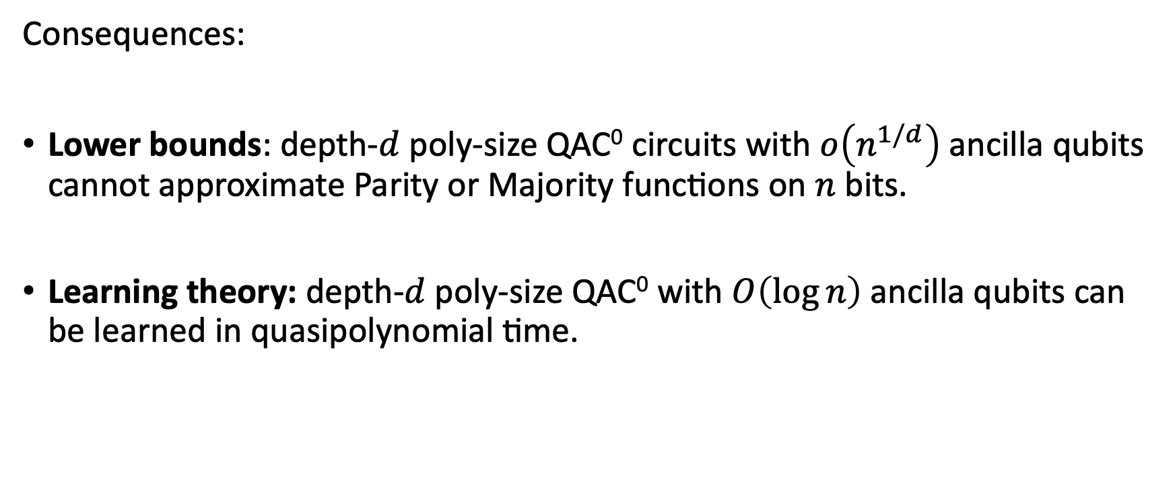
Quantum LMN in few-ancilla setting
Consequences:
Lower bounds: depth-$d$poly-size QAC⁰ circuits with $o\left(n^{1/d}\right)$ ancilla qubits cannot approximate Parity or Majority functions on $n$ bits.
Learning theory: depth-$d$poly-size QAC⁰ with $O\left(\log{n}\right)$ ancilla qubits can be learned in quasipolynomial time.

Slide 35
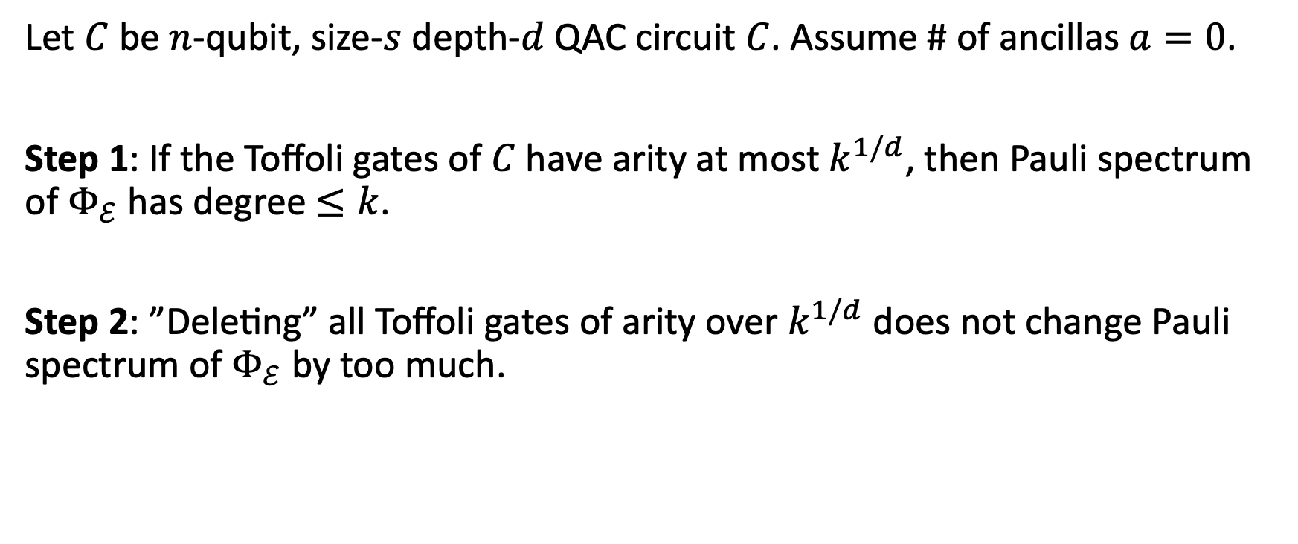
Overview of QAC⁰ low-degree concentration
Let $C$ be $n$-qubit, size-$s$ depth-$d$ QAC circuit $C$. Assume # of ancillas $a=0$.
Step 1: If the Toffoli gates of $C$have arity at most $k^{1/d}$, then Pauli spectrum of $Φ_{ℰ}$ has degree $≤k$.
Step 2: ”Deleting” all Toffoli gates of arity over $k^{1/d}$ does not change Pauli spectrum of $Φ_{ℰ}$ by too much.

Slide 36
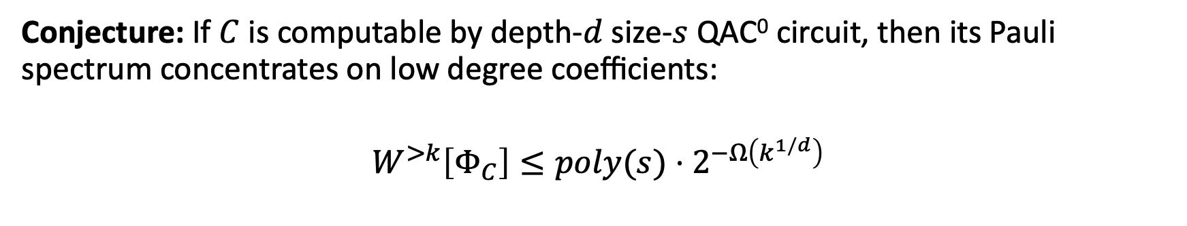
Quantum LMN Conjecture
Conjecture: If $C$ is computable by depth-$d$size-$s$ QAC⁰ circuit, then its Pauli spectrum concentrates on low degree coefficients:
$$W^{>k}\left[Φ_{C}\right]≤poly(s)⋅2^{−Ω\left(k^{1/d}\right)}$$
No ancilla dependence!
Corollary: Parity and Majority cannot be computed by polynomial-size QAC⁰ circuits.
Corollary: Poly-size QAC⁰ circuits can be learned in quasipolynomial time.

Slide 37
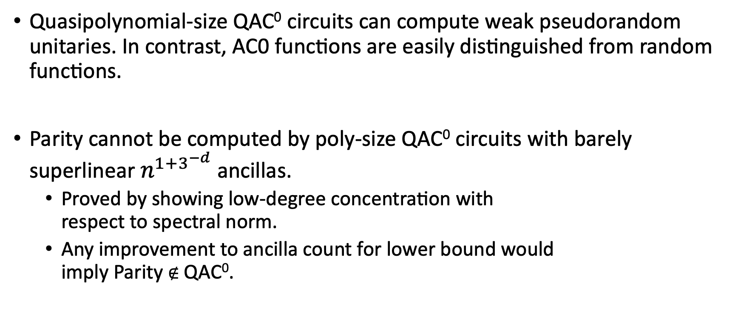
New developments
Quasipolynomial-size QAC⁰ circuits can compute weak pseudorandom unitaries. In contrast, AC0 functions are easily distinguished from random functions.
Parity cannot be computed by poly-size QAC⁰ circuits with barely superlinear $n^{1+3^{−d}}$ancillas.
  Proved by showing low-degree concentration with
  respect to spectral norm.
  Any improvement to ancilla count for lower bound would
  imply Parity $∉$ QAC⁰.
(Foxman, Parham, Yuen, upcoming)
(Anshu, Dong, Ou, Yao ‘25)

Slide 38
Summary
Concentration bound: QAC⁰ circuits with few ancillas have concentrated Pauli spectrum
Linial-Mansour-Nisan: AC⁰ functions $≈$ low degree polynomials
Quantum LMN: QAC⁰ functions $≈$ low degree Pauli-nomials
Circuit lower bounds: QAC⁰ circuits with few ancillas cannot approximate Parity or Majority functions.
Learning: QAC⁰ circuits with few ancillas can be learned in quasipolynomial time.

Slide 39
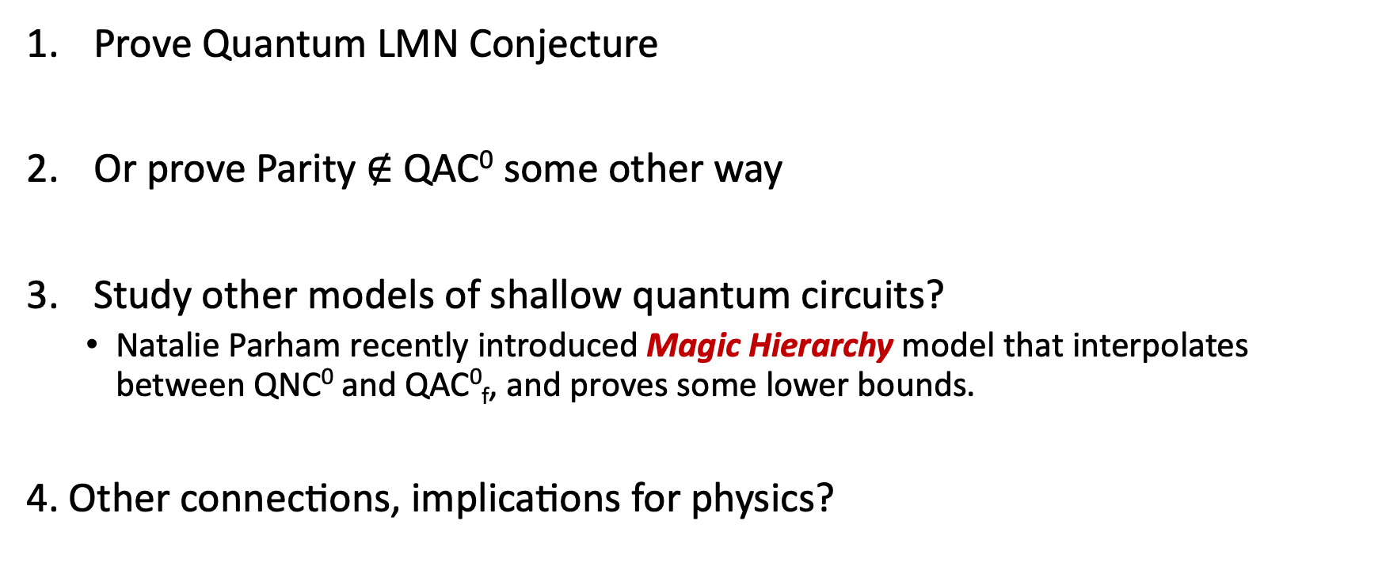
Future directions
Prove Quantum LMN Conjecture
Or prove Parity $∉$ QAC⁰ some other way
Study other models of shallow quantum circuits?
  Natalie Parham recently introduced Magic Hierarchy model that interpolates between QNC⁰ and QAC⁰_{f}, and proves some lower bounds.
4. Other connections, implications for physics?
Thank You!

