Slide 1
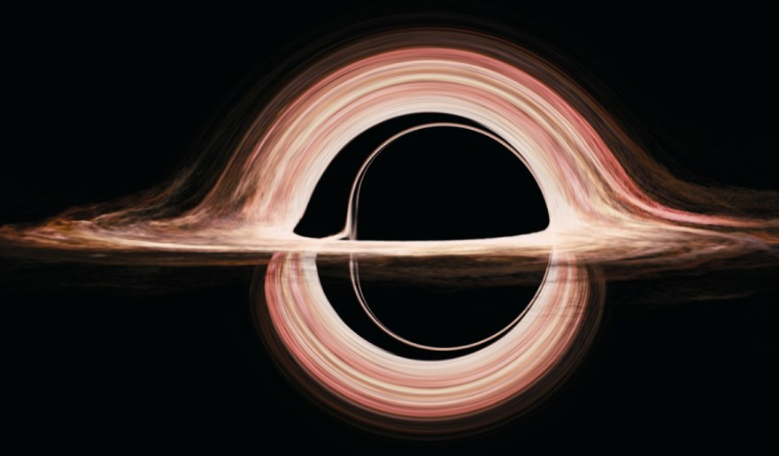
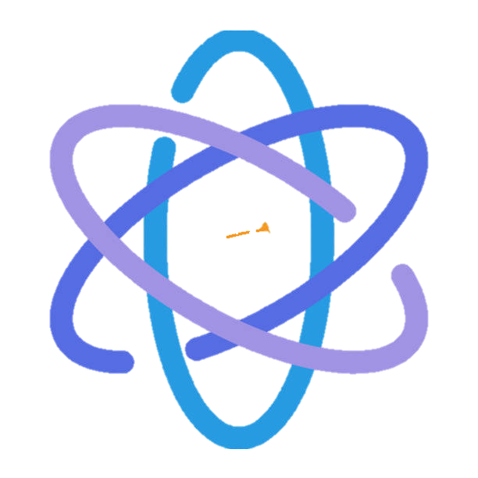
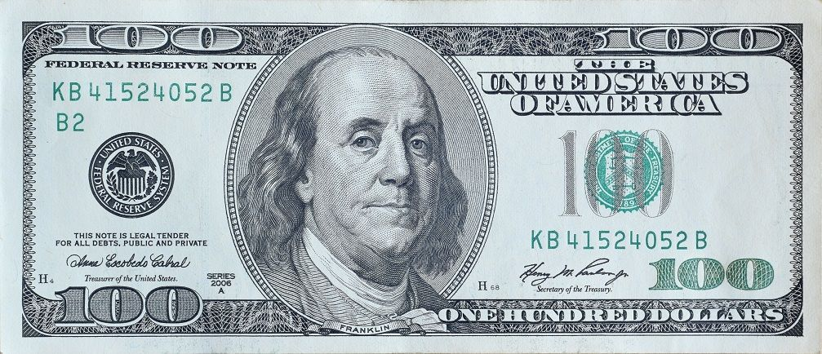
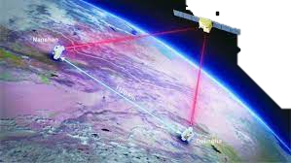
Quantum Cryptography
From Quantum Money to Quantum Gravity
Henry Yuen
Computer Science Columbia University
Notes:
Good morning everyone, I’m delighted to be here. I’m a faculty member in computer science, and my research focuses on the theory of quantum computing and quantum cryptography. In the previous talk you heard about using quantum computers to perform difficult calculations and simulations. This talk will be about how quantum computers can change the way we think about cryptography.

Slide 2
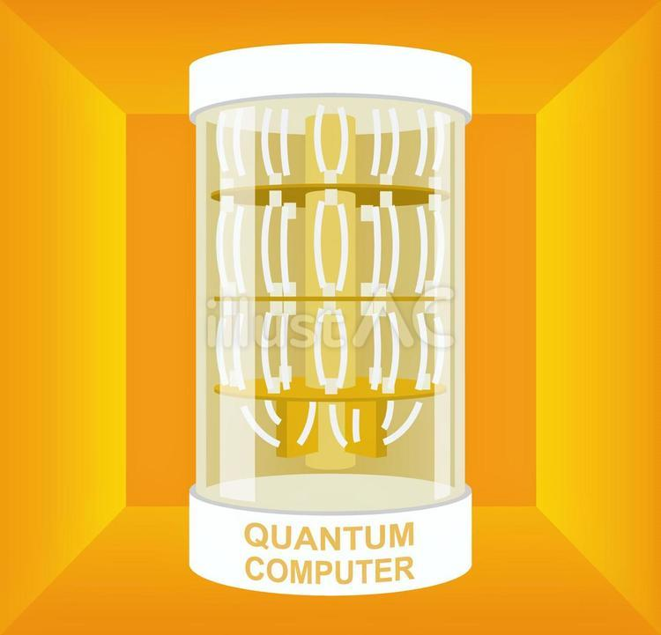
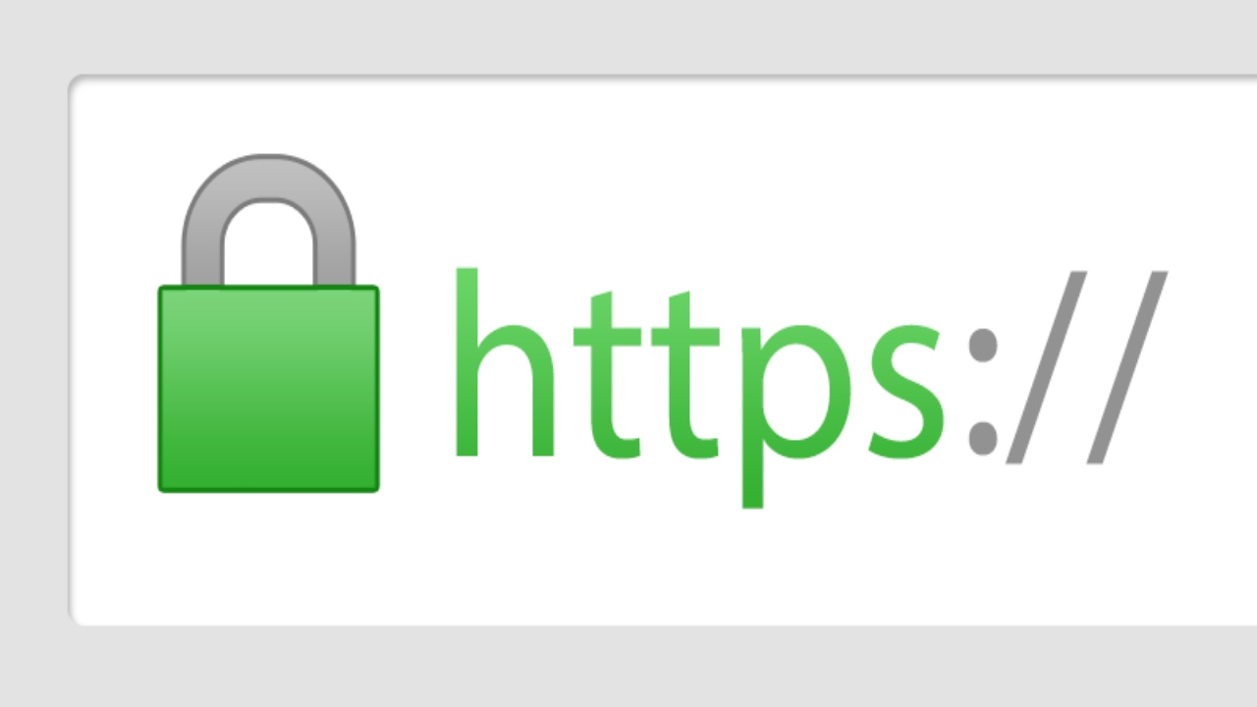
Quantum Cryptography
Threat
A fault-tolerant quantum computer can break RSA and other widely-used cryptosystems.
Notes:
When most people hear the phrase quantum cryptography, they think of quantum computers as a threat. Large-scale fault-tolerant quantum computers will be capable of factoring large integers quickly. Up to now, much of the security underpinning the Internet rests on the the belief that this problem is too difficult – quantum computers will render RSA and other widely-used cryptosystems useless. Quantum means bad news for cryptography.

Slide 3
Quantum Cryptography
Threat
Possibilities
Quantum physics enables new forms of cryptography that have no classical analogue.
Quantum Money
Uncopyable Software
Certified Deletion
Position Verification
A fault-tolerant quantum computer can break RSA and other widely-used cryptosystems.
Notes:
But that’s only half the story.
Quantum computers don’t just break classical cryptography. It also allows us to invent entirely new kinds of cryptography. Things that were once thought impossible: money that can’t be forged, programs that can’t be copied, data that can be provably deleted — even tools to probe the inner secrets of black holes.
Today I want to tell you the story of how these fascinating ideas came about, and give you a glimpse of what’s in store for the future.

Slide 4
Origins

Slide 5
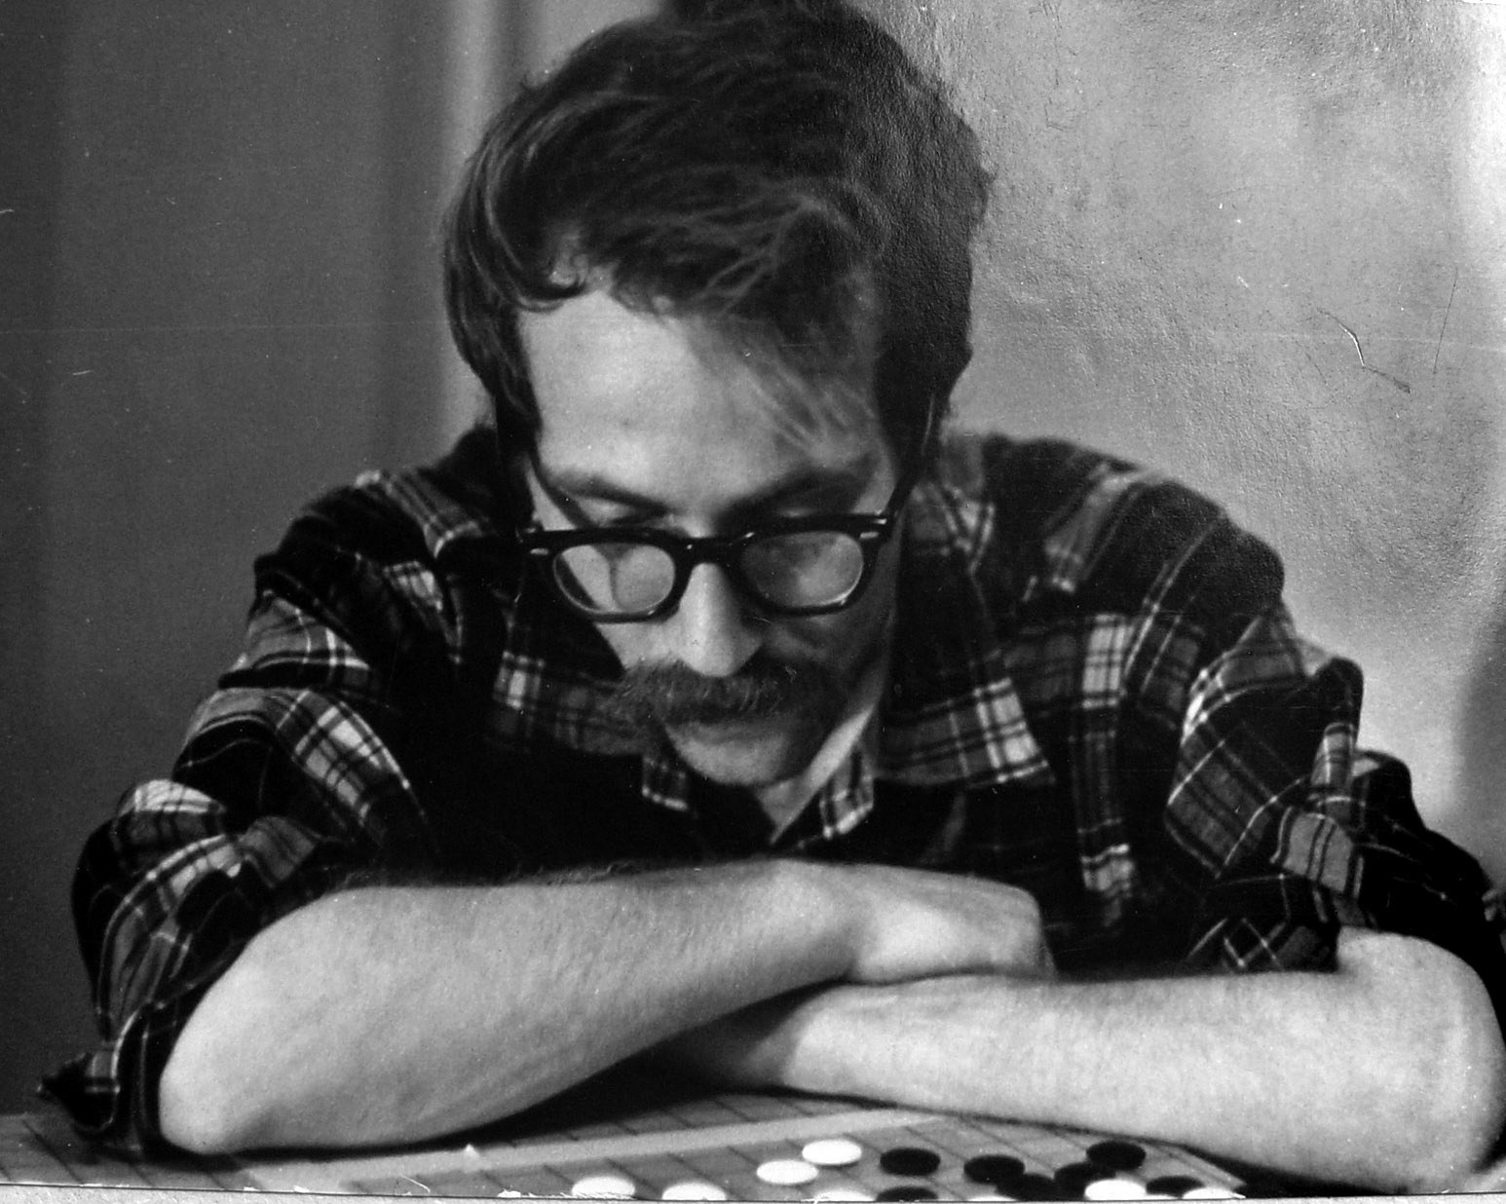
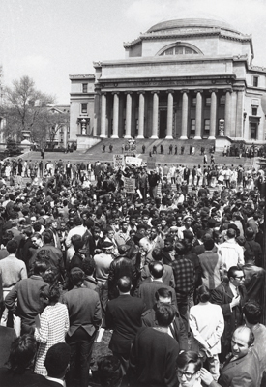
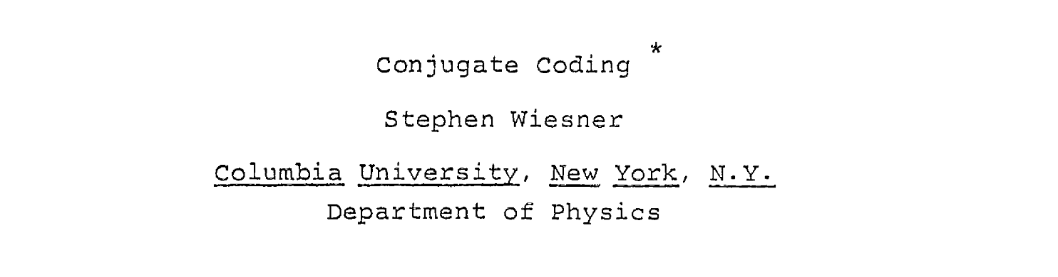
Columbia University (1968)
Notes:
We have to go back 57 years ago to 1968, right here at Columbia. This is the central character in our story: Stephen Wiesner, who was a graduate student in physics at the time. In the middle of the famous student protests at the time, Wiesner wrote a landmark, amazing, brilliant paper called Conjugate Coding. The only thing was nobody understood it or recognized its importance at the time.

Slide 6
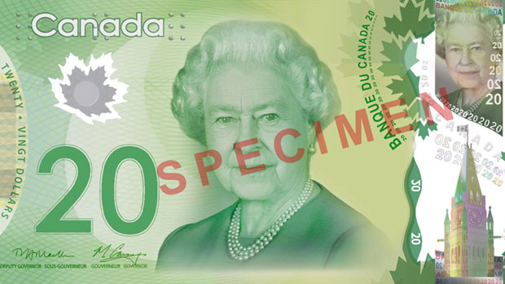
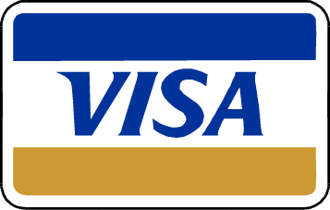
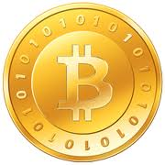
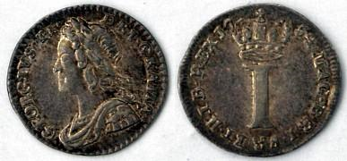
The Physics of Money
Wiesner’s goal: money that is physically impossible to counterfeit.
In classical physics, matter/information can always be copied in principle.
In quantum physics, the No-Cloning Theorem forbids this.
Notes:
Wiesner wondered: could you make money that was physically impossible to counterfeit? In classical physics, you can always in principle copy information. But in quantum physics, the no-cloning theorem says otherwise.

Slide 7


Classical vs Quantum Information
Credit: Barak Nehoran and Natalia
By contrast,
You can taste it, but it will destroy the cake!
Can’t make a copy without the recipe
Good luck emailing a cake…
You can
Read it
Make copies of it
Send it over the internet
Classical Information
Quantum Information
Notes:
Quantum information differs from classical information in other ways. I’m going to explain this via an analogy, which is entirely due to my brilliant postdoc Barak Nehoran and his partner Natalia. Classical information is like a book: you can…. Quantum information, on the other hand, is like a cake. You can taste it, but it will destroy the cake – or, at the very least, disturb it. You can’t make a copy of the cake without knowing the recipe. And good luck emailing the cake. So keep this analogy in mind.

Slide 8
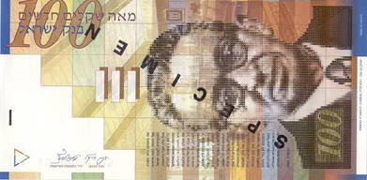
Wiesner Quantum Money
Each Wiesner note has a unique serial number, and a sequence of photons that the Mint secretly prepares in either up/down or diagonal polarizations.
Serial number: 011000010110
To verify a quantum note, the Mint can use serial number to look up the secret bases, and verify each photon’s polarization.
A counterfeiter attempting to learn the secret polarization information will disturb the state of the photons.
Notes:
Wiesner’s scheme was ingenious. Each banknote carried a serial number and a string of photons, each secretly polarized either up/down or diagonal. The mint, knowing the secret basis, could verify it. But a counterfeiter measuring without the secret would inevitably disturb the states, leaving detectable errors.

Slide 9
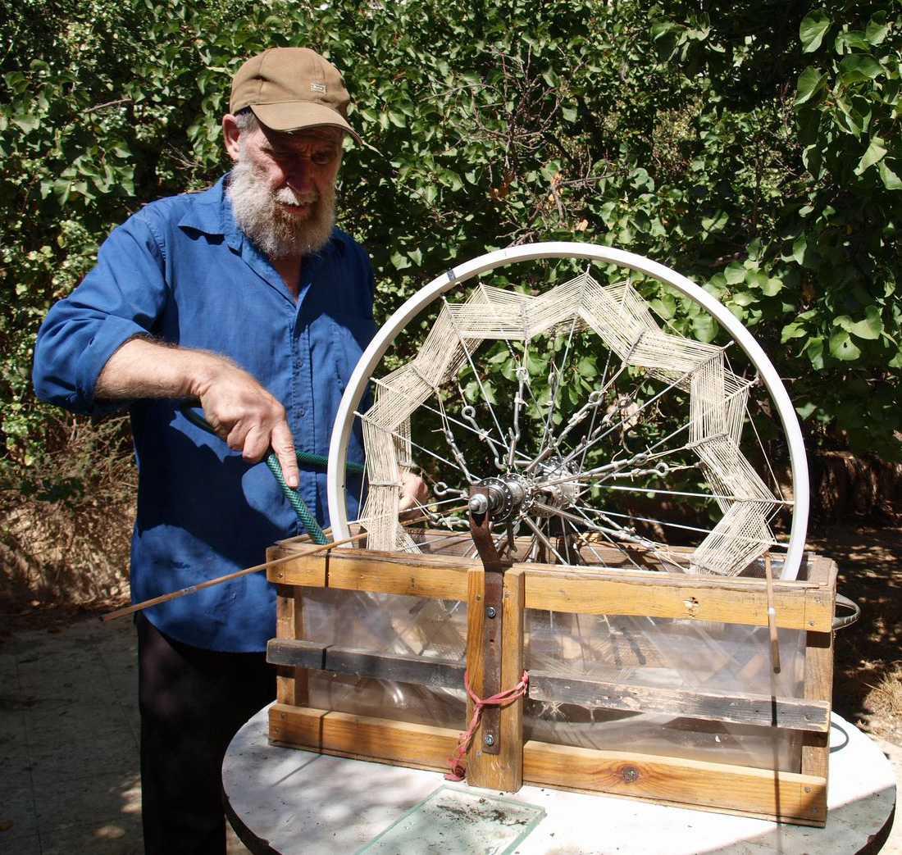
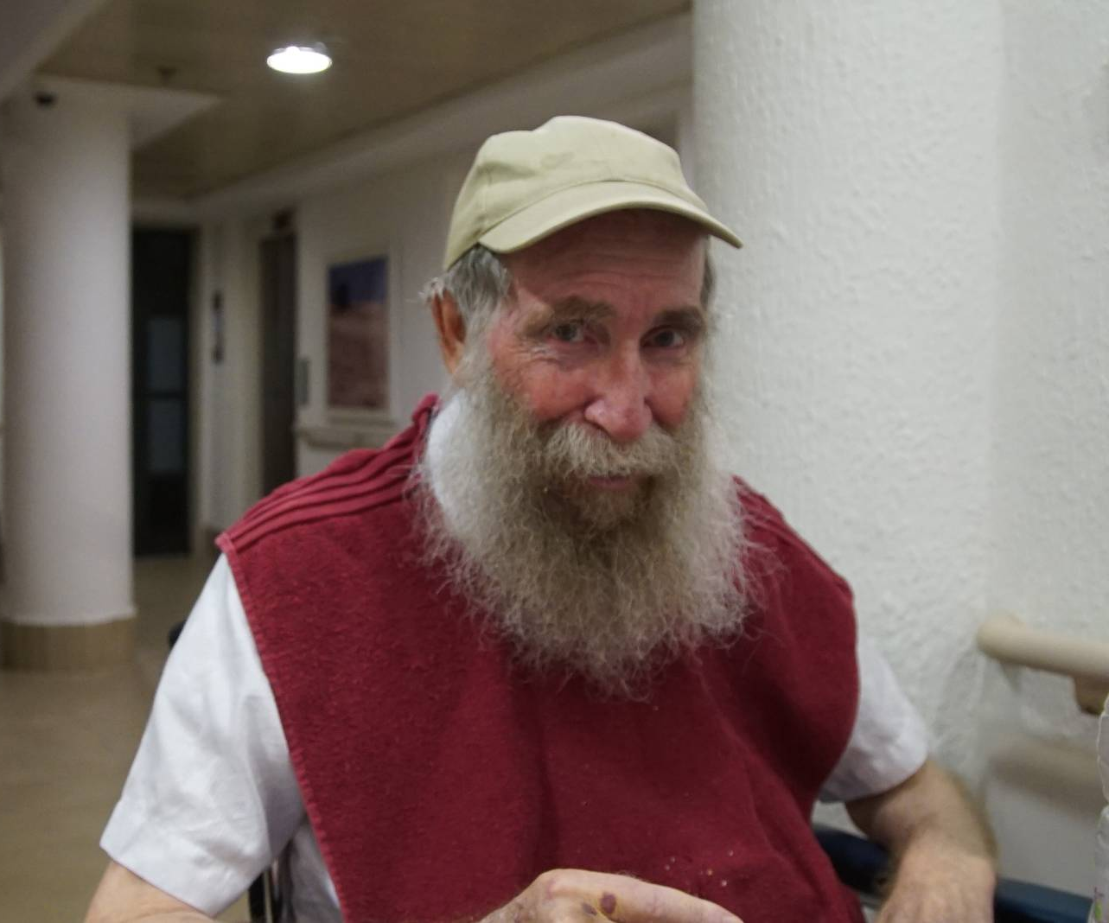
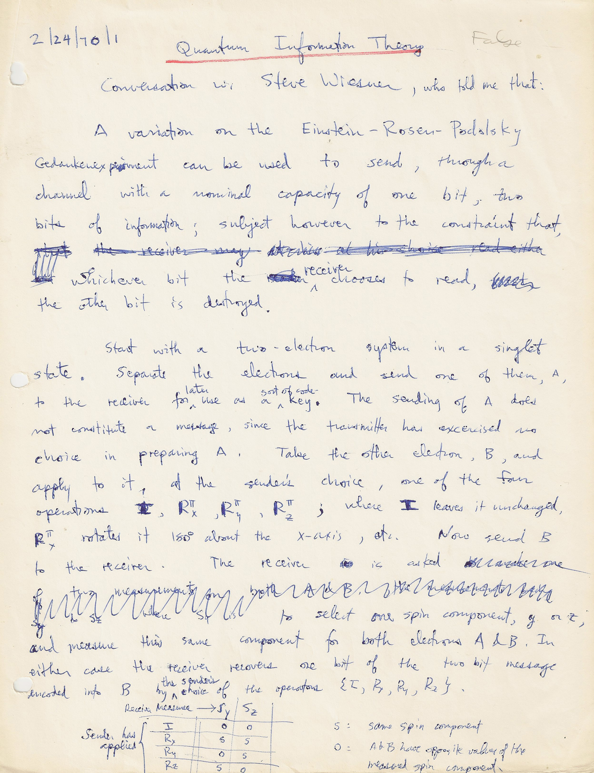
Wiesner after Quantum Money
Wiesner’s ideas were incredibly far ahead of their time. Wiesner submitted his paper in 1969, but it was rejected.
Wiesner eventually quit academia, moved to Israel, and became a construction laborer and tinkerer. He passed away in 2021.
In a fortuitous twist of history, before moving he told his friend Charlie Bennett about his ideas.
Notes:
Now, Wiesner submitted this paper in 1969—but it was rejected. He eventually left academia, moved to Israel, and became a construction worker and tinkerer. He passed away just a few years ago. But before leaving, he told his friend Charlie Bennett about these ideas. And that chance act of sharing would shape the entire field.

Slide 10
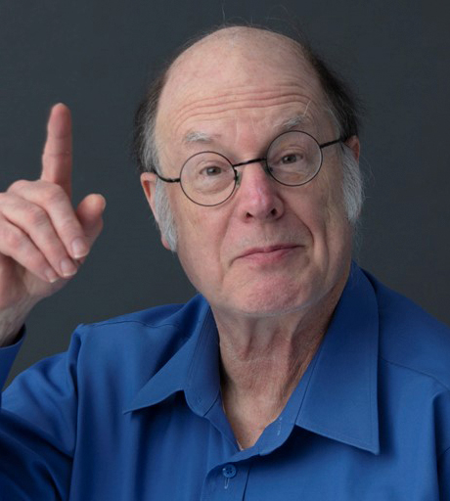
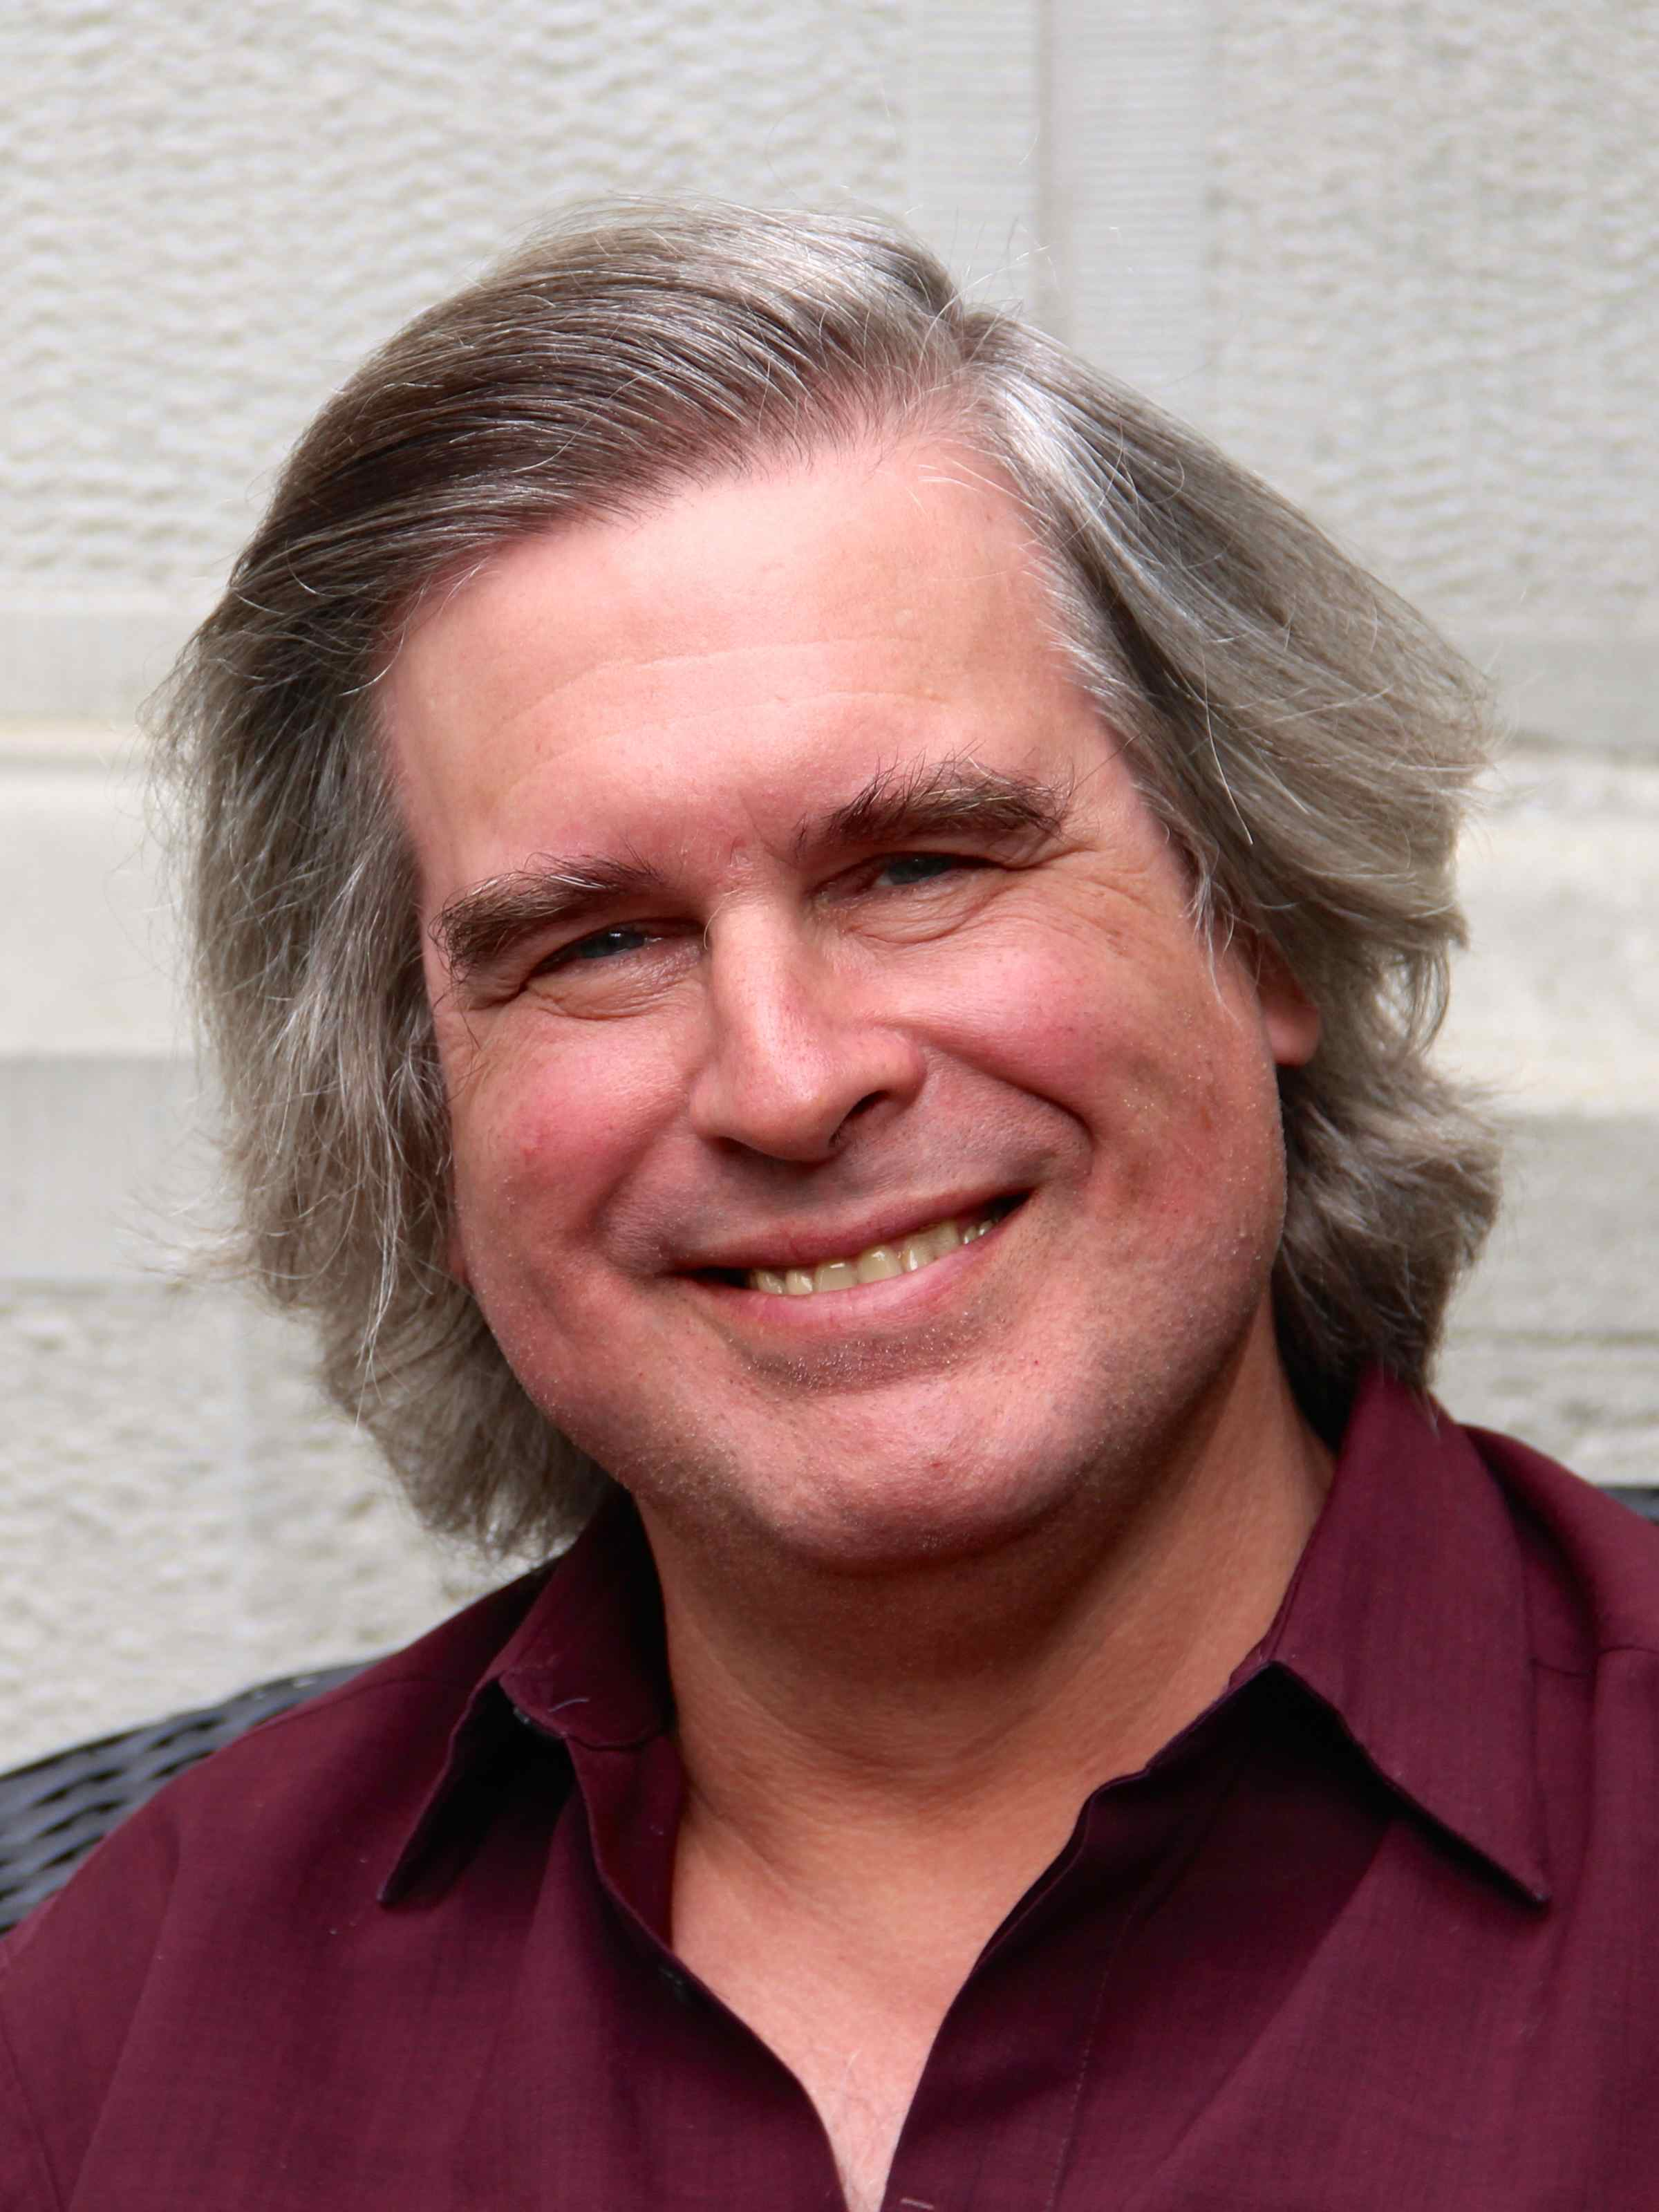
Quantum Key Distribution
In 1979 Charlie Bennett (IBM) and Gilles Brassard (U. Montreal) teamed up to explore Wiesner’s ideas. They coined the term quantum cryptography.
This led to their discovery of quantum key distribution (QKD). Two strangers, using quantum information over an insecure channel, can establish a secret key, and then communicate privately. Secrecy is guaranteed by the laws of physics.
Charlie Bennett
Gilles Brassard

Slide 11

Quantum Key Distribution
BB84: Alice sends Bob randomly-polarized photons, which Bob measures in random bases to generate secret key. Tampering of qubits by eavesdropper can be detected by comparing notes.
Alice
Bob
Eavesdropper
Insecure quantum channel
Authenticated (but public) classical channel
Notes:
In the famous BB84 protocol, Alice sends photons in random polarizations. Bob measures, and later they compare notes on which basis they used. Any eavesdropper introduces errors that Alice and Bob can detect.

Slide 12
Quantum Key Distribution
BB84: Alice sends Bob randomly-polarized photons, which Bob measures in random bases to generate secret key. Tampering of qubits by eavesdropper can be detected by comparing notes.
Alice
Bob
Eavesdropper
Insecure quantum channel
Authenticated (but public) classical channel
Notes:
In the famous BB84 protocol, Alice sends photons in random polarizations. Bob measures, and later they compare notes on which basis they used. Any eavesdropper introduces errors that Alice and Bob can detect.

Slide 13
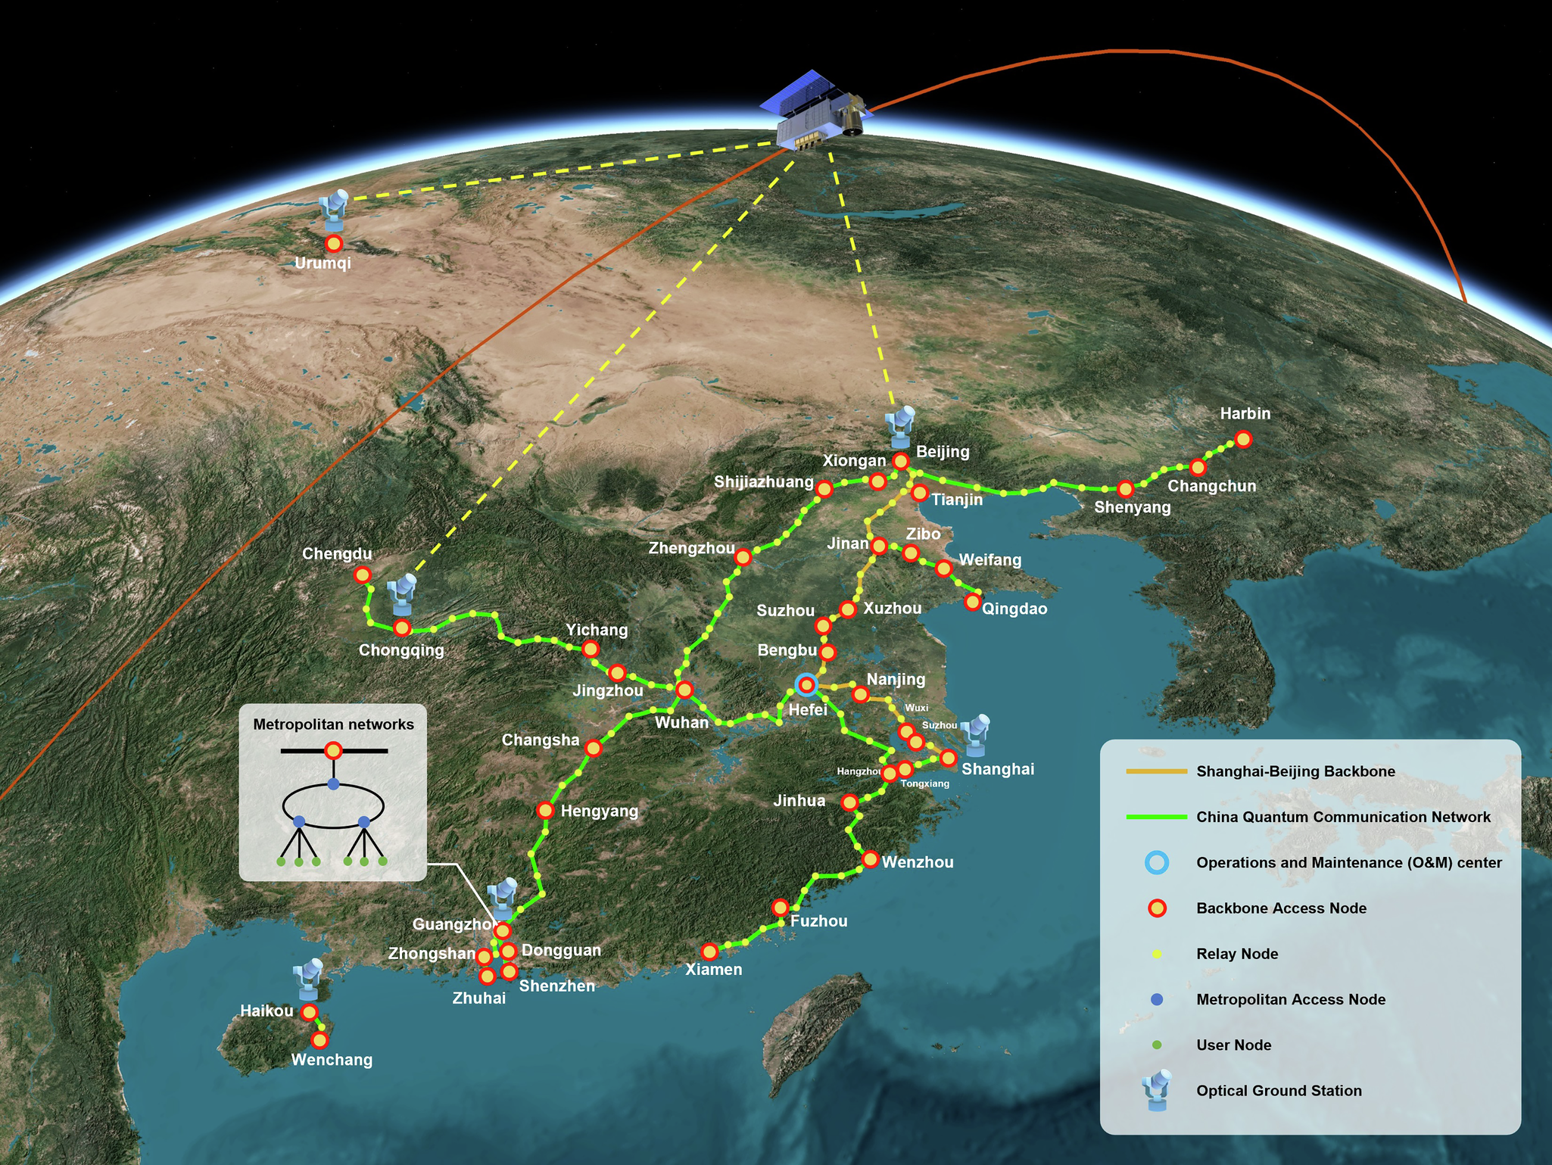
Quantum Key Distribution
Security is guaranteed by laws of physics, not unproven assumptions about hardness of some mathematical problem.
QKD is a mature quantum technology: off-the-shelf QKD equipment from id Quantique, MagiQ, Toshiba, etc.
In 2016, China launched the Micius satellite to perform QKD from space.
Notes:
Today, you can buy QKD equipment off the shelf, and in 2016 China even launched the Micius satellite to beam QKD keys from space. An idea from a beach conversation now orbits above us

Slide 14
The Frontier of Quantum Crypto

Slide 15
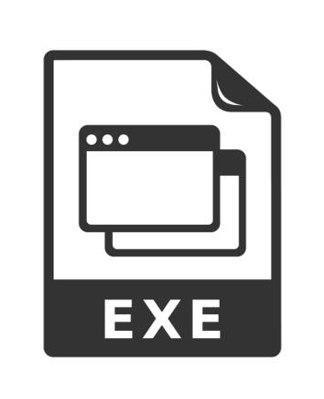


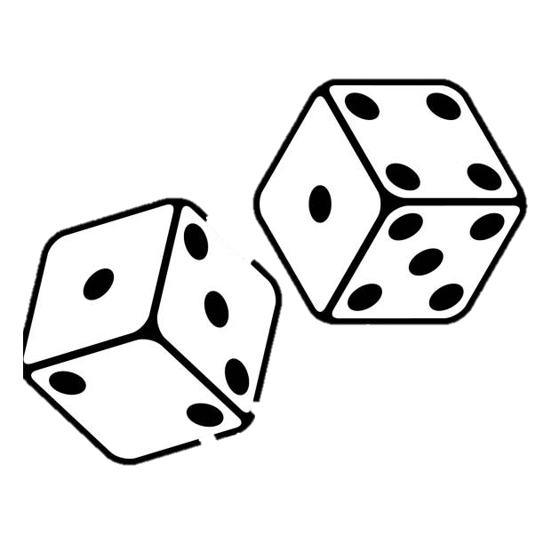

Quantum Crypto Renaissance
The last 15 years has been a new era of quantum cryptography: astonishing ideas and cryptographic wonders.
Public-key Quantum Money
Unclonable Software
Certified Deletion
Position Verification
One-Shot Signatures
Certified Randomness
Notes:
For many years, quantum cryptography has meant either quantum key distribution, or Shor’s algorithm (and finding replacements for RSA). The last 15 years, though, things have changed dramatically – quantum cryptography has exploded into a renaissance of ideas. Researchers have come up with an astonishing array of ideas: public-key quantum money, unclonable software, certified deletion, one-shot signatures, and even quantum ways of verifying your physical location. Each of these stretches our imagination of what cryptography can do.

Slide 16
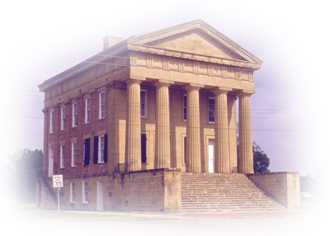


Publicly Verifiable Quantum Money
Wiesner’s scheme suffers from a serious drawback: only the Mint (who knows the secret polarizations) can verify quantum banknotes!
In 2009, computer scientist Scott Aaronson proposed a scheme for publicly verifiable quantum money.
Alice
Alice can check validity of quantum banknote
Mint

Slide 17

Publicly Verifiable Quantum Money
Wiesner’s scheme suffers from a serious drawback: only the Mint (who knows the secret polarizations) can verify quantum banknotes!
In 2009, computer scientist Scott Aaronson proposed a scheme for publicly verifiable quantum money.
Alice cannot make counterfeit copies (even though she knows how to verify quantum banknotes)
Alice
Mint

Slide 18
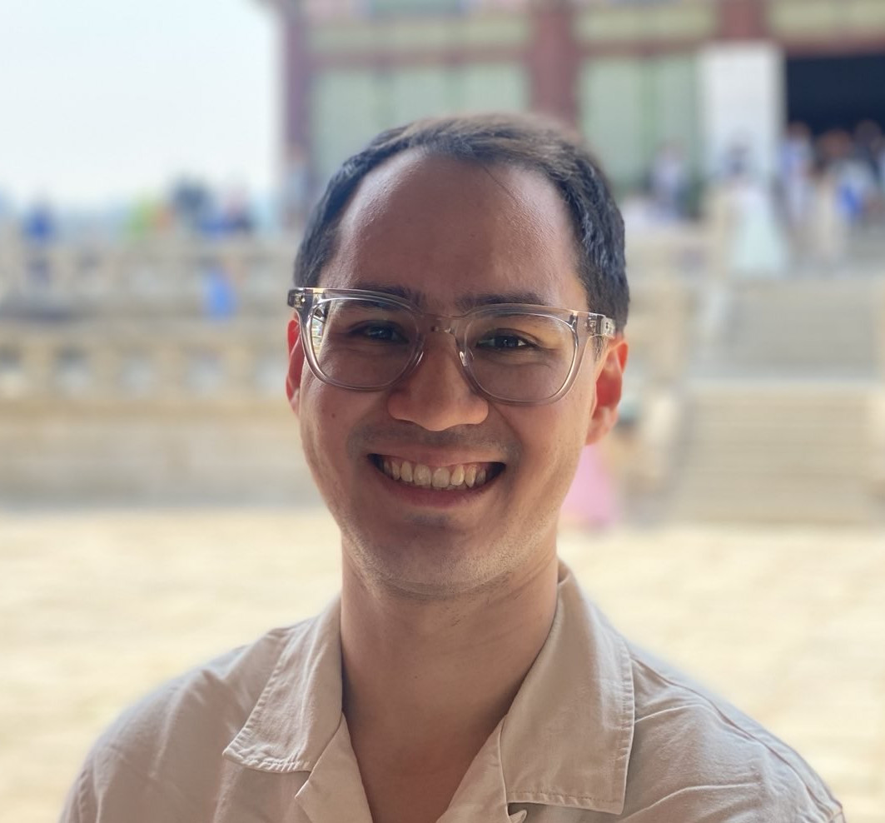
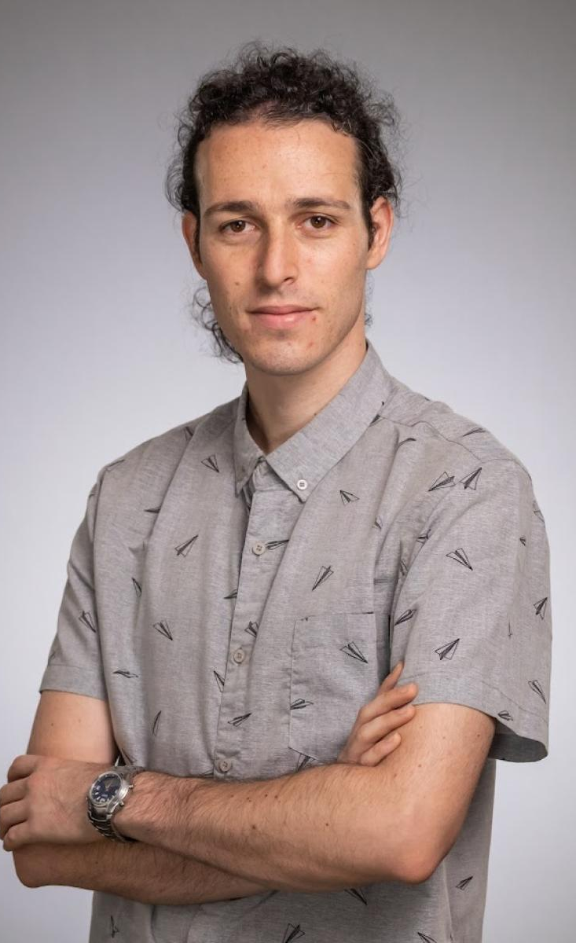
Publicly Verifiable Quantum Money
Many attempts to construct secure public-key quantum money schemes.
2009: random stabilizer states
2019: quadratic equations
2010: knot theory
2019: indistinguishability obfuscation
2012: polynomial-hiding subspaces
2023: abelian group actions
2018: commuting unitaries
2023: walkable invariants
2022: lattices
2025: nonabelian group actions
John Bostanci
Barak Nehoran
Notes:
Since then, researchers have tried everything. Stabilizer states. Knot theory. Polynomials. Lattices. Even exotic group actions.

Slide 19

Publicly Verifiable Quantum Money
Many attempts to construct secure public-key quantum money schemes.
2009: random stabilizer states
2019: quadratic equations
2010: knot theory
2019: indistinguishability obfuscation
2012: polynomial-hiding subspaces
2023: abelian group actions
2018: commuting unitaries
2023: walkable invariants
2022: lattices
2025: nonabelian group actions
= not broken yet, but based on unconventional mathematical assumptions

Slide 20

Publicly Verifiable Quantum Money
Building secure public-key quantum money schemes requires a magical brew of ideas from quantum physics, theoretical computer science, and mathematics.
Quantum Physics
Computational Complexity
Cryptography
Pure Mathematics

Slide 21
Quantum Copy-Protected Software
Scott Aaronson also proposed the concept of quantum copy-protected software: executable code, but physically infeasible to copy, because the programs are encoded into quantum states.
Imagine you want to give someone the power of attorney to digitally sign documents in your name…
Quantum copy-protected signing algorithm

Slide 22
Quantum Copy-Protected Software
Scott Aaronson also proposed the concept of quantum copy-protected software: executable code, but physically infeasible to copy, because the programs are encoded into quantum states.
Imagine you want to give someone the power of attorney to digitally sign documents in your name… ….but don’t want the signing algorithm to be copied and widely shared.
Quantum copy-protected signing algorithm

Slide 23
Quantum Certified Deletion
Quantum mechanics also allows proving that you deleted a piece of data.
Use case: enforce “Right to be forgotten” GDPR policy in EU.
Key idea: use Wiesner’s conjugate coding scheme!
= randomly interspersed decoy qubits
= encrypted data bits

Slide 24
Quantum Certified Deletion
Quantum mechanics also allows proving that you deleted a piece of data.
Use case: enforce “Right to be forgotten” GDPR policy in EU.
Key idea: use Wiesner’s conjugate coding scheme!
Proof of deletion: measure each qubit in up/down polarization. Adversary can’t tell difference between data and decoy qubits.

Slide 25

Quantum Certified Deletion
Quantum mechanics also allows proving that you deleted a piece of data.
Use case: enforce “Right to be forgotten” GDPR policy in EU.
Prof. James Bartusek Columbia Computer Science
Bartusek: many different cryptosystems can be “upgraded” to support certified deletion!
Example: certified deletion of software.

Slide 26
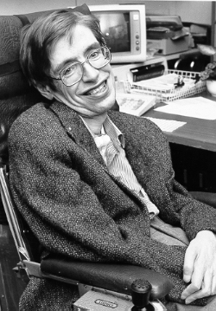
Quantum Cryptography and the Black Hole Information Paradox
Black holes: regions of spacetime so dense that no matter, no light, no information can escape.
…or can it? Stephen Hawking discovered that black holes slowly leak radiation and eventually evaporate.
General relativity: information destroyed.
Quantum mechanics: information preserved.
Notes:
Alright, in this last part of the talk, I want to leave the earthly realm of money and software and privacy… and talk about things of a more cosmic nature. We’ve all heard of black holes: these are regions of spacetime so dense, so extreme that no matter, no light, no information can escape.
…or can it? Stephen Hawking famously discovered that black holes aren’t actually black – they slowly leak radiation and eventually evaporate. Therein lies a fundamental paradox. On one hand, Einstein’s theory of general relativity says that information gets destroyed by black holes. Quantum physics, on the other hand, requires that information is always preserved.

Slide 27
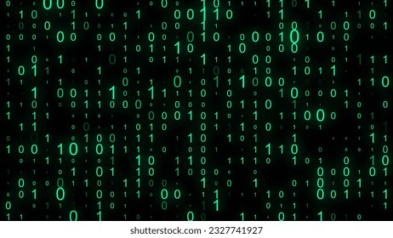
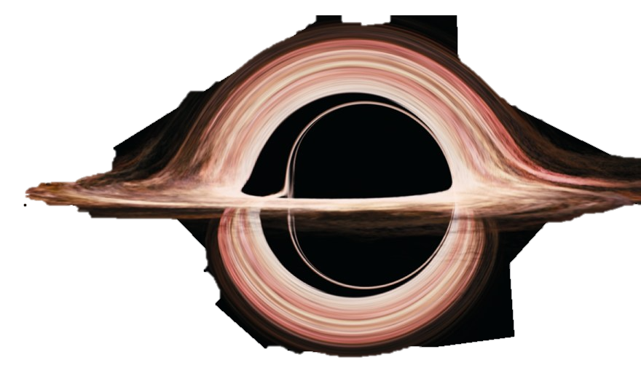
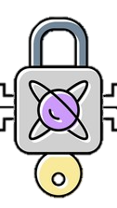
Quantum Cryptography and the Black Hole Information Paradox
Decades of incomplete solutions of the black hole information paradox. It must eventually be resolved by any theory of quantum gravity!
Daniel Harlow and Patrick Hayden (2013): Hawking radiation is encrypted information that cannot be quickly decrypted by a quantum computer. The apparent destruction of information is a quantum cryptographic phenomenon.
Notes:
Since the 70s there have been decades of incomplete solutions to the black hole information paradox. Every time someone tried to fix it, a problem would show up somewhere else. Whatever theory that unifies quantum mechanics with general relativity has to deal with this tension – and understanding what this theory should even *look* like is one of the biggest challenges in theoretical physics. In recent years, though, physicists have realized that quantum information and quantum cryptography may hold key pieces of the puzzle of black holes, and, more generally, a theory of quantum gravity. One instance of this is a fascinating proposal by Daniel Harlow at MIT and Patrick Hayden from Stanford: the information thrown into a black hole *is* preserved in the Hawking radiation, but it’s an encrypted in such a scrambled way that no quantum computer, even given millions times the lifetime of the universe, could hope to decrypt. What this means is that, for all intents and purposes, information is effectively destroyed –it’s really a quantum cryptographic phenomenon. Researchers are continuing to uncover more surprising connections between quantum gravity and quantum cryptography.

Slide 28
Quantum Cryptography began as a daring leap of creativity by Stephen Wiesner at Columbia University in 1960s.
Today, it is a fountain of astonishing ideas and connections, from unforgeable money to unclonable software to provable deletion to the inner secrets of black holes.
The biggest surprises in quantum cryptography still lie ahead.
Thank You!
Notes:
This brings me to the end of my talk.

