Slide 1
Private proofs of when and where
Henry Yuen
Columbia
joint work with
Uma Girish
Columbia
Greg Gluch
Berkeley/MIT
Shafi Goldwasser
Berkeley/MIT
Tal Malkin
Columbia
Leo Orshansky
Columbia

Slide 2
In interactive proofs, a prover tries to convince a verifier of some statement about a mathematical object:
”Graph G is 3-colorable”
“Generalized chess has no winning strategy”
“The Riemann Hypothesis is true"
Is it possible to prove statements about physical properties of a physical object?

Slide 3
For example, is it possible for a prover to convince a verifier of statements concerning its physical location?
“I was in London yesterday at 3pm”
“I am in the same location as Bob”
“I was not at the murder scene the night of January 1st, 1984”
Clearly, this is possible if the verifier was at the right place and right time to physically check these statements.
But can the verifiers check such statements remotely? Or long after the moment has passed?

Slide 4
Position verification

Slide 5
Position verification
Position verification are interactive proofs for statements of the form
I am at location X.
General idea: multiple verifiers can check the physical location of a prover by sending signals to the purported location, receiving signals back, and checking timing constraints.

Slide 6
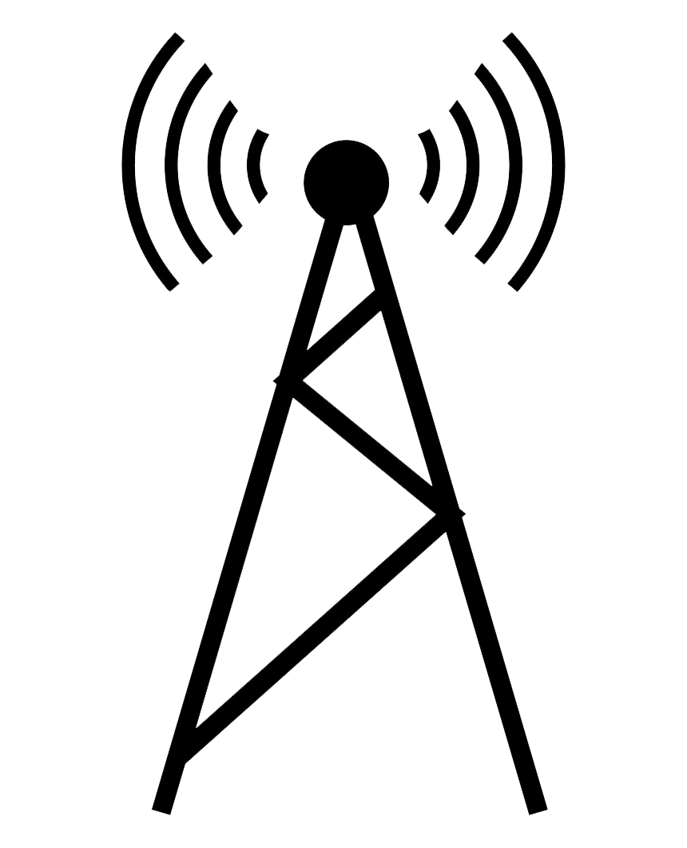







Example: 1D position verification
Time
$$t=2$$
$$t=1$$
$$t=0$$
$$−1$$
$$0$$
$$+1$$
Position $P$

Slide 7


Example: 1D position verification
Time
$$t=2$$
$$t=1$$
Prover
$$y$$
$$x$$
$$t=0$$
$$−1$$
$$0$$
$$+1$$
Position $P$

Slide 8


Example: 1D position verification
Time
$$t=2$$
$$f(x,y)$$
$$f(x,y)$$
$$t=1$$
Prover
$$y$$
$$x$$
$$t=0$$
$$−1$$
$$0$$
$$+1$$
Position $P$

Slide 9
Example: 1D position verification
Time
$$t=2$$
$$f(x,y)$$
$$f(x,y)$$
Verifiers check that prover’s responses combine both challenges, and
satisfy timing constraint.
Idea: the only way for prover to satisfy challenges is to be in the correct position.
$$t=1$$
Prover
$$y$$
$$x$$
$$t=0$$
$$−1$$
$$0$$
$$+1$$
Position $P$

Slide 10
Classical impossibility
Time
$$t=2$$
Theorem: every classical position verification protocol can be spoofed by colluding provers. This is because challenges can always be copied and forwarded.
$$t=1$$
$$x$$
$$y$$
Prover
Prover
$$t=0$$
$$−1$$
$$0$$
$$+1$$
Position $P$

Slide 11
Classical impossibility
Time
$$t=2$$
Theorem: every classical position verification protocol can be spoofed by colluding provers. This is because challenges can always be copied and forwarded.
$$t=1$$
$$x$$
$$y$$
Prover
Prover
$$t=0$$
$$−1$$
$$0$$
$$+1$$
Position $P$

Slide 12


Classical impossibility
Time
$$t=2$$
$$f(x,y)$$
$$f(x,y)$$
Theorem: every classical position verification protocol can be spoofed by colluding provers. This is because challenges can always be copied and forwarded.
$$t=1$$
$$x$$
$$y$$
Prover
Prover
$$t=0$$
$$−1$$
$$0$$
$$+1$$
Position $P$

Slide 13

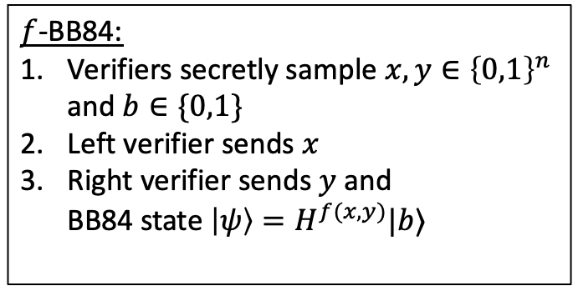
Quantum position verification
Idea: use quantum resources, and leverage unclonability.
Time
$f$-BB84:
Verifiers secretly sample $x,y∈{\left\{0,1\right\}}^{n}$ and $b∈\{0,1\}$
Left verifier sends $x$
Right verifier sends $y$ and BB84 state $\left|ψ\right\rangle =H^{f(x,y)}|b⟩$
$$t=2$$
$$t=1$$
$$x$$
Honest
Prover
$$y,\left|ψ\right\rangle$$
$$t=0$$
$$−1$$
$$0$$
$$+1$$

Slide 14


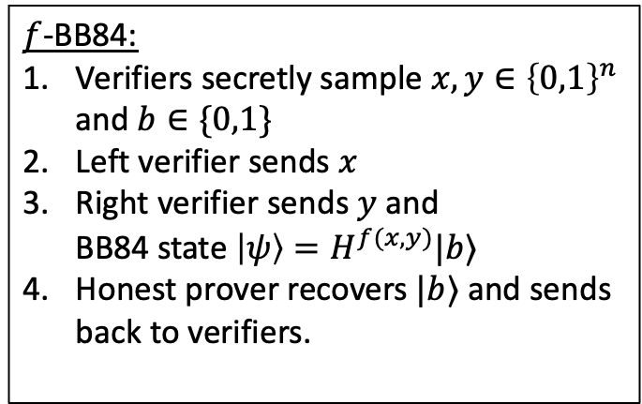
Quantum position verification
Idea: use quantum resources, and leverage unclonability.
Time
$f$-BB84:
Verifiers secretly sample $x,y∈{\left\{0,1\right\}}^{n}$ and $b∈\{0,1\}$
Left verifier sends $x$
Right verifier sends $y$ and BB84 state $\left|ψ\right\rangle =H^{f(x,y)}|b⟩$
Honest prover recovers $|b⟩$ and sends back to verifiers.
$$t=2$$
$$b$$
$$b$$
$$t=1$$
$$x$$
Honest
Prover
$$y,\left|ψ\right\rangle$$
$$t=0$$
$$−1$$
$$0$$
$$+1$$

Slide 15
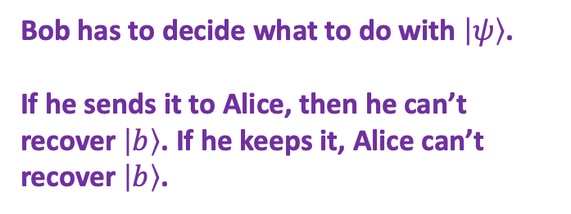
Quantum position verification
Idea: use quantum resources, and leverage unclonability.
Time
$f$-BB84:
Verifiers secretly sample $x,y∈{\left\{0,1\right\}}^{n}$ and $b∈\{0,1\}$
Left verifier sends $x$
Right verifier sends $y$ and BB84 state $\left|ψ\right\rangle =H^{f(x,y)}|b⟩$
Honest prover recovers $|b⟩$ and sends back to verifiers.
$$t=2$$
$$t=1$$
$$x$$
$$y,\left|ψ\right\rangle$$
Bob has to decide what to do with $\left|ψ\right\rangle$.
If he sends it to Alice, then he can’t recover $\left|b\right\rangle$. If he keeps it, Alice can’t recover $\left|b\right\rangle$.
$$t=0$$
$$−1$$
$$0$$
$$+1$$

Slide 16
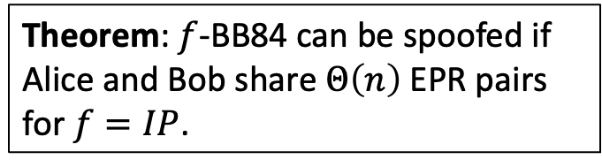
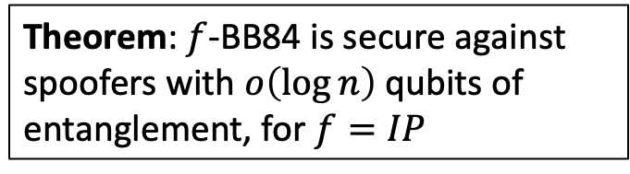
Quantum position verification
Time
Theorem: $f$-BB84 can be spoofed if Alice and Bob share $Θ\left(n\right)$EPR pairs
for $f=IP$.
$$t=2$$
(Kent-Munro-Spiller ’11, Lau-Lo ’11)
Theorem: $f$-BB84 is secure against spoofers with $o\left(\log{n}\right)$qubits of entanglement, for $f=IP$
$$t=1$$
$$x$$
$$y,\left|ψ\right\rangle$$
(Bluhm, Christandl, Speelman, ‘21)
$$t=0$$
Security: If no spoofers are in correct position, then verifiers accept with low probability.
$$−1$$
$$0$$
$$+1$$

Slide 17
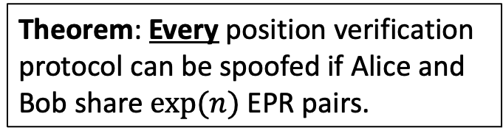
Quantum position verification
Time
Theorem: Every position verification protocol can be spoofed if Alice and Bob share $exp⁡(n)$EPR pairs.
$$t=2$$
(Buhrman, et al. ’11, Beigi-König ‘11)
Open question: Is there a position verification protocol secure against spoofers with superpoly qubits of entanglement?
$$t=1$$
$$x$$
$$y,\left|ψ\right\rangle$$
$$t=0$$
$$−1$$
$$0$$
$$+1$$

Slide 18
Generalizing position verification

Slide 19
Is it possible to prove statements beyond “I am at position P”? E.g.,
“I am not at position P”
“I am either in Kyoto or New York”
“My GPS coordinates satisfy a given 3SAT formula F”
Clearly, these statements can be proved by simply proving one’s precise location.
But can they be proved while keeping the prover’s position private?

Slide 20
Can one also prove position statements long after the fact? E.g.,
“I was not at the murder scene the night of January 1, 1984”
In other words, can a prover convince a judge of its past position, without revealing until necessary?
This motivates a notion of zero-knowledge proofs of position and time.

Slide 21
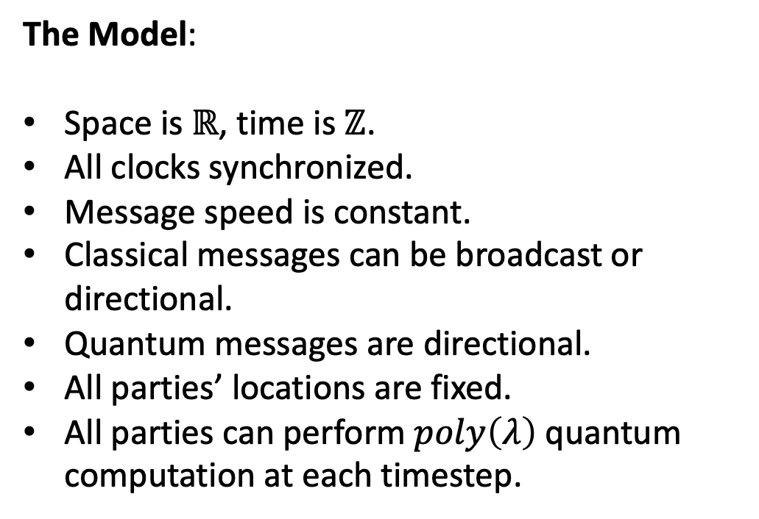
Zero-knowledge position verification
Time
The Model:
Space is $ℝ$, time is $ℤ$.
All clocks synchronized.
Message speed is constant.
Classical messages can be broadcast or directional.
Quantum messages are directional.
All parties’ locations are fixed.
All parties can perform $poly\left(λ\right)$ quantum computation at each timestep.
Position

Slide 22
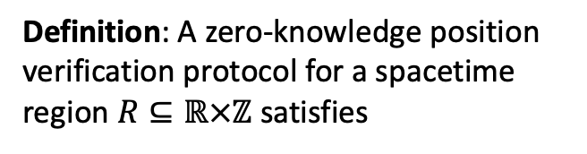

Zero-knowledge position verification
Time
Definition: A zero-knowledge position verification protocol for a spacetime region $R⊆ℝ×ℤ$ satisfies
$R$
Position

Slide 23
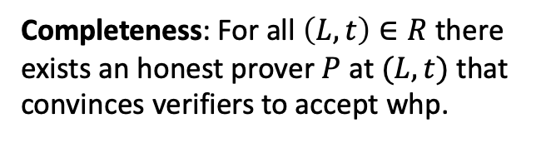
Zero-knowledge position verification
Time
Definition: A zero-knowledge position verification protocol for a spacetime region $R⊆ℝ×ℤ$ satisfies
Completeness: For all $\left(L,t\right)∈R$ there exists an honest prover $P$ at $(L,t)$ that convinces verifiers to accept whp.
$R$
Position

Slide 24
Zero-knowledge position verification
Time
Definition: A zero-knowledge position verification protocol for a spacetime region $R⊆ℝ×ℤ$ satisfies
Completeness: For all $\left(L,t\right)∈R$ there exists an honest prover $P$ at $(L,t)$ that convinces verifiers to accept whp.
$R$
Position

Slide 25
Zero-knowledge position verification
Time
Definition: A zero-knowledge position verification protocol for a spacetime region $R⊆ℝ×ℤ$ satisfies
Completeness: For all $\left(L,t\right)∈R$ there exists an honest prover $P$ at $(L,t)$ that convinces verifiers to accept whp.
$R$
Position

Slide 26
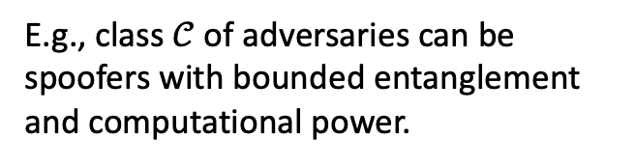
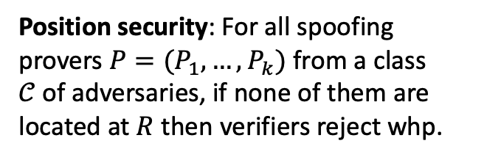
Zero-knowledge position verification
Time
Definition: A zero-knowledge position verification protocol for a spacetime region $R⊆ℝ×ℤ$ satisfies
Position security: For all spoofing provers $P=(P_{1},…,P_{k})$ from a class $𝒞$of adversaries, if none of them are located at $R$ then verifiers reject whp.
E.g., class $𝒞$of adversaries can be spoofers with bounded entanglement and computational power.
$R$
Position

Slide 27
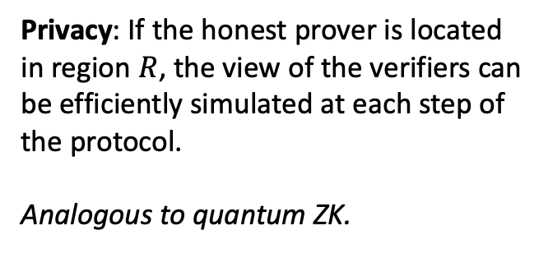
Zero-knowledge position verification
Time
Definition: A zero-knowledge position verification protocol for a spacetime region $R⊆ℝ×ℤ$ satisfies
Privacy: If the honest prover is located in region $R$, the view of the verifiers can be efficiently simulated at each step of the protocol.
Analogous to quantum ZK.
Position

Slide 28
Zero-knowledge position verification
Time
Definition: A zero-knowledge position verification protocol for a spacetime region $R⊆ℝ×ℤ$ satisfies
Privacy: If the honest prover is located in region $R$, the view of the verifiers can be efficiently simulated at each step of the protocol.
Analogous to quantum ZK.
Position

Slide 29
Zero-knowledge position verification
Time
Definition: A zero-knowledge position verification protocol for a spacetime region $R⊆ℝ×ℤ$ satisfies
Privacy: If the honest prover is located in region $R$, the view of the verifiers can be efficiently simulated at each step of the protocol.
Analogous to quantum ZK.
Position

Slide 30
Zero-knowledge position verification
Time
Definition: A zero-knowledge position verification protocol for a spacetime region $R⊆ℝ×ℤ$ satisfies
Privacy: If the honest prover is located in region $R$, the view of the verifiers can be efficiently simulated at each step of the protocol.
Analogous to quantum ZK.
Position

Slide 31
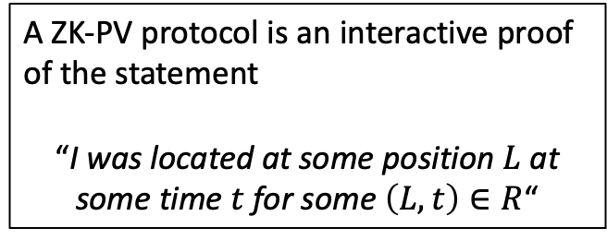
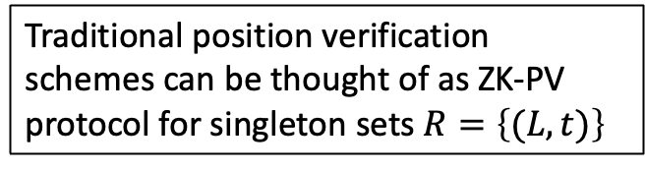
Zero-knowledge position verification
Time
A ZK-PV protocol is an interactive proof of the statement
“I was located at some position $L$ at some time $t$ for some $\left(L,t\right)∈R$“
Traditional position verification schemes can be thought of as ZK-PV protocol for singleton sets $R=\left\{(L,t)\right\}$
Just like ZK has many flavors (computational, statistical, honest verifier, malicious verifier, arguments, etc…) so can ZK-PV.
Position

Slide 32
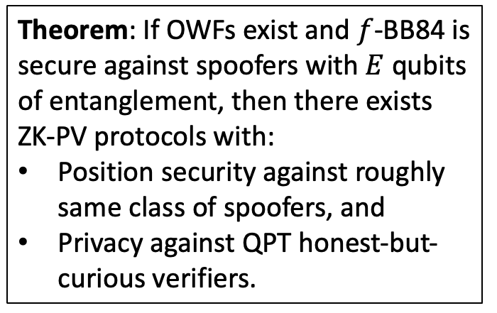
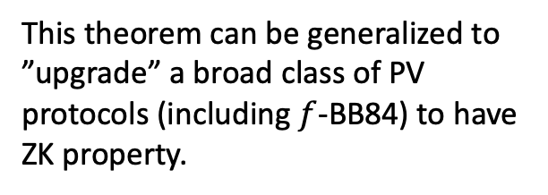
Zero-knowledge position verification
Time
Theorem: If OWFs exist and $f$-BB84 is secure against spoofers with $E$ qubits of entanglement, then there exists ZK-PV protocols with:
Position security against roughly same class of spoofers, and
Privacy against QPT honest-but-curious verifiers.
(Girish, Gluch, Goldwasser, Malkin, Orshansky, Y. ‘25)
This theorem can be generalized to ”upgrade” a broad class of PV protocols (including $f$-BB84) to have ZK property.
Position

Slide 33
Key primitive: Position commitments

Slide 34
We introduce (spacetime) position commitments, an interactive protocol with
Commit Phase: prover commits to its spacetime position $\left(L,t\right)$ from some commitable set $S⊆ℝ×ℤ$.
Reveal Phase: prover announces $(K,u)$, and verifiers check.
Hiding security: before Reveal Phase, verifiers learn nothing about prover’s spacetime location (simulation definition).
Position Binding security: after Reveal phase, if spoofers announces a position $\left(K,u\right)∈S$ that was not occupied by any spoofer, then verifiers reject whp.

Slide 35
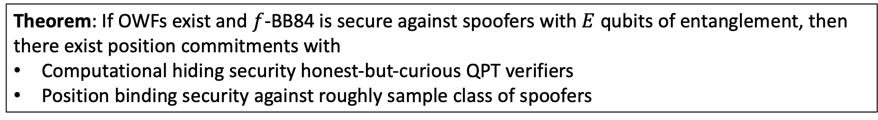
Theorem: If OWFs exist and $f$-BB84 is secure against spoofers with $E$ qubits of entanglement, then there exist position commitments with
Computational hiding security honest-but-curious QPT verifiers
Position binding security against roughly sample class of spoofers
(Girish, Gluch, Goldwasser, Malkin, Orshansky, Y. ‘25)

Slide 36
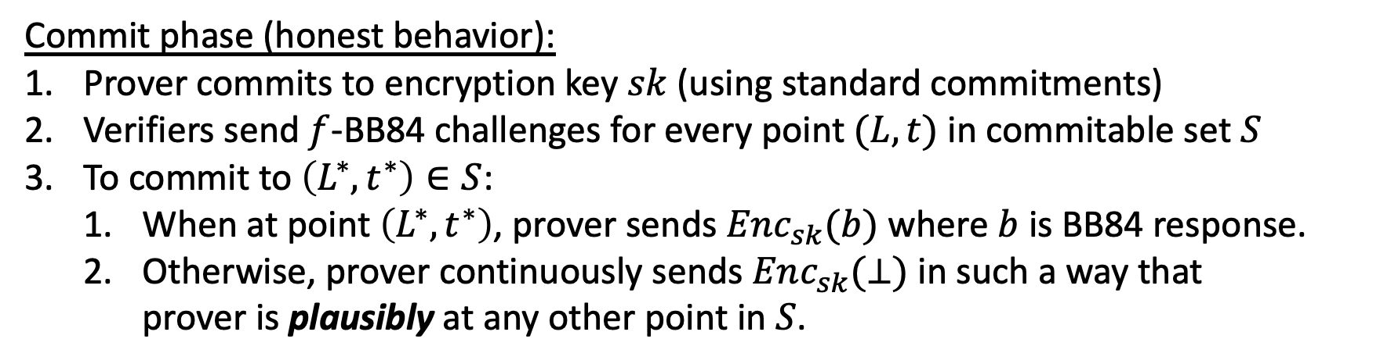
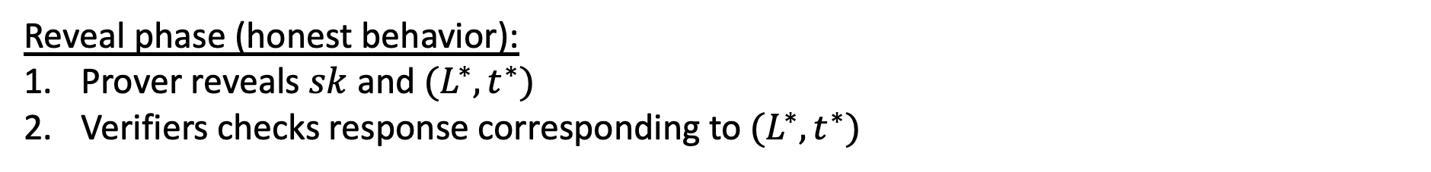
Theorem: If OWFs exist and $f$-BB84 is secure against spoofers with $E$ qubits of entanglement, then there exist position commitments with
Computational hiding security honest-but-curious QPT verifiers
Position binding security against roughly sample class of spoofers
(Girish, Gluch, Goldwasser, Malkin, Orshansky, Y. ‘25)
Commit phase (honest behavior):
Prover commits to encryption key $sk$ (using standard commitments)
Verifiers send $f$-BB84 challenges for every point $(L,t)$ in commitable set $S$
To commit to $\left(L^{∗},t^{∗}\right)∈S$:
When at point $\left(L^{∗},t^{∗}\right)$, prover sends $Enc_{sk}(b)$ where $b$ is BB84 response.
Otherwise, prover continuously sends $Enc_{sk}(⊥)$ in such a way that prover is plausibly at any other point in $S$.
Reveal phase (honest behavior):
Prover reveals $sk$ and $(L^{∗},t^{∗})$
Verifiers checks response corresponding to $(L^{∗},t^{∗})$

Slide 37

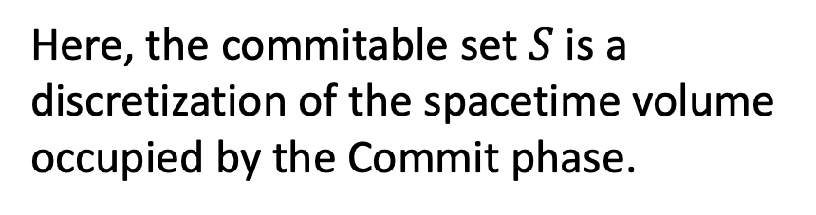
Position commitments
Time
$(L^{∗},t^{∗})$
Here, the commitable set $S$ is a discretization of the spacetime volume occupied by the Commit phase.
Position

Slide 38





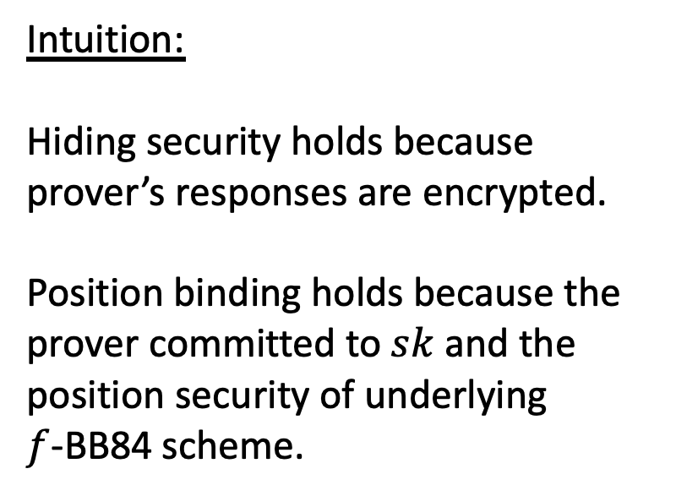








Position commitments
$$Enc_{sk}\left(⊥\right)$$
Time
$$Enc_{sk}\left(⊥\right)$$
$$Enc_{sk}\left(b\right)$$
Intuition:
Hiding security holds because prover’s responses are encrypted.
Position binding holds because the prover committed to $sk$ and the position security of underlying $f$-BB84 scheme.
$$Enc_{sk}\left(b\right)$$
$$Enc_{sk}\left(⊥\right)$$
$$Enc_{sk}\left(⊥\right)$$
$$Enc_{sk}\left(⊥\right)$$
$$Enc_{sk}\left(⊥\right)$$
$$Enc_{sk}\left(⊥\right)$$
$$Enc_{sk}\left(⊥\right)$$
$$Enc_{sk}\left(⊥\right)$$
$$Enc_{sk}\left(⊥\right)$$
$$Enc_{sk}\left(⊥\right)$$
Position

Slide 39
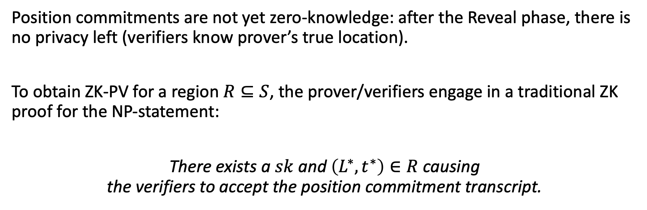
From position commitments to ZK-PV
Position commitments are not yet zero-knowledge: after the Reveal phase, there is no privacy left (verifiers know prover’s true location).
To obtain ZK-PV for a region $R⊆S$, the prover/verifiers engage in a traditional ZK proof for the NP-statement:
There exists a $sk$ and $\left(L^{∗},t^{∗}\right)∈R$ causing the verifiers to accept the position commitment transcript.

Slide 40
Summary and open questions

Slide 41
Private proofs of when and where
Position verification opens the door to position-based cryptography: a user’s credential is their physical location, rather than knowing a secret key. It can also be thought of as an interactive proof of physical statements.
This opens the door to exciting possibilities. We can perform cryptography with physical properties.
Zero-knowledge position verification is just one extension of position verification.
What are others?

Slide 42
Open questions
Making the model more realistic: clocks are imperfectly synchronized, position errors, etc.
What are other applications of ZK position verification? What are other extensions of position verification? For example, can we verify trajectories through space and time?
Are there stronger lower bounds for position verification, even under assumptions?
Thank You!

