Slide 1
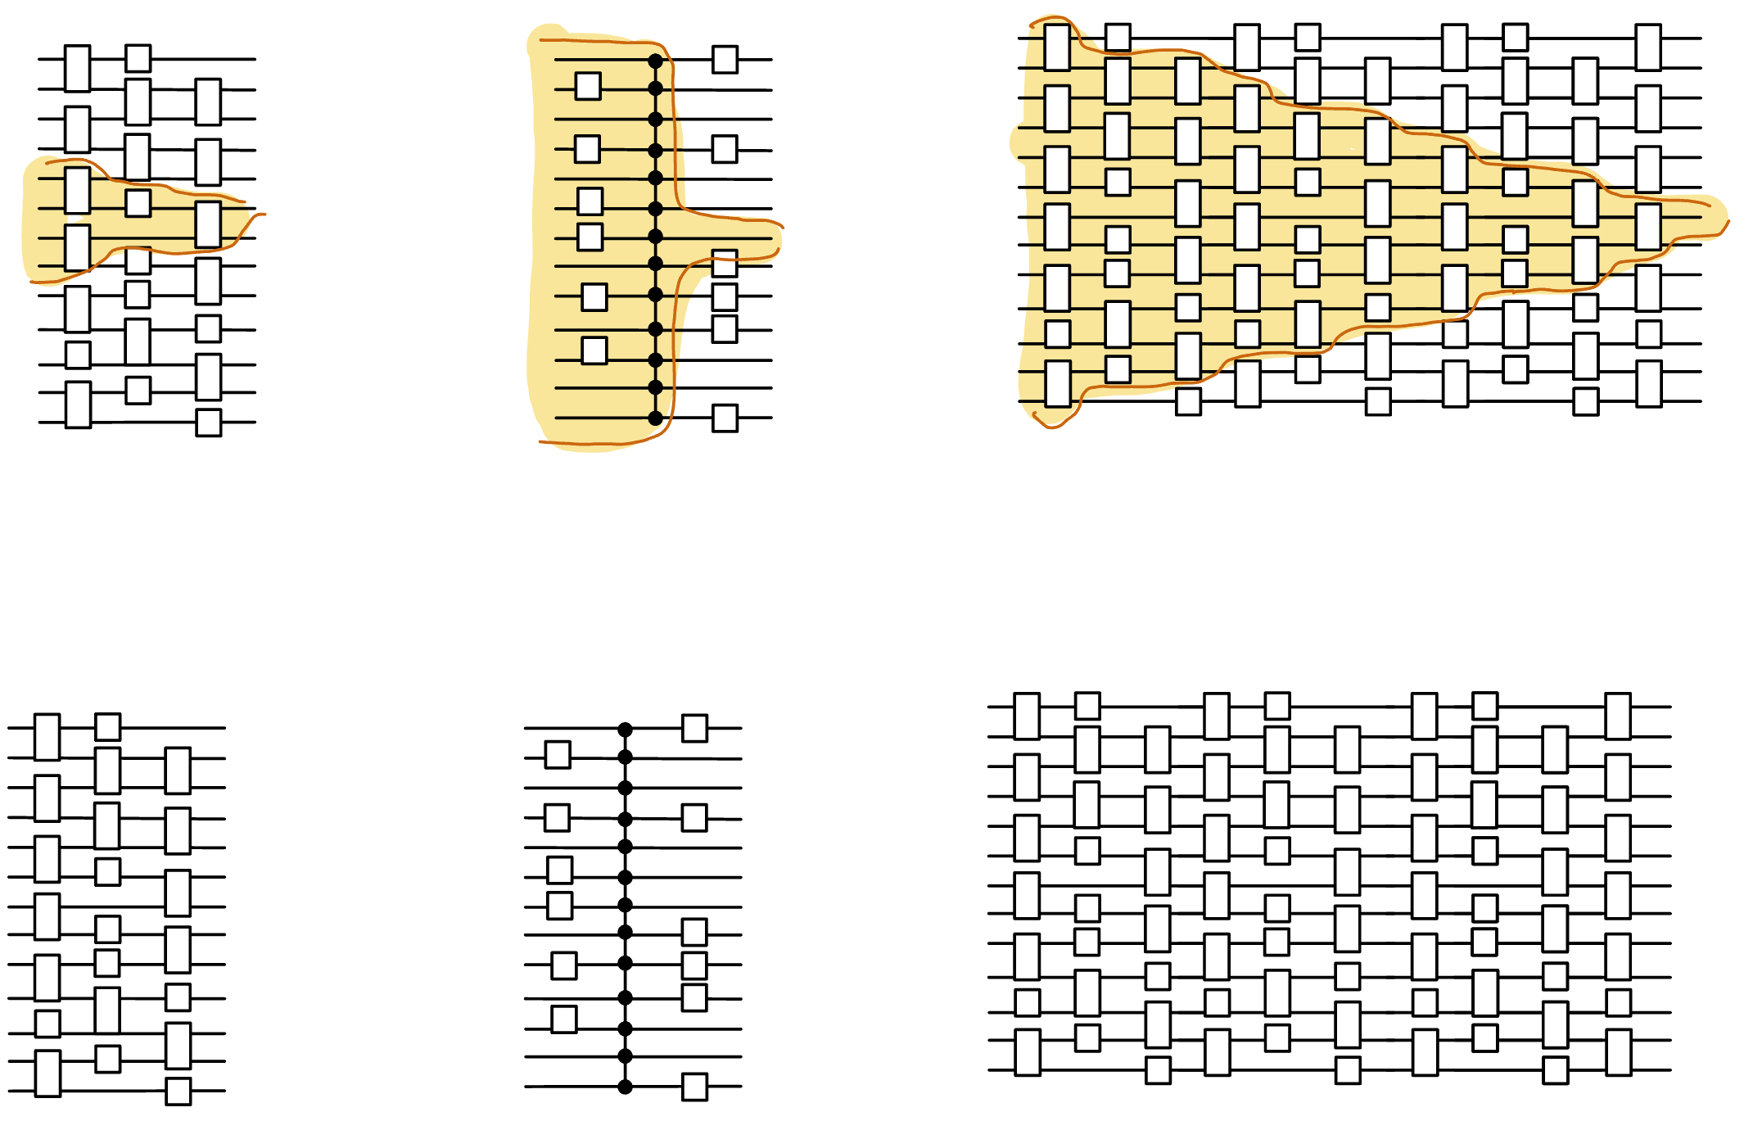
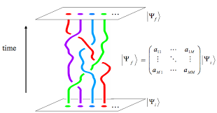
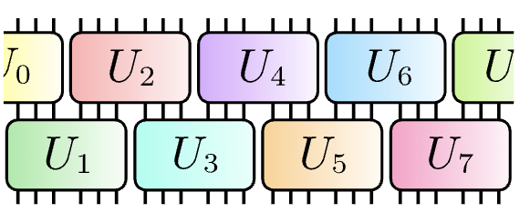
The power and limits of constant-time quantum computation
Henry Yuen
Columbia University
Notes:
Thanks for the invitation to speak. This talk will be about various models of constant-time quantum computation: these are models where the computation on the device takes an amount of time that is independent of the system size. It’s quite a fascinating problem to try to understand the computational power and limitations of these models. This talk will essentially be a bunch of different stories about these models.

Slide 2
Constant-time quantum computation

Slide 3

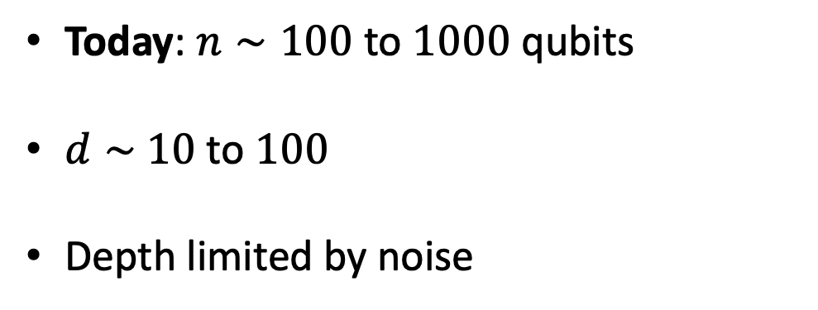
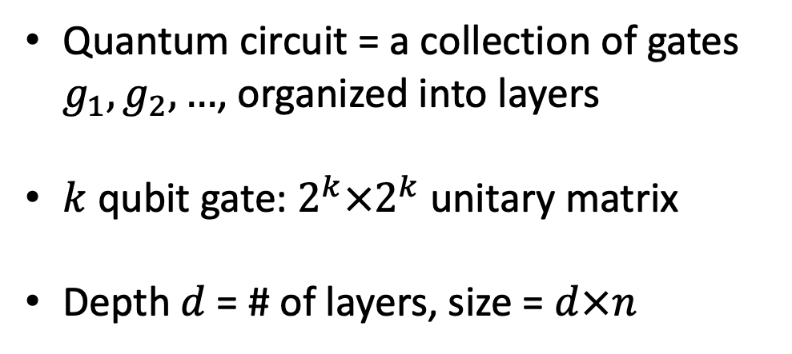
Quantum circuits
Quantum circuit = a collection of gates $g_{1},g_{2},…$, organized into layers
$k$ qubit gate: $2^{k}×2^{k}$unitary matrix
Depth $d$= # of layers, size = $d×n$
2 qubit gates
n qubit input
$$\left|ψ\right\rangle$$
….
Today: $n∼100$ to $1000$ qubits
$d∼$ $10$ to $100$
Depth limited by noise
1 qubit gates
Notes:
Just to be on the same page, here’s a review of the quantum circuit model. This is a picture of a quantum circuit on n-qubits. Each wire denotes a qubit, and as time proceeds the qubits get acted upon by layers of gates. Some of these gates are single-qubit gates, some of them are two-qubit gates, and one can have gates that act on more qubits. Mathematically each k-qubit gate is a 2^k x 2^k unitary matrix, and when you combine together all the gates you get a unitary matrix acting on n qubits, which is of size 2^n x 2^n. The depth of a quantum circuit is the number of layers.

Slide 4
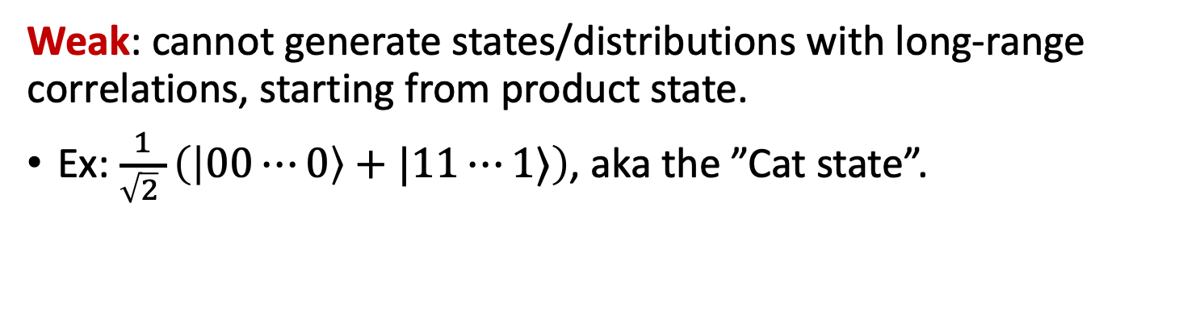
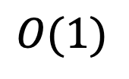
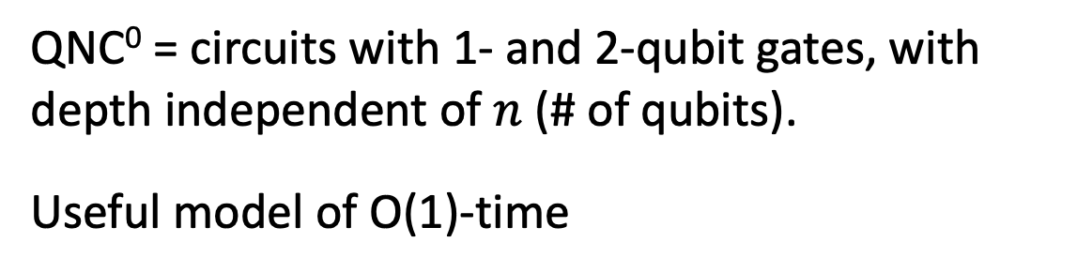

Constant-time quantum computation
QNC⁰ = circuits with 1- and 2-qubit gates, with depth independent of $n$ (# of qubits).
Useful model of O(1)-time
$$n$$
Powerful: QNC⁰ circuits can generate probability distributions that cannot be classically sampled from (under plausible complexity assumptions).
$$O(1)$$
(DiVincenzo-Terhal ’03, Bremner-Josza-Shepherd ‘09, …)
Weak: cannot generate states/distributions with long-range correlations, starting from product state.
Ex: $\frac{1}{\sqrt{2} }\left(\left|00⋯0\right\rangle +|11⋯1⟩\right)$, aka the ”Cat state”.
Notes:
The first model I’ll talk about it something most people are familiar with: constant-depth quantum circuits with single and two-qubit gates. In complexity-speak this model is called QNC0, after the analogous classical circuit model NC0. This is a useful model of constant-time in the NISQ era.
QNC0 circuits have been studied a lot over the last twenty years or so, and we know a lot about them. For example, we know that they can be powerful. On the other hand, these circuits are quite weak in others ways: for example they cannot prepare states with long-range correlations like the Cat state, starting from a product state. This is because of simple lightcone or Lieb-Robinson-type arguments. Constant-depth circuits with only local interactions cannot generate correlations fast enough.

Slide 5
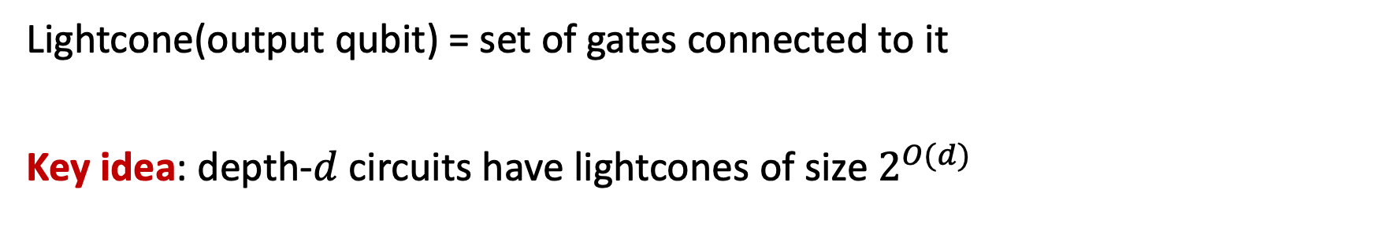
The lightcone argument
Lightcone(output qubit) = set of gates connected to it
Key idea: depth-$d$ circuits have lightcones of size $2^{O(d)}$
$$n$$
Output qubits with disjoint lightcones must be uncorrelated with each other.
$$O(1)$$
The main technique we have for showing limitations of quantum circuits!

Slide 6
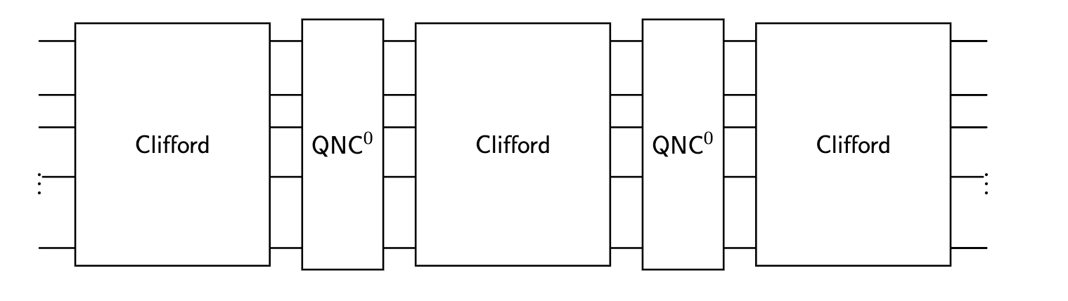
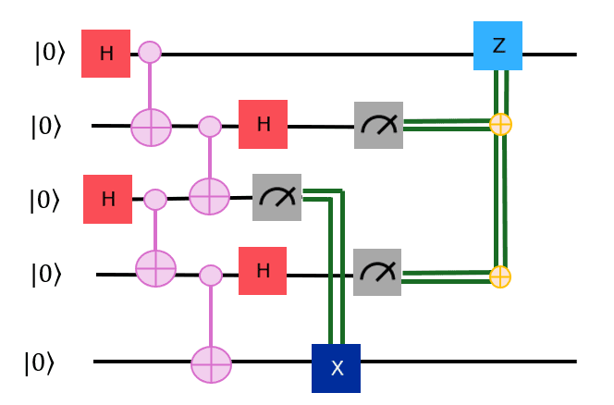
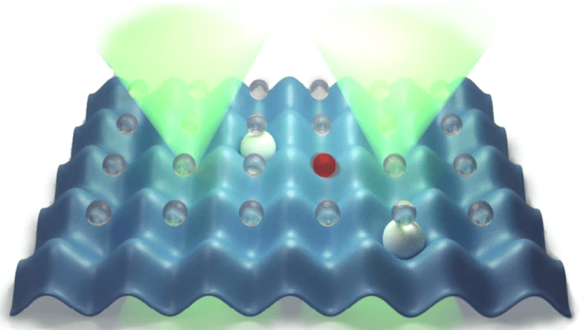
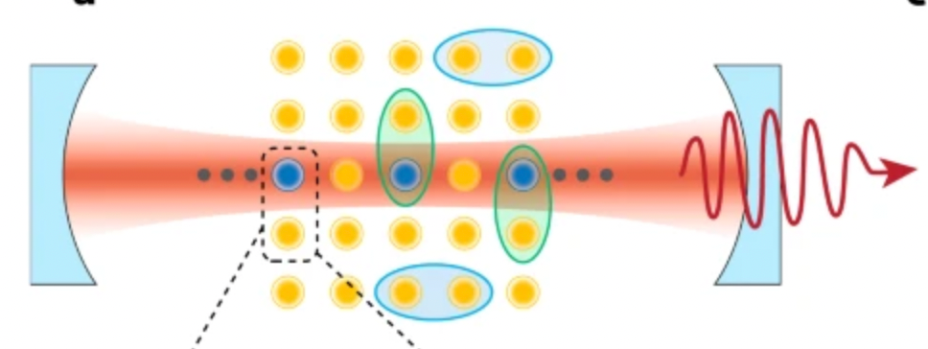
Constant-time models beyond QNC⁰
T-depth/
Magic Hierarchy
Circuits with many-qubit gates (QAC⁰, QAC⁰_{f})
Circuits with intermediate
measurements & feed-forward
(aka “adaptive circuits”)
Short-time global
Hamiltonian evolution
Notes:
We can consider models of constant-time quantum computation that are augmented with operations that can operate on many qubits simultaneously. Such models seem to get around lightcone arguments and Lieb Robinson bounds, so it’s interesting to think about what they’re capable of. This has motivated people to come up with a bunch of different models. The one that’s probably most familiar and experimentally relevant today are circuits with intermediate measurements and feed-forward operations. I’ll use the term “dynamic circuits” to refer to this; even though that’s a bit of marketing lingo it’s easier and shorter to say.
Another model is that of constant-depth circuits that are completely unitary but you allow many-qubit gates, such as many-qubit Toffoli or many-qubit CZ gates. In complexity theory people have studied models like these, they’re called QAC0 and QAC0_f, these will play an important role in this talk. These are more experimentally speculative, whenever I ask an experimentalist if they can implement many-qubit gates they go “yes! Absolutely! We can do 3-qubit gates. Maybe 4!”. I don’t have the heart to tell them that I mean n as n goes to infinity.
The next model is that of constant T-depth circuits, which is something that we learned about yesterday in Isaac Kim’s talk. This is closely related to another model called the Magic Hierarchy, which consists of Clifford circuits interleaved with QNC0 circuits a constant number of times. These models are motivated by fault tolerance, where implementing non-Clifford gates are the dominant cost.
And finally the last model is that of short-time global Hamiltonian evolutions, which is a model of what an analog quantum simulator can do. I won’t talk at all about this.

Slide 7
Constant-time models beyond QNC⁰
T-depth/
Magic Hierarchy
Circuits with many-qubit gates (QAC⁰, QAC⁰_{f})
Nontrivial equivalences between some of these models!
Circuits with intermediate
measurements & feed-forward
Short-time global
Hamiltonian evolution
Notes:
This might seem like a zoo of models, but what’s really interesting is that there are nontrivial equivalences been many of these! For example if you can implement something efficiently with constant-T depth, then you can efficiently implement it in the dynamic circuit model with constantly many rounds of measurement and classical post-processing, and vice versa.

Slide 8
Power of many-qubit gates?
What is the power of shallow circuits augmented with gates that can act on many qubits simultaneously?
Lightcone arguments are no longer a barrier: each output qubit can be affected by all input qubits simultaneously.
Answer depends the kind of many-qubit gates allowed.
In 1999, Chris Moore proposed two models QAC⁰ and QAC⁰_{f} as quantum analogues of the classical circuit model AC⁰

Slide 9
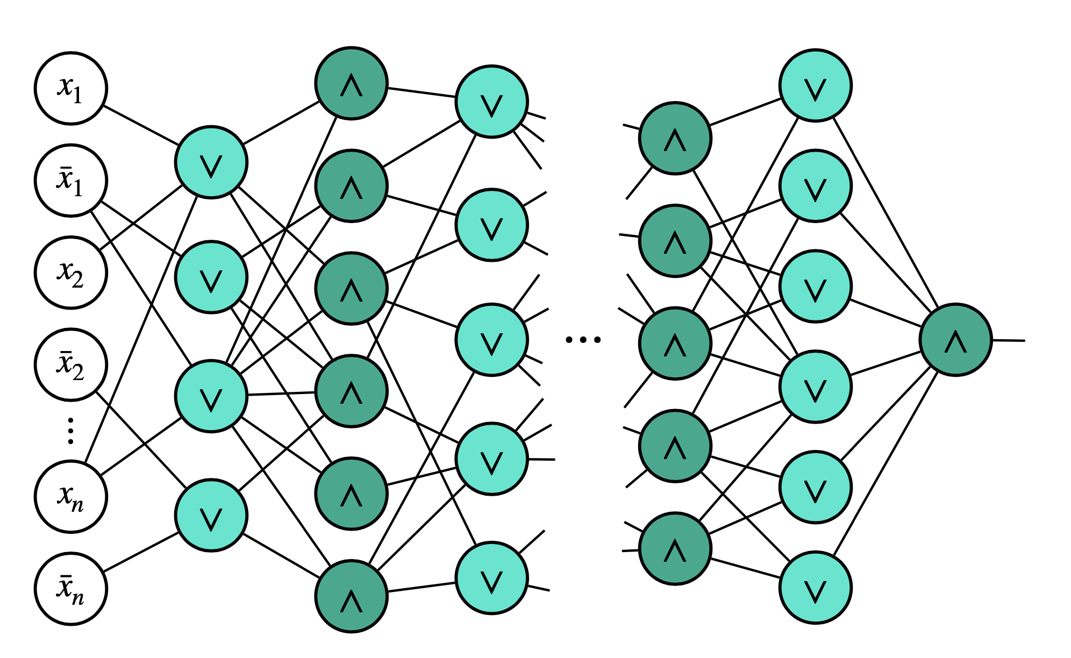
Classical AC⁰ circuits
AC⁰ = constant-depth, polynomial-size circuits with AND, OR, NOT gates with unbounded fan-in.
We have classical lower bounds beyond lightcones!
Parity cannot be computed by poly-sized AC⁰ circuits.
(Ajtai ’83, Furst-Saxe-Sipser ‘84, Yao ‘85, Hastad ‘86)
Depth

Slide 10





QAC⁰ with Toffoli gates
QAC⁰: constant-depth circuits with arbitrary single-qubit gates, and
many-qubit Toffoli gates (i.e., reversible AND)
$\text{Toffoli}\left|x_{1},…,x_{k},b\right\rangle =|x_{1},…,x_{k},b⊕x_{1}∧⋯∧x_{k}⟩$
$$x_{1}$$
$$x_{2}$$
$$x_{3}$$
$$b$$
Example of QAC⁰ circuit. Lightcones are large due to Toffoli gates.

Slide 11

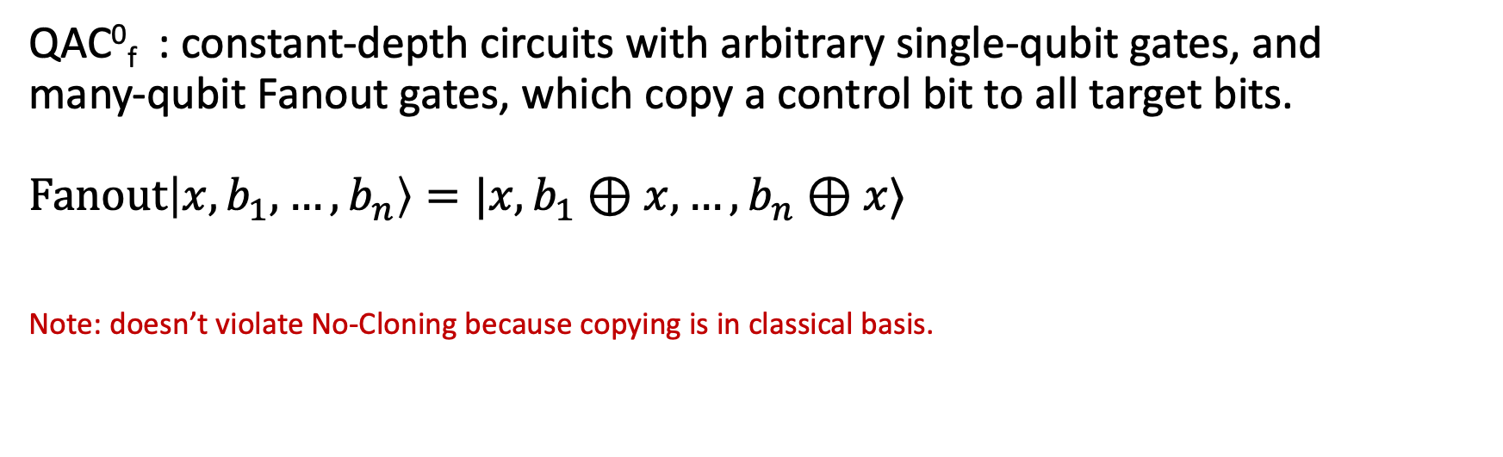



QAC⁰ with Fanout gates
QAC⁰_{f} : constant-depth circuits with arbitrary single-qubit gates, and
many-qubit Fanout gates, which copy a control bit to all target bits.
$\text{Fanout}\left|x,b_{1},…,b_{n}\right\rangle =|x,b_{1}⊕x,…,b_{n}⊕x⟩$
Note: doesn’t violate No-Cloning because copying is in classical basis.
$$x$$
$$b_{1}$$
$$b_{2}$$
$$b_{3}$$
Fanout gates can simulate Toffoli gates, so QAC⁰ $⊆$ QAC⁰_{f}
(Takahashi, Tani 2016)

Slide 12
QAC⁰ with Fanout gates
QAC⁰_{f} : constant-depth circuits with arbitrary single-qubit gates, and
many-qubit Fanout gates, which copy a control bit to all target bits.
$\text{Fanout}\left|x,b_{1},…,b_{n}\right\rangle =|x,b_{1}⊕x,…,b_{n}⊕x⟩$
Note: doesn’t violate No-Cloning because copying is in classical basis.
$$x$$
Note the ”f” subscript!
$$b_{1}$$
Key Questions:
1. What can be computed by QAC⁰, QAC⁰_{f}?
2. Is QAC⁰_{f} more powerful than QAC⁰?
$$b_{2}$$
$$b_{3}$$
Fanout gates can simulate Toffoli gates, so QAC⁰ $⊆$ QAC⁰_{f}
(Takahashi, Tani 2016)

Slide 13
Equivalence with dynamic circuits
O(1)-depth dynamic circuits:
1- and 2-qubit gates
intermediate measurements
classical postprocessing of measurement outcomes forwarded to next layer of gates

Slide 14
Equivalence with dynamic circuits
O(1)-depth dynamic circuits:
1- and 2-qubit gates
intermediate measurements
classical postprocessing of measurement outcomes forwarded to next layer of gates
Theorem: O(1)-depth dynamic circuits with parity postprocessing are equivalent to QAC⁰_{f}
(folklore, Buhrman, et al ’24, Parham ‘25)

Slide 15
Constant-time models of quantum computation can be powerful

Slide 16
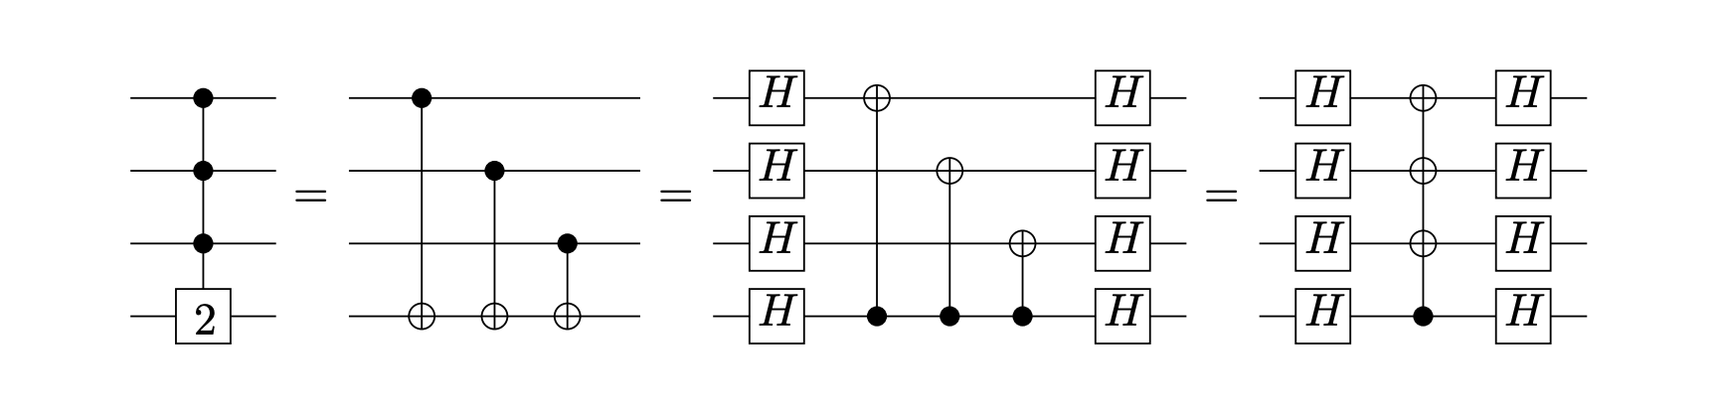

The power of QAC⁰_{f}
FANOUT is equivalent to computing Parity
Thus: PARITY $∈$ QAC⁰_{f}
PARITY
FANOUT

Slide 17
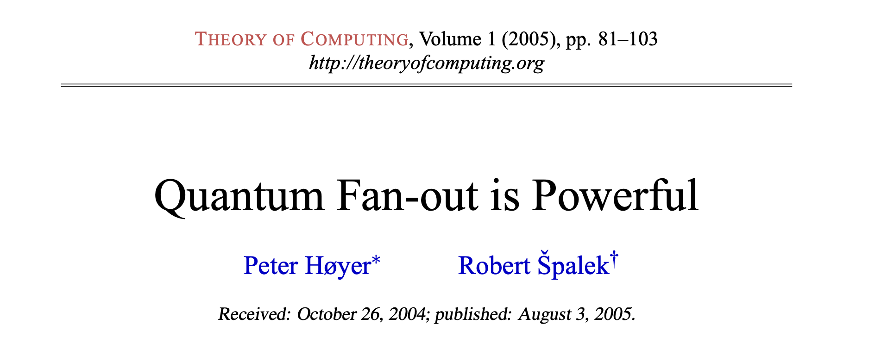
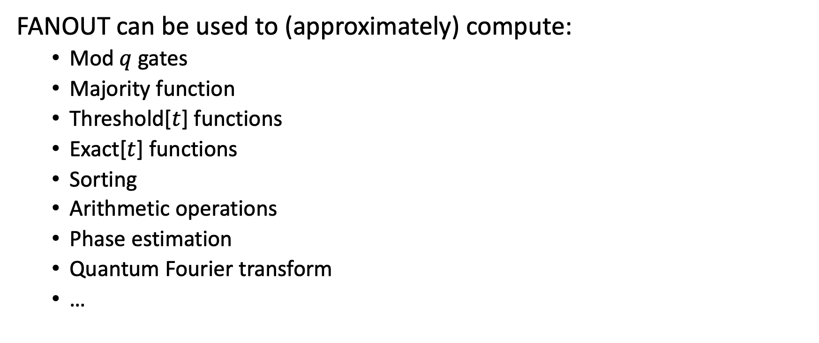
The power of QAC⁰_{f}
FANOUT can be used to (approximately) compute:
  Mod $q$ gates
  Majority function
  Threshold[$t$] functions
  Exact[$t$] functions
  Sorting
  Arithmetic operations
  Phase estimation
  Quantum Fourier transform
  …

Slide 18
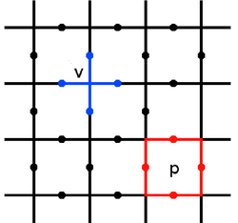
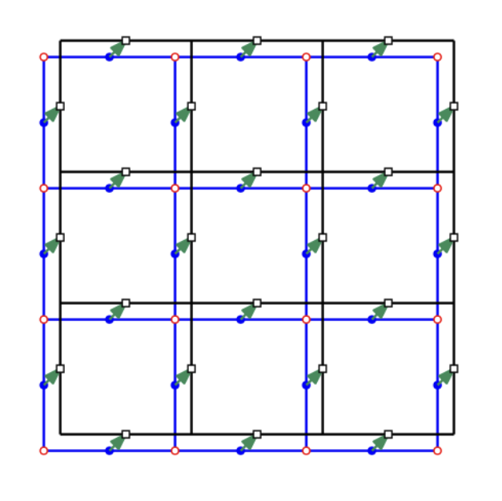



The power of QAC⁰_{f}
Globally entangled states can be prepared in QAC⁰_{f}
$$|0⟩$$
$$|0⟩$$
$$|0⟩$$
$$|0⟩$$
$$H$$
CAT state
Toric code
Non-abelian Anyons
(Quantum Double for Solvable Groups)
These states can also be prepared using adaptive circuits.
(Bravyi, et al. ‘22, Tantivasadakarn, Vishwanath, Verresen, ’23,…)

Slide 19
Example: preparing stabilizer states with Fanout
Every $n$-qubit CNOT circuit can be parallelized to depth $3$ and $O(n^{2})$ ancillas.
CNOT circuit $≡$invertible matrix $M∈𝔽_{2}^{n×n}$ on $n$ bits.

Slide 20


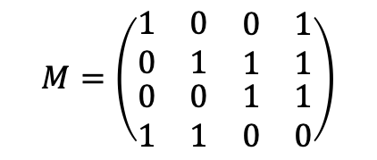





Example: preparing stabilizer states with Fanout
Every $n$-qubit CNOT circuit can be parallelized to depth $3$ and $O(n^{2})$ ancillas.
CNOT circuit $≡$invertible matrix $M∈𝔽_{2}^{n×n}$ on $n$ bits.
$$M$$
$$|x_{1}⟩$$
$$|x_{2}⟩$$
$$|x_{3}⟩$$
$$M=\left(\begin{matrix}\begin{matrix}1 & 0 \\ 0 & 1\end{matrix} & \begin{matrix}0 & 1 \\ 1 & 1\end{matrix} \\ \begin{matrix}0 & 0 \\ 1 & 1\end{matrix} & \begin{matrix}1 & 1 \\ 0 & 0\end{matrix}\end{matrix}\right)$$
$$|x_{4}⟩$$
$$|0⟩$$
$$|0⟩$$
$$|0⟩$$
$$|0⟩$$

Slide 21

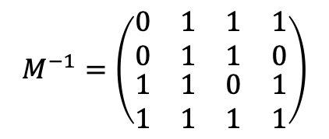
Example: preparing stabilizer states with Fanout
Every $n$-qubit CNOT circuit can be parallelized to depth $3$ and $O(n^{2})$ ancillas.
CNOT circuit $≡$invertible matrix $M∈𝔽_{2}^{n×n}$ on $n$ bits.
$$M$$
$$M^{−1}$$
$$|x_{1}⟩$$
$$|x_{2}⟩$$
$$|x_{3}⟩$$
$$M=\left(\begin{matrix}\begin{matrix}1 & 0 \\ 0 & 1\end{matrix} & \begin{matrix}0 & 1 \\ 1 & 1\end{matrix} \\ \begin{matrix}0 & 0 \\ 1 & 1\end{matrix} & \begin{matrix}1 & 1 \\ 0 & 0\end{matrix}\end{matrix}\right)$$
$$|x_{4}⟩$$
$$M^{−1}=\left(\begin{matrix}\begin{matrix}0 & 1 \\ 0 & 1\end{matrix} & \begin{matrix}1 & 1 \\ 1 & 0\end{matrix} \\ \begin{matrix}1 & 1 \\ 1 & 1\end{matrix} & \begin{matrix}0 & 1 \\ 1 & 1\end{matrix}\end{matrix}\right)$$
$$|0⟩$$
$$|0⟩$$
$$|0⟩$$
$$|0⟩$$

Slide 22




Example: preparing stabilizer states with Fanout
Every $n$-qubit CNOT circuit can be parallelized to depth $3$ and $O(n^{2})$ ancillas.
CNOT circuit $≡$invertible matrix $M∈𝔽_{2}^{n×n}$ on $n$ bits.
$$M$$
$$M^{−1}$$
Swap
$$|x⟩$$
$$|Mx⟩$$
$$M=\left(\begin{matrix}\begin{matrix}1 & 0 \\ 0 & 1\end{matrix} & \begin{matrix}0 & 1 \\ 1 & 1\end{matrix} \\ \begin{matrix}0 & 0 \\ 1 & 1\end{matrix} & \begin{matrix}1 & 1 \\ 0 & 0\end{matrix}\end{matrix}\right)$$
$$M^{−1}=\left(\begin{matrix}\begin{matrix}0 & 1 \\ 0 & 1\end{matrix} & \begin{matrix}1 & 1 \\ 1 & 0\end{matrix} \\ \begin{matrix}1 & 1 \\ 1 & 1\end{matrix} & \begin{matrix}0 & 1 \\ 1 & 1\end{matrix}\end{matrix}\right)$$
$$|0⟩$$
$$|0⟩$$
$$|0⟩$$
$$|0⟩$$
$$|0⟩$$
$$|0⟩$$
$$|0⟩$$
$$|0⟩$$

Slide 23











Example: preparing stabilizer states with Fanout
Theorem: Every Clifford circuit can be written as
Corollary: $n$-qubit Clifford circuits are parallelizable to depth 18 circuits with Fanout and $O(n^{2})$ ancillas.
(Aaronson, Gottesman 2004)
$$H$$
$$CNOT$$
$$P$$
$$CNOT$$
$$P$$
$$CNOT$$
$$H$$
$$P$$
$$CNOT$$
$$P$$

Slide 24
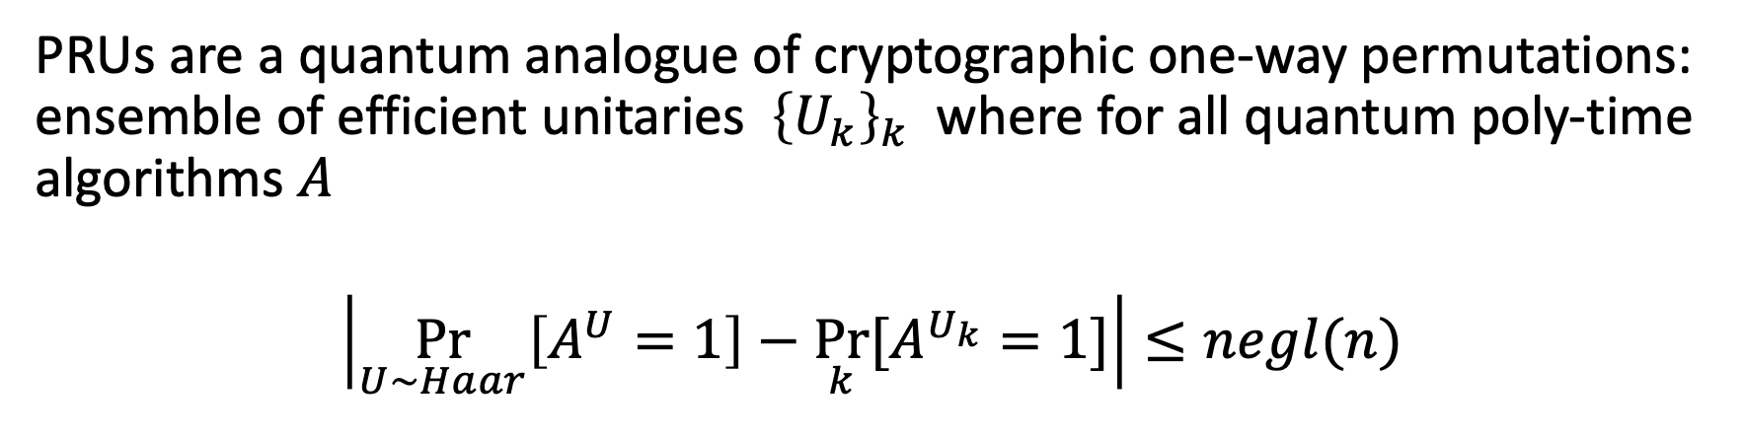
Example: Pseudorandom unitaries (PRUs)
PRUs are a quantum analogue of cryptographic one-way permutations: ensemble of efficient unitaries ${\left\{U_{k}\right\}}_{k}$ where for all quantum poly-time algorithms $A$
$$\left|\underset{U∼Haar}{Pr}\left[A^{U}=1\right]−\underset{k}{Pr}⁡[A^{U_{k}}=1]\right|≤negl(n)$$
Haar measure = “uniformly random” unitary
(Ji, Liu, Song 2018)
PRUs (and their information-theoretic analogue, unitary designs) are used for benchmarking quantum computers, quantum Shannon theory, quantum crypto, lower bounds in quantum learning, models of black holes, ….

Slide 25
The complexity of PRUs
Theorem (Foxman, Parham, Vasconcelos, Y. ‘25)
PRUs can be implemented to negligible error by poly-size QAC⁰_{f} circuits and inverse polynomial error by poly-size QAC⁰ circuits.
No classical analogue: Classical AC⁰ circuits have low average sensitivity, and can be distinguished from random via two queries.
(Linial-Mansour-Nisan ’93)
Learning lower bounds: Assuming subexponentially-secure LWE, QAC⁰ circuits cannot be learned in polynomial time.
Near-term implementation? QAC⁰_{f} circuits are equivalent to O(1)-depth circuits with midcircuit measurement and feedforward, which is experimentally relevant.

Slide 26
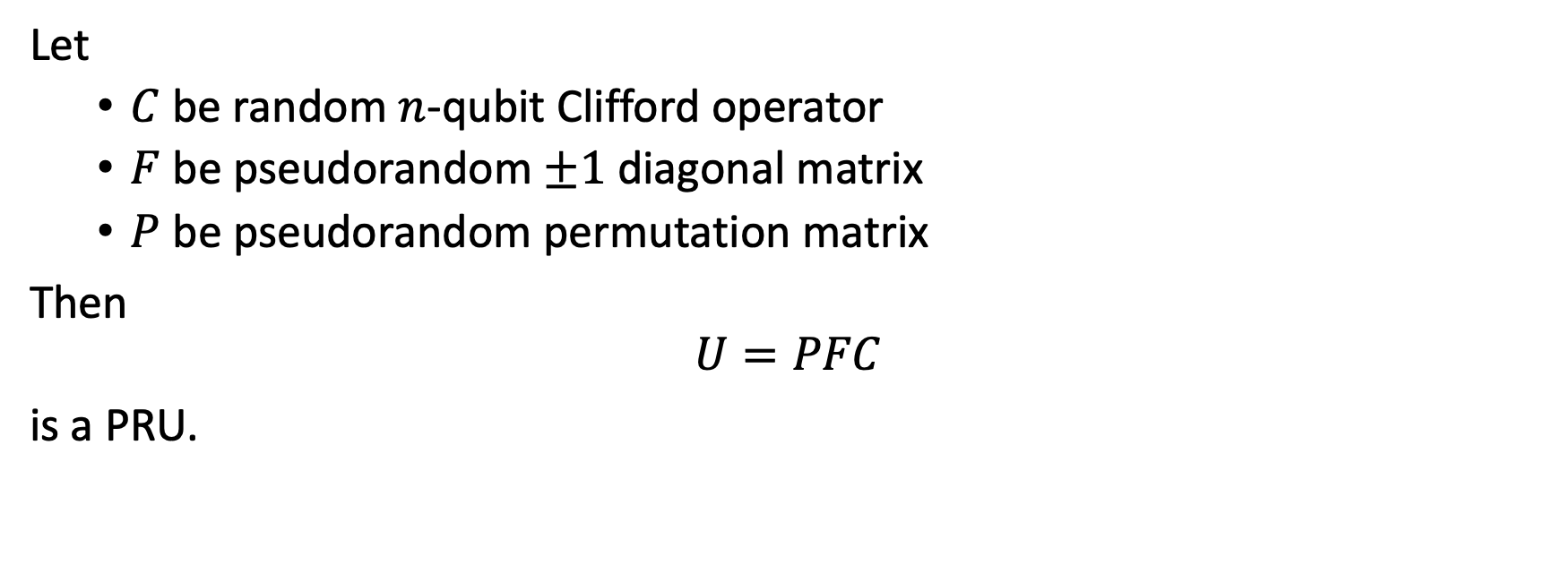
Pseudorandom unitaries in QAC⁰_{f}
Let
  $C$ be random $n$-qubit Clifford operator
  $F$ be pseudorandom $±1$diagonal matrix
  $P$ be pseudorandom permutation matrix
Then
$$U=PFC$$
is a PRU.
(Metger, Poremba, Sinha, Y. ‘24)

Slide 27
Pseudorandom unitaries in QAC⁰_{f}
O(1)-depth implementation using Fanout.
Let
  $C$ be random $n$-qubit Clifford operator
  $F$ be pseudorandom $±1$diagonal matrix
  $P$ be pseudorandom permutation matrix
Then
$$U=PFC$$
is a PRU.
(Metger, Poremba, Sinha, Y. ‘24)

Slide 28
Pseudorandom unitaries in QAC⁰_{f}
Let
  $C$ be random $n$-qubit Clifford operator
  $F$ be pseudorandom $±1$diagonal matrix
  $P$ be pseudorandom permutation matrix
Then
$$U=PFC$$
is a PRU.
Diagonal entries correspond evaluation of PRF computable in TC⁰, thus computable in QAC⁰_{f}.
(Metger, Poremba, Sinha, Y. ‘24)

Slide 29
Pseudorandom unitaries in QAC⁰_{f}
Let
  $C$ be random $n$-qubit Clifford operator
  $F$ be pseudorandom $±1$diagonal matrix
  $P$ be pseudorandom permutation matrix
Then
$$U=PFC$$
is a PRU.
Permutation is computed via “Luby-Rackoff” cipher, which is also computable in QAC⁰_{f}.
(Metger, Poremba, Sinha, Y. ‘24)

Slide 30
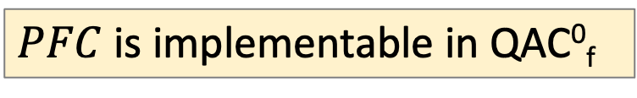
Pseudorandom unitaries in QAC⁰_{f}
Let
  $C$ be random $n$-qubit Clifford operator
  $F$ be pseudorandom $±1$diagonal matrix
  $P$ be pseudorandom permutation matrix
Then
$$U=PFC$$
is a PRU.
(Metger, Poremba, Sinha, Y. ‘24)
$PFC$ is implementable in QAC⁰_{f}
(Chia-Liang-Song ‘24, Foxman, Parham, Vasconcelos, Y. ‘25)

Slide 31
Non-abelian anyons in QAC⁰_{f}
Basis for topological quantum computing: highly entangled states with emergent “particles” (called non-abelian anyons) that can be braided together to implement quantum gates.
Kitaev’s quantum double: a recipe for constructing anyons with braiding action determined by a finite group G.
Quantum double for any solvable group G
can be prepared in QAC⁰_{f}
(Bravyi, et al. ‘22, Tantivasadakarn, Vishwanath, Verresen, ’23,…)

Slide 32
Non-abelian anyons in QAC⁰_{f}
Basis for topological quantum computing: highly entangled states with emergent “particles” (called non-abelian anyons) that can be braided together to implement quantum gates.
Kitaev’s quantum double: a recipe for constructing anyons with braiding action determined by a finite group G.
Quantum double for any solvable group G
can be prepared in QAC⁰_{f}
What about non-solvable groups?
(Bravyi, et al. ‘22, Tantivasadakarn, Vishwanath, Verresen, ’23,…)

Slide 33
Constant-time models of quantum computation can be weak

Slide 34
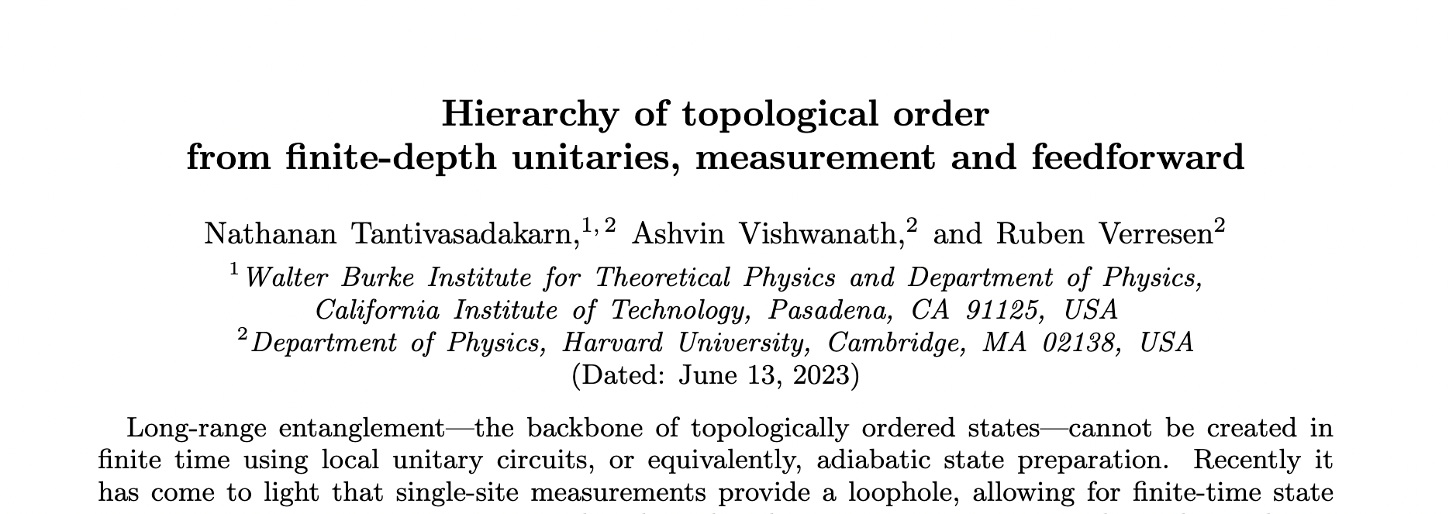
TVV Conjecture
Conjecture: The quantum double model for non-solvable groups
cannot be prepared by O(1)-depth adaptive circuits.
(Tantivasadakarn, Vishwanath, Verresen, ’23)
Condensed matter physicists: c’mon, this has gotta be true! There is physical intuition for why this conjecture holds.

Slide 35
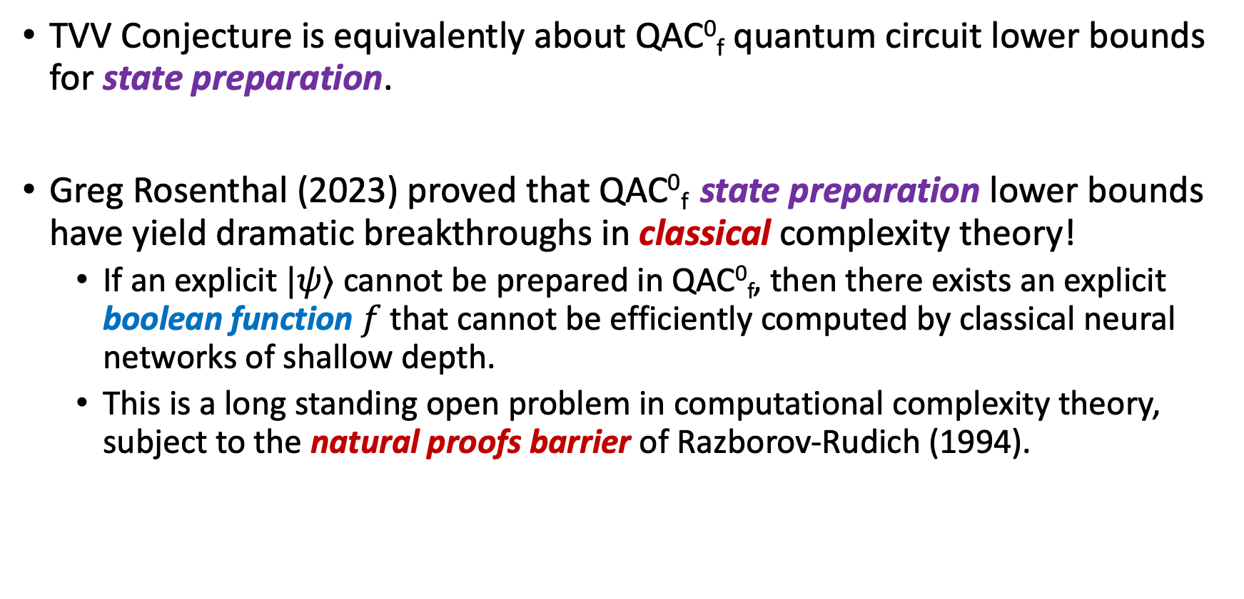
Quantum circuit lower bounds
TVV Conjecture is equivalently about QAC⁰_{f} quantum circuit lower bounds for state preparation.
Greg Rosenthal (2023) proved that QAC⁰_{f} state preparation lower bounds have yield dramatic breakthroughs in classical complexity theory!
  If an explicit $|ψ⟩$ cannot be prepared in QAC⁰_{f}, then there exists an explicit boolean function $f$ that cannot be efficiently computed by classical neural networks of shallow depth.
  This is a long standing open problem in computational complexity theory, subject to the natural proofs barrier of Razborov-Rudich (1994).

Slide 36

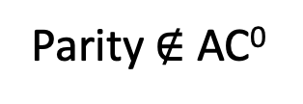

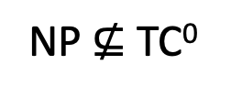

A map of complexity theory questions
QAC⁰_{f} state preparation lower bounds
P $≠$ NP
NP $⊈$ TC⁰
NEXP $⊈$ ACC⁰
Parity $∉$ AC⁰
Notes:
I want to start by connecting this talk to the theme of the conference, which is the P vs NP and complexity lower bounds. This is the picture I have of the landscape of circuit complexity lower bounds. The ultimate goal is to reach these peaks here: proving that NP or NEXP do not have poly-sized circuits. We’ve made some important strides given the technology we have, but so far it seems we’re pretty far away from making it up here.

Slide 37
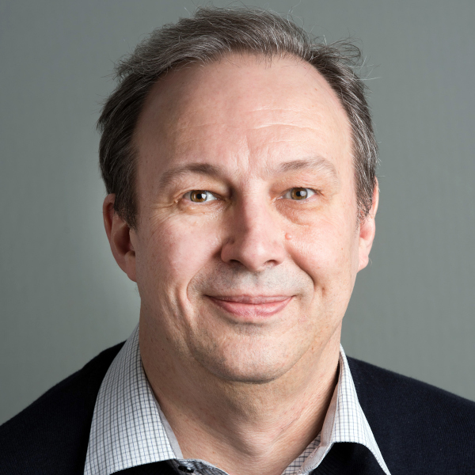
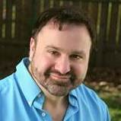
A map of complexity theory questions
QAC⁰_{f} state preparation lower bounds
P $≠$ NP
NP $⊈$ TC⁰
You shall not pass!
…at least, not with a natural proof.
🔥 🔥
🔥 🔥
🔥 🔥
NEXP $⊈$ ACC⁰
🔥 🔥
🔥 🔥
🔥 🔥
🔥 🔥
🔥 🔥
Parity $∉$ AC⁰
🔥 🔥
🔥 🔥
Notes:
I want to start by connecting this talk to the theme of the conference, which is the P vs NP and complexity lower bounds. This is the picture I have of the landscape of circuit complexity lower bounds. The ultimate goal is to reach these peaks here: proving that NP or NEXP do not have poly-sized circuits. We’ve made some important strides given the technology we have, but so far it seems we’re pretty far away from making it up here.

Slide 38
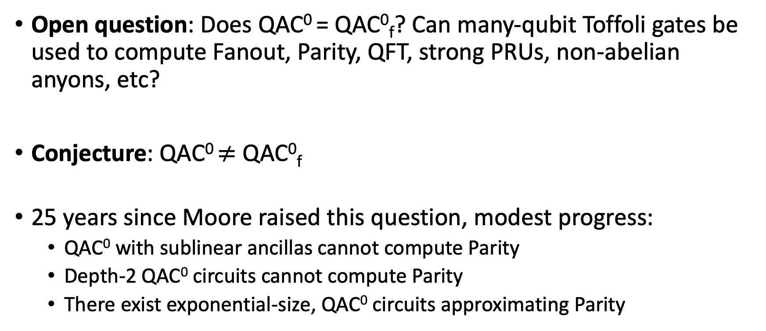
QAC⁰ vs. QAC⁰_{f}
Open question: Does QAC⁰ = QAC⁰_{f}? Can many-qubit Toffoli gates be used to compute Fanout, Parity, QFT, strong PRUs, non-abelian anyons, etc?
Conjecture: QAC⁰ $≠$ QAC⁰_{f}
25 years since Moore raised this question, modest progress:
  QAC⁰ with sublinear ancillas cannot compute Parity
  Depth-2 QAC⁰ circuits cannot compute Parity
  There exist exponential-size, QAC⁰ circuits approximating Parity
Fang, Fenner, Green, Homer, Zhang (‘03)
Pade, Fenner, Grier, Thierauf (‘20)
Rosenthal (‘20)

Slide 39
Pauli Analysis of QAC⁰ circuits
(Nadimpalli, Parham, Vasconcelos, Y. ‘24)
Motivation: develop general techniques for analyzing quantum circuits with many-qubit gates.
We introduce the notion of the Pauli spectrum of a quantum circuit, which is a quantum analogue of the Fourier spectrum of a Boolean function.
Main Result: Pauli spectrum of QAC⁰ circuits (with few ancilla) are highly concentrated on the low-degree components.
Analogous to Linial-Mansour-Nisan theorem (1993): AC⁰-computable Boolean functions have concentrated Fourier spectra.

Slide 40







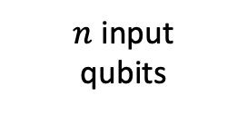

Pauli spectrum of quantum circuits
$C$ = quantum circuit with $n$ input qubits, $a$ ancilla qubits, and 1 output qubit
The following diagram defines an $n$-qubit matrix $Φ_{C}$:
Output qubit
$$Z$$
$n$ input
qubits
$$C^{†}$$
$$C$$
$$⟨0|$$
$$|0⟩$$
$a$ancilla
qubits
$$⟨0|$$
$$|0⟩$$

Slide 41
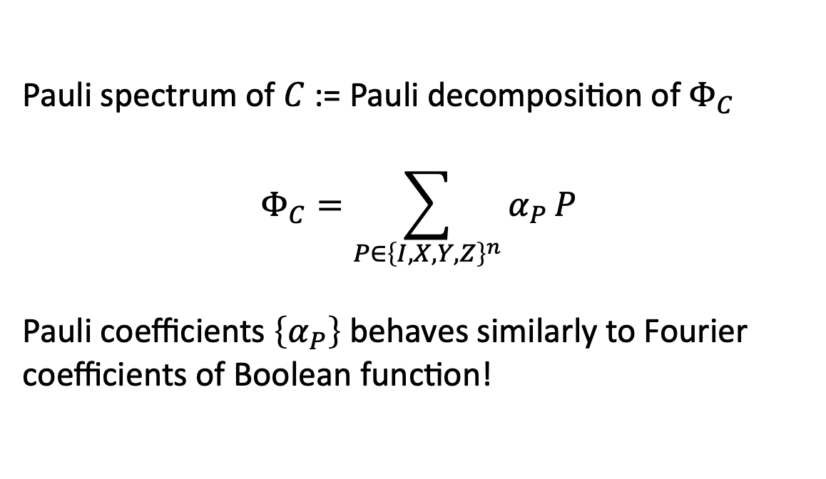
Pauli spectrum of quantum circuits
$C$ = quantum circuit with $n$ input qubits, $a$ ancilla qubits, and 1 output qubit
The following diagram defines an $n$-qubit matrix $Φ_{C}$:
Output qubit
$$Z$$
Pauli spectrum of $C$ := Pauli decomposition of $Φ_{C}$
$$Φ_{C}=\sum_{P∈{\left\{I,X,Y,Z\right\}}^{n}}{α_{P}}P$$
Pauli coefficients $\left\{α_{P}\right\}$ behaves similarly to Fourier coefficients of Boolean function!
$n$ input
qubits
$$C^{†}$$
$$C$$
$$⟨0|$$
$$|0⟩$$
$a$ancilla
qubits
$$⟨0|$$
$$|0⟩$$

Slide 42
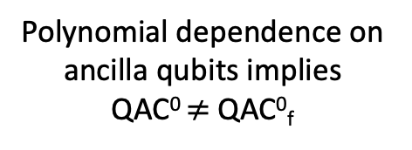

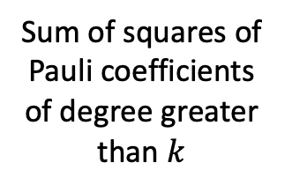
Pauli spectrum concentration of QAC⁰
Theorem (Nadimpalli, Parham, Vasconcelos, Y. ‘24)
If $C$ is computable by depth-$d$size-$s$ QAC⁰ circuit with $a$ ancilla qubits, then its Pauli spectrum concentrates on low degree coefficients:
$$W^{>k}\left[Φ_{C}\right]≤poly(s)⋅2^{−Ω\left(k^{1/d}\right)}⋅2^{a}$$
Resembles classical LMN!
Sum of squares of Pauli coefficients of degree greater than $k$
Polynomial dependence on
ancilla qubits implies
QAC⁰ $≠$ QAC⁰_{f}

Slide 43
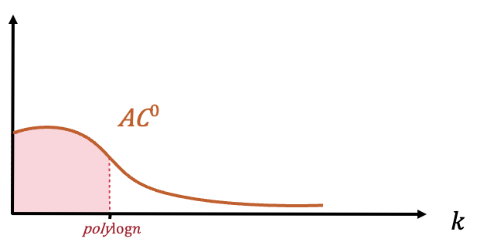
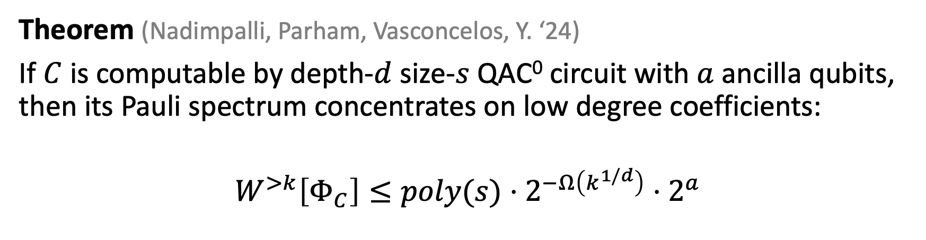
Pauli spectrum concentration of QAC⁰
Theorem (Nadimpalli, Parham, Vasconcelos, Y. ‘24)
If $C$ is computable by depth-$d$size-$s$ QAC⁰ circuit with $a$ ancilla qubits, then its Pauli spectrum concentrates on low degree coefficients:
$$W^{>k}\left[Φ_{C}\right]≤poly(s)⋅2^{−Ω\left(k^{1/d}\right)}⋅2^{a}$$
Corollaries
Poly-size QAC⁰ circuit with few ancilla qubits
Cannot approximate PARITY or MAJORITY
Can be learned in quasipoly time from Choi state samples.

Slide 44
Summary
Nontrivial equivalences between models of constant-time quantum computation: QAC⁰, QAC⁰_{f} , dynamic circuits, O(1) T-depth, Magic Hierarchy, …
Power of these models: Can compute complex functions, prepare complex globally entangled states (e.g., some non-abelian anyons), and implement (pseudo)random unitaries.
Weaknesses of these models: TVV conjecture, many-qubit Toffoli vs Fanout, Pauli spectrum analysis of QAC⁰ circuits, Magic Hierarchy lower bounds.

Slide 45
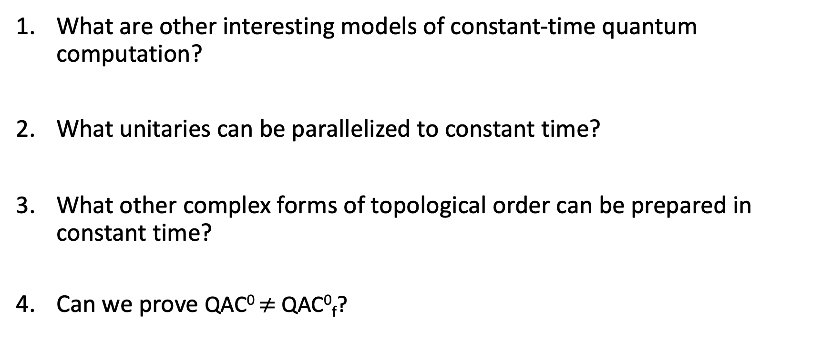
Questions
What are other interesting models of constant-time quantum computation?
What unitaries can be parallelized to constant time?
What other complex forms of topological order can be prepared in constant time?
Can we prove QAC⁰ $≠$ QAC⁰_{f}?
Thank You!

Slide 46
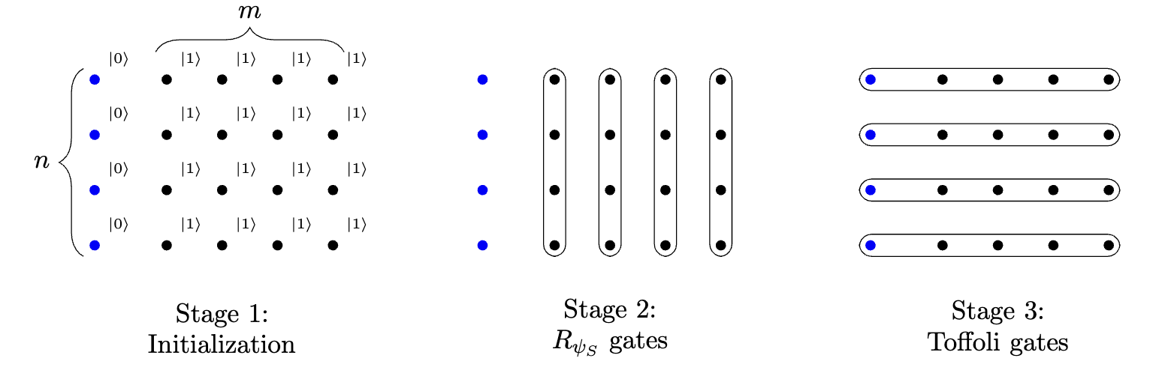
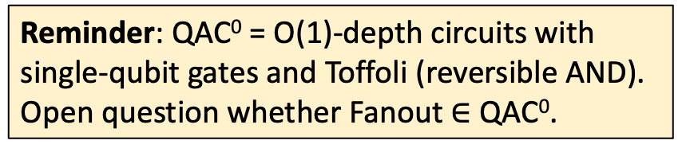


Pseudorandom unitaries without Fanout
Reminder: QAC⁰ = O(1)-depth circuits with
single-qubit gates and Toffoli (reversible AND).
Open question whether Fanout $∈$ QAC⁰.
PRU construction in QAC⁰:
Step 1. Scale down QAC⁰_{f} construction of PRUs to $ω(\log{n)}$ qubits, and simulate each Fanout with $poly(n)$-size QAC⁰ circuit.
Width $w$ Fanout gate can be implemented by QAC⁰ circuit with
Depth $d\log{d}$
Size $dw exp⁡(w^{1/d})$
Error $w\exp\left(−dw^{1/d}\right)$
(Rosenthal ‘21, Grier, Morris ‘25)

Slide 47
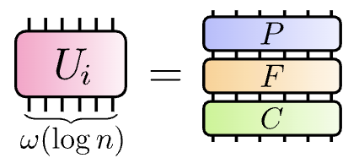


Pseudorandom unitaries without Fanout
Reminder: QAC⁰ = O(1)-depth circuits with
single-qubit gates and Toffoli (reversible AND).
Open question whether Fanout $∈$ QAC⁰.
PRU construction in QAC⁰:
Step 2. Use Gluing Lemma, which stitches together i.i.d. width-$ω(\log{n)}$PRUs into width-$n$ PRU.
(LaRacuente-Leditzky ’24, Schuster, Haferkamp, Huang ‘25)
$n$ qubits

Slide 48
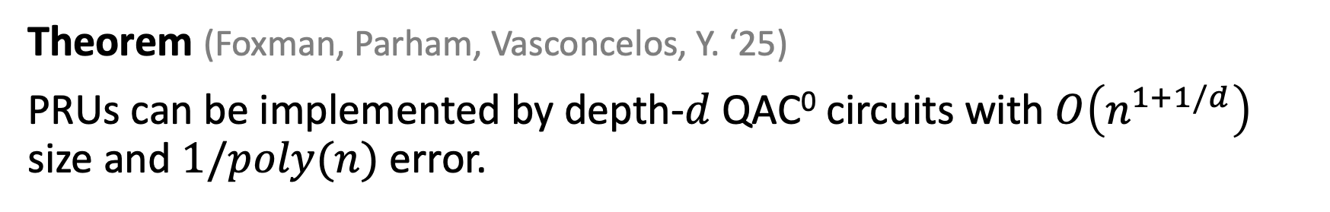
Pseudorandom unitaries without Fanout
Reminder: QAC⁰ = O(1)-depth circuits with
single-qubit gates and Toffoli (reversible AND).
Open question whether Fanout $∈$ QAC⁰.
PRU construction in QAC⁰:
Step 2. Use Gluing Lemma, which stitches together i.i.d. width-$ω(\log{n)}$PRUs into width-$n$ PRU.
Theorem (Foxman, Parham, Vasconcelos, Y. ‘25)
PRUs can be implemented by depth-$d$ QAC⁰ circuits with $O\left(n^{1+1/d}\right)$ size and $1/poly(n)$ error.
To our knowledge, first interesting
class of unitaries implementable in QAC⁰!

