Slide 1
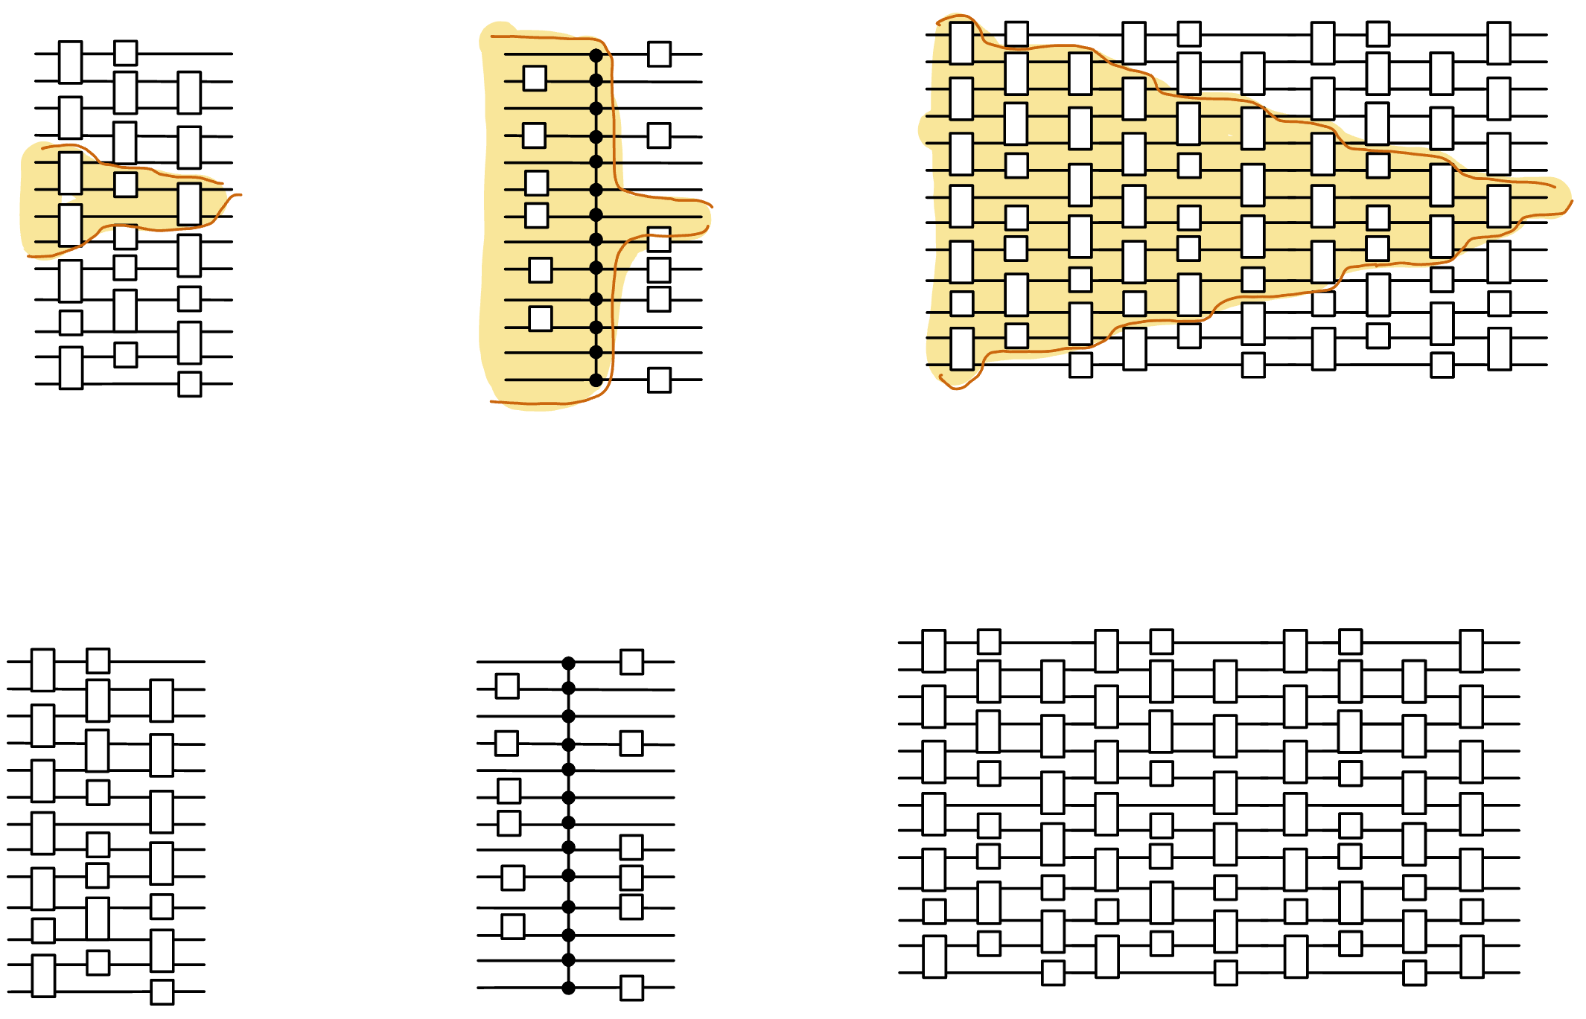
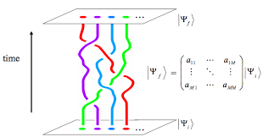
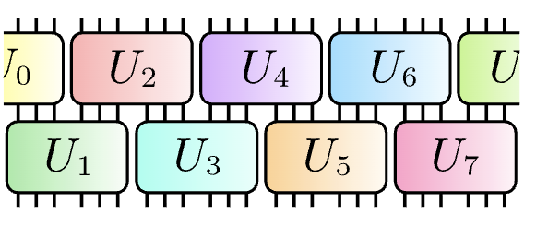
The power and limits of constant-time quantum computation
Henry Yuen
Columbia University
Notes:
Thanks for the invitation to speak. This talk will be about various models of constant-time quantum computation: these are models where the computation on the device takes an amount of time that is independent of the system size. It’s quite a fascinating problem to try to understand the computational power and limitations of these models. This talk will essentially be a bunch of different stories about these models.

Slide 2

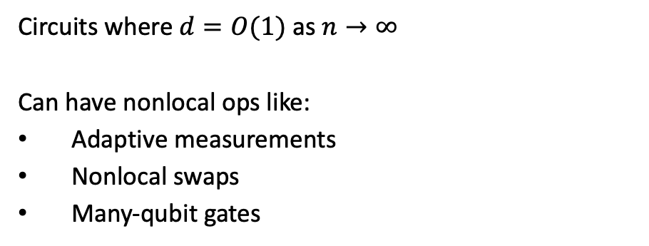

Constant-time quantum computation
Circuits where $d=O(1)$ as $n→∞$
Can have nonlocal ops like:
Adaptive measurements
Nonlocal swaps
Many-qubit gates
$n$: system size
X
Depth $d$
Experimental motivation: noisy devices are depth-constrained
Theory motivation: surprising algorithmic richness, applications to condensed matter and fault tolerance, and a fertile playground for understanding quantum computation.

Slide 3
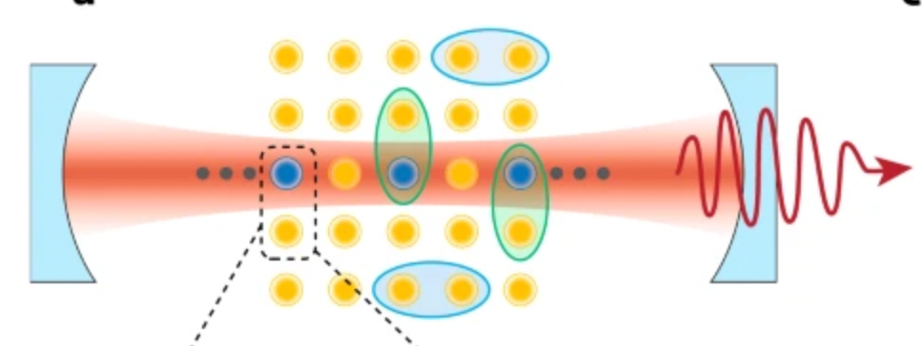
A zoo of constant-time models
QNC⁰
single and two-qubit gates
O(1)-depth

Slide 4
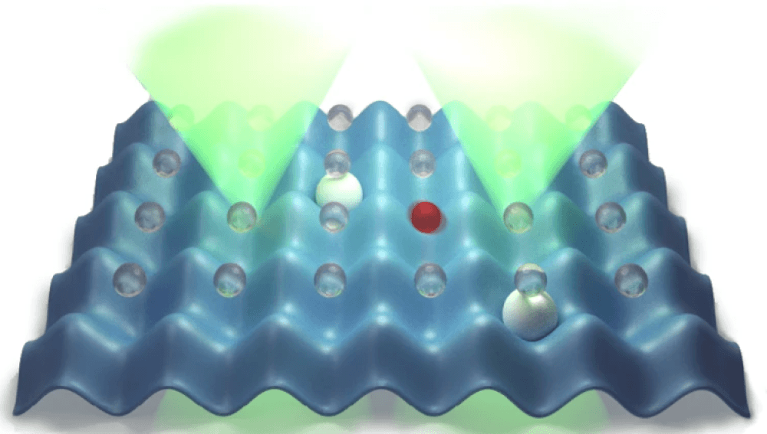
A zoo of constant-time models
QNC⁰
O(1)-time Hamiltonian
simulators

Slide 5
A zoo of constant-time models
QNC⁰
Simplest models
O(1)-time Hamiltonian
simulators

Slide 6
A zoo of constant-time models
QNC⁰
QNC⁰ + Toffoli
Many-qubit gate models
O(1)-time Hamiltonian
simulators
QNC⁰ + Fanout

Slide 7
A zoo of constant-time models
Most experimentally relevant
X
QNC⁰
QNC⁰ + Toffoli
Dynamic QNC⁰
O(1)-time Hamiltonian
simulators
QNC⁰ + Fanout

Slide 8
A zoo of constant-time models
X
QNC⁰
QNC⁰ + Toffoli
Dynamic QNC⁰
Relevant for fault-tolerance and cond-mat
Clifford
Clifford
QNC⁰ + Fanout
T-depth/Magic hierarchy
O(1)-time Hamiltonian
simulators

Slide 9
A zoo of constant-time models
How powerful are these models?
What are their limitations?
How do they compare to each other?
What do they tell us about physics and computation?
Can they be experimentally realized?
X
QNC⁰
QNC⁰ + Toffoli
This talk
Dynamic QNC⁰
Clifford
Clifford
QNC⁰ + Fanout
T-depth/Magic hierarchy
O(1)-time Hamiltonian
simulators

Slide 10
A zoo of constant-time models
X
QNC⁰
QNC⁰ + Toffoli
Dynamic QNC⁰
Clifford
Clifford
QNC⁰ + Fanout
T-depth/Magic hierarchy
O(1)-time Hamiltonian
simulators

Slide 11
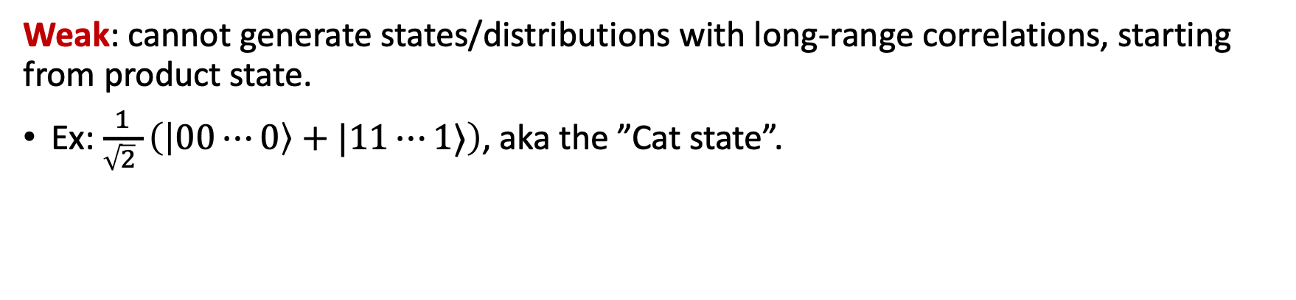
QNC⁰ circuits
Unitary circuits w/ 1- and 2-qubit gates, with depth independent of $n$.
Powerful: QNC⁰ circuits can generate probability distributions that cannot be classically sampled from (under plausible complexity assumptions).
(DiVincenzo-Terhal ’03, Bremner-Josza-Shepherd ‘09, …)
Weak: cannot generate states/distributions with long-range correlations, starting from product state.
Ex: $\frac{1}{\sqrt{2} }\left(\left|00⋯0\right\rangle +|11⋯1⟩\right)$, aka the ”Cat state”.
Notes:
The first model I’ll talk about it something most people are familiar with: constant-depth quantum circuits with single and two-qubit gates. In complexity-speak this model is called QNC0, after the analogous classical circuit model NC0. This is a useful model of constant-time in the NISQ era.
QNC0 circuits have been studied a lot over the last twenty years or so, and we know a lot about them. For example, we know that they can be powerful. On the other hand, these circuits are quite weak in others ways: for example they cannot prepare states with long-range correlations like the Cat state, starting from a product state. This is because of simple lightcone or Lieb-Robinson-type arguments. Constant-depth circuits with only local interactions cannot generate correlations fast enough.

Slide 12
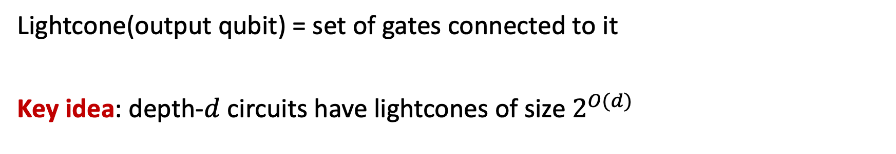
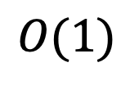

The lightcone argument
Lightcone(output qubit) = set of gates connected to it
Key idea: depth-$d$ circuits have lightcones of size $2^{O(d)}$
$$n$$
Output qubits with disjoint lightcones must be uncorrelated with each other.
$$O(1)$$
The main technique we have for showing limitations of quantum circuits!
What to do when the lightcone argument breaks down?

Slide 13
The zoo
X
QNC⁰
QNC⁰ + Toffoli
Dynamic QNC⁰
Many-qubit gate models
Clifford
Clifford
QNC⁰ + Fanout
T-depth/Magic hierarchy
O(1)-time Hamiltonian
simulators

Slide 14
Power of many-qubit gates?
What is the power of shallow circuits augmented with gates that can act on many qubits simultaneously?
Lightcone arguments are no longer a barrier: each output qubit can be affected by all input qubits simultaneously.
Answer depends the kind of many-qubit gates allowed.
In 1999, Chris Moore proposed two models as analogies to a well-studied classical circuit complexity class AC⁰

Slide 15
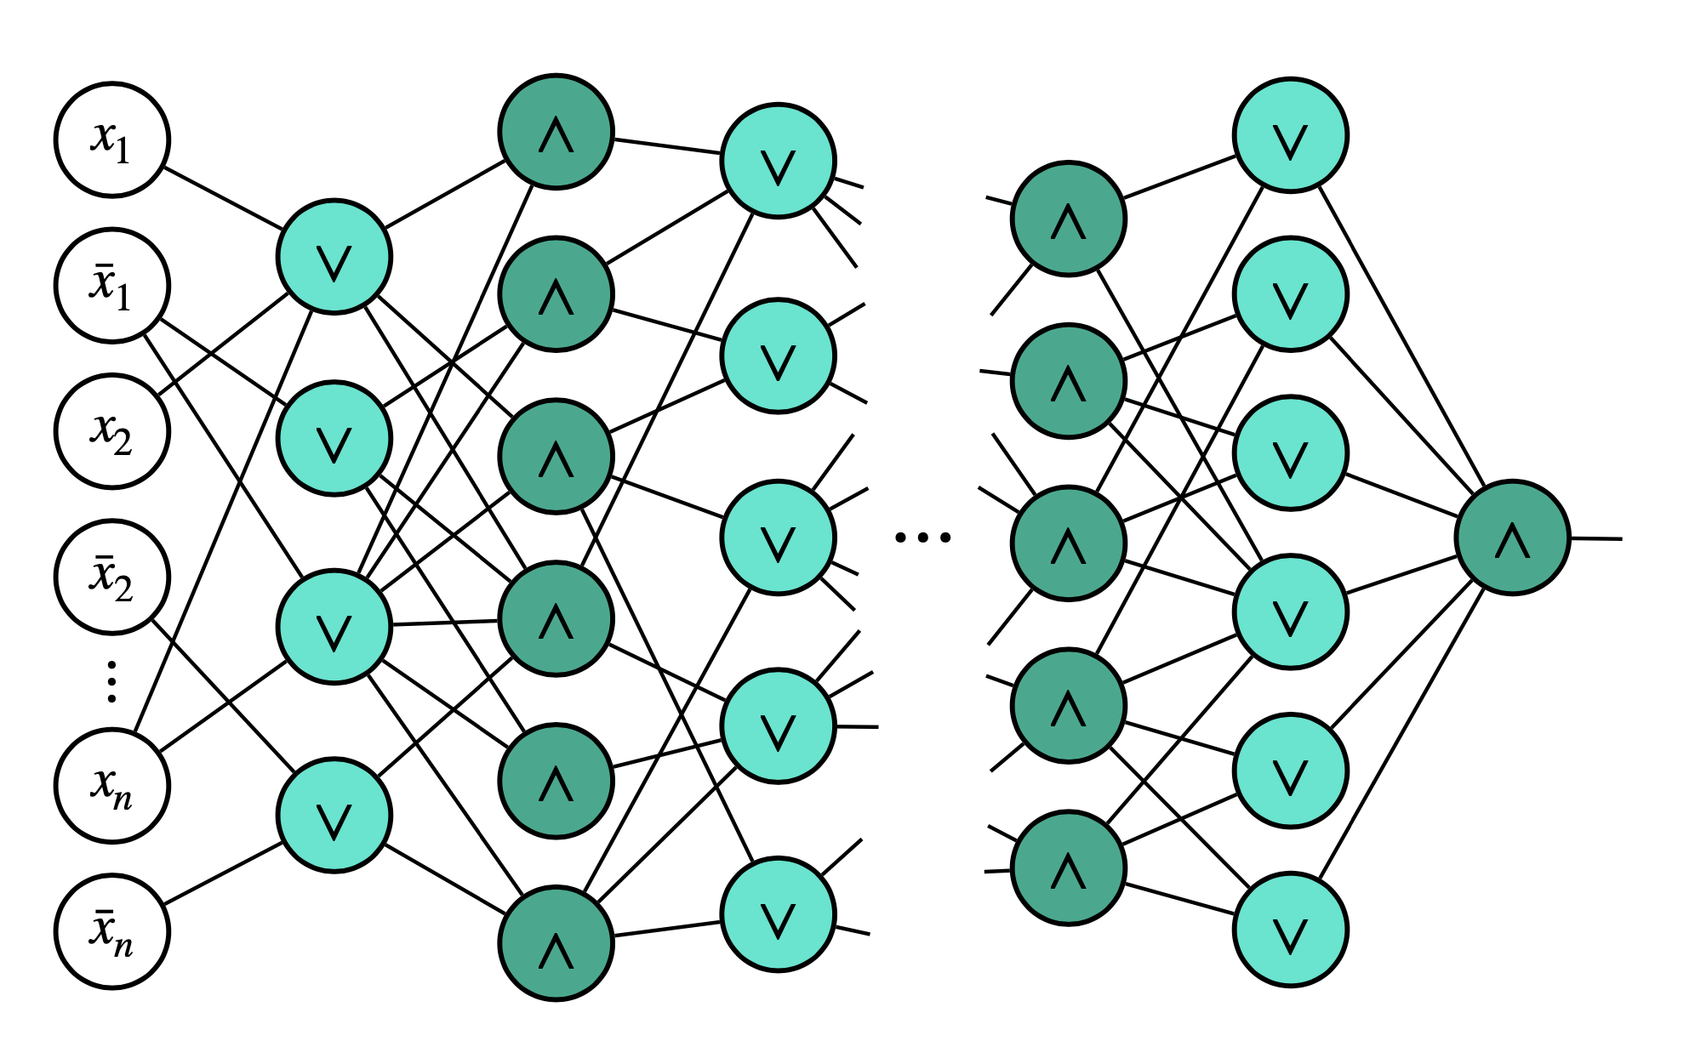
Classical AC⁰ circuits
AC⁰ = constant-depth, polynomial-size circuits with AND, OR, NOT gates with unbounded fan-in.
We have classical lower bounds beyond lightcones!
Parity cannot be computed by poly-sized AC⁰ circuits.
(Ajtai ’83, Furst-Saxe-Sipser ‘84, Yao ‘85, Hastad ‘86)
Depth

Slide 16
QNC⁰[Toffoli] and QNC⁰[Fanout]
In the literature,
they are called QAC⁰ and QAC⁰_{f}
Constant-depth circuits with 1- and 2-qubit gates, plus…
Toffoli
Fanout
Reversible AND
Copies in the classical basis
x₁
x
x₂
b₁
⋮
⋮
b₂
xₖ
⋮
⋮
b
bₘ
b ↦ b ⊕ (x₁ ∧ ⋯ ∧ xₖ)
bᵢ ↦ bᵢ ⊕ x for every i
Fanout can simulate Toffoli:
QNC⁰[Toffoli] ⊆ QNC⁰[Fanout]
(Takahashi, Tani 2016)
Notes:
Combines the introductions to QNC^0[Toffoli] and QNC^0[Fanout] from the existing presentation. Both classes have O(1) circuit depth and arbitrary 1- and 2-qubit gates, augmented by the indicated unbounded-arity gates. Toffoli maps |x1,...,xk,b> to |x1,...,xk,b XOR (x1 AND ... AND xk)> and leaves all controls unchanged. Fanout maps |x,b1,...,bm> to |x,b1 XOR x,...,bm XOR x> and leaves x unchanged. The displayed bit rules specify their action on computational-basis states, extended linearly to superpositions. Fanout copies computational-basis values into targets initially in |0>; it does not clone arbitrary quantum states. Gate arity may scale with input size. The inclusion QNC^0[Toffoli] subseteq QNC^0[Fanout] is the constant-depth simulation stated in the source presentation, citing Takahashi and Tani (2016). The diagrams are schematic, with vertical ellipses indicating arbitrarily many controls or targets.

Slide 17
QNC⁰[Toffoli] and QNC⁰[Fanout]
In the literature,
they are called QAC⁰ and QAC⁰_{f}
Constant-depth circuits with 1- and 2-qubit gates, plus…
Toffoli
Fanout
Key Questions:
1. What can be computed by QNC⁰ [Tof] and QNC⁰ [Fanout]?
2. Is Fanout more powerful than Toffoli?
Reversible AND
Copies in the classical basis
x₁
x
x₂
b₁
⋮
⋮
b₂
xₖ
⋮
⋮
b
bₘ
b ↦ b ⊕ (x₁ ∧ ⋯ ∧ xₖ)
bᵢ ↦ bᵢ ⊕ x for every i
Fanout can simulate Toffoli:
QNC⁰[Toffoli] ⊆ QNC⁰[Fanout]
(Takahashi, Tani 2016)
Notes:
Combines the introductions to QNC^0[Toffoli] and QNC^0[Fanout] from the existing presentation. Both classes have O(1) circuit depth and arbitrary 1- and 2-qubit gates, augmented by the indicated unbounded-arity gates. Toffoli maps |x1,...,xk,b> to |x1,...,xk,b XOR (x1 AND ... AND xk)> and leaves all controls unchanged. Fanout maps |x,b1,...,bm> to |x,b1 XOR x,...,bm XOR x> and leaves x unchanged. The displayed bit rules specify their action on computational-basis states, extended linearly to superpositions. Fanout copies computational-basis values into targets initially in |0>; it does not clone arbitrary quantum states. Gate arity may scale with input size. The inclusion QNC^0[Toffoli] subseteq QNC^0[Fanout] is the constant-depth simulation stated in the source presentation, citing Takahashi and Tani (2016). The diagrams are schematic, with vertical ellipses indicating arbitrarily many controls or targets.

Slide 18
The zoo
X
QNC⁰
QNC⁰ + Toffoli
Dynamic QNC⁰
These models are equivalent in power!
Clifford
Clifford
QNC⁰ + Fanout
T-depth/Magic hierarchy
O(1)-time Hamiltonian
simulators

Slide 19
Equivalence with dynamic circuits
O(1)-depth dynamic circuits:
1- and 2-qubit gates
intermediate measurements
classical postprocessing of measurement outcomes forwarded to next layer of gates
X
Dynamic QNC⁰

Slide 20
Equivalence with dynamic circuits
O(1)-depth dynamic circuits:
1- and 2-qubit gates
intermediate measurements
classical postprocessing of measurement outcomes forwarded to next layer of gates
X
Dynamic QNC⁰
Theorem: O(1)-depth dynamic circuits with parity postprocessing are equivalent to QNC⁰ [Fanout]
(folklore, Buhrman, et al ’24, Parham ‘25)

Slide 21
It is helpful to know that these models are equivalent. For one, it enables transference of algorithms as well as lower-bound techniques.
X
Dynamic QNC⁰
These models are equivalent in power!
Clifford
Clifford
QNC⁰ + Fanout
T-depth/Magic hierarchy

Slide 22
Power of constant-time QC

Slide 23
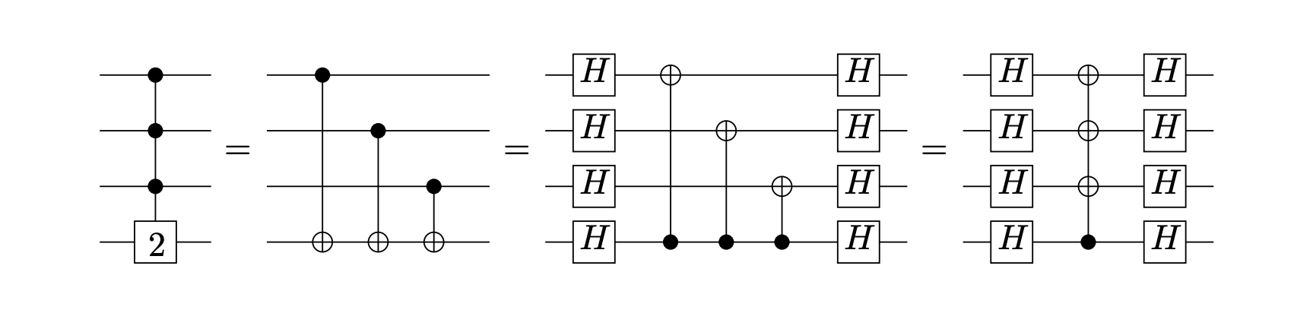
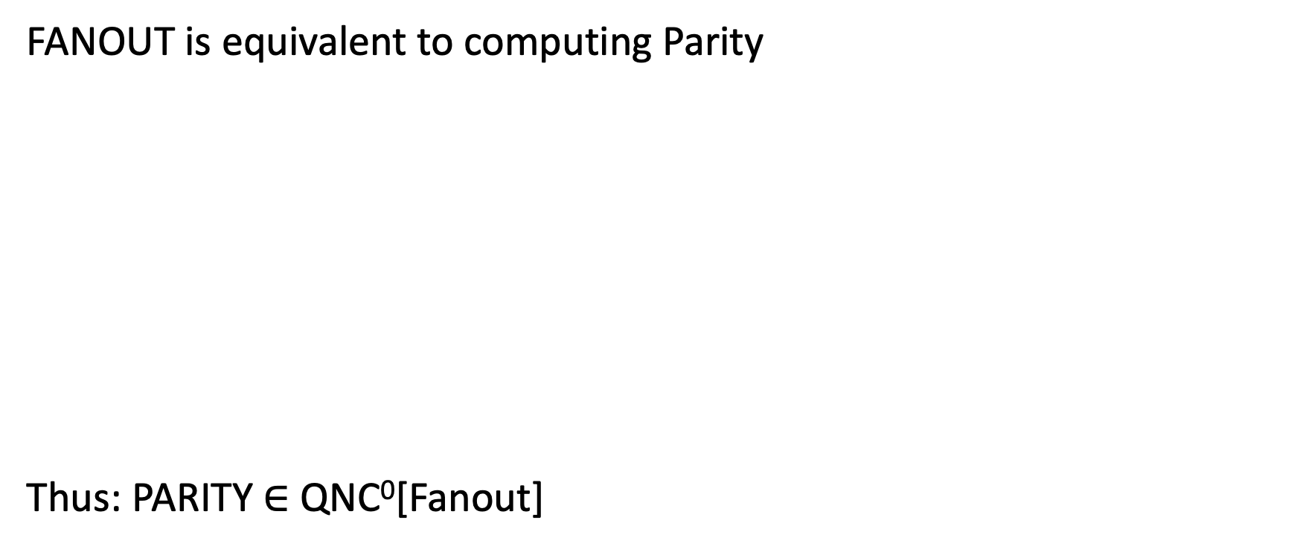
The power of QNC⁰[Fanout]
FANOUT is equivalent to computing Parity
Thus: PARITY $∈$ QNC⁰[Fanout]
PARITY
FANOUT

Slide 24
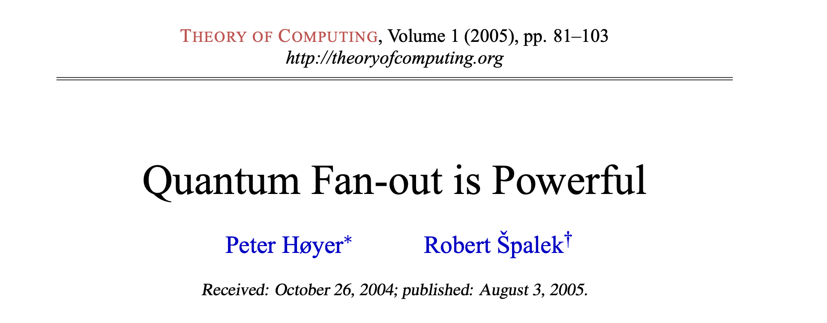
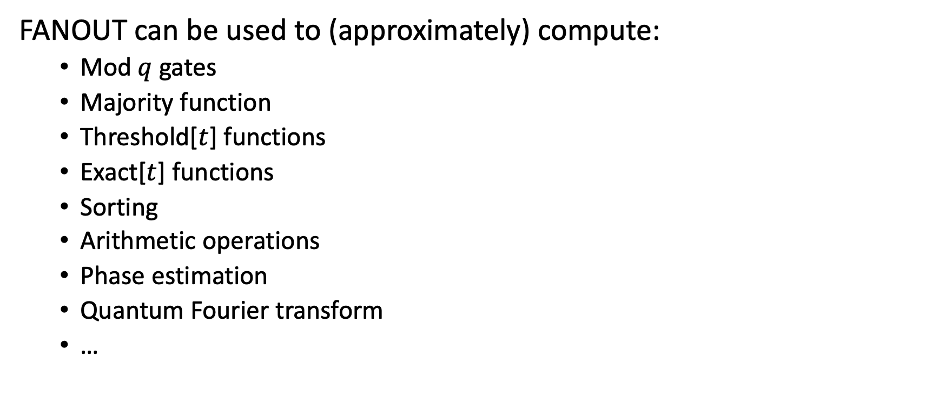
The power of QNC⁰[Fanout]
FANOUT can be used to (approximately) compute:
  Mod $q$ gates
  Majority function
  Threshold[$t$] functions
  Exact[$t$] functions
  Sorting
  Arithmetic operations
  Phase estimation
  Quantum Fourier transform
  …

Slide 25
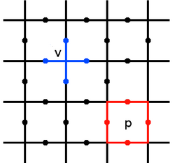
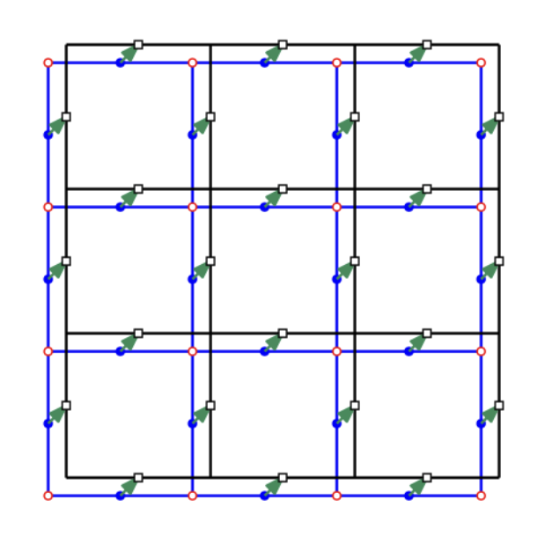



The power of QNC⁰[Fanout]
Globally entangled states can be prepared with Fanout
$$|0⟩$$
$$|0⟩$$
$$|0⟩$$
$$|0⟩$$
$$H$$
CAT state
Toric code
Non-abelian Anyons
(Quantum Double for Solvable Groups)
These states can also be prepared using dynamic circuits.
(Bravyi, et al. ‘22, Tantivasadakarn, Vishwanath, Verresen, ’23,…)

Slide 26
Example: preparing stabilizer states with Fanout
Every n-qubit CNOT circuit has an O(1)-depth implementation
with Fanout and O(n²) ancillas.
CNOT circuit $≡$invertible matrix $M∈𝔽_{2}^{n×n}$ on $n$ bits.
Parallel matrix multiplication
1. Fan out inputs into separate workspaces.
2. Compute all output parities in parallel.
3. Uncompute the copies, restoring the workspace to zero.
Parity is Fanout conjugated by Hadamards.
Notes:
For any binary matrix M, implement B_M: |x>|y>|0^N> -> |x>|y XOR Mx>|0^N>, using N <= n^2 private workspace qubits. For each input x_j, a fanout creates computational-basis copies in the workspaces of the outputs that require x_j. These fanouts have disjoint controls and fresh targets, so they form one layer. For each output i, XOR the parity of its private copies into y_i. Different outputs now use disjoint workspace registers and distinct targets. Each parity is implemented by Hadamards on every participating qubit, one fanout with the output as control, and another layer of Hadamards. All output parities therefore take three layers. Repeat the initial copy fanouts to return every workspace qubit to zero. B_M thus uses five layers of Hadamards and fanout. The complete coherent map follows by linearity from its action on computational-basis states; the copies are basis values, not cloned quantum states. Source for parity/fanout equivalence: Høyer and Špalek, Quantum Fan-out is Powerful, Theory of Computing 1 (2005), Example 2.2 and Figure 1, https://theoryofcomputing.org/articles/v001a005/v001a005.pdf.

Slide 27


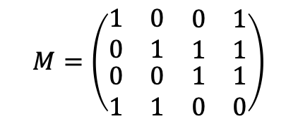





Example: preparing stabilizer states with Fanout
Every n-qubit CNOT circuit has an O(1)-depth implementation
with Fanout and O(n²) ancillas.
CNOT circuit $≡$invertible matrix $M∈𝔽_{2}^{n×n}$ on $n$ bits.
$$M$$
$$|x_{1}⟩$$
$$|x_{2}⟩$$
$$|x_{3}⟩$$
$$M=\left(\begin{matrix}\begin{matrix}1 & 0 \\ 0 & 1\end{matrix} & \begin{matrix}0 & 1 \\ 1 & 1\end{matrix} \\ \begin{matrix}0 & 0 \\ 1 & 1\end{matrix} & \begin{matrix}1 & 1 \\ 0 & 0\end{matrix}\end{matrix}\right)$$
$$|x_{4}⟩$$
$$|0⟩$$
$$|0⟩$$
$$|0⟩$$
$$|0⟩$$
Schematic: each matrix block has an O(1)-depth implementation. Workspace omitted.
Notes:
The displayed M block is a schematic for B_M. The drawn fanouts can overlap in their targets, so commutativity alone does not make them one layer. Use separate output workspaces to realize this entire block in O(1) depth. For any binary matrix M, implement B_M: |x>|y>|0^N> -> |x>|y XOR Mx>|0^N>, using N <= n^2 private workspace qubits. For each input x_j, a fanout creates computational-basis copies in the workspaces of the outputs that require x_j. These fanouts have disjoint controls and fresh targets, so they form one layer. For each output i, XOR the parity of its private copies into y_i. Different outputs now use disjoint workspace registers and distinct targets. Each parity is implemented by Hadamards on every participating qubit, one fanout with the output as control, and another layer of Hadamards. All output parities therefore take three layers. Repeat the initial copy fanouts to return every workspace qubit to zero. B_M thus uses five layers of Hadamards and fanout. The complete coherent map follows by linearity from its action on computational-basis states; the copies are basis values, not cloned quantum states. Source for parity/fanout equivalence: Høyer and Špalek, Quantum Fan-out is Powerful, Theory of Computing 1 (2005), Example 2.2 and Figure 1, https://theoryofcomputing.org/articles/v001a005/v001a005.pdf.

Slide 28

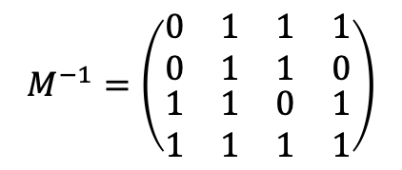
Example: preparing stabilizer states with Fanout
Every n-qubit CNOT circuit has an O(1)-depth implementation
with Fanout and O(n²) ancillas.
CNOT circuit $≡$invertible matrix $M∈𝔽_{2}^{n×n}$ on $n$ bits.
$$M$$
$$M^{−1}$$
$$|x_{1}⟩$$
$$|x_{2}⟩$$
$$|x_{3}⟩$$
$$M=\left(\begin{matrix}\begin{matrix}1 & 0 \\ 0 & 1\end{matrix} & \begin{matrix}0 & 1 \\ 1 & 1\end{matrix} \\ \begin{matrix}0 & 0 \\ 1 & 1\end{matrix} & \begin{matrix}1 & 1 \\ 0 & 0\end{matrix}\end{matrix}\right)$$
$$|x_{4}⟩$$
$$M^{−1}=\left(\begin{matrix}\begin{matrix}0 & 1 \\ 0 & 1\end{matrix} & \begin{matrix}1 & 1 \\ 1 & 0\end{matrix} \\ \begin{matrix}1 & 1 \\ 1 & 1\end{matrix} & \begin{matrix}0 & 1 \\ 1 & 1\end{matrix}\end{matrix}\right)$$
$$|0⟩$$
$$|0⟩$$
$$|0⟩$$
$$|0⟩$$
Schematic: each matrix block has an O(1)-depth implementation. Workspace omitted.
Notes:
After B_M on |x>|0>, the registers hold |x>|Mx>. Apply B_(M^-1) with the registers reversed to obtain |x XOR M^-1 Mx>|Mx> = |0>|Mx>. Both matrix blocks have clean O(1)-depth implementations; the workspace can be reused. For any binary matrix M, implement B_M: |x>|y>|0^N> -> |x>|y XOR Mx>|0^N>, using N <= n^2 private workspace qubits. For each input x_j, a fanout creates computational-basis copies in the workspaces of the outputs that require x_j. These fanouts have disjoint controls and fresh targets, so they form one layer. For each output i, XOR the parity of its private copies into y_i. Different outputs now use disjoint workspace registers and distinct targets. Each parity is implemented by Hadamards on every participating qubit, one fanout with the output as control, and another layer of Hadamards. All output parities therefore take three layers. Repeat the initial copy fanouts to return every workspace qubit to zero. B_M thus uses five layers of Hadamards and fanout. The complete coherent map follows by linearity from its action on computational-basis states; the copies are basis values, not cloned quantum states. Source for parity/fanout equivalence: Høyer and Špalek, Quantum Fan-out is Powerful, Theory of Computing 1 (2005), Example 2.2 and Figure 1, https://theoryofcomputing.org/articles/v001a005/v001a005.pdf.

Slide 29




Example: preparing stabilizer states with Fanout
Every n-qubit CNOT circuit has an O(1)-depth implementation
with Fanout and O(n²) ancillas.
CNOT circuit $≡$invertible matrix $M∈𝔽_{2}^{n×n}$ on $n$ bits.
$$M$$
$$M^{−1}$$
Swap
$$|x⟩$$
$$|Mx⟩$$
$$M=\left(\begin{matrix}\begin{matrix}1 & 0 \\ 0 & 1\end{matrix} & \begin{matrix}0 & 1 \\ 1 & 1\end{matrix} \\ \begin{matrix}0 & 0 \\ 1 & 1\end{matrix} & \begin{matrix}1 & 1 \\ 0 & 0\end{matrix}\end{matrix}\right)$$
$$M^{−1}=\left(\begin{matrix}\begin{matrix}0 & 1 \\ 0 & 1\end{matrix} & \begin{matrix}1 & 1 \\ 1 & 0\end{matrix} \\ \begin{matrix}1 & 1 \\ 1 & 1\end{matrix} & \begin{matrix}0 & 1 \\ 1 & 1\end{matrix}\end{matrix}\right)$$
$$|0⟩$$
$$|0⟩$$
$$|0⟩$$
$$|0⟩$$
$$|0⟩$$
$$|0⟩$$
$$|0⟩$$
$$|0⟩$$
Schematic: each matrix block has an O(1)-depth implementation. Workspace omitted.
Notes:
Compute with M, clear the first register using M^-1, then swap the two registers: |x>|0> -> |x>|Mx> -> |0>|Mx> -> |Mx>|0>. The parallel register swap has constant depth. Including the extra n-qubit register and clean matrix-multiplication workspace gives O(n^2) ancillas in total. For any binary matrix M, implement B_M: |x>|y>|0^N> -> |x>|y XOR Mx>|0^N>, using N <= n^2 private workspace qubits. For each input x_j, a fanout creates computational-basis copies in the workspaces of the outputs that require x_j. These fanouts have disjoint controls and fresh targets, so they form one layer. For each output i, XOR the parity of its private copies into y_i. Different outputs now use disjoint workspace registers and distinct targets. Each parity is implemented by Hadamards on every participating qubit, one fanout with the output as control, and another layer of Hadamards. All output parities therefore take three layers. Repeat the initial copy fanouts to return every workspace qubit to zero. B_M thus uses five layers of Hadamards and fanout. The complete coherent map follows by linearity from its action on computational-basis states; the copies are basis values, not cloned quantum states. Source for parity/fanout equivalence: Høyer and Špalek, Quantum Fan-out is Powerful, Theory of Computing 1 (2005), Example 2.2 and Figure 1, https://theoryofcomputing.org/articles/v001a005/v001a005.pdf.

Slide 30










Example: preparing stabilizer states with Fanout
Theorem: Every Clifford circuit can be written as
(Aaronson, Gottesman 2004)
$$H$$
$$CNOT$$
$$P$$
$$CNOT$$
$$P$$
$$CNOT$$
$$H$$
$$P$$
$$CNOT$$
$$P$$
$$CNOT$$
Corollary: Every n-qubit Clifford circuit has an O(1)-depth
implementation with Fanout and O(n²) ancillas.
Notes:
Aaronson and Gottesman give the eleven-stage canonical form H-C-P-C-P-C-H-P-C-P-C, with C denoting a CNOT-only circuit. The final CNOT block is required for the stated general circuit normal form. H and P stages have depth one. Each of the constantly many CNOT blocks has the clean O(1)-depth implementation from the preceding slides using Fanout and O(n^2) ancillas. Reuse the cleaned workspace between blocks. Thus every n-qubit Clifford circuit has an O(1)-depth implementation with Fanout and O(n^2) ancillas. Source: Aaronson and Gottesman, Improved Simulation of Stabilizer Circuits (2004), Theorem 8, https://www.scottaaronson.com/papers/chp6.pdf. For any binary matrix M, implement B_M: |x>|y>|0^N> -> |x>|y XOR Mx>|0^N>, using N <= n^2 private workspace qubits. For each input x_j, a fanout creates computational-basis copies in the workspaces of the outputs that require x_j. These fanouts have disjoint controls and fresh targets, so they form one layer. For each output i, XOR the parity of its private copies into y_i. Different outputs now use disjoint workspace registers and distinct targets. Each parity is implemented by Hadamards on every participating qubit, one fanout with the output as control, and another layer of Hadamards. All output parities therefore take three layers. Repeat the initial copy fanouts to return every workspace qubit to zero. B_M thus uses five layers of Hadamards and fanout. The complete coherent map follows by linearity from its action on computational-basis states; the copies are basis values, not cloned quantum states. Source for parity/fanout equivalence: Høyer and Špalek, Quantum Fan-out is Powerful, Theory of Computing 1 (2005), Example 2.2 and Figure 1, https://theoryofcomputing.org/articles/v001a005/v001a005.pdf.

Slide 31
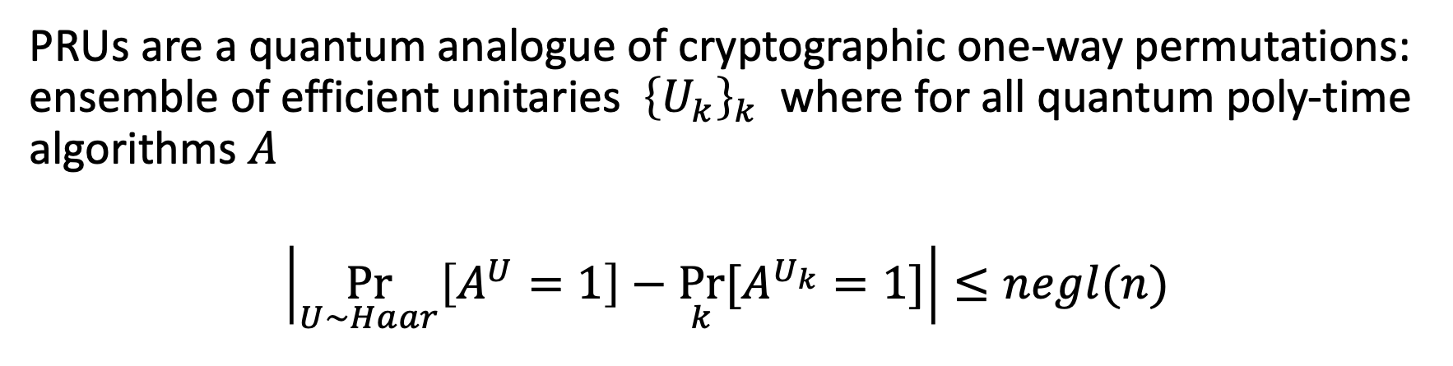
Example: Pseudorandom unitaries (PRUs)
PRUs are a quantum analogue of cryptographic one-way permutations: ensemble of efficient unitaries ${\left\{U_{k}\right\}}_{k}$ where for all quantum poly-time algorithms $A$
$$\left|\underset{U∼Haar}{Pr}\left[A^{U}=1\right]−\underset{k}{Pr}⁡[A^{U_{k}}=1]\right|≤negl(n)$$
Haar measure = “uniformly random” unitary
(Ji, Liu, Song 2018)
PRUs (and their information-theoretic analogue, unitary designs) are used for benchmarking quantum computers, quantum Shannon theory, quantum crypto, lower bounds in quantum learning, models of black holes, ….

Slide 32
The complexity of PRUs
Theorem (Foxman, Parham, Vasconcelos, Y. ‘25)
PRUs can be implemented with poly-size QNC⁰[Fanout] circuits.
No classical analogue: Classical AC⁰ circuits have low average sensitivity, and can be distinguished from random via two queries.
(Linial-Mansour-Nisan ’93)
Learning lower bounds: Assuming subexponentially-secure LWE, QNC⁰[Fanout] circuits cannot be learned in polynomial time.
Near-term implementation? QNC⁰[Fanout] circuits are equivalent to O(1)-depth dynamic circuits, which are experimentally relevant.

Slide 33
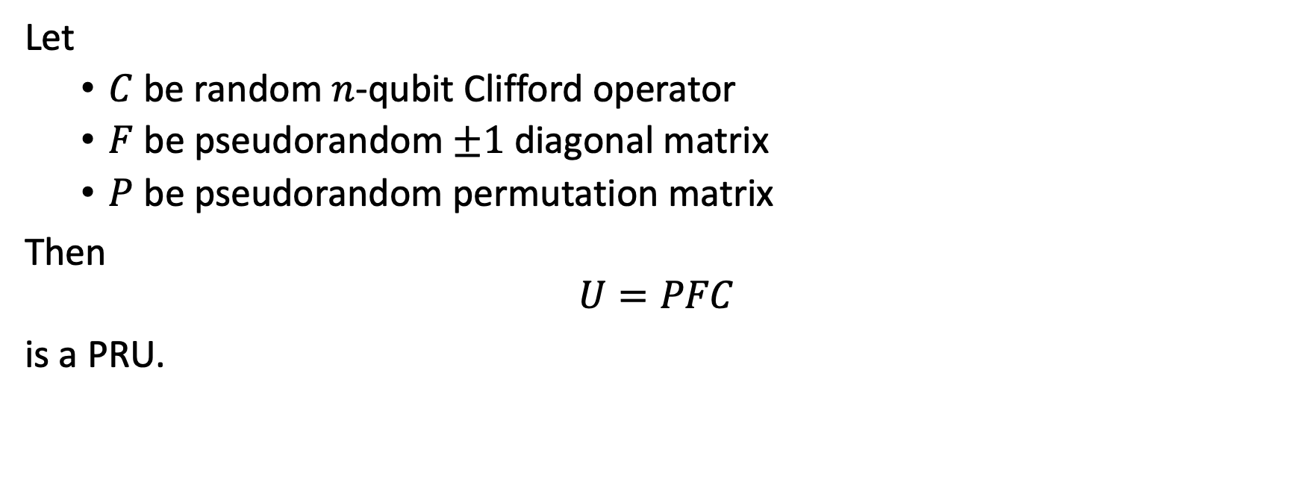
Pseudorandom unitaries in QNC⁰[Fanout]
Let
  $C$ be random $n$-qubit Clifford operator
  $F$ be pseudorandom $±1$diagonal matrix
  $P$ be pseudorandom permutation matrix
Then
$$U=PFC$$
is a PRU.
(Metger, Poremba, Sinha, Y. ‘24)
(Ma, Huang ‘25)

Slide 34
Pseudorandom unitaries in QNC⁰[Fanout]
O(1)-depth implementation using Fanout.
Let
  $C$ be random $n$-qubit Clifford operator
  $F$ be pseudorandom $±1$diagonal matrix
  $P$ be pseudorandom permutation matrix
Then
$$U=PFC$$
is a PRU.
(Metger, Poremba, Sinha, Y. ‘24)
(Ma, Huang ‘25)

Slide 35
Pseudorandom unitaries in QNC⁰[Fanout]
Let
  $C$ be random $n$-qubit Clifford operator
  $F$ be pseudorandom $±1$diagonal matrix
  $P$ be pseudorandom permutation matrix
Then
$$U=PFC$$
is a PRU.
Diagonal entries correspond evaluation of PRF computable in TC⁰, thus computable in QNC⁰[Fanout].
(Metger, Poremba, Sinha, Y. ‘24)
(Ma, Huang ‘25)

Slide 36
Pseudorandom unitaries in QNC⁰[Fanout]
Let
  $C$ be random $n$-qubit Clifford operator
  $F$ be pseudorandom $±1$diagonal matrix
  $P$ be pseudorandom permutation matrix
Then
$$U=PFC$$
is a PRU.
Permutation is computed via “Luby-Rackoff” cipher, which is also computable in QNC⁰[Fanout] .
(Metger, Poremba, Sinha, Y. ‘24)
(Ma, Huang ‘25)

Slide 37
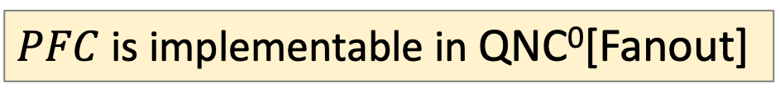
Pseudorandom unitaries in QNC⁰[Fanout]
Let
  $C$ be random $n$-qubit Clifford operator
  $F$ be pseudorandom $±1$diagonal matrix
  $P$ be pseudorandom permutation matrix
Then
$$U=PFC$$
is a PRU.
(Metger, Poremba, Sinha, Y. ‘24)
(Ma, Huang ‘25)
$PFC$ is implementable in QNC⁰[Fanout]
(Chia-Liang-Song ‘24, Foxman, Parham, Vasconcelos, Y. ‘25)

Slide 38
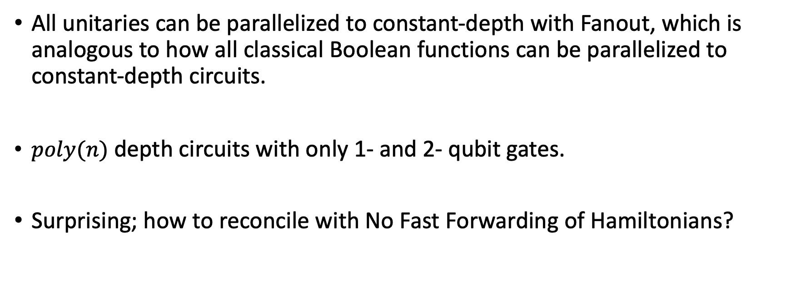
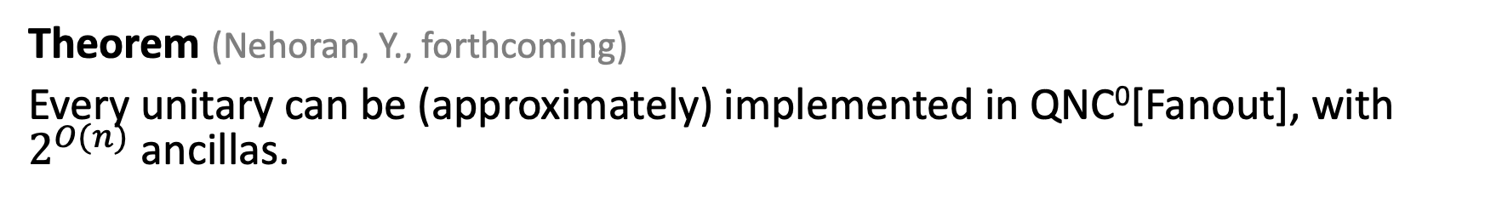
Bonus: all unitaries in constant-depth
Theorem (Nehoran, Y., forthcoming)
Every unitary can be (approximately) implemented in QNC⁰[Fanout], with $2^{O(n)}$ ancillas.
All unitaries can be parallelized to constant-depth with Fanout, which is analogous to how all classical Boolean functions can be parallelized to constant-depth circuits.
$poly(n)$ depth circuits with only 1- and 2- qubit gates.
Surprising; how to reconcile with No Fast Forwarding of Hamiltonians?

Slide 39
Anyon models in QNC⁰[Fanout]
Basis for topological quantum computing: highly entangled states with emergent “particles” (called anyons) that can be braided together to implement quantum gates.
Kitaev’s quantum double: a recipe for anyon models with braiding action determined by a finite group G.
g₁
Closed loops multiply to identity, e.g.,
g₁ g₂ g₃⁻¹ g₄⁻¹ = e
g₄
g₂
g₃
Ground state: uniform superposition
of all proper edge labelings.
∑
|ψ⟩ ∝
|edge labels⟩
oriented 2D lattice
proper labelings

Slide 40
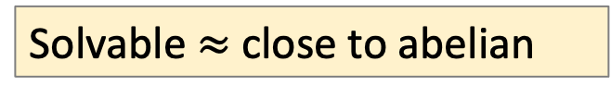
Anyon models in QNC⁰[Fanout]
Basis for topological quantum computing: highly entangled states with emergent “particles” (called anyons) that can be braided together to implement quantum gates.
Kitaev’s quantum double: a recipe for anyon models with braiding action determined by a finite group G.
Quantum double for any solvable group G can be prepared in QNC⁰[Fanout].
Solvable $≈$ close to abelian
(Bravyi, et al. ‘22, Tantivasadakarn, Vishwanath, Verresen, ’23,…)

Slide 41
Anyon models in QNC⁰[Fanout]
Basis for topological quantum computing: highly entangled states with emergent “particles” (called anyons) that can be braided together to implement quantum gates.
Kitaev’s quantum double: a recipe for anyon models with braiding action determined by a finite group G.
Quantum double for any solvable group G can be prepared in QNC⁰[Fanout].
What about non-solvable groups, e.g., S₅?
(Bravyi, et al. ‘22, Tantivasadakarn, Vishwanath, Verresen, ’23,…)

Slide 42
Limits of constant-time QC

Slide 43
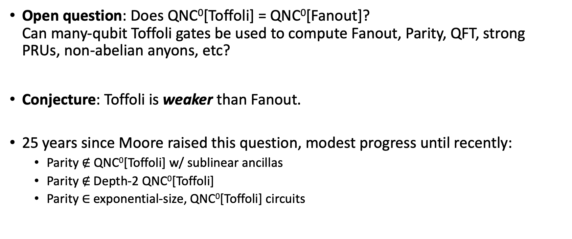
Toffoli vs Fanout
Open question: Does QNC⁰[Toffoli] = QNC⁰[Fanout]?
Can many-qubit Toffoli gates be used to compute Fanout, Parity, QFT, strong PRUs, non-abelian anyons, etc?
Conjecture: Toffoli is weaker than Fanout.
25 years since Moore raised this question, modest progress until recently:
  Parity $∉$ QNC⁰[Toffoli] w/ sublinear ancillas
  Parity $∉$Depth-2 QNC⁰[Toffoli]
  Parity $∈$exponential-size, QNC⁰[Toffoli] circuits
Fang, Fenner, Green, Homer, Zhang (‘03)
Pade, Fenner, Grier, Thierauf (‘20)
Rosenthal (‘20)

Slide 44
Pauli Analysis of QNC⁰[Toffoli] circuits
(Nadimpalli, Parham, Vasconcelos, Y. ‘24)
Motivation: develop general techniques for analyzing quantum circuits with many-qubit gates.
We introduce the notion of the Pauli spectrum of a quantum circuit, which is a quantum analogue of the Fourier spectrum of a Boolean function.
Main Result: Pauli spectrum of QNC⁰[Toffoli] circuits (with few ancilla) are highly concentrated on the low-degree components.
Analogous to Linial-Mansour-Nisan theorem (1993): AC⁰-computable Boolean functions have concentrated Fourier spectra.

Slide 45





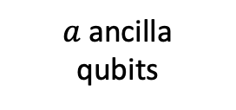

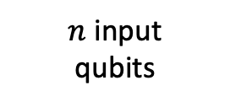

Pauli spectrum of quantum circuits
$C$ = quantum circuit with $n$ input qubits, $a$ ancilla qubits, and 1 output qubit
The following diagram defines an $n$-qubit matrix $Φ_{C}$:
Output qubit
$$Z$$
$n$ input
qubits
$$C^{†}$$
$$C$$
$$⟨0|$$
$$|0⟩$$
$a$ancilla
qubits
$$⟨0|$$
$$|0⟩$$

Slide 46
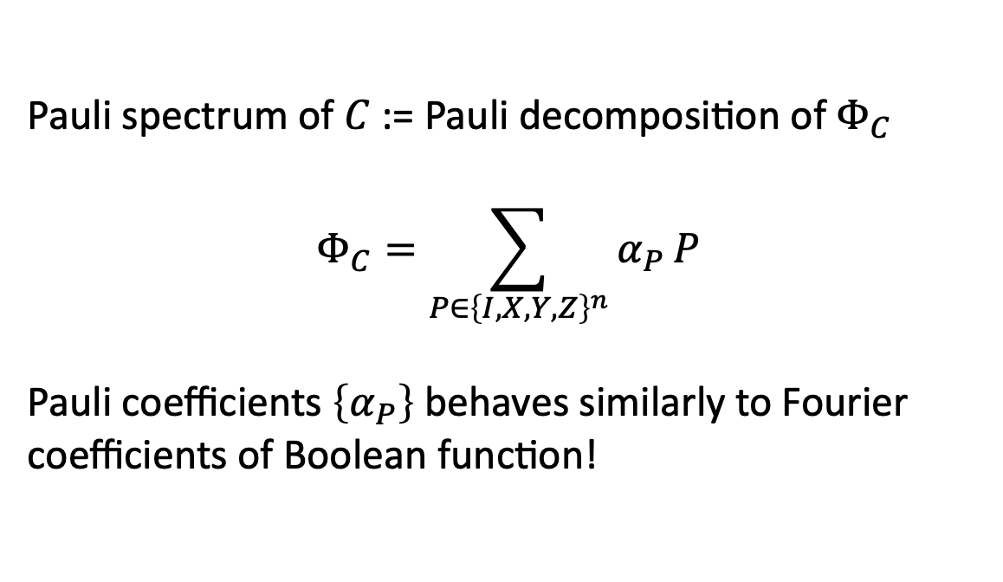
Pauli spectrum of quantum circuits
$C$ = quantum circuit with $n$ input qubits, $a$ ancilla qubits, and 1 output qubit
The following diagram defines an $n$-qubit matrix $Φ_{C}$:
Output qubit
$$Z$$
Pauli spectrum of $C$ := Pauli decomposition of $Φ_{C}$
$$Φ_{C}=\sum_{P∈{\left\{I,X,Y,Z\right\}}^{n}}{α_{P}}P$$
Pauli coefficients $\left\{α_{P}\right\}$ behaves similarly to Fourier coefficients of Boolean function!
$n$ input
qubits
$$C^{†}$$
$$C$$
$$⟨0|$$
$$|0⟩$$
$a$ancilla
qubits
$$⟨0|$$
$$|0⟩$$

Slide 47
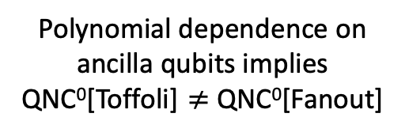
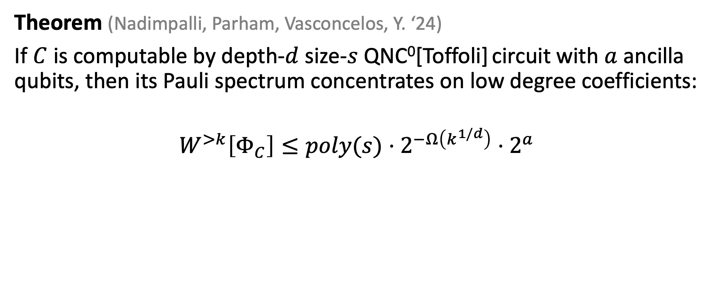
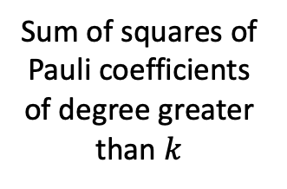
Pauli spectrum concentration of QNC⁰[Toffoli]
Theorem (Nadimpalli, Parham, Vasconcelos, Y. ‘24)
If $C$ is computable by depth-$d$size-$s$ QNC⁰[Toffoli] circuit with $a$ ancilla qubits, then its Pauli spectrum concentrates on low degree coefficients:
$$W^{>k}\left[Φ_{C}\right]≤poly(s)⋅2^{−Ω\left(k^{1/d}\right)}⋅2^{a}$$
Resembles classical LMN!
Sum of squares of Pauli coefficients of degree greater than $k$
Polynomial dependence on
ancilla qubits implies
QNC⁰[Toffoli] $≠$ QNC⁰[Fanout]

Slide 48
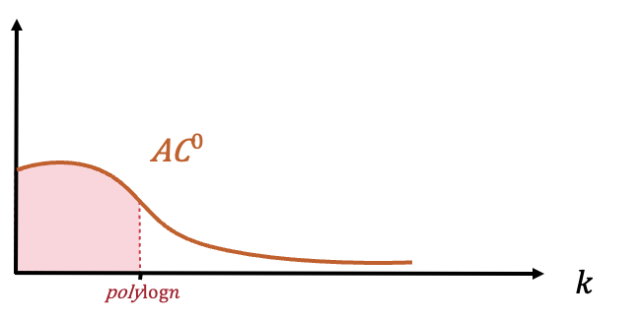
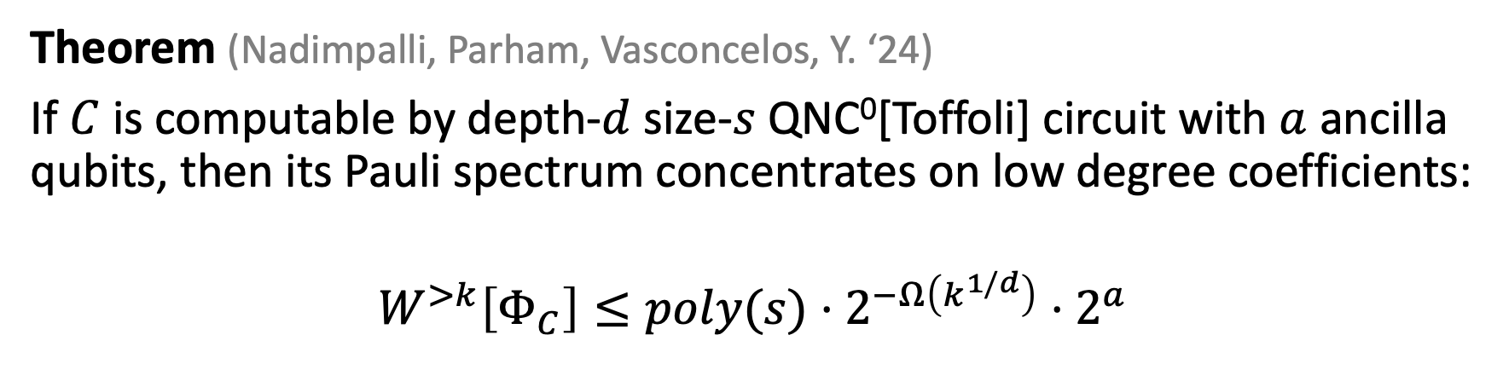
Pauli spectrum concentration of QNC⁰[Toffoli]
Theorem (Nadimpalli, Parham, Vasconcelos, Y. ‘24)
If $C$ is computable by depth-$d$size-$s$ QNC⁰[Toffoli] circuit with $a$ ancilla qubits, then its Pauli spectrum concentrates on low degree coefficients:
$$W^{>k}\left[Φ_{C}\right]≤poly(s)⋅2^{−Ω\left(k^{1/d}\right)}⋅2^{a}$$
Corollaries
Poly-size QNC⁰[Toffoli] circuit with few ancilla qubits
Cannot approximate PARITY or MAJORITY
Can be learned in quasipoly time from Choi state samples.

Slide 49
Later developments (2024–present)
Recent work on QNC⁰[Toffoli] (QAC⁰ in the literature)
•
PARITY lower bounds: superlinear ancillas; exact depth 3
Anshu–Dong–Ou–Yao ’24; Joshi–Tal–Vasconcelos–Wright ’25–’26
•
PARITY hardness ⇔ Boolean Fourier concentration
Gretta–Gupta–Joshi ’26
•
TC⁰ simulation with many copies of the input
Grier–Morris–Wu ’26
•
Polylog-weight Dicke states; all O(log n)-qubit states
Gretta–Gupta–Joshi ’26 (April & September)
•
Quantum Fourier transform ⇔ Fanout
Gretta–Joshi ’26
The general Toffoli vs Fanout question remains open.
Notes:
These results concern the standard unitary QAC^0 model, called QNC^0[Toffoli] in this talk. Polynomially many initially zero ancillas and polynomial circuit size are allowed, except where a more specific resource bound is stated. The circuit-depth convention in the cited small-depth work counts many-qubit layers, with one-qubit gates between them.
1. Anurag Anshu, Yangjing Dong, Fengning Ou, Penghui Yao, “On the Computational Power of QAC0 with Barely Superlinear Ancillae” (2024 preprint; STOC 2025). General-depth lower bounds extend to the barely-superlinear ancilla regime, via operator-norm low-degree approximation. https://arxiv.org/abs/2410.06499
Malvika Raj Joshi, Avishay Tal, Francisca Vasconcelos, John Wright, “Improved Lower Bounds for QAC0” (2025 preprint; STOC 2026; revised August 2026). Depth-2 approximation lower bounds hold regardless of size. The depth-3 PARITY result is for EXACT computation, not a general bounded-error depth-3 lower bound; it permits arbitrary ancillas. https://arxiv.org/abs/2512.14643
2. Lucas Gretta, Meghal Gupta, Malvika Raj Joshi, “Parity notin QAC0 iff QAC0 is Fourier-Concentrated” (April 2026, revised August 2026). This is an equivalence with PARITY hardness, not a proof of concentration. It concerns the Boolean Fourier spectrum of the single-output expectation function, rather than the entire Pauli/Choi spectrum. https://arxiv.org/abs/2604.02793
3. Daniel Grier, Jackson Morris, Kewen Wu, “QAC0 Contains TC0 (with Many Copies of the Input)” (January 2026). The multiple-input-copy qualification is essential: TC0 subseteq QAC0 composed with NC0. This is not a claim that ordinary QAC0 can compute PARITY with one copy of the input. https://arxiv.org/abs/2601.03243
4. Lucas Gretta, Meghal Gupta, Malvika Raj Joshi, “Polylogarithmic-Weight Dicke States in QAC0 and Arbitrary Symmetric States in QAC0_f” (April 2026, revised August 2026). Polylog(n)-weight n-qubit Dicke states can be prepared in plain QAC0. https://arxiv.org/abs/2604.15298
The same authors, “QAC0 Can Prepare Every Logarithmic-Qubit State” (September 15, 2026). Any O(log n)-qubit state can be exactly and cleanly prepared with poly(n) ancillas. Equivalently, an arbitrary m-qubit state can be prepared using 2^{O(m)} ancillas. Arbitrary one-qubit rotations can encode the target amplitudes. https://arxiv.org/abs/2609.17408
5. Lucas Gretta, Malvika Raj Joshi, “Shor’s algorithm requires Fanout” (August 2026). QFT over an n-qubit modulus is fanout-complete under QAC0 reductions, with approximate versions. This is a resource equivalence, not an unconditional factoring lower bound. https://arxiv.org/abs/2608.06703
The unrestricted polynomial-resource, constant-depth PARITY question remains open as of September 23, 2026.

Slide 50
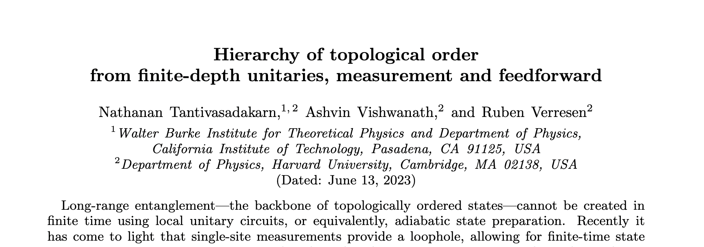
TVV Conjecture
Conjecture: The quantum double model for non-solvable groups
cannot be prepared by O(1)-depth adaptive circuits.
(Tantivasadakarn, Vishwanath, Verresen, ’23)
Condensed matter physicists
(at least the ones I asked):
c’mon, this has gotta be true!

Slide 51
Quantum circuit lower bounds
TVV Conjecture is equivalent to showing that QNC⁰[Fanout] circuits cannot prepare certain states.
Greg Rosenthal (2023) proved that proving state preparation lower bounds for QNC⁰[Fanout] would imply dramatic breakthroughs in
classical complexity theory!

Slide 52
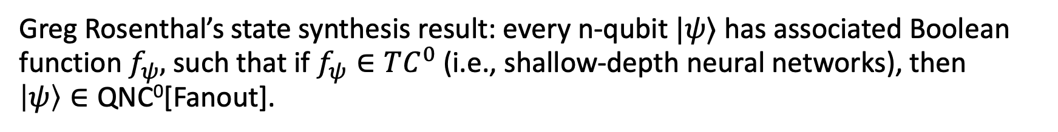
Quantum circuits and natural proofs
Greg Rosenthal’s state synthesis result: every n-qubit $|ψ⟩$ has associated Boolean function $f_{ψ},$ such that if $f_{ψ}∈TC^{0}$ (i.e., shallow-depth neural networks), then
$\left|ψ\right\rangle ∈\text{QNC}\text{0}\text{[Fanout]}$.
🫪
Contrapositive: if $\left|ψ\right\rangle ∉\text{QNC}\text{0}\text{[Fanout]}$, then $f_{ψ}∉TC^{0}$
Exhibiting a function that cannot be computed by shallow-depth neural networks is one of the biggest open problems in computational complexity theory.
It is subject to the famous natural proofs barrier of Razborov-Rudich, which shows that we do not have any natural ways of solving this question.

Slide 53

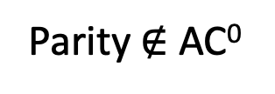
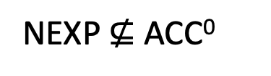
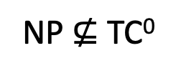

A map of complexity theory questions
QNC⁰[Fanout] state preparation lower bounds
P $≠$ NP
NP $⊈$ TC⁰
NEXP $⊈$ ACC⁰
Parity $∉$ AC⁰
Notes:
I want to start by connecting this talk to the theme of the conference, which is the P vs NP and complexity lower bounds. This is the picture I have of the landscape of circuit complexity lower bounds. The ultimate goal is to reach these peaks here: proving that NP or NEXP do not have poly-sized circuits. We’ve made some important strides given the technology we have, but so far it seems we’re pretty far away from making it up here.

Slide 54
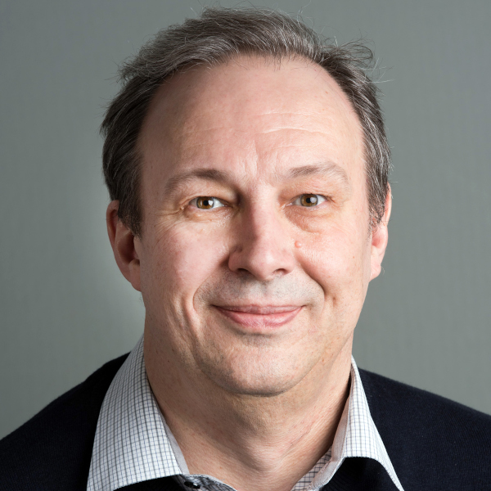
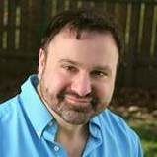
A map of complexity theory questions
QNC⁰[Fanout] state preparation lower bounds
P $≠$ NP
NP $⊈$ TC⁰
You shall not pass!
…at least, not with a natural proof.
NEXP $⊈$ ACC⁰
Parity $∉$ AC⁰
Notes:
I want to start by connecting this talk to the theme of the conference, which is the P vs NP and complexity lower bounds. This is the picture I have of the landscape of circuit complexity lower bounds. The ultimate goal is to reach these peaks here: proving that NP or NEXP do not have poly-sized circuits. We’ve made some important strides given the technology we have, but so far it seems we’re pretty far away from making it up here.

Slide 55
Summary
Nontrivial equivalences between models of constant-time quantum computation: QNC⁰[Fanout], dynamic circuits, O(1) T-depth, Magic Hierarchy, …
Power of these models: Can compute complex functions, prepare complex globally entangled states (e.g., some non-abelian anyons), and implement (pseudo)random unitaries.
Weaknesses of these models: TVV conjecture, many-qubit Toffoli vs Fanout, Pauli spectrum analysis of QNC⁰[Toffoli] circuits, Magic Hierarchy lower bounds.

Slide 56
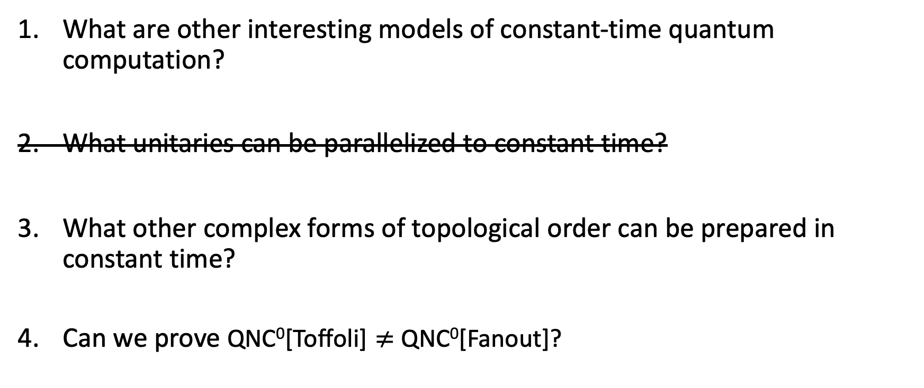
Questions
What are other interesting models of constant-time quantum computation?
What unitaries can be parallelized to constant time?
What other complex forms of topological order can be prepared in constant time?
Can we prove QNC⁰[Toffoli] $≠$ QNC⁰[Fanout]?
Thank You!

Slide 57
Kitaev’s quantum double
Let G be finite group. Each oriented edge has a qudit of dimension |G|.
g₁
g₄
g₂
Closed loops multiply to identity.
g₃
For the highlighted square, clockwise:
oriented 2D lattice
g₁ g₂ g₃⁻¹ g₄⁻¹ = e
Ground state: uniform superposition of all allowed edge labelings.
|ψ⟩ ∝
∑
|edge labels⟩
flat labelings
Notes:
The diagram is a simply connected 2D lattice grid. Each oriented edge has Hilbert space C[G] with basis |g>, g in G. Reversing traversal replaces g by its inverse. Products are ordered along the path; the highlighted clockwise loop has product g1 g2 g3^{-1} g4^{-1}. Plaquette flatness implies the identity constraint for every closed loop on this simply connected grid. With the usual vertex gauge averaging, the equal-amplitude superposition of all such flat labelings is gauge invariant and is a ground state. The expression is schematic and uses proportionality to omit normalization. General closed surfaces require a choice or superposition of global holonomy sectors. Sources: A. Yu. Kitaev, Fault-tolerant quantum computation by anyons, https://arxiv.org/abs/quant-ph/9707021 ; Cui et al., Kitaev’s quantum double model as an error correcting code, Sections 2.3–2.4, https://arxiv.org/html/1908.02829v3 .

Slide 58
Toric code: the ℤ₂ quantum double
G = ℤ₂ = {0, 1}: one qubit per edge.
Group multiplication becomes addition mod 2.
0
0
0
0
1
1
|ψ⟩ ∝
0
0
0
0
1
0
0
0
0
+
+
+ ⋯
0
0
1
1
1
1
0
0
0
0
1
0
0
1
0
0
0
0
0
0
0
Every square has an even number of 1s.
Equal amplitudes for all allowed labelings.
Flipping all edges at a vertex leaves this superposition unchanged.
Notes:
Kitaev’s untwisted quantum double for G=Z_2 is the toric code. The elements 0 and 1 label the computational basis of an edge qubit, and the group law is addition modulo 2. Every element is its own inverse, so edge orientations do not matter and are omitted. Flatness says the XOR of the edge bits around each square is zero, equivalently an even number of 1s. The illustrated states are valid labelings of the simply connected grid; all unshown allowed labelings enter with equal amplitude. Each displayed bit assignment was obtained from vertex bits s_v by b_uv=s_u XOR s_v. Acting with the star X operator flips all incident edges and permutes the allowed configurations, so the equal superposition is invariant. The plaquette Z product is +1. Sources: A. Yu. Kitaev, https://arxiv.org/abs/quant-ph/9707021 ; Cui et al., Section 2.3 and Eq. (17), https://arxiv.org/html/1908.02829v3 .

Slide 59

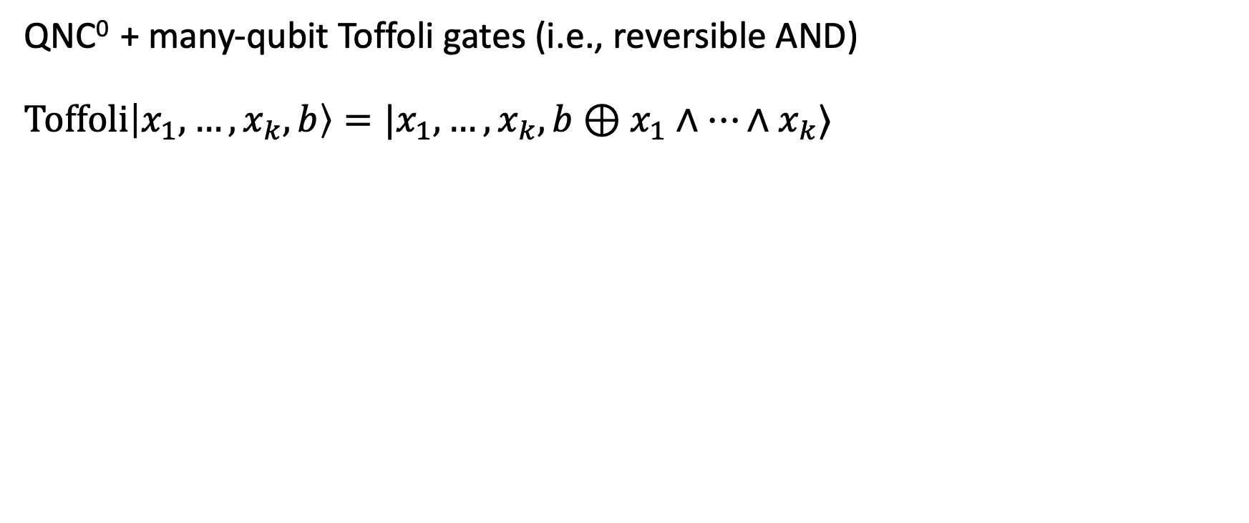



QNC⁰[Toffoli]
QNC⁰ + many-qubit Toffoli gates (i.e., reversible AND)
$\text{Toffoli}\left|x_{1},…,x_{k},b\right\rangle =|x_{1},…,x_{k},b⊕x_{1}∧⋯∧x_{k}⟩$
$$x_{1}$$
$$x_{2}$$
$$x_{3}$$
$$b$$
Example of QNC⁰ [Toffoli] circuit. Lightcones are large due to Toffoli gates.

Slide 60

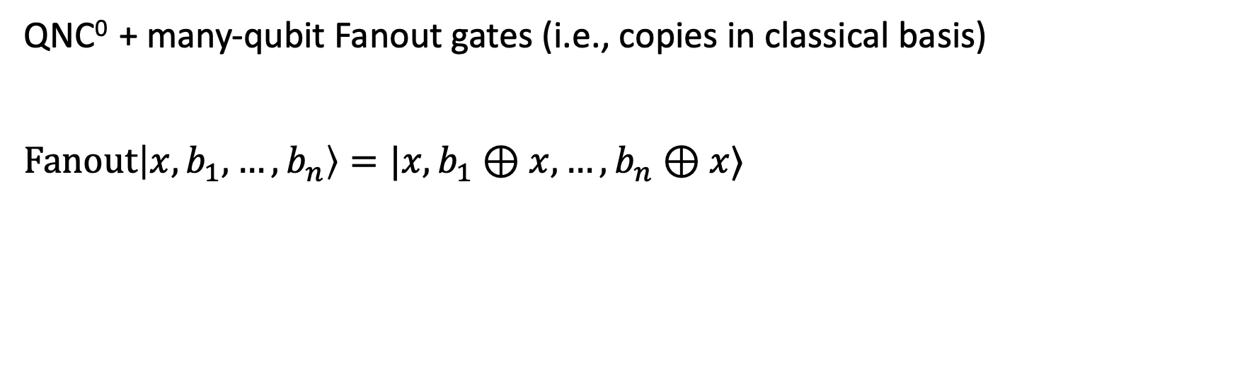



QNC⁰[Fanout]
QNC⁰ + many-qubit Fanout gates (i.e., copies in classical basis)
$\text{Fanout}\left|x,b_{1},…,b_{n}\right\rangle =|x,b_{1}⊕x,…,b_{n}⊕x⟩$
$$x$$
$$b_{1}$$
$$b_{2}$$
$$b_{3}$$
Fanout gates can simulate Toffoli gates, so QNC⁰[Tof] $⊆$ QNC⁰[Fanout]
(Takahashi, Tani 2016)

Slide 61
QNC⁰[Fanout]
QNC⁰ + many-qubit Fanout gates (i.e., copies in classical basis)
$\text{Fanout}\left|x,b_{1},…,b_{n}\right\rangle =|x,b_{1}⊕x,…,b_{n}⊕x⟩$
$$x$$
Key Questions:
1. What can be computed by QNC⁰ [Tof] and QNC⁰ [Fanout]?
2. Is Fanout more powerful than Toffoli?
$$b_{1}$$
$$b_{2}$$
$$b_{3}$$
Fanout gates can simulate Toffoli gates, so QNC⁰[Tof] $⊆$ QNC⁰[Fanout]
(Takahashi, Tani 2016)

