Slide 1
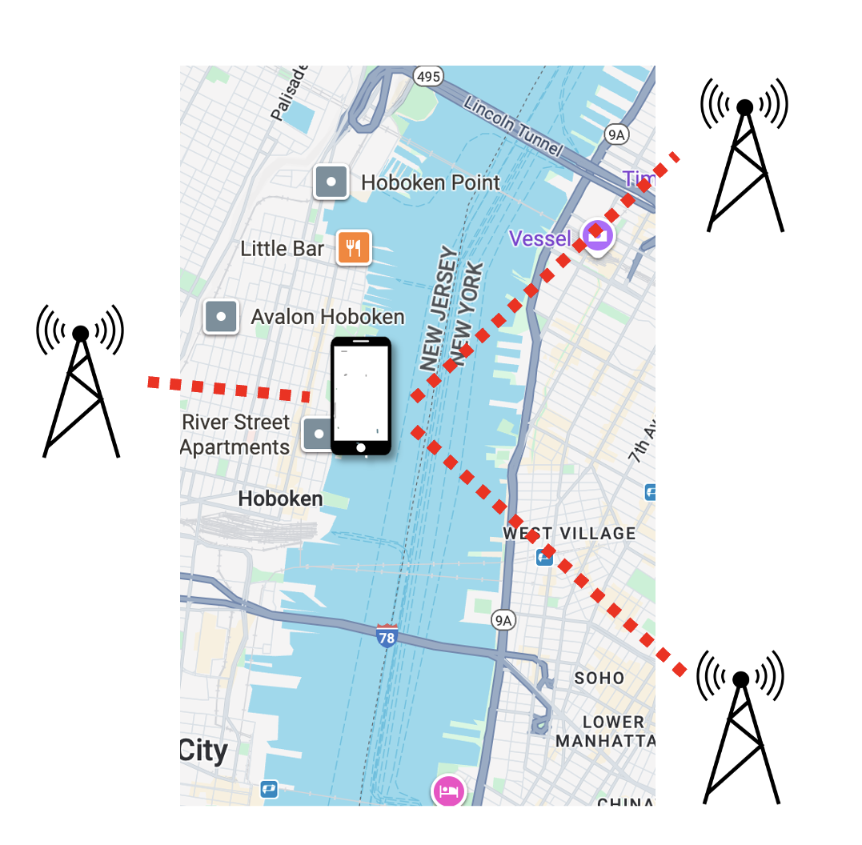
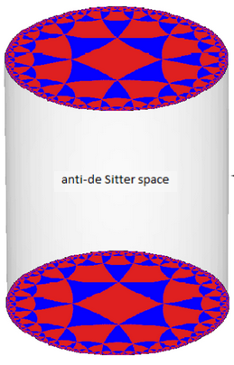
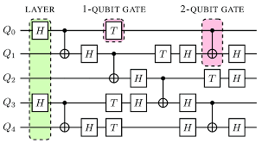
Quantum Position Verification
And Its Connections to
Cryptography, Complexity, and Beyond
Henry Yuen
Columbia
Notes:
Hi everyone. Thanks so much for the invitation to speak here. This talk is going to be about an area that I’ve gotten extremely excited about in the last couple of years, called quantum position verification (QPV). This is an idea from quantum cryptography, that allows you to remotely verify the physical location of someone. This is something that is not possible classically, but with quantum information becomes possible.

Slide 2
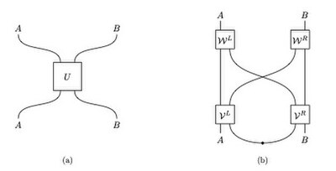

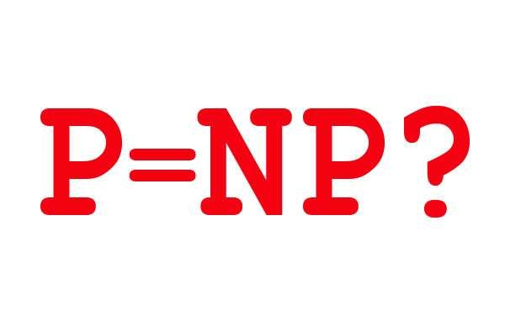
Nonlocal
Quantum Computation
Quantum gravity
Quantum Position Verification
Position-based
Cryptography
Computational
Complexity Theory
Notes:
QPV opens up new forms of really intriguing cryptography – and now it’s looking like people are trying to make it practical reality -- but also has deep, surprising connections to computer science and theoretical physics. So in this talk I want to tell people about QPV and these surprises. Since this is only a 25 minute talk I won’t be able to talk about quantum gravity, which is perhaps good given that it might conjure Juan Maldacena into the room.

Slide 3
Nonlocal
Quantum Computation
Quantum gravity
Quantum Position Verification
Position-based
Cryptography
Computational
Complexity Theory

Slide 4
Position-based cryptography
Is it possible to remotely verify someone’s – or something’s – location?
Example scenarios:
Export-control enforcement (e.g., GPU can only be run in country X)
Authorizing payment upon delivery
Verifying location of transaction (e.g., fraud detection)
In position-based cryptography, whether or not a user is authorized to do something depends on their physical location.

Slide 5
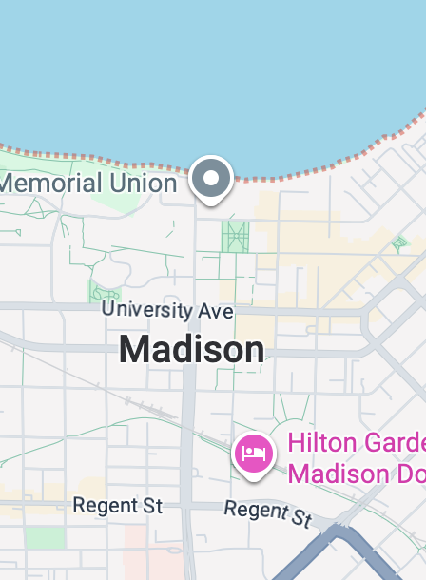
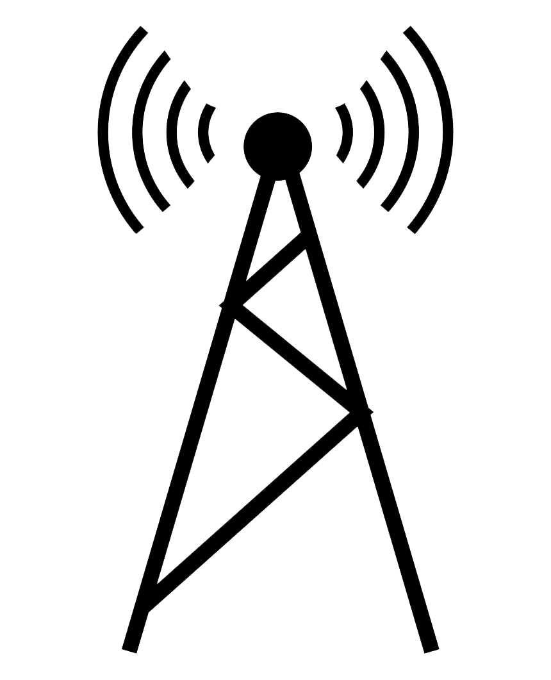

Position verification
A natural idea: multiple verifiers can check the physical location of a prover by sending signals to the purported location, receiving signals back, and checking timing constraints.
Provers are untrusted.
Verifiers want to guard against spoofing.

Slide 6
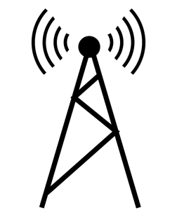








Example: 1D position verification
Time
Goal: verify prover is in position 0.
$$t=2$$
Verifiers send
challenges $x,y$
$$t=1$$
Prover
$$y$$
$$x$$
$$t=0$$
Position
$$0$$
$$−1$$
$$+1$$

Slide 7

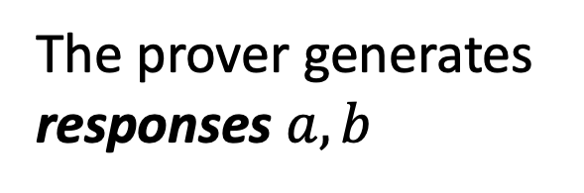

Example: 1D position verification
Time
Goal: verify prover is in position 0.
$$t=2$$
$$a$$
$$b$$
Verifiers send
challenges $x,y$
$$t=1$$
Prover
$$y$$
$$x$$
The prover generates responses $a,b$
$$t=0$$
Position
$$0$$
$$−1$$
$$+1$$

Slide 8
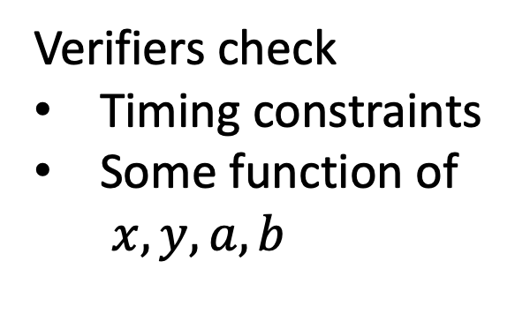
Example: 1D position verification
Time
Verifiers check
Timing constraints
Some function of
$x,y,a,b$
$$t=2$$
$$a$$
$$b$$
$$t=1$$
Hope: only way to generate good, timely responses is to be in correct position.
Prover
$$y$$
$$x$$
$$t=0$$
Position
$$0$$
$$−1$$
$$+1$$

Slide 9
Classical impossibility
Theorem:
Any position verification protocol using only classical resources can be spoofed.
Time
$$t=2$$
(Kent-Munro-Spiller ’11, Buhrman, et al. ‘10)
$$t=1$$
$$x$$
$$y$$
Spoofer
Spoofer
$$t=0$$
Not in position 0!
Position
$$0$$
$$−1$$
$$+1$$

Slide 10
Classical impossibility
Theorem:
Any position verification protocol using only classical resources can be spoofed.
Time
$$t=2$$
(Kent-Munro-Spiller ’11, Buhrman, et al. ‘10)
$$t=1$$
This is because classical information can be copied and both spoofers can pretend to be the honest prover.
$$x$$
$$y$$
Spoofer
Spoofer
$$t=0$$
Position
$$0$$
$$−1$$
$$+1$$

Slide 11
Classical impossibility
Theorem:
Any position verification protocol using only classical resources can be spoofed.
Time
$$t=2$$
$$a$$
$$b$$
(Kent-Munro-Spiller ’11, Buhrman, et al. ‘10)
$$t=1$$
This is because classical information can be copied and both spoofers can pretend to be the honest prover.
$$x$$
$$y$$
Spoofer
Spoofer
$$t=0$$
Position
$$0$$
$$−1$$
$$+1$$

Slide 12
Classical impossibility
Time
$$t=2$$
What if we used quantum resources?
🤔
$$a$$
$$b$$
$$t=1$$
We can leverage the
No-Cloning Principle
of quantum physics…
$$x$$
$$y$$
Spoofer
Spoofer
$$t=0$$
Position
$$0$$
$$−1$$
$$+1$$

Slide 13

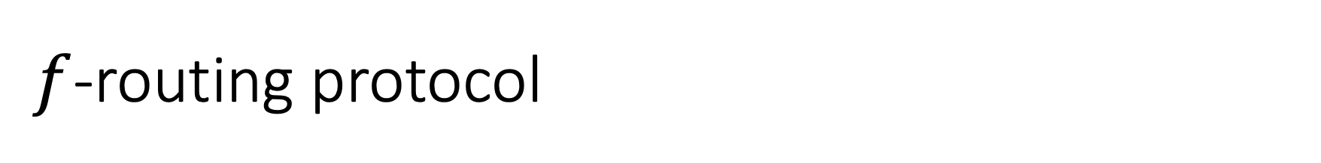
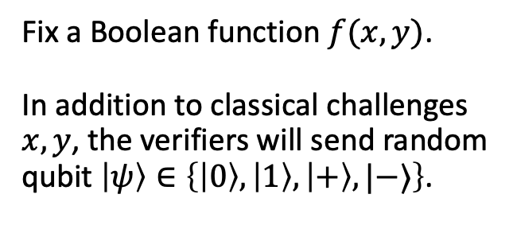
$f$-routing protocol
Time
$$t=2$$
Fix a Boolean function $f(x,y)$.
In addition to classical challenges $x,y$, the verifiers will send random qubit $\left|ψ\right\rangle ∈\left\{\left|0\right\rangle ,\left|1\right\rangle ,\left|+\right\rangle ,|−⟩\right\}$.
$$t=1$$
$$x$$
Honest
Prover
$$y,\left|ψ\right\rangle$$
$$t=0$$
$$−1$$
$$0$$
$$+1$$

Slide 14


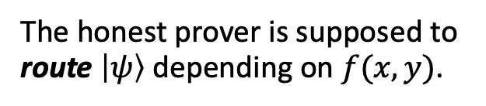
$f$-routing protocol
Time
$$t=2$$
$$|ψ⟩$$
Fix a Boolean function $f(x,y)$.
In addition to classical challenges $x,y$, the verifiers will send random qubit $\left|ψ\right\rangle ∈\left\{\left|0\right\rangle ,\left|1\right\rangle ,\left|+\right\rangle ,|−⟩\right\}$.
$$t=1$$
$$f\left(x,y\right)=0$$
$$x$$
Honest
Prover
$$y,\left|ψ\right\rangle$$
The honest prover is supposed to route $\left|ψ\right\rangle$ depending on $f(x,y)$.
$$t=0$$
$$−1$$
$$0$$
$$+1$$

Slide 15


$f$-routing protocol
Time
$$t=2$$
$$\left|ψ\right\rangle$$
Fix a Boolean function $f(x,y)$.
In addition to classical challenges $x,y$, the verifiers will send random qubit $\left|ψ\right\rangle ∈\left\{\left|0\right\rangle ,\left|1\right\rangle ,\left|+\right\rangle ,|−⟩\right\}$.
$$t=1$$
$$f\left(x,y\right)=1$$
$$x$$
Honest
Prover
$$y,\left|ψ\right\rangle$$
The honest prover is supposed to route $\left|ψ\right\rangle$ depending on $f(x,y)$.
$$t=0$$
$$−1$$
$$0$$
$$+1$$

Slide 16
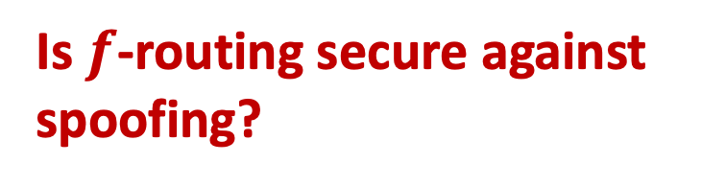
$f$-routing protocol
Time
$$t=2$$
Is $f$-routing secure against spoofing?
$$t=1$$
$$x$$
$$y,\left|ψ\right\rangle$$
Classical attack no longer works!
$$t=0$$
$$−1$$
$$0$$
$$+1$$

Slide 17
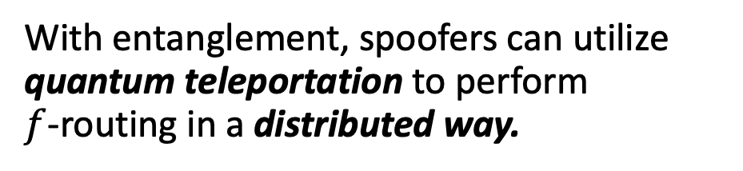
Entanglement attacks on QPV
Spoofers can do more than keep or forward qubits.
Quantum entanglement gives rise to a richer,
nontrivial set of spoofing strategies.
With entanglement, spoofers can utilize quantum teleportation to perform
$f$-routing in a distributed way.

Slide 18
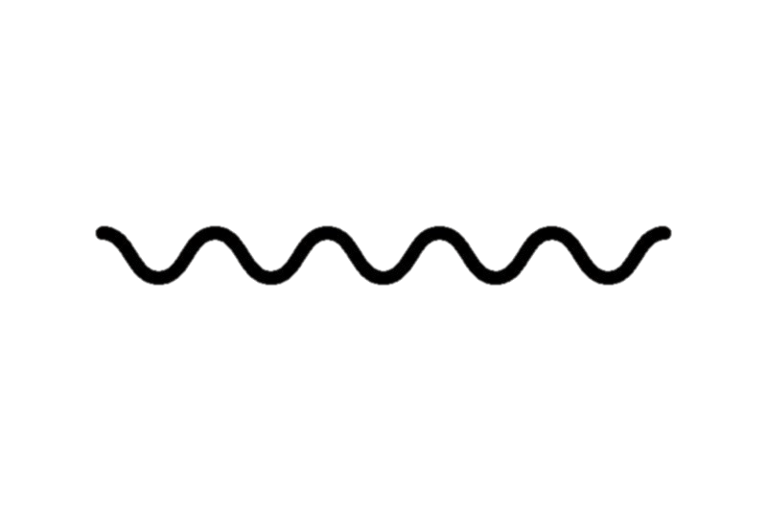
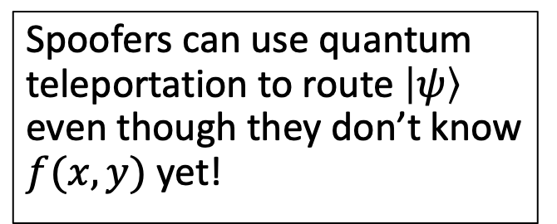


Entanglement attacks on QPV
Spoofers can use quantum teleportation to route $\left|ψ\right\rangle$ even though they don’t know $f(x,y)$ yet!
$$x$$
$$y,\left|ψ\right\rangle$$

Slide 19
Entanglement attacks on QPV
Spoofers can use quantum teleportation to route $\left|ψ\right\rangle$ even though they don’t know $f(x,y)$ yet!
$$x$$
$$y,\left|ψ\right\rangle$$

Slide 20
Entanglement attacks on QPV
Theorem: $f$-routing can be spoofed using ${\sim 2}^{\sqrt{n\log{n} }}$ qubits of entanglement for all $n$-bit Boolean functions $f$.
(Allerstorfer, et al. 2024)
This attack is highly nontrivial; it is a complicated teleportation-based attack that uses a breakthrough in classical cryptography about secure multiparty computation (Liu, Vaikuntanathan 2017)
Given enough resources, adversaries can spoof any $f$-routing position verification protocol.

Slide 21
Entanglement attacks on QPV
Open question: Is there a function $f$such that spoofing $f$-routing requires exponentially many qubits of pre-shared entanglement?
This question is immensely difficult, because of unexpected and deep connections to complexity theory and cryptography. (10/22/26: still seems hard for AI)
Theorem: When $f$ computes $n$-bit inner product function, spoofing $f$-routing requires at least $\sim \log{n}$ qubits of entanglement.
May yield practical security of QPV in near term!

Slide 22
Nonlocal
Quantum Computation
Quantum gravity
Quantum Position Verification
Position-based
Cryptography
Computational
Complexity Theory

Slide 23
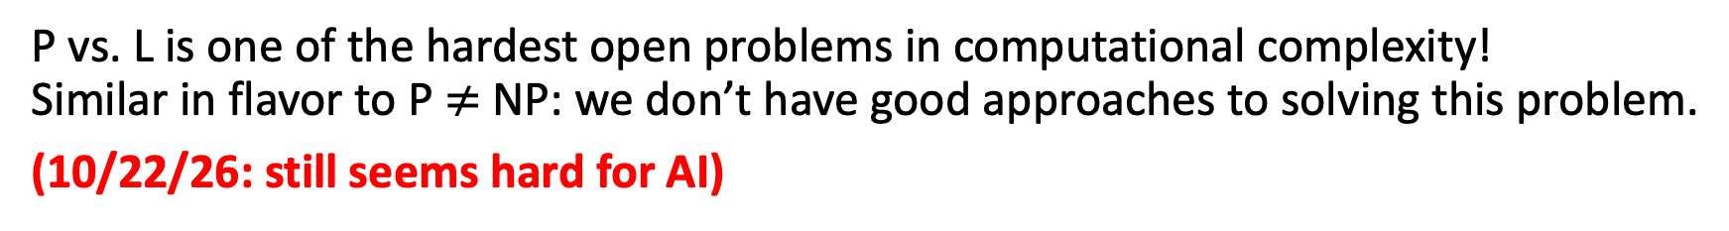
Connections with complexity and cryptography
Theorem: If there exists poly-time computable $f$ such that spoofing $f$-routing requires superpolynomial qubits of entanglement, then P $≠$L.
P = computable in polynomial time. L = computable in logarithmic memory.
P vs. L is one of the hardest open problems in computational complexity!
Similar in flavor to P $≠$ NP: we don’t have good approaches to solving this problem.
(10/22/26: still seems hard for AI)
🤔
What does security of quantum position verification have anything to do with the space complexity of functions on classical computers?!

Slide 24
Nonlocal Quantum Computation
Open question: Is there any QPV protocol (not just $f$-routing) that requires a lot of resources to spoof?
Theorem: Assuming some unproven conjectures in Banach space theory, there are QPV protocols requiring spoofers to use exponential entanglement.
(Junge, et al. 2021)
The security of QPV is equivalent to nonlocally splitting up quantum computation.

Slide 25
Nonlocal Quantum Computation
When can this…
quantum
process
…be implemented
non-locally like this?
communication
entanglement
e.g. computation, scattering process, Hamiltonian evolution…

Slide 26
Nonlocal Quantum Computation
Implication: the security of any position verification scheme must assume that spoofers have limited entanglement.
Theorem: Every quantum process on $n$ qubits can be implemented nonlocally using $\sim exp⁡(n)$ qubits of entanglement.
(Beigi-Koenig 2011)

Slide 27
Nonlocal Quantum Computation
Theorem: Every quantum circuit whose $T$-gate count is $k$ can be implemented nonlocally using $\sim 2^{k}$ qubits of entanglement.
(Speelman 2015)

Slide 28
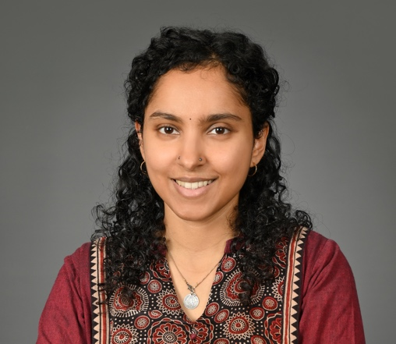
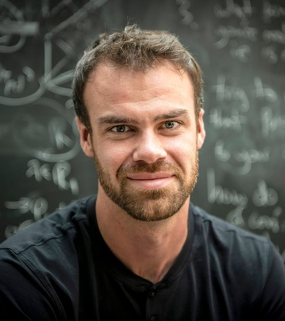
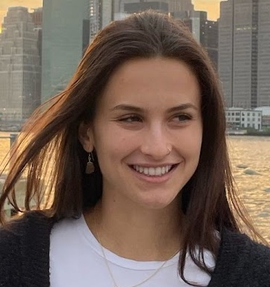
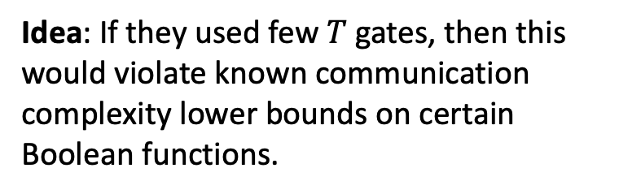
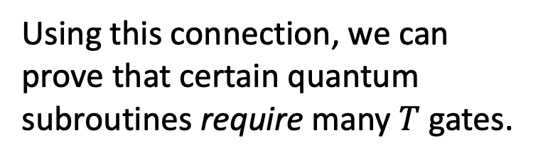
Nonlocal Quantum Computation
Using this connection, we can prove that certain quantum subroutines require many $T$ gates.
Idea: If they used few $T$ gates, then this would violate known communication complexity lower bounds on certain Boolean functions.
Theorem: The $n$-qubit Toffoli gate and the $n$-qubit multiplexer unitary requires $\sim n$ many $T$ gates to implement, even approximately.
(Girish, May, Parham, Y. STOC 2026)
See also: (Gosset, Kothari, Zhang STOC 2026)

Slide 29
Nonlocal
Quantum Computation
Quantum gravity
Quantum Position Verification
Position-based
Cryptography
Computational
Complexity Theory

Slide 30
Position-based cryptography
Computer security and cryptography is about knowing who to trust/distrust based on their identity. Identities are determined by knowledge of some secret information, like a password or a private key.
Position-based cryptography is a different paradigm where identities are determined by physical location.
Bank teller is trusted because they are behind a bullet-proof window, not because they showed us their credentials.
Nuclear missile launch should be trusted because the order came from the
White House.

Slide 31
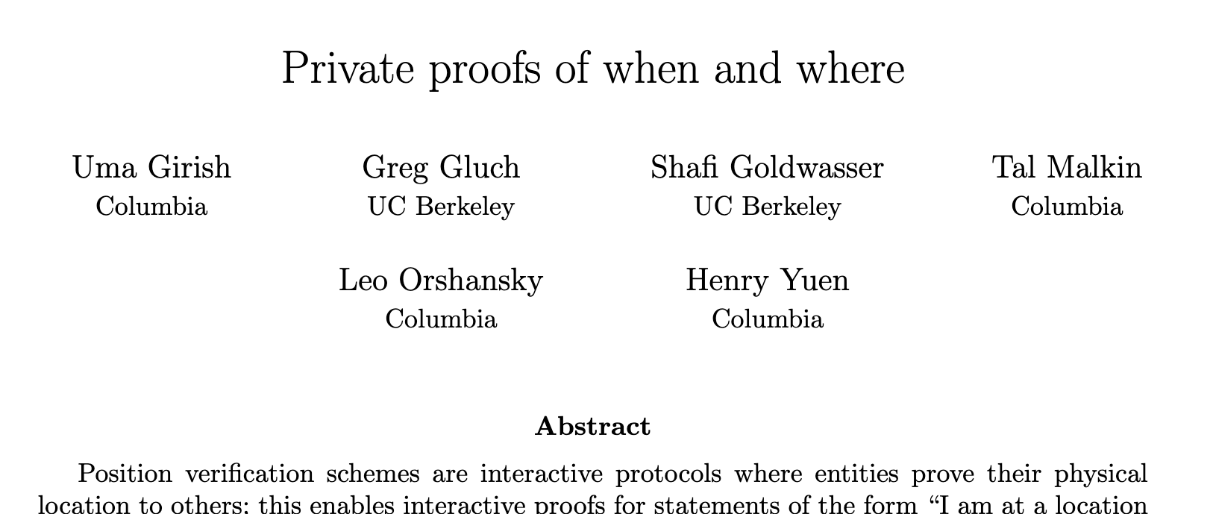
Position-based cryptography
Quantum position verification is a tantalizing starting point for this paradigm.
Can we do more?
It is possible to achieve privacy-preserving location proofs and location commitments!
Scenario: QPV allows a person to prove their location in the moment. Can they prove their location in the past to a judge?
E.g., “I was not at the murder scene the night of January 1, 20
Scenario: Can a person prove some fact about their location without fully revealing everything about it?
E.g., “I am either in location A or B, but you shouldn’t know which.”

Slide 32
Zero-knowledge position verification
Time
Zero-knowledge Position Verification:
1. The verifiers continuously run QPV with the prover.
2. The prover sends a continuous stream of encrypted responses.
3. Later, the prover can execute a cryptographic zero-knowledge proof to convince the verifiers of some statement about its past location history, while revealing zero extra info.
(Girish, Gluch, Goldwasser, Malkin, Orshansky, Y. 2025)
Position

Slide 33
Zero-knowledge position verification
Time
Zero-knowledge Position Verification:
1. The verifiers continuously run QPV with the prover.
2. The prover sends a continuous stream of encrypted responses.
3. Later, the prover can execute a cryptographic zero-knowledge proof to convince the verifiers of some statement about its past location history, while revealing zero extra info.
(Girish, Gluch, Goldwasser, Malkin, Orshansky, Y. 2025)
Position

Slide 34
Position-based cryptography
Quantum position verification is a tantalizing starting point for this paradigm.
Can we do more?
Scenario: Can QPV guarantee that a specific computation was performed at a location, and nowhere else?
E.g., Verifying that a proprietary LLM was run in an authorized data center.
Scenario: Can we verify a prover’s trajectory through space and time?
E.g., “I was in Ukraine for the past year.”

Slide 35
Trajectory verification
Time
Can we verify a prover’s trajectory through spacetime?
Position
$$0$$
$$−1$$
$$+1$$

Slide 36
Trajectory verification
Time
Can we verify a prover’s trajectory through spacetime?
Idea: run QPV for each point on discretized trajectory.
Position
$$0$$
$$−1$$
$$+1$$

Slide 37
Trajectory verification
Time
Can we verify a prover’s trajectory through spacetime?
Idea: run QPV for each point on discretized trajectory.
Position
$$0$$
$$−1$$
$$+1$$

Slide 38
Trajectory verification
Time
Can we verify a prover’s trajectory through spacetime?
Idea: run QPV for each point on discretized trajectory.
Position
$$0$$
$$−1$$
$$+1$$

Slide 39
Trajectory verification
Conceptual problem: QPV can’t tell the difference between a single traveling prover and multiple stationary clones!
Time
Position
$$0$$
$$−1$$
$$+1$$

Slide 40
Trajectory verification
Conceptual problem: QPV can’t tell the difference between a single traveling prover and multiple stationary clones!
Time
Philosophical problem: what defines an identity?
Position
$$0$$
$$−1$$
$$+1$$

Slide 41
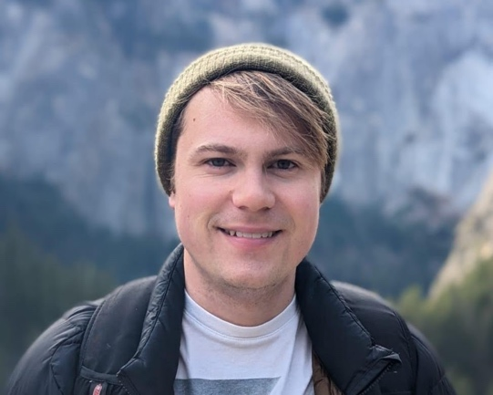
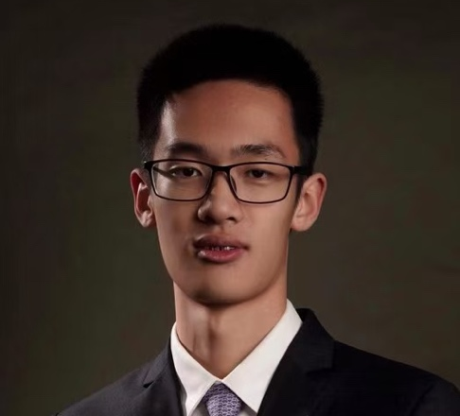

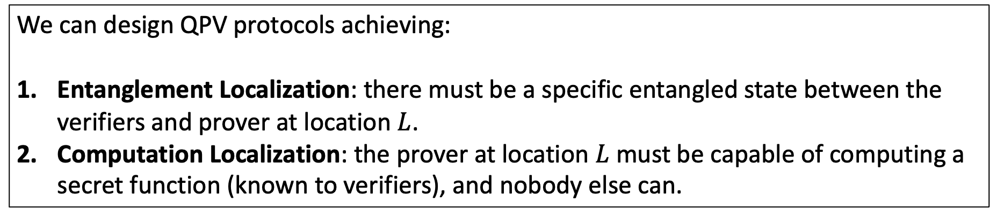
Quantum Localization
A stronger property of QPV where a unique object is localized to the desired position $L$.
We can design QPV protocols achieving:
Entanglement Localization: there must be a specific entangled state between the verifiers and prover at location $L$.
Computation Localization: the prover at location $L$ must be capable of computing a secret function (known to verifiers), and nobody else can.
(J. Bartusek, Z. Huang, L. Orshansky, H.Y. 2026)

Slide 42
Summary and Outlook

Slide 43
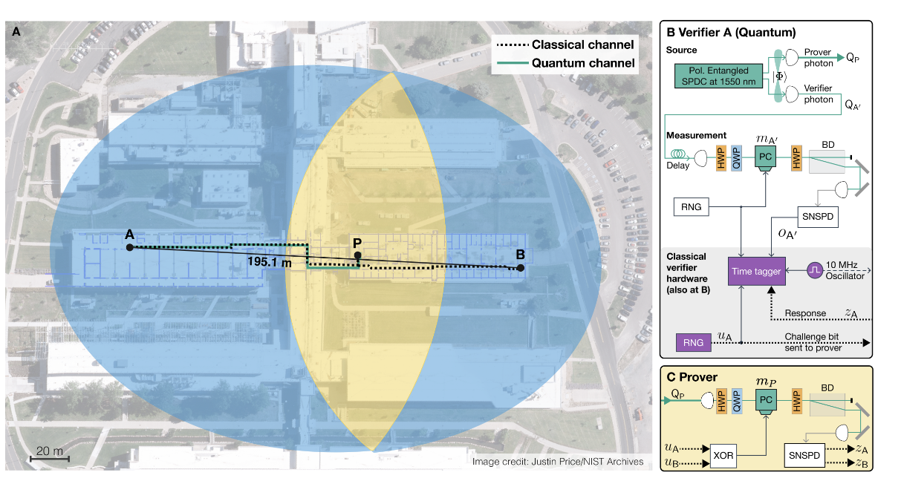
NIST experiment
In January 2026, NIST announced the first quantum position verification experiment.
Prover is ~90m from verifiers.
Challenges arrive in 3ns.
Measurement detection efficiency >81%.

Slide 44
Future Directions
Cryptography: what are applications of position-based cryptography?
Complexity: use QPV/NLQC as lens on complexity of quantum computation?
Quantum gravity: insights into AdS/CFT correspondence can QPV/NLQC give?
Experiment: practical deployments of QPV?
Thank You!

