Slide 1
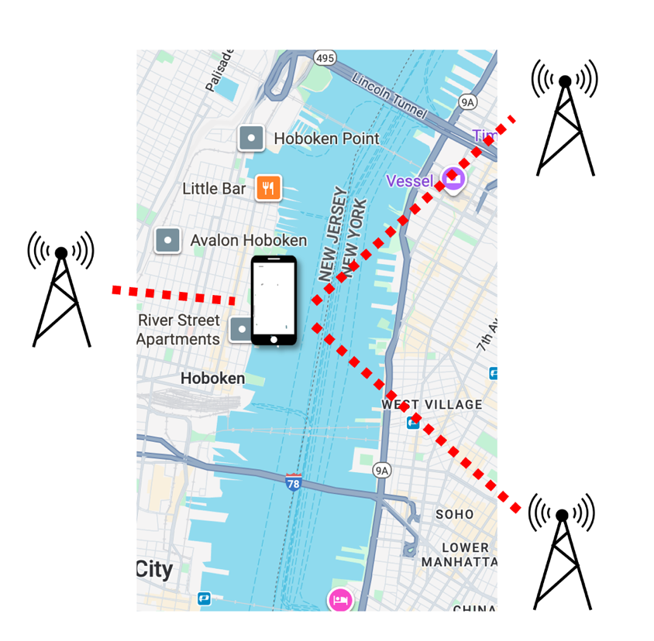
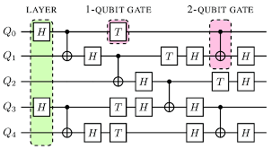
The Marvelous World of Quantum Position Verification
Henry Yuen
Columbia
Notes:
Hi everyone. Thanks so much for the invitation to speak here. I work on the theory of quantum computation, usually focusing on complexity theory and cryptography. This talk is going to be about the “marvelous world of QPV”; I’m going to describe a surprisingly rich ecosystem of questions and ideas that have enveloped my research agenda for the past couple of years. I know that UIUC is a hub for QPV research, so I am looking forward to hearing your perspectives and reactions.

Slide 2
Can quantum computations be efficiently computed in a distributed fashion?
What does a theory of quantum gravity look like?
Can all polynomial-time computable problems be solved using logarithmic memory?
Is it possible to remotely verify someone’s location?
Notes:
Let’s consider the following questions. They all seem pretty different – what ties them together?

Slide 3
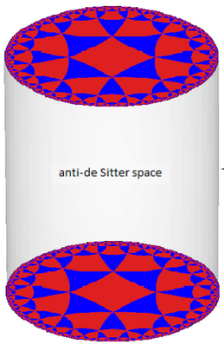
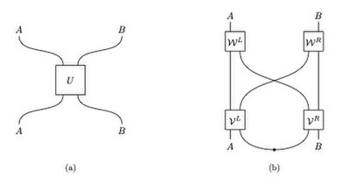

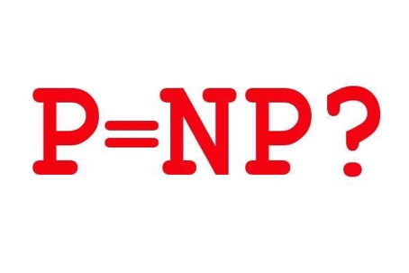
Nonlocal Quantum Computation
Quantum gravity
Position-based Cryptography
Computational Complexity Theory
Notes:
These are a fundamental, deep questions in various areas such as

Slide 4
Nonlocal Quantum Computation
Quantum gravity
Quantum Position Verification
Position-based Cryptography
Computational Complexity Theory

Slide 5
Nonlocal Quantum Computation
Quantum gravity
Quantum Position Verification
Position-based Cryptography
Computational Complexity Theory

Slide 6
Position-based cryptography
Is it possible to remotely verify someone’s – or something’s – location?
Example scenarios:
Export-control enforcement (e.g., GPU can only be run in country X)
Authorizing payment upon delivery
Verifying physical provenance of data (e.g., UFO video came from Area 51)
In position-based cryptography, whether or not a user is authorized to do something depends on their physical location.

Slide 7
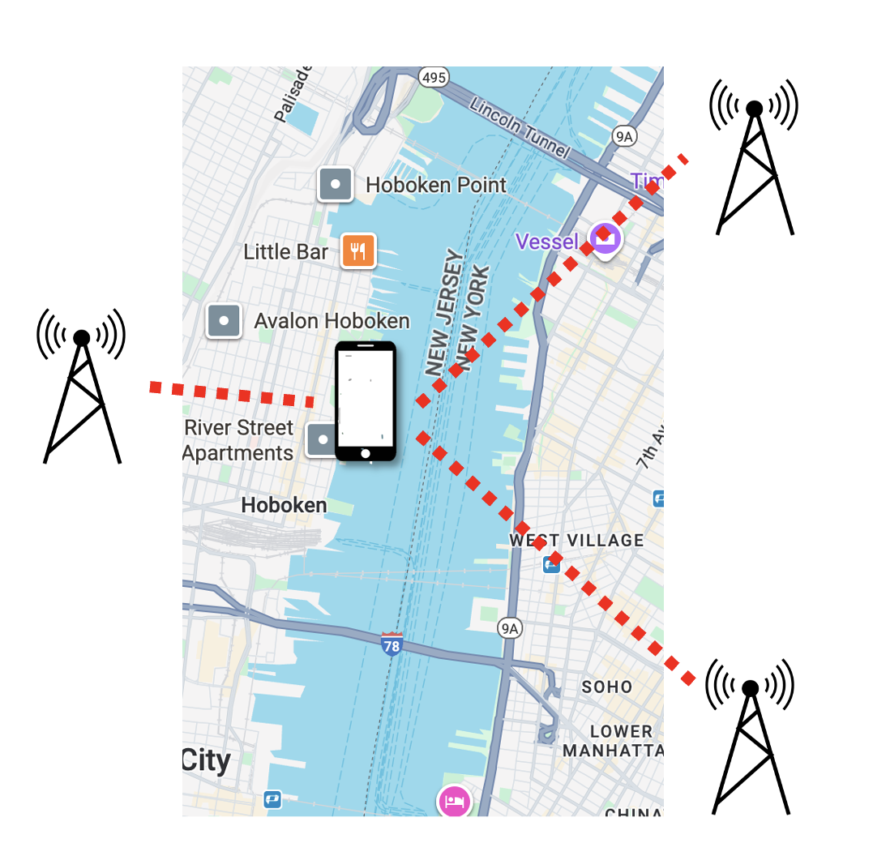
Position verification
A natural idea: multiple verifiers can check the physical location of a prover by sending signals to the purported location, receiving signals back, and checking timing constraints.
Provers are untrusted.
Verifiers want to guard against spoofing.

Slide 8
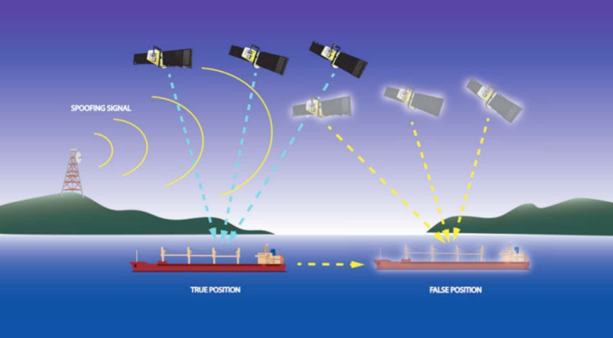
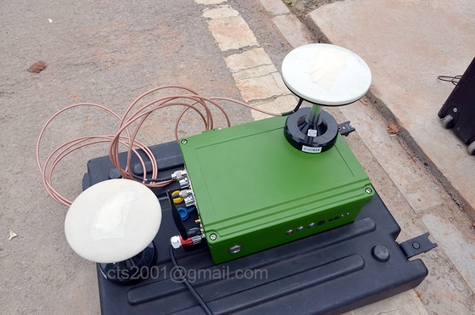
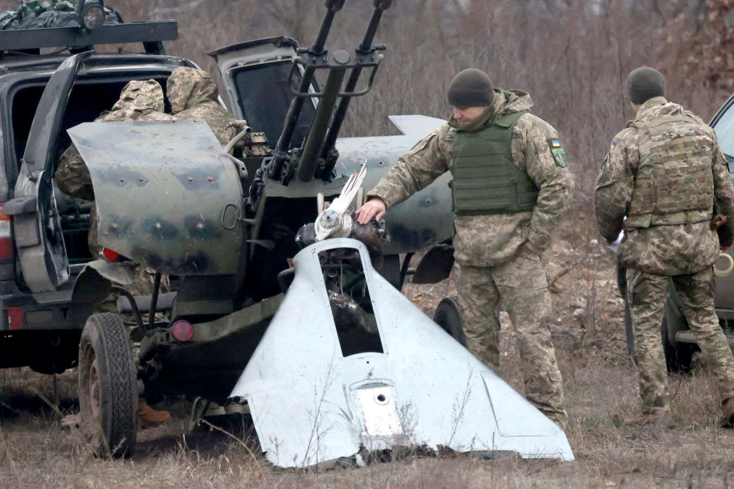
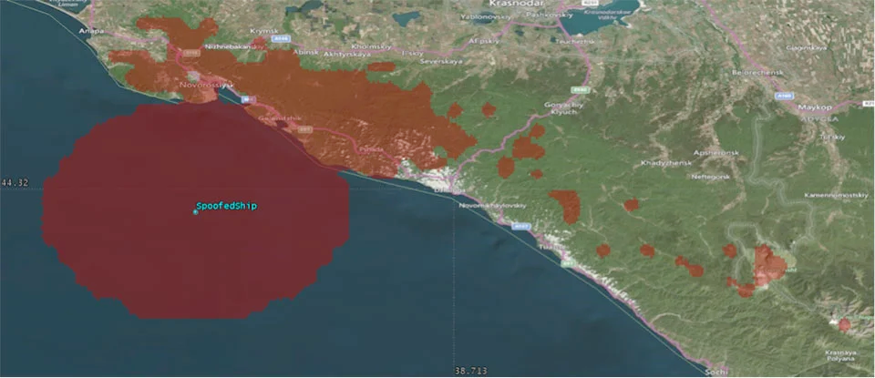
Position information is fragile
Cheap GPS
spoofer
GPS spoofing in Ukraine-Russia war
Maritime GPS spoofing in Black Sea

Slide 9
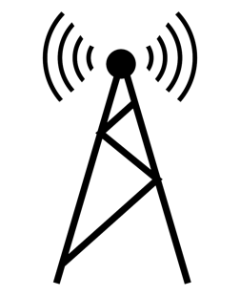







Example: 1D position verification
Time
$$t=2$$
$$t=1$$
$$t=0$$
$$−1$$
$$0$$
$$+1$$
Position $P$

Slide 10
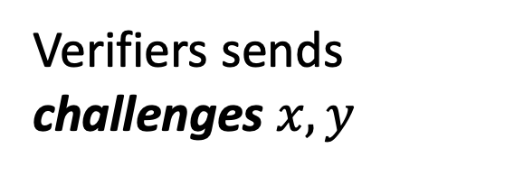


Example: 1D position verification
Time
Goal: verify prover is in position 0.
$$t=2$$
Verifiers sends
challenges $x,y$
$$t=1$$
Prover
$$y$$
$$x$$
$$t=0$$
Position
$$0$$
$$−1$$
$$+1$$

Slide 11

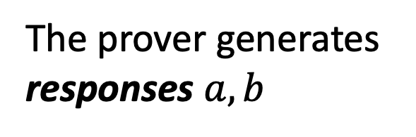

Example: 1D position verification
Time
Goal: verify prover is in position 0.
$$t=2$$
$$a$$
$$b$$
Verifiers sends
challenges $x,y$
$$t=1$$
Prover
$$y$$
$$x$$
The prover generates responses $a,b$
$$t=0$$
Position
$$0$$
$$−1$$
$$+1$$

Slide 12
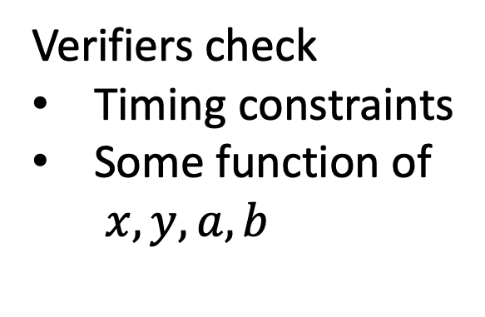
Example: 1D position verification
Time
Verifiers check
Timing constraints
Some function of $x,y,a,b$
$$t=2$$
$$a$$
$$b$$
$$t=1$$
Prover
$$y$$
$$x$$
$$t=0$$
Position
$$0$$
$$−1$$
$$+1$$

Slide 13
Example: 1D position verification
Time
Verifiers check
Timing constraints
Some function of $x,y,a,b$
$$t=2$$
$$a$$
$$b$$
$$t=1$$
Hope: only way to generate good, timely responses is to be in correct position.
Prover
$$y$$
$$x$$
$$t=0$$
Position
$$0$$
$$−1$$
$$+1$$

Slide 14
Classical impossibility
Theorem: Any position verification protocol using only classical resources can be spoofed.
Time
$$t=2$$
$$a$$
$$b$$
(Kent-Munro-Spiller ’11, Buhrman, et al. ‘10)
$$t=1$$
Prover
$$y$$
$$x$$
$$t=0$$
Position
$$0$$
$$−1$$
$$+1$$

Slide 15
Classical impossibility
Theorem: Any position verification protocol using only classical resources can be spoofed.
Time
$$t=2$$
(Kent-Munro-Spiller ’11, Buhrman, et al. ‘10)
$$t=1$$
$$x$$
$$y$$
Spoofer
Spoofer
$$t=0$$
Not in position 0!
Position
$$0$$
$$−1$$
$$+1$$

Slide 16
Classical impossibility
Theorem: Any position verification protocol using only classical resources can be spoofed.
Time
$$t=2$$
(Kent-Munro-Spiller ’11, Buhrman, et al. ‘10)
$$t=1$$
This is because classical information can be copied and both spoofers can pretend to be the honest prover.
$$x$$
$$y$$
Spoofer
Spoofer
$$t=0$$
Position
$$0$$
$$−1$$
$$+1$$

Slide 17
Classical impossibility
Theorem: Any position verification protocol using only classical resources can be spoofed.
Time
$$t=2$$
$$a$$
$$b$$
(Kent-Munro-Spiller ’11, Buhrman, et al. ‘10)
$$t=1$$
This is because classical information can be copied and both spoofers can pretend to be the honest prover.
$$x$$
$$y$$
Spoofer
Spoofer
$$t=0$$
Position
$$0$$
$$−1$$
$$+1$$

Slide 18
Classical impossibility
Time
$$t=2$$
What if we used quantum resources?
🤔
$$a$$
$$b$$
$$t=1$$
We can leverage the No-Cloning Principle
of quantum physics…
$$x$$
$$y$$
Spoofer
Spoofer
$$t=0$$
Position
$$0$$
$$−1$$
$$+1$$

Slide 19

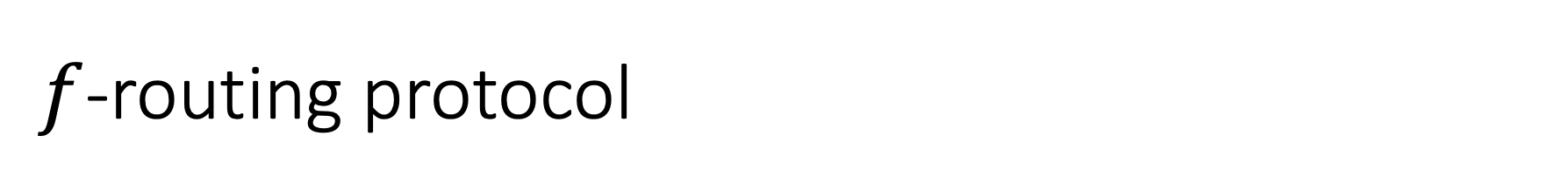
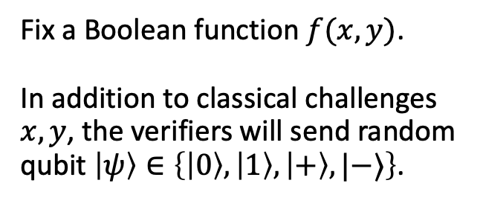
$f$-routing protocol
Time
$$t=2$$
Fix a Boolean function $f(x,y)$. In addition to classical challenges $x,y$, the verifiers will send random qubit $\left|ψ\right\rangle ∈\left\{\left|0\right\rangle ,\left|1\right\rangle ,\left|+\right\rangle ,|−⟩\right\}$.
$$t=1$$
$$x$$
Honest
Prover
$$y,\left|ψ\right\rangle$$
$$t=0$$
$$−1$$
$$0$$
$$+1$$

Slide 20


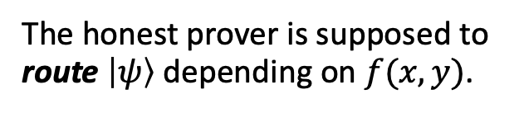
$f$-routing protocol
Time
$$t=2$$
$$|ψ⟩$$
Fix a Boolean function $f(x,y)$. In addition to classical challenges $x,y$, the verifiers will send random qubit $\left|ψ\right\rangle ∈\left\{\left|0\right\rangle ,\left|1\right\rangle ,\left|+\right\rangle ,|−⟩\right\}$.
$$t=1$$
$$f\left(x,y\right)=0$$
$$x$$
Honest
Prover
$$y,\left|ψ\right\rangle$$
The honest prover is supposed to route $\left|ψ\right\rangle$ depending on $f(x,y)$.
$$t=0$$
$$−1$$
$$0$$
$$+1$$

Slide 21


$f$-routing protocol
Time
$$t=2$$
$$\left|ψ\right\rangle$$
Fix a Boolean function $f(x,y)$. In addition to classical challenges $x,y$, the verifiers will send random qubit $\left|ψ\right\rangle ∈\left\{\left|0\right\rangle ,\left|1\right\rangle ,\left|+\right\rangle ,|−⟩\right\}$.
$$t=1$$
$$f\left(x,y\right)=1$$
$$x$$
Honest
Prover
$$y,\left|ψ\right\rangle$$
The honest prover is supposed to route $\left|ψ\right\rangle$ depending on $f(x,y)$.
$$t=0$$
$$−1$$
$$0$$
$$+1$$

Slide 22
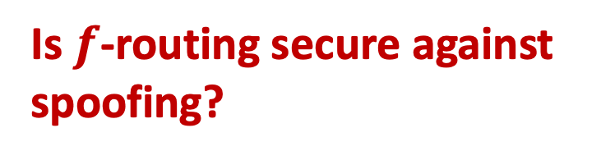
$f$-routing protocol
Time
$$t=2$$
Is $f$-routing secure against spoofing?
$$t=1$$
$$x$$
$$y,\left|ψ\right\rangle$$
Classical attack no longer works!
$$t=0$$
$$−1$$
$$0$$
$$+1$$

Slide 23


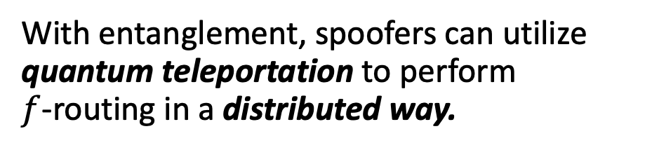

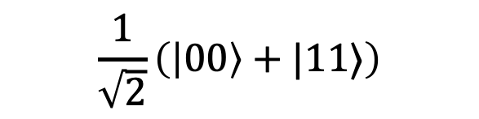
Entanglement attacks on QPV
Spoofers can do more than keep or forward qubits. Quantum entanglement gives rise to a richer, nontrivial set of spoofing strategies.
$$|ψ⟩$$
Teleportation corrections
With entanglement, spoofers can utilize quantum teleportation to perform $f$-routing in a distributed way.
Time
Teleportation measurement
Quantum teleportation is a protocol for transferring qubits using classical communication and pre-shared entanglement.
$$\frac{1}{\sqrt{2}}\left(\left|00\right\rangle +|11⟩\right)$$
$$|ψ⟩$$

Slide 24
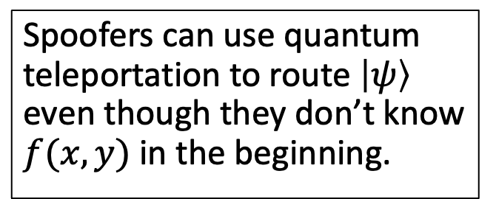


Entanglement attacks on QPV
Spoofers can use quantum teleportation to route $\left|ψ\right\rangle$ even though they don’t know $f(x,y)$ in the beginning.
$$x$$
$$y,\left|ψ\right\rangle$$

Slide 25
Entanglement attacks on QPV
Spoofers can use quantum teleportation to route $\left|ψ\right\rangle$ even though they don’t know $f(x,y)$ in the beginning.
$$x$$
$$y,\left|ψ\right\rangle$$

Slide 26
Entanglement attacks on QPV
Theorem: $f$-routing can be spoofed using ${\sim 2}^{\sqrt{n\log{n} }}$ qubits of entanglement for all $n$-bit Boolean functions $f$.
(Allerstorfer, et al. 2024)
This attack is highly nontrivial; it uses a breakthrough in classical cryptography about Conditional Disclosure of Secrets (CDS) protocols (Liu, Vaikuntanathan, Wee 2017).
Any low-communication CDS protocol for $f$ can be generically converted into an low-entanglement attack on $f$-routing. (Allerstorfer, et al. 2024)

Slide 27
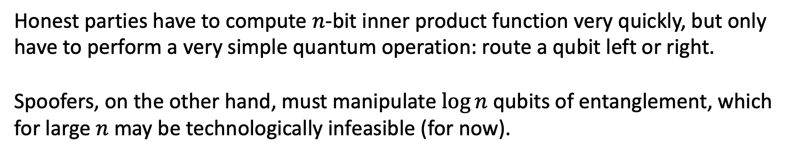
Secure QPV
Theorem: When $f$ computes $n$-bit inner product function, spoofing $f$-routing requires at least $\sim \log{n}$ qubits of entanglement.
(Bluhm, Christandl, Speelman 2021)
Honest parties have to compute $n$-bit inner product function very quickly, but only have to perform a very simple quantum operation: route a qubit left or right.
Spoofers, on the other hand, must manipulate $\log{n}$ qubits of entanglement, which for large $n$ may be technologically infeasible (for now).

Slide 28
Entanglement attacks on QPV
Open question: Is there a function $f$such that spoofing $f$-routing requires exponentially many qubits of pre-shared entanglement?
This question is immensely difficult, because of unexpected and deep connections to complexity theory and cryptography.

Slide 29
Nonlocal Quantum Computation
Quantum gravity
Quantum Position Verification
Position-based Cryptography
Computational Complexity Theory

Slide 30
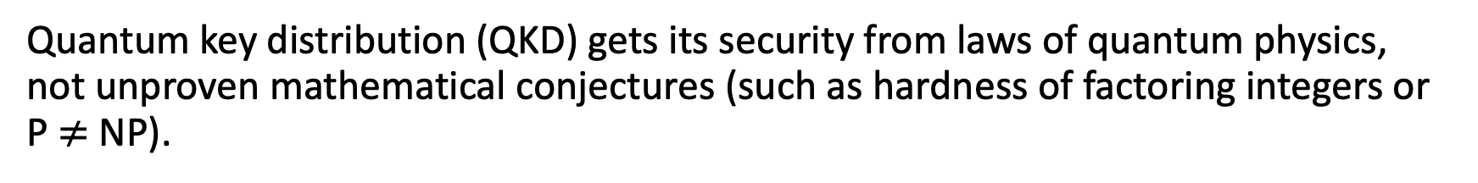
Connections with complexity and cryptography
Quantum key distribution (QKD) gets its security from laws of quantum physics, not unproven mathematical conjectures (such as hardness of factoring integers or P $≠$NP).
Though QPV resembles QKD, it has deeper and unavoidable connections to the theory of computation.
Theorem: If $f$ can be computed using $S$ bits of memory on a classical computer, then $f$-routing can be spoofed using $exp⁡(S)$ qubits of entanglement.
(Allerstorfer, et al. 2024)
This is because such an $f$ admits a CDS protocol with $exp⁡(S)$ communication. (Feige, Kilian, Naor 1994).

Slide 31
Connections with complexity and cryptography
Corollary: If $f$ is computable in polynomial time, but $f$-routing is secure against spoofers with polynomial qubits of entanglement, then P $≠$L.
P = computable in polynomial time. L = computable in logarithmic memory.
P vs. L is one of the hardest open problems in computational complexity! Similar in flavor to P $≠$ NP: we don’t have good approaches to solving this problem.
🤔
What does security of quantum position verification have anything to do with the space complexity of functions on classical computers?!

Slide 32
Nonlocal Quantum Computation
Quantum gravity
Quantum Position Verification
Position-based Cryptography
Computational Complexity Theory

Slide 33
Nonlocal Quantum Computation
Open question: Is there any QPV protocol (not just $f$-routing) that requires a lot of resources in order to spoof?
Theorem: Assuming some unproven conjectures in Banach space theory, there are QPV protocols requiring spoofers to use exponential entanglement.
(Junge, et al. 2021)
The security of QPV is equivalent to nonlocally splitting up quantum computation.

Slide 34
Nonlocal Quantum Computation
When can this…
quantum process
…be implemented non-locally like this?
communication
entanglement
e.g. computation, scattering process, Hamiltonian evolution…

Slide 35
Nonlocal Quantum Computation
Implication: the security of any position verification scheme must assume that spoofers have limited entanglement.
Theorem: Every quantum process on $n$ qubits can be implemented nonlocally using $\sim exp⁡(n)$ qubits of entanglement.
(Beigi-Koenig 2011)

Slide 36
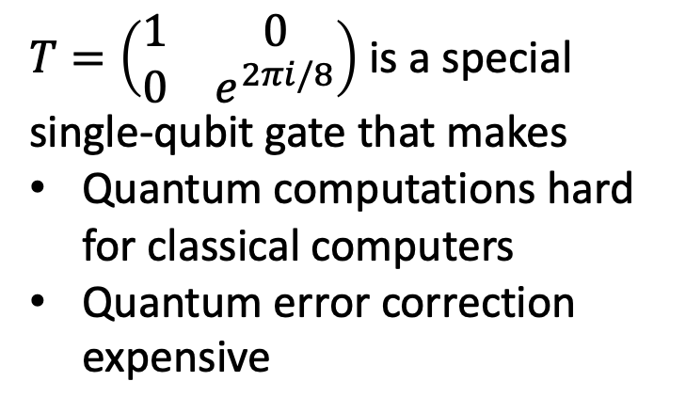
Nonlocal Quantum Computation
$T=\left(\begin{matrix}1 & 0 \\ 0 & e^{2πi/8}\end{matrix}\right)$ is a special single-qubit gate that makes
Quantum computations hard for classical computers
Quantum error correction expensive
Theorem: Every quantum circuit whose $T$-gate count is $k$ can be implemented nonlocally using $\sim 2^{k}$ qubits of entanglement.
(Speelman 2015)

Slide 37
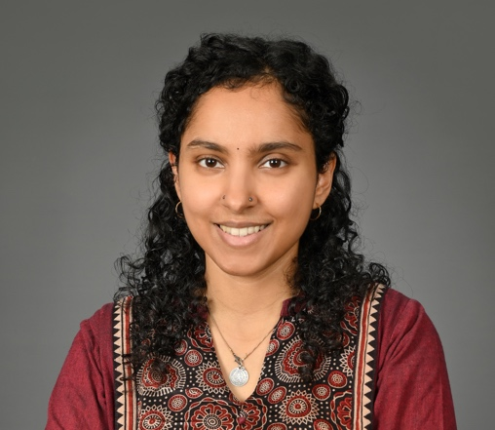
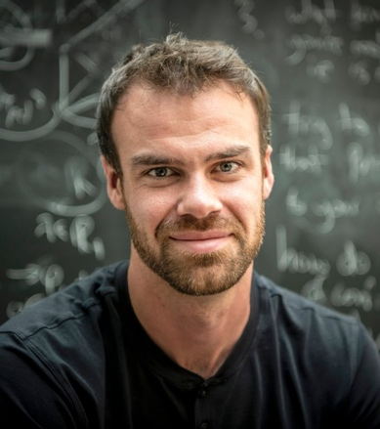
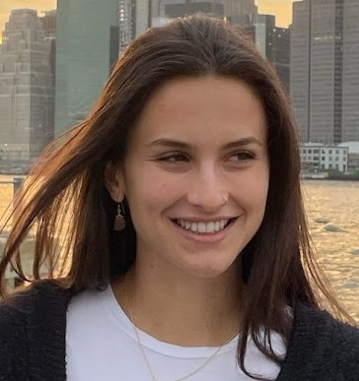
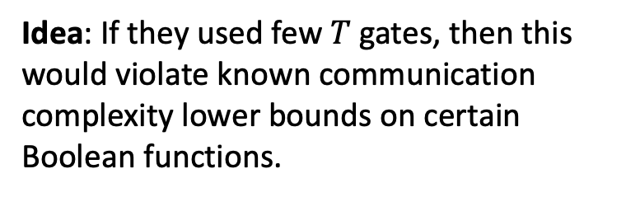
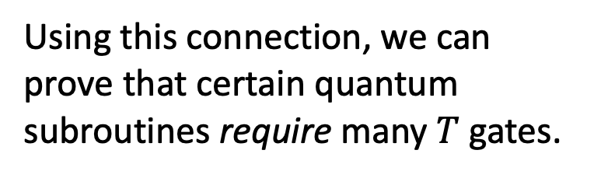
Nonlocal Quantum Computation
Using this connection, we can prove that certain quantum subroutines require many $T$ gates.
Idea: If they used few $T$ gates, then this would violate known communication complexity lower bounds on certain Boolean functions.
Theorem: The $n$-qubit Toffoli gate and the $n$-qubit multiplexer unitary requires $\sim n$ many $T$ gates to implement, even approximately.
(Girish, May, Parham, Y. STOC 2026)

Slide 38
Nonlocal Quantum Computation
Quantum gravity
Quantum Position Verification
Position-based Cryptography
Computational Complexity Theory

Slide 39
Position-based cryptography
Computer security and cryptography is about knowing who to trust/distrust based on their identity. Identities are determined by knowledge of some secret information, like a password or a private key.
Position-based cryptography is a different paradigm where identities are determined by physical location.
Bank teller is trusted because they are behind a bullet-proof window, not because they showed us their credentials.
Missile launch order should be trusted because it came from the Pentagon.

Slide 40
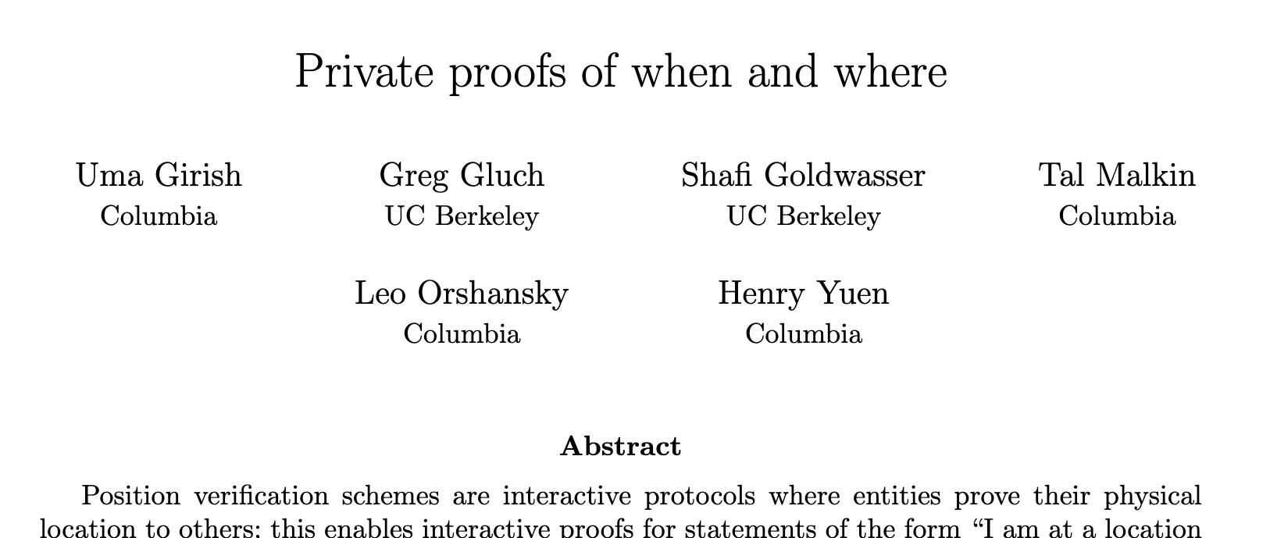
Position-based cryptography
Quantum position verification is a tantalizing starting point for this paradigm. Can we do more?
It is possible to achieve privacy-preserving location proofs and location commitments!
Scenario: QPV allows a person to prove their location in the moment. Can they prove their location in the past to a judge?
E.g., “I was not at the murder scene the night of January 1, 2007”
Scenario: Can a person prove some fact about their location without fully revealing everything about it?
E.g., “I am either in location A or B, but you shouldn’t know which.”

Slide 41
Position-based cryptography
Quantum position verification is a tantalizing starting point for this paradigm. Can we do more?
Scenario: Can QPV guarantee that a specific computation was performed at a location, and nowhere else?
E.g., Verifying that a proprietary LLM was run in an authorized data center.
Scenario: Can we verify a prover’s trajectory through space and time?
E.g., “I was in Ukraine for the past year.”

Slide 42
Trajectory verification
Time
Can we verify a prover’s trajectory through spacetime?
Position
$$0$$
$$−1$$
$$+1$$

Slide 43
Trajectory verification
Time
Can we verify a prover’s trajectory through spacetime?
Idea: run QPV for each point on discretized trajectory.
Position
$$0$$
$$−1$$
$$+1$$

Slide 44
Trajectory verification
Time
Can we verify a prover’s trajectory through spacetime?
Idea: run QPV for each point on discretized trajectory.
Position
$$0$$
$$−1$$
$$+1$$

Slide 45
Trajectory verification
Time
Can we verify a prover’s trajectory through spacetime?
Idea: run QPV for each point on discretized trajectory.
Position
$$0$$
$$−1$$
$$+1$$

Slide 46
Trajectory verification
Conceptual problem: QPV can’t tell the difference between a single traveling prover and multiple stationary clones!
Time
Position
$$0$$
$$−1$$
$$+1$$

Slide 47
Trajectory verification
Conceptual problem: QPV can’t tell the difference between a single traveling prover and multiple stationary clones!
Time
Philosophical problem: what defines an identity?
Position
$$0$$
$$−1$$
$$+1$$

Slide 48
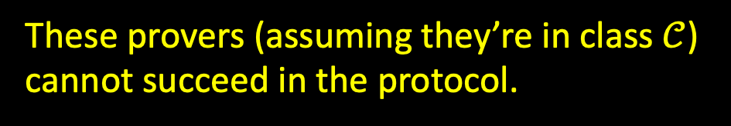
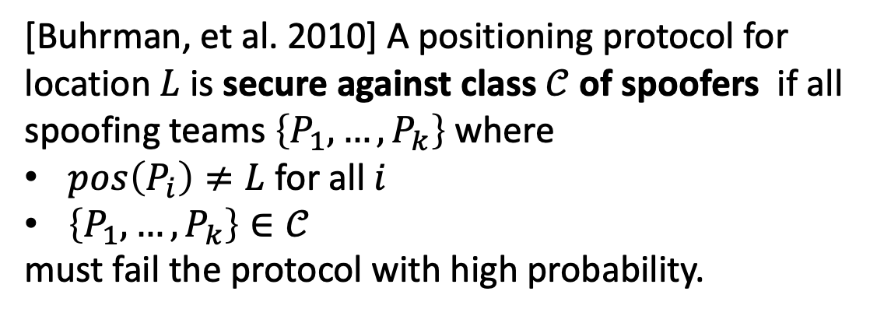
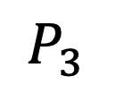
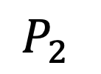
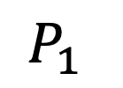

A fundamental issue
We must confront a difficulty with how position verification has been formalized.
[Buhrman, et al. 2010] A positioning protocol for location $L$ is secure against class $𝒞$ of spoofers if all spoofing teams $\left\{P_{1},…,P_{k}\right\}$ where
$pos\left(P_{i}\right)≠L$ for all $i$
$\left\{P_{1},…,P_{k}\right\}∈𝒞$
must fail the protocol with high probability.
$P_{2}$
$P_{1}$
$L$
$P_{3}$
These provers (assuming they’re in class $𝒞$) cannot succeed in the protocol.

Slide 49

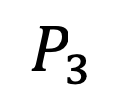
A fundamental issue
We must confront a difficulty with how position verification has been formalized.
[Buhrman, et al. 2010] A positioning protocol for location $L$ is secure against class $𝒞$ of spoofers if all spoofing teams $\left\{P_{1},…,P_{k}\right\}$ where
$pos\left(P_{i}\right)≠L$ for all $i$
$\left\{P_{1},…,P_{k}\right\}∈𝒞$
must fail the protocol with high probability.
$P_{2}$
$P_{1}$
$L$
This definition of security does not rule out a nontrivial collusion strategy.
$P_{3}$
Equivalently: if any team of spoofers $\left\{P_{1},…,P_{k}\right\}$ succeeds with noticeable probability, then at least one spoofer $P_{i}$ must be at location $L$.

Slide 50


A fundamental issue
In other words, the standard definition of position verification only establishes presence of a prover at a location, but does not localize the prover at $L$.
This guarantee is not satisfactory for many natural applications of QPV (e.g., proving an alibi, authenticating messages, etc.).
Officer, I was nowhere near the scene of the crime…

Slide 51
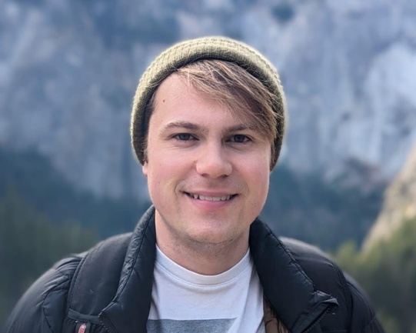
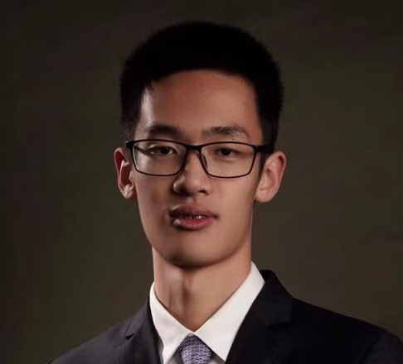

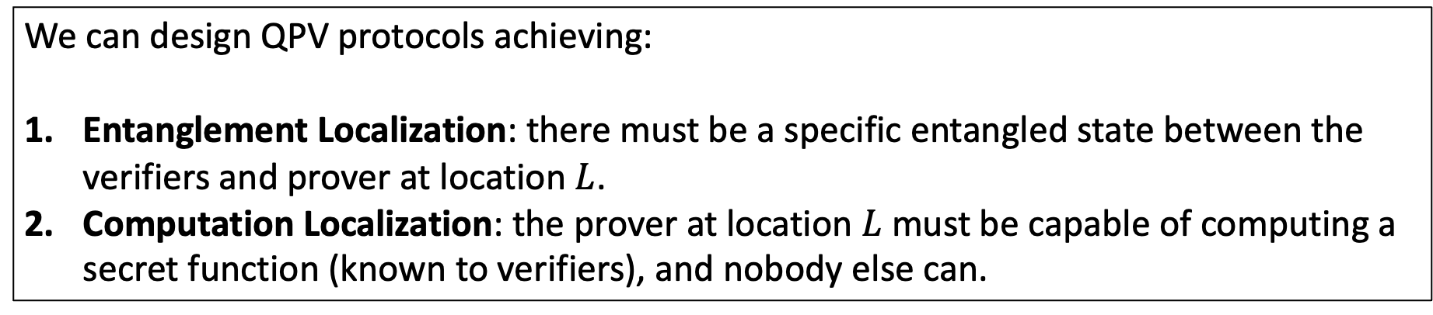
Quantum Localization
A stronger property of QPV where a unique object is localized to the desired position $L$.
We can design QPV protocols achieving:
Entanglement Localization: there must be a specific entangled state between the verifiers and prover at location $L$.
Computation Localization: the prover at location $L$ must be capable of computing a secret function (known to verifiers), and nobody else can.
(Upcoming work with James Bartusek, Zikuan Huang, and Leo Orshansky)

Slide 52


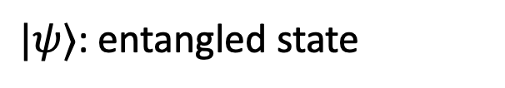
Entanglement Localization
Verifiers will send an entangled state as part of protocol.
$L$
$|ψ⟩$: entangled state

Slide 53

Entanglement Localization
The provers can intercept and perform arbitrary operations.
$L$
$|ψ⟩$: entangled state

Slide 54
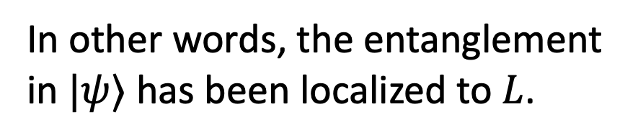
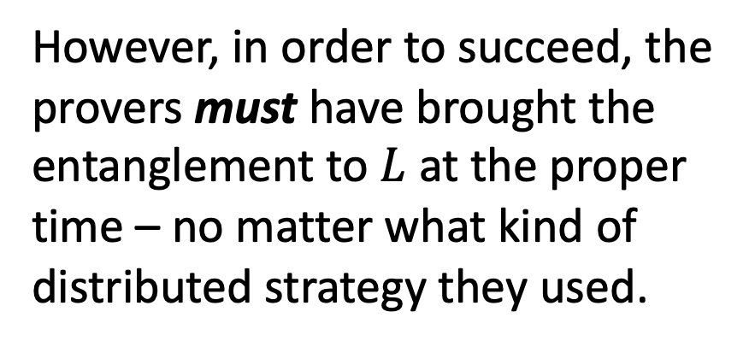
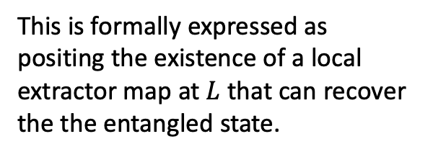
Entanglement Localization
However, in order to succeed, the provers must have brought the entanglement to $L$ at the proper time – no matter what kind of distributed strategy they used.
This is formally expressed as positing the existence of a local extractor map at $L$ that can recover the the entangled state.
$L$
In other words, the entanglement in $|ψ⟩$ has been localized to $L$.
$|ψ⟩$: entangled state

Slide 55

Trajectory verification
Conceptual solution: we can meaningfully track the trajectory of the entanglement.
The monogamy of entanglement principle ensures this is unclonable and unique!
Time
Position
$$0$$
$$−1$$
$$+1$$

Slide 56
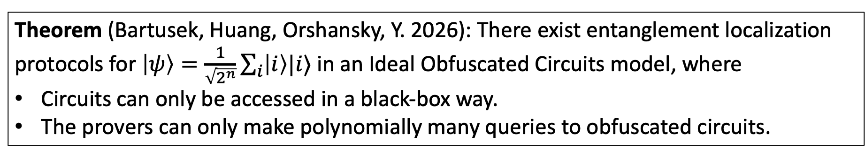
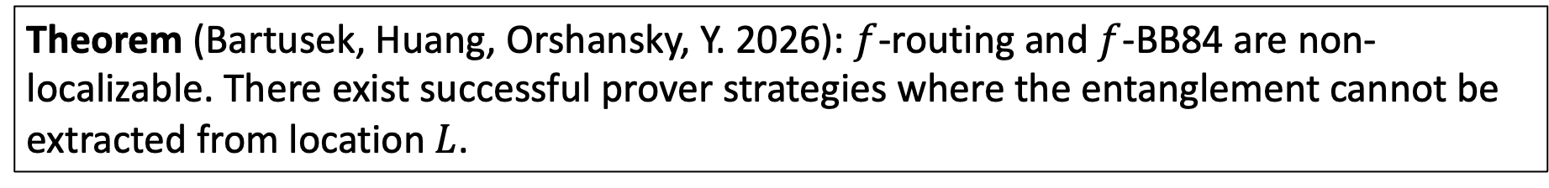
Entanglement Localization
What QPV protocols achieve entanglement localization?
Theorem (Bartusek, Huang, Orshansky, Y. 2026): $f$-routing and $f$-BB84 are non-localizable. There exist successful prover strategies where the entanglement cannot be extracted from location $L$.
Theorem (Bartusek, Huang, Orshansky, Y. 2026): There exist entanglement localization protocols for $\left|ψ\right\rangle =\frac{1}{\sqrt{2^{n}}}\sum_{i}{\left|i\right\rangle |i⟩}$ in an Ideal Obfuscated Circuits model, where
Circuits can only be accessed in a black-box way.
The provers can only make polynomially many queries to obfuscated circuits.

Slide 57
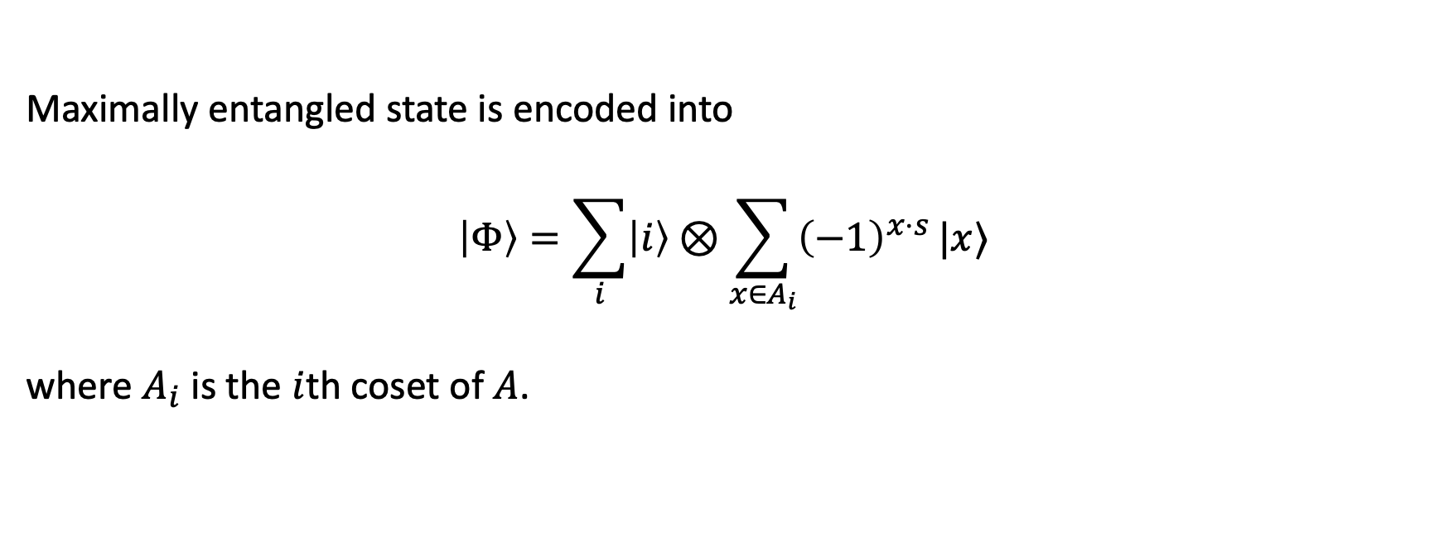
Entanglement Localization Protocol (Simplified)
Verifiers choose random subspace $A≤𝔽_{2}^{n}$ of dim $n/2$, and secret string $s∈𝔽_{2}^{n}$
Maximally entangled state is encoded into
$$\left|Φ\right\rangle =\sum_{i}{\left|i\right\rangle ⊗\sum_{x∈A_{i}}{{\left(−1\right)}^{x⋅s}}|x⟩ }$$
where $A_{i}$ is the $i$th coset of $A$.
Verifiers keep this register

Slide 58
Entanglement Localization Protocol (Simplified)
Verifiers choose random subspace $A≤𝔽_{2}^{n}$ of dim $n/2$, and secret string $s∈𝔽_{2}^{n}$
Maximally entangled state is encoded into
$$\left|Φ\right\rangle =\sum_{i}{\left|i\right\rangle ⊗\sum_{x∈A_{i}}{{\left(−1\right)}^{x⋅s}}|x⟩ }$$
where $A_{i}$ is the $i$th coset of $A$.
In quantum cryptography, this state is called a coset state, which is a high-dimensional generalization of BB84 states.
Fundamental primitive in quantum money, quantum copy-protection, and other forms of unclonable cryptography.
Verifiers send this register to the provers.

Slide 59
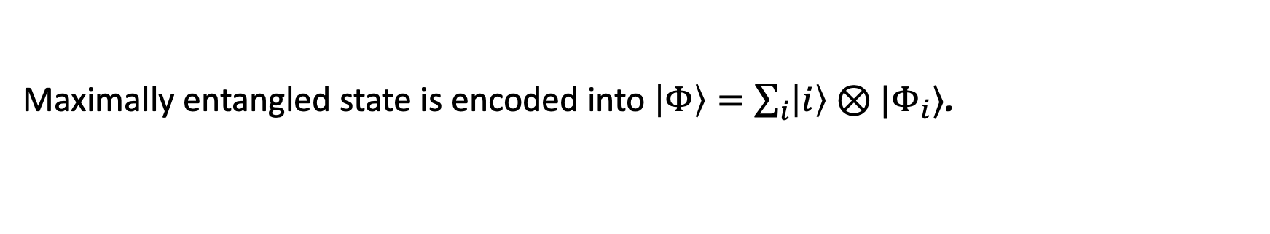
Entanglement Localization Protocol (Simplified)
Verifiers choose random subspace $A≤𝔽_{2}^{n}$ of dim $n/2$, and secret string $s∈𝔽_{2}^{n}$
Maximally entangled state is encoded into $\left|Φ\right\rangle =\sum_{i}{\left|i\right\rangle ⊗|Φ_{i}⟩}$.

Slide 60
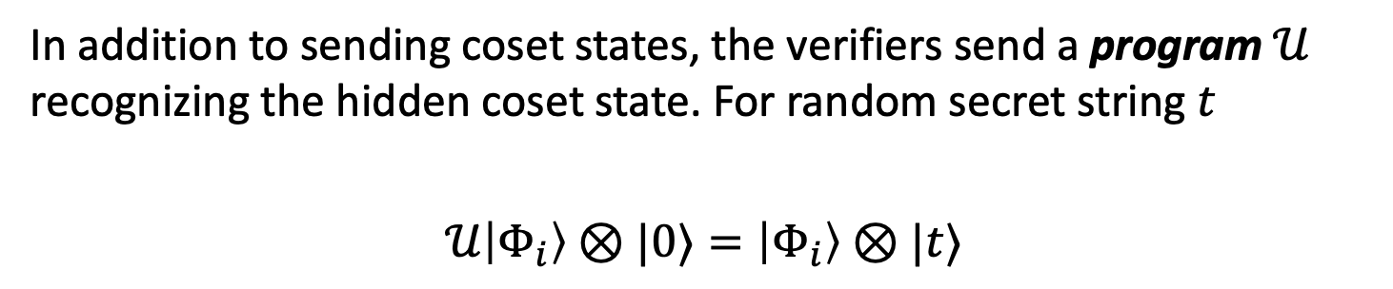
Entanglement Localization Protocol (Simplified)
Verifiers choose random subspace $A≤𝔽_{2}^{n}$ of dim $n/2$, and secret string $s∈𝔽_{2}^{n}$
Maximally entangled state is encoded into $\left|Φ\right\rangle =\sum_{i}{\left|i\right\rangle ⊗|Φ_{i}⟩}$.
In addition to sending coset states, the verifiers send a program $𝒰$ recognizing the hidden coset state. For random secret string $t$
$$𝒰\left|Φ_{i}\right\rangle ⊗|0⟩=\left|Φ_{i}\right\rangle ⊗|t⟩$$
Program enables verification of the coset state, but cannot be used to clone it.
The circuit of the program $𝒰$ is assumed to be sufficiently obfuscated so that it doesn’t reveal any information about the secret subspace $A$ and secret string $s$.

Slide 61
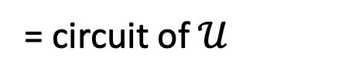
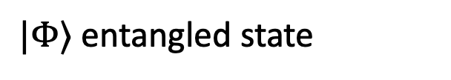
Entanglement Localization Protocol (Simplified)
Time
$$t=2$$
$$t=1$$
$$t=0$$
$|Φ⟩$ entangled state
= circuit of $𝒰$
$$−1$$
$$0$$
$$+1$$

Slide 62

Entanglement Localization Protocol (Simplified)
Time
$$t=2$$
Once prover reconstructs program $𝒰$, it can verify the coset state and output secret string $t$.
$$t=1$$
$$t=0$$
$|Φ⟩$ entangled state
= circuit of $𝒰$
$$−1$$
$$0$$
$$+1$$

Slide 63



Entanglement Localization Protocol (Simplified)
Time
$$t=2$$
$$t$$
$$t$$
Verifiers can check $t$.
$$t=1$$
$$t=0$$
= circuit of $𝒰$
$$−1$$
$$0$$
$$+1$$

Slide 64

Entanglement Localization Protocol (Simplified)
Time
$$t=2$$
Idea: assuming provers query $𝒰$ at most $poly(n)$ times, the coset state must be localized at $L$ to be input to the program $𝒰$.
$$t$$
$$t$$
$$t=1$$
$$t=0$$
Making this idea rigorous takes a lot of work!
$$−1$$
$$0$$
$$+1$$

Slide 65



Functionality Localization
Let $f$ be a secret, complex function (e.g., proprietary LLM).
Again, this is formally expressed as positing the existence of a local extractor map at $L$ that can compute $f$. Furthermore, nobody else can compute $f$.
Verifiers can localize the functionality $f$: if provers succeed, then only the prover at $L$ knows how to compute $f$.
$L$
Theorem (Bartusek, Huang, Orshansky, Y. 2026): For all copy-protectable functions $f$ there exist protocols that localize $f$ in the Ideal Obfuscated Circuits model.

Slide 66
Towards stronger foundations for position-based cryptography
Position-based cryptography inspires new ways of thinking about how to obtaining trust in complex systems, using people’s physical placement as a precious attribute of their identity.
QPV can serve as the primitive base layer for position-based crypto. However, previous formalizations don’t quite capture the idea of “being at a position” in a satisfactory way.
Entanglement and functionality localization can potentially give a more satisfying guarantee that can unlock useful applications of position-based crypto.

Slide 67
Summary

Slide 68
Nonlocal Quantum Computation
Quantum gravity
Quantum Position Verification
Position-based Cryptography
Computational Complexity Theory

Slide 69

NIST experiment
Last month, NIST announced the first quantum position verification experiment.
Prover is ~90m from verifiers.
Challenges arrive in 3ns.
Measurement detection efficiency >81%.

Slide 70
Open questions
Are there are simple QPV protocols that perform Entanglement Localization or Trajectory Verification? Our protocol requires verifiers/provers to use quantum computers.
Can we prove security without assuming Idealized Obfuscation?
We showed how to localize classical computations. Can we localize quantum computations?
What cryptography is enabled by quantum localization?
Thank You!

Slide 71
Future Directions
Cryptography: what are applications of position-based cryptography?
Complexity: use QPV/NLQC as lens on complexity of quantum computation?
Quantum gravity: insights into AdS/CFT correspondence can QPV/NLQC give?
Experiment: make QPV more practical?
Thank You!

