Slide 1
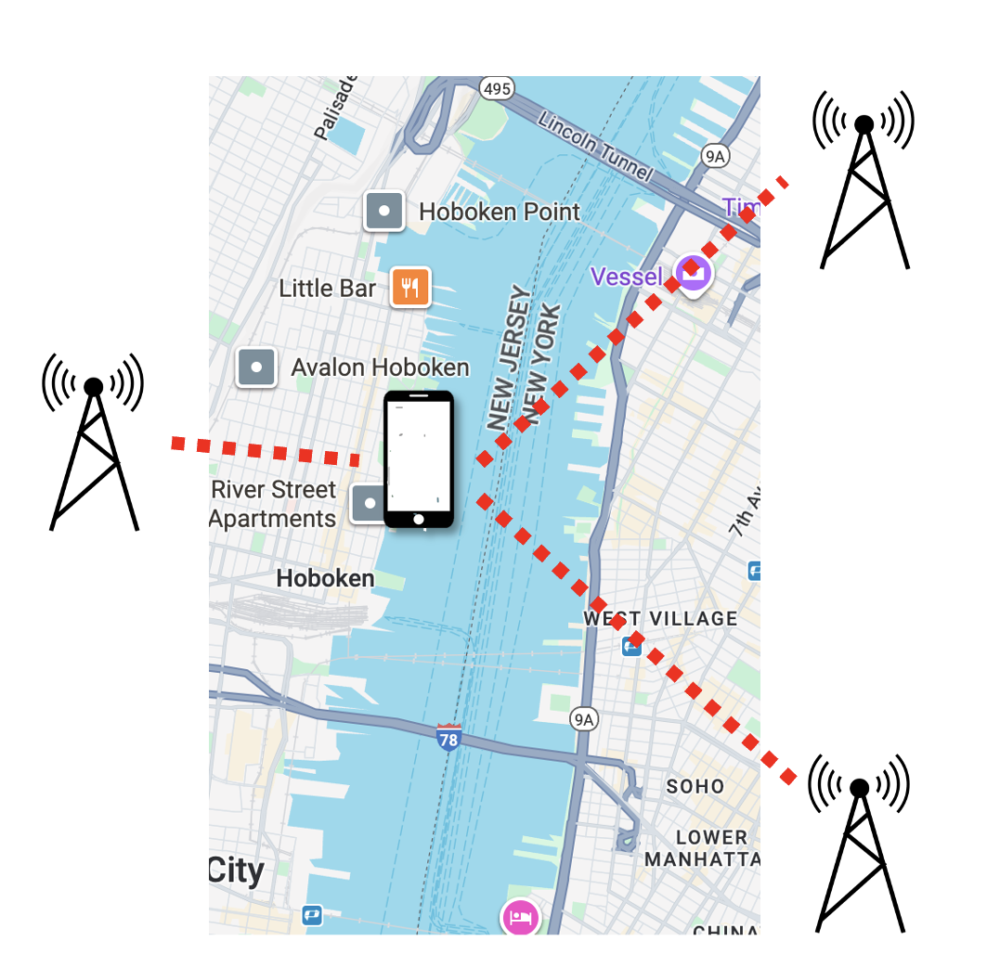
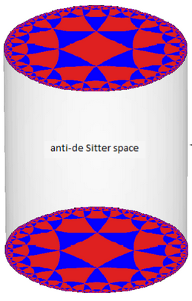
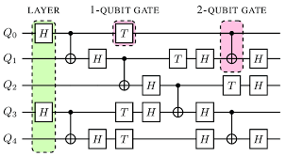
Quantum Position Verification
From Cryptography to Complexity to Quantum Gravity
Henry Yuen
Columbia
Notes:
Hi everyone. Thanks so much for the invitation to speak here – I’ve had a lot of fun the past two days meeting many of you. I work on the theory of quantum computation, usually focusing on complexity theory and cryptography. This talk is going to be about an area that I’ve gotten extremely excited about in the last couple of years, called quantum position verification. QPV opens up new forms of really intriguing cryptography, but also has deep, surprising connections to computer science and theoretical physics.

Slide 2
Can quantum computations be efficiently computed in a distributed fashion?
What does a theory of quantum gravity look like?
Can all polynomial-time computable problems be solved using logarithmic memory?
Is it possible to remotely verify someone’s location?
Notes:
I’m going to

Slide 3
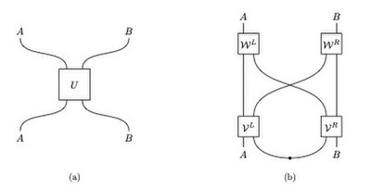

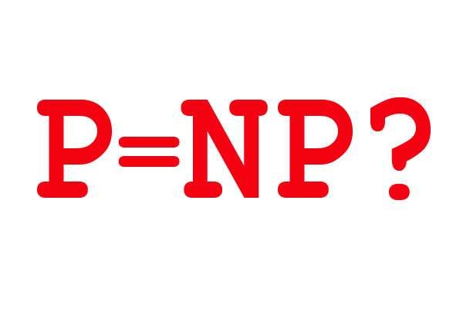
Nonlocal Quantum Computation
Quantum gravity
Position-based Cryptography
Computational Complexity Theory

Slide 4
Nonlocal Quantum Computation
Quantum gravity
Quantum Position Verification
Position-based Cryptography
Computational Complexity Theory

Slide 5
Nonlocal Quantum Computation
Quantum gravity
Quantum Position Verification
Position-based Cryptography
Computational Complexity Theory

Slide 6
Position-based cryptography
Is it possible to remotely verify someone’s – or something’s – location?
Example scenarios:
Export-control enforcement (e.g., GPU can only be run in country X)
Authorizing payment upon delivery
Verifying location of request (e.g., pizza order was placed in the claimed house)
In position-based cryptography, whether or not a user is authorized to do something depends on their physical location.

Slide 7
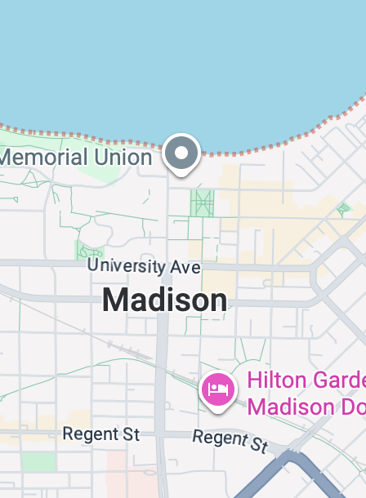
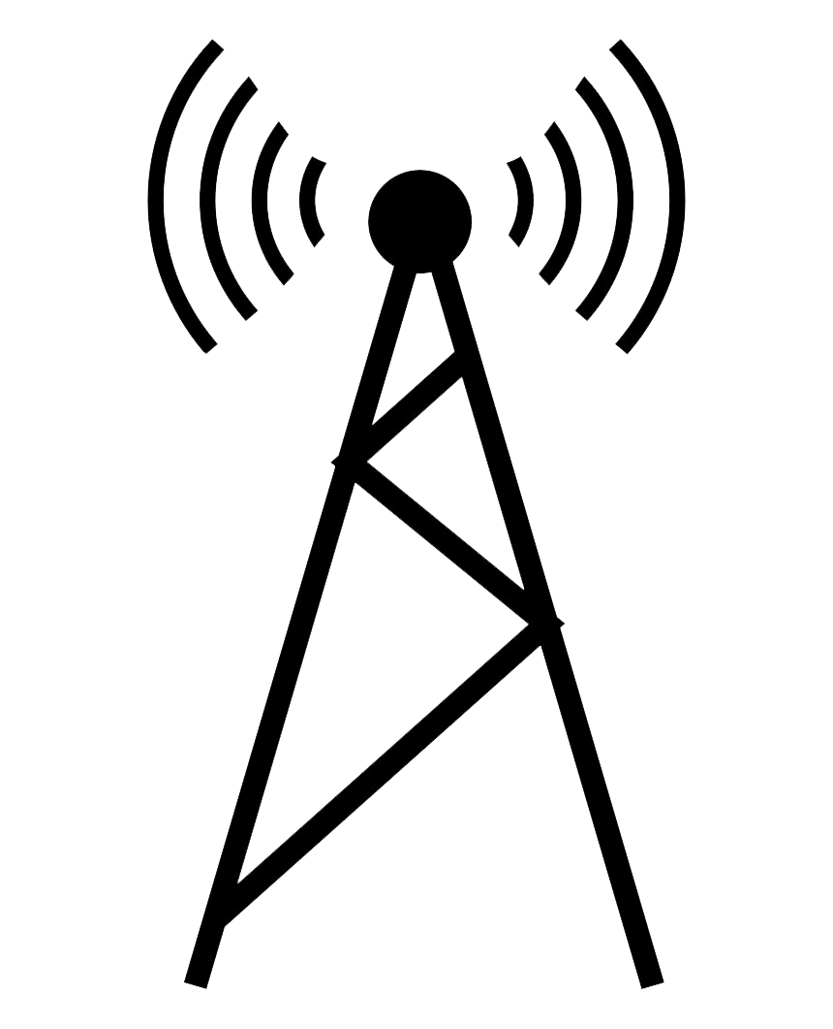

Position verification
A natural idea: multiple verifiers can check the physical location of a prover by sending signals to the purported location, receiving signals back, and checking timing constraints.
Provers are untrusted.
Verifiers want to guard against spoofing.

Slide 8
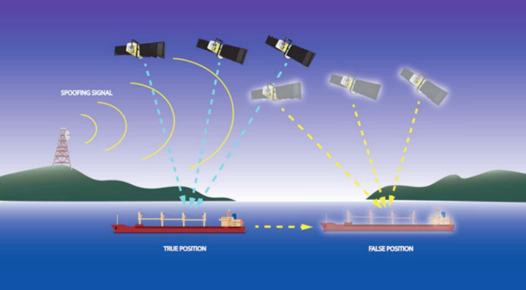
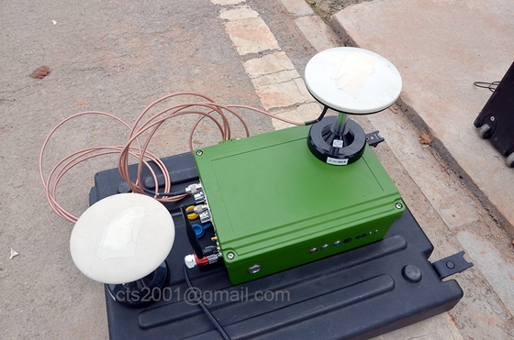
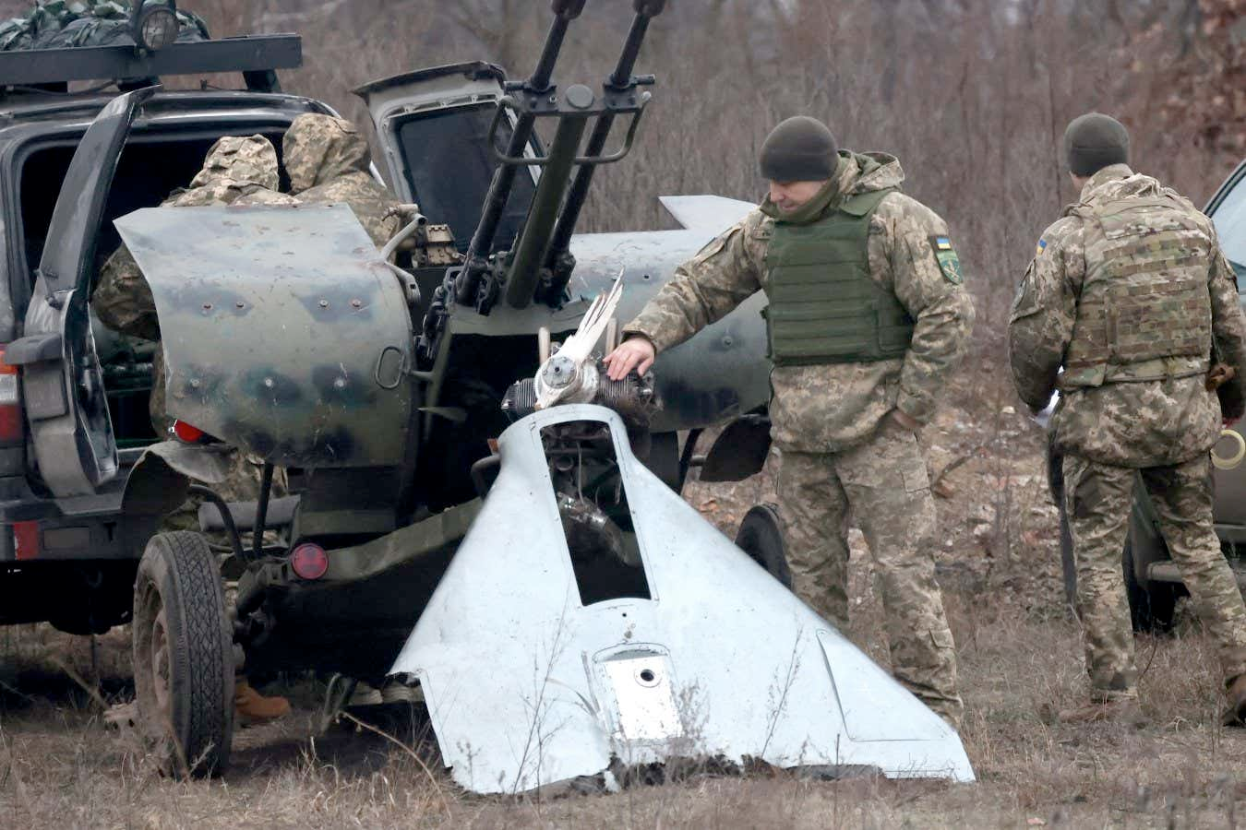
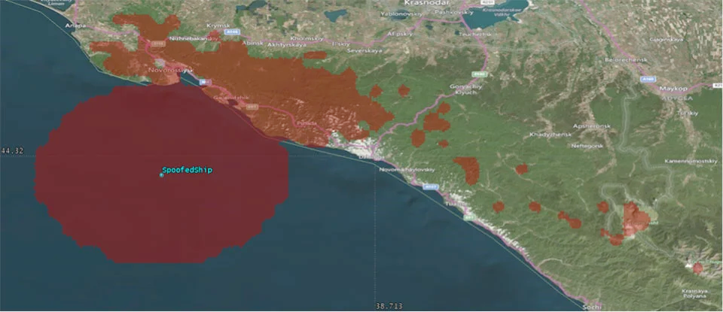
Position information is fragile
Cheap GPS
spoofer
GPS spoofing in Ukraine-Russia war
Maritime GPS spoofing in Black Sea

Slide 9







Example: 1D position verification
Time
$$t=2$$
$$t=1$$
$$t=0$$
$$−1$$
$$0$$
$$+1$$
Position $P$

Slide 10
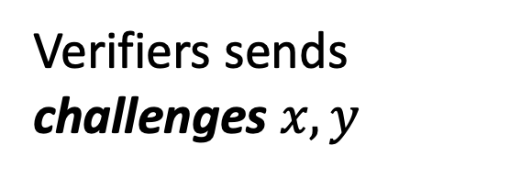


Example: 1D position verification
Time
Goal: verify prover is in position 0.
$$t=2$$
Verifiers sends
challenges $x,y$
$$t=1$$
Prover
$$y$$
$$x$$
$$t=0$$
Position
$$0$$
$$−1$$
$$+1$$

Slide 11

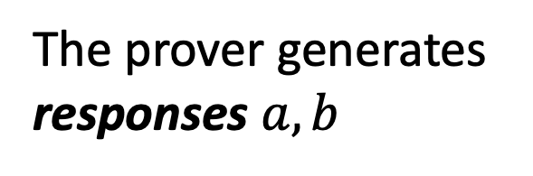

Example: 1D position verification
Time
Goal: verify prover is in position 0.
$$t=2$$
$$a$$
$$b$$
Verifiers sends
challenges $x,y$
$$t=1$$
Prover
$$y$$
$$x$$
The prover generates responses $a,b$
$$t=0$$
Position
$$0$$
$$−1$$
$$+1$$

Slide 12
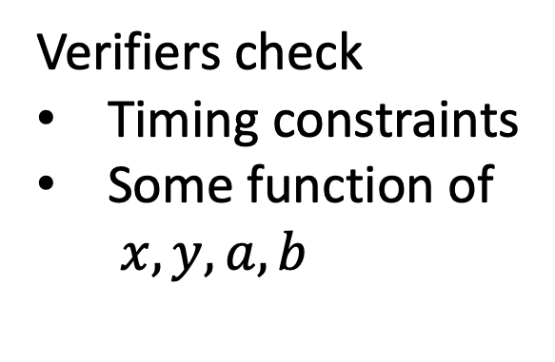
Example: 1D position verification
Time
Verifiers check
Timing constraints
Some function of $x,y,a,b$
$$t=2$$
$$a$$
$$b$$
$$t=1$$
Prover
$$y$$
$$x$$
$$t=0$$
Position
$$0$$
$$−1$$
$$+1$$

Slide 13
Example: 1D position verification
Time
Verifiers check
Timing constraints
Some function of $x,y,a,b$
$$t=2$$
$$a$$
$$b$$
$$t=1$$
Hope: only way to generate good, timely responses is to be in correct position.
Prover
$$y$$
$$x$$
$$t=0$$
Position
$$0$$
$$−1$$
$$+1$$

Slide 14



Example: 1D position verification
Bad protocol: Both verifiers send identical challenges, and prover repeats them back.
Time
$$t=2$$
$$x$$
$$x$$
$$t=1$$
Prover
$$x$$
$$x$$
$$t=0$$
Position
$$0$$
$$−1$$
$$+1$$

Slide 15
Spoofing attacks
Bad protocol: Both verifiers send identical challenges, and prover repeats them back.
Time
$$t=2$$
$$t=1$$
$$x$$
$$x$$
Spoofer
Spoofer
$$t=0$$
Not in position 0!
Position
$$0$$
$$−1$$
$$+1$$

Slide 16
Spoofing attacks
Bad protocol: Both verifiers send identical challenges, and prover repeats them back.
Time
$$t=2$$
$$t=1$$
(wait)
Cheating strategy: Spoofers can wait before sending responses.
$$x$$
$$x$$
Spoofer
Spoofer
$$t=0$$
Position
$$0$$
$$−1$$
$$+1$$

Slide 17
Spoofing attacks
Bad protocol: Both verifiers send identical challenges, and prover repeats them back.
Time
$$t=2$$
$$x$$
$$x$$
$$t=1$$
(wait)
Cheating strategy: Spoofers can wait before sending responses.
$$x$$
$$x$$
Spoofer
Spoofer
$$t=0$$
Position
$$0$$
$$−1$$
$$+1$$

Slide 18
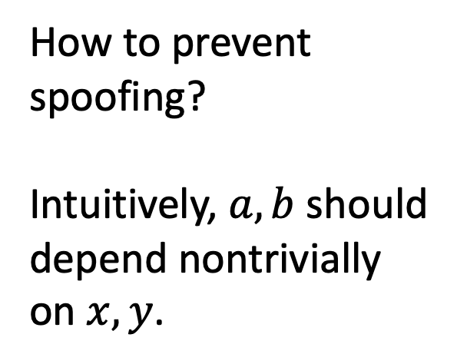
Spoofing attacks
Time
How to prevent spoofing?
Intuitively, $a,b$ should depend nontrivially on $x,y$.
$$t=2$$
$$a$$
$$b$$
$$t=1$$
Prover
$$y$$
$$x$$
$$t=0$$
Position
$$0$$
$$−1$$
$$+1$$

Slide 19
Classical impossibility
Theorem: Any position verification protocol using only classical resources can be spoofed.
Time
$$t=2$$
$$a$$
$$b$$
(Kent-Munro-Spiller ’11, Buhrman, et al. ‘10)
$$t=1$$
Prover
$$y$$
$$x$$
$$t=0$$
Position
$$0$$
$$−1$$
$$+1$$

Slide 20
Classical impossibility
Theorem: Any position verification protocol using only classical resources can be spoofed.
Time
$$t=2$$
(Kent-Munro-Spiller ’11, Buhrman, et al. ‘10)
$$t=1$$
$$x$$
$$y$$
Spoofer
Spoofer
$$t=0$$
Position
$$0$$
$$−1$$
$$+1$$

Slide 21
Classical impossibility
Theorem: Any position verification protocol using only classical resources can be spoofed.
Time
$$t=2$$
(Kent-Munro-Spiller ’11, Buhrman, et al. ‘10)
$$t=1$$
This is because classical information can be copied and both spoofers can pretend to be the honest prover.
$$x$$
$$y$$
Spoofer
Spoofer
$$t=0$$
Position
$$0$$
$$−1$$
$$+1$$

Slide 22
Classical impossibility
Theorem: Any position verification protocol using only classical resources can be spoofed.
Time
$$t=2$$
$$a$$
$$b$$
(Kent-Munro-Spiller ’11, Buhrman, et al. ‘10)
$$t=1$$
This is because classical information can be copied and both spoofers can pretend to be the honest prover.
$$x$$
$$y$$
Spoofer
Spoofer
$$t=0$$
Position
$$0$$
$$−1$$
$$+1$$

Slide 23
Classical impossibility
Time
$$t=2$$
What if we used quantum resources?
🤔
$$a$$
$$b$$
$$t=1$$
We can leverage the No-Cloning Principle
of quantum physics…
$$x$$
$$y$$
Spoofer
Spoofer
$$t=0$$
Position
$$0$$
$$−1$$
$$+1$$

Slide 24
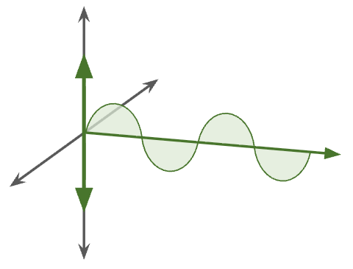
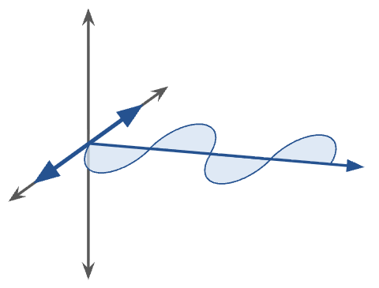
Quantum Information Basics
A qubit is a quantum analogue of a classical bit.
The polarization of light can be used as a qubit.
Horizontal polarization
Graphics and idea courtesy of Barak Nehoran, postdoc

Slide 25
Quantum Information Basics
A qubit is a quantum analogue of a classical bit.
The polarization of light can be used as a qubit.
Vertical polarization
Graphics and idea courtesy of Barak Nehoran, postdoc

Slide 26
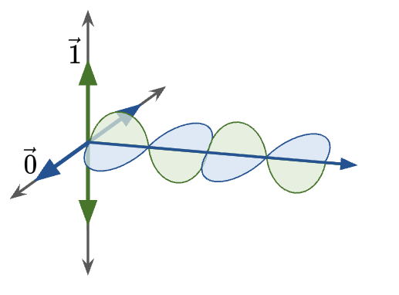
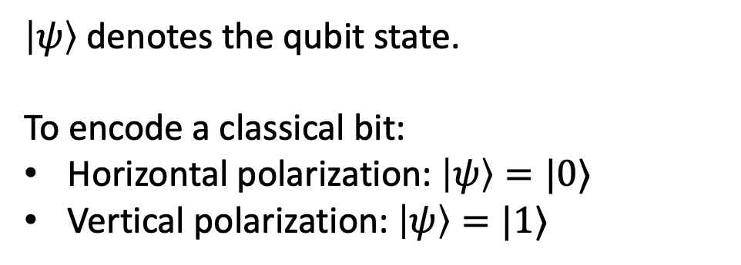
Quantum Information Basics
A qubit is a quantum analogue of a classical bit.
The polarization of light can be used as a qubit.
$\left|ψ\right\rangle$ denotes the qubit state.
To encode a classical bit:
Horizontal polarization: $\left|ψ\right\rangle =|0⟩$
Vertical polarization: $\left|ψ\right\rangle =|1⟩$
Graphics and idea courtesy of Barak Nehoran, postdoc

Slide 27
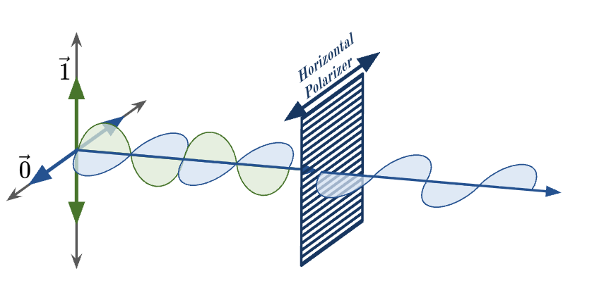
Quantum Information Basics
A qubit is a quantum analogue of a classical bit.
The polarization of light can be used as a qubit.
Using a horizontal filter, can measure whether light is horizontally polarized.
Graphics and idea courtesy of Barak Nehoran, postdoc

Slide 28
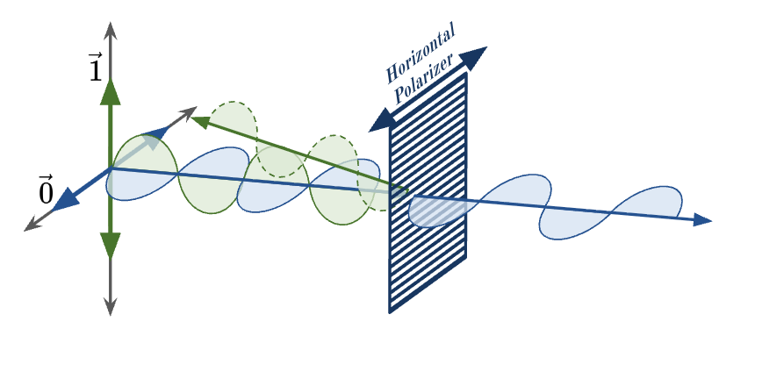
Quantum Information Basics
A qubit is a quantum analogue of a classical bit.
The polarization of light can be used as a qubit.
Using a horizontal filter, can measure whether light is horizontally polarized.
Graphics and idea courtesy of Barak Nehoran, postdoc

Slide 29
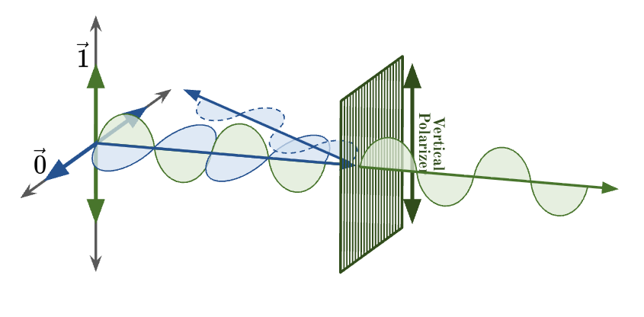
Quantum Information Basics
A qubit is a quantum analogue of a classical bit.
The polarization of light can be used as a qubit.
Using a vertical filter, can measure whether light is vertically polarized.
Graphics and idea courtesy of Barak Nehoran, postdoc

Slide 30
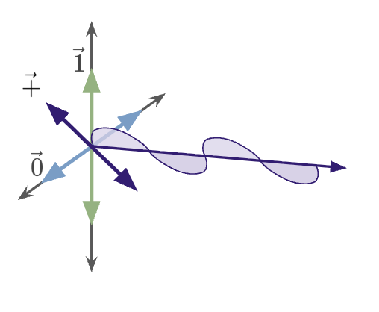
Quantum Information Basics
A qubit is a quantum analogue of a classical bit.
The polarization of light can be used as a qubit.
Light can be diagonally polarized: a superposition of horizontal and vertical polarization.
$$\left|+\right\rangle =\cos\left({45}^{°}\right)\left|0\right\rangle +\sin\left({45}^{°}\right)|1⟩$$
Graphics and idea courtesy of Barak Nehoran, postdoc

Slide 31
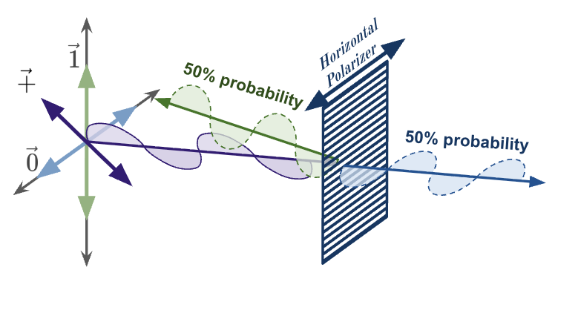
Quantum Information Basics
A qubit is a quantum analogue of a classical bit.
The polarization of light can be used as a qubit.
Measuring diagonally polarized light with horizontal/vertical filters yields probabilistic outcome.
Graphics and idea courtesy of Barak Nehoran, postdoc

Slide 32
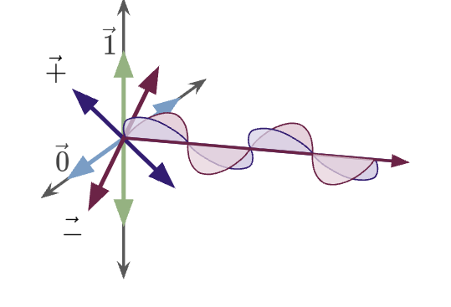
Quantum Information Basics
A qubit is a quantum analogue of a classical bit.
The polarization of light can be used as a qubit.
There are different kinds of diagonally polarized light.
$$\left|−\right\rangle =\cos\left({45}^{°}\right)\left|0\right\rangle −\sin\left({45}^{°}\right)|1⟩$$
Graphics and idea courtesy of Barak Nehoran, postdoc

Slide 33
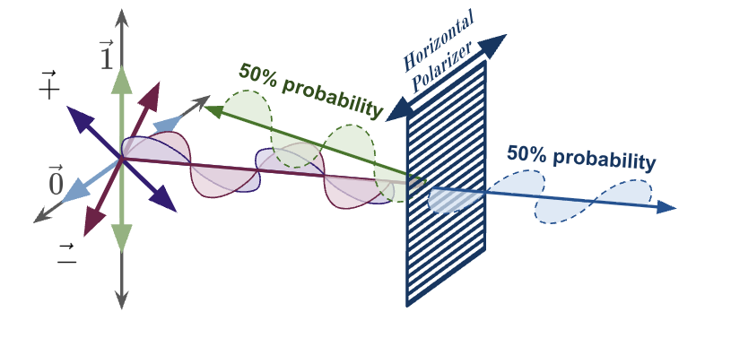
Quantum Information Basics
A qubit is a quantum analogue of a classical bit.
The polarization of light can be used as a qubit.
Horizontal/vertical filters do not distinguish between different diagonal states.
Graphics and idea courtesy of Barak Nehoran, postdoc

Slide 34
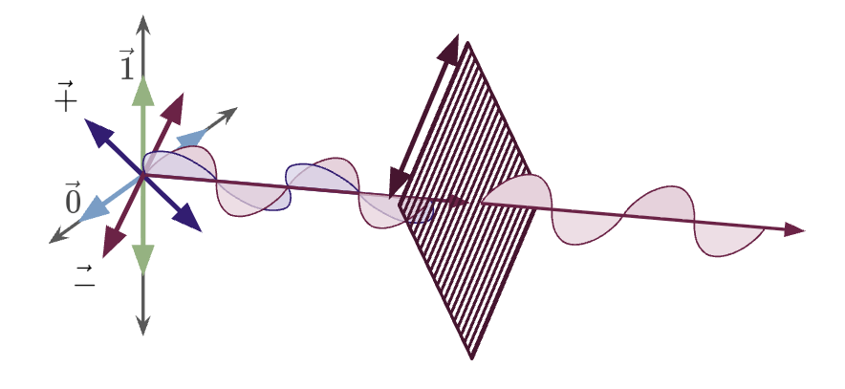
Quantum Information Basics
A qubit is a quantum analogue of a classical bit.
The polarization of light can be used as a qubit.
But diagonal filters can.
Graphics and idea courtesy of Barak Nehoran, postdoc

Slide 35
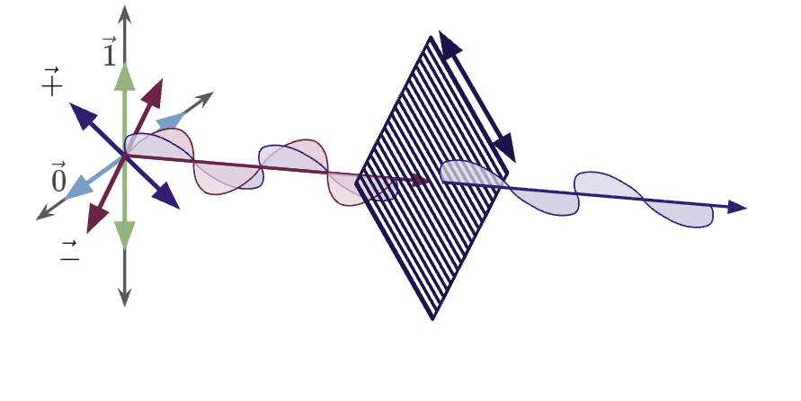
Quantum Information Basics
A qubit is a quantum analogue of a classical bit.
The polarization of light can be used as a qubit.
But diagonal filters can.
Graphics and idea courtesy of Barak Nehoran, postdoc

Slide 36
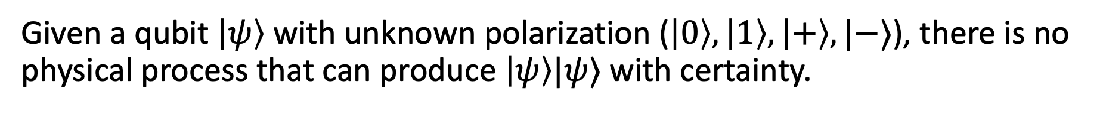
Quantum Information Basics
No-Cloning Theorem: quantum information cannot be copied (in general).
Given a qubit $\left|ψ\right\rangle$ with unknown polarization ($\left|0\right\rangle ,\left|1\right\rangle ,\left|+\right\rangle ,|−⟩$), there is no physical process that can produce $\left|ψ\right\rangle |ψ⟩$ with certainty.
Intuitively, cloning a qubit allows you to measure its state with certainty. On the other hand, given a qubit with unknown polarization, measuring it in the wrong basis will destroy its state.

Slide 37

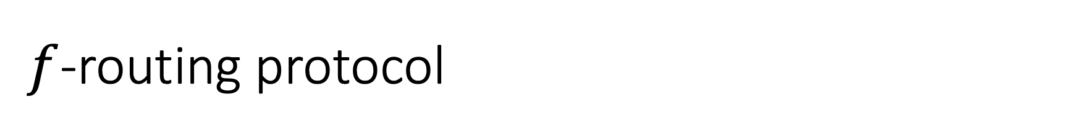
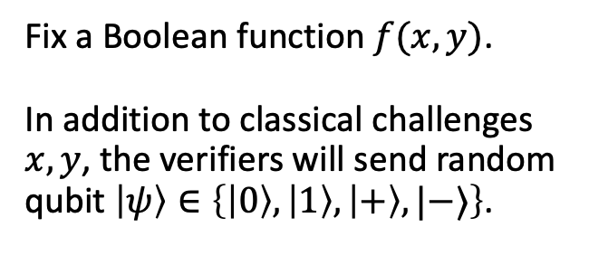
$f$-routing protocol
Time
$$t=2$$
Fix a Boolean function $f(x,y)$. In addition to classical challenges $x,y$, the verifiers will send random qubit $\left|ψ\right\rangle ∈\left\{\left|0\right\rangle ,\left|1\right\rangle ,\left|+\right\rangle ,|−⟩\right\}$.
$$t=1$$
$$x$$
Honest
Prover
$$y,\left|ψ\right\rangle$$
$$t=0$$
$$−1$$
$$0$$
$$+1$$

Slide 38


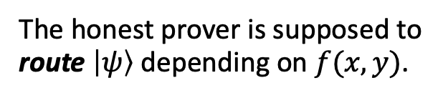
$f$-routing protocol
Time
$$t=2$$
$$|ψ⟩$$
Fix a Boolean function $f(x,y)$. In addition to classical challenges $x,y$, the verifiers will send random qubit $\left|ψ\right\rangle ∈\left\{\left|0\right\rangle ,\left|1\right\rangle ,\left|+\right\rangle ,|−⟩\right\}$.
$$t=1$$
$$f\left(x,y\right)=0$$
$$x$$
Honest
Prover
$$y,\left|ψ\right\rangle$$
The honest prover is supposed to route $\left|ψ\right\rangle$ depending on $f(x,y)$.
$$t=0$$
$$−1$$
$$0$$
$$+1$$

Slide 39


$f$-routing protocol
Time
$$t=2$$
$$\left|ψ\right\rangle$$
Fix a Boolean function $f(x,y)$. In addition to classical challenges $x,y$, the verifiers will send random qubit $\left|ψ\right\rangle ∈\left\{\left|0\right\rangle ,\left|1\right\rangle ,\left|+\right\rangle ,|−⟩\right\}$.
$$t=1$$
$$f\left(x,y\right)=1$$
$$x$$
Honest
Prover
$$y,\left|ψ\right\rangle$$
The honest prover is supposed to route $\left|ψ\right\rangle$ depending on $f(x,y)$.
$$t=0$$
$$−1$$
$$0$$
$$+1$$

Slide 40
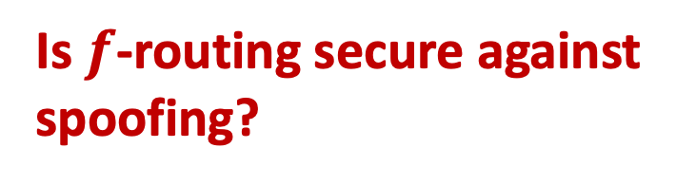
$f$-routing protocol
Time
$$t=2$$
Is $f$-routing secure against spoofing?
$$t=1$$
$$x$$
$$y,\left|ψ\right\rangle$$
Classical attack no longer works!
$$t=0$$
$$−1$$
$$0$$
$$+1$$

Slide 41
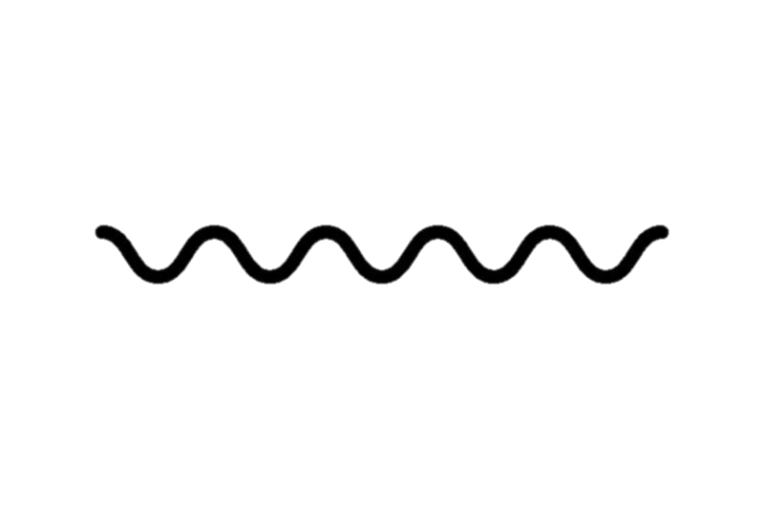

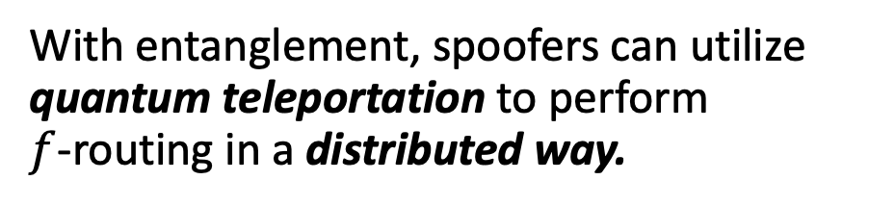

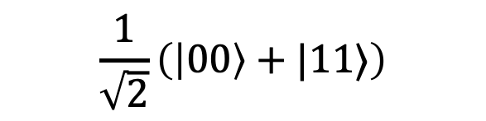
Entanglement attacks on QPV
Spoofers can do more than keep or forward qubits. Quantum entanglement gives rise to a richer, nontrivial set of spoofing strategies.
$$|ψ⟩$$
Teleportation corrections
With entanglement, spoofers can utilize quantum teleportation to perform $f$-routing in a distributed way.
Time
Teleportation measurement
Quantum teleportation is a protocol for transferring qubits using classical communication and pre-shared entanglement.
$$\frac{1}{\sqrt{2}}\left(\left|00\right\rangle +|11⟩\right)$$
$$|ψ⟩$$

Slide 42
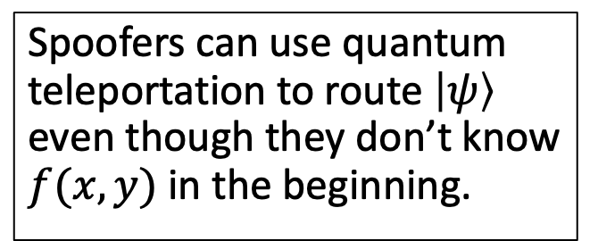


Entanglement attacks on QPV
Spoofers can use quantum teleportation to route $\left|ψ\right\rangle$ even though they don’t know $f(x,y)$ in the beginning.
$$x$$
$$y,\left|ψ\right\rangle$$

Slide 43
Entanglement attacks on QPV
Spoofers can use quantum teleportation to route $\left|ψ\right\rangle$ even though they don’t know $f(x,y)$ in the beginning.
$$x$$
$$y,\left|ψ\right\rangle$$

Slide 44
Entanglement attacks on QPV
Theorem: $f$-routing can be spoofed using ${\sim 2}^{\sqrt{n\log{n} }}$ qubits of entanglement for all $n$-bit Boolean functions $f$.
(Allerstorfer, et al. 2024)
This attack is highly nontrivial; it is a complicated teleportation-based attack that uses a breakthrough in classical cryptography about secure multiparty computation (Liu, Vaikuntanathan 2017)
Given enough resources, adversaries can spoof any $f$-routing position verification protocol.

Slide 45
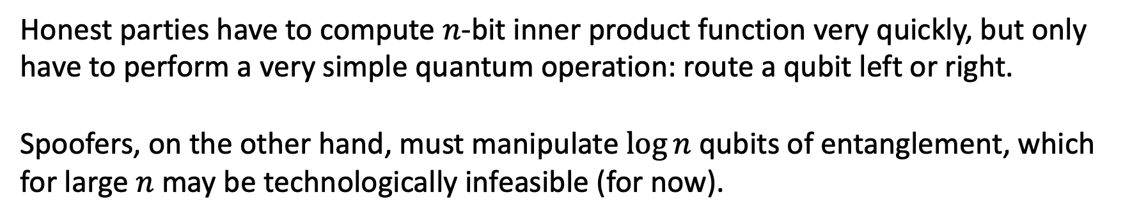
Secure QPV
Theorem: When $f$ computes $n$-bit inner product function, spoofing $f$-routing requires at least $\sim \log{n}$ qubits of entanglement.
(Bluhm, Christandl, Speelman 2021)
Honest parties have to compute $n$-bit inner product function very quickly, but only have to perform a very simple quantum operation: route a qubit left or right.
Spoofers, on the other hand, must manipulate $\log{n}$ qubits of entanglement, which for large $n$ may be technologically infeasible (for now).

Slide 46
Entanglement attacks on QPV
Open question: Is there a function $f$such that spoofing $f$-routing requires exponentially many qubits of pre-shared entanglement?
This question is immensely difficult, because of unexpected and deep connections to complexity theory and cryptography.

Slide 47
Nonlocal Quantum Computation
Quantum gravity
Quantum Position Verification
Position-based Cryptography
Computational Complexity Theory

Slide 48
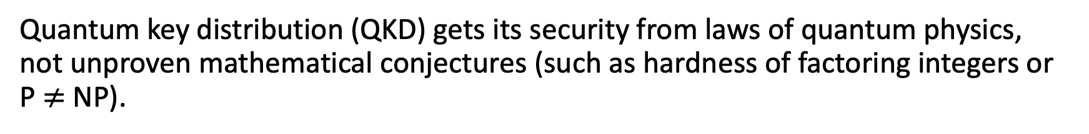
Connections with complexity and cryptography
Quantum key distribution (QKD) gets its security from laws of quantum physics, not unproven mathematical conjectures (such as hardness of factoring integers or P $≠$NP).
Though QPV resembles QKD, it has deeper and unavoidable connections to the theory of computation.
Theorem: If $f$ can be computed using $S$ bits of memory on a classical computer, then $f$-routing can be spoofed using $exp⁡(S)$ qubits of entanglement.
(Allerstorfer, et al. 2024)

Slide 49
Connections with complexity and cryptography
Corollary: If $f$ is computable in polynomial time, but spoofing $f$-routing requires more than polynomial qubits of entanglement, then P $≠$L.
P = computable in polynomial time. L = computable in logarithmic memory.
P vs. L is one of the hardest open problems in computational complexity! Similar in flavor to P $≠$ NP: we don’t have good approaches to solving this problem.
🤔
What does security of quantum position verification have anything to do with the space complexity of functions on classical computers?!

Slide 50
Nonlocal Quantum Computation
Quantum gravity
Quantum Position Verification
Position-based Cryptography
Computational Complexity Theory

Slide 51
Nonlocal Quantum Computation
Open question: Is there any QPV protocol (not just $f$-routing) that requires a lot of resources in order to spoof?
Theorem: Assuming some unproven conjectures in Banach space theory, there are QPV protocols requiring spoofers to use exponential entanglement.
(Junge, et al. 2021)
The security of QPV is equivalent to nonlocally splitting up quantum computation.

Slide 52
Nonlocal Quantum Computation
When can this…
quantum process
…be implemented non-locally like this?
communication
entanglement
e.g. computation, scattering process, Hamiltonian evolution…

Slide 53
Nonlocal Quantum Computation
Implication: the security of any position verification scheme must assume that spoofers have limited entanglement.
Theorem: Every quantum process on $n$ qubits can be implemented nonlocally using $\sim exp⁡(n)$ qubits of entanglement.
(Beigi-Koenig 2011)

Slide 54
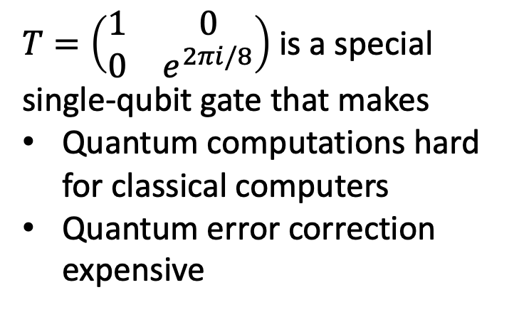
Nonlocal Quantum Computation
$T=\left(\begin{matrix}1 & 0 \\ 0 & e^{2πi/8}\end{matrix}\right)$ is a special single-qubit gate that makes
Quantum computations hard for classical computers
Quantum error correction expensive
Theorem: Every quantum circuit whose $T$-gate count is $k$ can be implemented nonlocally using $\sim 2^{k}$ qubits of entanglement.
(Speelman 2015)

Slide 55
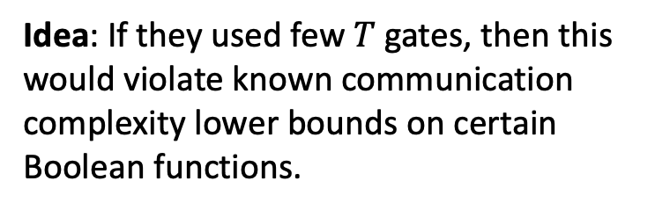
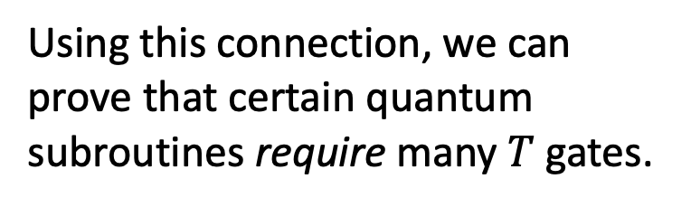
Nonlocal Quantum Computation
Using this connection, we can prove that certain quantum subroutines require many $T$ gates.
Idea: If they used few $T$ gates, then this would violate known communication complexity lower bounds on certain Boolean functions.
Theorem: The $n$-qubit Toffoli gate and the $n$-qubit multiplexer unitary requires $\sim n$ many $T$ gates to implement, even approximately.
(Girish, May, Parham, Y. STOC 2026)

Slide 56
Nonlocal Quantum Computation
Quantum gravity
Quantum Position Verification
Position-based Cryptography
Computational Complexity Theory

Slide 57
Holography and QPV
Holographic principle is conjectured property of theories of quantum gravity that the description of volume of spacetime can be encoded onto boundary.
Juan Maldacena introduced AdS/CFT correspondence as a “toy” model of holographic principle where gravity theory in bulk has equivalent description as pure quantum field theory on boundary.

Slide 58
Holography and QPV
In 2019, Alex May drew a connection between holography and QPV. According to AdS/CFT correspondence, every scattering process in the bulk has an equivalent description on the boundary as a NLQC
Thus, if there exists NLQC requiring exponential entanglement, this would contradict some physics arguments that the entanglement on boundary scales polynomially with the complexity of the scattering process.

Slide 59
Nonlocal Quantum Computation
Quantum gravity
Quantum Position Verification
Position-based Cryptography
Computational Complexity Theory

Slide 60
Position-based cryptography
Computer security and cryptography is about knowing who to trust/distrust based on their identity. Identities are determined by knowledge of some secret information, like a password or a private key.
Position-based cryptography is a different paradigm where identities are determined by physical location.
Bank teller is trusted because they are behind a bullet-proof window, not because they showed us their credentials.
Nuclear missile launch should be trusted because the order came from the White House.

Slide 61
Position-based cryptography
Quantum position verification is a tantalizing starting point for this paradigm. Can we do more?
Scenario: QPV allows a person to prove their location in the moment. Can they prove their location in the past to a judge?
E.g., “I was not at the murder scene the night of January 1, 2007”
Scenario: Can a person prove some fact about their location without fully revealing everything about it?
E.g., “I am either in location A or B, but you shouldn’t know which.”

Slide 62
Zero-knowledge position verification
In cryptography, zero-knowledge proofs are protocols for convincing someone that a statement is true, without revealing nothing else about the statement.
E.g., with a zero-knowledge proof you can convince someone that the Riemann Hypothesis is true, but the listener will learn nothing else about the proof aside from the fact that it exists.
Zero-knowledge Position Verification: A user can selectively reveal some information about their location, while keeping the rest private.

Slide 63
Zero-knowledge position verification
Time
Zero-knowledge Position Verification: 1. The verifiers continuously run QPV with the prover.
2. The prover sends a continuous stream of encrypted responses.
3. Later, the prover can execute a cryptographic zero-knowledge proof to convince the verifiers of some statement about its past location history, while revealing zero extra info.
(Girish, Gluch, Goldwasser, Malkin, Orshansky, Y. 2025)
Position

Slide 64
Zero-knowledge position verification
Time
Zero-knowledge Position Verification: 1. The verifiers continuously run QPV with the prover.
2. The prover sends a continuous stream of encrypted responses.
3. Later, the prover can execute a cryptographic zero-knowledge proof to convince the verifiers of some statement about its past location history, while revealing zero extra info.
(Girish, Gluch, Goldwasser, Malkin, Orshansky, Y. 2025)
Position

Slide 65
Summary and Outlook

Slide 66
Nonlocal Quantum Computation
Quantum gravity
Quantum Position Verification
Position-based Cryptography
Computational Complexity Theory

Slide 67
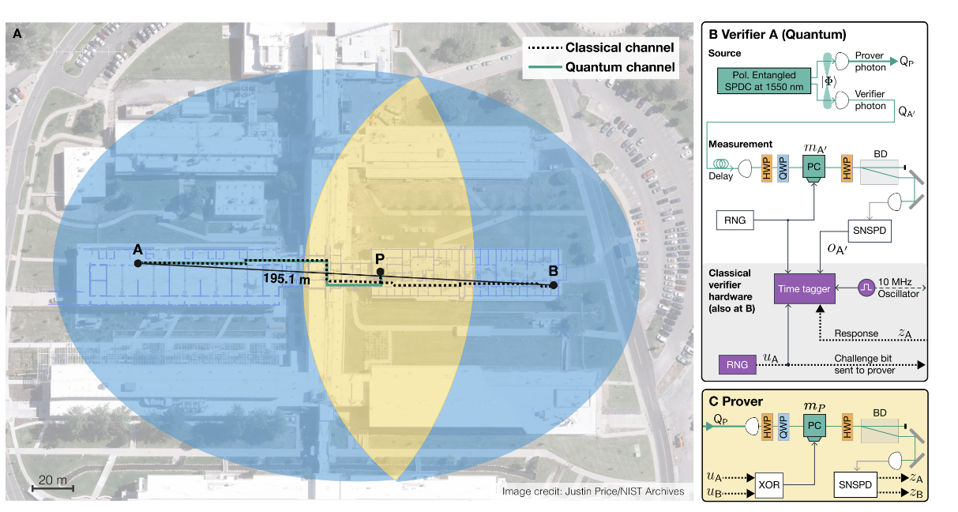
NIST experiment
Last month, NIST announced the first quantum position verification experiment.
Prover is ~90m from verifiers.
Challenges arrive in 3ns.
Measurement detection efficiency >81%.

Slide 68
Future Directions
Cryptography: what are applications of position-based cryptography?
Complexity: use QPV/NLQC as lens on complexity of quantum computation?
Quantum gravity: insights into AdS/CFT correspondence can QPV/NLQC give?
Experiment: demonstrate QPV in real life?
Thank You!

Slide 69
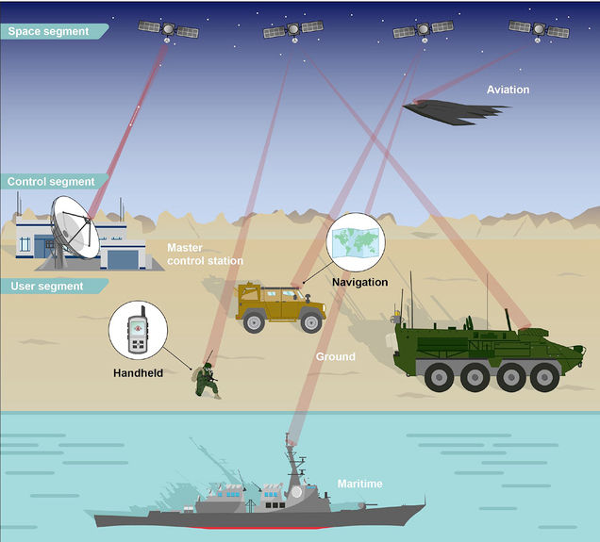
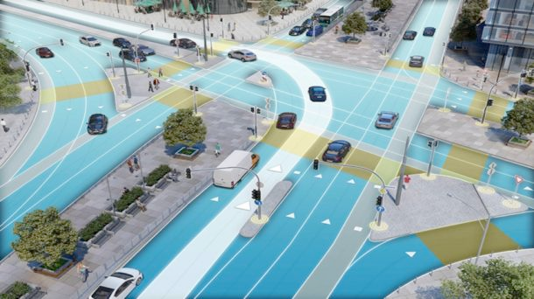
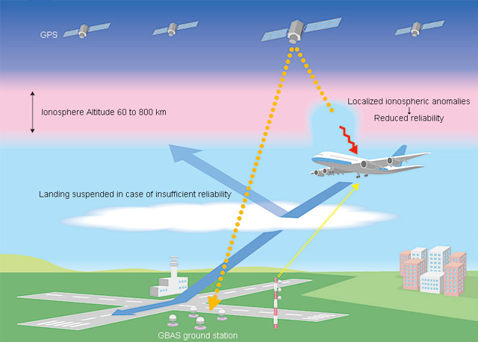
Position information is critical
Complex operations in the physical world rely on trusted positioning.
Autonomous vehicles
Commercial aviation
Defense
Current backbone: GPS and other global navigation satellite systems

Slide 70
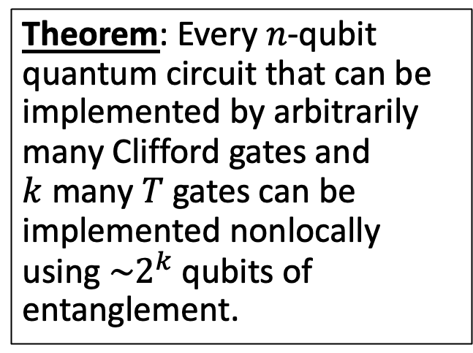
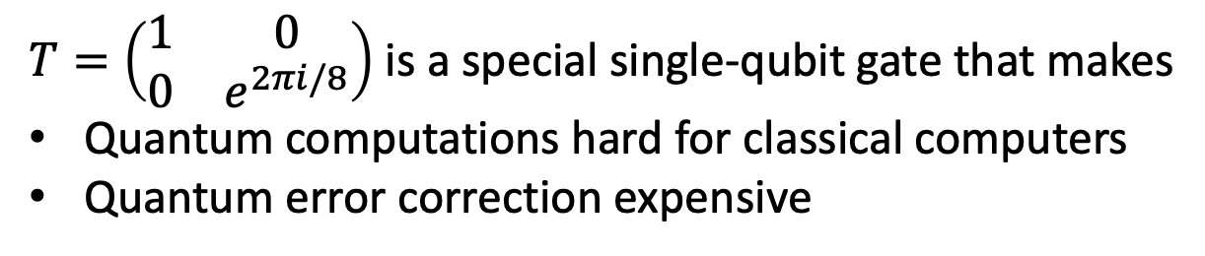
Nonlocal Quantum Computation
Theorem: Every $n$-qubit quantum circuit that can be implemented by arbitrarily many Clifford gates and $k$ many $T$ gates can be implemented nonlocally using $\sim 2^{k}$ qubits of entanglement.
(Speelman 2015)
$T=\left(\begin{matrix}1 & 0 \\ 0 & e^{2πi/8}\end{matrix}\right)$ is a special single-qubit gate that makes
Quantum computations hard for classical computers
Quantum error correction expensive

Slide 71
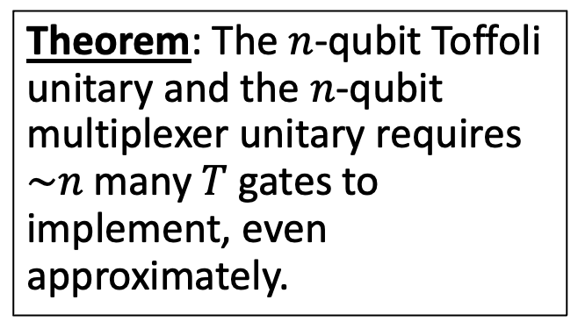
From NLQC to Quantum Circuit Complexity
Using this connection, we can prove that certain quantum subroutines require many $T$ gates.
Theorem: The $n$-qubit Toffoli unitary and the $n$-qubit multiplexer unitary requires $\sim n$ many $T$ gates to implement, even approximately.
Idea: Speelman’s NLQC for Toffoli/multiplexer yields efficient classical communication protocol for classical Boolean functions, which are well studied in theoretical computer science.
(Girish, May, Parham, Y. 2025)

Slide 72
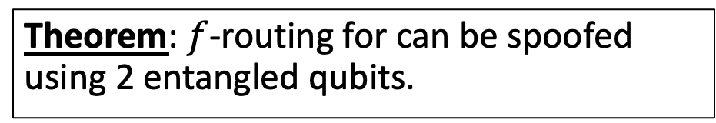
Entanglement attacks on QPV
Spoofers can do more than keep or forward qubits. Quantum entanglement gives rise to a richer, nontrivial set of spoofing strategies.
$$|ψ⟩$$
Teleportation corrections
With entanglement, spoofers can utilize quantum teleportation to perform $f$-routing in a distributed way.
Time
Teleportation measurement
Theorem: $f$-routing for can be spoofed using 2 entangled qubits.
$$\frac{1}{\sqrt{2}}\left(\left|00\right\rangle +|11⟩\right)$$
$$|ψ⟩$$
(Kent-Munro-Spiller ’11, Lau-Lo ’11)

Slide 73

Classical impossibility
Time
$$t=2$$
Suppose the protocol only used classical resources.
Theorem: every classical position verification protocol can be spoofed by colluding provers. This is because challenges can always be copied and both provers can perform the same operation $Q$.
$$t=1$$
$$x$$
$$y$$
Spoofer
Spoofer
(Kent-Munro-Spiller ’11, Buhrman, et al. ‘10)
$$t=0$$
Position
$$0$$
$$−1$$
$$+1$$

Slide 74
Classical impossibility
Time
$$t=2$$
Suppose the protocol only used classical resources.
Theorem: every classical position verification protocol can be spoofed by colluding provers. This is because challenges can always be copied and both provers can perform the same operation $Q$.
$$t=1$$
$$x$$
$$y$$
Spoofer
Spoofer
(Kent-Munro-Spiller ’11, Buhrman, et al. ‘10)
$$t=0$$
Position
$$0$$
$$−1$$
$$+1$$

Slide 75
Classical impossibility
Time
$$t=2$$
Suppose the protocol only used classical resources.
$$a$$
$$b$$
Theorem: every classical position verification protocol can be spoofed by colluding provers. This is because challenges can always be copied and both provers can perform the same operation $Q$.
$$t=1$$
$$x$$
$$y$$
Spoofer
Spoofer
(Kent-Munro-Spiller ’11, Buhrman, et al. ‘10)
$$t=0$$
Position
$$0$$
$$−1$$
$$+1$$

Slide 76



Quantum position verification
$f$-BB84:
Verifiers send random BB84 state $|ψ⟩$. Honest prover is supposed to identify the state by computing $f\left(x,y\right)$ and measuring in the right basis.
Time
$$t=2$$
$$b$$
$$b$$
$$t=1$$
$$x$$
Honest
Prover
$$y,\left|ψ\right\rangle$$
$$t=0$$
$$−1$$
$$0$$
$$+1$$

Slide 77

Quantum Information Basics

Slide 78

Quantum Information Basics

Slide 79
Quantum Information Basics

